Slide 1
HACKATHON PROJECT
TEAM 4
IDENTIFY COURSES
QEA21QE032
AZIYA SOLKER
ISHWARYA K.S.
PUSHPRAJ CHAUHAN
PRAJVAL
KALYAN KUMAR

Slide 2
PROJECT DESCRIPTION
1. Search for web development courses for Beginners level & English Language and extract the course names and rating for first 2 courses.
2. Look for Language Learning; Extract all the languages and different levels with its total count and display them.
3. In Home page, go to "For Enterprise"; Look into Courses for Campus under Product; Fill the "Ready to transform" form with any one input invalid (example: email) Capture the error message and display.
PROJECT WEBSITE URL: https://www.coursera.org/in

Slide 3
TOOLS USED
SELENIUM WEBDRIVER
TESTNG
MAVEN
APACHE POI
DATA DRIVEN FRAMEWORK

Slide 4
FIRST DESCRIPTION
1. Search for web development courses for Beginner's level and English Language and extract the course names and rating for first 2 courses.

Slide 5
STEPS
Open the website selected for automation
Enter the “ Web development course ” in search box
Hit enter button and search the course
Filter the search by entering language as “English” and level as “Beginner”
Get title and rating of first two courses

Slide 6
SECOND DESCRIPTION
2. Look for Language Learning; Extract all the languages and different levels with its total count and display them.

Slide 7
STEPS
Open the language filter in the same search page
Click on show all
Extract all the languages present in the filter box
Similarly extract all the level present in the level filter dropdown

Slide 8
THIRD DESCRIPTION
3. In Home page, go to "For Enterprise"; Look into Courses for Campus under Product; Fill the "Ready to transform" form with any one input invalid (example: email); Capture the error message and display.

Slide 9
STEPS
Navigate Back to Homepage
Click on ‘For Enterprise’ on Top Right
Select ‘Product’ Dropdown under it click on ‘For Campus’
A new tab open go to that tab
Click on “Contact Us”
Page navigate to bottom of the page to open a form
Enter all the details into the form
And if any details is entered wrong get error message

Slide 10
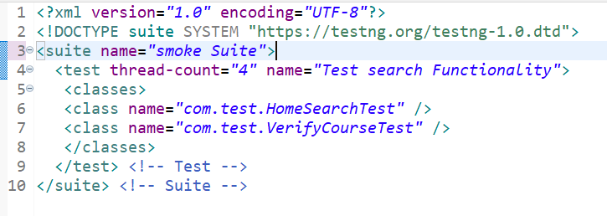
SMOKE SUITE

Slide 11
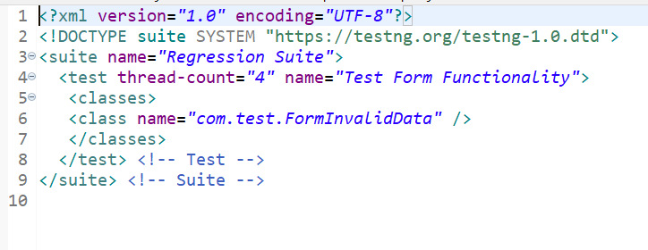
REGRESSION SUITE

Slide 12
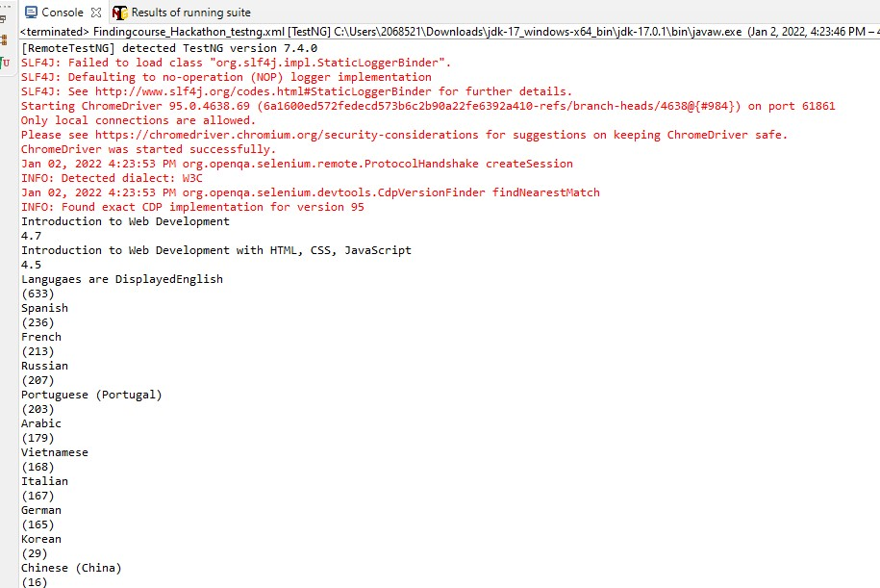
CONSOLE

Slide 13
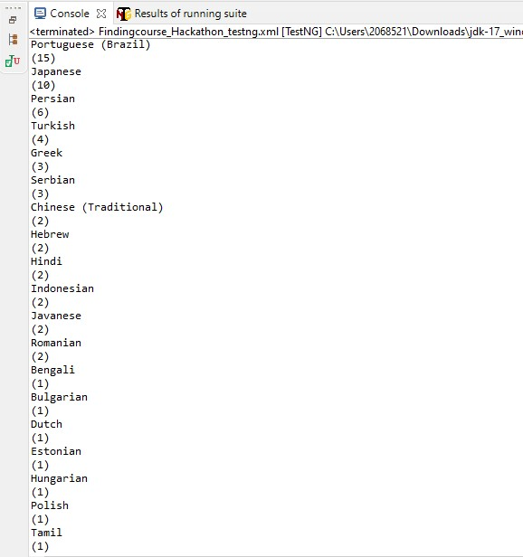

Slide 14
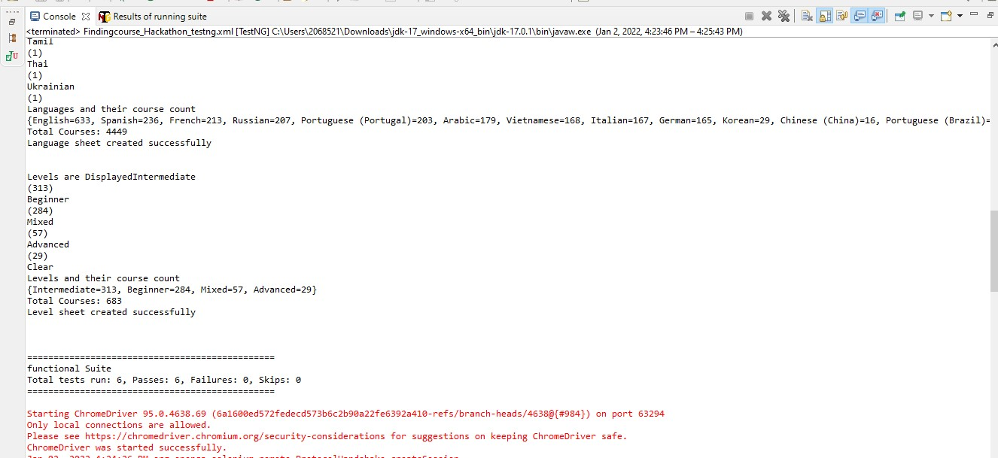

Slide 15
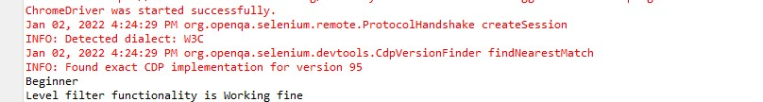
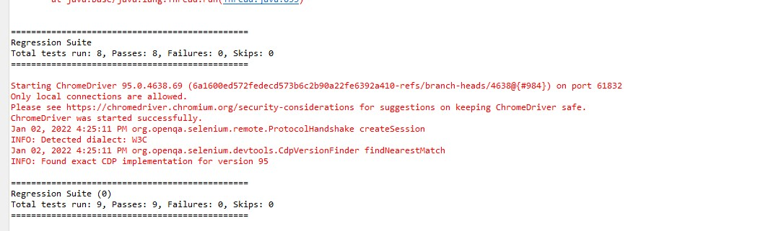

Slide 16
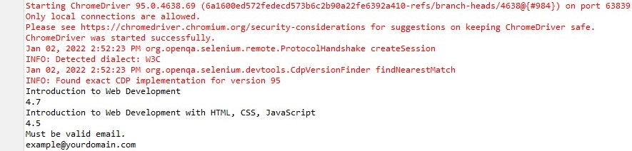
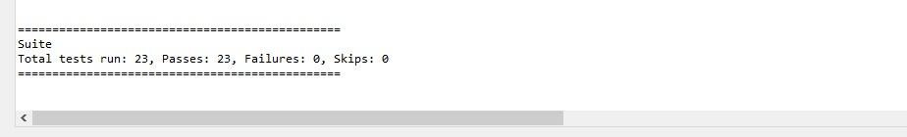

Slide 17
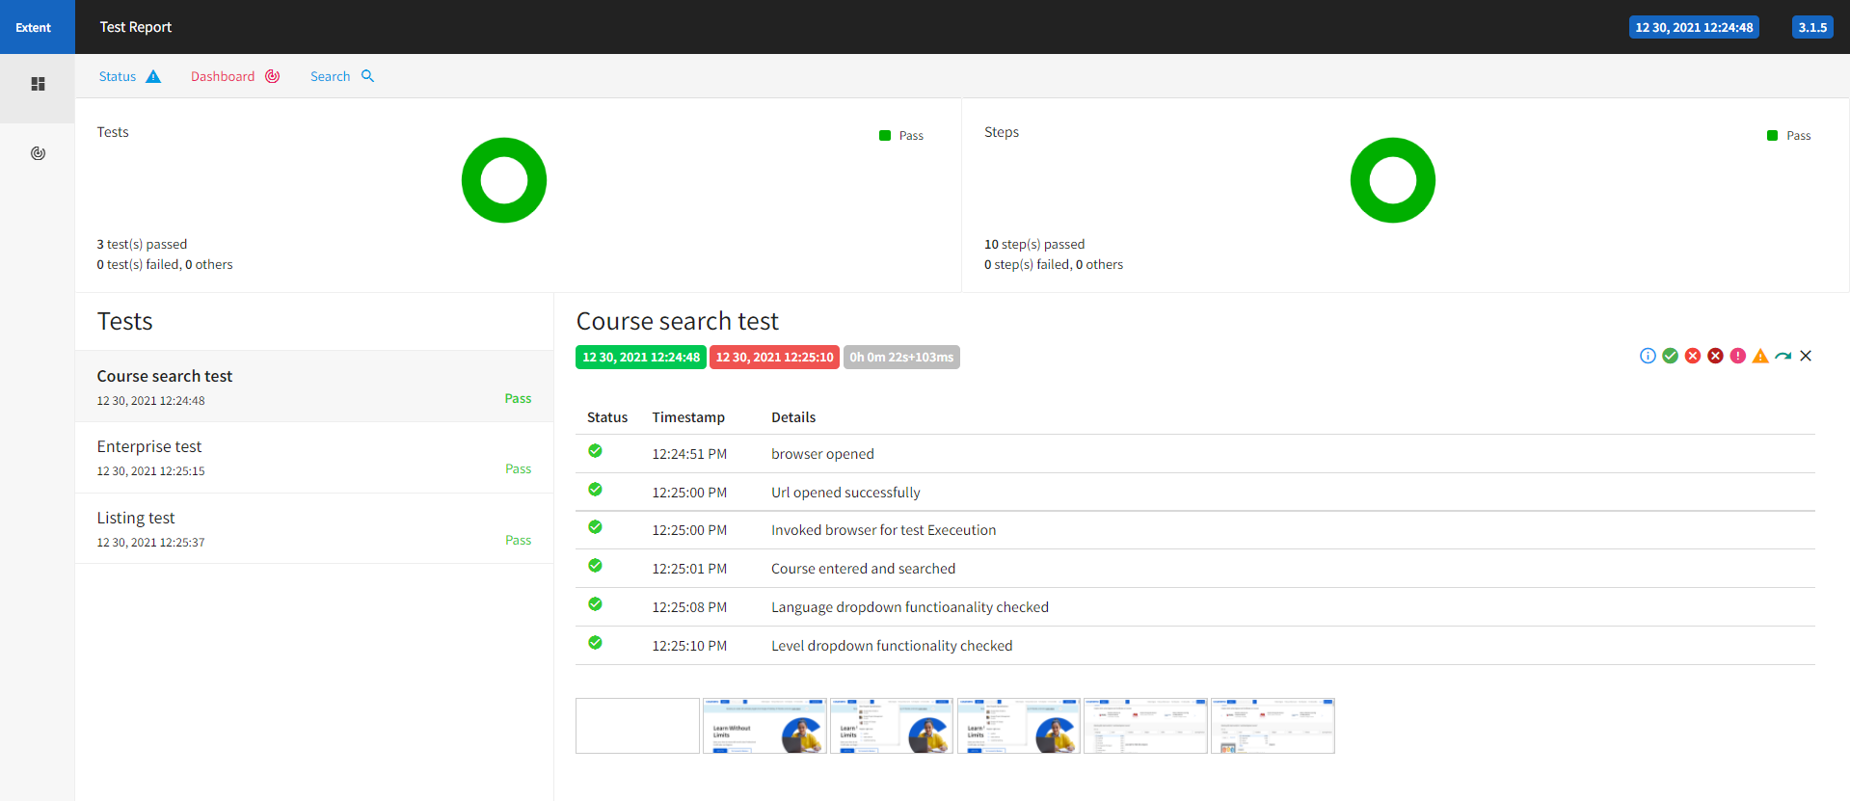
EXTENT REPORT

