Slide 1
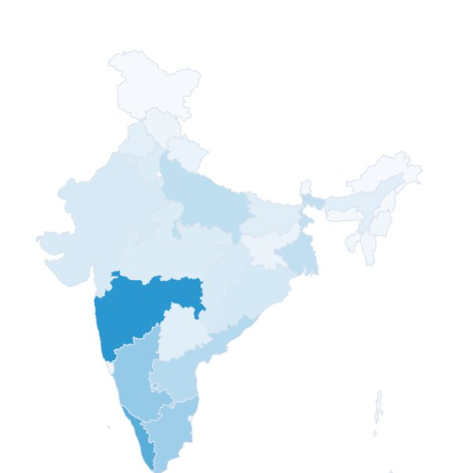
BCA 5TH SEMESTER MINOR PROJECT
COVID-19 Data
Visualization Dashboard
State-wise COVID-19 Analysis and Interactive Data Visualization
Sigma University
Cases
Recovered
Department / Program: Bachelor of Computer Applications (BCA)
Data Analytics + Web Development + Data Engineering
Deaths
Vaccination
Notes:
Introduce the project: an interactive web dashboard for state-wise COVID-19 data (India, 2020-2022). One sentence: we turned raw data into an interactive visual analytics tool.

Slide 2







01 | PROJECT OVERVIEW
What is this project?
An interactive, web-based analytics dashboard that analyses and visualizes India's state-wise COVID-19 data from 2020 to 2022.
THE CORE IDEA
RAW DATA
Interactive statistics
Charts
DATA CLEANING
DATA VALIDATION
Geographic map
State comparisons
DATA TRANSFORMATION
ANALYSIS
Year-wise analysis
Vaccination analysis
VISUALIZATION
Automated insights
INTERACTIVE DASHBOARD
Simple explanation: We take a large data file and turn it into something anyone can explore with a few clicks.
COVID-19 Data Visualization Dashboard | BCA 5th Semester Minor Project | Sigma University
2
Notes:
Explain the pipeline top to bottom. Emphasise this is a demonstration of data engineering plus visualization, not just charts.

Slide 3

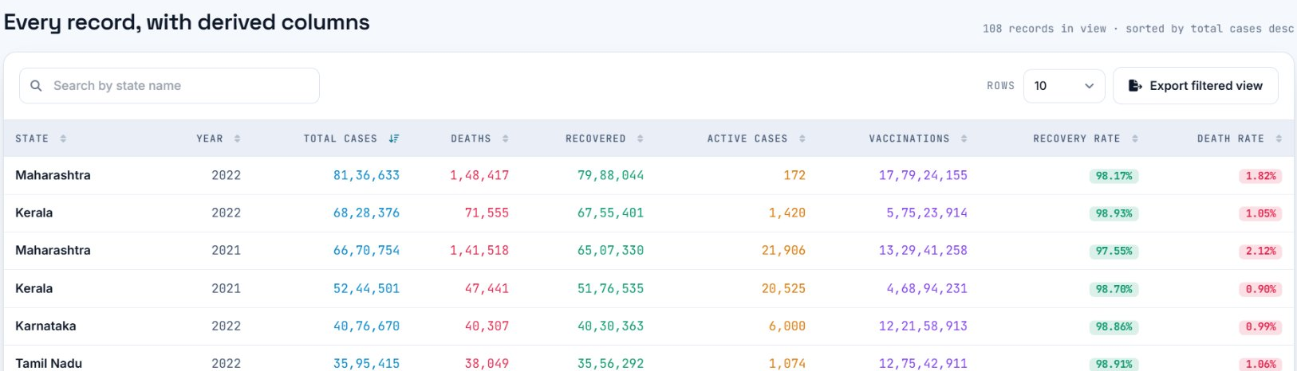
02 | BACKGROUND
COVID-19 & the data behind the project
THE PROJECT DATASET
What is COVID-19?
An infectious disease caused by the SARS-CoV-2 virus. The pandemic produced large amounts of data: cases, deaths, recoveries and vaccination doses.
India
36
2020-22
108
Coverage
States / UTs
Period
Records
WHY THIS DATA IS USEFUL
Understand how the pandemic spread
Compare regions
Study change over time
Analyze outcomes
Examine vaccination trends
Demonstrate analytics & visualization
Sample rows from the dashboard data grid (with derived columns). Metrics: cases, deaths, recoveries, vaccination doses, year, state/UT.
Source: Historical COVID-19 state-wise dataset used for academic analysis.
COVID-19 Data Visualization Dashboard | BCA 5th Semester Minor Project | Sigma University
3
Notes:
Do not claim a specific source. Say: historical state-wise dataset used for academic analysis. The table shown is a crop of the dashboard data grid.

Slide 4
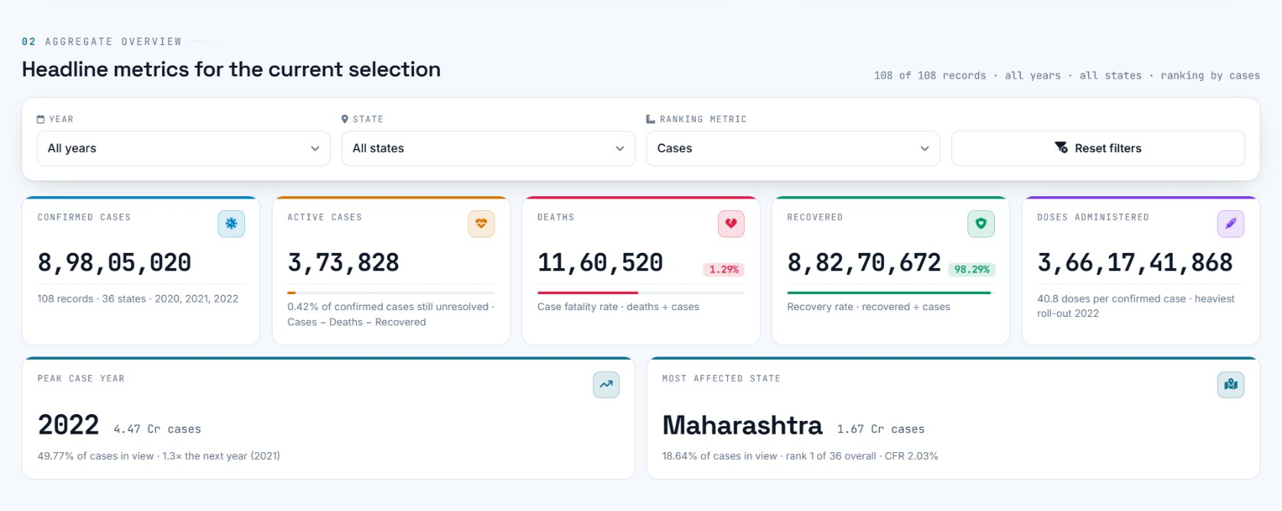
03 | PROBLEM STATEMENT
Raw data is hard to read
RAW CSV / XLSX
State | Year | Cases | Deaths | Recov.
.... | .... | ........ | ...... | ......
.... | .... | ........ | ...... | ......
.... | .... | ........ | ...... | ......
.... | .... | ........ | ...... | ......
.... | .... | ........ | ...... | ......
.... | .... | ........ | ...... | ......
.... | .... | ........ | ...... | ......
.... | .... | ........ | ...... | ......
Difficult to interpret
Interactive dashboard: easy to understand
x Large number of records
x Trends are hard to spot
x State comparison needs manual work
x Geographic differences are invisible
x CSV / Excel is not user-friendly
x Insights stay hidden
Simple explanation: The project turns a big table of numbers into pictures, maps and comparisons.
COVID-19 Data Visualization Dashboard | BCA 5th Semester Minor Project | Sigma University
4
Notes:
Contrast the left (raw file) with the right (dashboard). The aim of the project is to bridge that gap.

Slide 5




04 | OBJECTIVES
Project objectives
01
02
03
Build an interactive COVID-19 dashboard
Analyze state-wise pandemic data
Compare year-wise statistics
04
05
06
Visualize vaccination data
Clean and validate raw datasets
Generate meaningful insights
07
08
09
Interactive geographic visualization
Allow CSV / XLSX dataset upload
Present complex data clearly
COVID-19 Data Visualization Dashboard | BCA 5th Semester Minor Project | Sigma University
5
Notes:
Nine objectives. Read them quickly; the rest of the deck shows how each one was implemented.

Slide 6
05 | TECHNOLOGIES
Technologies & tools
FRONTEND
VISUALIZATION
DATA PROCESSING
FILE HANDLING
DEVELOPMENT
HTML5
Chart.js
Python
SheetJS
Node.js
Structure of the dashboard page.
Creates interactive charts.
Data processing and ETL.
Processes CSV/XLSX in the browser.
JavaScript runtime for tooling.
CSS3
Highcharts
Pandas
CSV
npm
Styling and layout.
Charting library for rich visuals.
Cleaning and transforming data.
Simple text-based data format.
Package manager.
Tailwind CSS
Highmaps
OpenPyXL
XLSX
Git / GitHub
Utility classes for a clean, responsive design.
Geographic visualization of Indian states.
Reading and writing Excel files.
Excel workbook format.
Version control and repository hosting.
JavaScript
Controls dashboard logic, filtering and interaction.
Simple explanation: Python prepares the data, JavaScript runs the dashboard, and chart/map libraries draw the visuals.
COVID-19 Data Visualization Dashboard | BCA 5th Semester Minor Project | Sigma University
6
Notes:
Only technologies actually used in the repository are listed. Be ready to explain what each one does in one sentence.

Slide 7
06 | SYSTEM ARCHITECTURE
System architecture
DATA ENGINEERING
WEB APPLICATION (BROWSER)
RAW COVID DATA
CSV / XLSX
DATA INGESTION
PYTHON ETL LAYER
PROCESSED DATASET
JAVASCRIPT DATA ENGINE
VISUALIZATION ENGINE
INTERACTIVE DASHBOARD
CLEANING
FILTERING
CHARTS
VALIDATION
CALCULATIONS
MAP
TRANSFORMATION
INSIGHTS
Simple explanation: Python cleans the data first; then the browser filters it, calculates results and draws charts and the map.
COVID-19 Data Visualization Dashboard | BCA 5th Semester Minor Project | Sigma University
7
Notes:
Walk left to right. Python ETL produces a processed dataset. The JavaScript engine filters, calculates and generates insights. The visualization engine draws charts and the map, which together form the dashboard.

Slide 8
07 | DATA ENGINEERING
Data cleaning & ETL pipeline
RAW DATA
1
2
3
Data ingestion
Column standardization
Missing value handling
MESSY / INCONSISTENT
4
5
6
CLEANING
Data type conversion
Data validation
Invalid record detection
VALIDATION
7
8
9
STRUCTURED DATA
Duplicate checking
Logical consistency checks
Processed dataset generated
ANALYSIS READY
Python + Pandas handle this stage. "Good visualization depends on reliable data."
Simple explanation: Python prepares and cleans the data before the dashboard ever uses it.
COVID-19 Data Visualization Dashboard | BCA 5th Semester Minor Project | Sigma University
8
Notes:
These nine steps are the checks the pipeline performs. The dashboard also shows a validation result (rows matched schema) after loading.

Slide 9














08 | FEATURES
Key dashboard features
KPI cards
Dynamic filters
Year-wise analysis
State-wise analysis
Headline numbers at a glance
Year, state and metric selectors
Compare 2020, 2021, 2022
Rank and explore states / UTs
Interactive India map
Dynamic charts
Vaccination analysis
Outcome analysis
Colour shows state-level values
Update with every selection
Doses per year and cumulative
Recovered, deaths, active
State deep dive
Two-state comparison
CSV / XLSX upload
Automated insights
One state in full detail
Put two states side by side
Bring your own dataset
Rule-based findings
Searchable data grid
Responsive interface
Light / dark theme
Client-side processing
Sort, search, export view
Works across screen sizes
Switch theme in one click
Uploaded files stay in the browser
COVID-19 Data Visualization Dashboard | BCA 5th Semester Minor Project | Sigma University
9
Notes:
Every feature listed here is visible in the screenshot of the final dashboard. Point at it while presenting.

Slide 10
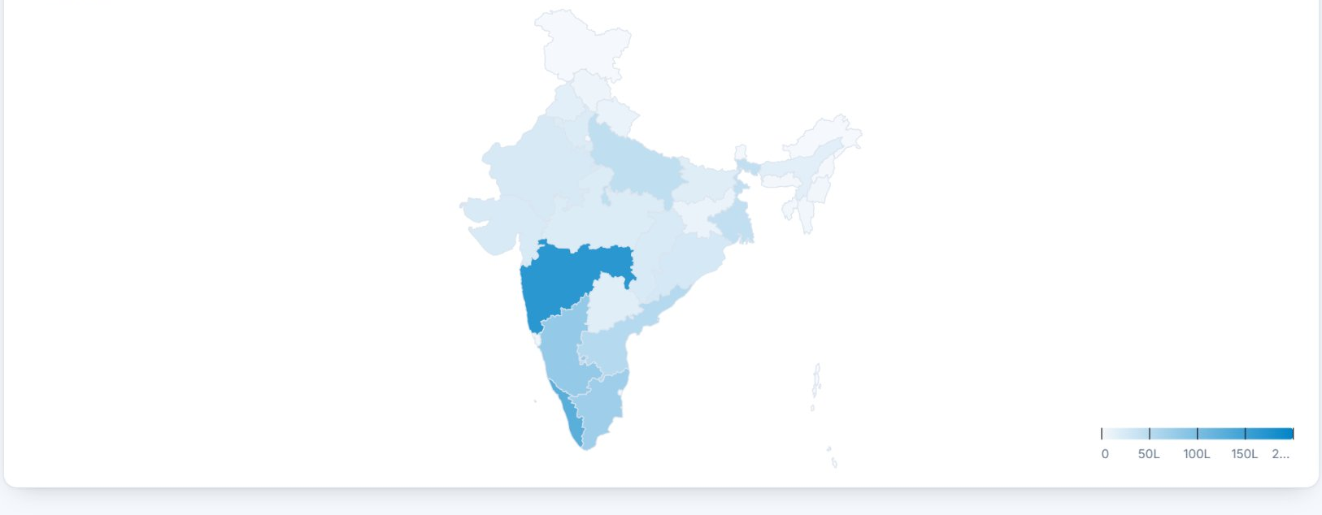
09 | GEOGRAPHIC VISUALIZATION
Dynamic geographic visualization
WHAT CHANGES DYNAMICALLY
o Selected year
o Selected metric
o State-level values
o Colour intensity
o User filters
SELECT METRIC
SELECT YEAR
DATA UPDATES
MAP COLOURS UPDATE
An interactive India state / UT map shows COVID-19 impact geographically. Built with Highmaps.
STATE IMPACT BECOMES CLEAR
Simple explanation: This is a choropleth map: different colours show differences between states.
COVID-19 Data Visualization Dashboard | BCA 5th Semester Minor Project | Sigma University
10
Notes:
Do not say "real-time". The data is historical (2020-2022); the map is interactive and updates when the user changes filters.

Slide 11
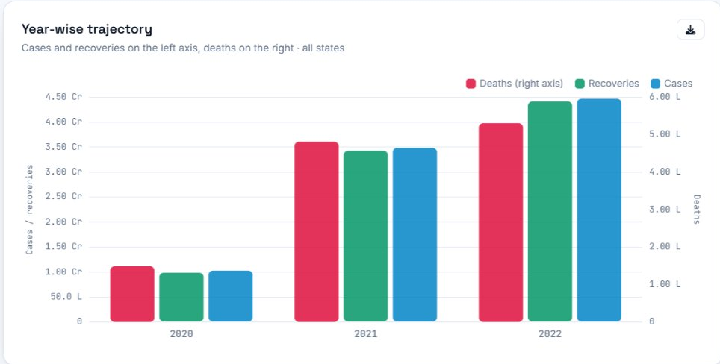
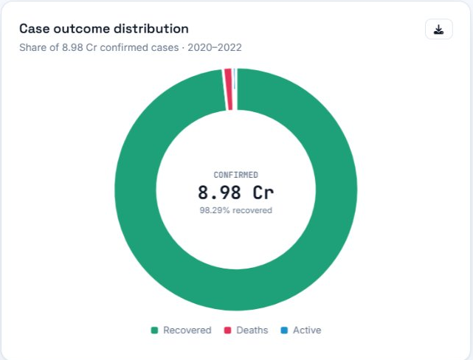

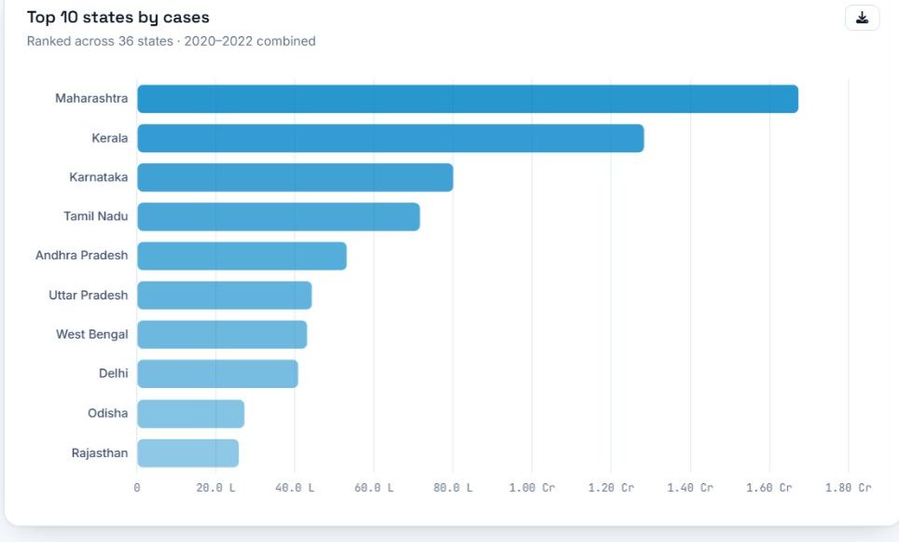
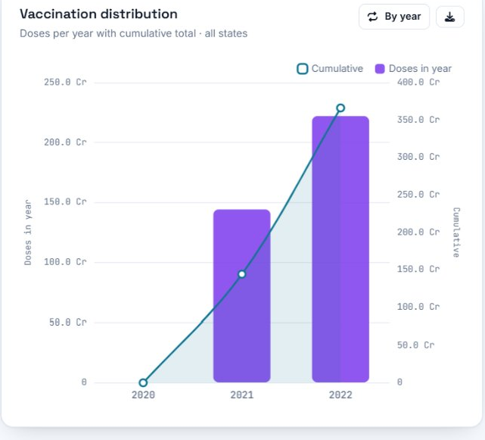


10 | VISUAL ANALYTICS
Interactive charts & visual analytics
EVERY CHART ANSWERS A QUESTION
Column chart
What changed between years?
Horizontal bars
Which states had higher values?
Line + bars
How do vaccinations build up over time?
Donut chart
How are outcomes distributed?
India map
Where is the impact concentrated?
KPI cards
What are the main numbers?
Simple explanation: Different chart types are used because each one answers a different question.
COVID-19 Data Visualization Dashboard | BCA 5th Semester Minor Project | Sigma University
11
Notes:
Charts shown are crops from the real dashboard. The vaccination chart combines yearly bars with a cumulative line.

Slide 12
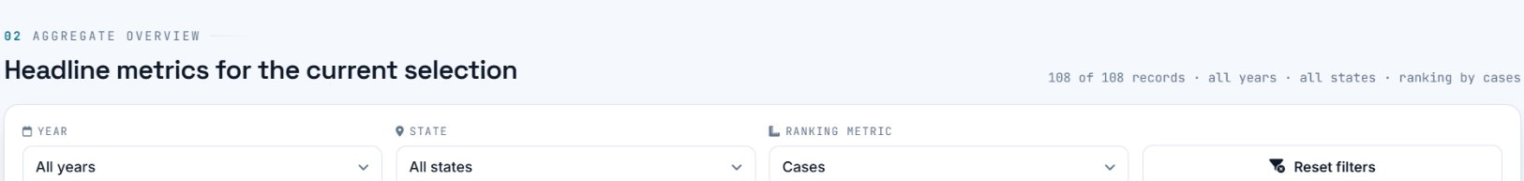




11 | USER INTERACTION
Interactive dashboard experience
WHAT HAPPENS AFTER A CLICK
USER SELECTION
DATA FILTER
Year selection
State selection
Metric selection
CALCULATIONS
KPI UPDATE
Filters & reset
Search in data grid
File upload
CHART UPDATE
MAP UPDATE
Theme switching
Chart updates
Map updates
INSIGHTS UPDATE
Simple explanation: It is not a static set of charts: every selection recalculates and redraws the whole dashboard.
COVID-19 Data Visualization Dashboard | BCA 5th Semester Minor Project | Sigma University
12
Notes:
Demo suggestion: change the year, then the metric, then click a state, and show that KPIs, charts, map and insights all change together.

Slide 13
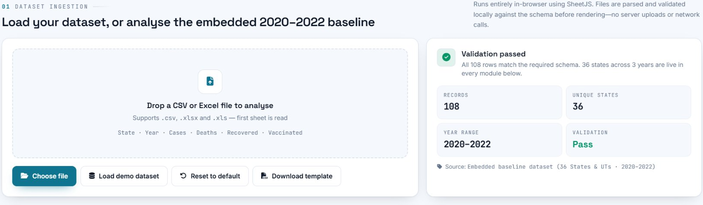



12 | DATA FLEXIBILITY
Custom dataset upload
UPLOAD CSV / XLSX
FILE PARSING
VALIDATION
DATA PROCESSING
CSV files
XLSX files
DASHBOARD VISUALIZATION
Files are parsed with JavaScript and SheetJS directly in the browser.
Processed client-side: uploaded data is not sent to a project backend server.
Simple explanation: The uploaded file is processed directly in your browser.
COVID-19 Data Visualization Dashboard | BCA 5th Semester Minor Project | Sigma University
13
Notes:
The dashboard also validates the uploaded file against the expected schema and offers a downloadable template.

Slide 14
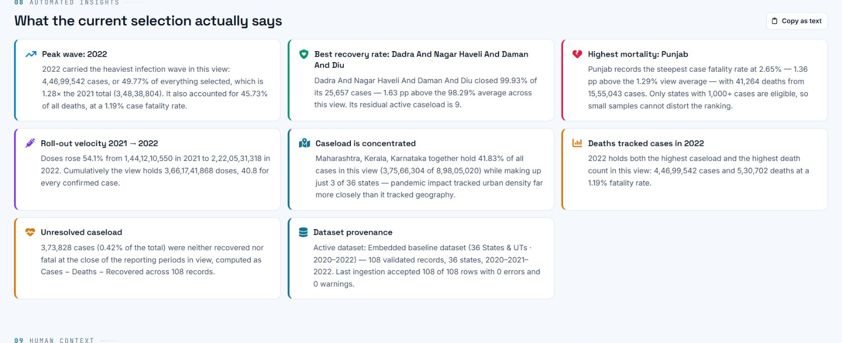

13 | AUTOMATED INSIGHTS
Rule-based automated insights
WHAT THE RULES LOOK FOR
o Highest case count
o Highest death count
o Highest recovery count
o Highest vaccination count
o Significant year-over-year changes
o State-level differences
EXAMPLE
Rule: find the state with the highest deaths ÷ cases in the current view
Not AI / machine learning. Fixed rules on the selected data.
Insight: "Highest mortality: [State]"
Simple explanation: The system automatically points out the important patterns in whatever data is selected.
COVID-19 Data Visualization Dashboard | BCA 5th Semester Minor Project | Sigma University
14
Notes:
Be explicit if asked: this is rule-based logic (comparisons, maximums, percentage changes). It is not AI or ML.

Slide 15
14 | EVALUATION
Advantages & limitations
ADVANTAGES
LIMITATIONS
✓ Interactive visualization
! Analysis depends on dataset quality
✓ Easy state-wise comparison
✓ Dynamic map
! Reporting methods varied across states and over time
✓ Multiple analytical perspectives
! Missing / inconsistent source records can affect results
✓ Data cleaning and validation
✓ Supports CSV / XLSX upload
! Covers historical 2020-2022 information only
✓ Automated insights
✓ Responsive interface
! Primarily an academic analytics project
✓ Client-side uploaded file processing
! Not for medical, clinical or policy decisions
✓ Combines data engineering with visualization
COVID-19 Data Visualization Dashboard | BCA 5th Semester Minor Project | Sigma University
15
Notes:
Be honest here. Examiners respect a clear list of limitations.

Slide 16
15 | IMPLEMENTATION
What we built
DATA STAGE (steps 1-5) | APPLICATION STAGE (steps 6-16)
1
2
3
4
5
6
7
8
Loaded the COVID-19 dataset
Cleaned raw data
Standardized fields
Validated records
Generated processed metrics
Built frontend structure
Built JavaScript data engine
Added dynamic filters
APPLICATION STAGE (continued)
9
10
11
12
13
14
15
16
Added KPI cards
Added interactive charts
Added India geographic map
Added CSV / XLSX upload
Added automated insights
Added responsive design
Added light / dark mode
Integrated into one dashboard
Simple explanation: Data first, then the dashboard: 5 data steps and 11 application steps.
COVID-19 Data Visualization Dashboard | BCA 5th Semester Minor Project | Sigma University
16
Notes:
Walk the timeline quickly. Be ready to say which teammate did which step if asked.

Slide 17
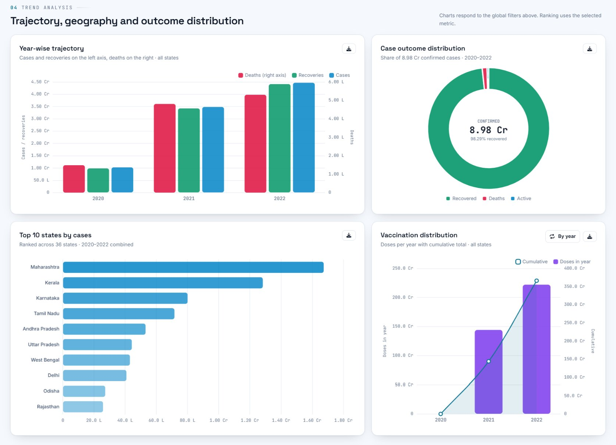
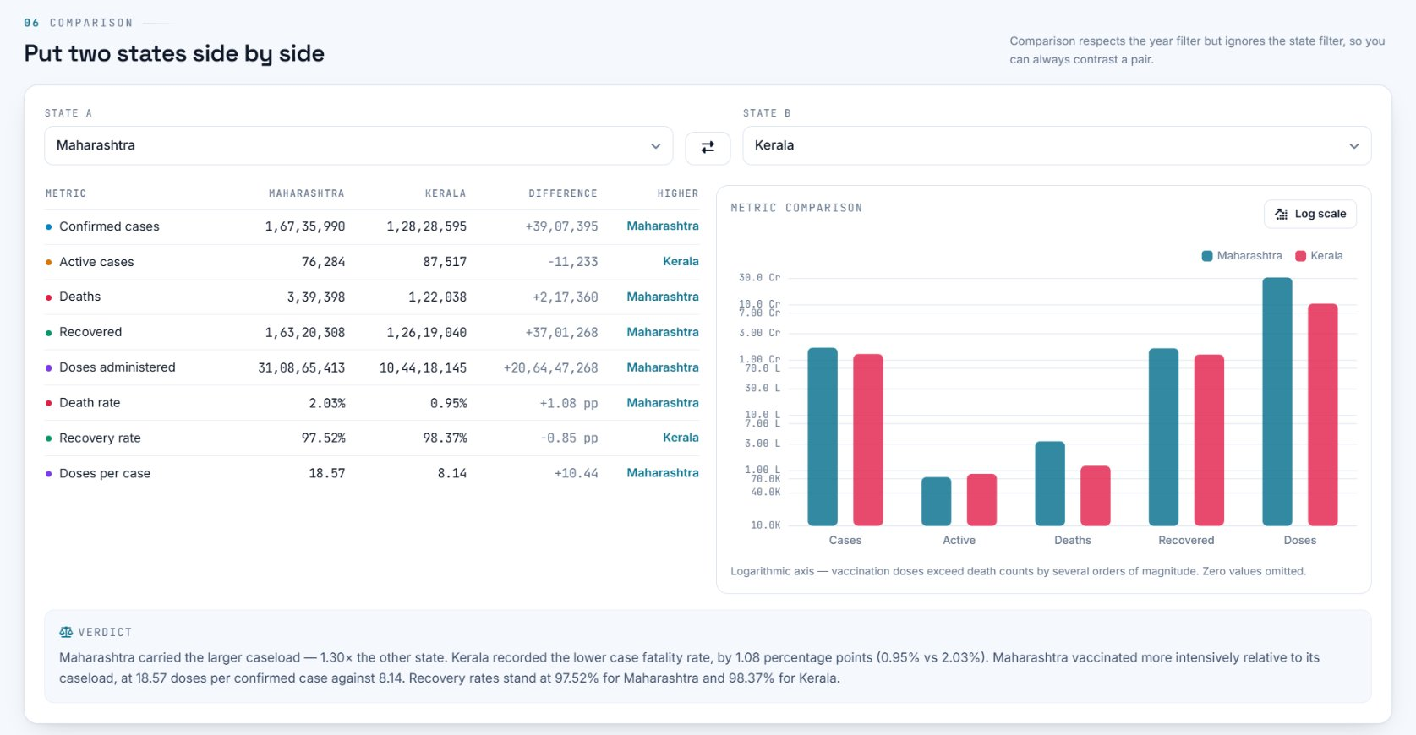
16 | RESULT
Final dashboard
From raw data to interactive analytics.
One dashboard for state-wise and year-wise COVID-19 exploration.
COVID-19 Data Visualization Dashboard | BCA 5th Semester Minor Project | Sigma University
17
Notes:
Screenshots are from the working dashboard. Live demo recommended here.

Slide 18

17 | WRAP-UP
Conclusion & future scope
FUTURE SCOPE (not part of the current system)
CONCLUSION
Additional historical / current datasets
More advanced statistical analysis
The project shows how data engineering, preprocessing, JavaScript development and data visualization can turn a complex COVID-19 dataset into an interactive analytical dashboard.
Predictive analytics
Forecasting models
More demographic indicators
District-level analysis
API-based data ingestion
Advanced anomaly detection
Data Analytics + Web Development + Data Engineering
More healthcare indicators
Deployment improvements
COVID-19 Data Visualization Dashboard | BCA 5th Semester Minor Project | Sigma University
18
Notes:
Stress that everything on the right is future scope, not implemented. Do not let anyone think prediction or ML is in the current system.

Slide 19

18 | TEAM
Project team & contributors
LEAD DEVELOPER & PROJECT ARCHITECT
Aziz Taheribhai Chharchhodawala
Enrollment No.: 24S01BCA0004
CONTRIBUTORS
BS
Bhavin Suryavanshi
CD
Chirag Dodiya
Enrollment No.: 24S01BCA0039
Enrollment No.: 24S01BCA0034
BCA 5th Semester | Sigma University
COVID-19 Data Visualization Dashboard | BCA 5th Semester Minor Project | Sigma University
19
Notes:
Placeholders (initials / icon) are used instead of photographs.

Slide 20
Thank You
Questions & Discussion
COVID-19 Data Visualization Dashboard
BCA 5th Semester Minor Project
Sigma University
github.com/aziz-ch52/covid19-data-dashboard-visualization
Notes:
Invite questions. Keep the dashboard open for a live demo.

