Slide 1
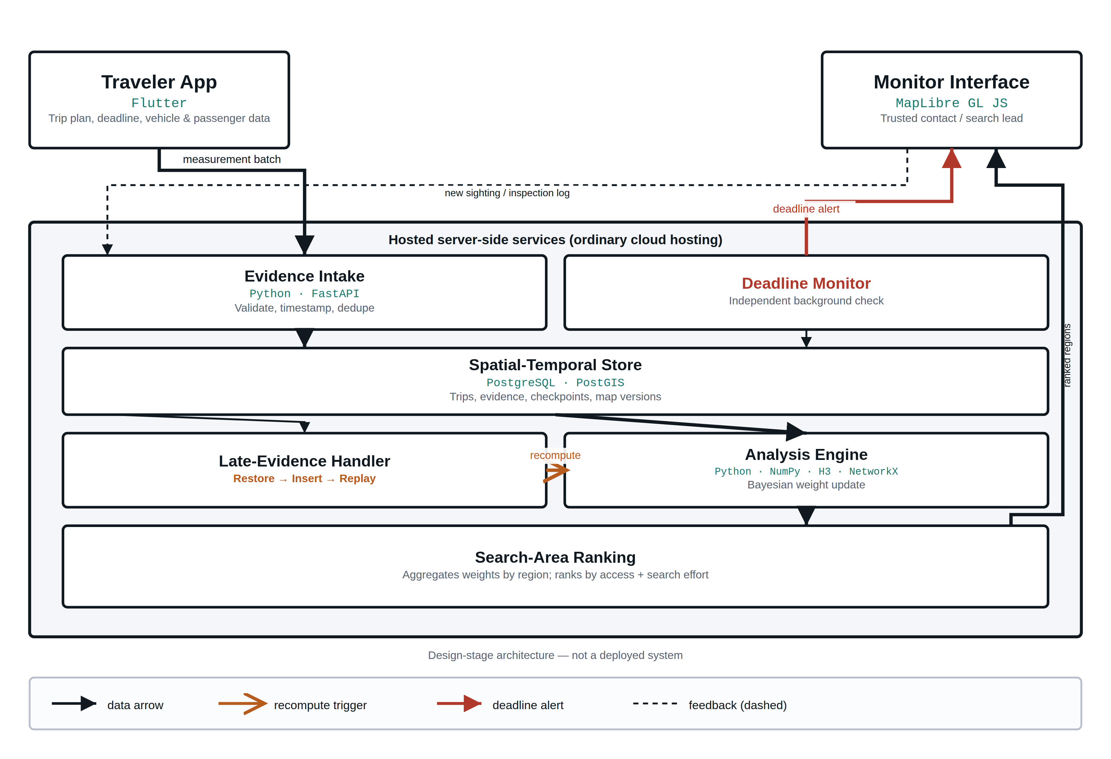
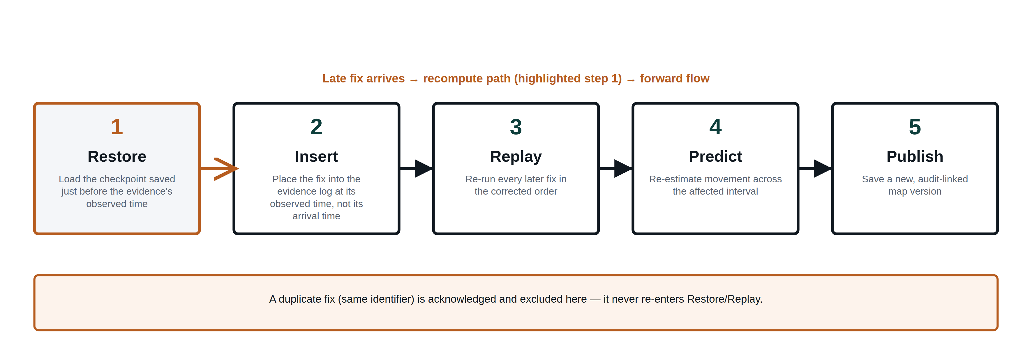
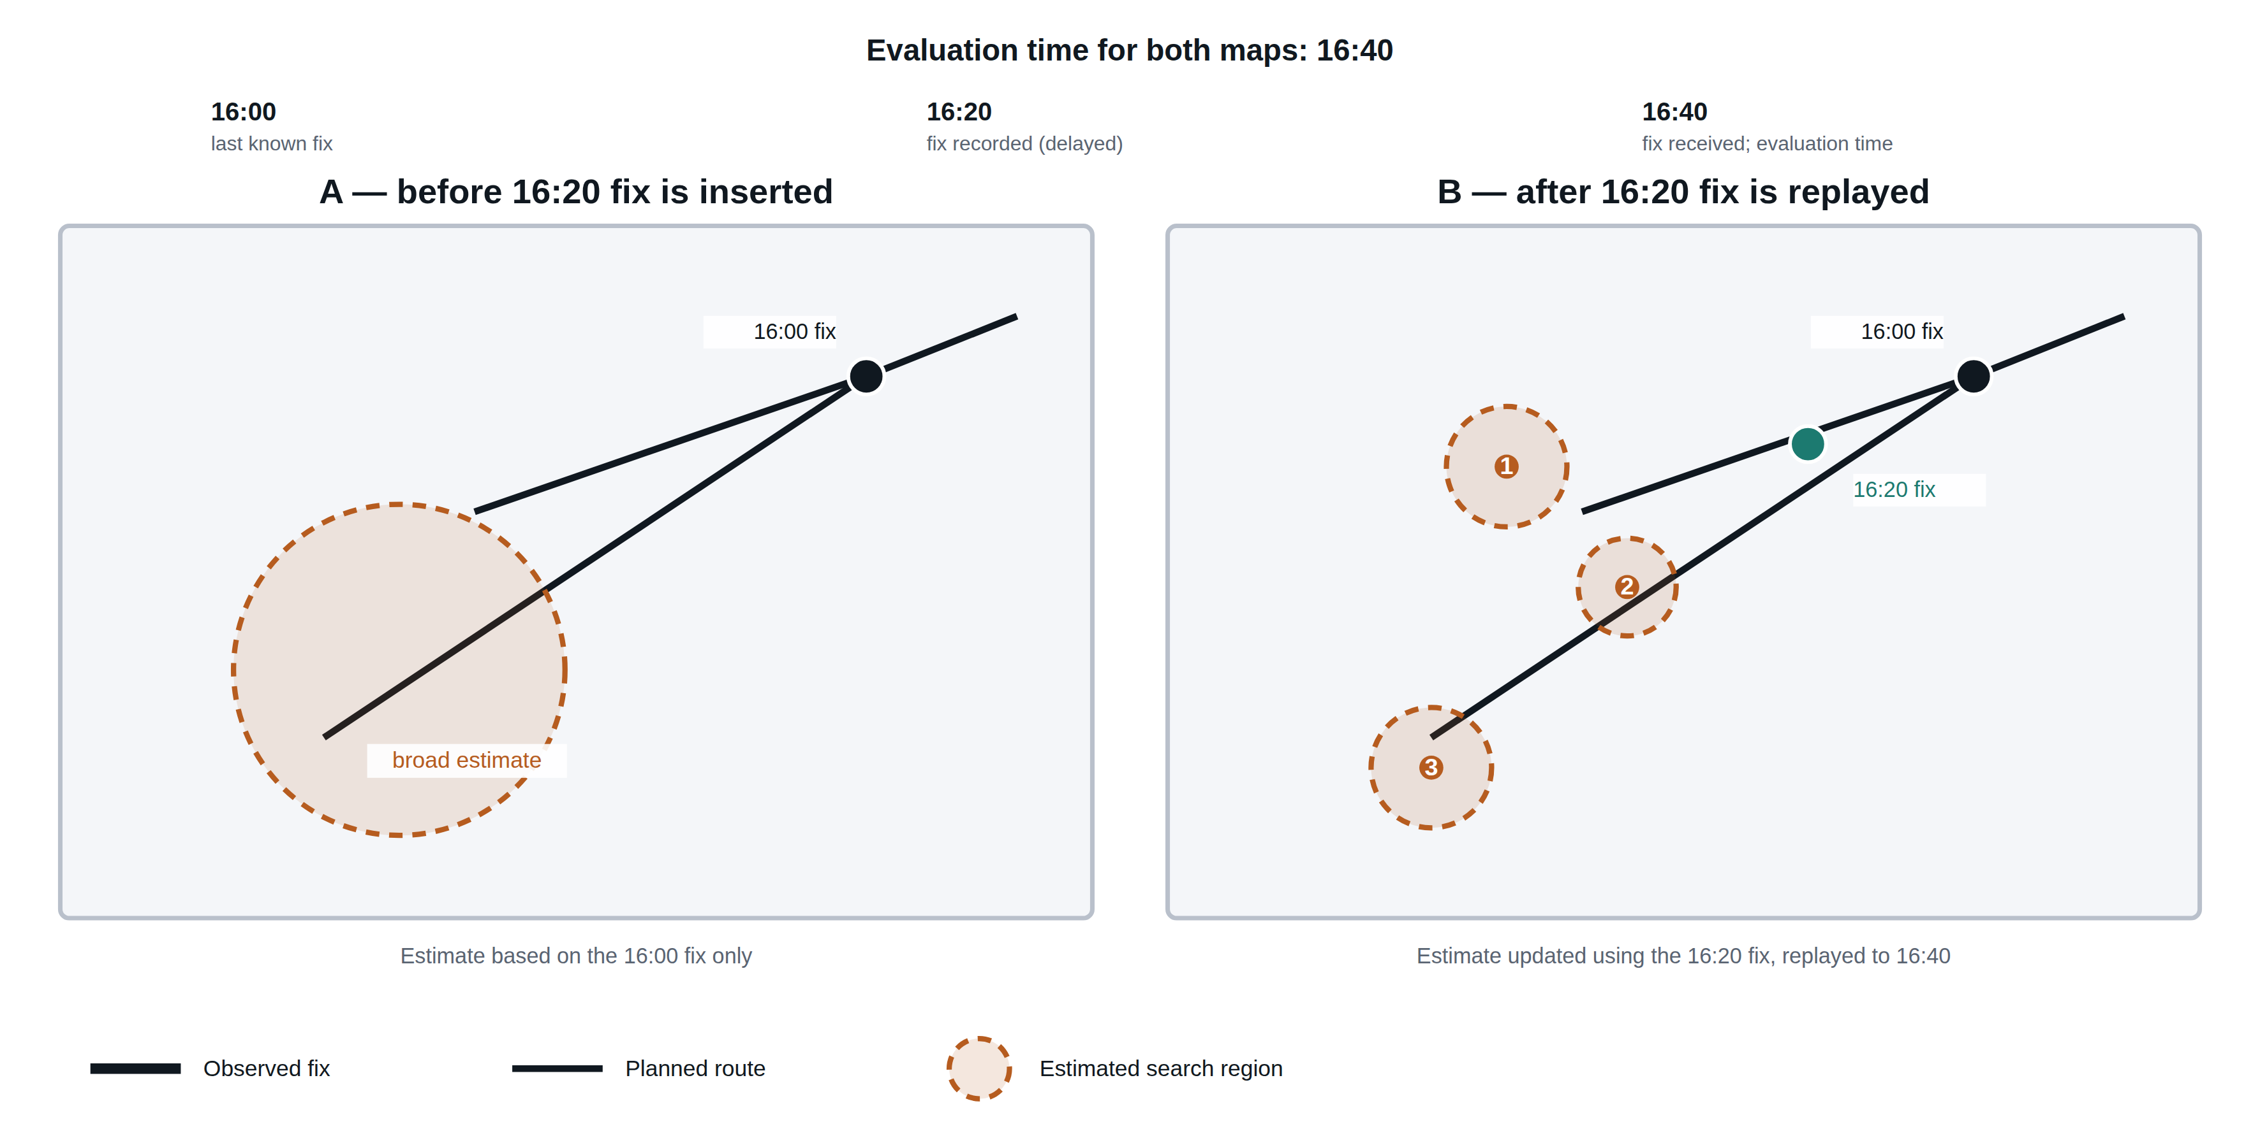
ATHAR — Smart Assistant for Missing-Person Search
Bayesian Search-Area Prioritization Using Trip Context and Delayed Location Evidence
QR
Code
Booth
Number
Country Flag Here
Student Name: ABDULAZIZ KHALID ALJURAID
King Saud University
ID: pending
Introduction
Methodology
Missing-traveler search requires combining incomplete location evidence with trip context. Terrain-aware Bayesian models represent uncertain movement [1], while out-of-sequence measurement research addresses delayed observations [2]. Under intermittent connectivity, a received fix may describe a past position, not the traveler's current location.
Objective: specify a reproducible framework for updating search regions using observation-time evidence, and ranking candidate areas by model weight and estimated search effort.
“Can observation-time updates improve ground-truth inclusion at a fixed search-area budget, compared with receipt-time updates?”
ATHAR combines a trip plan, a timestamped evidence log, and a road-and-terrain motion model (Figure 1), deduplicating fixes and propagating vehicle, walking and stationary states over time.
Eq. 1 — Evidence weight update
w′(s) = [ L(e|s) · w(s) ] / Σ [ L(e|s*) · w(s*) ]
w = prior weight · w′ = updated weight · L = evidence compatibility, applied at the evidence's observed time.
A late fix restores a checkpoint and replays evidence (Figure 2). Regions are then ranked by weight relative to access and search time (full formula in the appendix).
1. Proposed system architecture. Data flow from intake through analysis to the monitor interface; the highlighted arrow marks the recompute trigger. Design-stage architecture.
2. Observation-time processing of delayed evidence. Restore → Insert → Replay → Predict → Publish. Design-stage workflow, not a measured run.
Results
Innovation
Current outputs comprise a system architecture, interface mock-ups and a specified evidence-update workflow (Design-Stage Outputs). Quantitative performance has not yet been evaluated.
Legend: Observed fix — Planned route — Estimated search region
The proposed contribution is an auditable workflow linking pre-trip context, observation-time evidence replay, and effort-aware search-area ranking. Recorded locations stay distinct from current estimates, and every priority update traces back to its evidence and assumptions.
A proposed system design — not a claim of priority over Bayesian search modeling or out-of-sequence estimation generally.
 | Last-known location view | Receipt-time baseline | ATHAR (proposed)
Uses trip context | No | No | Proposed
Orders by observation time | No | No | Proposed
Distinguishes recorded vs. estimated position | No | Partial | Proposed
Ranks by access + search effort | No | No | Proposed
3. Design-stage search-update illustration. Two maps at 16:40: (A) before the 16:20 fix is inserted; (B) after it is replayed. Schematic illustration; regions are not computed experimental output.
Conclusion
Future Work & References
ATHAR defines a design-stage framework for organizing trip evidence and updating search priorities under intermittent connectivity. The current contribution is a documented computational workflow and interface concept; its operational benefit remains to be established through implementation and comparative evaluation.
Estimates support human review and do not establish live location after disconnection.
1. Implementation — build an executable pipeline for evidence intake, region updates and incident-card generation.
2. Controlled evaluation — replay known trips under message delay, disconnection and measurement noise, comparing methods.
3. Supervised usability assessment — evaluate clarity of priorities with domain reviewers, after computational verification.
Full reference list [1]–[5] and the evaluation appendix are linked via the QR code above.
Evaluation plan
Metrics | Ground-truth inclusion at matched budget · arrival-order consistency · recalculation latency · incident-card prep time
Baselines | Last-known circle · road/time access radius · receipt-time processing · full observation-time processing (proposed)
Ablations | Without trip plan · without temporal replay
Acknowledgments Statement: No external funding or institutional support to acknowledge.

