Slide 1
CSE4204 LAB-5 : Intro to Three.js

Slide 2
Download the materials at: shorturl.at/CMN26

Slide 3
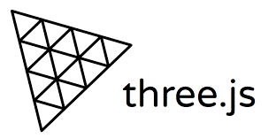
What is three.js?
A javascript library
You can create and display 3D graphics on web browser
Built on WebGL API
Easy to use
https://threejs.org

Slide 4
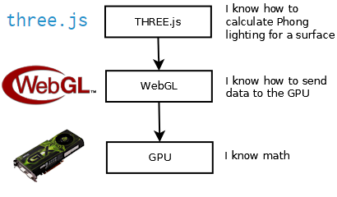
three.js
Source: https://cglearn.codelight.eu/pub/computer-graphics/computer-graphics

Slide 5
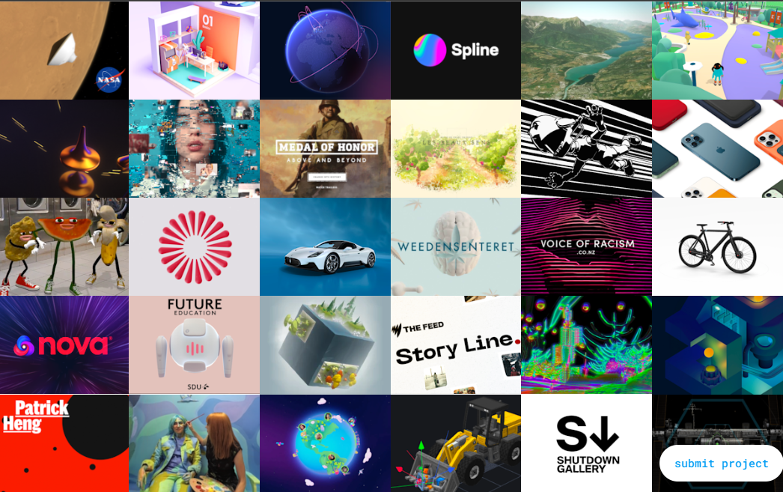
What you can do with three.js
Source: https://threejs.org/

Slide 6
Installation
three.js can be installed with npm
or can be used with static hosting or a CDN
npm is the most common approach

Slide 7
Installation with npm
Download and install the latest version of Node.js
Open a terminal window in your project folder and run:
Package will be downloaded and installed
Full download will give so many additional files
You can only use the Three.js source
npm install three

Slide 8
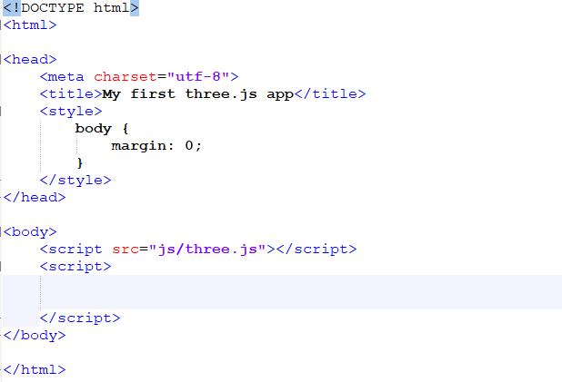
Basic Setup: Adding the library file

Slide 9
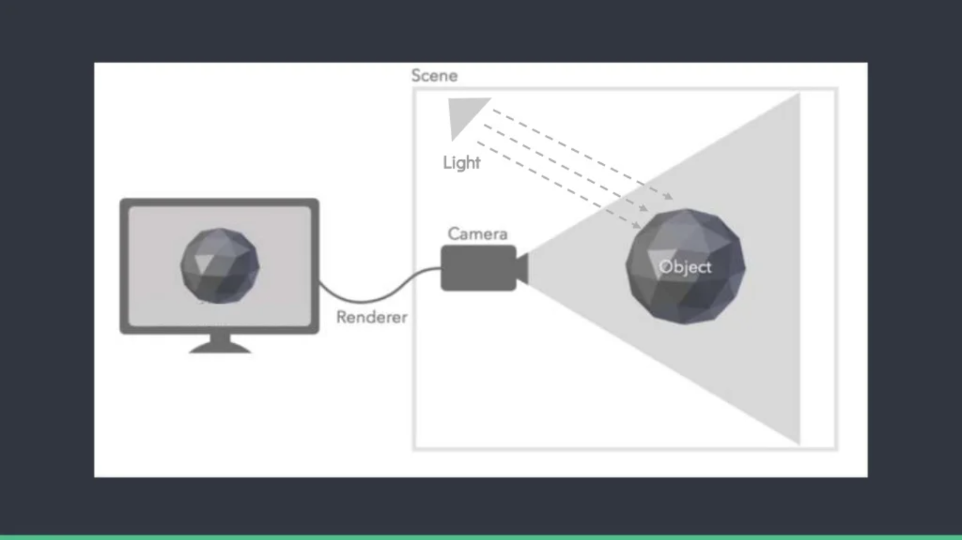
Basic Elements of Three.js

Slide 10
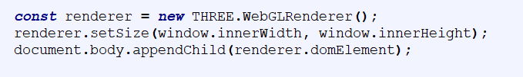

Basic Elements: Renderer
Renderer draws the scene
Needs to be attached to an HTML element
Create a WebGLRenderer
II. Beautify it

Slide 11

Output!

Slide 12
Basic Elements: Camera
Camera is the view port to look at the objects in a scene
Camera controls how your object will be seen
2 main types of camera: Orthographic and Perspective
III. Creating a Camera

Slide 13
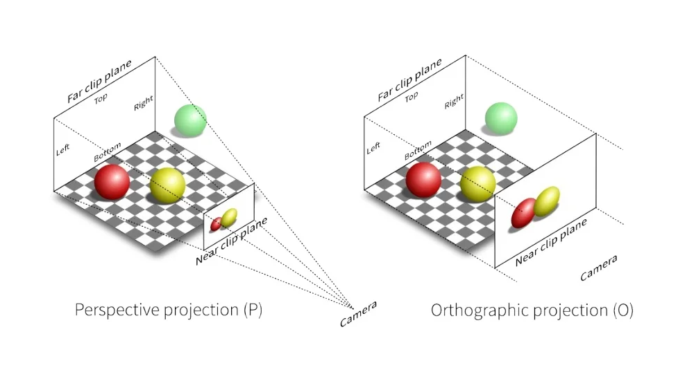
Basic Elements: Camera
Source: https://www.slideshare.net/GarethMarland/introduction-tothreejs

Slide 14

Basic Elements: Scene
Scene is where you put your modes, such as car, house or cubes
IV. Create a Scene
V. Render the scene from the camera

Slide 15
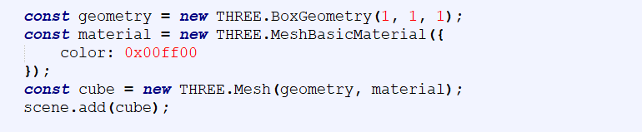
Basic Elements: Geometry (Objects)
three.js provides some predefined geometry
You can define your own vertices
Use an existing model
VI. Create a mesh with geometry and add it to the scene

Slide 16
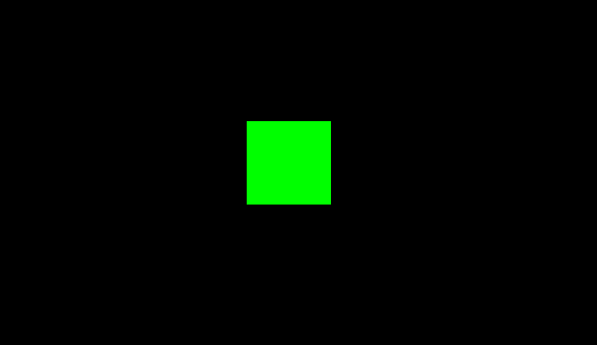
cube.html

Slide 17
Recap
Create a Renderer
new THREE.WebGLRenderer()
Create a camera
new THREE.PerspectiveCamera(FOV, viewAspectRatio, zNear, zFar)
Create a Scene
new THREE.Scene()
Render the scene from the camera
renderer(scene, camera)
Create a mesh with geometry and add it to the scene
const cube = new THREE.Mesh(geometry, material);
scene.add(cube);

Slide 18
Lighting
Light globally illuminates the objects
three.js provides some lighting models
Common lighting model: Ambient Light, Point Light, Directional Light

Slide 19
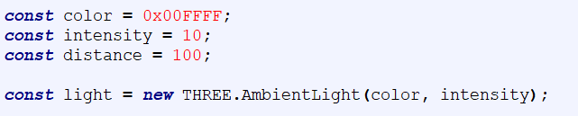
Lighting
Just create the light and add it to the scene
Ambient Light
Point Light
Directional Light

Slide 20
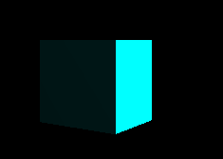
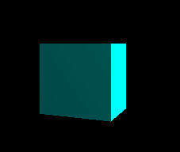

lighting.html
Ambient Light
Point Light
Directional Light

Slide 21
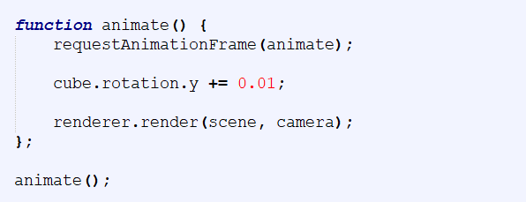
Animation
requestAnimationFrame creates a loop
It causes renderer to draw a new scene
Generally refresh rate is 60FPS

Slide 22
cubeRotation.html

Slide 23
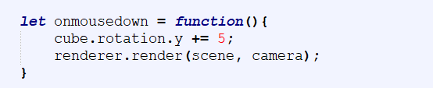
User Interaction
User interaction can be done with mouse clicking or moving or pressing a key on the keyboard
Create the action method and add it to the event listener

Slide 24
mouseClick.html

Slide 25
Shaders
A shader is a small program written in GLSL
It runs on the GPU
Two types of shader: Vertex Shader and Fragment Shader
Vertex shader is applied on every vertex
Fragment shader is applied on every fragment/pixel
In three.js ShaderMaterial allows a material to be rendered with custom shaders

Slide 26
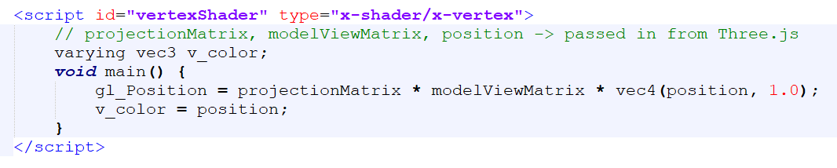
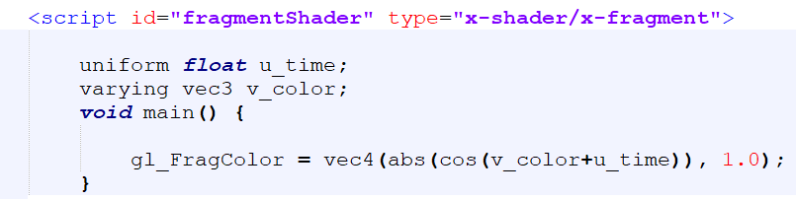
Shaders
Create a vertex shader as a script
Create a fragment shader as a script

Slide 27
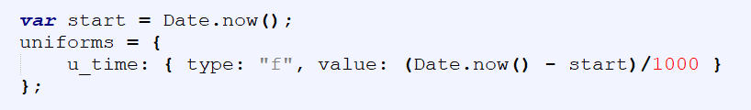
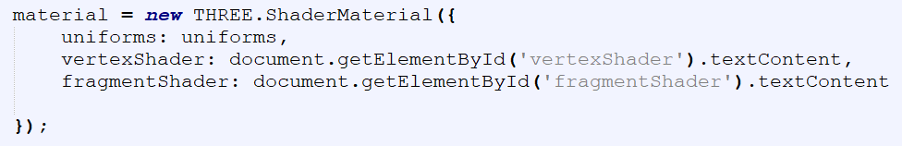
Shaders
Define some uniform variables if required in dictionary
Create a ShaderMaterial and assign your shaders to it

Slide 28
shaderMaterial.html

Slide 29
Texture Mapping
We can give realistic appearance to our objects by applying texture mapping
A texture is an image that would wrap the object
In order to apply texture mapping, we need to load the texture
Texture is loaded as a texture object

Slide 30
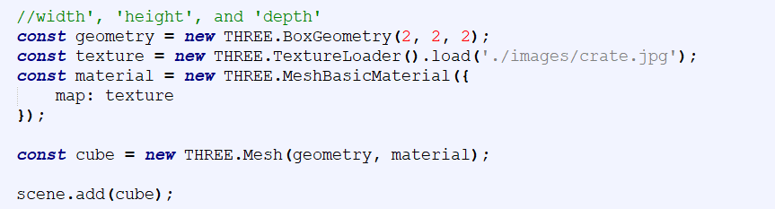
Texture Mapping
Load the texture object and map it onto the object

Slide 31
texture.html

