Slide 1
Valon Mortgage Servicing Analytics Assessment
Aziz Akhtar

Slide 2
Key Metrics to Track
Total Call Volume Over Time
Aggregate the calls over time period (weeks, months, quarter which will help with trend analysis with rolling views)
Call Volume by Topic
How many calls are being generated for a specific topic (customer journey)
Average Calls per Borrower
Measures customer engagement or friction (repeat callers)
Time to First Call
Median days between onboarding and first support call (onboarding)

Slide 3
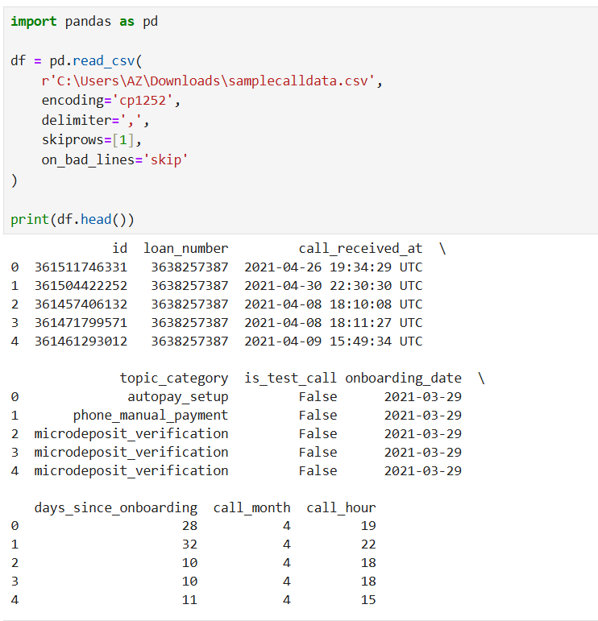
Loading data into notebook
WITH call_data AS (
SELECT
C.*,
L.onboarding_date,
DATE_DIFF(DATE(C.call_received_at), DATE(L.onboarding_date), DAY) AS days_since_onboarding,
EXTRACT(MONTH FROM C.call_received_at) AS call_month,
EXTRACT(HOUR FROM C.call_received_at) AS call_hour
FROM `valon-lookml-interview-project.analytics_interview_case_study.calls` AS C
RIGHT JOIN `analytics_interview_case_study.loans` AS L
ON L.loan_number = C.loan_number
WHERE CAST(C.is_test_call AS STRING) = "false"
--AND C.id NOT IN (361454543192, 361545807691)
)
SELECT
call_month,
COUNT(*) AS total_calls,
COUNT(DISTINCT loan_number) AS unique_loans,
COUNTIF(topic_category = 'microdeposit_verification') AS microdeposit_calls,
COUNTIF(topic_category = 'phone_manual_payment') AS manual_payment_calls,
COUNTIF(topic_category = 'autopay_setup') AS autopay_calls,
COUNTIF(topic_category = 'website_registration') AS website_reg_calls,
COUNTIF(topic_category IS NULL OR topic_category = '') AS uncategorized_calls
FROM call_data
WHERE call_month IS NOT NULL
GROUP BY call_month
ORDER BY call_month;
Used CTE in order to aggregate call volume by topic, then realized notebooks are allowed and switched over to python.

Slide 4
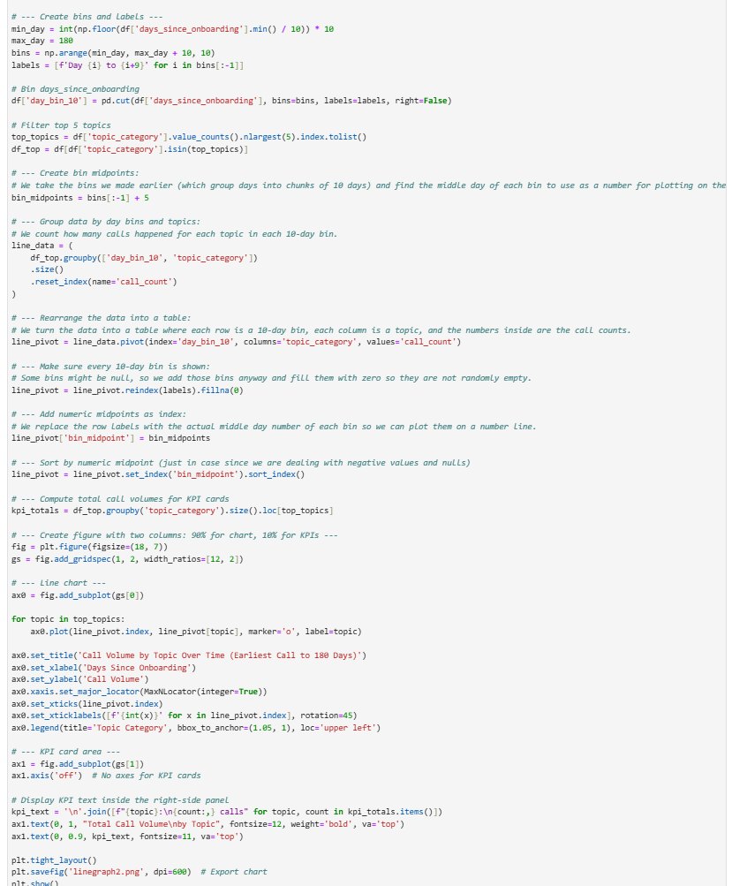
Call volume line graph code

Slide 5
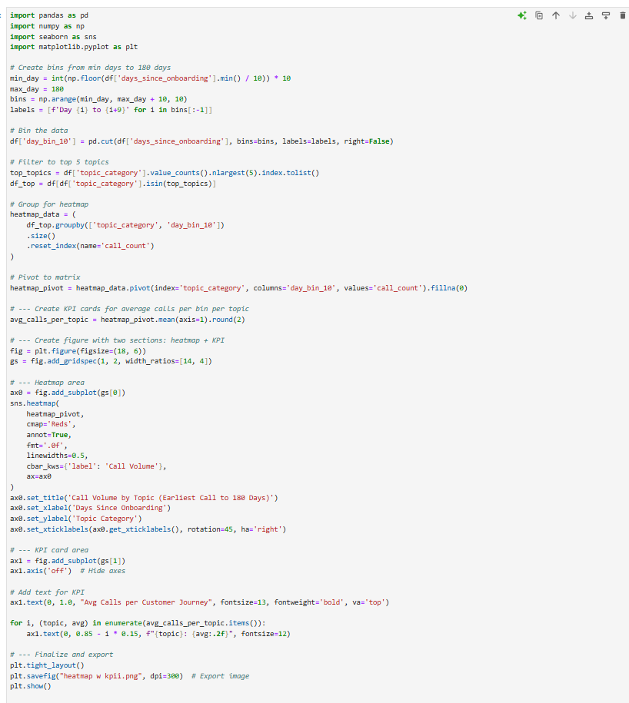
Heatmap Code

Slide 6
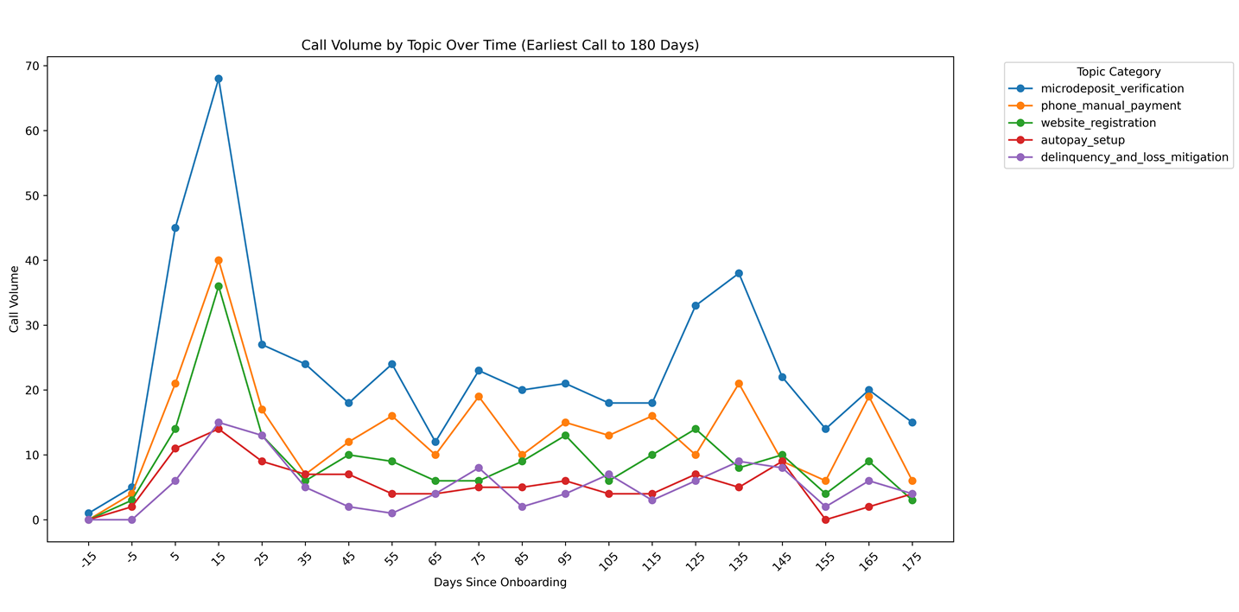
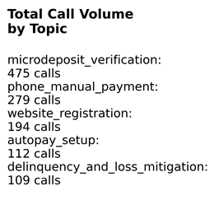
Notes:
Pre-onboarding activity:
Noticeable call volumes in negative days — likely onboarding prep or loan setup questions.
Initial surge post-onboarding:
Sharp spikes in call volume immediately after onboarding (first 10-30 days), likely due to setup issues, education, or initial loan servicing questions.
Topic shifts over time:
Topics related to “payment questions” or “account management” tend to rise steadily post-onboarding as customers are starting to familiarize themselves to what the payment agreement is.
Declining volume after 3 months:
Call volume typically tapers after 90-120 days, suggesting customers get familiar or issues are resolved.
Some topics peak later:
Certain complex issues or escalations peak later, maybe around 4-6 months.

Slide 7
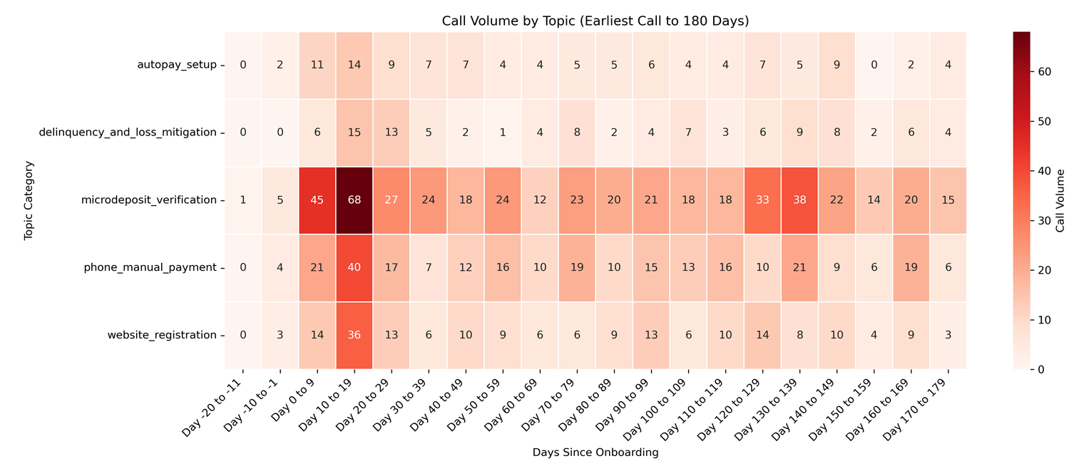
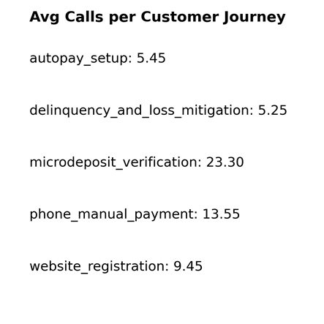

Slide 8
Trends
Pre-onboarding activity:
Noticeable call volumes in negative days — likely onboarding prep or loan setup questions.
Initial surge post-onboarding:
Sharp spikes in call volume immediately after onboarding (first 10-30 days), likely due to setup issues, education or lack-there-of, or initial loan servicing questions.
Topic shifts over time:
Topics related to “payment questions” or “account management” tend to rise after customers have on boarded since customers are likely only starting to familiarize themselves to what the payment terms and conditions are.
Declining volume after 3 months:
Call volume typically tapers after 90-120 days, suggesting customers get familiar or issues are resolved, however this does not mean their experience is smooth and there was no friction.
Some topics peak later:
Certain complex issues or escalations peak later, maybe around 4-6 months.

Slide 9
Hypotheses on Borrower Behavior
Pre-onboarding calls are driven by proactive customer support or initial inquiries.
The early post-onboarding spike reflects onboarding friction points and customer onboarding education.
Topics with sustained volume may indicate ongoing servicing complexity or payment concerns.
The decline after 3 months suggests effective resolution and customer adaptation.
Late-peaking topics could signal seasonal or lifecycle-specific issues (e.g., annual escrow analysis).

Slide 10
Topics Recommendations to improve Customer Journey
Microdeposit verification: Make the self-service experience easier to use and prominently show onboarding FAQs.
Phone manual payment: Include clear, step-by-step instructions during the welcome process.
Website registration: Improve the phone menu options and set up smart call routing.
Autopay setup: Make the payment confirmation process simpler and more straightforward.
Delinquency and loss mitigation: Focus on these important topics in chatbot conversations to better assist customers.

Slide 11
How might you track this data over time, and how would you operationalize this data with
different cross-functional stakeholders (i.e. product, operations, compliance, etc.)
Automating data ingestion via pipelines and enhancing processes to ensure real-time and historical tracking.
Building interactive dashboards accessible by product, operations, compliance, and leadership teams. Establish governance around the metrics that are able to be leveraged (golden source of truth)
Establishing SLA and KPI monitoring with alerting for anomalies or surges (operational and regulatory/compliant reports)
Partnering cross-functionally to align on operational goals and root cause investigations. (product enhancements, research & development, A/B Testing)
Using the data to guide resource planning, process improvements, and compliance audits.
Regularly reviewing trends in recurring stakeholder meetings to inform strategic decisions.
This approach empowers stakeholders to make data-driven decisions, optimize workflows, and maintain regulatory compliance.

Slide 12
We can set up alerts based on spikes in call volume per borrower by topic. How would
you determine a good threshold for an alert?
Steps to Determine a Threshold for Call Volume Alerts
Analyze Historical Data
Gather a sufficient amount of past call volume data segmented by borrower and topic.
Calculate baseline statistics for each topic, such as average daily call volume per borrower, standard deviation, and typical variability over time. This will provide you rolling data to observe trends and have a reference base line to determine outliers and deviations.
Use Statistical Methods for Thresholds
Mean + N × Standard Deviation: Set a threshold at a certain number of standard deviations above the mean (e.g., mean + 2σ or 3σ). This flags volumes significantly above normal fluctuations.
Percentile-Based Threshold: Use a high percentile (e.g., 95th or 99th) of historical call volumes as the threshold.
Consider Seasonality & Trends
Adjust thresholds based on expected seasonal patterns, promotions, or onboarding waves. For example, if call volumes spike every month-end, set dynamic thresholds to avoid false positives during those times.
Define Minimum Volume
To avoid alerts on very low counts with high variance, set a minimum call count before triggering an alert.
Incorporate Business Context
Collaborate with operations and compliance teams to understand what magnitude of spike would genuinely impact borrower experience or regulatory risk.
Pilot and Tune
Initially run alerts in “monitor-only” mode to evaluate false positives and missed events.
Adjust thresholds iteratively based on feedback and outcomes. This created a feedback loop for iterative improvements.
Consider the following –
A threshold that's too low will overwhelm teams with alerts, causing alert fatigue.
A threshold too high might miss early warnings of systemic issues affecting borrowers.
Using data-driven, dynamic thresholds lets you catch meaningful spikes early without noise.

Slide 13
We can set up alerts based on spikes in call volume per borrower by topic. How would
you determine a good threshold for an alert?
Data that would improve the analytics platform.
Call Duration
Why: Helps measure call efficiency and agent workload. Long calls may indicate complex issues or inefficiencies.
Procurement: Typically logged automatically in call center telephony systems (e.g., Genesys, Avaya).
Call Outcome / Resolution Status
Why: Knowing if calls ended resolved, escalated, or abandoned helps evaluate call effectiveness and customer satisfaction.
Procurement: Often captured by agents post-call or through CRM systems.
Agent Information
Why: Track performance by agent, identify training needs, and workload balance.
Procurement: From workforce management or call center operations software.
Call Type (Inbound/Outbound)
Why: Differentiate proactive outreach from reactive support to understand demand sources.
Procurement: Available in call logs or telephony platforms.
Customer Demographics & Loan Details
Why: Segment calls by borrower profile, loan type, or risk level to tailor operational focus.
Procurement: Integrate with loan servicing databases or CRM platforms, ensuring compliance with privacy laws.
Wait Time / Hold Time
Why: Key for customer experience metrics and operational efficiency.
Procurement: Typically logged in telephony systems.
Call Abandonment Rates
Why: Indicates customer frustration or insufficient staffing.
Procurement: From telephony system metrics.
Time of Day / Day of Week
Why: Identify peak call times to optimize staffing and improve service levels.
Procurement: Extract from timestamp data in call logs.
Customer Satisfaction (CSAT) Scores or Post-Call Surveys
Why: Direct feedback on service quality and agent performance.
Procurement: Via post-call survey tools or customer experience platforms.

