Slide 1

Hypothesis Testing, part II

Slide 2

Learning Objectives
By the end of this lecture, you should be able to:
  List, from memory, the basic steps in a hypothesis test.
  Describe what is meant by a p value
  Take a p-value and say whether the result is statistically significant, and therefore, whether we reject or fail to reject the null hypothesis.
  Explain what is meant by the significance level, alpha
  Know the difference for a one-tailed v.s. two-tailed test
  Calculate a p-value for either one-tailed or two-tailed tests

Slide 3
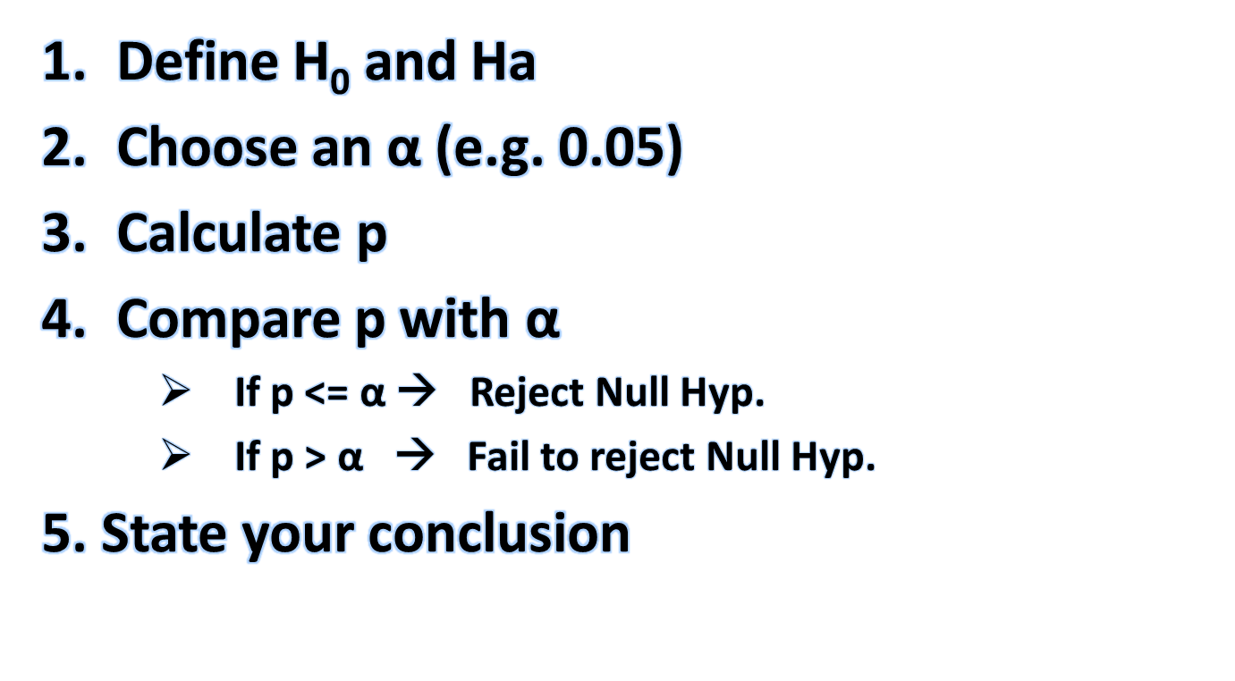
Overview of Steps in a Hypothesis Test

Slide 4
Hypothesis Test
The folllowing is one way of phrasing the key question asked by a hypothesis test:
Is the probability high or low that the difference between the mean of one group and the mean of the second group can be explained by sampling variability?
If this difference is NOT likely to be due to sampling variability, then we say the result is statistically significant.
The statistical test we apply to determine if the difference between the two means is statistically significant is called a hypothesis test.
Restated: In other words, the hypothesis test is a calculation we do to determine whether or not the difference between two values is statistically significant.

Slide 5

The hypothesis test calculation uses our Normal density curve (what else!) to come up with a probability. This probability is called a p-value.
If the p-value is less than or equal to a predetermined significance level, (usually 0.05), we reject the null hypothesis (and accept our alternate hypothesis).
If the p-value is HIGHER than than our predetermined value, we fail to reject the null-hypothesis. In other words, we say that this sample has not convinced us to change our minds.

Slide 6
YES
NO
“Statistically Significant”
“Not Statistically Significant”
Reject Null Hypothesis
Fail to reject Null Hypothesis
Note: If an experiment fails to reject the null hypothesis, this does NOT make the null hypothesis true. It simply means that our experiment did not prove that it was false.

Slide 7
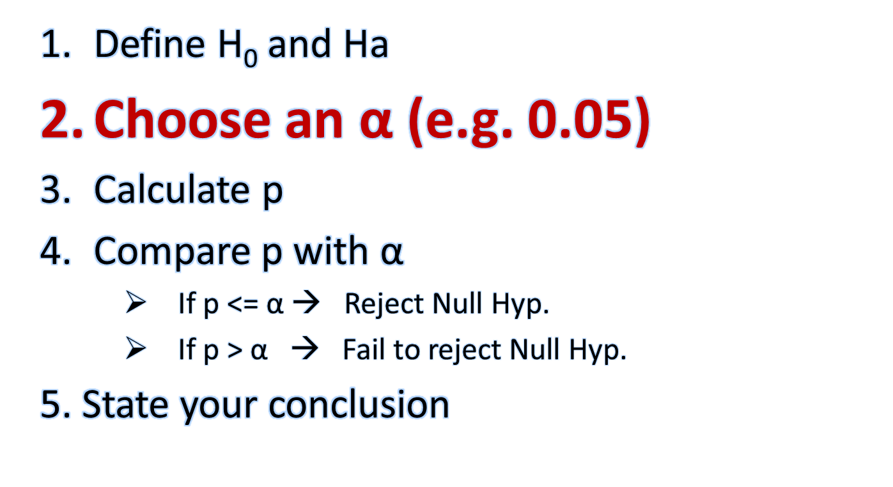
Overview of Steps in a Hypothesis Test

Slide 8
Significance Level ‘α’
The significance level is the value at which we will decide whether or not to call the result of a hypothesis test “statistically significant” or “not statistically significant”.
We call this significance level ‘alpha’ (α)
Much like the confidence level ‘C’ for confidence intervals must be decided in advance, we must also decide the significance level (α) in advance.
Much like we commonly choose 95% for ‘C’, there is also a “typical” value for alpha: It is 0.05.
  That is, if p <= 0.05 we call our result significant
  If p>0.05, we call our result not-statistically significant
OPTIONAL DISCUSSION:
Tradeoff: Recall the ‘tradeoff” when choosing a C: The higher the C, we’ll be more confident, but at the price of a higher margin of error. Things work very similarly, for statistical significance. The main difference is that we want a lower value for α. As with C, it’s up to us to decide what value of α we are “comfortable” with. Typically, we choose 5%. Allowing a lower α is more forgiving, but just as with desiring a higher C, there is a cost. If we choose a very low significance level, we are setting the bar extremely high for rejecting the null hypothesis.

Slide 9
“Statistically Significant”
Recall that the p-value is the calculated result of a hypothesis test.
The smaller this p-value, the more confident we are that the DIFFERENCE between the value obtained by our sample and the value indicated by our null-hypothesis is not due to chance, i.e. not due to sampling variability.
Important: The term Signifcant does NOT mean “major” or “important” or “big”. It just means that the DIFFERENCE between the two means is not likely to be due to chance.
Example: Though we are looking for p<=0.05, is it NOT unusual to see values for p such as p = 0.00000012. However, such a value for p does NOT mean that our null hypothesis is very, very, very false! It simply means that we can reject it.
In other words, all the p-value is tells us is whether the difference between the mean of the two groups is likely or not to be due to sampling variability.

Slide 10
Example
A p-value that is somewhat high (i.e. the result is not statistically significant) is one of the MOST COMMON ways in which people mislead (intentionally or otherwise) with statistics. That is, they will report a difference that may appear to be large, but in reality, is not large enough that we can rule out the possibility that it is due to chance.
Example: The average weight of a random sample of 3 people from Illinois is 163 pounds. The average weight of a random sample of 3 people from California is 287 pounds. There is over a 100 pound difference!! Does this mean that people in Illinois have their weight under much better control than people in California?
Answer: Of course not… And, in fact, if we did a hypothesis test, we would find that our p-value for this hypothesis test was not even close to being below our 0.05 threshold. In other words, we would say that the results of this test were “not statistically significant”. I hope you recognize that in this case, the flaw is in our very small sample size which means it is very reasonable to believe that this 100+ difference between the two means was due to sampling variability.

Slide 11
Significance Test and p-Value Restated:
“The spirit of a test of significance is to give a clear statement of the degree of evidence provided by the sample against the null hypothesis.”
  Represented by the p-value
  As p gets lower, the evidence allowing you to reject the null hypothesis gets stronger.
    If p <= alpha (significance level), we reject the null hypothesis.
    If p > alpha (significance level), we fail to reject the null hypothesis.

Slide 12

Example
The packaging process has a known standard deviation σ = 5 g.
H₀ : µ = 227 grams (i.e. package weight = 227 g)
H_{a} : µ ≠ 227 grams (i.e. package weight not equals 227 g)
The key point: Could sampling variation account for the difference between the H₀ and the sample results?
  A small p-value implies that random variation due to the sampling process is not likely to account for the observed difference.
  With a small p-value we reject H₀. The true property of the population is “significantly” different from what was stated in H₀.

Slide 13
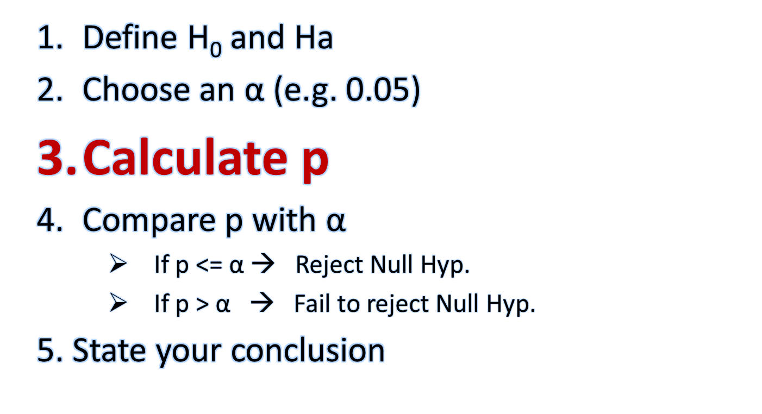
Overview of Steps in a Hypothesis Test

Slide 14
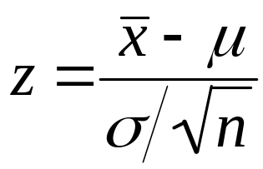
Calculating a p-value – The Z Score
estimate – hypothesized value
We calculate the z-score using the formula above
  It shold look familiar!
If your Ha is of the ‘<‘ (i.e. “less than”) variety, your p value is the area to the LEFT of your z-score.
  E.g. H_{a} : Weight of Californians < Weight of Illinoisans
If your Ha is of the ‘>‘ (i.e. “greater than”) variety, your p value is the area to the RIGHT of your z-score.
  E.g. H_{a} : Nicotine in cigarettes >= 1.4
If your Ha is of the ‘≠’ (i.e. “not equal to”) variety, your p value is the area to the left of your negative z-score PLUS the area to the right of your positive z-score.
  E.g. For the package of tomatoes, H_{a} : µ ≠ 227 grams

Slide 15
Calculating a p-value: One-Tail v.s. Two-Tail
If your H_{a} refers to ‘<‘, you calculate p by looking at the probability to the left of your calculated z-score.
  This is called a “one-tailed” test
If your H_{a} refers to ‘>‘, you calculate p by looking at the probability to the right of your calculated z-score.
  This is also called a “one-tailed” test.
If your H_{a} refers to ‘not equal‘, you calculate p by adding the probabilities to the right AND left of your z-score.
  The fastest way to do this, is to calculate the area to the left of your z-score (right off the table), and double it!
  This is called a “two-tailed” test
  This is the most commonly used form

Slide 16

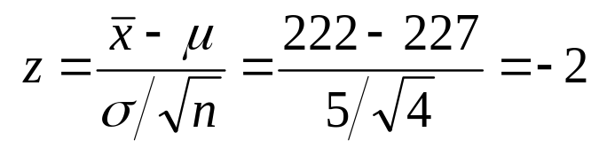

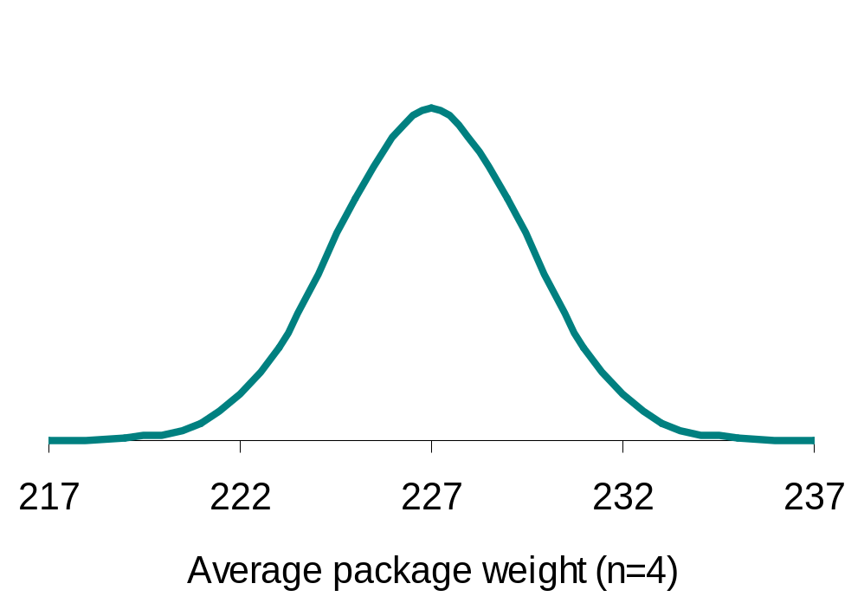
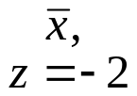
Does the packaging machine need calibration?
  H₀ : µ = 227g versus H_{a} : µ ≠ 227 g
  sigma=5
The area under the standard normal curve to the left of z= -2, is 0.0228. However, because our Ha is a ‘not equals” question, this is a two-tailed test, so: p = 2 * 0.0228 = 0.0456
Sampling distribution
σ/√n = 2.5 g
2.28%
2.28%
µ (H₀)

Slide 17
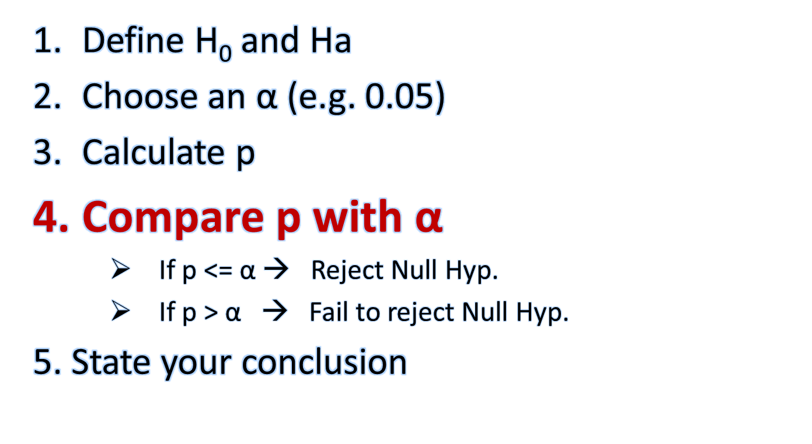
Overview of Steps in a Hypothesis Test

Slide 18
Does the packaging machine need calibration?
  H₀ : µ = 227g (s=5) versus H_{a} : µ ≠ 227 g
  Our calculated p was 0.0456
  Our chosen value for alpha was 0.05
Because p <= alpha, we say our result is statistically significant.
Therefore, we can REJECT the null hypothesis and state that the mean weight of a package of tomatoes is NOT 227 grams.
Conclusion: Our calibration machine needs adjusting!

Slide 19
Example
A 1999 study looked at a large sample of university students and reported that the mean cholesterol level among women is 168 mg/dl with a standard deviation of 27 mg/dl. A recent study of 71 individuals found a mean level of 173.7 mg/dl. Has the level changed in the intervening years?
  Note: We did NOT ask if the level increased. The question asks whether the levels today have changed from 1999. (Or is the difference too small to rule out being due to chance)?
Solution:
  Ha: cholesterol level today has changed (i.e. is not equal to) choleseterol level in 1999. I.E:
    H_{a}: 1999 mean cholesterol level ≠2013 mean cholesterol level.
    H₀: 1999 mean cholesterol level = 2013 mean cholesterol level
  Because no other value was stated, we will choose the “typical” significance level (alpha) of 0.05 as our significance thereshold.
  Calculation:
    z = Est – Hyp / sd estimate
    = (173.7 – 168) / 27/ sqrt(71)
    = 1.78
Now this is a positive z-score, and the probability of getting a value >1.78 is 0.0375.
However, because this would only be the ‘>’ situation. However, NOTE that Ha is a “NOT EQUAL” claim. Therefore, we also need to add the ‘<‘ situation. So we could add the probability of Z < -1.78 (which is also 0.0375). Our p-value is, therefore 0.075.
p = 0.075 is NOT less than 0.05, so we “fail to reject the null hypothesis”.
Conclusion: Based on THIS sample, we can not claim that cholesterol levels have changed.
Define H₀ and H_{a}
Decide on α
Calculate p
Compare p with α
State Conclusion

Slide 20
Example
In a discussion of the average SATM (math SAT) scores of California high school students, an educational expert points out that because only those HS students planning on attending college will take the SAT, there is in fact, a selection bias at work. The person claims that if all California HS students were to take the test, the score would be 450 or even lower. As an experiment, a random sample of 500 students were given the test, and the mean was found to be 461, with a standard deviation of 100. Is our expert’s claim borne out?
Answer:
Define H₀ and Ha:
  H₀: mean score <= 450, Ha: mean score > 450
Decide α: α = 0.05
Calculate p: Z = (461-450) / (100/sqrt(500)) = 2.46.
  Note that because our Ha claim is of the ‘>’ type, we have a one-sided test.
Compare p with α: A z>2.46 has a probability of 0.00069. This is well below our threshold of α . Therefore we can reject Ho.
Conclusion: We reject our expert’s claim that the average of all students would be below 450.

Slide 21
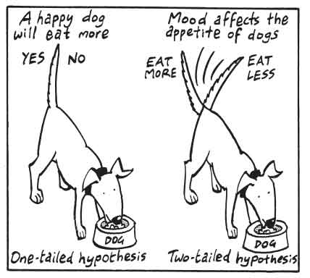
Optional…
The remaining slides are here for your interest/convenience. They include some examples on how these p-values are determined from the Normal curve.
They also discuss some ‘real-world’ considerations of alpha that were touched on earlier.

Slide 22
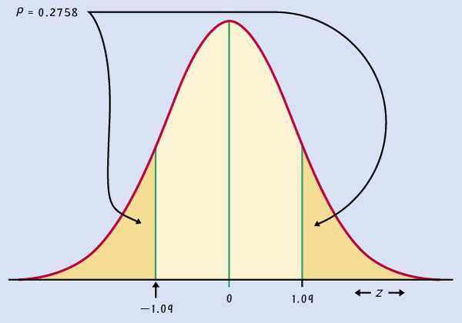
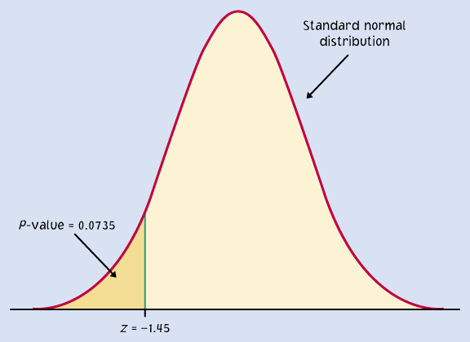
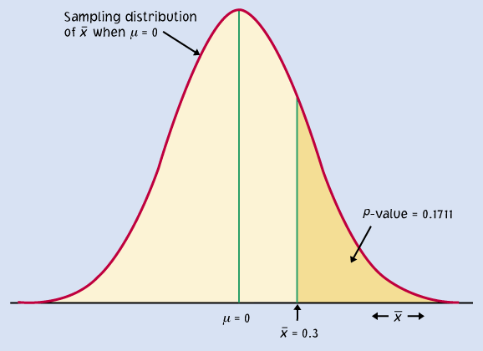
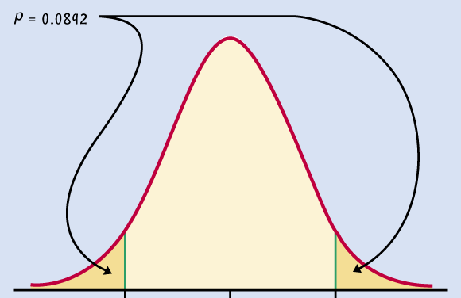
Recall that a sampling distribution of sample means follows a Normal pattern. Most samples will give a result that approximates the population (i.e. true) mean. (The number at the center of the distribution). However, some percentage of the time, by complete fluke, we’ll draw a sample that gives a result much higher or lower than the true mean.
These examples (two-tailed tests on left, one-tail tests on right), show that as the likelihood of a sample coming from way out on the sides (i.e. not close to the population value) is smaller, the P value also gets smaller and smaller. We will discuss how to calculate these numbers for P momentarily.
(See note).
Notes:
If I pick a single random sample, is it’s mean more likely to be around the population mean or more around one of the extreme sides of the above graphs?
Key Point: Most samples have means with values in the middle regions of the distribution. But a certain percentage of samples, will have means closer to the edges.

Slide 23
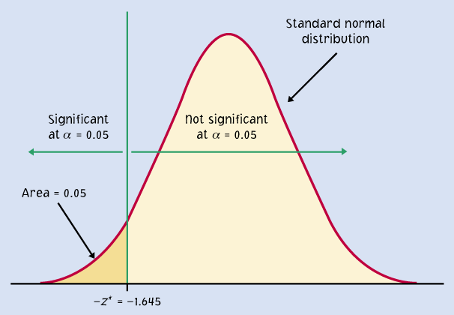
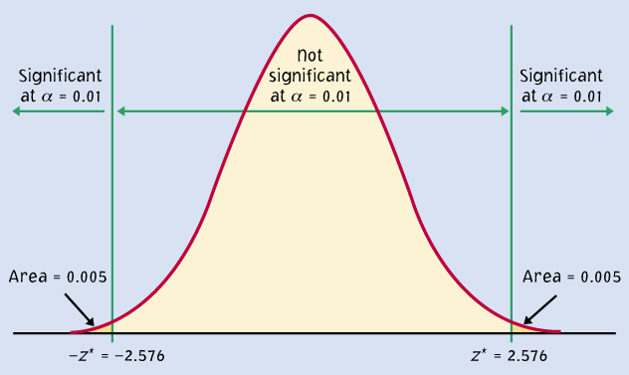
P = 0.2758
P = 0.0735
P = 0.1711
P = 0.05
P = 0.0892
P = 0.01
When the shaded area becomes very small, the probability of drawing such a sample at random gets very slim. Typically, we call a P-value of 0.05 or less significant.
We are saying that the phenomenon observed is unlikely to be a fluke that has resulted from our random sampling.

Slide 24
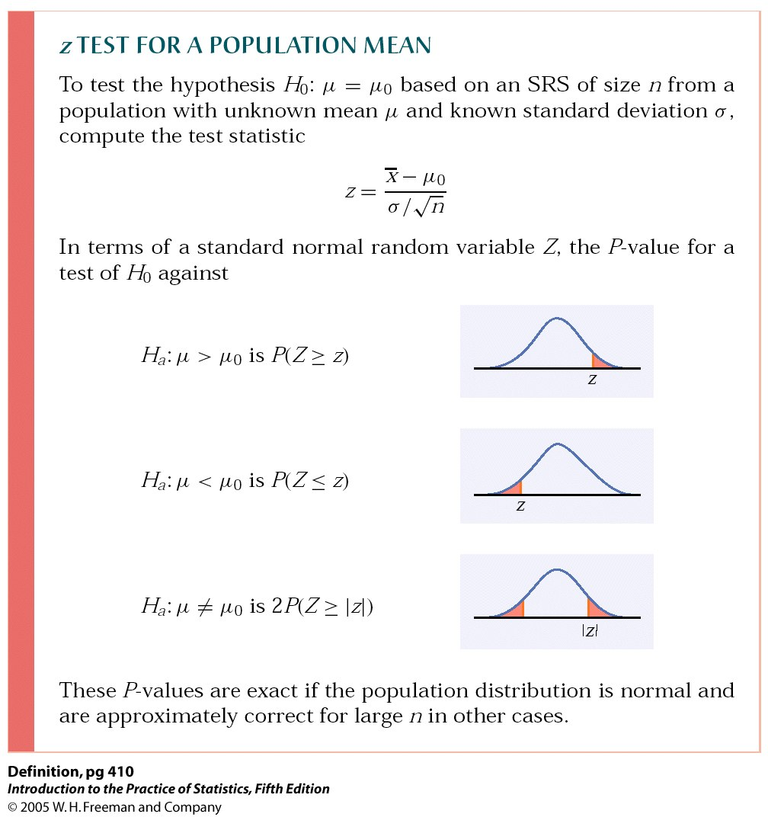
P-value in one-sided and two-sided tests
(null hypothesis value)
One-sided (one-tailed) test
Two-sided (two-tailed) test
To calculate the P-value for a two-sided test, use the symmetry of the normal curve. Find the P-value for a one-sided test and double it.

Slide 25
The significance level α
The significance level, α, is the largest P-value tolerated for rejecting a true null hypothesis!
This value is decided before conducting the test.
  If the P-value is equal to or less than α (P ≤ α), then we reject H₀.
  If the P-value is greater than α (P > α), then we fail to reject H₀.
Does the packaging machine need revision?
Two-sided test. The P-value is 4.56%.
* If α had been set to 5%, then the P-value would be significant.
* If α had been set to 1%, then the P-value would not be significant.

Slide 26
Cautions about significance tests
Choosing the significance level α
Factors often considered:
What are the consequences of rejecting the null hypothesis
(e.g., global warming, convicting a person for life with DNA evidence)?
Are you conducting a preliminary study? If so, you may want a larger α so that you will be less likely to miss an interesting result.
Some conventions:
We typically use the standards of our field of work.
There are no “sharp” cutoffs: e.g., 4.9% versus 5.1 %.
It is the order of magnitude of the p-value that matters: “somewhat significant,” “significant,” or “very significant.”

Slide 27
Very, very Important:
Failing to reject H₀ does NOT mean that Ho is true!
A lack of significance, that is, if p ends up > alpha, does NOT prove that the null hypothesis is true.
It just means that the evidence from our particular sample was not compelling enough to say that it is false.

Slide 28
Practical significance
The specific value that you come up with for p has very little practical significance.
You are ONLY interested in knowing whether or not p is less than 0.05 (or whichever value you chose for alpha).
No matter how high or low the p-value, this value does NOT tell you about the magnitude of the effect. It ONLY tells you whether the difference between the two values is or is not likely to be due to chance.

Slide 29
* Don’t ignore lack of significance
  There is a tendency to conclude that there is no effect whenever a p-value fails to attain the alpha standard (e.g. 5%).
  Consider this provocative title from the British Medical Journal: “Absence of evidence is not evidence of absence”.
  Having no proof of who committed a murder does not imply that the murder was not committed.
Indeed, failing to find statistical significance simply means that the particular sample failed to give sufficient evidence allowing you to reject the null hypothesis. That does NOT mean that the null hypothesis is true. It only means that you were not able to prove that it is false.
This is the reasonwe use the admittedly wordy: “fail to reject the null hypothesis”.

