Slide 1
TOGAF 9
Content & Completeness Comparison
Thought Leadership / Point of View
March 2011
Notes:
Copyright © 2009 Accenture All Rights Reserved.
Quality & Client Satisfaction

Slide 2
Contents
Objective
EA Context & Accenture EA Assets
TOGAF 9 Overview
TOGAF 9 Comparison
  Methodology
  Organization and Operating Model
  Governance
  Implementation Roadmap
  Reference Architectures and Assets
  Repository and Tools
TOGAF 9 Adoption
Key Implementation Steps
References & Key Contacts
Copyright © 2011 Accenture All Rights Reserved.

Slide 3
Objective & Audience
Objective:
Our view on TOGAF 9 content and completeness
Compare and contrast TOGAF 9 with Accenture EA Assets
Practical insights to implement TOGAF 9
Highlight areas where Accenture EA assets fills gaps to complement TOGAF 9 material
Audience:
CIOs
Chief Architects/CTOs
IT Directors & Managers
Enterprise Architecture Teams
Copyright © 2011 Accenture All Rights Reserved.

Slide 4
EA Context
EA Capability at our clients consists of a set of core interrelated areas
Methodology
Level of detail
Templates
Our clients focus on one or more areas to set up or enhance their EA Capability
EA Frameworks have been evolving over time to address different areas of an EA Capability
Plan
Initiatives
Training
Publication
Tools
Integrated Models
Productivity Aids
EA Planning
Methodology
Implementation
Roadmap
Repository
and Tools
Enterprise
Architecture
Capability
Architecture
Governance
Reference
Architectures and
Assets
Organization
and
Operating
Model
Decision Framework
Team Charters
Processes
Templates
BAITS¹ Reference Models
Standards
Policies
Principles
Organization
Roles / Skills
Process
Metrics
Note:
1: BAITS = Business, Application, Information, Technology and Security Architecture
Copyright © 2011 Accenture All Rights Reserved.

Slide 5

EA links long range strategy to day-to-day execution
EA is the essential link between the business strategies and the technologies needed to enable them
Strategy & Imperatives
Strategy
Enables
Enterprise Business Architecture
Drives
Enterprise Application Architecture
Enterprise Architecture
Enterprise Information Architecture
Enterprise Technology Architecture
Enterprise Security Architecture
Projects
IT Investments and Solutions
Copyright © 2011 Accenture All Rights Reserved.

Slide 6
Accenture Enterprise Architecture
How we organize our work to meet client needs?
Establish EA Capability, Define Current & Future State EA, and Support ongoing EA management
Establish EA Operating Model & Governance
Define EA Vision, Mission, Objectives & Value
Design EA Governance Model & EA Organization model with roles & responsibilities
Establish EA Framework and Standards
Establish EA Management Functions and Processes
Define EA Capability Roadmap to establish EA Management & EA Components
Future State EA Components
EA Managed Services
Utilize mature offshore model to provide high value services
Help client EA Teams focus on high-value work
Maintain current artifacts to describe clients EA Components
Run and manage ‘back-office’ activities for EA Management
Establish & Organize
EA Management
Ongoing
EA
Management
EA Managed Services
Current State EA Components
Execute EA Operating Model & Governance
Maintain current & future state of EA Components
Execute EA Management Processes
Establish & maintain assets to define EA Components
Report on EA Management metrics consisting of EA Value & EA Activity
Define EA - EA Planning - EA ADM (Accenture Delivery Methods)
Method containing of prescribed activities & deliverables
Describe Current State
Define Future State Architecture
Establish Roadmap to achieve Future State
Copyright © 2011 Accenture All Rights Reserved.

Slide 7
The Open Group Architecture Framework (TOGAF 9)
Who is The Open Group?
The Open Group is a vendor and technology neutral consortium focused on open standards and global interoperability
What is TOGAF?
TOGAF is a framework - a detailed method and a set of supporting tools - for developing an enterprise architecture
In 2009, The Open Group released TOGAF 9 which had significant advancements compared to previous version of TOGAF (8.1)
Why TOGAF so popular?
  Cost - TOGAF may be used freely by any organization wishing to develop an enterprise architecture for use within that organization
  Industry Consortium – TOGAF has been developed and continuously evolving since the mid-90’s by representatives of some of the world’s leading IT customers and vendor organizations such as Capgemini, HP, IBM and SAP
Source: TOGAF Documentation (http://www.opengroup.org/togaf/)
Copyright © 2011 Accenture All Rights Reserved.

Slide 8
Contents
Objective
EA Context & Accenture EA Assets
TOGAF 9 Overview
TOGAF 9 Comparison
  Methodology
  Organization and Operating Model
  Governance
  Implementation Roadmap
  Reference Architectures and Assets
  Repository and Tools
TOGAF 9 Adoption
Key Implementation Steps
References & Key Contacts
Copyright © 2011 Accenture All Rights Reserved.

Slide 9
What TOGAF 9 and Accenture EA Assets address various components of an EA Capability?
 | TOGAF 9 | Accenture Assets
Methodology | TOGAF ADM - Architecture Development Methodology | Establish EA – EA Operating Model Define EA - EA Planning Accenture Delivery Method (EA ADM) EA Roadmap and Change Management Templates
Organization and Operating Model | Architecture Capability Framework* Architecture Skills Framework | EA Operating Model and Governance
Governance | Architecture Capability Framework* | EA Operating Model and Governance
Implementation Roadmap | Capability Based Planning | Establish EA – EA Operating Model EA Roadmap and Change Management Templates
Reference Architectures and Assets | Architecture Content Framework TOGAF Reference Models Enterprise Continuum | Accenture High Performance Models EA Industry Architectures Accenture Delivery Architecture (Cube) EA Asset Templates
Repository & Tools | Architecture Repository Guidelines Tools Evaluation Criteria and Guidelines | Detailed EA Tool PoV and ‘real-life’ experience templates EA Tool Evaluation Framework
* TOGAF 9 Quote – “Architecture Capability Framework is not intended to be a comprehensive template for operating an EA capability”
Copyright © 2011 Accenture All Rights Reserved.

Slide 10
While TOGAF 9 has made significant progress to improve its previous framework, Accenture assets and experience can significantly add or enhance many areas of TOGAF 9
 | TOGAF 9 | Accenture Assets
Methodology | Mature but needs customization | Establish EA – EA Operating Model Define EA - EA Planning Accenture Delivery Method (EA ADM) EA Roadmap & Change Management Templates
Organization and Operating Model | Requires Significant Additions | EA Operating Model and Governance
Governance | Requires Significant Additions | EA Operating Model and Governance
EA Maturity Assessment | High Level Guidance Only (Requires Some Additions) | Accenture EA Maturity Model Accenture EA Maturity Assessment Methodology
Reference Architectures and Assets | High Level Guidance Only (Requires Some Additions) | Accenture High Performance Models EA Industry Architectures Accenture Delivery Architecture (Cube) EA Asset Templates
Repository & Tools | Requires Significant Additions | Detailed EA Tool PoV and ‘real-life’ experience templates EA Tool Evaluation Framework
Ready for use
High Level – Requires some additions
Requires Significant Additions
Copyright © 2011 Accenture All Rights Reserved.

Slide 11
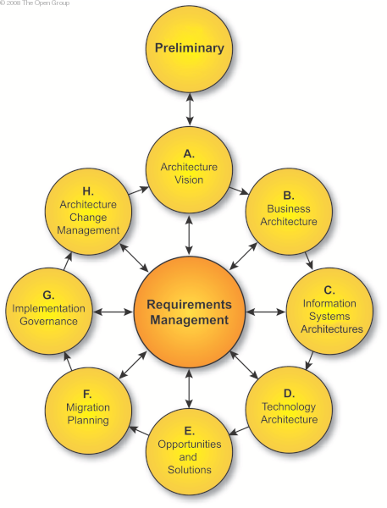
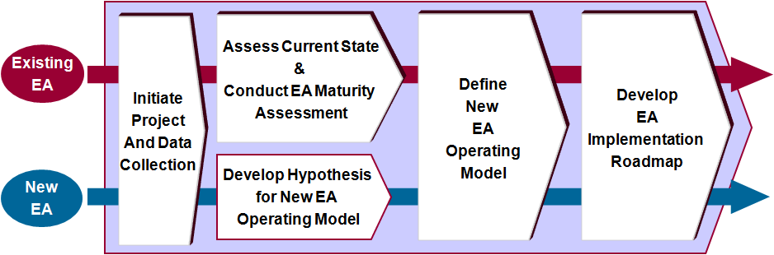

Methodology
TOGAF Architecture Development Methodology
Accenture Methodology for EA
Establish EA – EA Operating Model
Define EA - EA Planning Accenture Delivery Method
TOGAF’s ADM is at the heart of its framework and its key strength
Detailed methodology to design EA with prescriptive steps with inputs and outputs for each phase
Provides suggested outlines of deliverables for each phase
TOGAF 9 supplies multiple iterations and uses for its ADM based on the type of EA project
TOGAF certifies architects with a training and test based certification program
Key Differences
TOGAF does not prescribe any methodology to establish EA . Accenture has industry leading material on this topic
Accenture’s EA Methodology is a comprehensive collection of Accenture’s industry experience in Enterprise Architecture
Accenture methodology includes multiple examples of ‘real-life’ architecture deliverables and templates
Accenture EA method does not have a formal certification program. However, most Accenture EA practitioners are trained in methods and tools and bring significant ‘real-life experience’
Accenture has sizable pool of EA practitioners that are TOGAF 8.1 and TOGAF 9 certified
Copyright © 2011 Accenture All Rights Reserved.

Slide 12
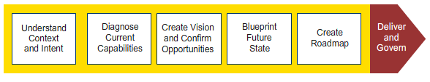
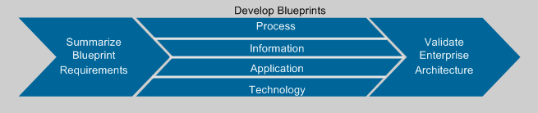
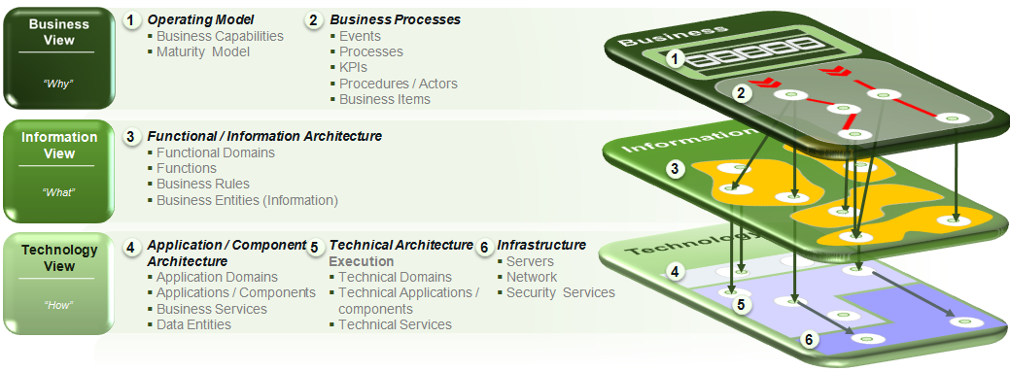
Accenture’s Enterprise Architecture methodology is used on our client engagements to perform enterprise architecture work. Our Industry Architecture Reference Models map to the Enterprise Architecture methodology and provide reference and comparison deliverables
Accenture Delivery Methods for Enterprise Architecture
Accenture Delivery Methods for Enterprise Architecture (top-level)
Accenture’s own Enterprise Architecture Methodology (analogous to TOGAF or another standard EA methodology/framework)
Accenture Delivery Methods for Enterprise Architecture (blueprint future state activity)
Accenture Industry Architectures
Industry architecture
6-layer reference model
Architectures cover multiple industries and are continually refined based on client experience

Slide 13
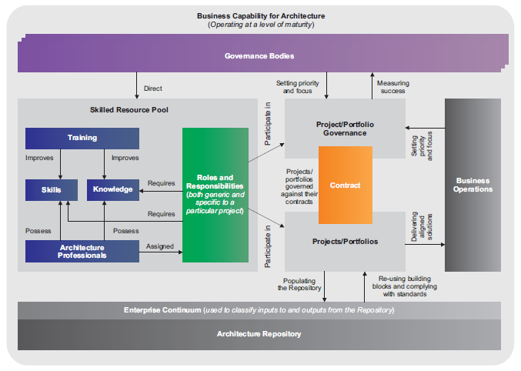
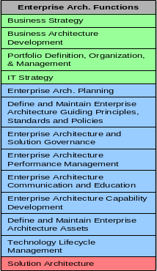
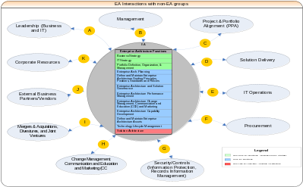
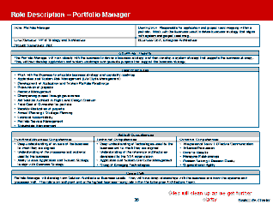
Organization and Operating Model
TOGAF Architecture Capability Framework
Accenture EA Operating Model
EA Functions
EA Interaction with other Teams
EA Roles
Detailed Description
TOGAF 9 introduces Architecture Capability Framework consisting of high-level Architecture Board, Compliance, Contracts, Governance and Skills
TOGAF 9 added a brief section on factors to consider while establishing an Architecture Capability
TOGAF provides an Architecture Skills Framework to measure different roles within an EA discipline
TOGAF provides a way to scope architecture compliance of solutions
Accenture’s EA Operating Model Asset has extensive templates and client examples for EA Functions, EA Processes, Roles, Skills and deliverables
Key Differences
EA Operating Model asset provides comprehensive detail on EA Functions and Processes. Detailed material to analyze and depict EA interaction with other stakeholders
EA Organization models with Pro/Con analysis
Accenture material includes BPMN templates for EA processes to be used as starting point.
A comprehensive list of EA metrics to measure an EA Capability
Copyright © 2011 Accenture All Rights Reserved.

Slide 14
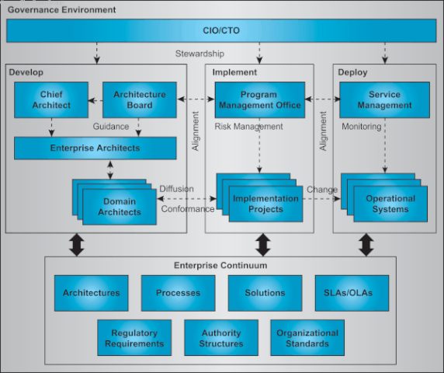
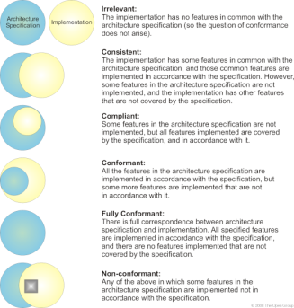
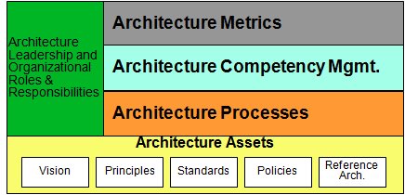
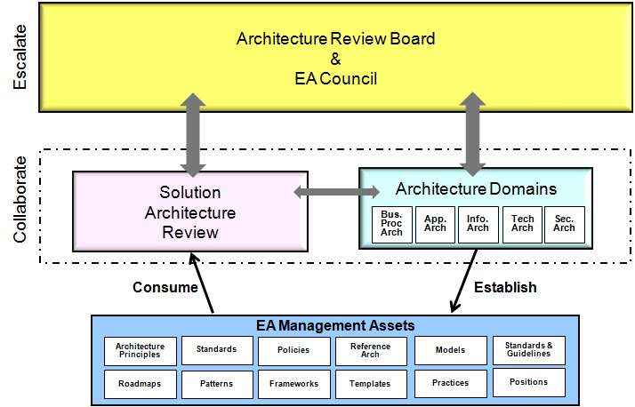
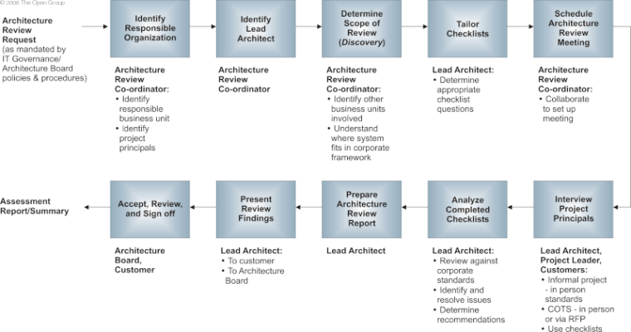
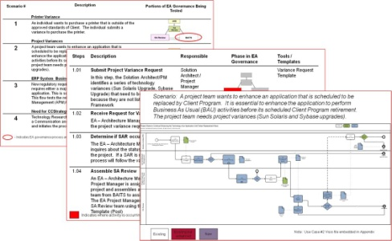
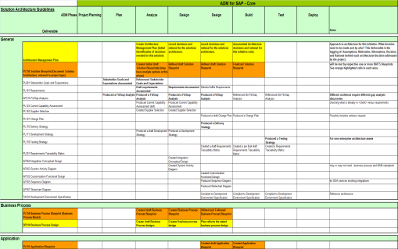
Governance
TOGAF Architecture Capability Framework
Accenture EA Governance Model
EA Governance Framework
EA Governance Model
EA Governance Use-Case Scenarios
Solution Review Checklists
TOGAF outlines a high-level Architecture Governance Framework that needs to be customized for adoption
TOGAF suggest a high-level Architecture Compliance process to perform architecture reviews
TOGAF provides some guidance and drivers to set up an Architecture Board
When compared to TOGAF8.1, the new TOGAF 9 has not made any significant changes to the Architecture Governance section
Accenture’s EA Governance Model provides ‘real-life’ Governance (implemented at our clients) with a detailed Framework, Processes, scenarios and review checklists
Key Differences
TOGAF 9 leaves out a lot of important detail needed to implement EA governance. Accenture’s EA Governance Model consists of ready to use frameworks, processes and templates that have been matured over 10+ years
Accenture has a broad governance offering which includes EA governance but not limited to this area alone
Copyright © 2011 Accenture All Rights Reserved.

Slide 15
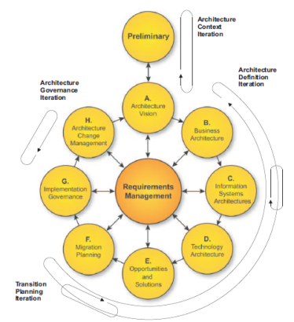
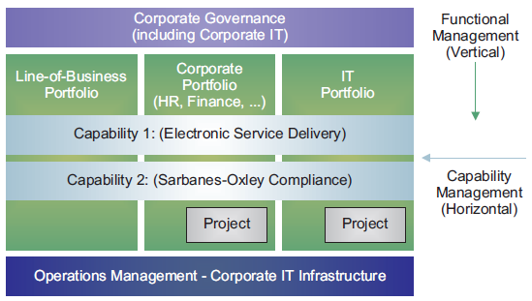
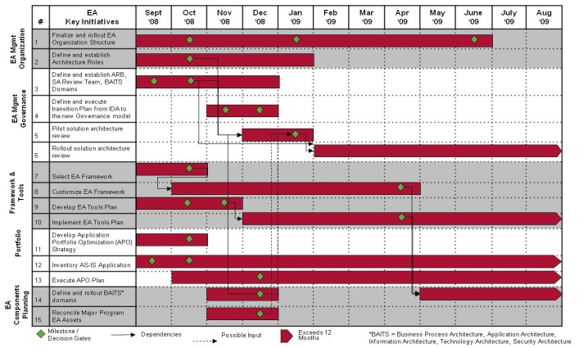
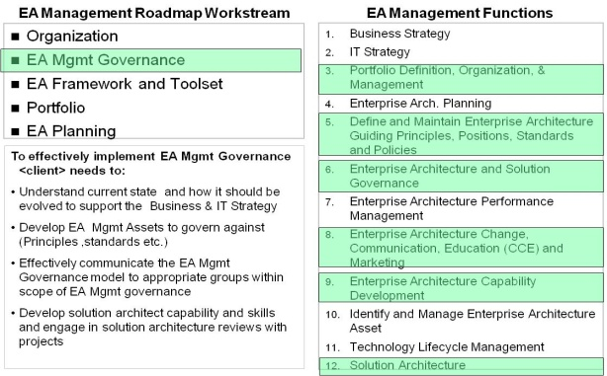
Implementation Roadmap
TOGAF ADM Iteration
Capability Based Planning
EA Implementation Roadmap
(Communication and Change Management Plan)
ADM Iterations
Capability Based Planning
TOGAF 9 has added new material to give guidance on how to apply iterations to ADM as well as how to apply ADM at different levels of the enterprise
TOGAF 9 gives a way to conduct Capability based planning for cross enterprise initiatives
Accenture has experience and detailed examples from various clients on how to implement TOGAF and other frameworks in order to establish or enhance EA Capability in an enterprise
Key Differences
Accenture provides planning templates and reference materials to create an effective EA implementation plan
Accenture assets integrate other critical success factors such as EA Change management, Stakeholder expectation management, EA Communication Plan, EA Training and EA Repository/Tool to create a EA implementation plan that has high chance of being successful
Copyright © 2011 Accenture All Rights Reserved.

Slide 16
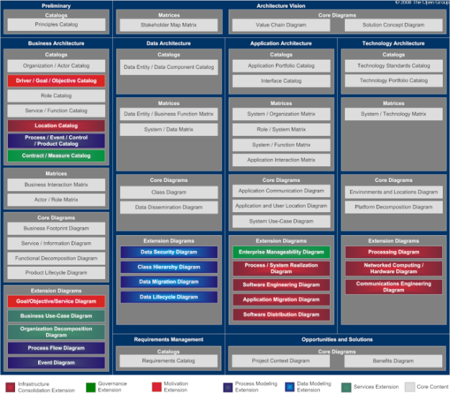
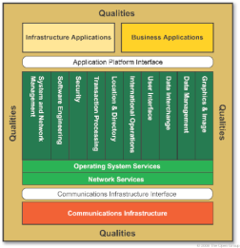
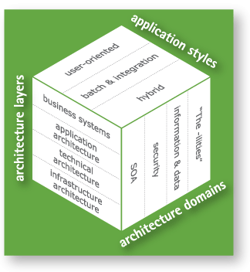
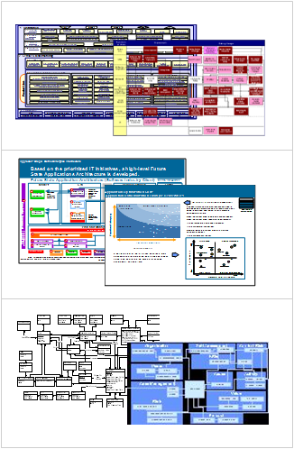
Reference Architectures and Assets
TOGAF Architecture Content Framework
TOGAF Reference Models
Accenture Architecture Cube
Detailed Architecture Examples and Templates
TOGAF 9 introduces advancements in types of artifacts through its meta-model that should be created and maintained as part of an EA Capability
TOGAF 9 provides a description of the artifacts and defines the type of relationships
TOGAF provides a basic technical reference architecture
Due to Accenture’s experience, Accenture has multiple defined and detailed templates and artifacts of architecture deliverables
Key Differences
While TOGAF 9 only identifies the deliverables, Accenture has multiple sample deliverables and templates for all aspects of the architecture within the enterprise including business, application, information, technology and security
Accenture has deep industry relevant Enterprise Architectures for various industries including Financial Services, C&HT etc.
Accenture artifacts are consistently updated based on project experience
Copyright © 2011 Accenture All Rights Reserved.

Slide 17
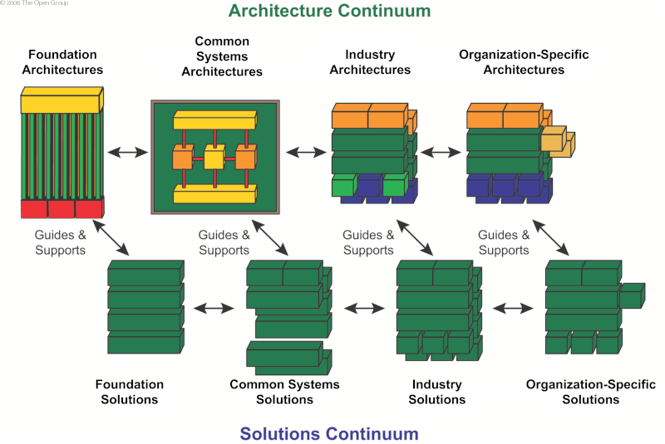
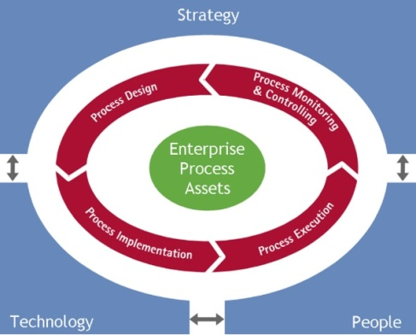
Reference Architectures and Assets Continued
TOGAF Enterprise Continuum
Accenture’s High Performance Operating Models
Accenture’s ADM and Accelerators
TOGAF defines the need for foundational architectures, common system architectures, industry architectures and organization-specific architectures through the use of its Enterprise Continuum
TOGAF gives high level direction and relationships to develop architecture models
Accenture provides industry, technology and platform specific (e.g. SAP, Oracle) architectures
Key Differences
In addition to defining the artifacts, Accenture has a comprehensive list of architecture examples, assets and templates
Copyright © 2011 Accenture All Rights Reserved.

Slide 18
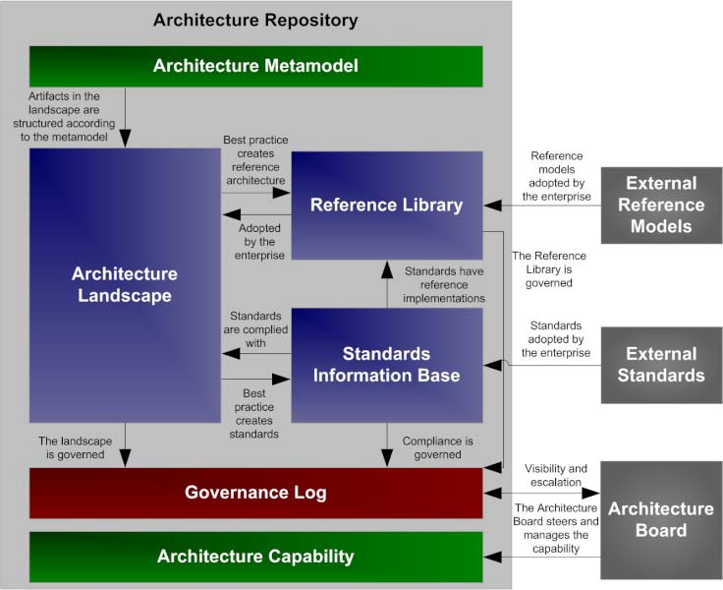
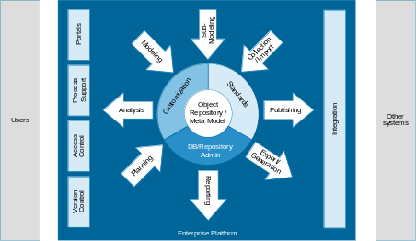
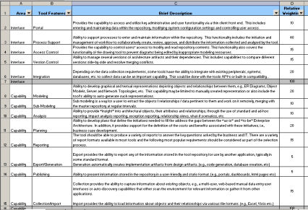
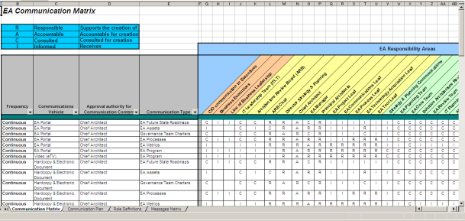
Repository and Tools
Tools, Architecture Repository
Implementation and Change Management
EA Tool PoV and Evaluation Framework
TOGAF 9 identifies the need for an Architecture Repository and defines six classes of information to structure the repository
TOGAF 9 only suggests a list of artifacts and assets to be stored in the Architecture Repository
TOGAF 9 does not require or recommend any tool. It provides a list of tool selection criteria
TOGAF does not provide implementation steps or change management approaches to implement TOGAF in an organization
Accenture has a list of assets specifically around EA Tools, Implementation and Communication and Change Management
Key Differences
Accenture provides a list of assets to help evaluate EA Tools based on client specific requirements
Accenture has implemented many EA Tools globally for its clients in various industries
Accenture provides templates to help clients plan and implement TOGAF framework
Copyright © 2011 Accenture All Rights Reserved.

Slide 19
Contents
Objective
EA Context & Accenture EA Assets
TOGAF 9 Overview
TOGAF 9 Comparison
  Methodology
  Organization and Operating Model
  Governance
  Implementation Roadmap
  Reference Architectures and Assets
  Repository and Tools
TOGAF 9 Adoption
Key Implementation Steps
References & Key Contacts
Copyright © 2011 Accenture All Rights Reserved.

Slide 20
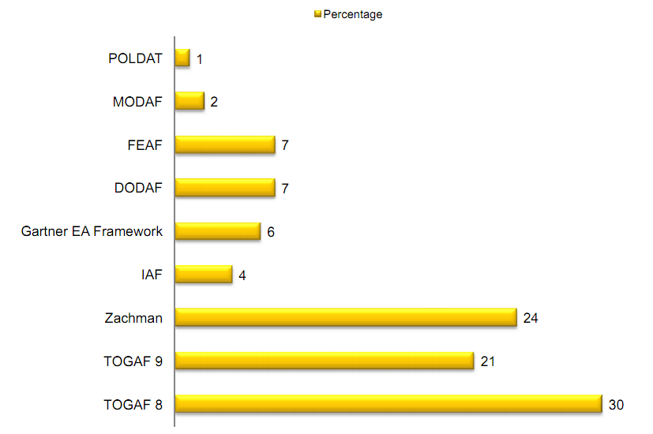
TOGAF – Industry Adoption
TOGAF is most popular EA Framework with over 51% adoption among surveyed companies
Over 71% of clients surveyed modify EA Framework to suit their needs *
Top reasons for clients to modify EA Framework include:
Integrate with own organizational and development process
Too complex and long drawn out – needs a lighter framework
Does not meet all enterprise requirements
Source: The Open Group, EA Survey 2009
* Source: Infosys Enterprise Architecture Survey 2008-2009
Copyright © 2011 Accenture All Rights Reserved.

Slide 21
TOGAF 9 Adoption
Debunking the Myths – 1 of 2
Myth #1: TOGAF 9 has Everything We Need to do Enterprise Architecture
  Reality: While TOGAF 9 has made significant advancements in addressing various parts of EA, the framework still has gaps in many areas which clients should proactively address
Myth #2: TOGAF 9 Does Require Specialized Skills to Implement
  Reality: An organization should evaluate the skills and maturity of the EA Capability first before adopting any EA Framework. Organizations that lack an EA team or EA Management function may struggle to implement TOGAF 9 or to demonstrate the value of the framework
Copyright © 2011 Accenture All Rights Reserved.

Slide 22
TOGAF 9 Adoption
Debunking the Myths – 2 of 2
Myth #3: We Should Rollout Everything at TOGAF 9 All at Once
  Reality: Avoid the “big bang” approach. Clients should target the high value components of TOGAF 9 first then follow a phased approach to implementation
Myth #4: TOGAF 9 is so Easy That We Won’t Need to Invest in a Change Management Effort
  Reality: The implementation of TOGAF 9 should be treated as a project and requires a solid communication, change management and training plan for the implementation to be successful
Copyright © 2011 Accenture All Rights Reserved.

Slide 23
What Steps Should I Follow To Adopt TOGAF 9?
Adopting TOGAF 9 requires some time and effort to add the most value to an organization. To implement TOGAF 9, an organization should consider the following 5 steps for successful adoption and implementation.
Step 1:
Understand the organization’s EA Capability
Step 2:
Adopt the relevant areas of TOGAF 9
Step 3:
Make TOGAF 9 relevant and fill gaps
Step 4:
Develop TOGAF 9 roadmap and roll-out
Step 5:
Monitor and adapt framework over time
Copyright © 2011 Accenture All Rights Reserved.

Slide 24
Key Implementation Steps
How can an organization adopt TOGAF 9?
Step 1: Understand what is working and what is not working
An organization should do an evaluation of its EA capability to understand its strengths and weaknesses
A good way to baseline an EA capability is utilizing a EA Maturity Model and interview its key stakeholders to make an EA capability more relevant and valuable
Step 2: Based on step 1, look at TOGAF 9 and see what is most relevant to the organization
There are many components in TOGAF 9 that may or may not be relevant. An organization should not eliminate elements of its Enterprise Architecture that are working but should try to fix or add high-value services
Prioritize the components of TOGAF 9 based on organizational importance
Copyright © 2011 Accenture All Rights Reserved.

Slide 25
Key Implementation Steps Continued
How can an organization adopt TOGAF 9?
Step 3: Customize TOGAF, understand the gaps of TOGAF 9 and work to fill them
By its nature, TOGAF tries to be vendor and industry neutral. An organization should take TOGAF and make the framework organizationally relevant
Also, as illustrated earlier, while TOGAF 9 has made significant advancements as a framework, TOGAF still has gaps that need to be supplemented
An organization should strive to make supplement these gaps either internally or externally through a working group, external research or consulting
Another consideration: if done internally, identify resources that can represent the entire organization to avoid “ivory tower mandates.” Also, look internally on assets and templates that can help supplement TOGAF 9
Copyright © 2011 Accenture All Rights Reserved.

Slide 26
Key Implementation Steps Continued
How can an organization adopt TOGAF 9?
Step 4: Develop roadmap to implement and roll-out an organization’s version of TOGAF 9
As with any implementation that affects an entire organization, a solid roadmap with milestones, dependencies, timelines and deliverables should be created to successfully roll out TOGAF 9 for an organization
Focus on quick wins and implementing high value components of the framework first
Another consideration: do not underestimate the Communication, Change Management and Training effort involved in rolling out TOGAF 9. A solid plan should be created to help with organization adoption
Step 5: Monitor, enhance and adapt the framework over time
An organization should not “build and forget” its framework but should proactively measure, enhance and adapt the framework over time as an organization’s requirements change
Copyright © 2011 Accenture All Rights Reserved.

Slide 27
References
Accenture EA Operating Model & Governance (Asset)
Accenture EA ADM (Accenture Delivery Methods)
TOGAF Version 9
TOGAF 9 - Pocket Guide
TOGAF 9 - Migration Overview
Copyright © 2011 Accenture All Rights Reserved.

Slide 28
Key Contacts
For additional information regarding this material please feel free to contact any of the following individuals:
Name | Email
Steve Westland | steven.westland@accenture.com
Raman Johar | raman.johar@accenture.com
Robby Rajan | robby.rajan@accenture.com
Jim Marshall | james.e.marshall@accenture.com
Copyright © 2011 Accenture All Rights Reserved.

