Slide 1
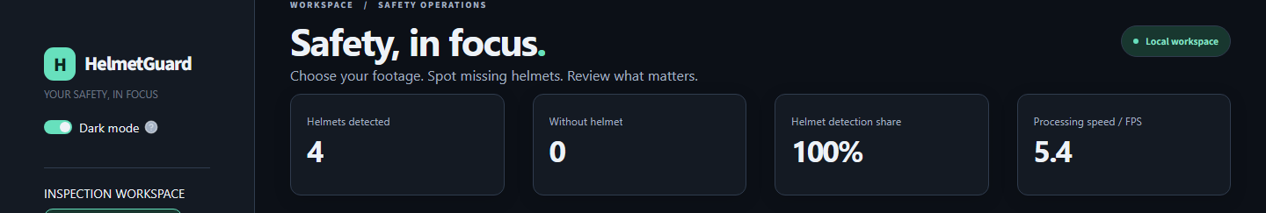
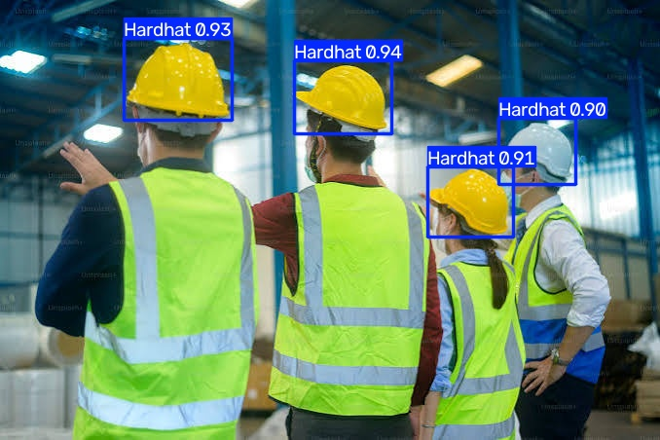
HelmetGuard
AI-powered helmet monitoring
for workplace safety
Developed a computer vision prototype that detects helmets and bare heads in images, uploaded videos, and live camera feeds. The dashboard highlights detections and flags missing helmets for review.
Model Architecture
• Ultralytics YOLO object detection
• Explicit Hardhat and NO-Hardhat classes
• Frame processing with OpenCV
• Adjustable confidence threshold
• Bounding boxes and review alerts
• Per-frame counts and processing FPS
• Streamlit dashboard with light/dark themes
Technologies Used
Python, Ultralytics YOLO, OpenCV, Streamlit
Prototype • Camera performance requires field validation

