Slide 1
Analysis and Prediction of Singapore HDB Resale Flat Prices (2017-2024)
Azizbek Siddikov

Slide 2

Data Description
This dataset was sourced from data.gov.sg.
This dataset contains information on the resale prices of HDB flats in Singapore from January 2017 to June 2024. It includes detailed data on transaction month, town, flat type, block, street name, storey range, floor area, flat model, lease commencement date, remaining lease, and resale price.

Slide 3

Data Preprocessing
Handling Missing Values:
1
There were no missing values in the dataset.
Deleting Duplicate Values:
2
Removed duplicate entries to ensure data integrity and accuracy.
Encoding Categorical Variables:
3
Used one-ho and ordinal encoding to handle categorical data without imposing any ordinal relationship.

Slide 4
Exploratory Data Analysis (EDA)
Trends Over Time:
Analyzed resale price trends over the months and years.
Distribution Analysis:
Analyzed the distribution of flat prices based on different flat types, towns, and storey ranges.
Price by Town:
Displayed a bar chart of average resale prices by town.
Price by Flat Type:
Displayed a bar chart of average resale prices by flat type.

Slide 5

Model Building and Evaluation
Models Used:
Polynomial Regression
Neural Network
Decision Tree Regressor
Random Forest Regressor
Gradient Boosting Regressor
XGBoost Regressor

Slide 6
Evaluation Metrics:
MAE (Mean Absolute Error): Average of absolute differences between predicted and actual values.
1
RMSE (Root Mean Squared Error): Square root of the average of squared differences between predicted and actual values.
2
R² (Coefficient of Determination): Proportion of variance in the dependent variable that is predictable from the independent variables.
3

Slide 7
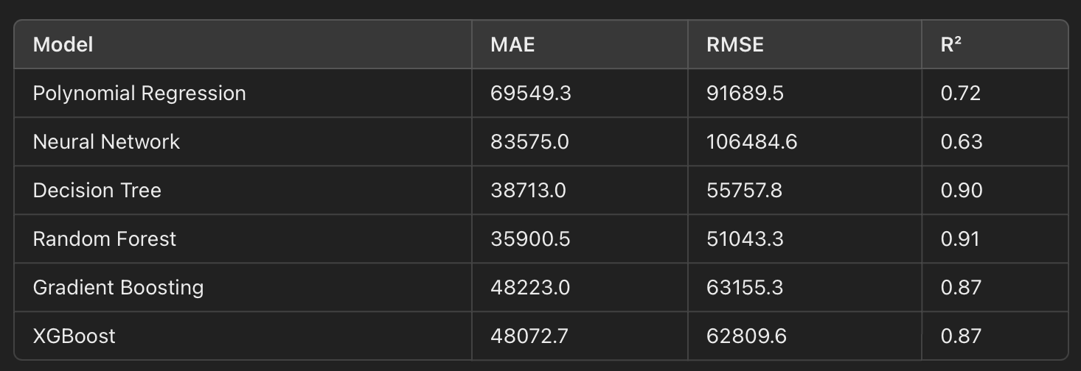
Model Performance

Slide 8
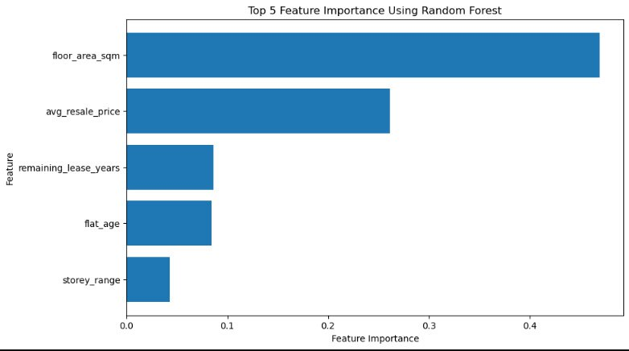
Feature Importance

Slide 9

Key Insights
Trends:
Observed an overall increase in resale prices over the analyzed period, however, price significantly fluctuated during certain months
Model Performance:
Random Forest and Decision Tree models performed the best with high R² values, indicating strong predictive power.
Feature Importance:
Floor area, flat type, and remaining lease were the most influential features affecting resale prices.

Slide 10


Q&A
asiddikov.04@gmail.com
https://www.linkedin.com/in/azzd/

