Slide 1

Sales Data Analysis
Azizbek Siddikov

Slide 2

Introduction
Objective: To analyze sales data to identify trends, top-performing products, and customer insights.
Dataset: https://www.kaggle.com/datasets/rohitsahoo/sales-forecasting/data
Tools Used: Python, Tableau

Slide 3
Data Preparation
Loaded the dataset and checked for missing values and duplicates.
Cleaned and preprocessed the data.
Aggregated daily sales data for time series analysis.

Slide 4
Exploratory Data Analysis (EDA)
Analyzed sales trends over time.
Identified top-selling products and categories.
Examined customer purchase behavior and segmentation.
Conducted geographical sales analysis.

Slide 5
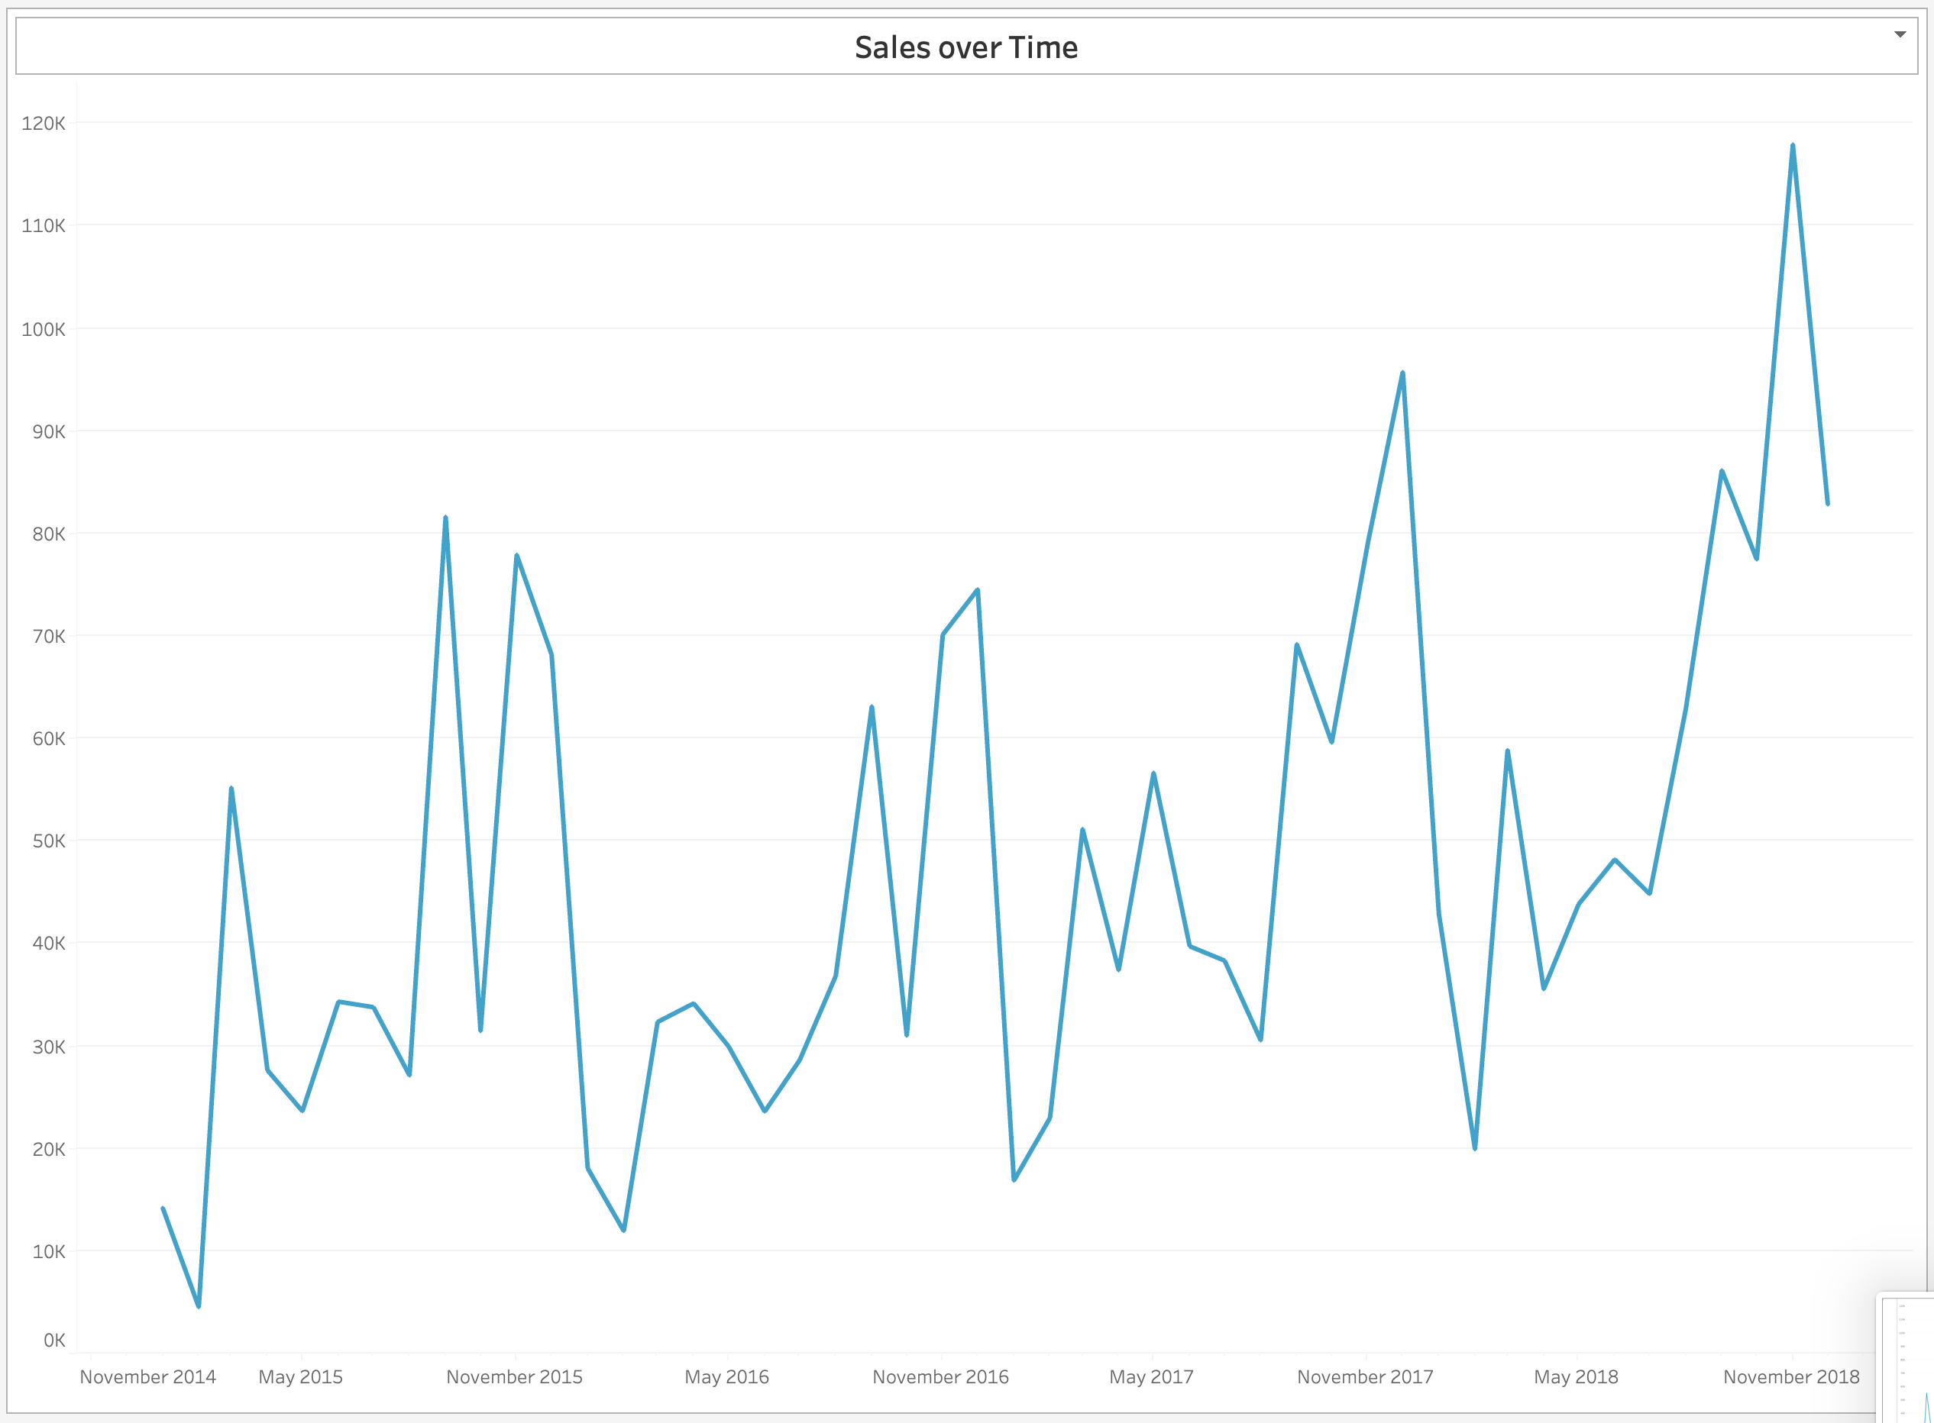
Sales Trends Over Time

Slide 6
Sales Trends Over Time
The general upward trend in sales is a positive indicator of growth.
The recurring peaks around the end of each year highlight the importance of the holiday season for sales.
Each year, the sales show a significant increase towards the end of the year.

Slide 7
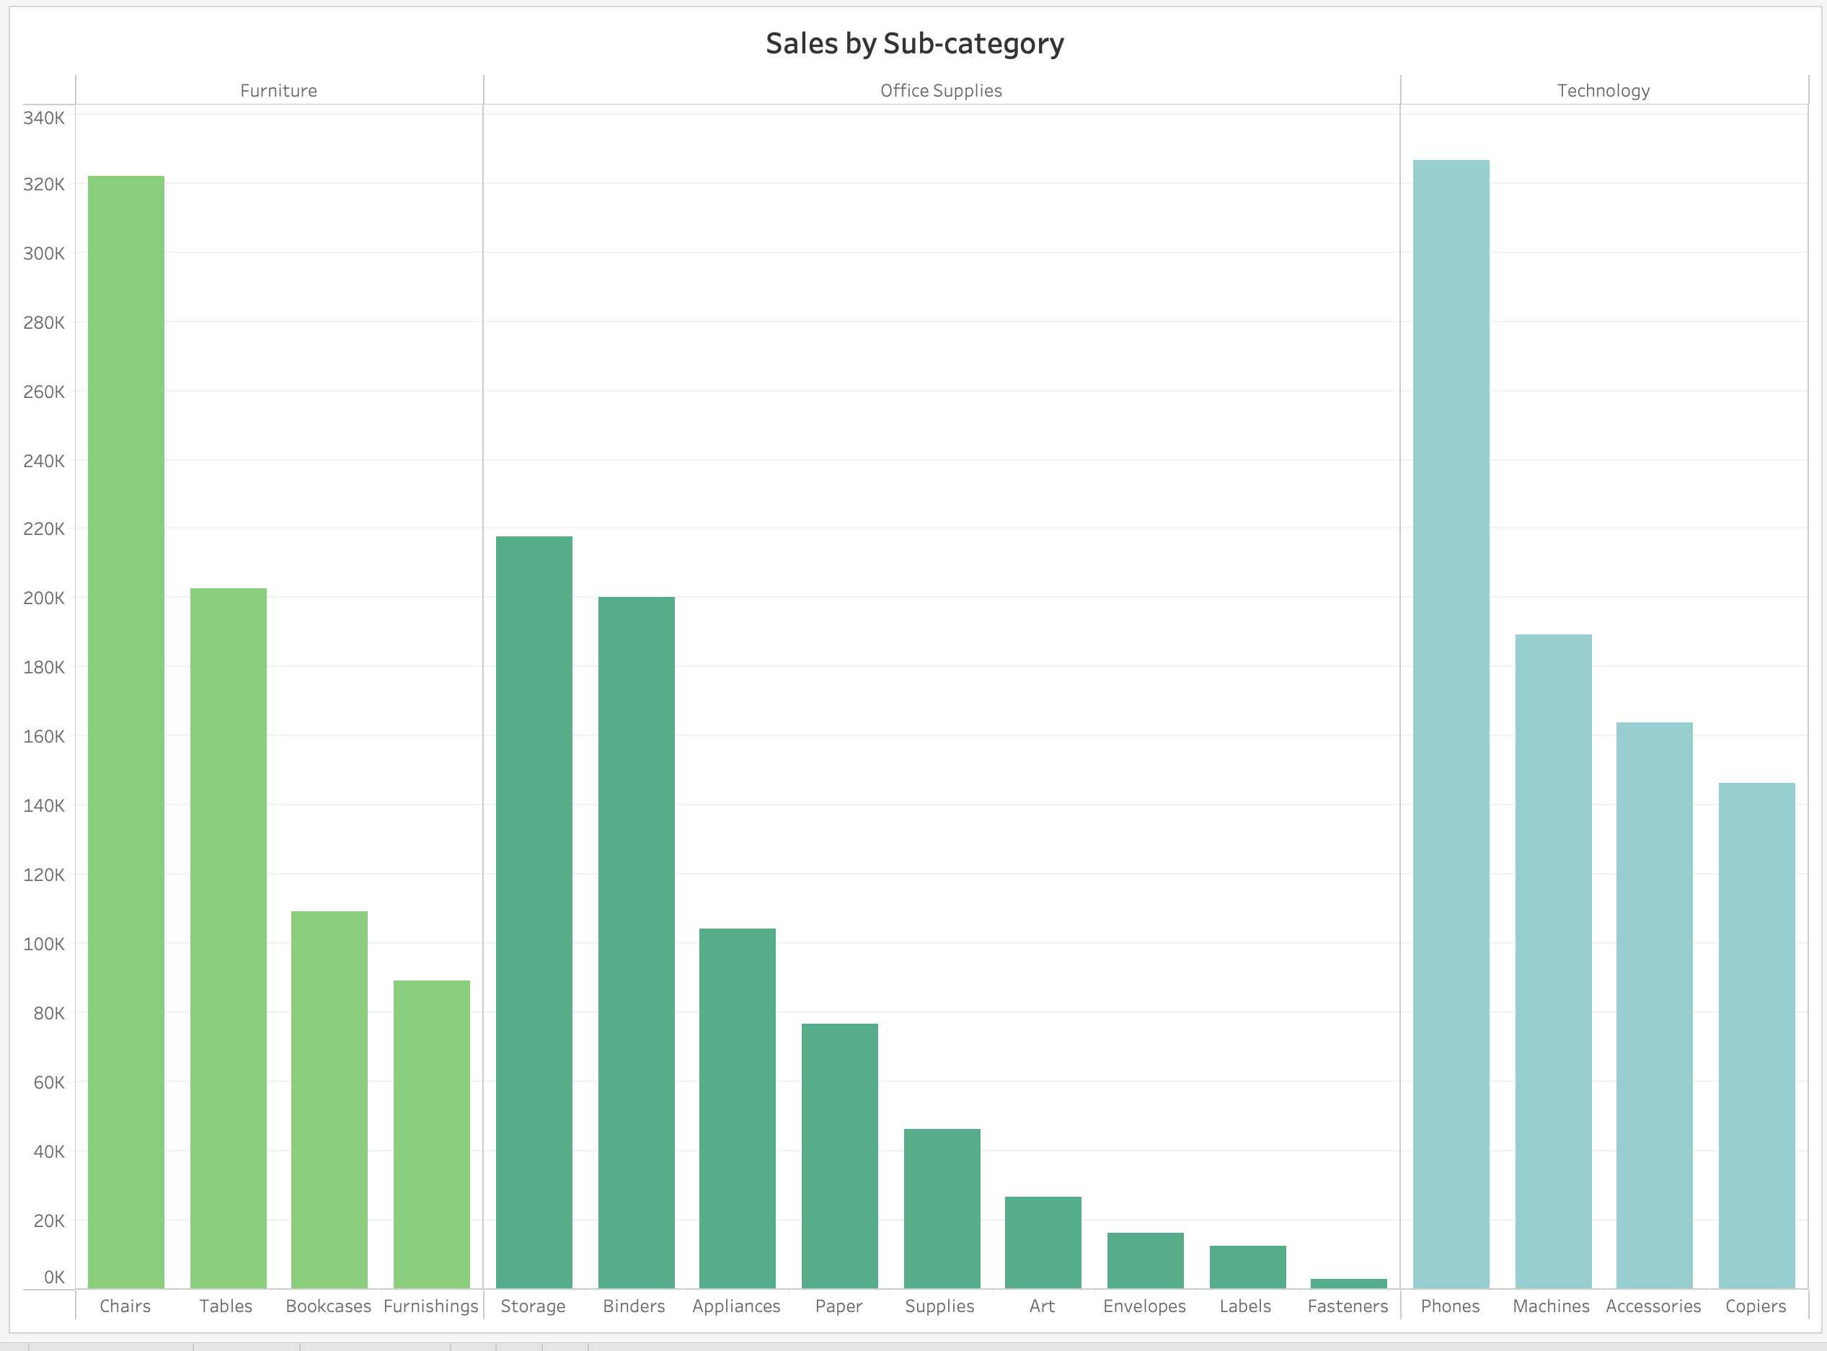
Top-Selling Products and Categories

Slide 8
Top-Selling Products and Categories
The bar chart shows sales distribution across different sub-categories.
Highest sales are observed in "Chairs" under Furniture, "Storage" under Office Supplies, and "Phones" under Technology.
”Envelopes”, "Labels”, and “Fasteners” have the lowest sales.

Slide 9
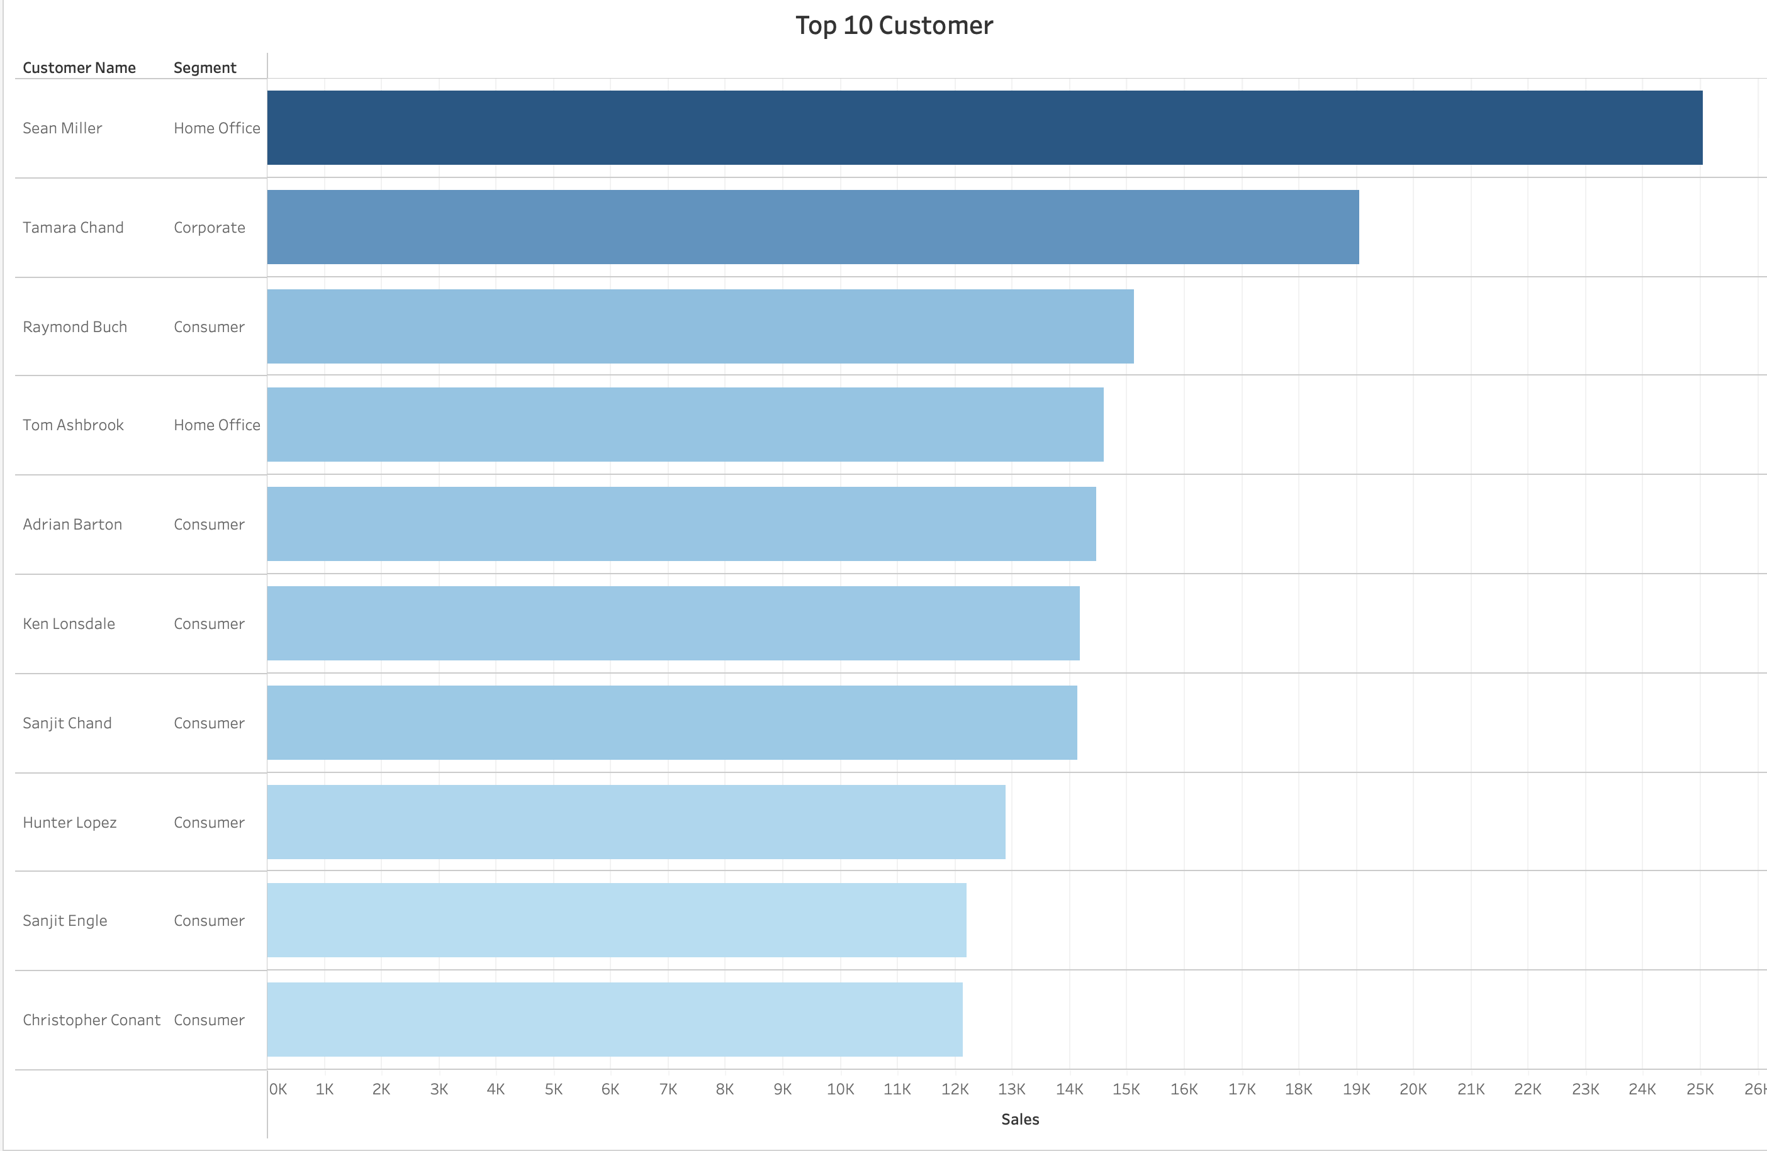
Customer Insights

Slide 10
Customer Insights
The bar chart lists the top 10 customers by sales.
"Sean Miller" (Home Office) is the top customer, followed by "Tamara Chand" (Corporate).
Customers from all segments (Home Office, Corporate, Consumer) are represented.

Slide 11
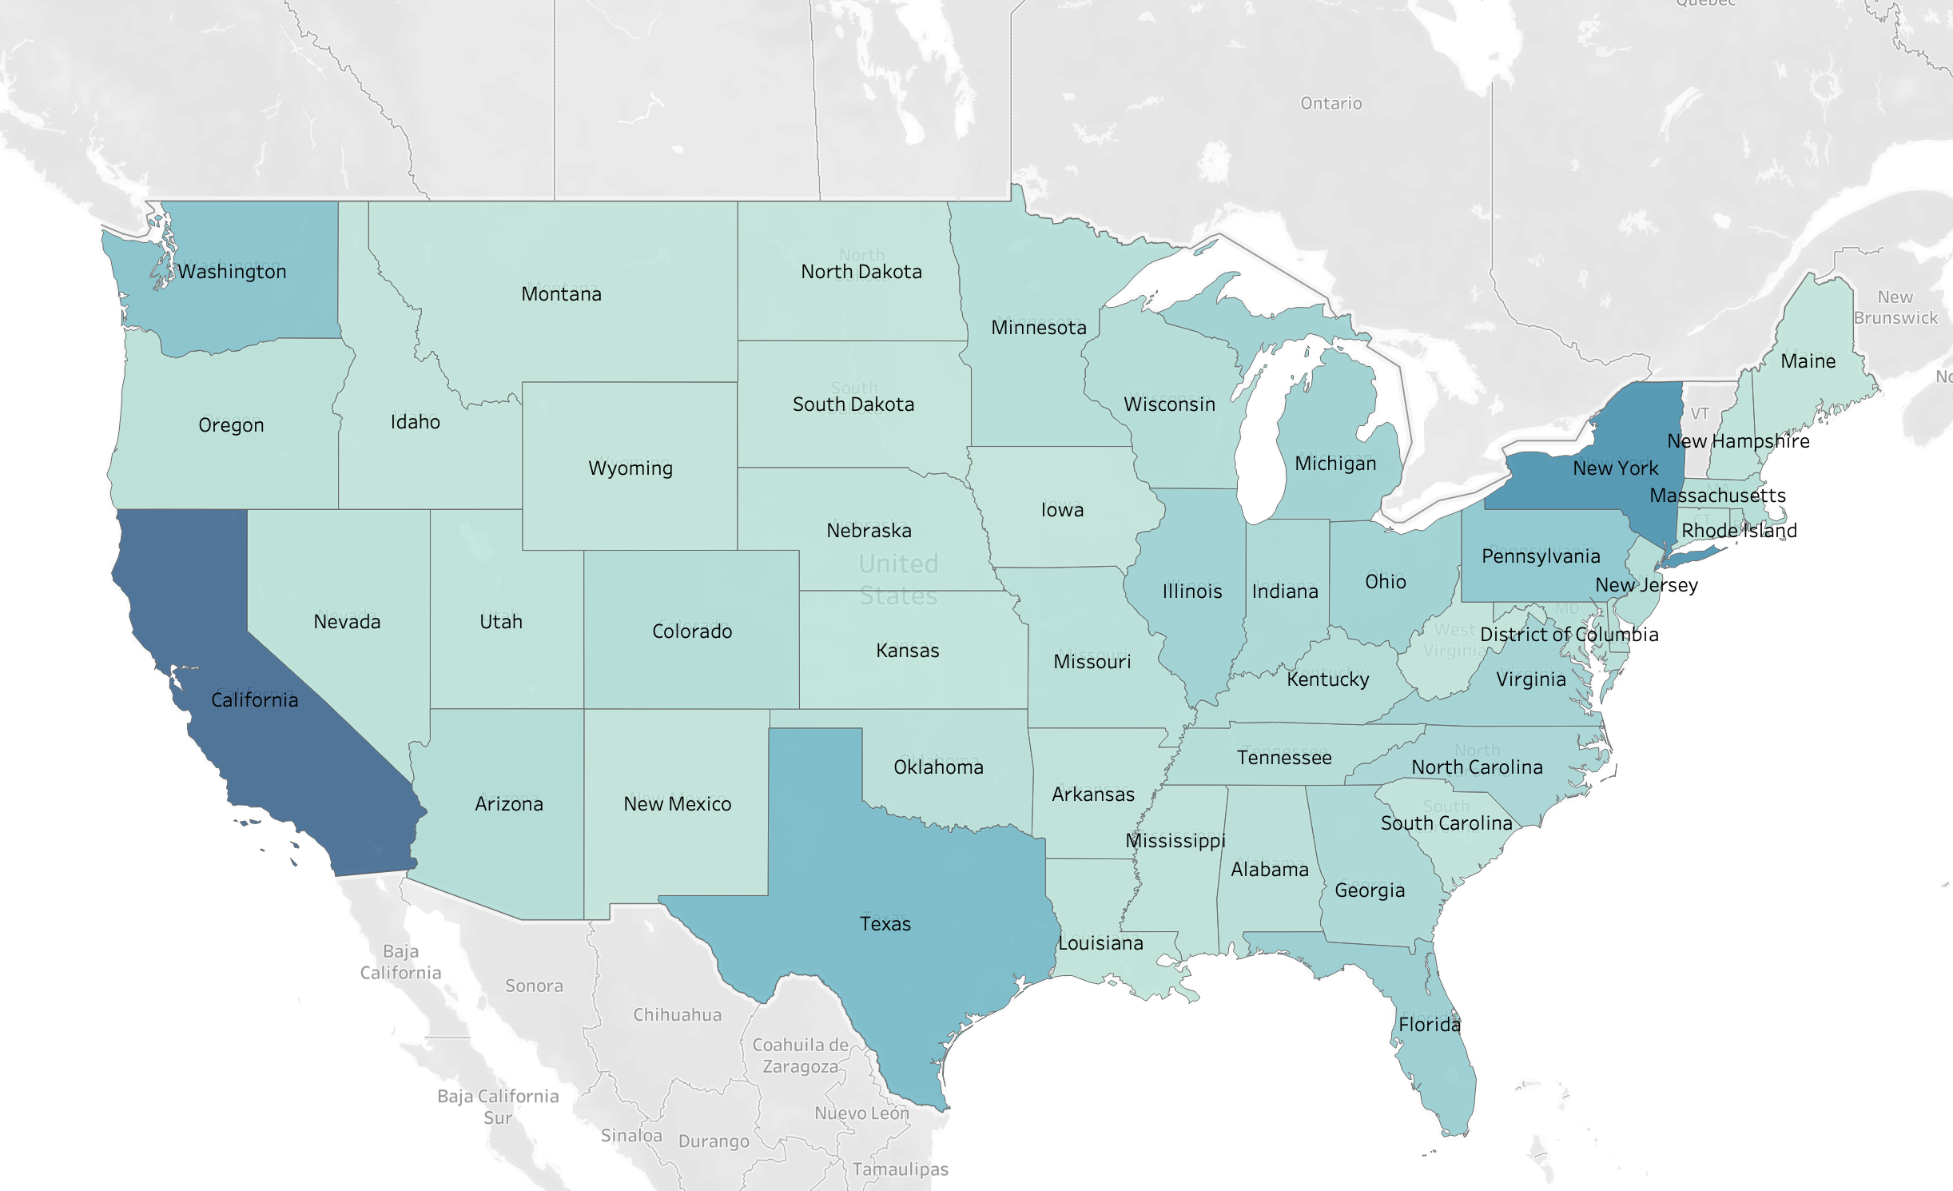
Geographical Sales Distribution

Slide 12
Geographical Sales Distribution
The map shows sales distribution across different states.
California, New York, and Texas have the highest sales.
Some states have significantly lower sales.

Slide 13
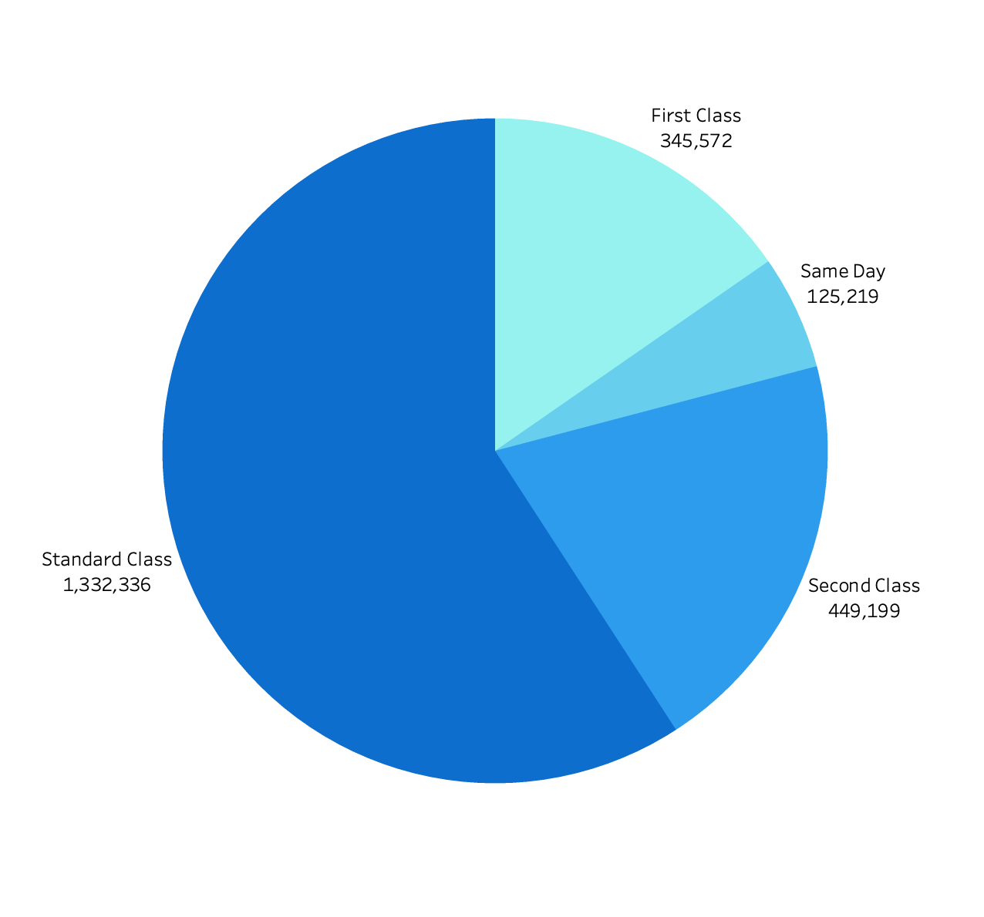
Shipping Mode

Slide 14
Sales by Ship Mode
The pie chart shows the distribution of sales by shipping mode.
"Standard Class" accounts for the majority of sales.
"First Class" and "Second Class" also have significant shares.

Slide 15
Conclusion and Recommendations
Summary of key insights from the analysis.
Actionable recommendations based on the findings.
Focus on high-performing sub-categories and regions.
Investigate and address sales dips.
Develop strategies for boosting sales during off-peak periods.
Optimize shipping processes and explore premium shipping options.

Slide 16


Q&A
asiddikov.04@gmail.com
https://www.linkedin.com/in/azzd/

