Slide 1
IELTS General Training
2nd year engineering classes

Slide 2
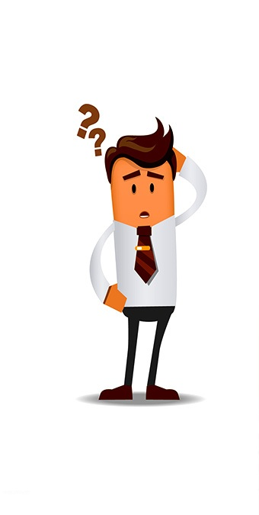
What is IELTS?
IELTS: International English Language Testing System
Accepted by 8000 organisations worldwide
For higher education and global migration
2 million tests taken per year
Two versions: General Training and Academic
Tests the four skills (reading, writing, speaking and listening)
Reflects real life use of English
Unique 9-Band scale accurately pinpoints English level
IELTS is jointly managed by the British Council, IDP: IELTS Australia and Cambridge English Language Assessment

Slide 3
What is the test format?

Slide 5

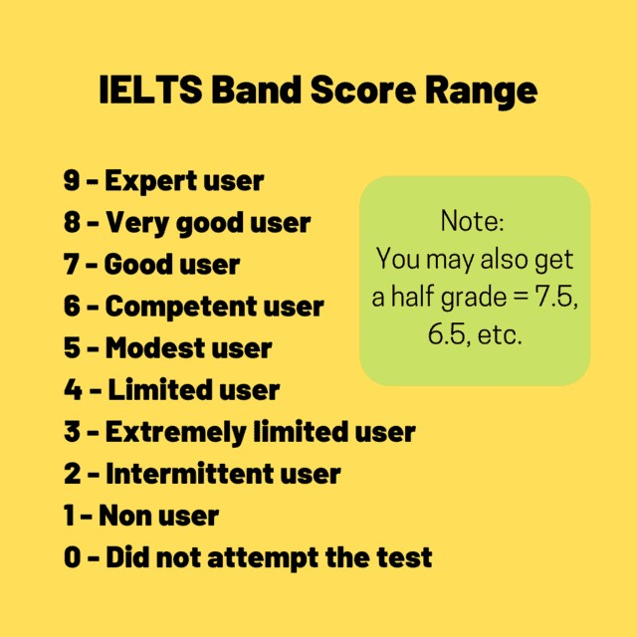
Scoring

Slide 6
Listening (30 minutes)

Slide 7
General Training Reading (60 minutes)

Slide 8
General Training Writing (60 minutes)

Slide 9
Speaking (11-14 minutes)

