Slide 1


OCEAN and AI2NBSE postprocessors of ABINIT for
Core and Valence Spectra
J.J.Rehr¹, John Vinson¹, E.L.Shirley²
J.J. Kas¹ and F. Vila¹
¹U. of Washington Seattle, WA
²N.I.S.T. Gaithersburg, MD

Slide 2
aka SKWIGGLiE
Spectra from K-space Wave-functions with Interactions, Gradually Getting Like Experiment

Slide 3
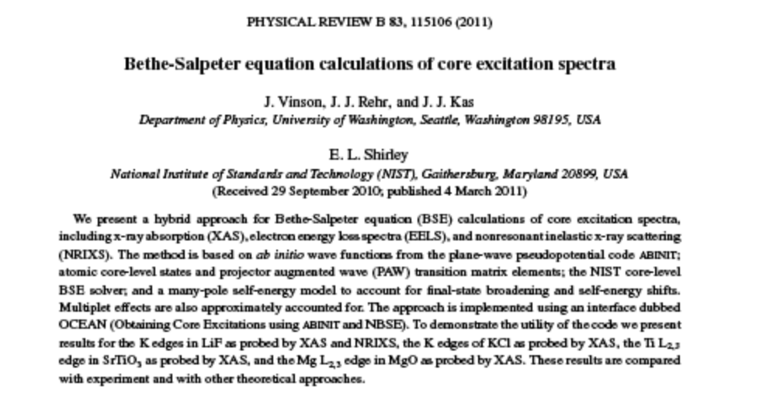
1. OCEAN*
Obtaining
Core Excitation
spectra using
ABINIT and
NBSE
Hybrid approach to core spectroscopy
  GW/BSE for XAS, NRIXS, EELS, …
  PAW Pseudo-potential / planewave DFT
Includes self energy damping, multiplets … …
*Phys. Rev. B 83, 115106 (2011)

Slide 4
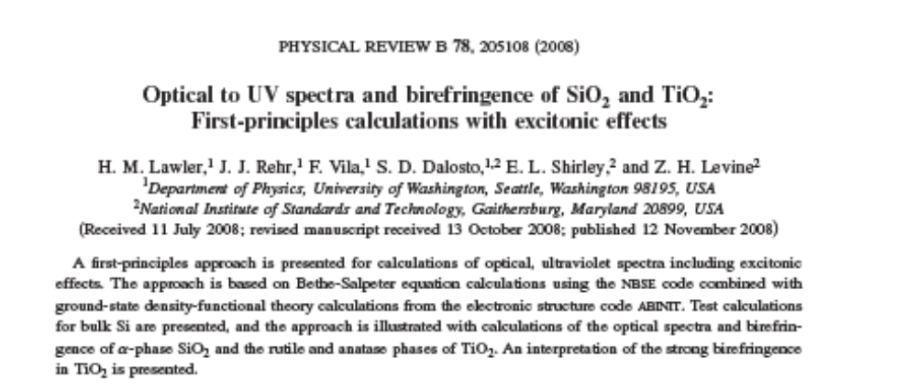
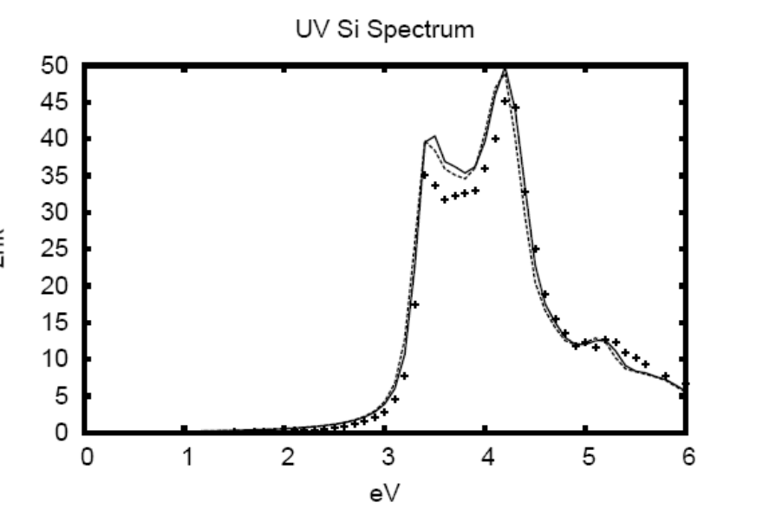
2. Optical-UV Spectra AI2NBSE*
(ABINIT +
NIST BSE)
*Phys. Rev. B 78, 205108 (2008)

Slide 5
Bethe-Salpeter Equation
Bubble
Ladder
Particle-Hole Hamiltonian
H = E₀ + V_{c} + W
Bubble V_{c} is unscreened
Ladder W is screened

Slide 6



Bethe-Salpeter Equation
Central term
Multiplets

Slide 7

Dielectric Response < BSE
H particle-hole Hamiltonian including:
many-pole GW self-energy Σ
Algorithm: Haydock recursion

Slide 8
Ground-state
Standard Density-Functional Theory
  Pseudopotential, Plane-wave, LDA
  ABINIT (www.abinit.org)
Well-documented shortcomings; improvements:
  GW
  XC + U
Core to pseudo transitions with PAW
  Following Blöchl, PRB 50, 17953 (1994)

Slide 9
Kohn-Sham Wave-Functions
  ABINIT (Plane-wave, pseudo-potential)*
  LDA (Ceperley-Alder) V_{xc}
  Zero Temp / Frozen lattice
Regular grid in k-space
  Size required varies with BZ volume
Core states from NIST HF atomic code
*Other PW/PP DFT codes may also work

Slide 10




Electron-hole pair approximation
…
…
Conduction electron
Core hole

Slide 11



PAW Matrix Elements

Slide 12
Core-Hole Screening
Core response from self-consistent HF
Use neutralizing shell to divide valence
  RPA for short range
  Model dielectric for long range
Hybersten and Louie, Phys Rev B 35, 5585 (1987)

Slide 13
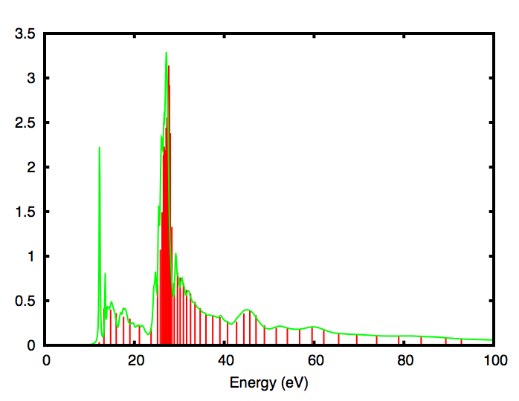
GW Many-pole self-energy
Extension of Hedin-Lundqvist plasmon-pole
MPSE (Kas et al.*)
  Calculate loss function
  with AI2NBSE
  Model as a series
  of (many) poles
  Apply as convolution
LiF loss
J.J. Kas et. al, Phys Rev B 76, 195116 (2007)

Slide 14





OCEAN Package
Structure
DFT/ABINIT
HFAtom
Spectra
BSE

Slide 15
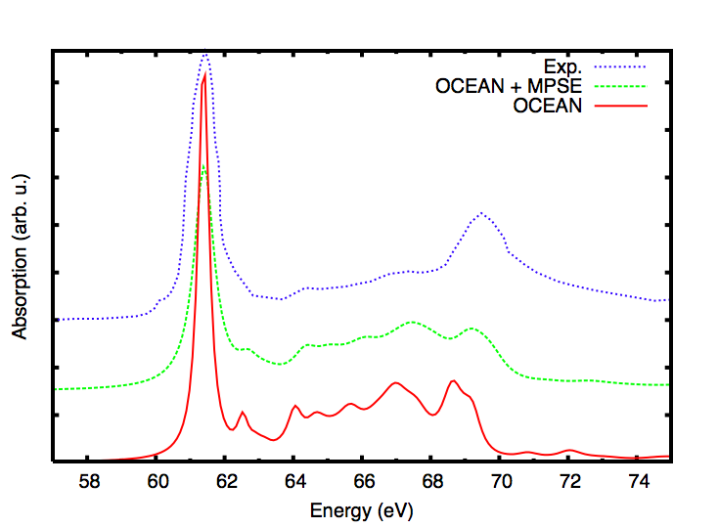
Example: Li K-edge XAS of LiF
1000 k-points
100 Ha. cut-off
Expt. data from K. Handa et. al, Memoires Sr. Center Ritsumeika Univ 7 (2005)

Slide 16
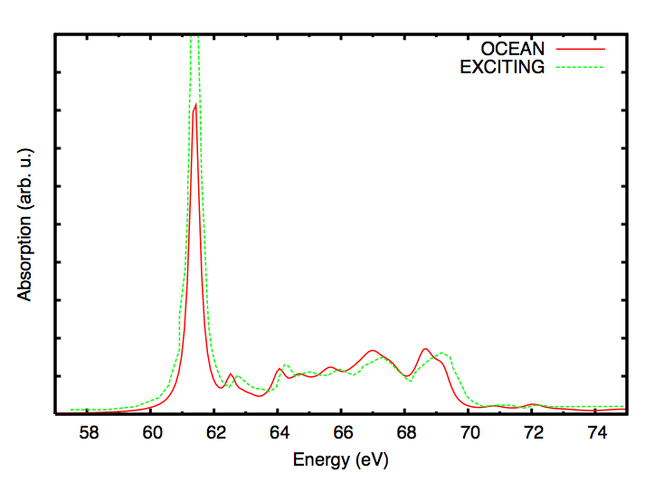
Example: Li K-edge XAS of LiF
Comparison with EXC!TING* (NO MPSE)
1000 k-points
100 Ha. cut-off
NO MPSE
*W. Olovsson et. al, Phys Rev B 79, 041102(R) (2009)

Slide 17
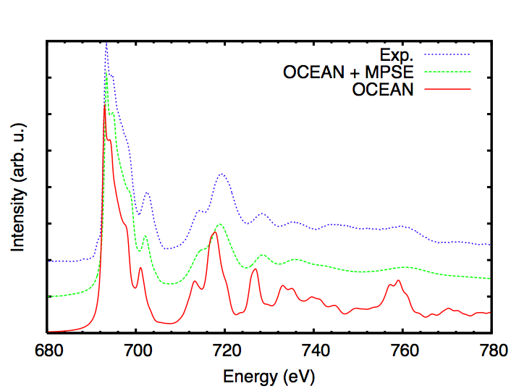
Example: F K-edge XAS in LiF
1000 k-points
100 Ha. cut-off
Expt. data from E. Hudson et. al, Phys. Rev. B 49, 3701 (1994)

Slide 18
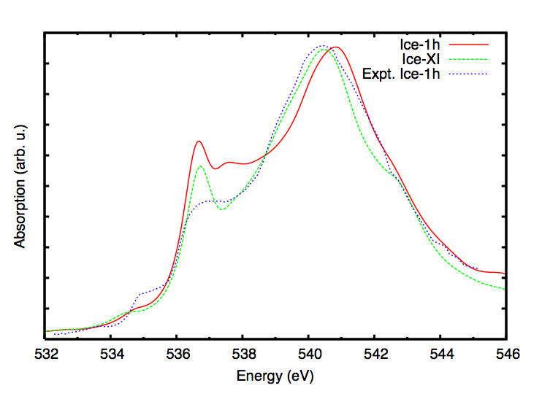
Ice: O K edge XAS
8 molecule cells
216 k-points
50 Ha. cut-off
Expt. data from P. Wernet et. al, Science 304, 995 (2004)

Slide 19
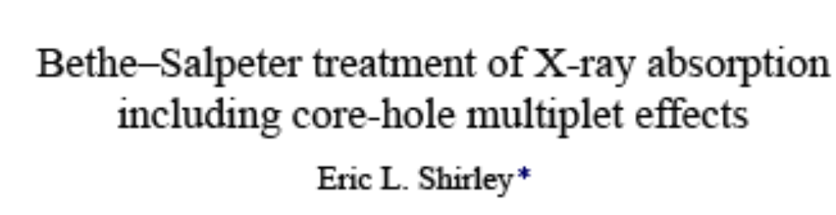
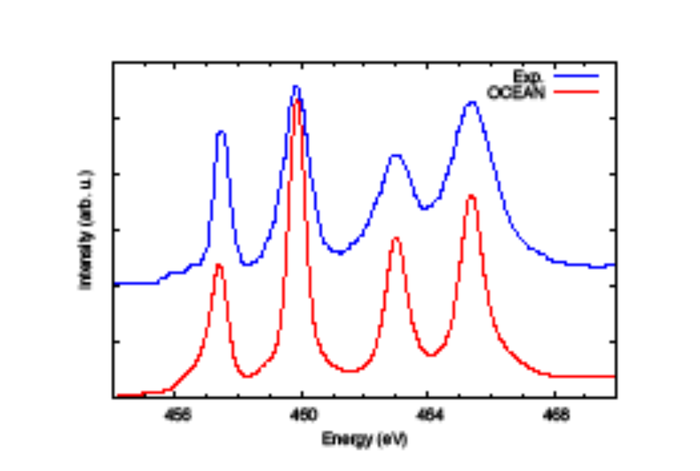





Example: L-edge Spectra – Multiplet effects
Ti L_{2,3} edge SrTiO3
*J. Elec.Spect. Rel. Phen. 144, 1187(2005)
alá E. Shirley: BSE
+ KS crystal potential
ab initio – no parameters
cf. De Groot et al – Atomic
model + crystal-field parameters

Slide 20
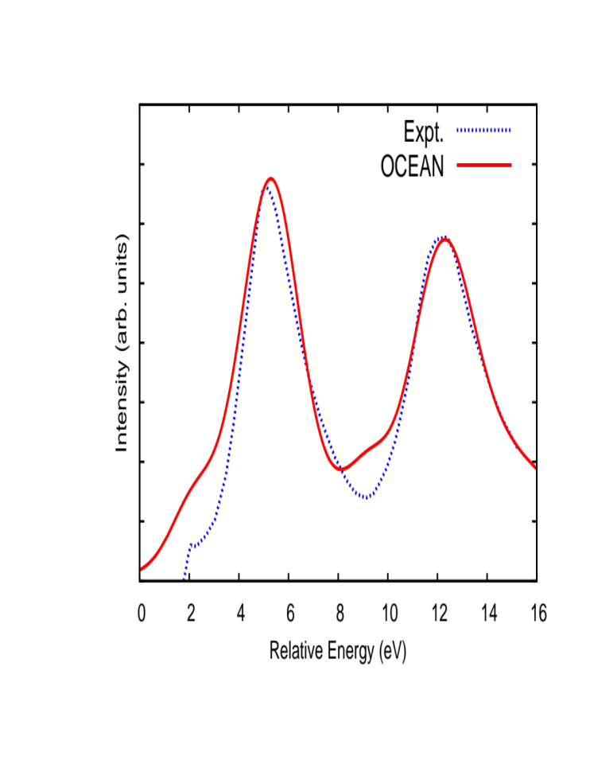
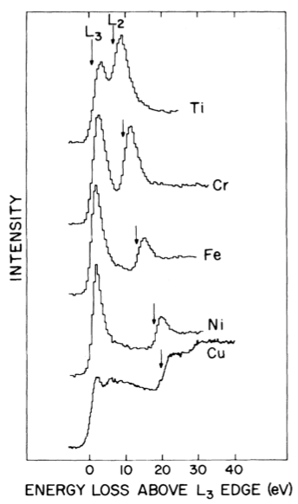
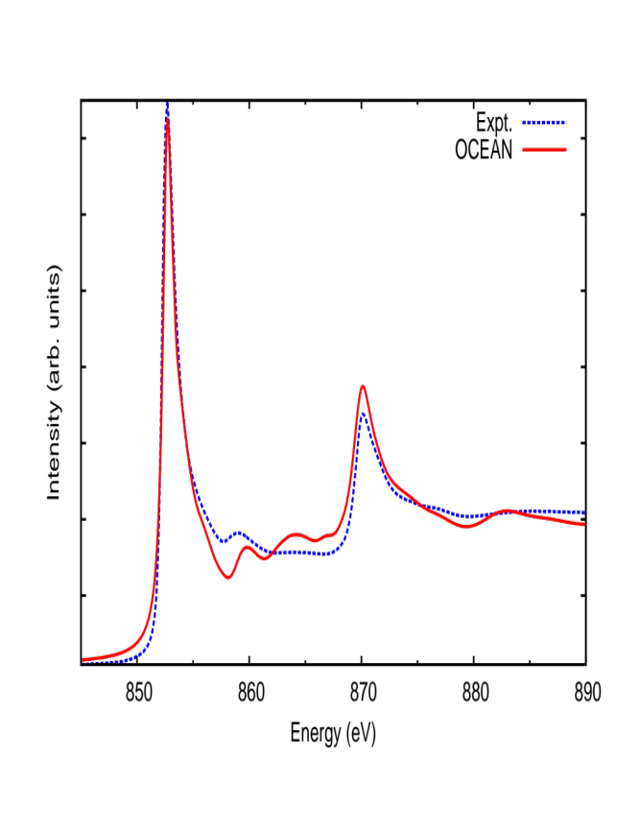
L₂₃ Transition Elements
V L₂₃
Ni L₂₃
PRL 45, 397 (1980)

Slide 21
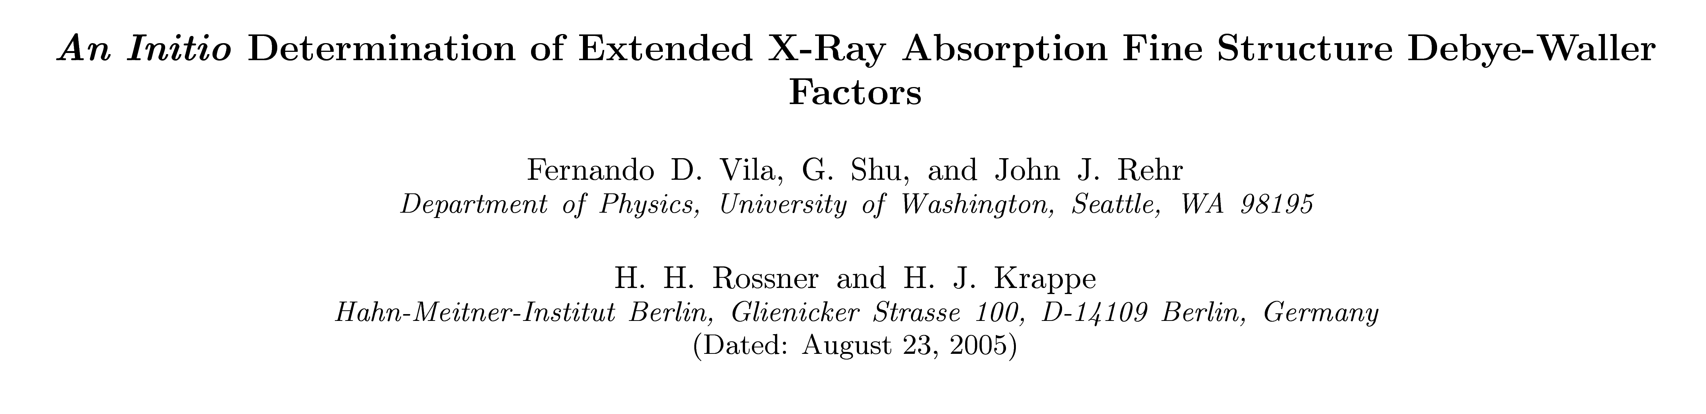
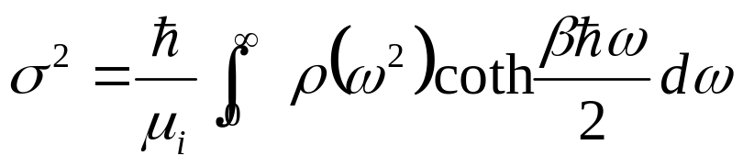
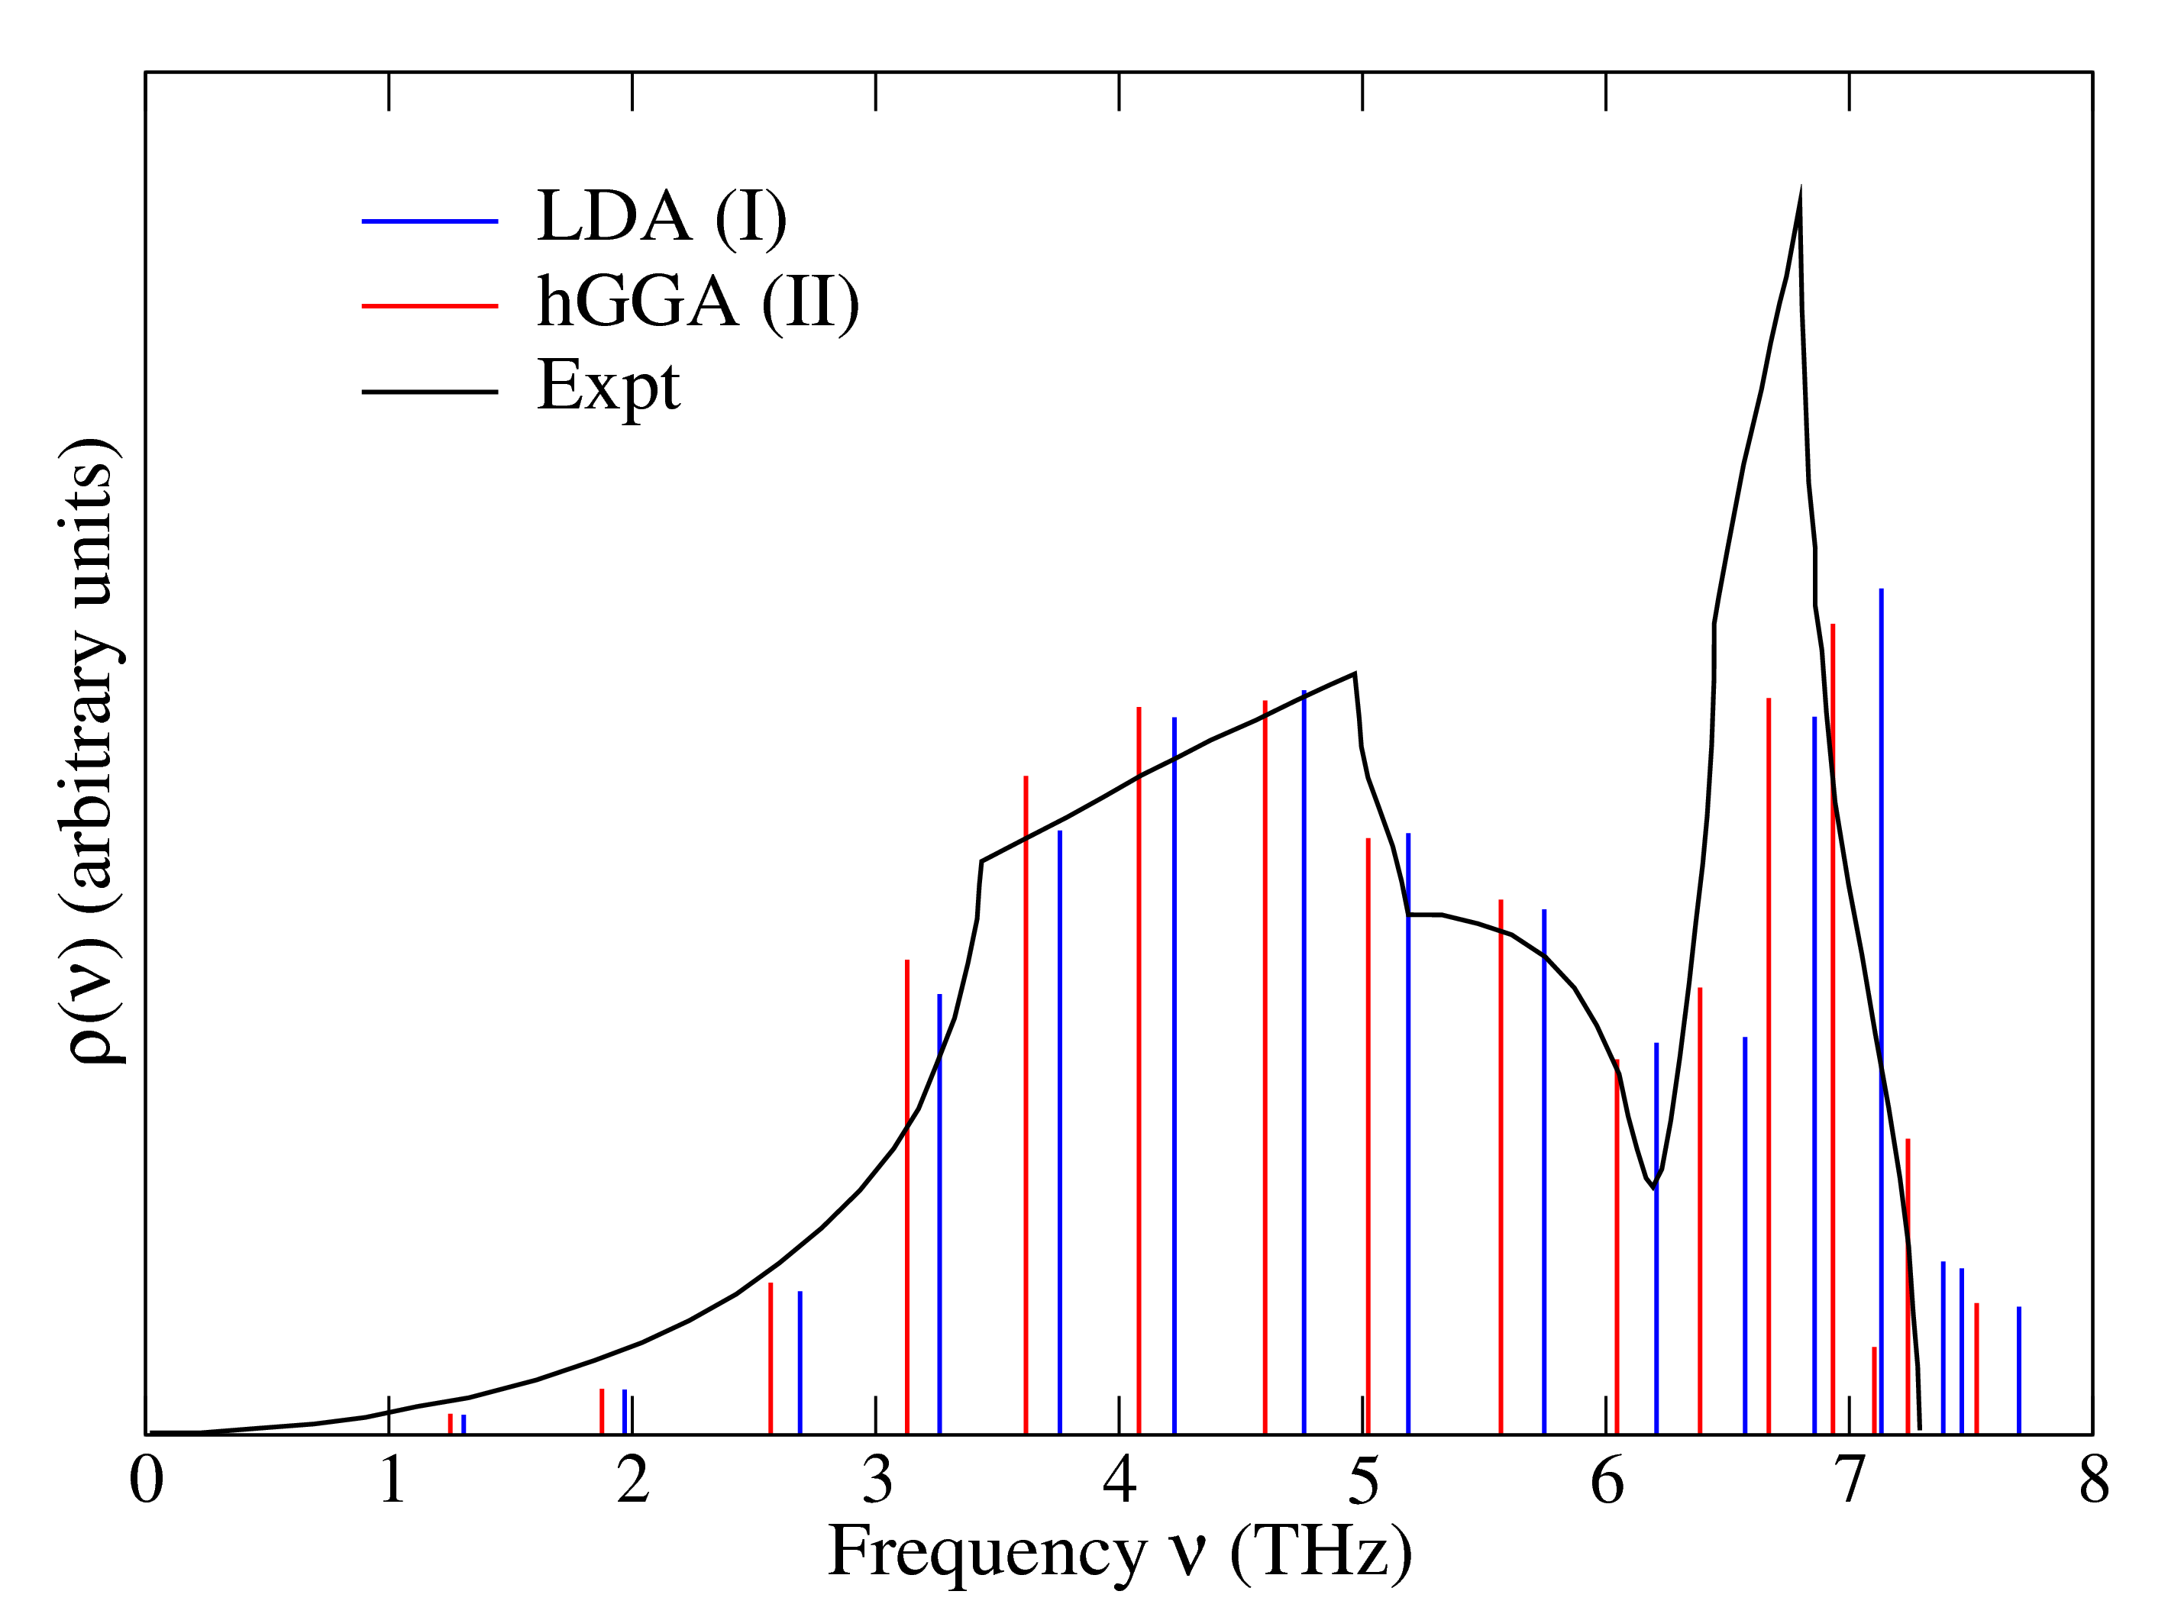
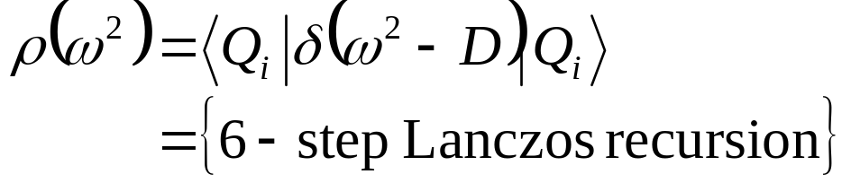
3. Ab initio XAS Debye Waller Factors _{e}-2σ² k²
*
Ψ
Many Pole model
for phonons
VDOS ρ
D ynamical matrix D from ABINIT
*Phys. Rev. B 76, 014301 (2007)

Slide 22
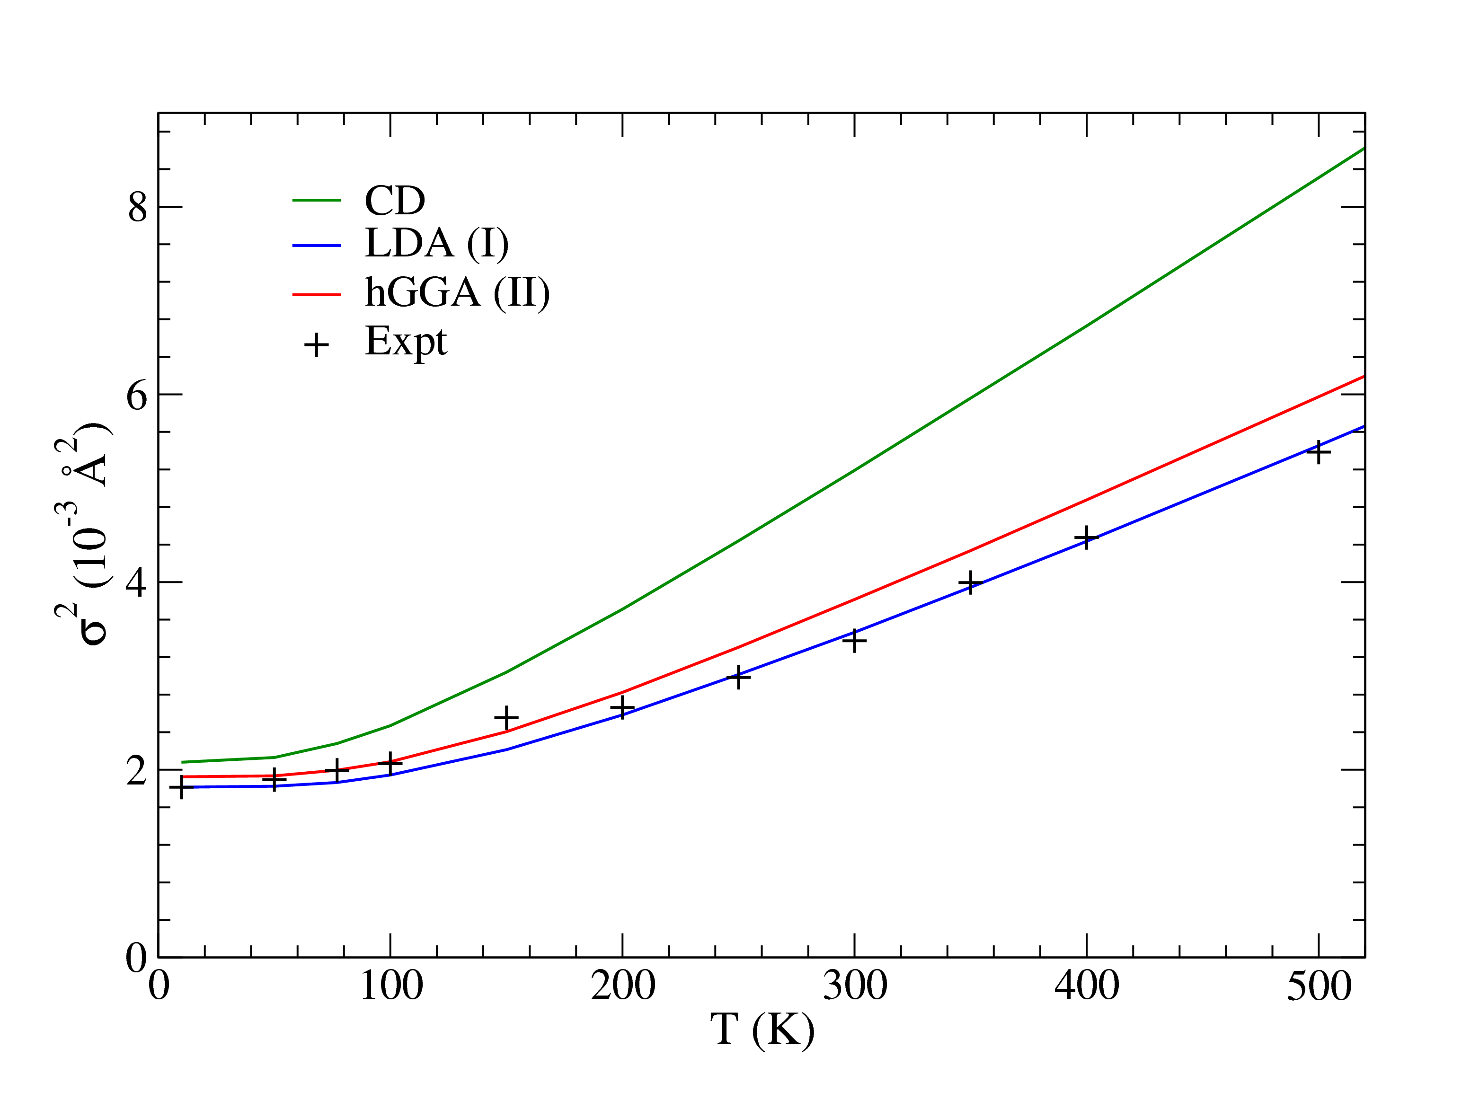
Example: XAFS Debye-Waller Factor of Ge
F. Vila et al. Phys. Rev. B76, 014301 (2007)
Expt: Dalba et al. (1999)

Slide 23
Conclusions
Core & Valence BSE+GW packages
OCEAN & AI2NBSE
NRIXS, EELS, XAS,
Includes GW self-energy, multiplets, ..
Future: RIXS, XPS, DW factors, etc.

Slide 24
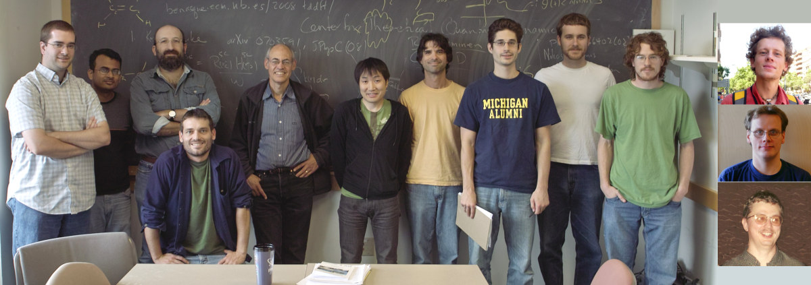
Acknowledgments
Rehr Group & collaborators
Thanks to
J. Vinson (UW)
J. Kas (UW)
F. Vila (UW)
K. Jorissen (UW)
H. Lawler (Vanderbilt)
E. Shirley (NIST)
X. Gonze, UC de Louvain
A. Soininen (U. Helsinki)
L. Reining (E. Polytechnique)
C. Ambrosch-Draxl (U. Leobon)
T. Ahmed (UW)
Supported by DOE BES Grant DEFG03-97ER45623
& DOE Computational Materials Science Network

