Slide 1


Theoretical approaches to the temperature and zero-point motion effects of the electronic band structure of semiconductors
Paul Boulanger
Xavier Gonze and Samuel Poncé
Université Catholique de Louvain
Michel Côté and Gabriel Antonius
Université de Montréal
paul.boulanger@umontreal.ca

Slide 2
Motivation
Context: Semi-empirical AHC theory
The New DFPT formalism
Validation: Diatomic molecules
Validation: Silicon
Future Work
Conclusion

Slide 3

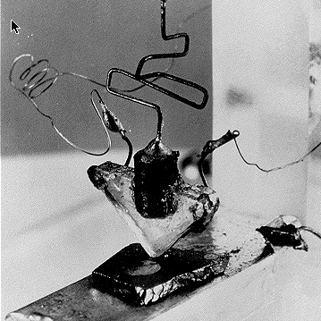
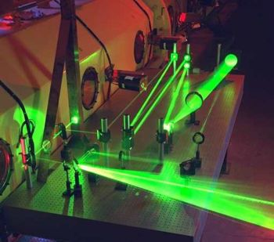

Why semiconductors?
Honestly: Problem is easily tackled with the adiabatic approximation
Practically: Interesting materials with broad applications
LED introduced as practical electrical component: ~1962
Photovoltaïcs effect : ~1839
Solar Cells : ~1883
Transistor : 1947
Laser: ~1960

Slide 4
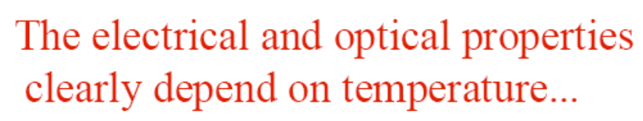
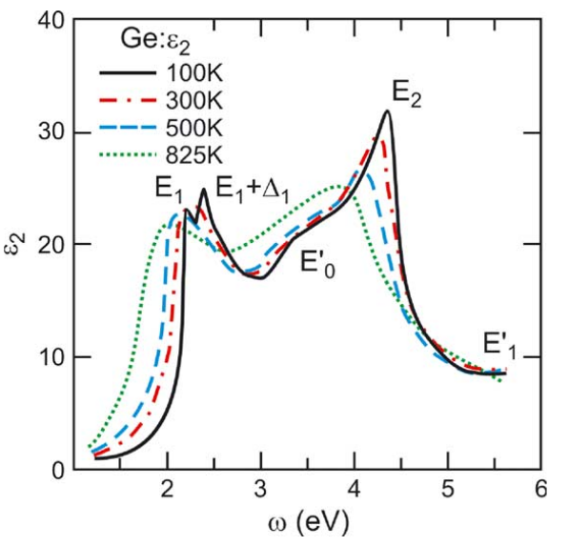
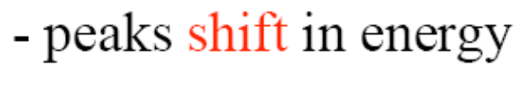
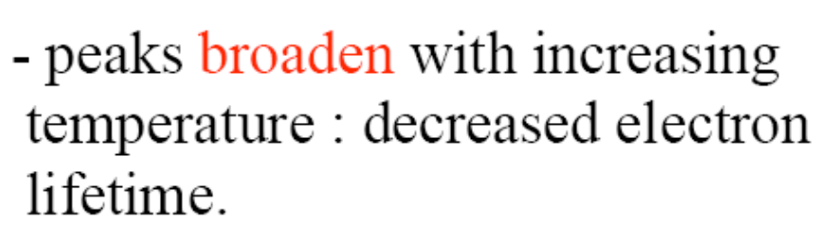
L. Viña, S. Logothetidis and M. Cardona, Phys. Rev. B 30, 1979 (1984)

Slide 5
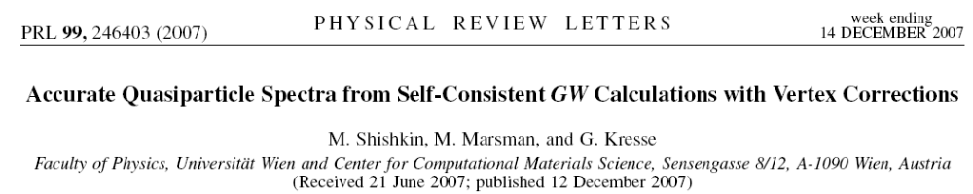
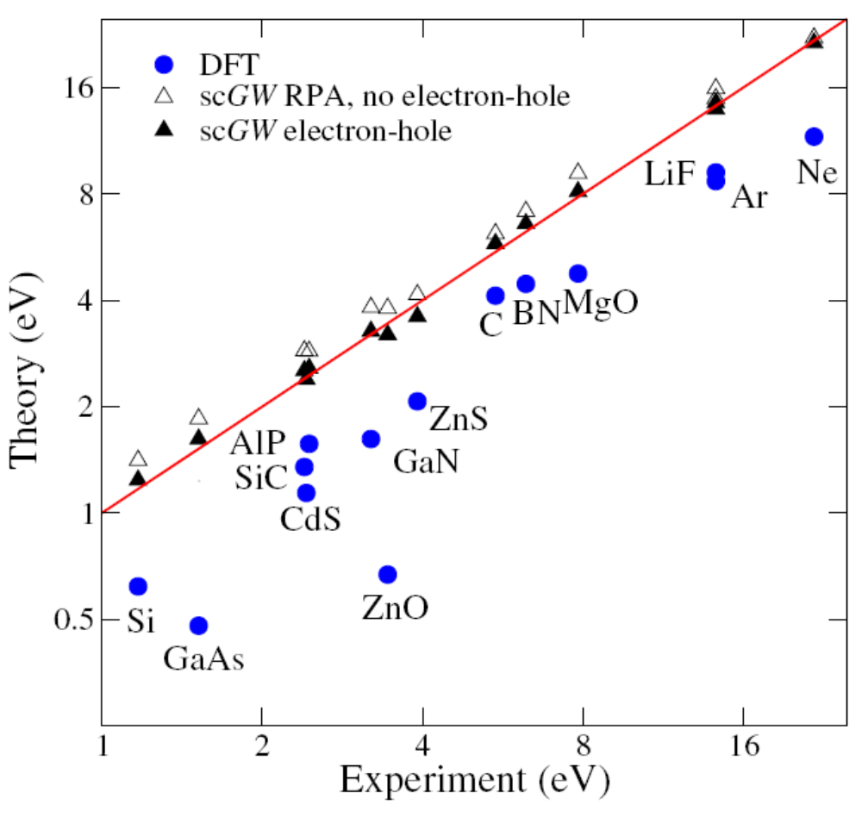
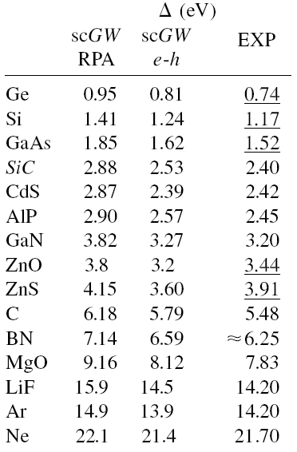

Slide 6
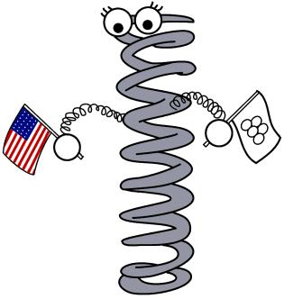
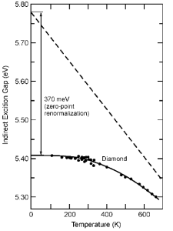
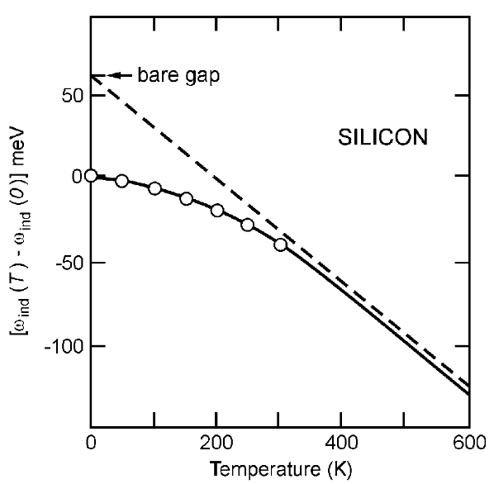
No good even for T= 0 K, because of Zero Point (ZPT) motion.
M. Cardona, Solid State Communications 133, 3 (2005)

Slide 7
Diff.
ZPT
(Exp.)
0.07
0.052
0.07
0.057
0.10
0.035
0.130
-0.03
0.068
0.12
0.023
0.07
0.173
-0.24
0.164
-0.31
0.105
0.31
0.370
0.34
0.29
0.30

Slide 8
Motivation
Context: Semi-empirical AHC theory
The New DFPT formalism
Validation: Diatomic molecules
Validation: Silicon
Future Work
Conclusion

Slide 9
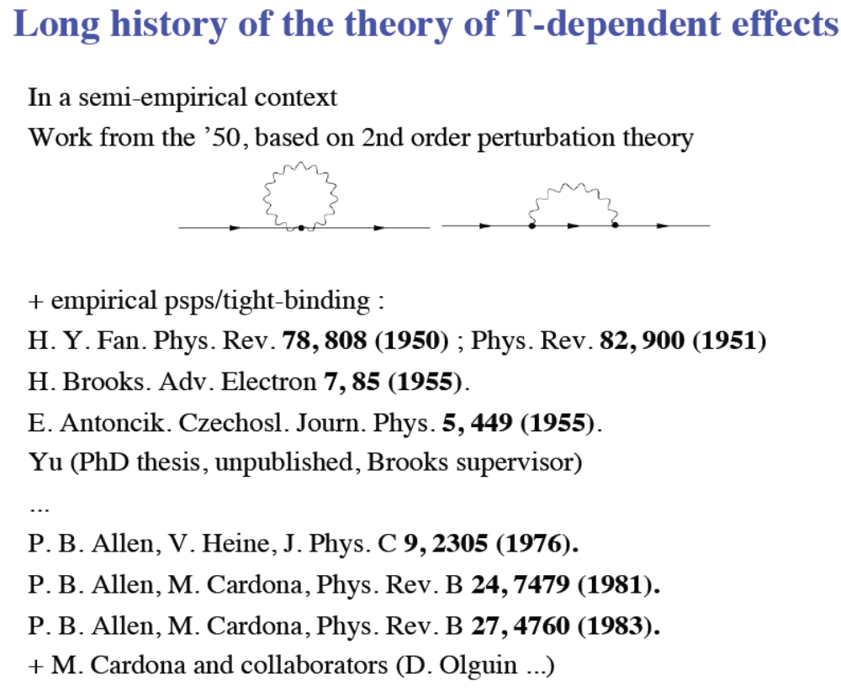

Slide 10
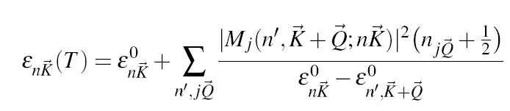
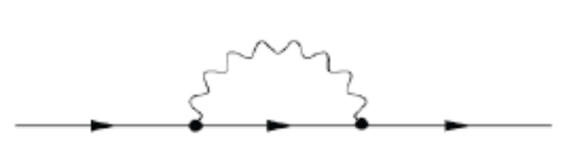

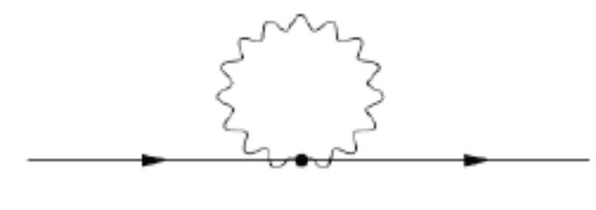
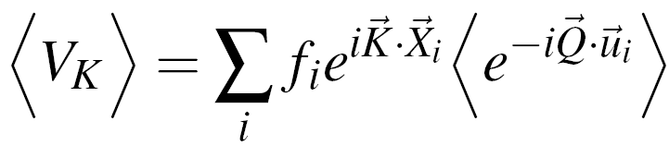
Fan theory (Many Body self-energy):
Antoñcik theory:
Electrons in a weak potential :
Debye-Waller coefficient for the form-factor:
2nd order

Slide 12
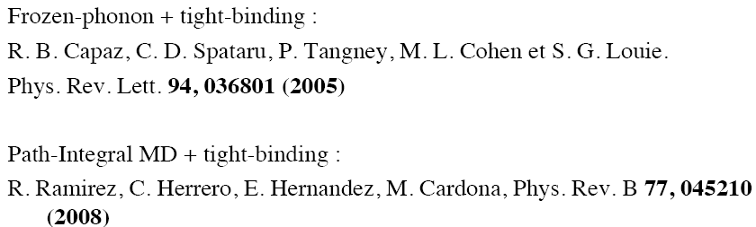
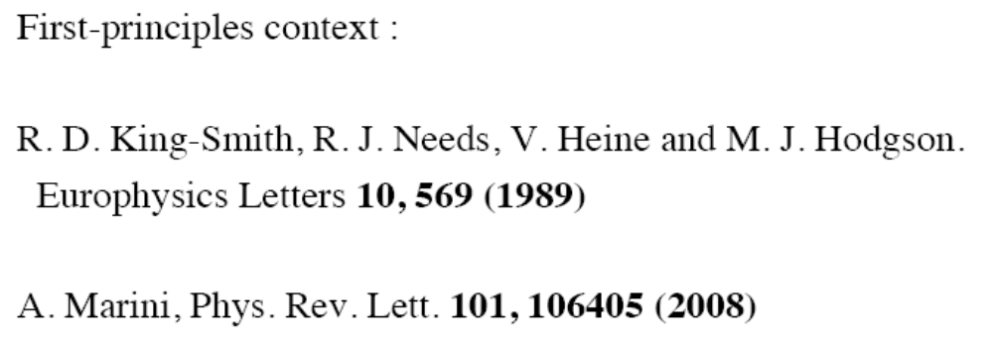
F. Giustino, F. Louie and M.L. Cohen, Physical Review Letters 105, 265501 (2010)

Slide 13
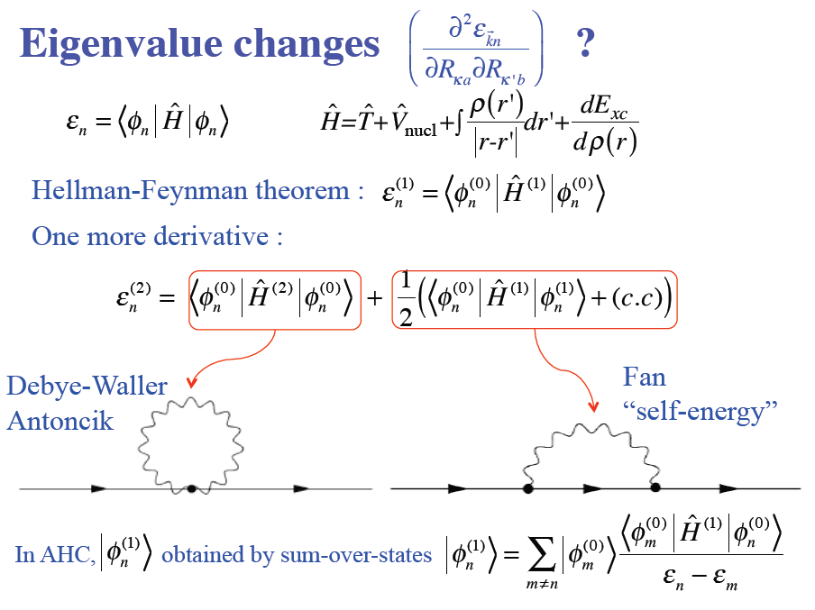

Slide 14

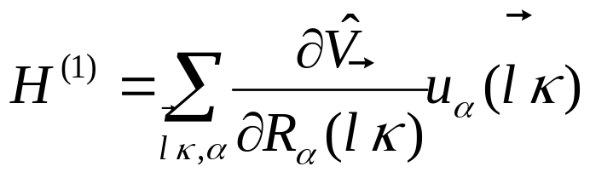
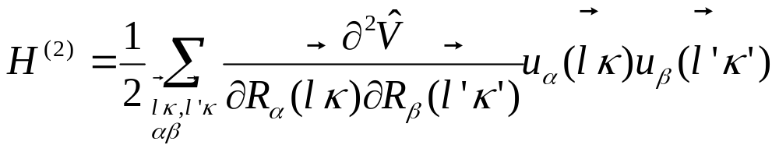
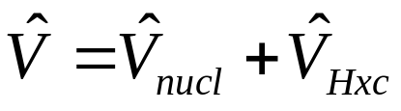
where
: self-consistent total potential

Slide 15
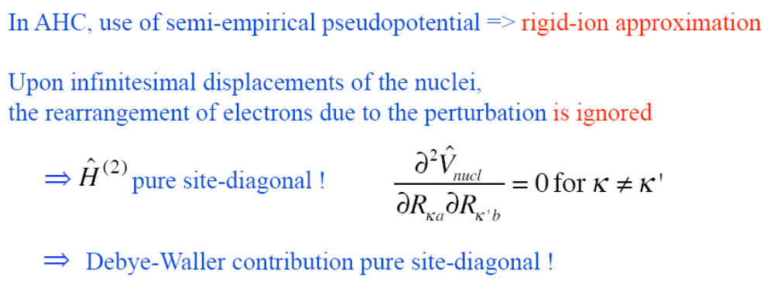

Slide 16
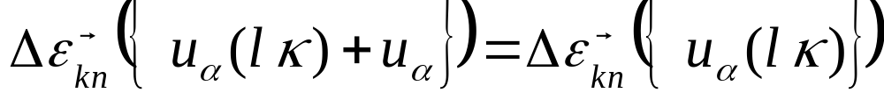
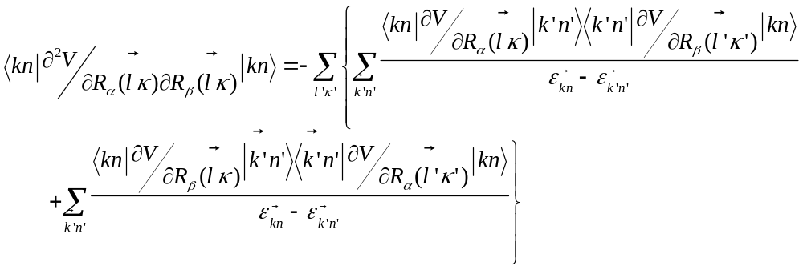
This is done because using the Acoustic Sum Rule:
We can rewrite the site-diagonal Debye-Waller term:

Slide 17
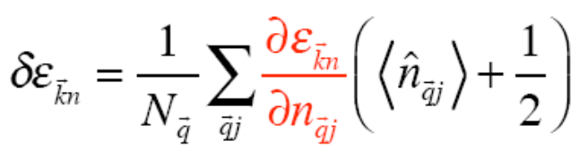
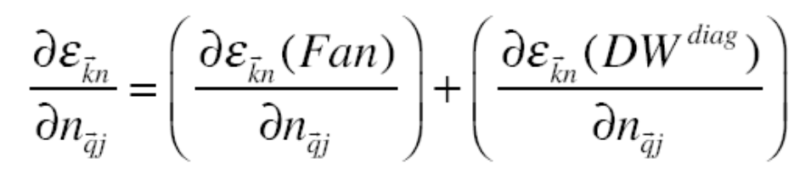
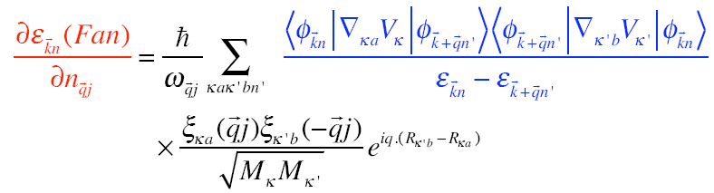
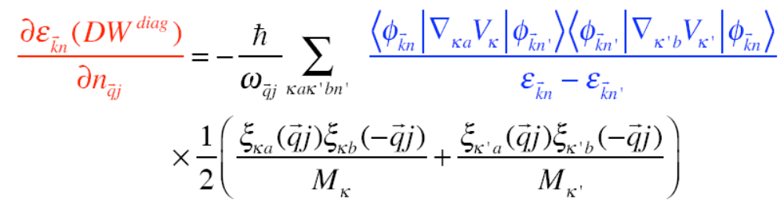

Slide 18
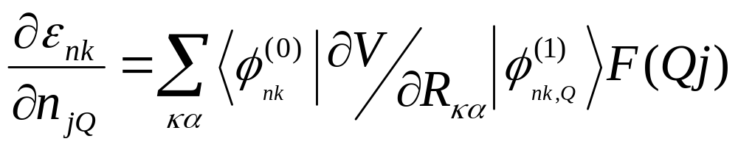

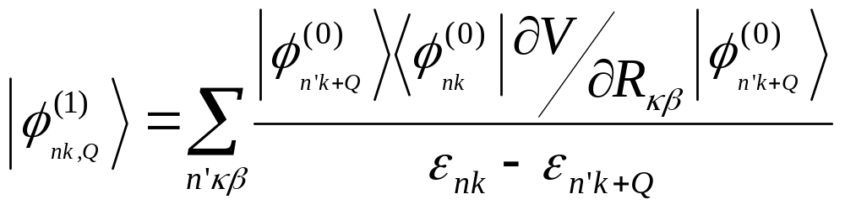
This is (roughly) just:
Basically, we are building the first order wavefunctions using the unperturbed wavefunctions as basis:

Slide 19
Motivation
Context: Semi-empirical AHC theory
The New DFPT formalism
Validation: Diatomic molecules
Validation: Silicon
Future Work
Conclusion

Slide 20
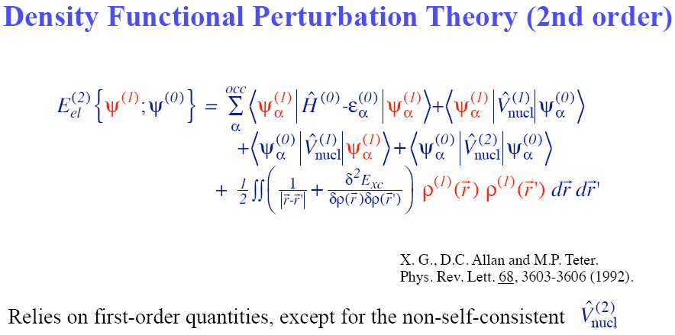

Or we solve the self-consistent Sternheimer equation:

Slide 21
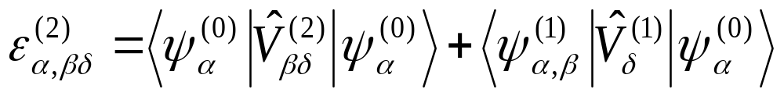
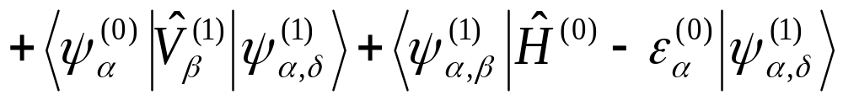
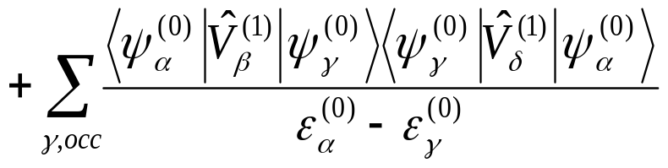
Using the DFPT framework, we find a variational expression for the second order eigenvalues:
Only occupied bands !!!

Slide 22
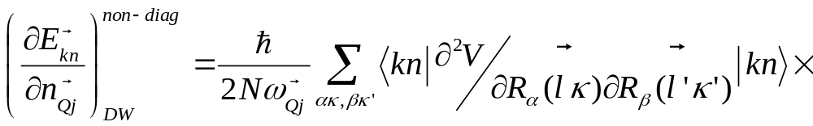
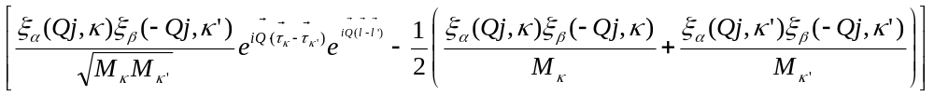
All previous simulations used the “Rigid-ion approximation”
DFPT is not bound to such an approximation
Third derivative of the total energy
Term is related to the electron density redistribution on one atom, when we displace a neighboring atom.

Slide 23
This was implemented in two main subroutines:
In ABINIT:
_EIGR2D
72_response/eig2tot.F90
_EIGI2D
Important variables:
ieig2rf 1 DFPT formalism
2 AHC formalism
smdelta 1 calculation of lifetimes
Tests:
V5/26,27,28
V6/60,61
In ANADDB:
_TBS
77_response/thmeig.F90
_G2F

Slide 24
This was implemented in two main subroutines:
In ABINIT:
_EIGR2D
72_response/eig2tot.F90
_EIGI2D
In ANADDB:
_ep_TBS
77_response/thmeig.F90
_ep_G2F
Important variables:
Thmflg 3 Temperature corrections
ntemper 10
tempermin 100
temperinc 100
a2fsmear 0.00008
Tests:
V5/28
V6/60,61

Slide 25
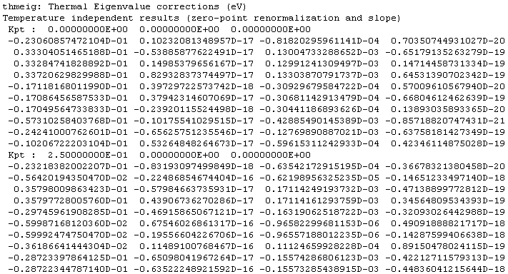

Slide 26
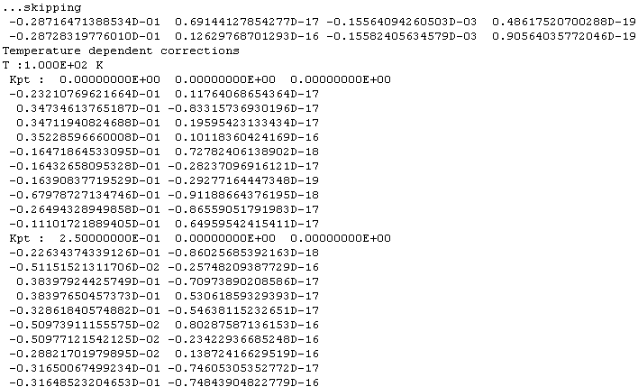

Slide 27
Motivation
Thermal expansion contribution
Context: Semi-empirical AHC theory
The New DFPT formalism
Results: Diatomic molecules
Results: Silicon and diamond
Future Work
Conclusion

Slide 28
Need to test the implementation and approximations
Systems:
Diatomic molecules: H₂, N₂, CO and LiF
Of course, Silicon

Slide 29
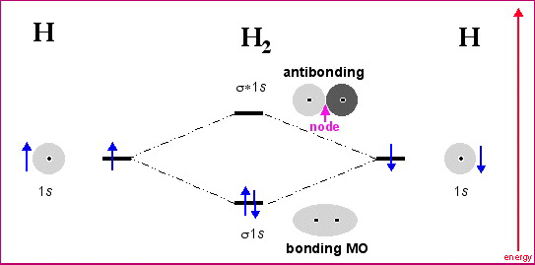
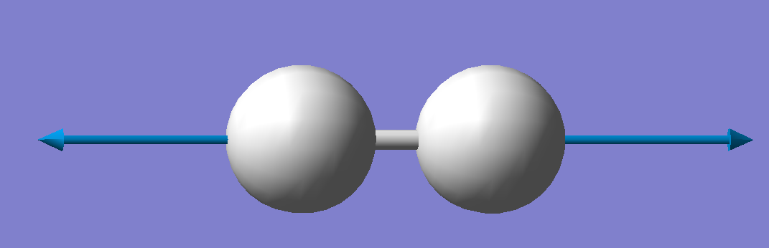
Discrete eigenvalues : Molecular Orbital Theory
Dynamic properties:
● 3 translations
● 2 rotations
● 1 vibration

Slide 30
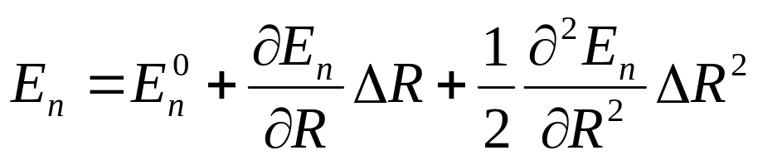

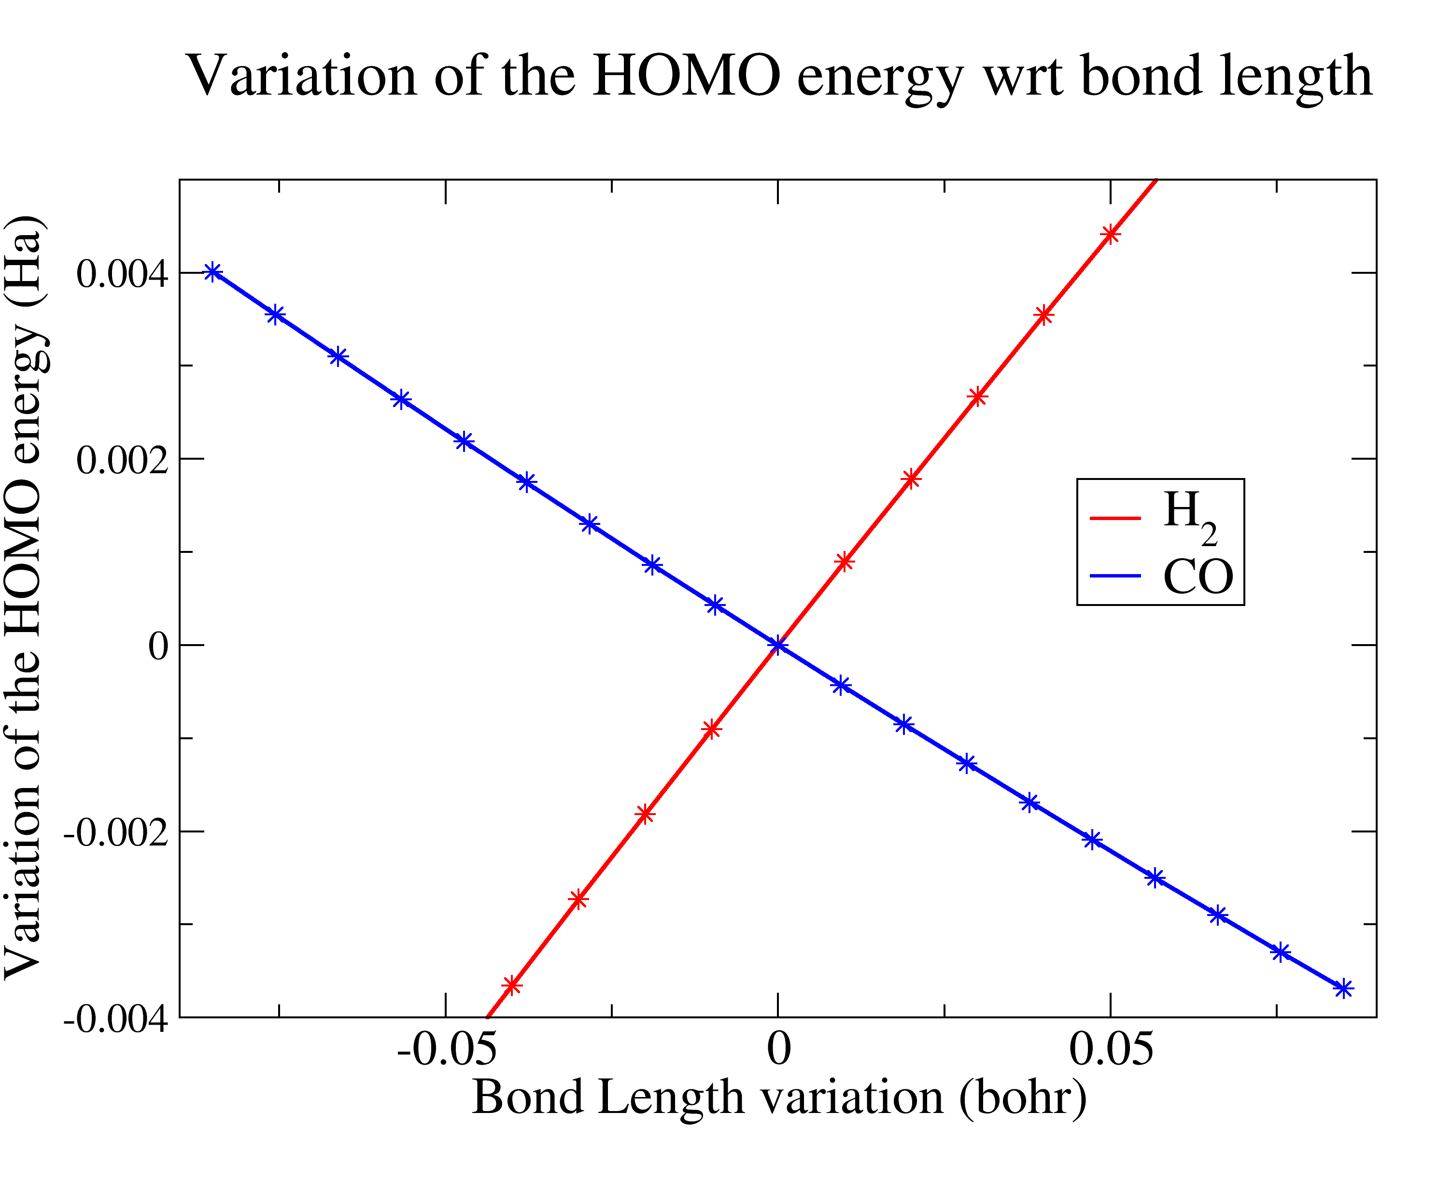
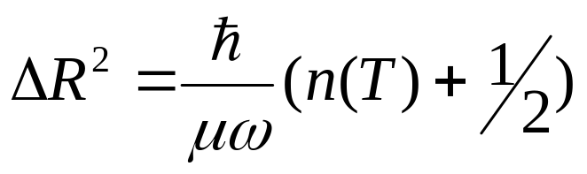
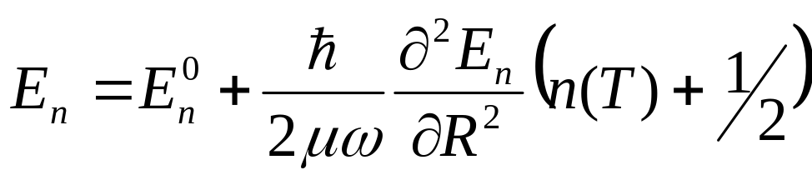
Write the electronic Eigen energies as a Taylor series on the bond length:
Quantum harmonic oscillator:
Bose-Einstein distribution
Zero-Point Motion

Slide 31
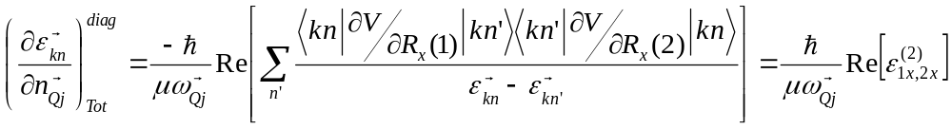
While the adiabatic perturbation theory states:
1
2
But only one vibrational mode:

Slide 32
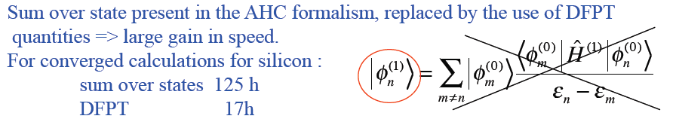
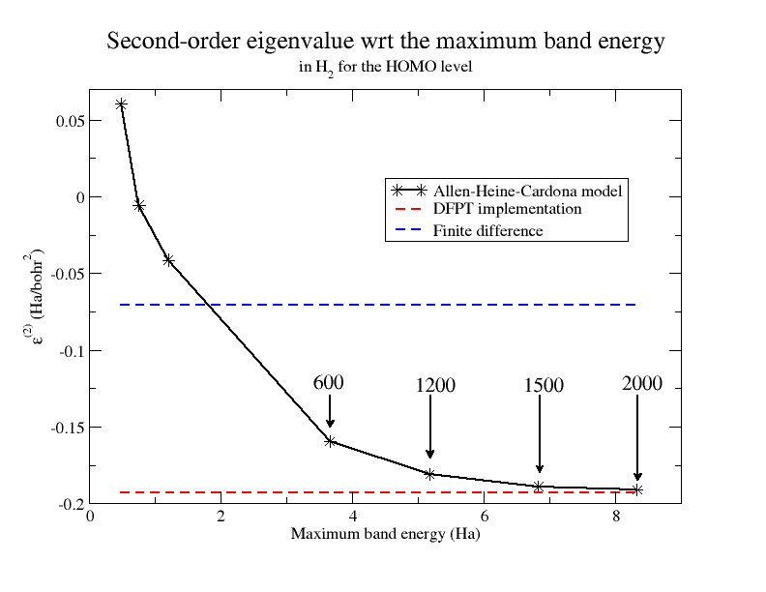
H₂ :
18
2 min.
AHC (2000 bands):
18 hours
DFPT (10 bands):
2 minutes

Slide 33
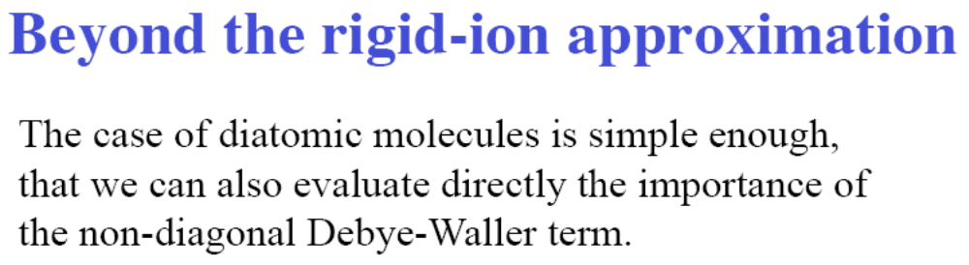


Slide 34
Second derivatives of the HOMO-LUMO separation
 | H₂ (Ha/bohr²) | N₂ (Ha/bohr² ) | CO (Ha/bohr²) | LiF (Ha/bohr²)
DDW +FAN | 0,1499291 | 0,2664681 | 0,0982577 | 0,03779
NDDW | -0,0780353 | -0,028155 | 0,0145269 | -0,014139
NDDW+DDW+FAN | 0,0718937 | 0,2383129 | 0,1127847 | 0,023660
Finite diff. | 0,0718906 | 0,2386011 | 0,1127233 | 0,023293

Slide 35
Motivation
Thermal expansion contribution
Context: Semi-empirical AHC theory
The New DFPT formalism
Results: Diatomic molecules
Results: Silicon and diamond
Future Work
Conclusion

Slide 36

Results for Silicon :

Slide 37


Slide 38


Slide 39


Elecron-phonon coupling of silicon:

Slide 40

Electronic levels and optical properties depends on vibrational effects …
Allen, Heine, Cardona, Yu, Brooks
The thermal expansion contribution is easily calculated using DFT + finite differences
The calculation of the phonon population contribution for systems with many vibration modes can be done efficiently within DFPT + rigid-ion approximation. However, sizeable discrepancies remain for certain systems
The non-site-diagonal Debye-Waller term was shown to be non-negligible for the diatomic molecules. It remains to be seen what is its effect in semiconductors.
-

