Slide 1

Université de Liège
The position operator in extended systems:
Application to electron localization and non-linear optics
M. Veithen, Ph. Ghosez and X. Gonze
Supported by: FNRS-Belgium

Slide 2
Outline
The modern theory of polarization
The localization tensor
  Background
  Band by band decomposition
  Implementation
Electrooptic effect
  Electronic contribution
    Perturbation expansion of the polarization : continuous form
    Perturbation expansion of the polarization : discretized form
    Convergence study
    Implementation
  Ionic contribution : computation of the Raman susceptibilities
    Finite differences
    Perturbative approaches
Conclusions and perspectives

Slide 3

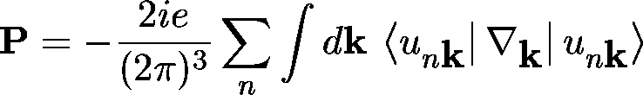
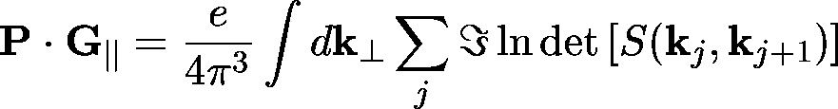

Modern theory of polarization
Interaction of electrons with an electric field
Position operator incompatible with BvK boundary conditions
Polarization can be expressed as a Berry phase of the electronic wavefunctions
  continuous form
  discretized form
recent developments based on this formalism
  Electron localization tensor
  Non-linear optical response

Slide 4
Localization tensor: Background
Characteristic length that is finite in insulators and diverges in metals
Linear response formulation
  V_{c} = unit cell volume
  N = number of doubly occupied bands
  u_{nk} = periodic part of the Bloch functions
Sgiarovello, Peressi and Resta, Phys. Rev. B 64, 115202 (2001).
First order wavefunctions
  linear response approach to density functional theory
  diagonal gauge

Slide 5
Band by band decomposition
Global characterization of the whole electron gaz
  core and valence electrons exhibit different localization properties
  result depends on the construction of the pseudopotentials
Sum of random variables
  u₁, u₂ → probability density function f(u₁, u₂)
  Total mean
  Total variance
  The covariance indicates how u₁ and u₂ are related together.
  It is zero if they are independent:
  f(u₁,u₂)=f₁(u₁)f₂(u₂)
Band by band decomposition allows to focus on individual
groups of bands

Slide 6
Band by band decomposition
Localization tensor
  variance
  covariance
  Many-body wavefunction = Slater determinant of the one particle orbitals
  and not their product
N_{g} groups of
occupied bands
group i,
n_{i} bands

Slide 7
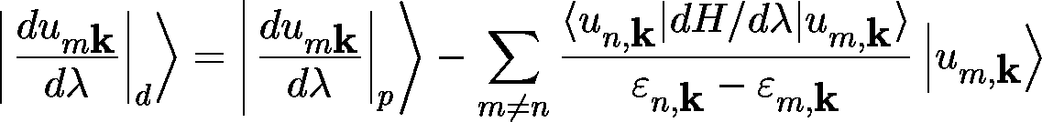
Implementation
Gauge for linear response computations
  First-order wavefunctions are computed within the parallel gauge
  Band by band decomposition meaningful in the diagonal gauge
Relevant ABINIT routines
  nstwf3.f : computation of second-order derivatives from non-stationary expressions
    computation of the localization tensor and its band-by-band decomposition
    band-by-band decomposition of Born effective charges (phonon-type perturbations)
  gaugetransfo.f :
    transforms first-order wavefunctions to the diagonal gauge
  wrtloctens.f :
    ouput of the localization tensor

Slide 8
Implementation
New input variable
  prtbbb : governs the computation of the band-by-band decomposition of the localization tensor and the Born effective charges
Subtlety
  the variable getddk has to be declared the number of the dataset where the ddk is computed (ex: getddk3 3)
Documentation
  Band-by-band decomposition of the Born effective charges
    Ph. Ghosez and X. Gonze, J. Phys. Condens. Matter 12, 9179 (2000)
  Band-by-band decomposition of the localization tensor
    M. Veithen and Ph. Ghosez, AIP conference proceeding 626, 208 (2002).
    M. Veithen, X. Gonze and Ph. Ghosez, to appear in Phys. Rev. B. (preprint available at cond-mat/0206580)
  + references therein

Slide 9

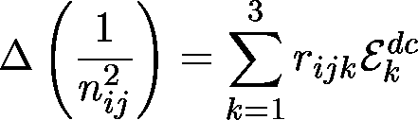

Electrooptic effect
Modification of the index ellipsoid of a compound induced by a static electric field
Electrooptic tensor
Separation into a bare electronic and an ionic contribution
  electronic contribution :
    interaction of the electric field with the electronic cloud at clamped ionic positions
    related to the non linear optical susceptibility
  ionic contribution :
    electric field → atomic displacements → refractive index changes
    can be computed from the Born effective charges, phonon frequencies and eigendisplacements, Raman susceptibilities

Slide 10

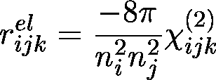

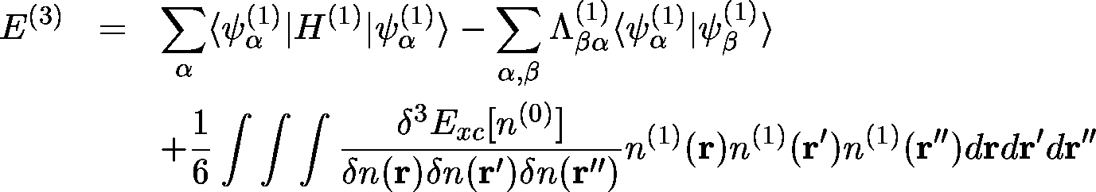
Electronic contribution
Non linear optical susceptibility
Third-order derivative with respect to an electric field
2n + 1 theorem
Electric field dependent energy functional

Slide 11
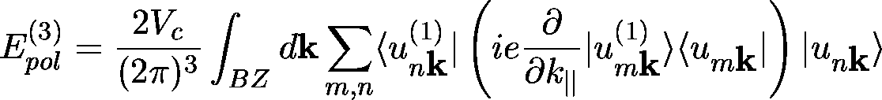

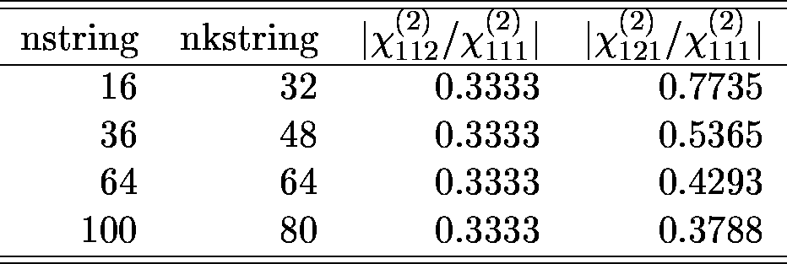
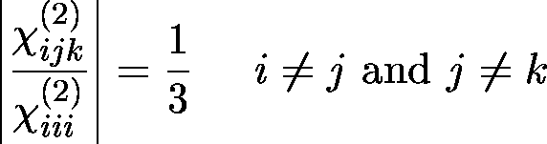
Perturbation expansion of the polarization: continuous form
Finite differences along strings
Example: cristalline GaAs
  cartesian coordinates :
  reduced coordinates :

Slide 12
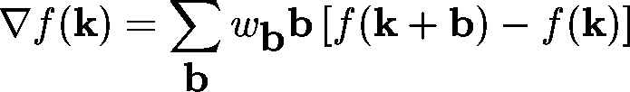
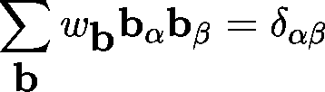
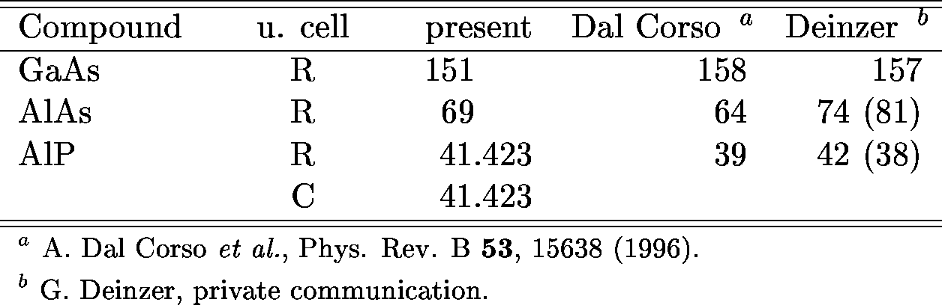
Finite difference expression of Marzari and Vanderbilt on a regular grid of k-points
Application to cubic semiconductors: χ in pm/V
Shells of first neighbors
  SC grid of k-points : 6
  FCC grid of k-points : 12
  BC grid of k-points : 8
Phys. Rev. B 53, 15638 (1996).
right symmetry

Slide 13
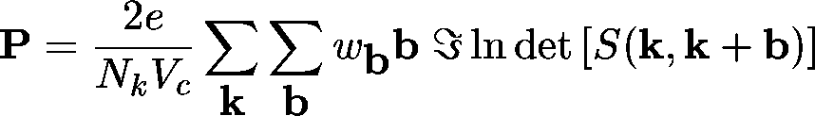
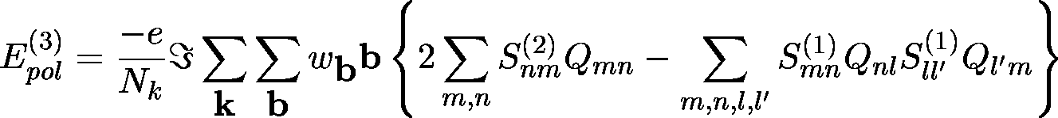
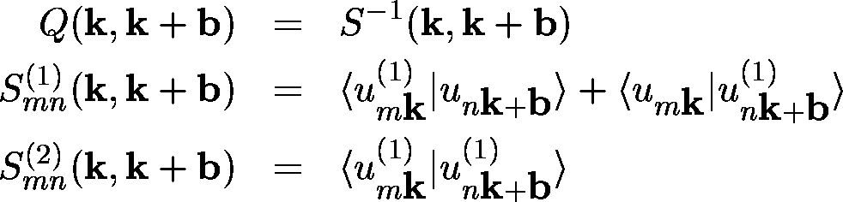
Perturbation expansion of the polarization: discretized form
Regular k-point grid
Perturbative expansion

Slide 14
Convergence study : k-point sampling
Case of AlAs
  ngkpt = n × n × n
  shiftk = 0.5 0.5 0.5
  0.5 0.0 0.0
  0.0 0.5 0.0
  0.0 0.0 0.5

Slide 15
Implementation notes
General structure
driver.f
nonlinear.f : equivalent of respfn.f for 2nd order derivatives
initialization tasks
reads pseudopotential files, GS wavefunctions + density
computes 3rd order XC kernel
loop3dte.f : loop over the 3 perturbations j₁, j₂ and j₃
read 1st order wavefunctions + densities
compute 1st order hartee and XC potential
compute 3rd order XC energy
mv_3dte.f : compute ddk-part of the 3rd order energy
resp3dte.f : compute matrix elements of v⁽¹⁾_{hxc}

Slide 16
Relevant input variables
  3rd order derivatives are computed in case optdriver = 5
  The reading of the 1st order densities is controlled by get1den
  At the opposite with the computation of 2nd order derivatives, the 3 perturbations j₁, j₂ and j₃ have to be specified explicitely
    rf1elfd, rf2elfd, rf3elfd : electric field-type perturbations
    rf1phon, rf2phon, rf3phon : phonon-type perturbations
    rf1dir, rf2dir, rf3dir : direction of the perturbations
    rf1atpol, rf2atpol, rf3atpol : atomic polarization

Slide 17
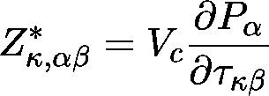

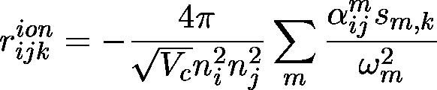
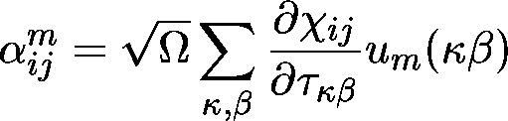

Ionic contribution
Relaxation of the atoms within an electric field
  Born effective charges :
variations of the refractive index
First-order changes of the linear susceptibility :
General expression :
(Raman susceptibility)

Slide 18

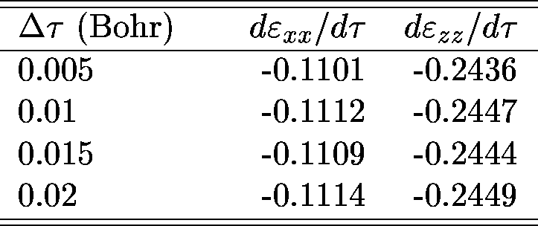
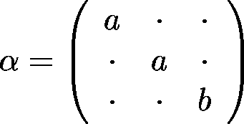
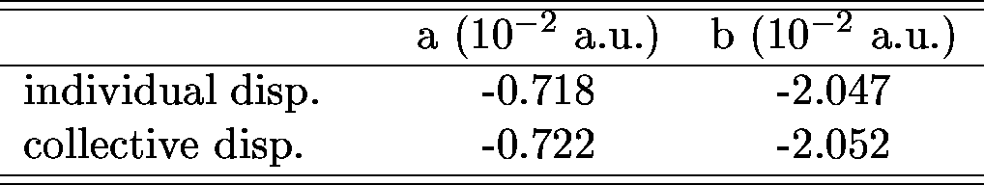
Raman susceptibilities: finite difference approach
Individual atomic displacements (case of LiNbO₃)
Collective displacements along the normal mode coordinates (case of the lowest A₁ mode in LiNbO₃)

Slide 19
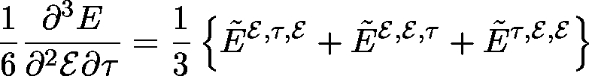


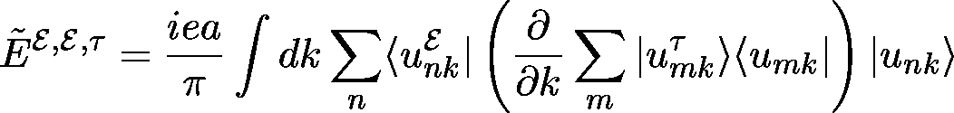
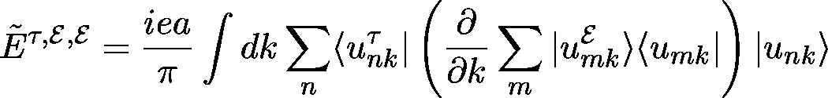
Raman susceptibilities: perturbative approaches
Berry phase approach (1d, non self-consistent case)

Slide 20
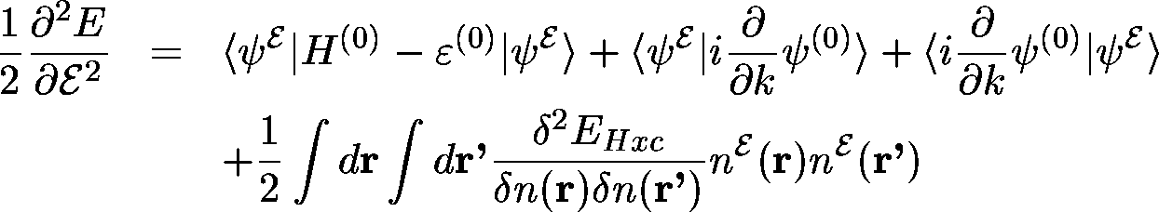
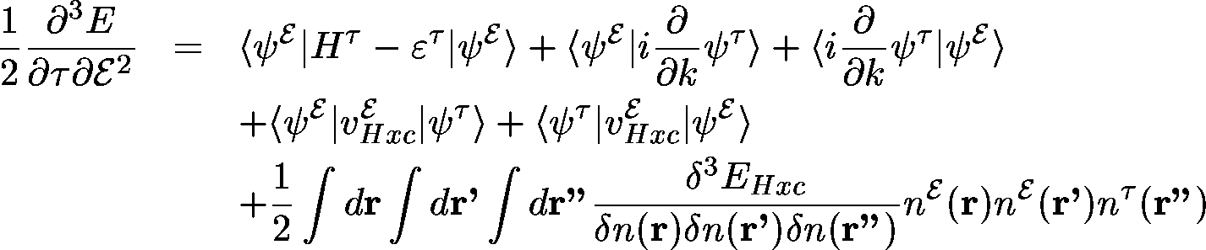
Derivative of the linear susceptibility
  stationary expression of the second order energy
  derivative with respect to an atomic displacement τ
  mixed derivative of the wavefunctions : non self consistent calculation

Slide 21
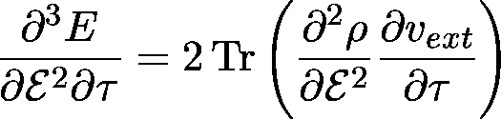

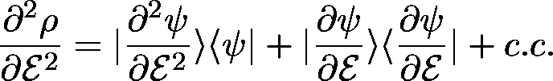

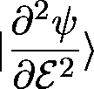
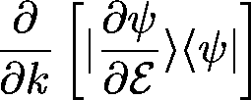
Method of M. Lazzeri and F. Mauri
  Density matrix of the Kohn-Sham eigenstates
  The wavefunctions and can be computed from a self-consistent calculation
  Comment : the computation of needs the operator
  that has to be computed from finite differences
(preprint available at cond-mat/0207039)

Slide 22
Conclusions and Perspectives
Implementation of 2 quantities based on the modern theory of polarization into the ABINIT package
Electron localization tensor
  Characteristic length that quantifies the degree of electron localization in crystalline solids
  Computed from the ground-state and ddk wavefunctions
Electrooptic tensor
  Electronic contribution : expression based on the 2n + 1 theorem and the modern theory of polarization has been implemented
  Ionic contribution (Raman susceptibilities) :
    Actually accessible from finite differences of the dielectric tensor
    Perturbative approach will be implemented in the future

