Slide 1
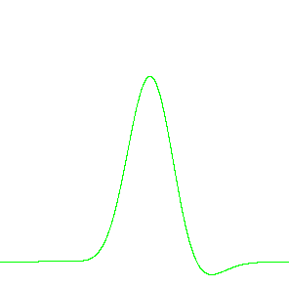
Finite-T smearing scheme in ABINIT
M. Verstraete and X. Gonze
PCPM Université Catholique de Louvain, Louvain-la-Neuve, Belgium

Slide 2


Overview (lots of stuff)
Re-smearing scheme
  The physical & simulation problems
  Our solution: convolution
  Coding in ABINIT: metallic occupations
Angular momentum projection
  The straightforward theory
  Extension of cut3d
Pseudopotential testing project

Slide 3
Re-smearing scheme:
Two uses for smearing schemes (I)
Finite-T physical free energy (Mermin)
Entropic term which depends only on occupations.
Electronic temperature T
For fermions statistical mechanics gives the Fermi-Dirac f and S
Recent work on variable occupation numbers to validate HKS extension

Slide 4
Re-smearing scheme:
Two uses for smearing schemes (II)
Accelerate the convergence wrt nkpt
Why? The fermi surface is not well sampled:
  K-points near the Fermi surface representative in energy but
  Occupation is 1 or 0
  Artificial smearing with gaussian-type occupation
  Problems in MD (crossings)

Slide 5
Re-smearing scheme:
Two uses for smearing schemes (III)
How large should (can) the smearing be?
Empirical convergence in kpoints for large smearing value
  Reduce smearing and re-converge
Intuitively, if the band is flat, σ=infinity and nkpt=1

Slide 6
The problem
FD only useful for kpoints at 2000 K
For smaller T more k-points are needed
Depends if you need
  T related details, or
  Just thermalisation (w ionic thermostat)

Slide 7
Combine the two:
finite T with faster convergence
Only at 2000 K FD occupation useful for kpoint
For smaller T more k-points are needed
Re-smear the occupation to accelerate convergence hence:
Convolute the smearings
Verstraete & Gonze PRB 46 035111

Slide 8
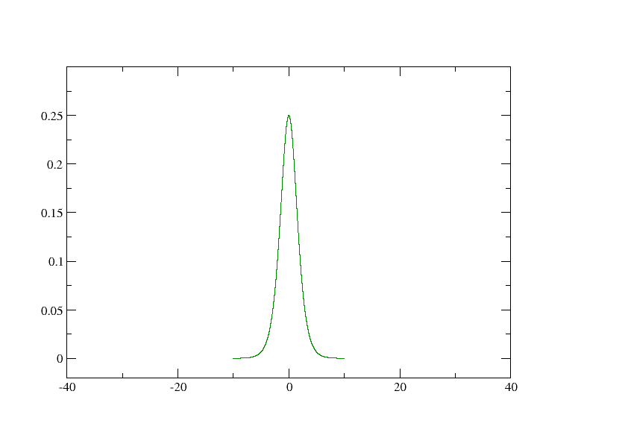
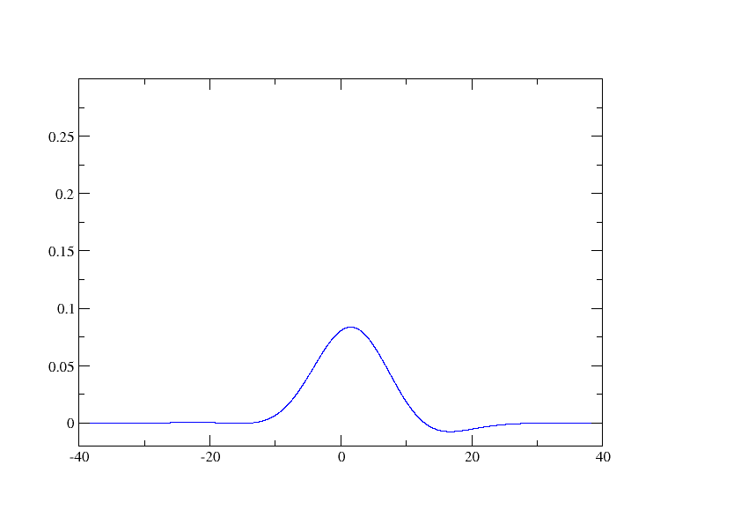
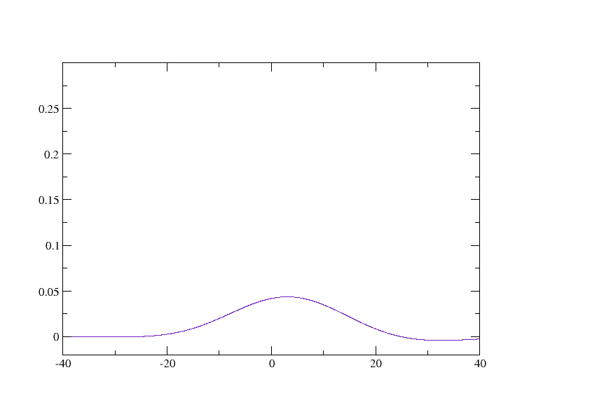
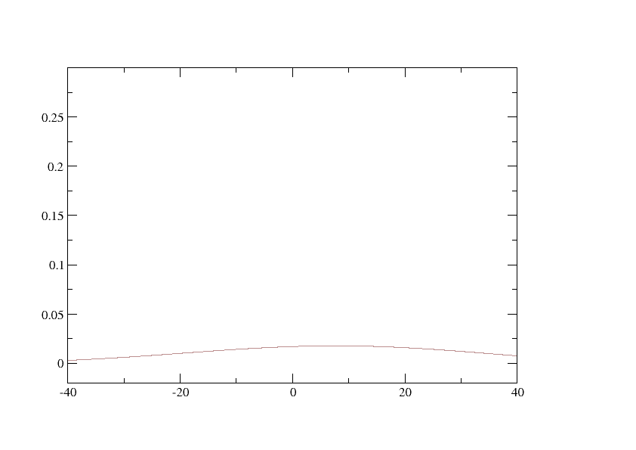
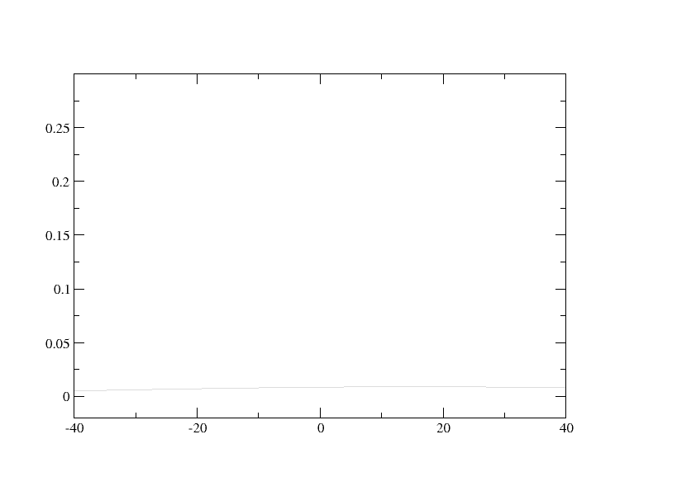
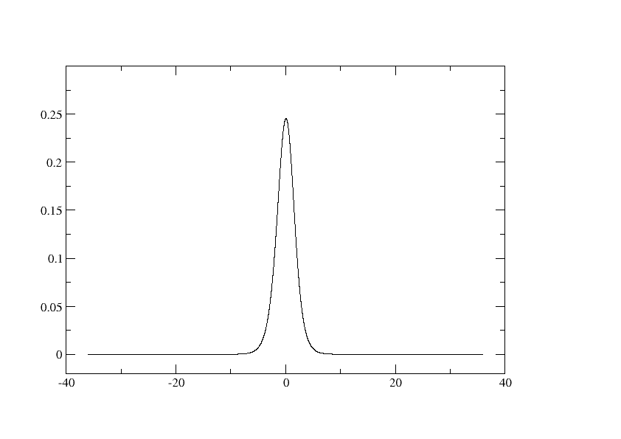
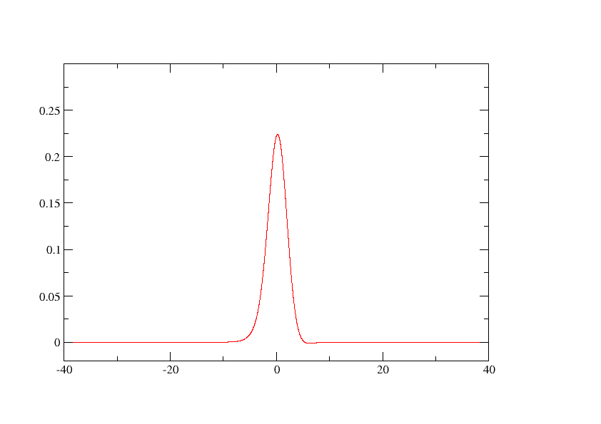
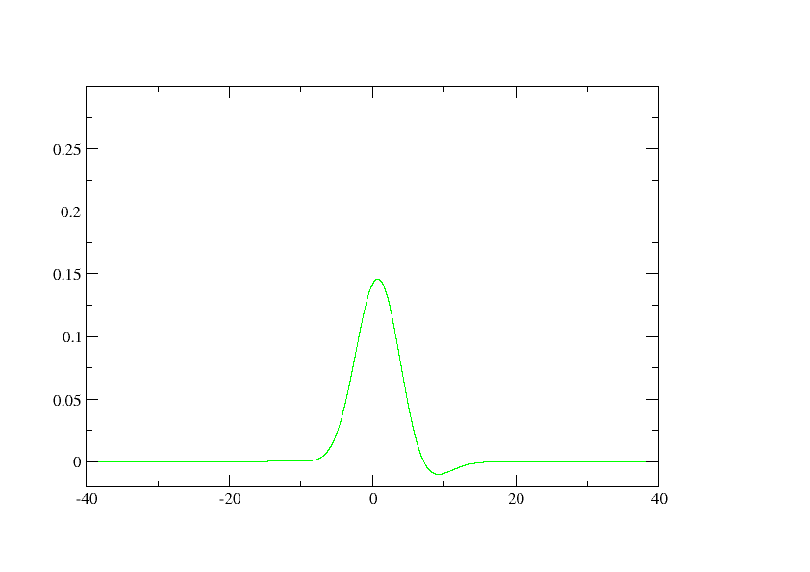
What does the smearing delta look like?

Slide 9
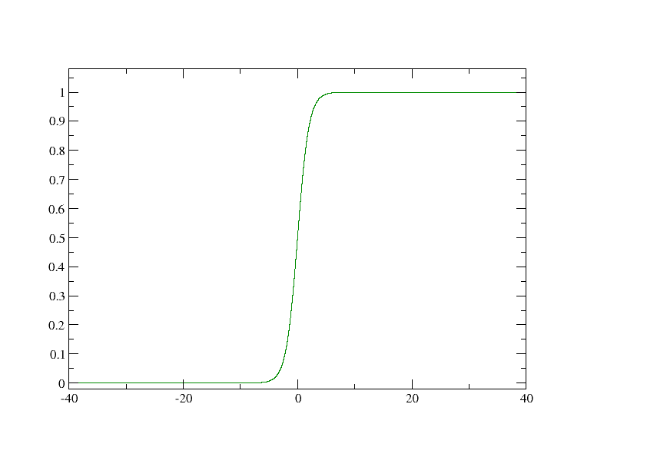
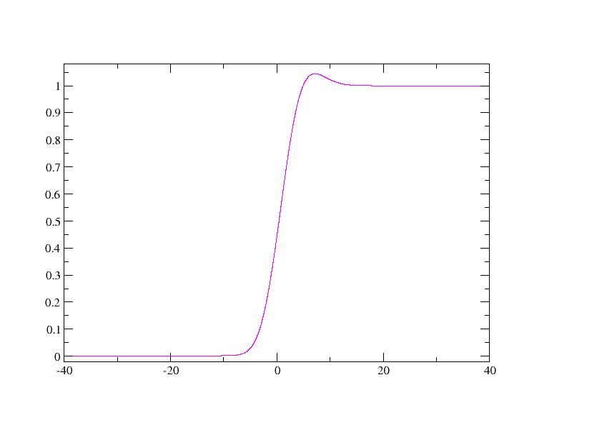
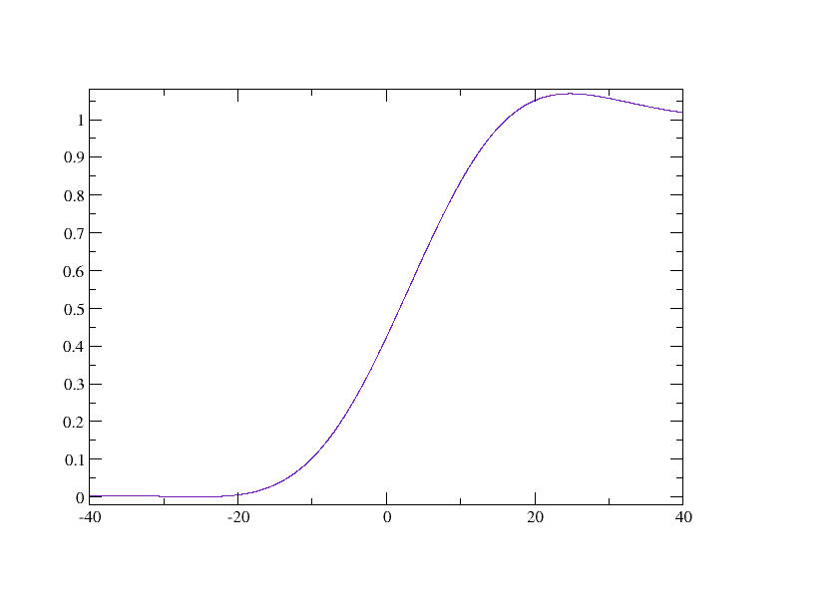
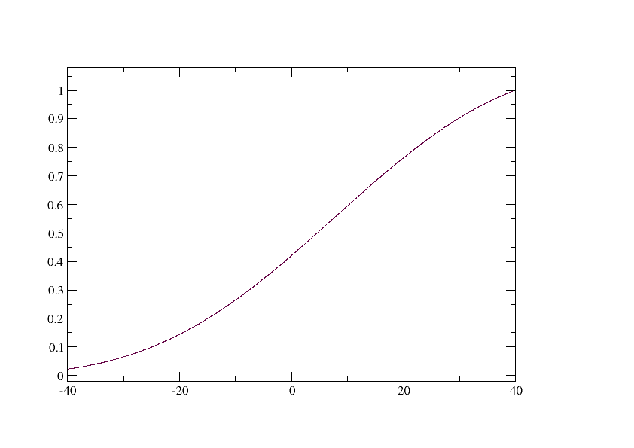
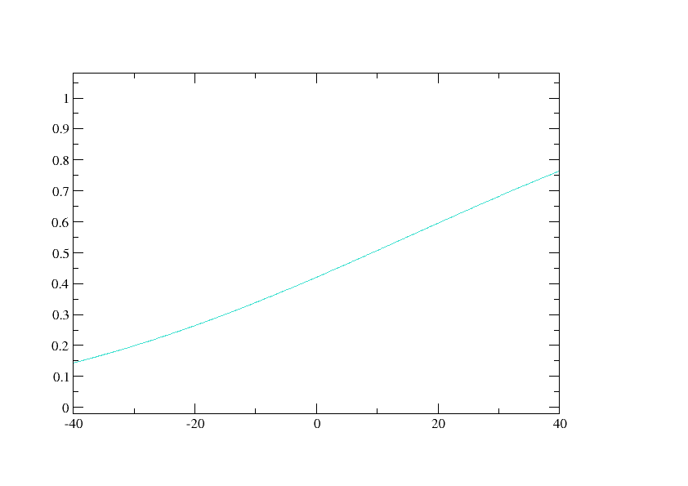
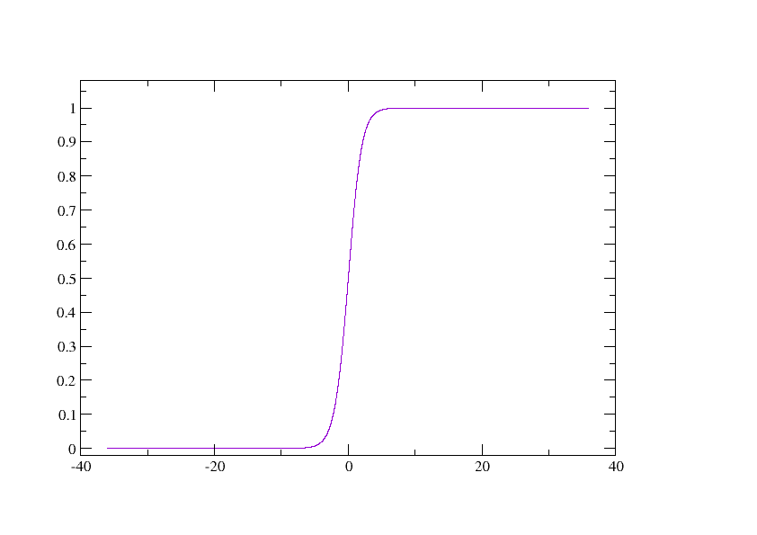
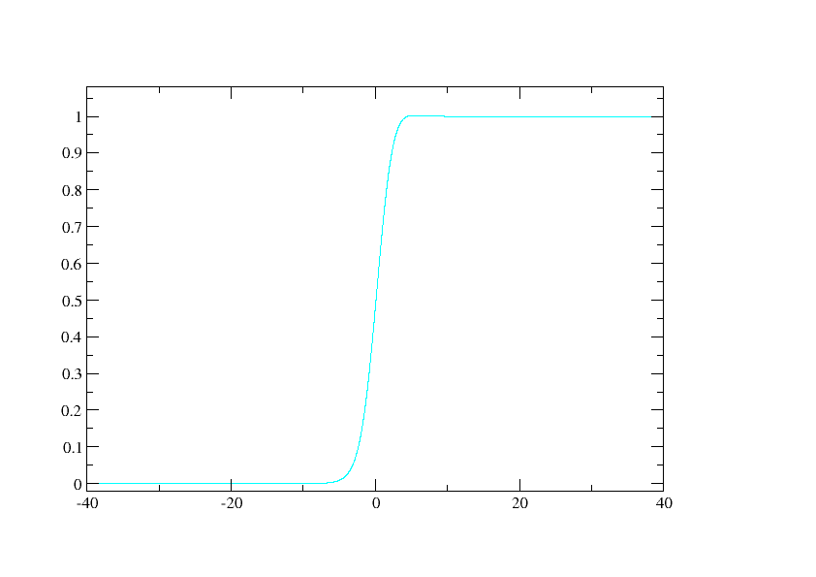
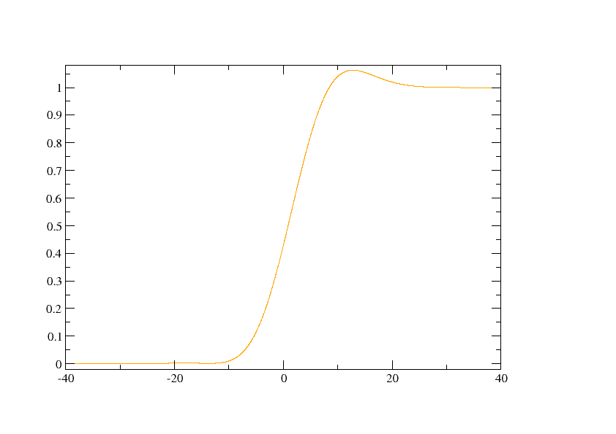
What does the occupation look like?

Slide 10
Occupation functions in ABINIT
Occopt = 3-7 with tsmear + tphysel
getnel.f feeds the rest of ABINIT with
  1 splined occ function f and entropy function S
  1 fermi energy
1st pass: convolute deltas, obtain total f & S
Smearing scheme transparent for rest of code.

Slide 11
Projection on angular momenta
Projection on atomic-like states:
Operate in reciprocal space
  1D integral over r: exp(ikr) gives Bessel fct
  Sum over all G vectors

Slide 12

Changes to cut3d
Jean-François Brière and Michel Côté added treatment of _WFK files to cut3d (wffile.f)
1) Initialize 1D real space integration
2) project state in reciprocal space
3) output proportions of s,p,d, for each atom
Local change to wffile.f, encapsulated code
Quick because wfk treated in reciprocal space

Slide 13
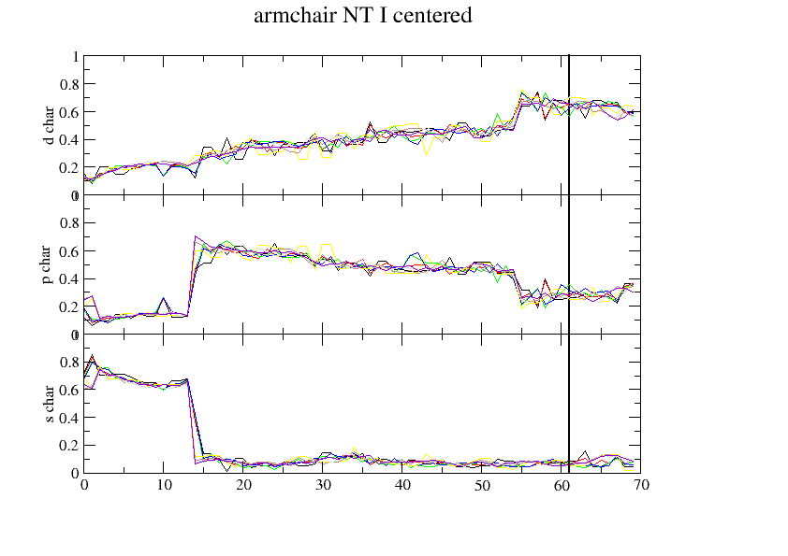
An application
because Xavier said no applications

Slide 14
Pseudopotential testing and benchmarking: a proposal (I)
Many types of pseudopotentials
Reliability, hardness, transferability problems
Systematic comparison of different
  schemes (HGH, TM flavors)
  XC functionals PBE, PW…
  Codes? SIESTA, VASP, or vs. Gaussian

Slide 15
Pseudopotential testing and benchmarking (II)
Generate and test whole tables
  Atomic case is simple
  Solids (+ oxides?)
Systematize tests of pseudopotentials on small fast but pertinent systems.
Output: ecut, expected acell for bulk, transferability quality…
Oh, and the users may like it too

Slide 16
Pseudopotential testing and benchmarking (III)
What’s been done so far:
Table of HGH psp
Perl scripts for making
  All FHI psps
  Testing them in simple systematic ways (needs more work)
Q: how much of this is useful if we have PAW?

