Slide 1

Macroscopic averages in Abinit
Université de Liège
Javier Junquera
Départament de Physique
Université de Liège

Slide 2
Macroscopic averages
Microscopic quantities
Macroscopic quantities
Very rapidly functions of position
Resembles the microscopic atomic structure
Output of first-principles calculations (DEN, POT, …)
Smooth variations with the position
Magnitudes that enter in the discussion of dielectrics.
Magnitudes measured experimentally.
Macroscopic Average Technique
Average over a region that is small on the macroscopic scale, but
large compared with the atomic dimensions.

Slide 3
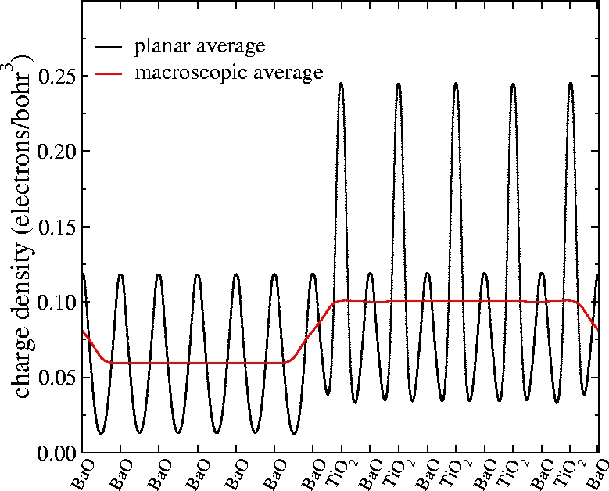

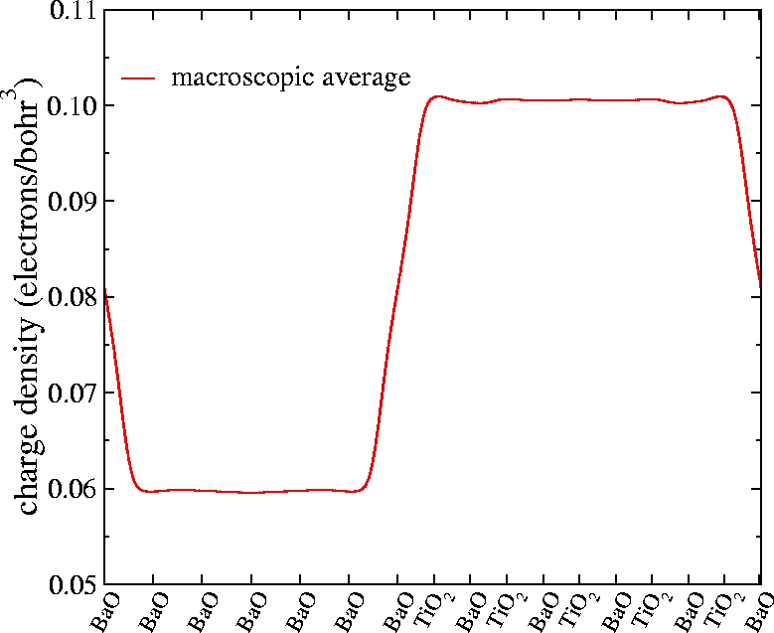


Macroscopic average technique
First step: Planar average
Second step: Averaging with a filter
(convolution with step functions)
A. Baldereschi et al., Phys. Rev. Lett., 61, 734 (1988)
L. Colombo et. al., Phys. Rev. B, 44, 5572 (1991)

Slide 4
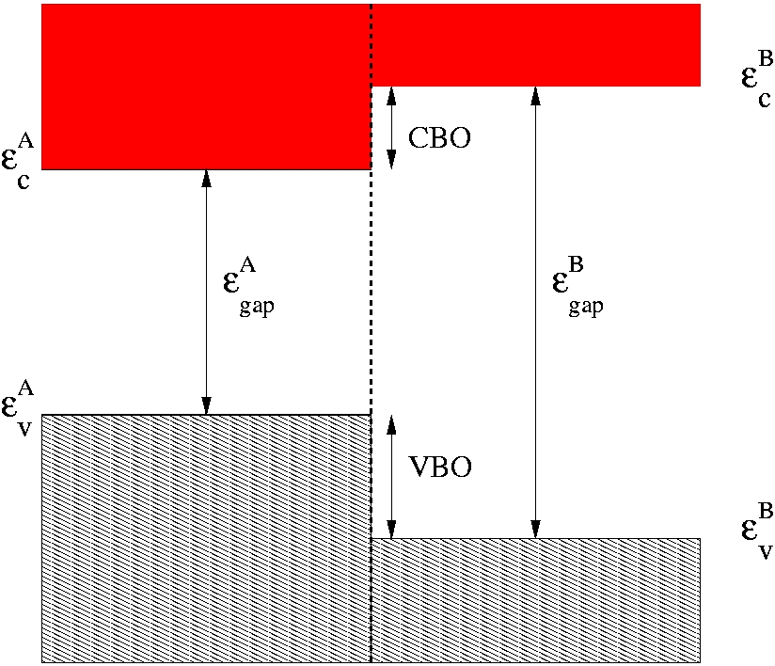
Band offsets
BAND OFFSET: Relative position of the band gaps of both constituents at the interface
CBO: Conduction Band Offset
VBO: Valence Band Offset
<V_{A,B}> Arbitrary averages of the electrostatic potential
Relation <V_{A}>→ <V_{B}>?
<V_{A}>
<V_{B}>

Slide 5
Band offset calculation
Band-structure term
Difference between the two valence band edges
Standard bulk structure calculations
Line-up of the electrostatic potential
Relates the average of the electrostatic potential in the two materials.
Can only be obtained from a SCF calculation on the supercell
Contains all the intrinsic effect of the interface
Obtained by macroscopic average technique
  A. Baldereschi, S. Baroni and R. Resta, PRL 61, 734 (1988)

Slide 6
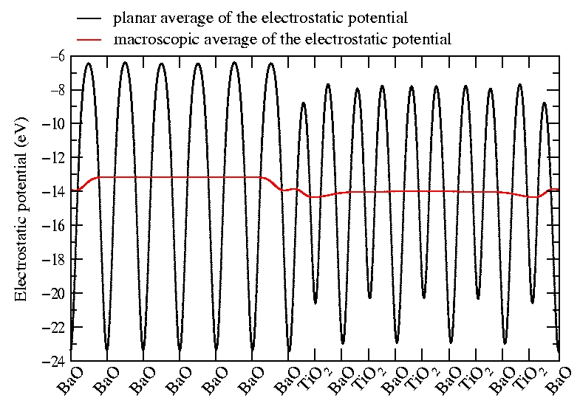
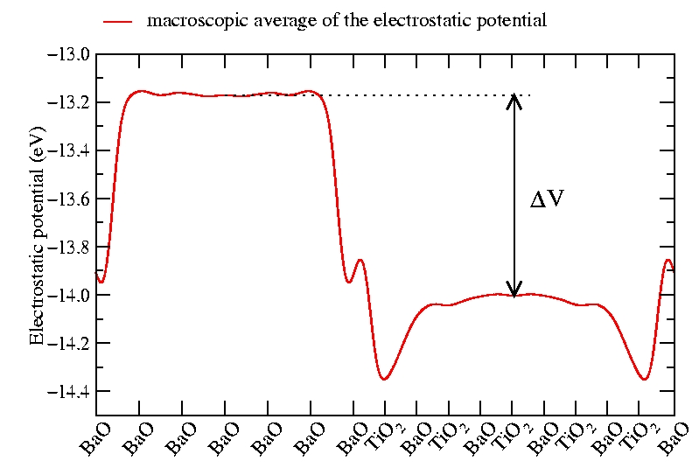
Double-macroscopic average
Planar average
Average on normal direction
Convolution with two filter functions
L. Colombo et al, Phys. Rev. B, 44, 5572 (1991)

Slide 7
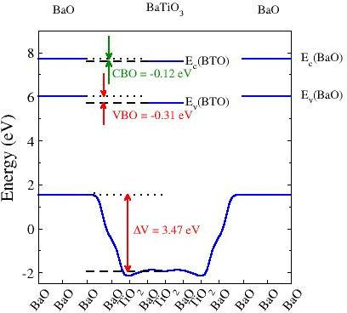
BaO/BaTiO₃ band offset
ABINIT:
3 BaO / 3 BaTiO₃
VBO: -0.31 eV
SIESTA:
2 BaO / 3 BaTiO₃
VBO: -0.21 eV
3 BaO / 5 BaTiO₃
VBO: -0.12 eV

Slide 8
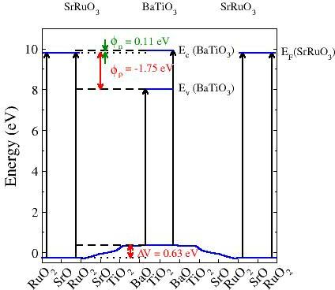
Schottky barrier of SrRuO₃/BaTiO₃
SrO-TiO₂ interface
ABINIT:
3.5 SrRuO₃ / 2.5 BaTiO₃
φ_{p}: -1.75 eV

Slide 9
Dynamical charges
Collective displacement:
macroscopic polarization P
Linear response :
Individual displacement along z:
local dipole p
- from the density :
Finite
difference :
- from the potential :
  R. Martin and K. Kunc,
  PRB 24, 2081 (1981)
Layer dependent quantity relevant for thin films: Z*_{L}

Slide 10
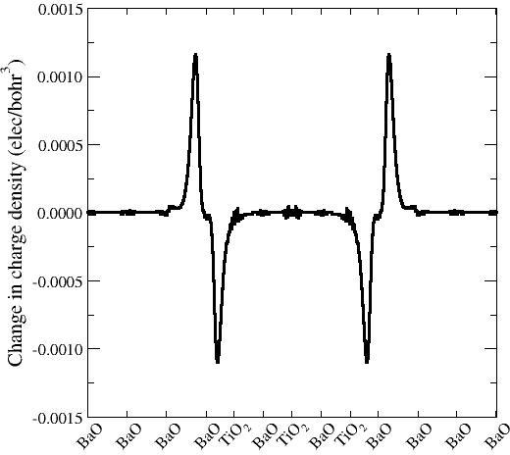
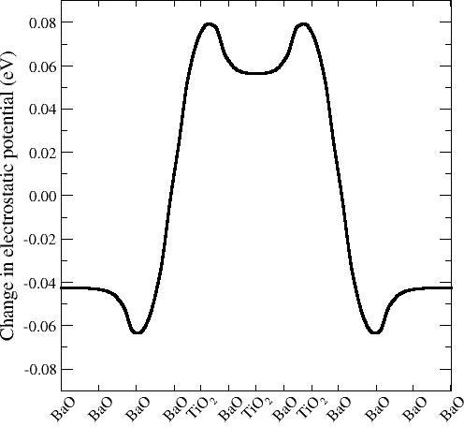
Computation of longitudinal charges
Δτ
−Δτ
Δρ(z)
ΔV(z)
ΔV

Slide 11
BaO/BaTiO₃ interface: Z*_{L} along z
Ζ∗_{L}(Ba)= 0.65 Bulk BO Ζ∗ _{L}(O||)= -0.65
Ba
O
Ζ∗_{L} = 0.64
Ζ∗ _{L} = -0.64
Ζ∗ _{L} = 0.64
Ba
O
linear response and
finite differences
techniques yield
similar results
sharp interface
(for Z*)
Ζ∗ _{L} = -0.64
Ζ∗ _{L} = 0.68
Ba
O
Ζ∗ _{L} = -0.62
Ζ∗ _{L} = 0.50
Ba
O
Ζ∗ _{L} = -0.72
Ζ∗ _{L} = 0.99
Ti
O₂
Ζ∗ _{L} = -0.32
Ζ∗ _{L} = 0.44
Ba
O
Ζ∗ _{L} = -0.83
Ζ∗ _{L} = 1.06
Ti
O₂
Ζ∗ _{L} = -0.33
Ζ∗ _{L}(Ba) = 0.43 Bulk BTO  Ζ∗ _{L}(O||) = -0.83
Ζ∗ _{L}(Ti) = 1.06 Ζ∗ _{L}(O⊥) = -0.33

Slide 12
SrRuO₃/BaTiO₃ interface: Z*_{L} along z
Ζ∗_{L}(Sr,Ru)= 0 Bulk SRO Ζ∗ _{L}(O||)= 0
Ζ∗_{L} = 0.00
Ru
O₂
Ζ∗ _{L} = -0.00
Ζ∗ _{L} = ???
Sr
O
Ζ∗ _{L} = -0.04
only finite differences
technique
broad interface
(for Z*)
Ζ∗ _{L} = ???
Ru
O₂
Ζ∗ _{L} = -0.18
Ζ∗ _{L} = 0.26
Sr
O
Ζ∗ _{L} = -0.48
Ζ∗ _{L} = 0.97
Ti
O₂
Ζ∗ _{L} = -0.52
Ζ∗ _{L} = 0.53
Ba
O
Ζ∗ _{L} = -0.47
Ζ∗ _{L} = 1.06
Ti
O₂
Ζ∗ _{L} = -0.33
Ζ∗ _{L}(Ba) = 0.43 Bulk BTO Ζ∗ _{L}(O||) = -0.83
Ζ∗ _{L}(Ti) = 1.06 Ζ∗ _{L}(O⊥) = -0.33

Slide 13

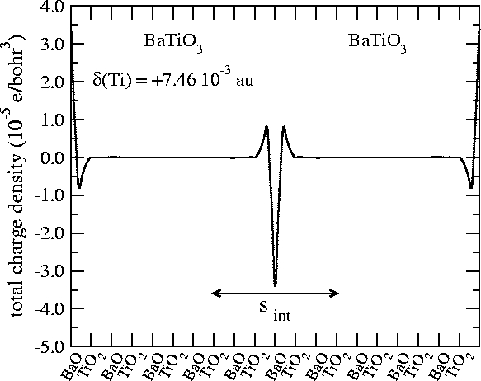



Electronic dielectric constants
F. Bernardini & V. Fiorentini, Phys. Rev. B, 58 15292 (98)
Converge:
Size of the supercell
Atomic displacemets

