Slide 1





ABINIT Developer
Workshop 2011
WELCOME !
THANKS TO :
- Int. organizing committee (F. Bruneval, B. Partoens, M. Verstraete, J. Zwanziger, X.G.)
Local organizing committee (S. Benyoub, B. Bertau, J.-M. Beuken, N. Coisman, H. Dixit, G. Franco, A. Jacques, A. Miglio, S. B. Partoens, Poncé, T. Rangel, G.-M. Rignanese, D. Waroquiers)

Slide 2
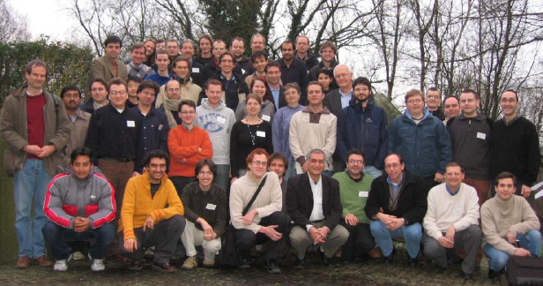
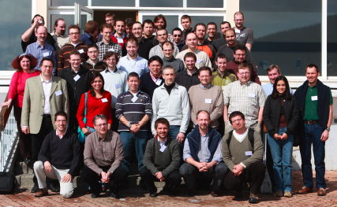
ABINIT : some dates
  Precursor : the Corning PW code (commercialized 1992-1995 by Biosym)
  1997 : beginning of the ABINIT project
  Dec 2000 : release of ABINITv3 under the GNU General Public License (GPL)
  Nov 2002 : 1st int. ABINIT dev. workshop about 40 participants (LLN)
  May 2004 : 2nd int. ABINIT dev. workshop about 40 participants (Paris)
  Jan 2007 : 3rd int. ABINIT dev. workshop about 60 participants (Liège)
  Mar 2009 : 4rd int. ABINIT dev. workshop about 60 participants (Autrans)
  April 2011 : 5th int. ABINIT dev. workshop - 57 participants (Han-sur-Lesse)
2007
2009

Slide 3
2009-10 : main events for the community
  2009-2010 : creation of Forum+new Web site, developmemt of Test Farm
  Aug-Sep 2009 : beautification v5.9-v6.0 with >20 devs
  Dec 2009 : Publication of the Comp. Phys. Communication article
  May 2010 : CECAM School “Linear and non-linear responses with ABINIT”
  Also :
  May 2009 : CECAM School “Theoretical Spectroscopy”, Zurich
  June 2010 : CECAM School “Basic techniques and tools for the development of atomic-scale software”, Zaragoza
  June 2010 : Tutorial BigDFT/ABINIT Carnegie-Mellon U., Pittsburgh PA, US
  Oct 2010 : Tutorial ABINIT Cornell University, Ithaca NY, US
  Nov 2010 : School on Computational Condensed Matter, Irbid, Jordan.
  May 2011 : CECAM School “Theoretical Spectroscopy”, Lausanne
  + The first ETSF users survey (October 2009).

Slide 4
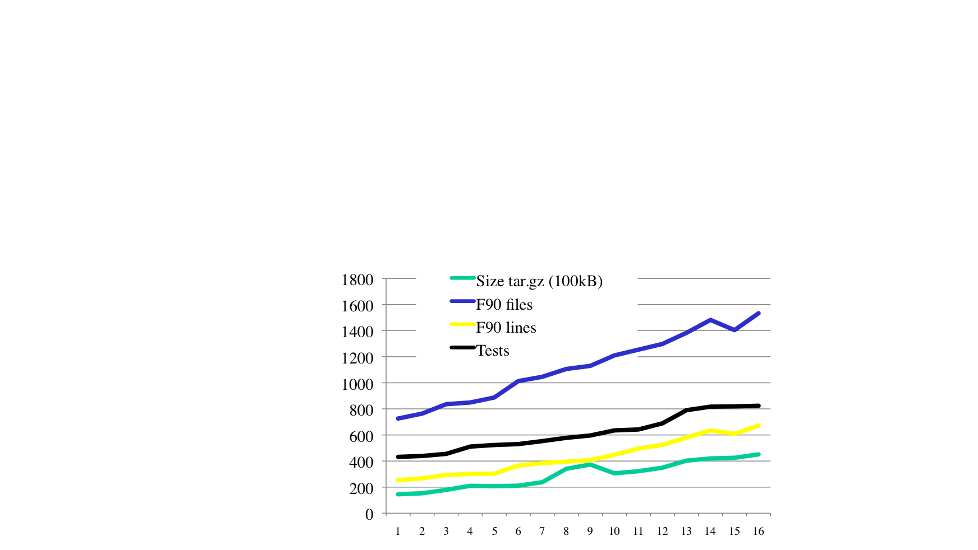
Time evolution since 2004
Jan’04
Jan’05
Jan’06
Jan’07
Jan’08
Jan’09
Jan’10
Jan’11
v4.3
v4.5
v5.1
v5.3
v5.5
v5.7
v6.0
v6.4
v4.4
v4.6
v5.2
v5.4
v5.6
v5.8
v6.2
v6.6
As of Jan 2011 :
1533 routines (files)
824 automatic tests
670 kLines of F90
45.1 MBytes tar.gz
package
v4.5 v5.3 v5.7 v6.6

Slide 5
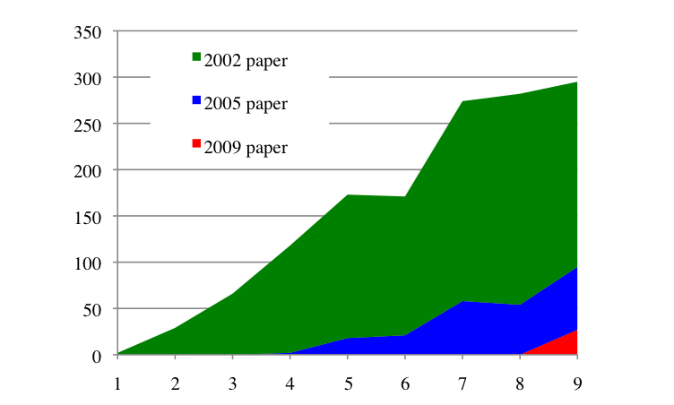
Bibliometry
Some measure of usefulness of ABINIT :
the three papers co-authored by all active developers.
(Not the only papers from ABINIT developers !)
Comput. Mat. Science 25, 478 (2002)
– 16 authors
As of April 10, 2011 : 1211 citations
(2, 29, 66, 116, 155, 150, 216, 228, 200)
Z. Kristallogr. 220, 558 (2005)
– 20 authors
As of April 10, 2011: 244 citations
(2, 18, 21, 58, 54, 68)
Comp. Phys. Comm. 180, 2582 (2009)
– 33 authors
As of April 10, 2011: 53 citations
26 citation in 2011
2002 2004 2006 2008 2010
Number of citations per year

Slide 6
The user and developer community : analysis of mailing lists/repository
As of April 2011 :
1400 registered addresses in "announce" mailing list
587 registered addresses at forum.abinit.org (started 09)
61 names from "contributors" file for ABINIT v6 (Sep 09)
48 GNU Arch branches (25 active in v6.5-6.6 preparation)
The "announce" list:
about 100 in Dec 2000
about 300 in Feb 2002
about 600 in May 2004
about 1000 in Nov 2006
about 1300 in Mar 2009

Slide 7
The ETSF user’s survey
ABINIT part of the European Theoretical Spectroscopy Facility software suite, with some packages delivered on ETSF Web site http ://www.etsf.eu
Other applications : APE, DP, Elk, Exc, Exciting, FHI98PP, Octopus, V_Sim, YAMBO
Results available at
http://www.etsf.eu/2009_etsf_software_survey_results
-About 193 usable replies (response rate estimated 12.5 %) most of which mentioned the use of ABINIT.

Slide 8
2011 ABINIT Workshop
The most important : interactions between the developers !!
Discussion sessions !
Monday (Software development)
1. build system / test farm / testing / Web site
2. modularization / libraries
Tuesday
3. pseudopotentials and PAW for the whole periodic table
4. future beautification / documentation
Wednesday
Meeting of the ABINIT advisory committee
Thursday
5. Roadmap of development, the next 2+ years

Slide 9
Some practical information
Posters : can be posted during the whole workshop
Wednesday : visit of the caves,
FREE, but need to sign-up at the reception
Leave : sign-up at the reception if earlier than 4pm Friday
Internet : WIFI everywhere in the main building, also in
the animatique room, close to the conference room
Hotel : get the keys around 6pm today, WIFI OK for PC ...
Do not forget to fill the ETSF user’s survey

