Slide 1



Materials for white-LED: efforts for Ab initio Materials Design
M. Mikami et al., IOP Conf. Ser.: Mater. Sci. Eng. 1, 012002 (2009)
M. Mikami, N. Kijima, B.Bertrand, M.Stankovski, X.Gonze, ibid (in press).
Masayoshi Mikami
Mitsubishi Chemical Group Science & Technology Research Center
Bruno Bertrand*, Martin Stankovski, Xavier Gonze
ETSF/Universite Catholique de Louvain, Belgium
* CERDECAM, Institut Supérieur Industriel ECAM, Belgium
ABINT 2011 Workshop (11-14 April, 2011, Han-sur-Lesse, Belgium)

Slide 2
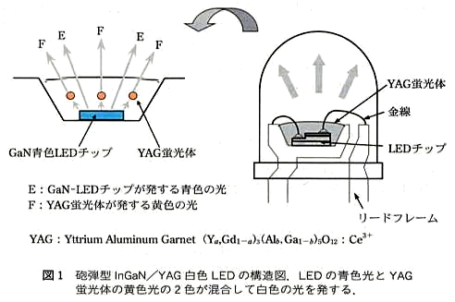
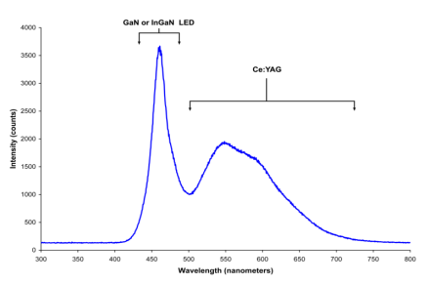
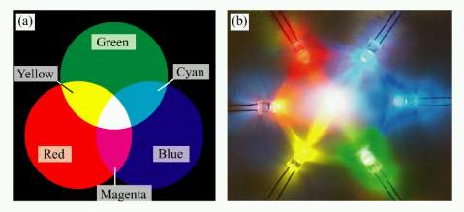
Background
Phosphor-converted white LEDs
MM
Conventional type:
Blue-LED + yellow phosphor
New (Next) type:
High color rendering types
Blue-LED + yellow & red
Near UV-LED + blue & green & red
Blue-LED + green & red
(typically, Y₃Al₅O₁₂:Ce³⁺)
YAG phosphor
InGaN chip
YAG phosphor
Blue from LED
Yellow from YAG
New phosphors to be explored !
Cross-section of present type
(Blue-LED + yellow phosphor)
板東ら,応物, 71(2002),1518
lacking red
→ cool white
“www.lightemittingdiodes.org”
B
Y
M.Mikami & B.Bertrand – ABINIT 2011 Workshop, Han-sur-Lesse - 2

Slide 3
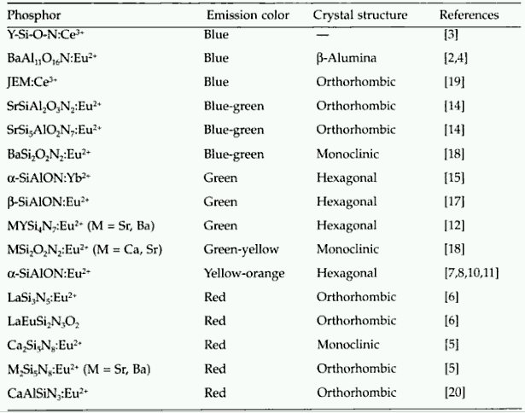
“Phosphor Handbook” (2006)
WE NEED GUIDING PRINCIPLES (THEORY) !
+ updates (from literatures)
blue(-green) nitride?!
AlN:Eu2+,Si4+
BaSi₇N₁₀:Eu2+
Ba₃Si₆O₁₂N₂:Eu2+
Ba₃Si₆O₉N₄:Eu2+
Ba₁Si₂O₂N₂:Eu2+
Sr₁Si₂O₂N₂:Eu2+
Ca₁Si₂O₂N₂:Eu2+
β-SiAlON:Eu2+
LaSi₃N₅:Ce3+
La₃Si₆N₁₁:Ce3+
(Sr,Ca)AlSiN₃:Eu2+
SrAlSi₄N₇:Eu2+
M.Mikami & B.Bertrand – ABINIT 2011 Workshop, Han-sur-Lesse - 3

Slide 4
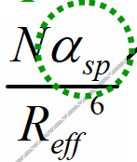

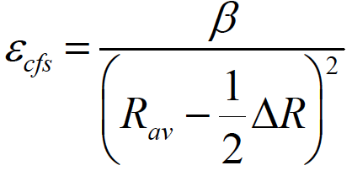
from oxides to (oxy)nitrides (or sulfides…)
Background
From oxides to (oxy)nitrides (or sulfides)
MM
isolated Eu²⁺
in solid “A”
(Likewise with Ce3+)
spectroscopic
polarizability
atomic
polarizability (Dorenbos)
4f⁶5d¹
ε_{c}(2+, A)
Crystal Field
Splitting
D(2+, A)
ε_{cfs}(2+)
Centroid Shift
“Nephelauxetic”
→ Covalency??
Dielectric const., ε
(Refractive index, n)
E_{FreeA}(Eu²⁺)
E_{abs}(Eu²⁺, A)
4f⁷ ground state
Eu²⁺/Ce³⁺ in “more covalent host”
exhibits longer λem ? ... Not always!
Notations based on Dorenbos
M.Mikami & B.Bertrand – ABINIT 2011 Workshop, Han-sur-Lesse - 4
Notes:
The centroid shift εc (2+, A), crystal field splitting εcfs(2+), redshift D(2+, A), and the lowest energy 4f-5d transition of Eu2+ Eabs(Eu2+, A) are indicated. Similar scheme holds true for Ce3+ ligand field.

Slide 5
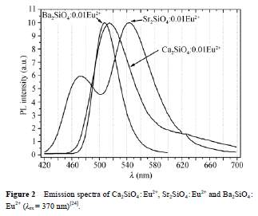
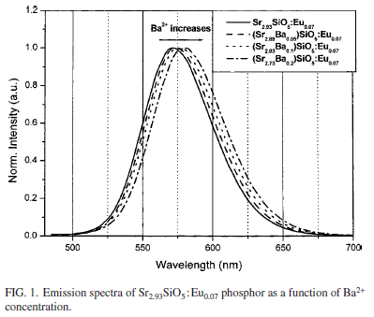
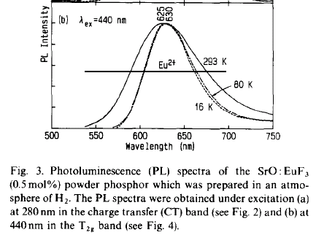
More polarizable (More “MO”), longer λ _{em}
from oxides to (oxy)nitrides (or sulfides…)
Background
More polarizable (More “MO”), longer λem
Background
MM
from MM & Kijima, Opt. Mater. (2010)
covalent
“2SrO+SiO₂”
“3SrO+SiO₂”
“SrO”
ionic
Sr₂SiO₄:Eu
Sr₃SiO₅:Eu
SrO:Eu
Sr₂SiO₄: 3.16, 3.28, 3.18
Sr₃SiO₅: 3.33, 3.33, 3.35
SrO: 3.76, 3.76, 3.76
XiXian, Chin. Sci. Bull.(2008)
Park, Appl.Phys.Lett.(2006)
Yamashita, J.Lumin (1994)
dielectric const.(ε_{xx} ε_{yy} ε_{zz} ) by ABINIT (Density functional Perturbation Theory)
M.Mikami & B.Bertrand – ABINIT 2011 Workshop, Han-sur-Lesse - 5
Notes:
calc: Sr2SiO4 : 3.13, 3.35, 3.21 or 3.16, 3.28, 3.18 v.s. Sr3SiO5: 3.32, 3.32, 3.35 v.s. SrO 3.758
The ionicity of binary oxides and silicates Yale Y. Guo*, C.K. Kuo, Patrick S. Nicholson,
R.R. Reddy et al., Correlation between optical electronegativity, molar refraction, ionicity and density of binary oxides, silicates and minerals

Slide 6
from oxides to (oxy)nitrides (or sulfides…)
Background
From oxides to (oxy)nitrides (or sulfides)
MM
isolated Eu²⁺
in solid “A”
spectroscopic
polarizability
4f⁶5d¹
ε_{c}(2+, A)
Crystal Field
Splitting
D(2+, A)
ε_{cfs}(2+)
Centroid Shift
“Nephelauxetic”
→ Covalency??
Dielectric const., ε
(Refractive index, n)
E_{FreeA}(Eu²⁺)
E_{abs}(Eu²⁺, A)
Coordinate bond length
to be examined !
4f⁷ ground state
Notations based on Dorenbos
M.Mikami & B.Bertrand – ABINIT 2011 Workshop, Han-sur-Lesse - 6
Notes:
The centroid shift εc (2+, A), crystal field splitting εcfs(2+), redshift D(2+, A), and the lowest energy 4f-5d transition of Eu2+ Eabs(Eu2+, A) are indicated. Similar scheme holds true for Ce3+ ligand field.

Slide 7
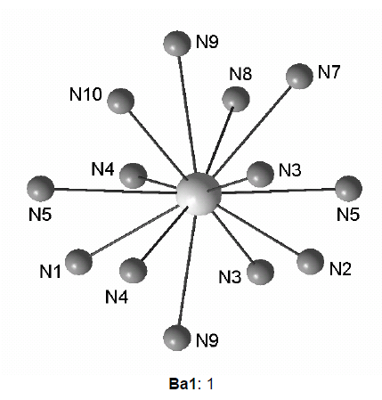
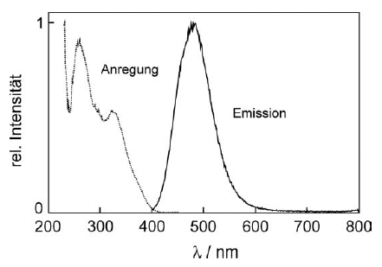

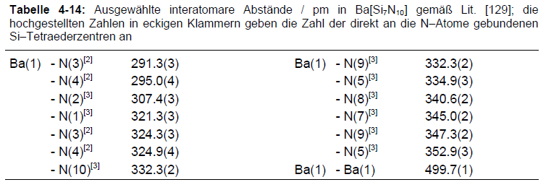

from oxides to (oxy)nitrides (or sulfides…)
Background
BaSi₇N₁₀:Eu (H.A. Höppe’s Thesis - 2003)
Background
MM
ref. Y.-Q. Li et al. (2009)
FWHM ∼ 79nm
Blue-green !
v.s.
c.f. AlN:Eu, Si → Eu site (CN = 12)
by Takeda et al.@NIMS, J. Mater. Chem. (2010) 20, 9948
M.Mikami & B.Bertrand – ABINIT 2011 Workshop, Han-sur-Lesse - 7

Slide 8
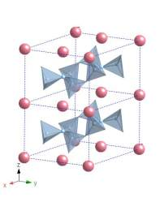
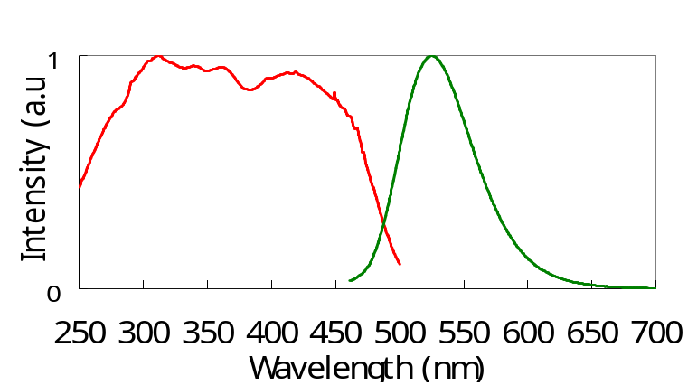
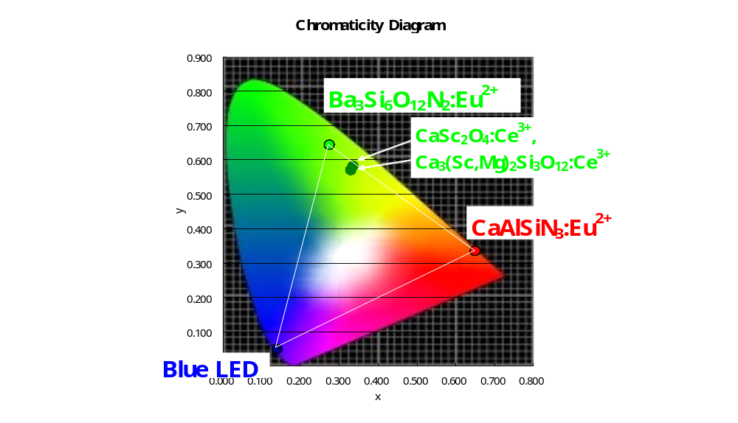
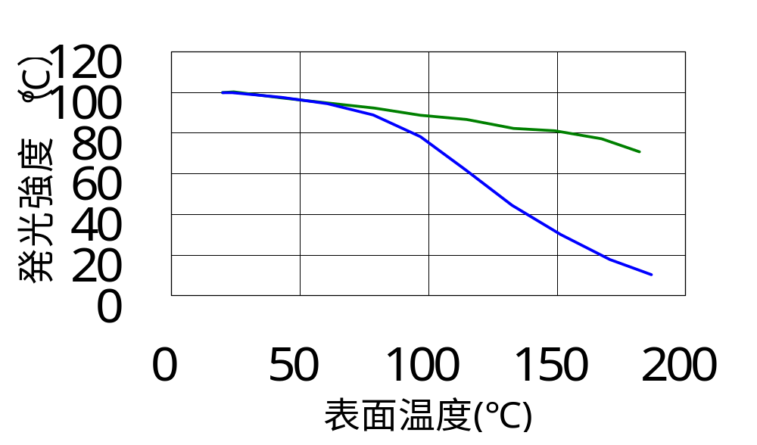
from oxides to (oxy)nitrides (or sulfides…)
Phosphor
Ba₃Si₆O₁₂N₂:Eu²⁺
New green phosphor Ba₃Si₆O₁₂N₂:Eu²⁺
Background
MM
New crystal phase
Green luminescence
excited by 400-460nm LED light
Si
Ba
N
excellent color reproduction
small thermal quenching
Ba₃Si₆O₁₂N₂:Eu²⁺
Emission intensity(20℃=100)
(Ba,Sr)₂SiO₄:Eu²⁺
Temperature
M.Mikami & B.Bertrand – ABINIT 2011 Workshop, Han-sur-Lesse - 8

Slide 9
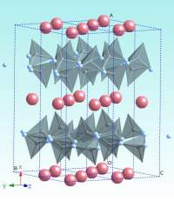
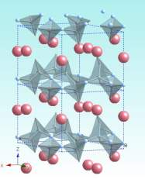
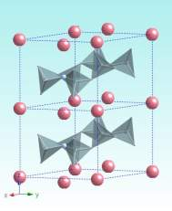
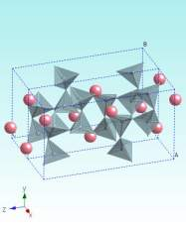
(Schnick, Hintzen) (Schnick) (Mitsubishi Chemical) (“Sanbornite”)
Phosphor
Ba₃Si₆O₁₂N₂:Eu²⁺
The missing piece
MM
BaSi₂O₂N₂ (Ba₃Si₆O₆N₆)
N-rich
larger refractive index n ?
(→ calculation)
Ba₃Si₆O₉N₄
Ba₃Si₆O₁₂N₂
BaSi₂O₅ (Ba₃Si₆O₁₅)
12 anions/(Ba₃+Si₆)
n=1.90-1.95
13 anions
n=1.81
Question:
N-rich
⇒ more polarizable
⇒ longer λ _{em} ?
14 anions
n=1.76
15 anions
n=1.65
M.Mikami & B.Bertrand – ABINIT 2011 Workshop, Han-sur-Lesse - 9

Slide 10
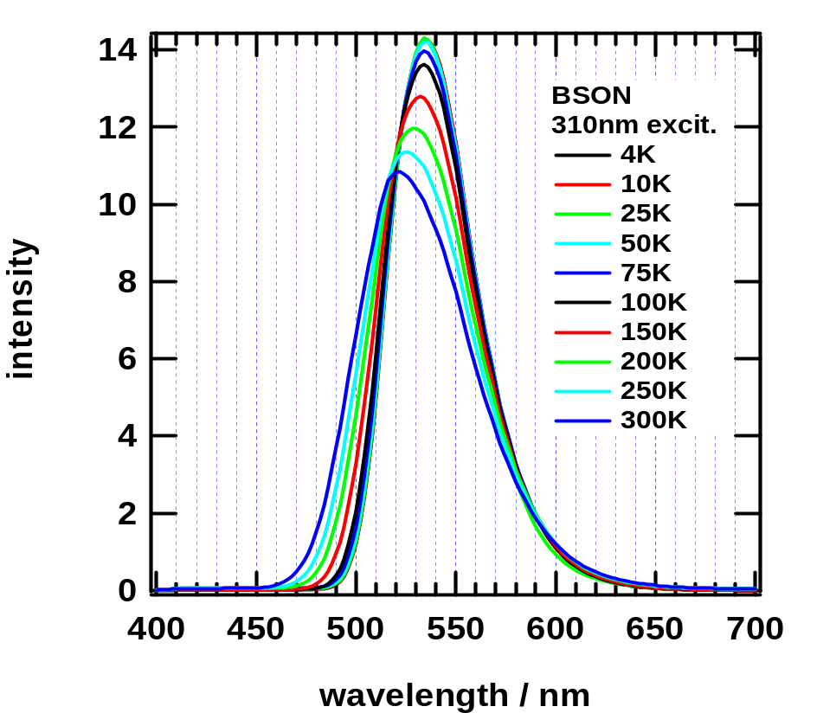
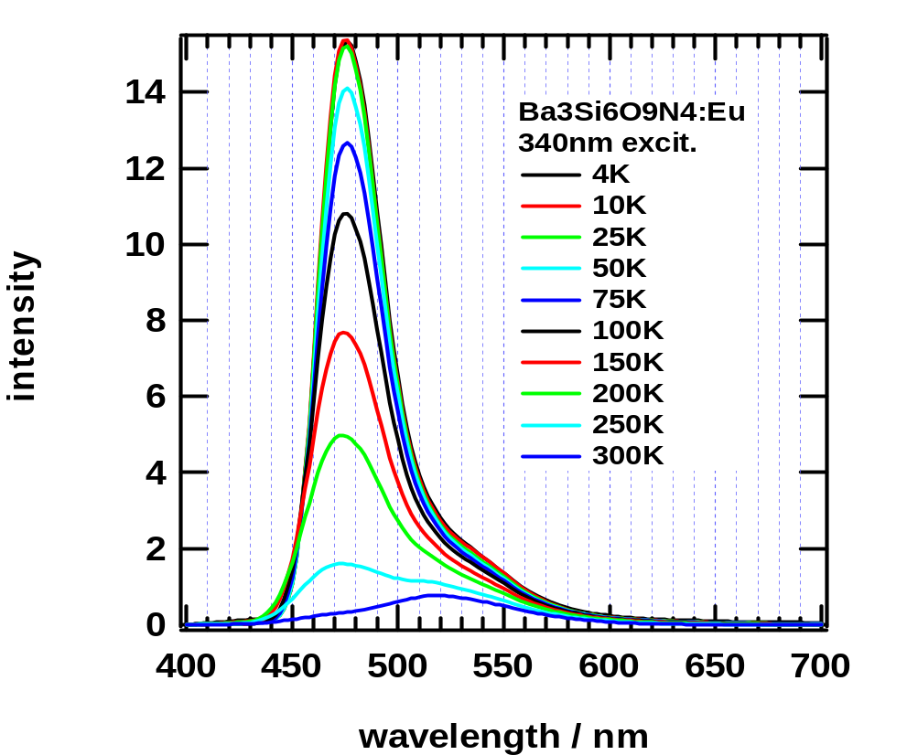
from oxides to (oxy)nitrides (or sulfides…)
Phosphor
Ba₃Si₆O₁₂N₂:Eu²⁺
Ba₃Si₆O₁₂N₂ / Ba₃Si₆O₉N₄ Eu f-d emission
MM
Ba₃Si₆O₁₂N₂:Eu
Ba₃Si₆O₉N₄:Eu
PL peak ∼ 530nm (Green)
strong luminescence@R.T.
PL peak ∼ 480nm (Blue-green)
quenching @ R.T.
Uheda et al. (2007), MM et al. (2009); see also, C. Braun et al.(2010)
M.Mikami & B.Bertrand – ABINIT 2011 Workshop, Han-sur-Lesse - 10

Slide 11
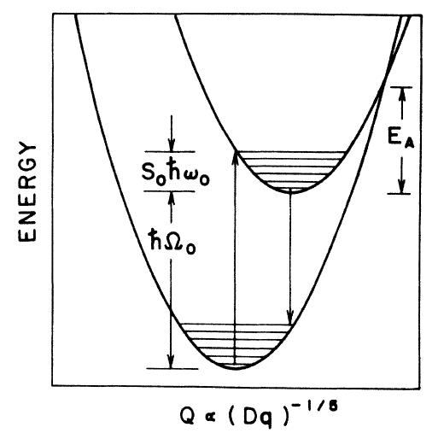
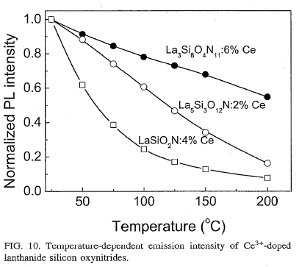
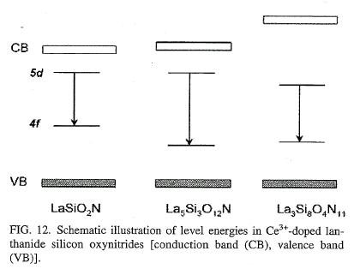
from oxides to (oxy)nitrides (or sulfides…)
Phosphor
Ba₃Si₆O₁₂N₂:Eu²⁺
Thermal quenching mechanism
MM
Difficult to explain thermal quenching with configurational coordinate diagram…
Natural to explain with auto-ionization mechanism
e ⁻ release
heat
heat
absorption
emission
B.Dierre et al. (2007)
configurational coordinate
auto-ionization
M.Mikami & B.Bertrand – ABINIT 2011 Workshop, Han-sur-Lesse - 11
Notes:
Xie alpha-SiAlON paper to be cited here ?

Slide 12
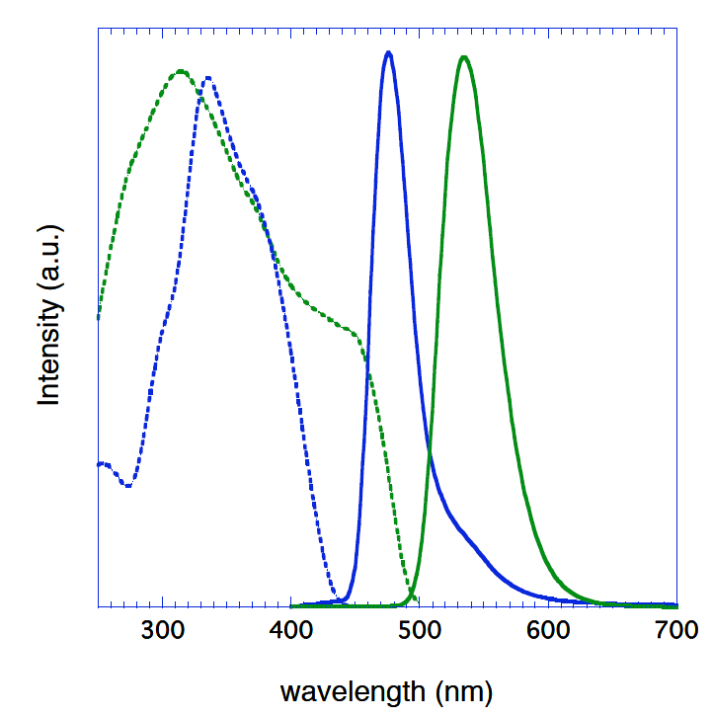

from oxides to (oxy)nitrides (or sulfides…)
Phosphor
Ba₃Si₆O₁₂N₂:Eu²⁺
PL/PLE of Ba₃Si₆O₁₂N₂ & Ba₃Si₆O₉N₄
MM
Stokes shift (cm⁻¹)
Ba₃Si₆O₁₂N₂:Eu 2790
Ba₃Si₆O₉N₄:Eu 3230
Difficult to explain
thermal quenching with
configurational coordinate diagram…
Natural to explain with
auto-ionization mechanism
M.Mikami & B.Bertrand – ABINIT 2011 Workshop, Han-sur-Lesse - 12
Notes:
“Entities should not be multiplied beyond necessity.“ "plurality should not be posited without necessity".
2788 & 3232
Occam's razor: "Given two equally predictive theories, choose the simplest."

Slide 13
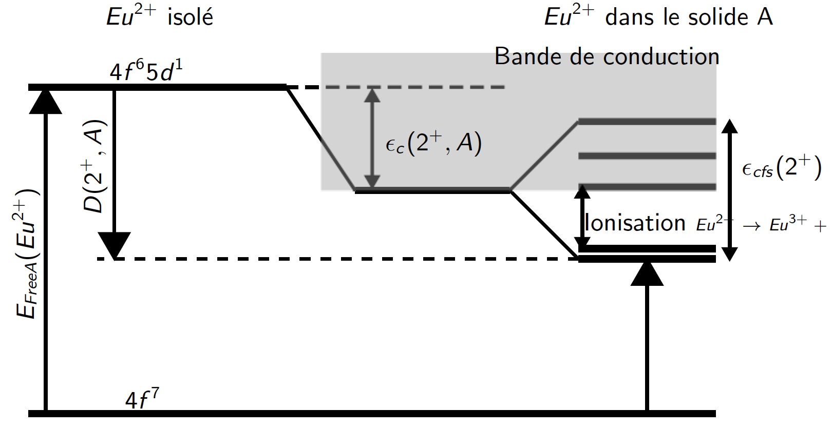
from oxides to (oxy)nitrides (or sulfides…)
Phosphor
Ba₃Si₆O₁₂N₂:Eu²⁺
An empirical model
BB
How to determine the luminescence mechanism from DFT ?
1) Model for photo-emission
Energy gap between the lowest 5d and 4f states of Europium impurities within the host gap
Isolated Eu²⁺
Eu²⁺ in the bulk
Bulk conduction band
5d
4f
Bulk valence band
M.Mikami & B.Bertrand – ABINIT 2011 Workshop, Han-sur-Lesse - 13

Slide 14

from oxides to (oxy)nitrides (or sulfides…)
Phosphor
Ba₃Si₆O₁₂N₂:Eu²⁺
An empirical model
BB
How to determine the luminescence mechanism from DFT ?
1) Model for photo-emission
Energy gap between the lowest 5d and 4f states of Europium impurities within the host gap
2) Model for thermal quenching
Auto-ionization of Eu²⁺ → Eu³⁺ + e⁻
Energy gap between 5d levels of Eu and the conduction band.
Isolated Eu²⁺
Eu²⁺ in the bulk
Bulk conduction band
5d
4f
Bulk valence band
P. Dorenbos J.Phys.Cond.Mat.17 (2005)
M.Mikami & B.Bertrand – ABINIT 2011 Workshop, Han-sur-Lesse - 13

Slide 15

from oxides to (oxy)nitrides (or sulfides…)
Phosphor
Ba₃Si₆O₁₂N₂:Eu²⁺
Using Abinit : general overview
Background
BB
Calculation for the host Ba₃Si₆O₁₂N₂
Crystalline structure of host material
Electronic structure
of host material
Bulk conduction band
Calculation for Ba₃Si₆O₁₂N₂ : Eu²⁺
Bulk valence band
PAW atomic data
for Europium
Position of the 4f and 5d orbitals of Europium
Position and concentration of Eu impurities
M.Mikami & B.Bertrand – ABINIT 2011 Workshop, Han-sur-Lesse - 14

Slide 16
from oxides to (oxy)nitrides (or sulfides…)
Host material
Crystal structure
Using abinit : DFT calculation
Background
BB
Calculation for the host Ba₃Si₆O₁₂N₂
Crystalline structure of host material
↓
Ground state structural relaxation
Bulk conduction band
Calculation for Ba₃Si₆O₁₂N₂ : Eu²⁺
Bulk valence band
M.Mikami & B.Bertrand – ABINIT 2011 Workshop, Han-sur-Lesse - 15

Slide 17
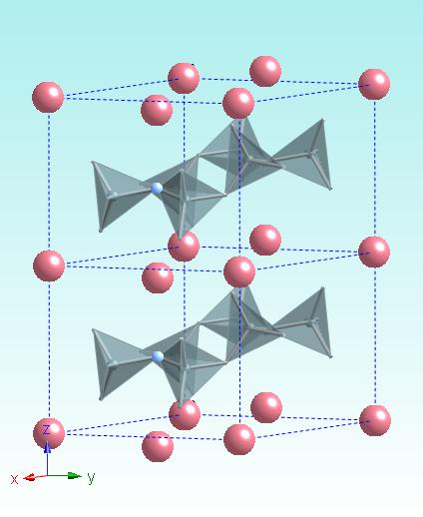

Host material
Crystal structure
New crystal structure for oxynitride
BB
Crystalline structure of Ba₃Si₆O₁₂N₂ by Abinit
Crystalline structure of Ba₃Si₆O₁₂N₂ by Abinit
Ba
Ba
Lattice parameters :
DFT (GGA) with PAW atomic data
 | Parameter a (Å) | Parameter c (Å)
Experimental | 7.5046(8) | 6.4703(5)
[1] Ba without semi-core states | 7.597 | 6.575
[2] Ba with semi-core states | 7.610 | 6.552
Si
O
N
[1] M. Mikami et al., Key Engineering Material Vol. 403 (2009).
[2] M. Mikami, N. Kijima, B. Bertrand, M. Stankovski and X. Gonze, In press
M.Mikami & B.Bertrand – ABINIT 2011 Workshop, Han-sur-Lesse - 16

Slide 18
Host material
Crystal structure
New crystal structure for oxynitride
BB
Crystalline structure of Ba₃Si₆O₁₂N₂ by Abinit
Crystalline structure of Ba₃Si₆O₁₂N₂ by Abinit
Ba
Ba
Lattice parameters :
DFT (GGA) with PAW atomic data
 | Parameter a (Å) | Parameter c (Å)
Experimental | 7.5046(8) | 6.4703(5)
[1] Ba without semi-core states | 7.597 | 6.575
[2] Ba with semi-core states | 7.610 | 6.552
Si
O
PAW atomic data for Barium
Results are coherent with experimental data whether semi-core states are used or not
N
[1] M. Mikami et al., Key Engineering Material Vol. 403 (2009).
[2] M. Mikami, N. Kijima, B. Bertrand, M. Stankovski and X. Gonze, In press
M.Mikami & B.Bertrand – ABINIT 2011 Workshop, Han-sur-Lesse - 16

Slide 19
from oxides to (oxy)nitrides (or sulfides…)
Host material
Electronic structure
Using abinit : GW + PAW calculation
Background
BB
Calculation for the host Ba₃Si₆O₁₂N₂
Crystalline structure of host material
Electronic structure
of host material
↓
G₀W₀ + PAW calculation
Bulk conduction band
Calculation for Ba₃Si₆O₁₂N₂ : Eu²⁺
Bulk valence band
M.Mikami & B.Bertrand – ABINIT 2011 Workshop, Han-sur-Lesse - 17

Slide 20
from oxides to (oxy)nitrides (or sulfides…)
Host material
Electronic structure
Using a GW calculation
Background
BB
Why is it mandatory to invoke a GW correction ?
Highly covalent oxynitride phosphors
Large effects of the screening on the optical properties
Density functional theory (DFT) fails seriously in the description of band gaps or photoemission.
The standard way to go beyond is to invoke many-body perturbation theory (MBPT).
 | DFT indirect gap (eV) | G₀W₀ indirect gap (eV) | Experimental gap (eV)
Ba₃Si₆O₁₂N₂ | 4.589 | 6.772 | 7.05 ± 0.25
M.Mikami & B.Bertrand – ABINIT 2011 Workshop, Han-sur-Lesse - 18

Slide 21
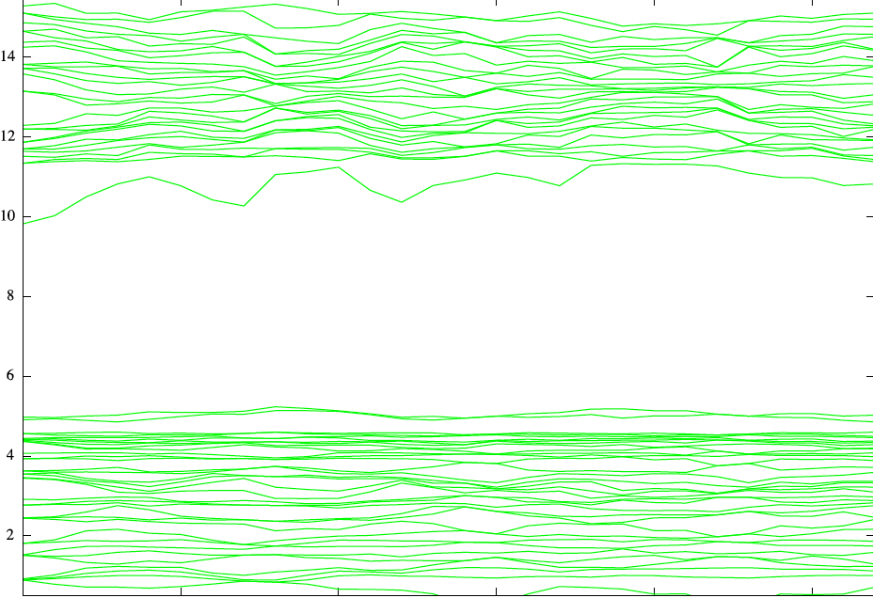
from oxides to (oxy)nitrides (or sulfides…)
Host material
Electronic structure
GW correction to DFT
BB
Band energy (eV)
DFT Gap :
4.589 eV
Zoom on the state around the band gap
Γ
M
A
K
L
H
M
M.Mikami & B.Bertrand – ABINIT 2011 Workshop, Han-sur-Lesse - 19

Slide 22
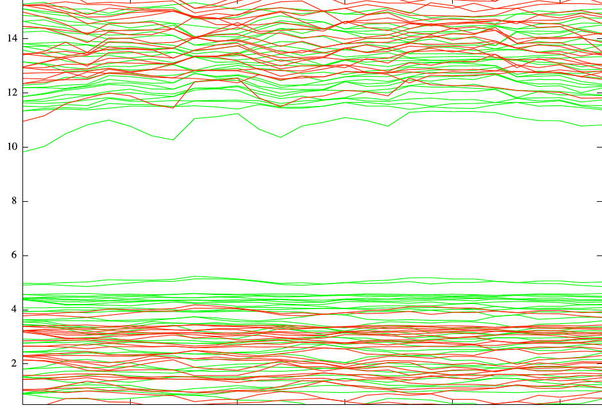
Host material
Electronic structure
GW correction to DFT
BB
Band energy (eV)
Γ
M
A
K
L
H
M
M.Mikami & B.Bertrand – ABINIT 2011 Workshop, Han-sur-Lesse - 19

Slide 23
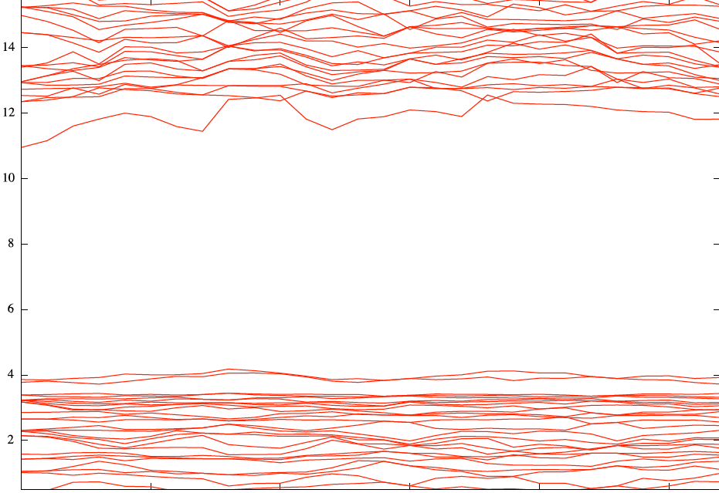
Host material
Electronic structure
GW correction to DFT
BB
Band energy (eV)
G₀W₀ Gap :
6.772 eV
Γ
M
A
K
L
H
M
M.Mikami & B.Bertrand – ABINIT 2011 Workshop, Han-sur-Lesse - 19

Slide 24
from oxides to (oxy)nitrides (or sulfides…)
Host material
Electronic structure
Ba₃Si₆O₁₂N₂ / Ba₃Si₆O₉N₄ Eu f-d emission
Background
BB
Ba₃Si₆O₁₂N₂:Eu
Ba₃Si₆O₉N₄:Eu
PL peak ∼ 530nm (Green)
strong luminescence@R.T.
PL peak ∼ 480nm (Blue-green)
quenching @ R.T.
Uheda et al. (2007), MM et al. (2009); see also, C. Braun et al.(2010)
M.Mikami & B.Bertrand – ABINIT 2011 Workshop, Han-sur-Lesse - 20

Slide 25
from oxides to (oxy)nitrides (or sulfides…)
Host material
Electronic structure
Comparison of energy gaps
BB
Comparison of materials with similar composition but different thermal quenching
1) Ba₃Si₆O₁₂N₂ + Eu²⁺ : Strong luminescence at room temperature
2) Ba₃Si₆O₉N₄ + Eu²⁺ : Little luminescence at room temperature
Our results are in agreement with the auto-ionization model to explain the better thermal properties of Ba₃Si₆O₁₂N₂
 | GW indirect gap (eV) | GW direct gap at Γ (eV) | Experimental gap (eV)
1) Ba₃Si₆O₁₂N₂ | 6.772 | 7.092 | 7.05 ± 0.25
2) Ba₃Si₆O₉N₄ | 6.443 | 6.698
Nband (SCR) : 423
Nband (SIG) : 450
Gwencomp (SCR) : 2.5
Gwencomp (SIG) : 2.0
Ecuteps : 7 Ha
Ecutsigx : 20 Ha
Ba₃Si₆O₁₂N₂ : Grid of 30 k-points with a (controlled) numerical error of 0.06 eV.
Ba₃Si₆O₉N₄ : Grid of 14 k-points with a (controlled) numerical error of 0.06 eV.
M.Mikami & B.Bertrand – ABINIT 2011 Workshop, Han-sur-Lesse - 21

Slide 26
Host material
Electronic structure
Comparison of energy gap
BB
Bulk conduction band
Bulk conduction band
5d
5d
6.772 eV
6.443 eV
4f
4f
Bulk valence band
Bulk valence band
Ba₃Si₆O₁₂N₂
Ba₃Si₆O₉N₄
M.Mikami & B.Bertrand – ABINIT 2011 Workshop, Han-sur-Lesse - 22

Slide 27
from oxides to (oxy)nitrides (or sulfides…)
PAW
Atomic data
Using abinit : PAW atomic data
Background
BB
Calculation for the host Ba₃Si₆O₁₂N₂
Crystalline structure of host material
Electronic structure
of host material
Bulk conduction band
Calculation for Ba₃Si₆O₁₂N₂ : Eu²⁺
Bulk valence band
PAW atomic data
for Europium
↓
Semi-core states
M.Mikami & B.Bertrand – ABINIT 2011 Workshop, Han-sur-Lesse - 23

Slide 28


from oxides to (oxy)nitrides (or sulfides…)
PAW
Atomic data
PAW
Atomic data
Construction of PAW atomic data
Background
Background
BB
Semi-core states are required in order to make sensible the G₀W₀ correction.
Ba₃Si₆O₁₂N₂ | G₀W₀ indirect gap (eV) | G₀W₀ direct gap (eV)
4d semi-core | 6.772 Γ - A | 7.092 Γ
Without semi-core state | 3.740 L - A | 3.807 L
Experimental | 7.05
Barium
Semi-core : 4d¹⁰ 5s²
Valence : 5p⁶ 6p²
Europium
Semi-core : 4d¹⁰ 5s²
Valence : 5p⁶ 4f⁷ 6p²
Test of the G₀W₀ correction to EuO : - Introduction of semi-core 4d¹⁰ states - Problems with the correction of 4f states
M.Mikami & B.Bertrand – ABINIT 2011 Workshop, Han-sur-Lesse - 24
Notes:
Similar conclusions also apply to simple compounds like BaO

Slide 29
from oxides to (oxy)nitrides (or sulfides…)
Phosphors
Eu impurities
Using abinit
Background
BB
Calculation for the host Ba₃Si₆O₁₂N₂
Crystalline structure of host material
Electronic structure
of host material
Bulk conduction band
Calculation for Ba₃Si₆O₁₂N₂ : Eu²⁺
Bulk valence band
Position and concentration of Eu impurities
↓
Spin polarized GGA(+U)
PAW atomic data
for Europium
M.Mikami & B.Bertrand – ABINIT 2011 Workshop, Han-sur-Lesse - 25

Slide 30
from oxides to (oxy)nitrides (or sulfides…)
Phosphors
Eu impurities
Adding Europium impurities
Background
Background
Background
BB
Eu impurities act as luminescence centers
Ba-(O,N) or Eu-(O,N)
Ba-(O) or Eu-(O)
Ba
or doping Eu
Onxynitride layer :
SiO₃N tetrahedra
Si
O
N
M.Mikami & B.Bertrand – ABINIT 2011 Workshop, Han-sur-Lesse - 26

Slide 31
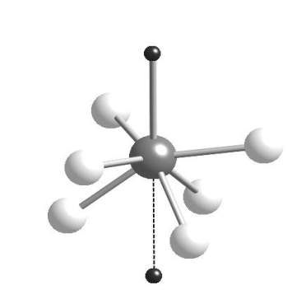
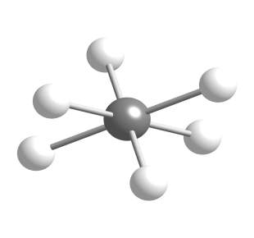
from oxides to (oxy)nitrides (or sulfides…)
Phosphors
Eu impurities
Non equivalent positions
Background
Background
Background
BB
Europium substitutes to Barium atoms in two possible non equivalent positions
N
O
O
O
O
O
O
Eu
Eu
O
O
O
O
O
O
N
M.Mikami & B.Bertrand – ABINIT 2011 Workshop, Han-sur-Lesse - 27

Slide 32
from oxides to (oxy)nitrides (or sulfides…)
Background
Using abinit : Perspectives
Perspectives
BB
Calculation for the host Ba₃Si₆O₁₂N₂
Crystalline structure of host material
Electronic structure
of host material
Bulk conduction band
Calculation for Ba₃Si₆O₁₂N₂ : Eu²⁺
Bulk valence band
Perspective :
Position of the 4f and 5d states of Europium
PAW atomic data
for Europium
Position and concentration of Eu impurities
M.Mikami & B.Bertrand – ABINIT 2011 Workshop, Han-sur-Lesse - 28

Slide 33
from oxides to (oxy)nitrides (or sulfides…)
Perspectives
The difference of EU PL : a model
MM
Ba₃Si₆O₁₂N₂:Eu
Ba₃Si₆O₉N₄:Eu
conduction bands
Eu-O₆
cluster
Eu²⁺→Eu³⁺+ e⁻ (auto-ionization)
Eu-O₆
cluster
Eu-N
ligand
Eu-N
ligand
Eu 5d
Eu 5d
6.772 eV (GW)
6.443eV (GW)
Blue-Green PL
peak ∼ 480nm
Green PL
peak ∼ 530nm
Eu 4f
Eu 4f
valence bands
proposed by MM et al.(2009): based on Dorenbos scheme (J.Phys.Cond.Mat.17, 2005)
M.Mikami & B.Bertrand – ABINIT 2011 Workshop, Han-sur-Lesse - 29
Notes:
Dorenbos, J. Phys. Condens. Matter 17, 8103 (2005)

Slide 34
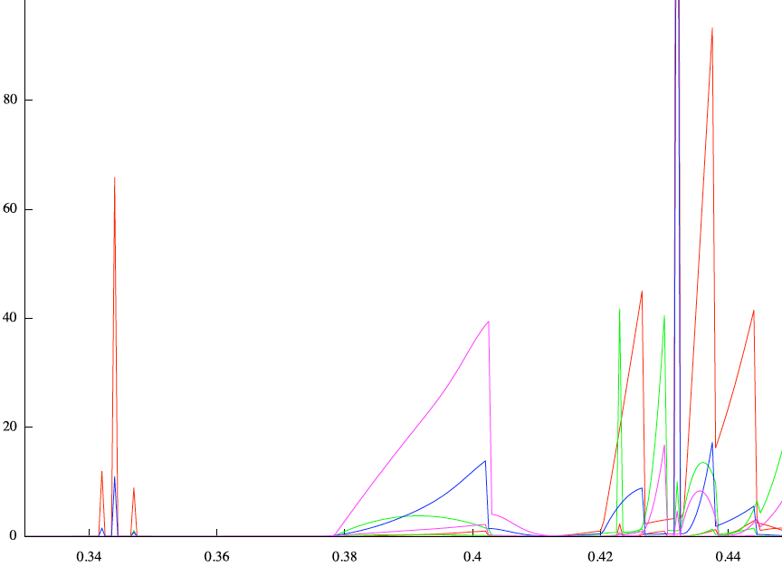
from oxides to (oxy)nitrides (or sulfides…)
Perspectives
Towards a validation of the model
BB
Ba₃Si₆O₁₂N₂:Eu
N
Partial density of states
Eu d channel
Eu s channel
Ba d channel
Ba s channel
conduction bands
Eu
O
Eu-O₆
cluster
Eu-N
ligand
Eu 5d
Eu 4f
valence bands
Energy (Ha)
Zoom on the bottom of the conduction band - Preliminary results
M.Mikami & B.Bertrand – ABINIT 2011 Workshop, Han-sur-Lesse - 30
Notes:
Dorenbos, J. Phys. Condens. Matter 17, 8103 (2005)

Slide 35

Conclusion
New crystal structure for oxynitride
BB
Scientific interest
Luminescence properties of rare-earth doping oxynitrides phosphors
    Emission and absorption spectra
    Thermal quenching
Numerical Challenge
Electronic structure of Ba₃Si₆O₁₂N₂ phosphor
  Current : G₀W₀ with PAW atomic data including semi-core and 4f states
  Future : Electron-phonon interaction
Industry ► Reducing the cost of R&D
  Discovery of new compounds
  Prediction of properties before synthesis
M.Mikami & B.Bertrand – ABINIT 2011 Workshop, Han-sur-Lesse - 31

Slide 36
Acknowledgments
(MCRC) for development/analysis of our phosphors, encouragement from theoretical Gr.
Kyota Uheda, Satoshi Shimooka, Yasuo Shimomura, Tomoyuki Kurushima,
Takatoshi Seto, Hiromu Watanabe, Toshio Akai, Masaki Takashima,
Yutaka Sasaki, Motoyuki Shigeiwa, Kaoru Okamoto, Hiroyuki Imura,
Katsuya Kanda, Shinichiro Nakamura
(ETSF/Universite Catholique de Louvain) for PAW-GW calc. & build system of ABINIT
Matteo Giantomassi, Alain Jacques, Gian-Marco Rignanese, Yann Pouillon
BB, MS, XG: financial support from the European Union, 7th Framework Programme (Grant Agreement 211956 ETSF I3 e-Infrastructure project), the Agentschap voor Innovatie door Wetenschap en Technologie (IWT project N°080023 ISIMADE), as well as the Walloon region Belgium (RW project N°816849, WALL-ETSF)

Slide 37

A photo from Sendai (Tohoku University)
“Prof. Kotaro Honda in Director office is keeping up
even after breakdown of the table by Tohoku-Pacific
Ocean Earthquake on March 11 2011”
Notes:
http://www.imr.tohoku.ac.jp/jpn/about/fukkyu/fukkyu_index.html

