Slide 1
Discussion on ABINIT: builds + tests + web
Abinit workshop Han-sur-Lesse
April 2011

Slide 2
Plan
Discuss some maintenance aspects:
build system (extra slides from Yann)
test farm
testing
web site
Please intervene and comment!

Slide 3
Build system
Strong evolution since last workshop
automation/recognition seems improved
linalg, plugins more clearly defined
Issues / problems:
documentation, vocabulary: trio? flavor?
need internet (tgz and bzr)
2 (different!) bottom lines: developers and users, who are even more important

Slide 4
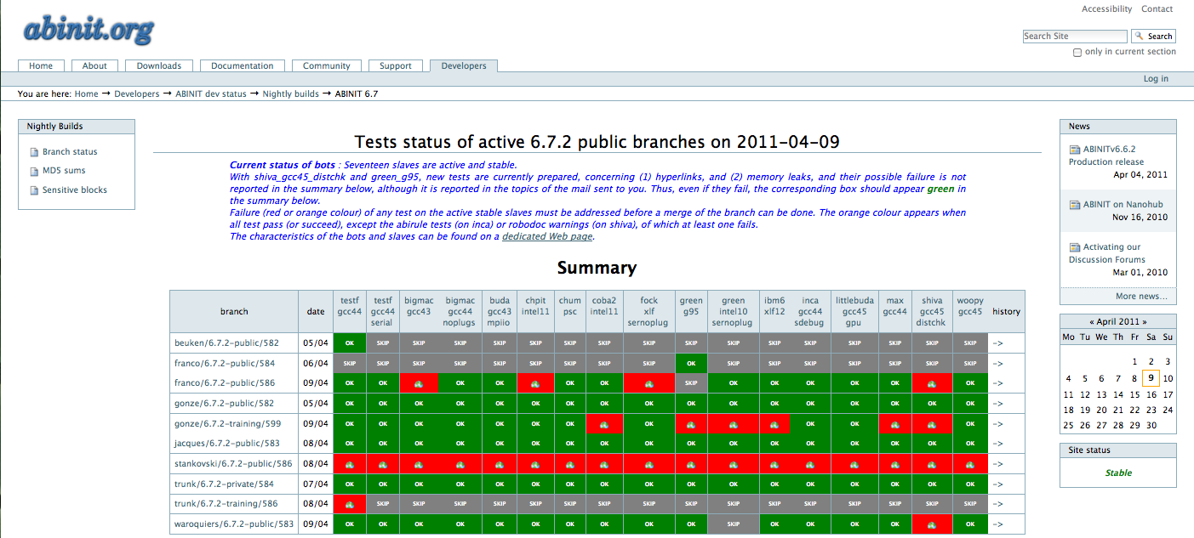
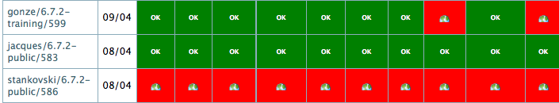
Test farm
State of the farm
http://www.abinit.org/developers/abinit-dev-status/nightly-builds/abinit-6.7/build-status-6.7.html
Screen shot:

Slide 5
Test farm
New bots? Debug (g95)? Platform (eg more IBM)?
Need for different testing schemes
  specific bots
  quick test
Does everyone know how to log into bb slaves?
Sufficient for merging needs (Xavier?)

Slide 6
Testing
Functionality of present situation?
Is simple fldiff precise enough?
How to improve portability? Tips for optimal tests
Test suite revamp is planned (Yann?)
  several runs in 1 « conceptual » test
  python backbone

Slide 7
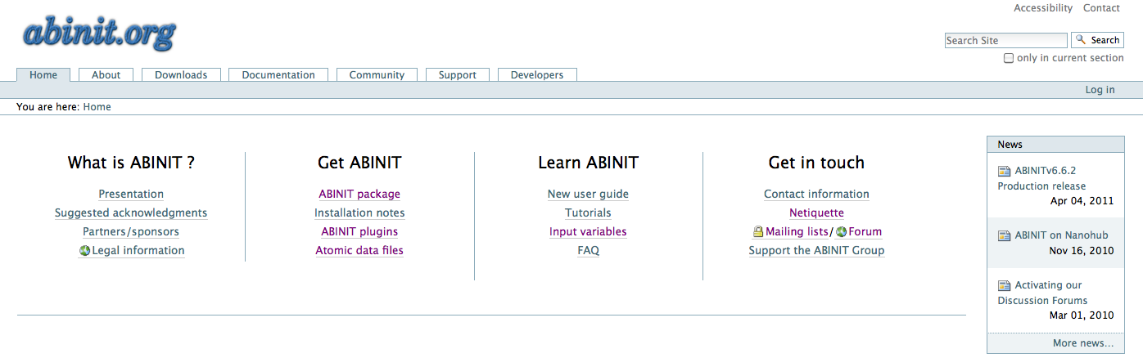
Web site
http://www.abinit.org
State of web site? Some sub-pages cluttered

Slide 8
Web site
Proposals for simplification/ enhanced functionality?
  separate archives from current version
  single periodic table (or 1 NC + 1PAW)
Is the site used as much as it could be?
Distinguish psp from core/AE density files
Can we get file instead of xml from Plone?
Links to internet psp databases

Slide 9
Web site
Missing / broken links
revamp front page:
  direct download
  simplified menu
  is the CMS optimal? Other suggestions?
Add db with articles + input files

Slide 10
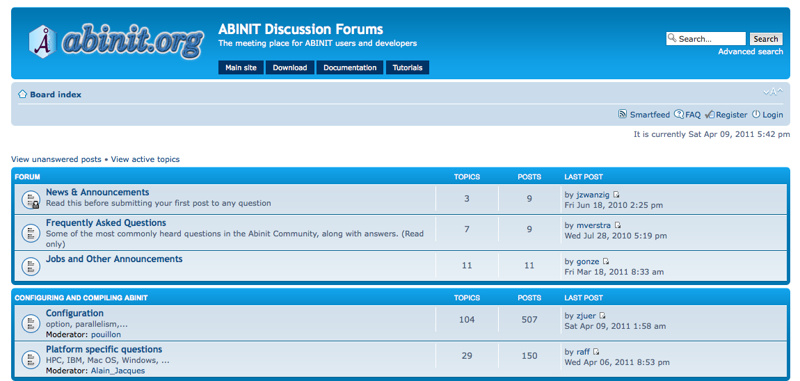
Forum
http://forum.abinit.org

Slide 11
Forum
Forum seems efficient and useful
need to regiment topics better?
new topics?
open announcements list?
is present tool sufficient for our needs?
Encourage identification of users

