Slide 1
Self-Documentation of ABINIT source
(How to avoid duplicated efforts for documentation ?)
WORKSHOP ABINIT_02 (Louvain-la-Neuve, November, 6-8, 2002 )
Masayoshi Mikami (Mitsubishi Chemical Co.)
and the following developers (in alphabet order)
(CEA)
François Jollet, Marc Torrent, Gilles Zerah
(UCL)
Razvan Caracas, François Detraux,
Martin Fuchs (FHI-MPG), Xavier Gonze,
Luc Sindic, Matthieu Verstraete
(ULG)
Philippe Ghosez, Jean-Yves Raty (and their students)

Slide 2
Contents of this talk
Background ( “Self-assembled(organized) way” )
Robodoc & Src2tex
Example (source code –> HTML & DVI(PS))
Future plan (Open discussion)
Summary

Slide 3
Background
In the long run :
a unique manual for the developers/contributors
* nicely formatted (equations)
* explaining all the formalism
* explaining the data structures
* making references to the proper subroutines
For each subroutine:
* having locally the information on what it does
* having a list of related routines (parents, children)
and having also hyperlinks to these routines
* being able to view the routine in a nicely formatted way
As little duplication of the same information as possible
in order to ease maintenance and coherence
Manual
here!
Notes:
Section 0. What we want.
0.a In the long term
- a unique manual for the developpers
* nicely formatted (equations!) * explaining all the formalism
* explaining the data structures * making references to the proper subroutines
- for each subroutine,
* having locally the information on what it does (keeping local all the informations already present in the routine)
* having a list of related routines (parents, children), and having also hyperlinks to these routines
* being able to view the routine in a nicely formatted way
- as little duplication of the same information as possible, in order to ease maintenance and coherence.

Slide 4
Making documents by self-assembled (self-organized) way
Source codes as “documents”
“parents” routines
hyperlink
Subroutine “A”
References for the “A”
Description
Offline Documents (on HD)
(LaTeX, HTML, PDF, …)
Online Documents (WWW)
hyperlink
Formalism
Equations
Data Structure
hyperlink
“children” routines
Notes:
Imagine using Unix, hyperlinks can be regarded as “ln –s”. The modifications can be automatically reflected !

Slide 5
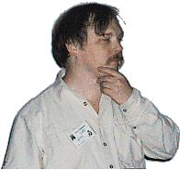
Organization of the Self-Documentation
On Not Reinventing the Wheel,
“Laziness is an economic virtue”
(by Eric S. Raymond, “The Art of Unix Programming”)
as little human work as possible
as few and simple rules as possible
changes should be gradual to avoid useless efforts
proper tools to automate boring tasks
(maintenance and coherence of information)
=> Robodoc & src2tex way
Notes:
Reluctance to do unnecessary work is a great virtue in programmers.
0.b Organisation of the work
- as little human work as possible !
- changes should be gradual, letting us the time to digest each step, so as to think carefully on the next step, not making useless efforts
- definitely, there will be high-level human work, but we want to have first proper tools to automate boring tasks, especially in view of the maintenance and coherence of information.

Slide 6
Src2tex for LaTeX formatting (printout)
Robodoc for HTML formatting (browsing)
Robodoc v. 3.2.3 (v.3.2.4 to be released soon on WEB) (http://www.xs4all.nl/~rfsber/Robo/robodoc.html)
http://www.eng.gunma-u.ac.jp/~amano version 2.13j (obsolete…)
modifications done by MM, to routines text2tex.c & modflag.c
to accept the Robodoc style.
Notes:
1.a Sources
For Robodoc, see :
http://www.xs4all.nl/~rfsber/Robo/robodoc.html and http://www.xs4all.nl/~rfsber/Robo/manual.html
For src2latex, see :
http://www.eng.gunma-u.ac.jp/~amano version 2.13j modifications have been done by MM, to routines text2tex.c and modflag.c
(for this reason, we might have to distribute a modified version, from the SourceForge Web site - no use of SSH to dump something from SourceForge).
1.b Possibilities of the softwares
Robodoc will produce automatically HTML files from the set of source files for each subroutine, with hyperlinks to access other subroutine HTML files. It works accross directories.
Needs reformatting of the header of each routine, to be done by hand.
However, the work is mostly copy/paste and adding keywords (see below).
What is not done by Robodoc: the list of parent subroutine. However, Luc Sindic can work on a Perl routine that insert
automatically (just before Robodoc processing), the list of parent routines. Also, nothing fancy for the treatment of equations.
Other automation might be also possible, e.g. the line
!{¥src2tex{texfont=tt}} | font setting for "src2tex"
could be also added automatically during such process...
Src2latex will produce automatically tex files from source files for each subroutine, with nicely formatted equations. Can be used simultaneously with robodoc. Needs formatting the equations in each subroutine file.
Then, a tex file might be processed to give a ps file, and printed, or viewed using ghostview. Examples of the specific procedure would be explained somewhere. e.g. "dvi2ps -> psnup -2 (for "two pages in one sheet")"
At this level, one does EITHER get a HTML file with hyperlink, OR a latex file with nicely formatted equations.

Slide 7
“Template” for ABINIT source codes
!{\src2tex{texfont=tt}} | font setting for "src2tex"
!!****f* ABINIT/(subroutine name) | Robodoc region starts
(package/name)
!! |N.B. other "!!****..." are also available
!! NAME | SUBROUTINE(or FUNCTION) NAME declaration
!! (subroutine name) | (the name of the subroutine here)
!! |
!! FUNCTION | FUNCTION declaration
!! ... | (explanation of the routine here)
!! |
!! COPYRIGHT | COPYRIGHT declaration
!! Copyright (C) ABINIT group (...) | (Authors and Date here)
!! |
!! INPUTS | INPUT variables declaration
!! aa= ... | (explanations for input variables)
!! bb= ... |
!! |
!! OUTPUT | OUTPUTS variables declaration
!! xx= ... | (explanations for output variables)
!! yy= ... |
!! |
!! SIDE EFFECTS | SIDE EFFECTS declaration
!! Input/output | if any variables may be changed
!! ll= ... | when exiting, explanation here
!! |

Slide 8
“Template” for ABINIT source codes (continued)
!! NOTES | NOTES declaration
!! (warning, etc.) | If any annotations (e.g. warning)
!! | should be noticed, explanation here
!! |
!! TODO | TODO declaration
!! ... | What to implement next & ideas (if any)
!! |
!! SEE ALSO | References
!! ... | References to other functions, man
!! | pages, other documentations (if any)
!! |
!! PARENTS | PARENTS declaration
!! ... | Which modules use this one.
!! |
!! CHILDREN | CHILDREN declaration
!! ... | What modules are used by this one
!! |
!! BUGS | BUGS declaration
!! ... | Known bugs. (if any)
!! |
!! SOURCE | Source region (if it should be included.
| If not, ends with "!!***" here.

Slide 9
“Template” for ABINIT source codes (continued)
subroutine ...
implicit none
!Arguments ---------------------------------------------
....
!Local variables ---------------------------------------
...
!******************************************************************************
... (source code here)
...
...
end subroutine
!!*** | end of robodoc

Slide 10
Process for Self-documentation
The Perl script “parents” builds the list of “parents/children” routines.
To make the sources (HTML format), at ~ABINIT directory, type
1) “make parents”
parents -s
2) “ make robodoc”
./makemake.ROBODOC ( to complete “Makefile.ROBODOC”)
make -f Makefile.ROBODOC xhtml (“xref” files)
make -f Makefile.ROBODOC html (html files)
(The scripts were devised by L. Sindic. Merci !)
Notes:
A. Work to use robodoc and src2tex efficiently
- reformatting each subroutine (mostly the header)
- reformatting each equation already present in each subroutine using latex
- writing a script for generating automatically the list of parent routines
- making the modified src2tex available
- modifying the ABINIT Makefile and associated scripts to be able to
"make robodoc" or to "make src2tex", that would call automatically
Robodoc or src2tex to generate HTML or tex files for all subroutines,
to be placed in new subdirectories.
update Infos/rules_coding
B. Work that is left for the future.
The generation of a unique manual is not (yet) in the scope of this
solution. Data structures are also not in its scope.
However :
- equations inside each routine will be formatted in latex
style, and this might be used automatically in the future, for the
generation of a manual.
- keywords that are used for Robodoc might be the basis of links
to external files (to be written) that explain the data structures.
- the already existing abinis_help.htm contains
some datastructure sections, only related to disk files
(sections 6.4 to 6.7). It might be worth to pay attention to this
interaction between documentation and source file. The present
writing of these sections in abinis_help.htm should be modified,
of course ...
Some thought is to be given to this next step !!
A preference should be given to try to
re-use Robodoc and src2tex in setting up new documentation blocks.
In any case these documentation blocks are not yet existing !
A SEE ALSO file could be used as hyperlink,
and contain a description of the code with equations.
This file could be part of a larger tex document.
There is also the problem of generating nicely formatted equations in HTML.
One might generate automatically GIF picture, but there is a GIF patent problem...
(The Unisys has the patent of their "data compressing method" (LZW).
For further detail, please take a look of the following URL:
http://burnallgifs.org/
http://www.unisys.com/unisys/lzw/lzw-license.asp One might use a "gif to png" converter (reference to be found).
Additional notes :
- the tool pstogif exists on Linux boxes

Slide 11
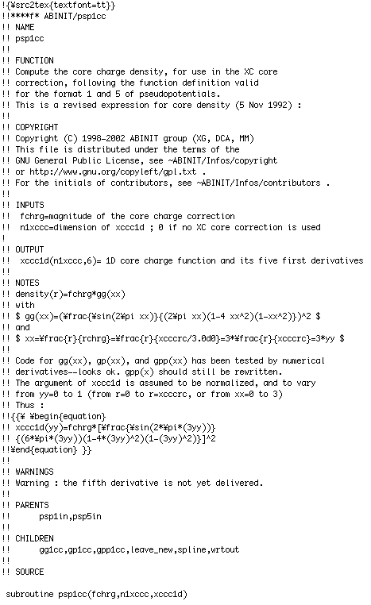
Example file (psp1cc.f)

Slide 12
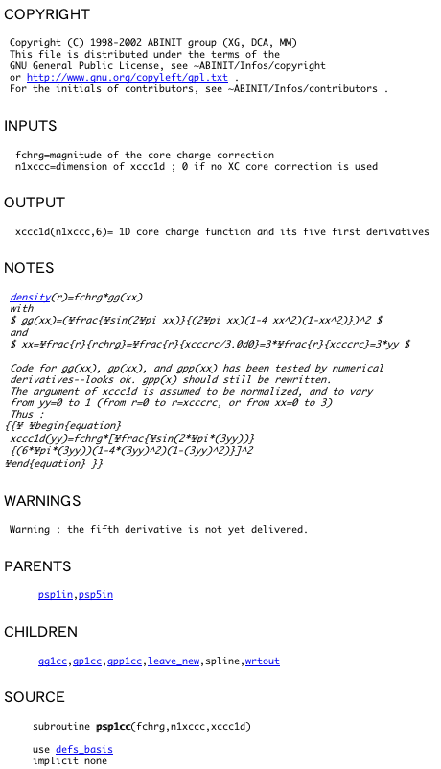
Converted HTML file
Notes:
Src2tex example here, pseudopotential code ?

Slide 13
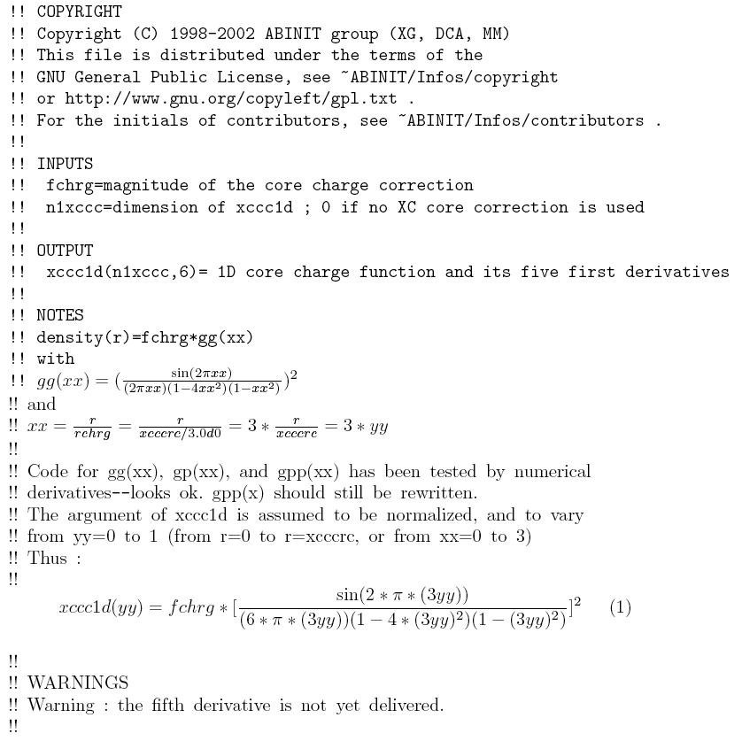
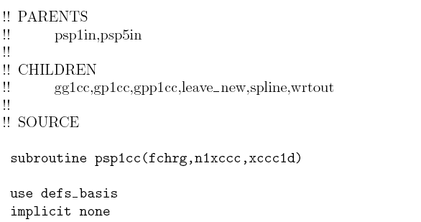
Converted LaTeX (dvi) file
Notes:
Src2tex example here, pseudopotential code ?

Slide 14
Future Plan (Open Discussion)
1) Linking to references on WWW (HTML)
Robodoc latest version (v. 3.2.4) enables us to do :
http://someaddress.somewhere
file:/fullpath/to/file
href:localpathtofile (relative paths allowed)
2) Linking to available document files (e.g. LaTeX)
a) LaTeX –> PDF (by dvipdfm)
“hyperref.sty” work for hyperlinks (URL, links inside PDF)
good display/printout for Math equations
Most browsers can treat PDF (using “plug-in”)
b) LaTeX –> HTML
TtH: No images for Eqn (using MathML) => fast !
but Symbol Fonts (for Eqn) depend on Browsers.
H^{E}VEA : No images for Eqn, -nosymb option (–> low quality)
(NB: LaTeX2HTML, TeX4ht : many images are needed)
Notes:
Section 2. Keeping the future open
The search for tools should continue.
Concerning the equations, there is a tool to view more or
less directly tex file under netscape. It is distributed by IBM.
See their site. Also, another viewer could be used.
Likely, the ROBODOC modifications to the source files
are sufficiently "general" that they will be of interest
to any other solution (the present splitting of the
header content is actually already close to the
needed splitting for ROBODOC).
The formatting of equations in latex, needed
for src2tex will not be of interest to tools that are not based
on Latex. However, tools for conversion to HTML begin
to appear. Except latex and HTML, are there other
"nice" equation formatting language under UNIX ?
The answer is likely negative.

Slide 15
From LaTeX to PDF
dvipdfm
foo.tex
(emacs)
platex
foo.dvi
(xdvi)
dvips
foo.ps
(gv)
ps2pdf
foo.pdf
(acroread)
pdftex
Notes:
ps-> psnup …

Slide 16
Example of “LaTeX to PDF” (hyperref.sty)
\documentclass{article}
\usepackage[colorlinks]{hyperref}
\begin{document}
\section{}
…
\hypertarget{tag}{displayed strings} % “label”
\hyperlink{tag}{displayed strings} % “cite”
\href{URL}{displayed strings} % URL
…
\end{document}
For further details, see, for example,
http://www.tug.org/applications/hyperref/manual.html
Notes:
URL should be given full (otherwise, basename should be defined …)

Slide 17
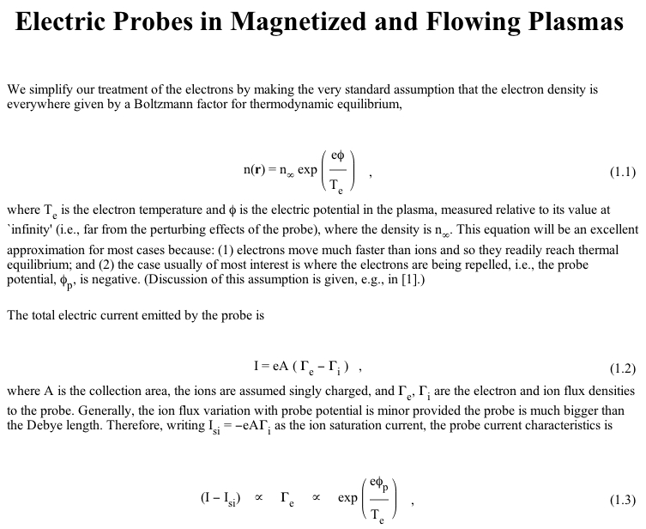
Example of TtH (browsed with IE, not Mozilla!)
(taken from TtH page (http://hutchinson.belmont.ma.us/tth/))
Notes:
Note that no figure files (gif, etc.) for visualizing.

Slide 18
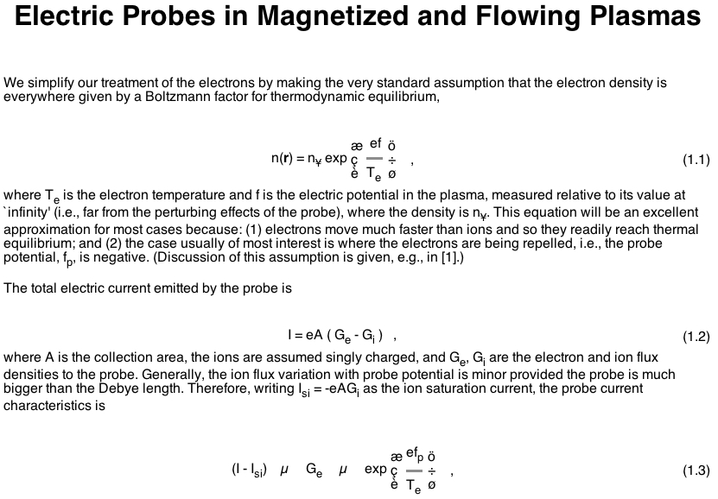
Example of TtH (browsed with Mozilla (Netscape 7.0))
HTML for Mozilla should be different from that for IE !
(TtH can manage it, so two types of HTML would be necessary for IE and Mozilla)
Notes:
See also http://hutchinson.belmont.ma.us/tth/Xfonts.html
http://hutchinson.belmont.ma.us/tth/webmath.html

Slide 19
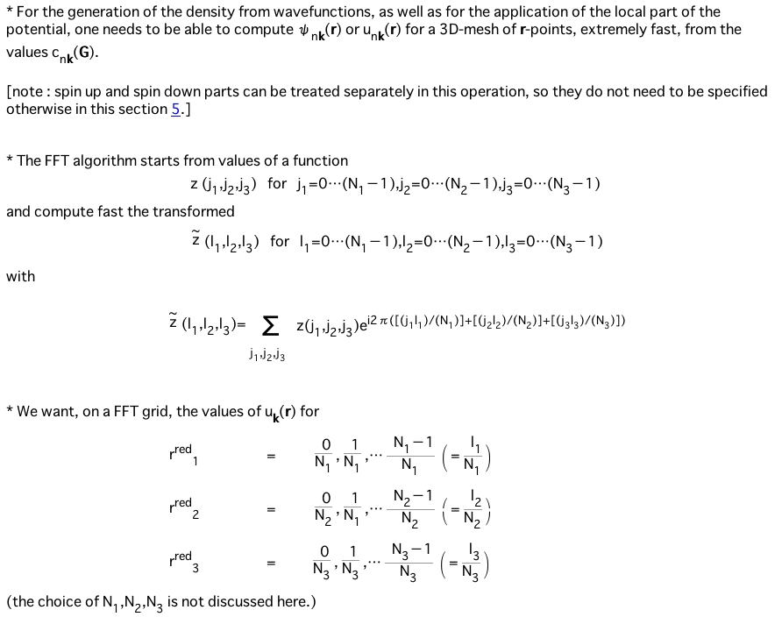
Example of TtH (Infos/Theory/1WF.tex)

Slide 20
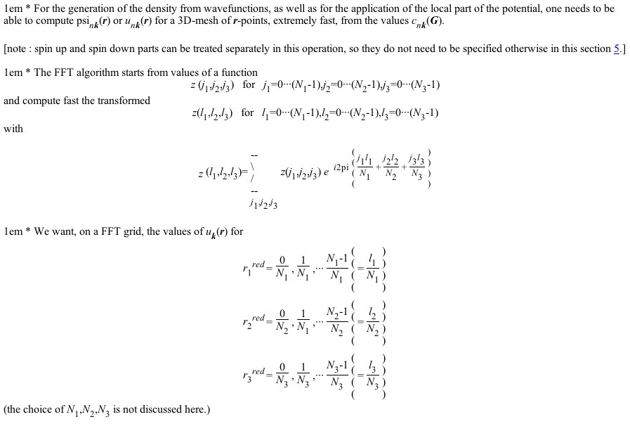
Example of H^{E}VEA (Infos/Theory/1WF.tex)
-nosymb option for any browsers
H^{E}VEA page (http://pauillac.inria.fr/~maranget/hevea/ )
Notes:
“\vskip 1em” is misinterpreted. “\tilde{z}” is also misinterpreted., not so nice, still might be acceptable …?
“\varepsilon” is not interpreted… “\Bigr” “Bigl” is not interpreted …

Slide 21
Future Plan (Open Discussion)
3) Anything else ?
• Techexplorer (IBM) : Browser plug-in for LaTeX documents
This is not for equations in “source codes”
All browsers accept the Plug-in or not ? (needs benchmark)
• Other possibilities may be available …
LaTeX–>PDF may be one solution (for browsing/printout)
at present, especially for Math equations, although
hyperlinkability may be somewhat lost … How do you think ?
In any case,
Don’t depend too much on the specification of one tool.
(Specifications will change !)
“Plan to throw one away; you will, anyhow”
(by Eric S. Raymond, “The Cathedral and the Bazaar”)
Notes:
soft4science http://www.soft4science.com/ (MathML & XML editor)
Hevea http://pauillac.inria.fr/~maranget/hevea/ (use -nosymb option)
word<->tex http://www.tex2word.com/
excel2latex http://plaza19.mbn.or.jp/~Butcher_Bird/Mac/Excel2LaTeX/Excel2LaTeX.html
MathTyp http://www.dessci.com/features/win/

Slide 22
Summary
• “Robodoc & src2tex” style (for browsing and printout.)
• LaTeX files –> PDF/HTML (linked with Source HTML)
NB: How to call(link) local files from PDF ?
Problem of symbol fonts for Browsers ?
Still, the search for tools should continue !
The present style appears sufficiently general,
so possible further modification of the coding_rules
would be acceptable (if needed in future).
“How to visualize Math equations with Browsers? ”
PDF, HTML (MathML) ?
Good Refs. “The LaTeX Web Companion”, M. Goossens et al. (Addison-Wesley)
TtH page (esp. http://hutchinson.belmont.ma.us/tth/webmath.html)
Notes:
Keeping the future open
The search for tools should continue.
Concerning the equations, there is a tool to view more or
less directly tex file under netscape. It is distributed by IBM.
See their site. Also, another viewer could be used.
Likely, the ROBODOC modifications to the source files
are sufficiently "general" that they will be of interest
to any other solution (the present splitting of the
header content is actually already close to the
needed splitting for ROBODOC).
The formatting of equations in latex, needed
for src2tex will not be of interest to tools that are not based
on Latex. However, tools for conversion to HTML begin
to appear. Except latex and HTML, are there other
"nice" equation formatting language under UNIX ?
The answer is likely negative.
The measure of success is, successing !

