Slide 1

The Siesta program for electronic structure simulations
Université de Liège
Javier Junquera
Départament de Physique
Université de Liège

Slide 2
Linear Scaling
CPU load
3
~ N
~ N
Early
90’s
~ 100
N (# atoms)
G. Galli and M. Parrinello, Phys. Rev Lett. 69, 3547 (1992)

Slide 3

Our method
Linear-scaling DFT based on
NAOs (Numerical Atomic Orbitals)
P. Ordejon, E. Artacho & J. M. Soler , Phys. Rev. B 53, R10441 (1996)
D. Sánchez-Portal, P. Ordejón, E. Artacho & J. M. Soler, Int. J. Quantum Chemistry 65, 453 (1997)
Born-Oppenheimer (relaxations, mol. dynamics)
DFT (LDA, GGA)
Pseudopotentials (norm conserving, factorised)
Numerical atomic orbitals as basis (finite range)
Numerical evaluation of matrix elements (3D grid)
Implemented in the SIESTA program
J. M. Soler, E. Artacho, J. D. Gale, A. García, J. Junquera, P. Ordejón & D. Sánchez-Portal J. Phys.: Condens. Matter 14, 2745 (2002)

Slide 4
Key: Locality
Large system
x2
“Divide and Conquer”
W. Yang, Phys. Rev. Lett. 66, 1438 (1992)

Slide 5
Atomic Orbitals
Very efficient
Lack of systematic for convergence
Main features:
  Size
  Range
  Shape
Numerical Atomic Orbitals (NAOs):
Numerical solution of the Kohn-Sham Hamiltonian
for the isolated pseudoatom with the
same approximations (xc, pseudos) as for the condensed system

Slide 6
Accuracy vs computed load
Depending on the required accuracy and
available computational power
Quick and dirty calculations
Highly converged calculations
Minimal basis set
(single- ζ; SZ)
Complete multiple-ζ
+
Polarization
+
Diffuse orbitals

Slide 7
Two steps in DFT
Calculating H (and S) matrices
  Long range interactions (electrostatics)
  Rest
  Always in Order-N
Solving H
  Order-N
  Standard diagonalization O(N³)

Slide 8
Linear-scaling matrix-element calculations
FINITE SUPPORT BASIS FUNCTIONS
Two-centre integrals
1D Numerical (tabulated)
3D integral in finite real-space grid

Slide 9
Grid integrations
. . . . . . . . . . . . . . . . . . . . . . . . . . . . . . . . . . . . . . . . . . . . . . . . . . . . . . . . . . . . . . . . . . . . . . . . . . . . . . . . . . . . . . . . . . . . . . . . . . . . . . . . . . . . . . . . . . . . .
Finite-range orbitals => Lists of points
Sparse matrices

Slide 10
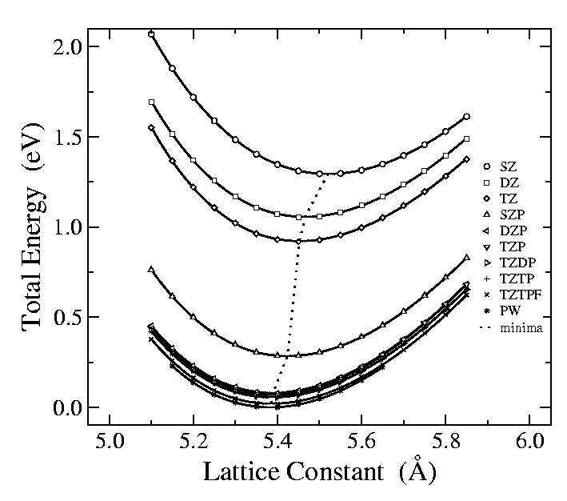
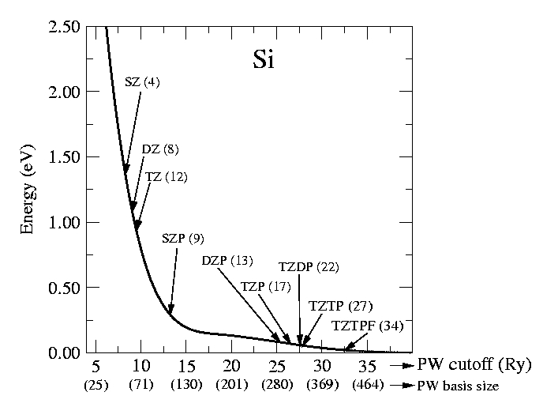
Convergence of the basis set
Bulk Si
Cohesion curves
PW and NAO convergence

Slide 11
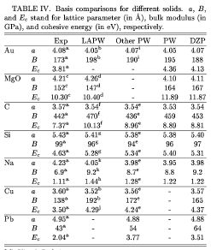
Some materials properties

Slide 12
Equivalent PW cutoff (E_{cut}) to optimal DZP
System
DZP # funct.
per atom
PW # funct.
per atom
E_{cut} (Ry)
H₂
5
11296
34
O₂
13
45442
86
Si
13
227
22
diamond
13
284
59
α-quartz
13
923
76
For molecules: cubic unit cell 10 Å of side

Slide 13
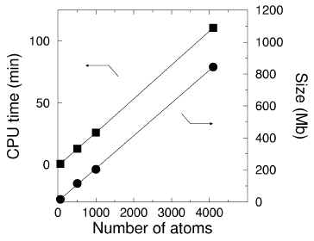
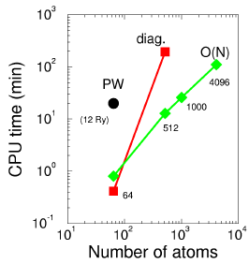
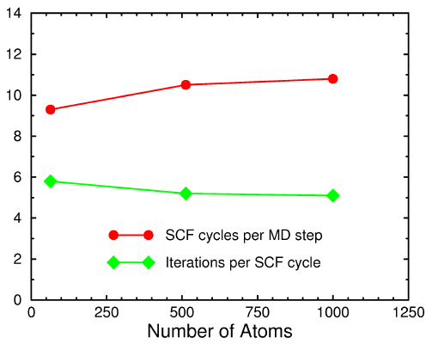
Actual linear scaling
Pentium III 800 MHz (single processor)
1 Gb of RAM

Slide 14
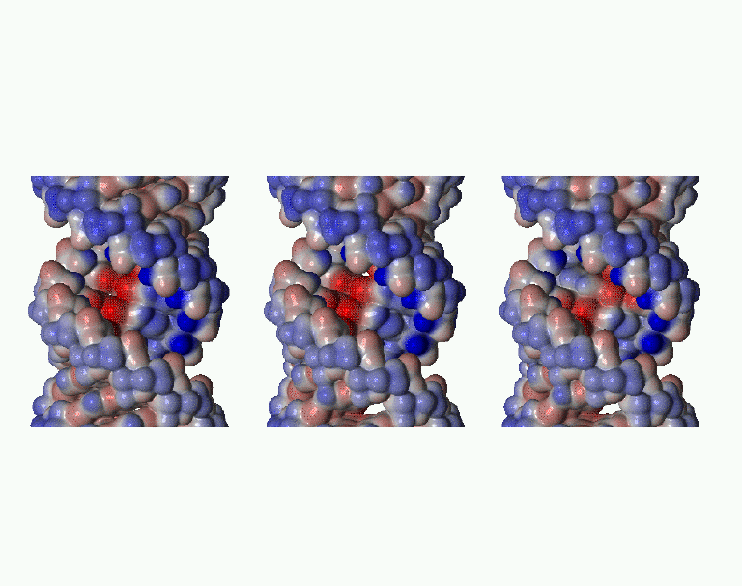
Dry DNA: poly dC – poly dG
11 base pairs in the unit cell (715 atoms)
relaxation (~800 steps; ~7 SCFs/step; ~5 O(N) iter/SCF)
full diagonalisation at the end:
E[O(N)] – E[diag] ~ 5 meV/atom
Avg. residual force O(N) : 2 meV/Ang
diag : 6 meV/Ang
Electrostatic potential (colours) on iso-density surface
3 different configurations

Slide 15
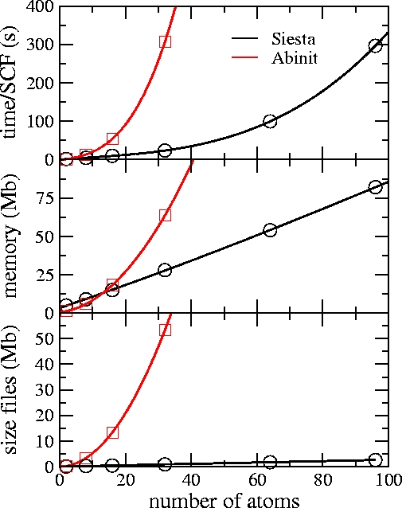
Comparison Siesta-Abinit
Si
diamond structure
Basis set:
  Abinit: 8 Ry
  Siesta: SZ
#k-points: 32
SGI Origin 3800
1 processor

Slide 16
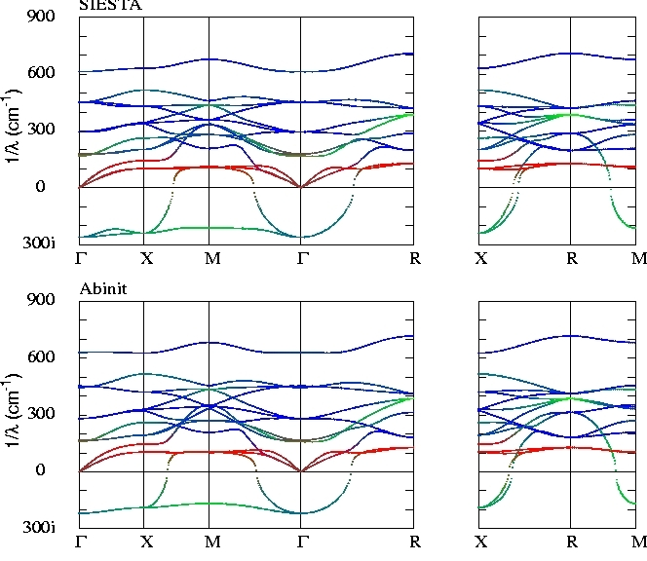
Dynamical properties of BaTiO₃

Slide 17
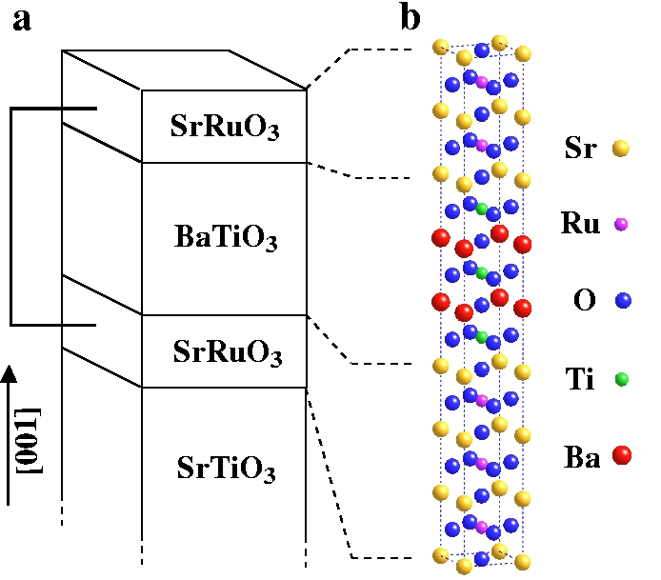
Structure of the ferroelectric capacitor
Abinit
Siesta
n=3, m=2
n=5, m=2
number atoms
30
40
memory (Mb)
262
372
time/SCF (s)
5929
1073
cont. file (Mb)
555
9
SrO-(RuO₂-SrO)_{n}/TiO₂-(BaO-TiO₂)_{m}
SGI-Origin 3800

Slide 18
Structural relaxations: BaO/BaTiO₃
Ti
O
η = 0
Ti
O
η = 0
-0.005
+0.002
Ba
O
η = 0.004
Ba
O
η = 0.001
+0.028
+0.006
Ti
O
η = -0.007
Ti
O
η = -0.001
-0.054
-0.006
Ba
O
η = +0.022
Ba
O
η = 0.004
+0.016
+0.028
Ti
O
η = -0.007
Ba
O
η = 0.010
-0.051
-0.023
Ba
O
η = 0.022
Ba
O
η = -0.005
+0.017
+0.005
Ba
O
η = 0.009
Ba
η = 0
O
-0.008
M.Zimmer, J. Junquera, and Ph Ghosez
AIP. Conf. Proc. 626, 232 (2000)
Ba
O
η = -0.004
+0.012
(Half a slab; Units in Å)
Ba
O
η = 0

Slide 19
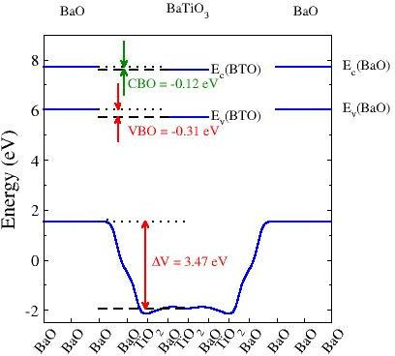
BaO/BaTiO₃ band offset
ABINIT:
3 BaO / 3 BaTiO₃
VBO: -0.31 eV
SIESTA:
2 BaO / 3 BaTiO₃
VBO: -0.21 eV
3 BaO / 5 BaTiO₃
VBO: -0.12 eV

Slide 20
Growth of carbon nanotubes
ABINIT
SIESTA
Timing (s/SCF step)
  SIESTA: 197 s
  Abinit: 381 s
T. Cours & J. P. Gasard

Slide 21
Applications
~ 70 groups use SIESTA worldwide
materials
biomolecules
minerals
nanostructures
liquids
Built-in flexibility (driven by users)
Brief reviews in:
E. Artacho et al. Phys. Stat. Solidi (b) 215, 809 (1999)
P. Ordejon Phys. Stat.Solidi (b) 217, 335 (2000)
More updated information: http://www.uam.es/siesta

Slide 22
SIESTA team
Emilio Artacho (University of Cambridge)
Daniel Sanchez-Portal (UPV San Sebastian)
Pablo Ordejon (ICMAB Barcelona)
Jose M. Soler (UAM Madrid)
Julian Gale (Imperial College)
Alberto Garcia (UPV Bilbao)
Richard Martin (U. Illinois, Urbana)
Javier Junquera (U. Liège)
Acknowledgments
Jose Luis Martins (Lisboa)
Otto Sankey (Arizona)
Volker Heine (Cambridge)
Philippe Ghosez (Liège)

Slide 23
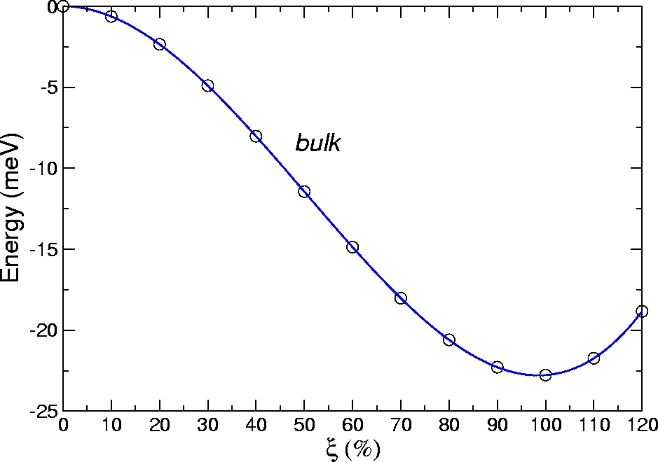
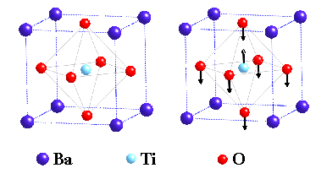
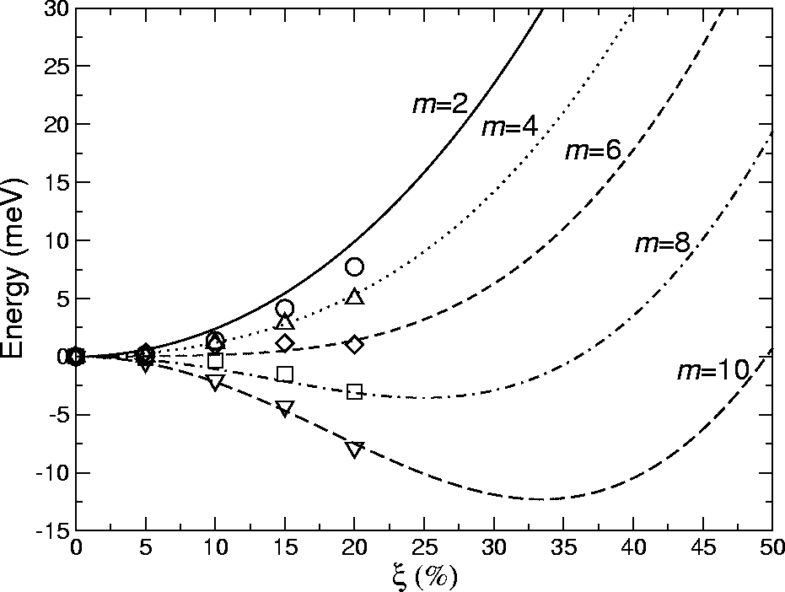
Thin-film energy
Bulk
Thin film
Double well energy: U
Depolarizing energy: -EP
E = U - EP
(m≡number of unit cells of BaTiO₃)

Slide 24
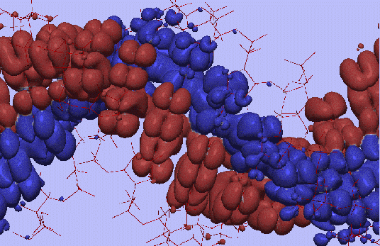
Absence of DC conductivity in -DNA
P. J. de Pablo et al. Phys. Rev. Lett. 85, 4992 (2000)
Effect of sequence disorder and vibrations on the electronic structure
=> Band-like conduction is extremely unlikely: DNA is not a wire

Slide 25
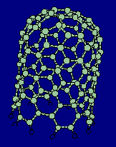
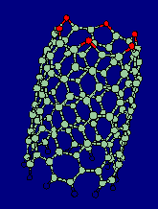
Opening carbon nanotubes
Why do they remain open after burning?
+ 3 CO ->
+ 0.2 eV
2
M. S. C. Mazzoni et al. Phys. Rev. B 60, R2208 (1999)

Slide 26
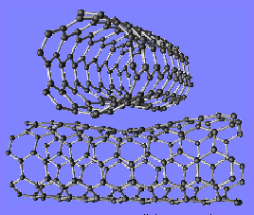
Pressing nanotubes for a switch
Pushed them together, relaxed &
calculated conduction at the contact: SWITCH
M. Fuhrer et al. Science 288, 494 (2000)
Y.-G. Yoon et al. Phys. Rev. Lett. 86, 688 (2001)

Slide 27
Solving H (diagonalising)
Nearsightedness principle
W. Kohn, Phys. Rev. Lett. 76, 3168 (1996)
Implies localisation:
Wannier-like unitary transformations of eigenvectors:
localised basis of occupied space

Slide 28
Linear-scaling solution
Search directly for localised quantities:
-
- by minimising E
Make them strictly local (finite support)
(the approximation is here)

Slide 29
Localised solutions
R
c

Slide 30
Converging the basis size
  Single-ζ (minimal or SZ)
  One single radial function per angular
  momentum shell occupied in the free –atom
Improving the quality
  Radial flexibilization:
  Add more than one radial function within the same angular momentum than SZ
  Multiple-ζ
  Angular flexibilization:
  Add shells of different atomic symmetry (different l)
  Polarization

Slide 31
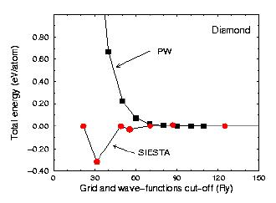
Grid fineness: Energy cut-off
Convergence: no problem (real-space rippling)

Slide 32
How to double the basis set
Different schemes to generate Double- ζ :
Quantum Chemistry: Split Valence
    Slowest decaying (most extended) gaussian (ϕ).
Nodes: Use excited states of atomic calculations.
    Orthogonal, asympotically complete but inefficient
    Only works for tight confinement
Chemical hardness: Derivative of the first-ζ respect
  the atomic charge.
SIESTA: extension of the Split Valence to NAO.

Slide 33
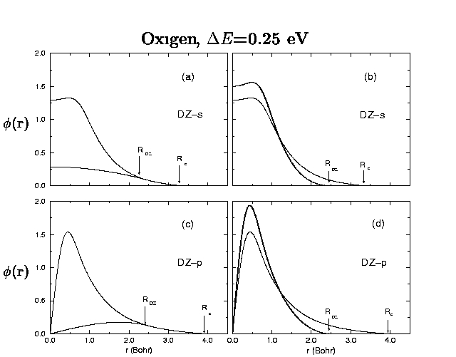
Split valence in NAO formalism
E. Artacho et al, Phys. Stat. Sol. (b), 215, 809 (1999)

Slide 34
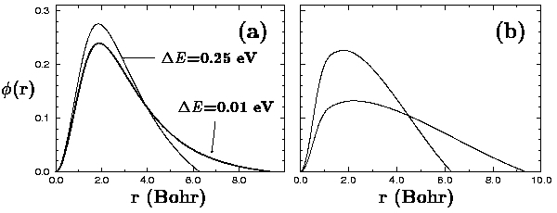
Polarization orbitals
Perturbative polarization
Atomic polarization
Apply a small electric field to the orbital we want to polarize
Solve Schrödinger equation for higher angular momentum
E
unbound in the free atom ⇒ require short cut offs
s
s+p
Si 3d
orbitals
E. Artacho et al, Phys. Stat. Sol. (b), 215, 809 (1999)

Slide 35
Range
How to get sparse matrix for O(N)
  Neglecting interactions below a tolerance or beyond some scope of neighbours ⇒ numerical instablilities for high tolerances.
  Strictly localized atomic orbitals (zero beyond a given cutoff radius, r_{c})
  ⇓
Accuracy and computational efficiency depend on the range
of the atomic orbitals
Way to define all the cutoff radii in a balanced way

Slide 36

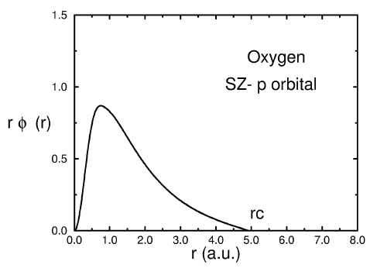
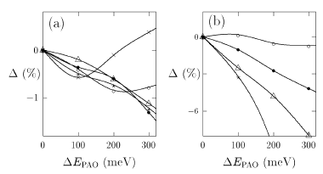
Energy shift
A single parameter for all cutoff radii
E. Artacho et al. Phys. Stat. Solidi (b) 215, 809 (1999)
Convergence vs Energy shift of
Bond lengths Bond energies
Fireballs
O. F. Sankey & D. J. Niklewski, Phys. Rev. B 40, 3979 (1989)
BUT:
A different cut-off radius for each orbital

Slide 37
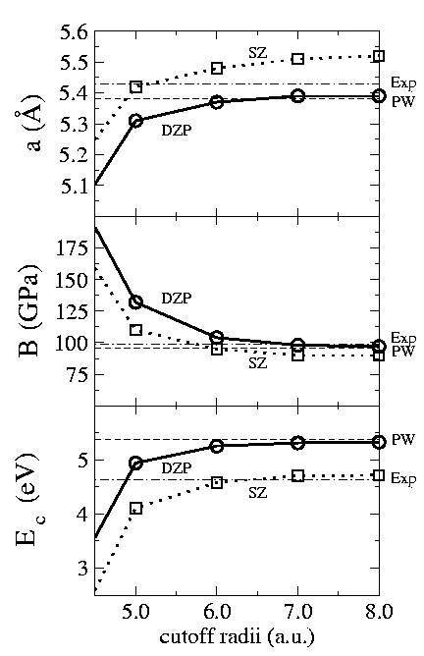
Convergence with the range
bulk Si
equal s, p orbitals radii
J. Soler et al, J. Phys: Condens. Matter, 14, 2745 (2002)

Slide 38
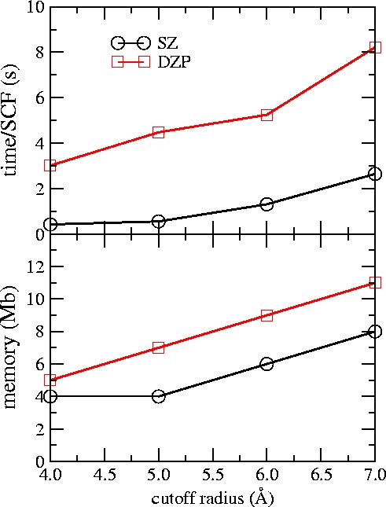
Convergence with the range
bulk Si
equal s, p orbitals radii
J. Soler et al, J. Phys: Condens. Matter, 14, 2745 (2002)

Slide 39
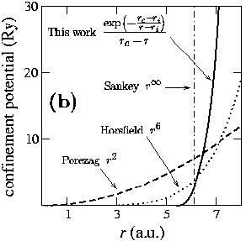
Confinement
Hard confinement (Sankey et al, PRB 40, 3979 (1989) )
  Orbitals: discontinuos derivative at r_{c}
Polinomial:
  n = 2 (Porezag et al, PRB 51, 12947 (95) )
  n = 6 (Horsfield, PRB 56, 6594 (97) )
  No radius where the orbital is stricly zero
  Non vanishing at the core region
Direct modification of the wf:
  Bump for large α and small r_{c}
New proposal:
  Flat at the core region
  Continuos
  Diverges at r_{c}
  (J. Junquera et al,
  Phys. Rev. B, 64, 23511 (01))

Slide 40
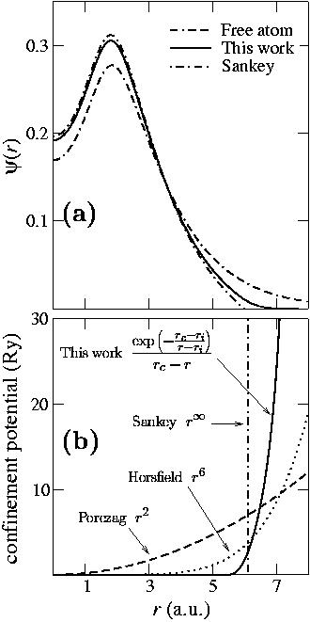
Soft confinement
(J. Junquera et al, Phys. Rev. B 64, 235111 (01) )
Shape of the optimal 3s orbital of Mg in MgO for different schemes
Corresponding optimal confinement potential
Better variational basis sets
Removes the discontinuity of the derivative

Slide 41
Comparison of confinement schemes
Mg and O basis sets variationally optimized for all the schemes
MgO
SZ
DZP
Basis scheme
a B E_{c}
(Å) (GPa) (eV)
a B E_{c}
(Å) (GPa) (eV)
Unconfined
Sankey
Direct modification
Porezag
Horsfield
This work
4.25 119 6.49
4.17 222 10.89
4.16 228 11.12
4.18 196 11.17
4.15 221 11.26
4.15 226 11.32
4.12 165 11.82
4.12 163 11.84
4.09 183 11.83
4.11 168 11.86
4.10 167 11.87
PW (100 Ry)
Exp
4.10 168 11.90
4.21 152 10.3

Slide 42
Convergence of the basis set
Bulk Si
SZ
DZ
TZ
SZP
DZP
TZP
TZDP
PW
APW
Exp
a
(Å)
5.52
5.46
5.45
5.42
5.39
5.39
5.39
5.38
5.41
5.43
B
(GPa)
89
96
98
98
97
97
96
96
96
98.8
E_{c}
(eV)
4.72
4.84
4.91
5.23
5.33
5.34
5.34
5.37
5.28
4.63
SZ = single-ζ
DZ= doble- ζ
TZ=triple- ζ
P=Polarized
DP=Doble-polarized
PW: Converged Plane Waves (50 Ry)
APW: Augmented Plane Waves (all electron)

Slide 43
HARTREE (electrostatics)
SIESTA (and others): real-space grids
FFT, Multigrid (Numerical Recipes)
Quantum Chemistry: Fast multipoles
Head-Gordon
Scuseria
Linear-scaling: SOLVED

