Slide 1
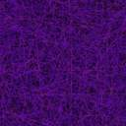
R. Caracas & X. Gonze
WORKSHOP ABINIT 2002
Louvain-la-Neuve
Crystallography
and
lattice Wannier functions
in ABINIT

Slide 2

CRYSTALLOGRAPHY
mainly pre-processing tools
Crystal
structure
=
Unit cell
+
Symmetry
+
Atomic positions
check
primitivity
all symmetries
space group
all atoms
asymmetric atoms

Slide 3
space groups
“International tables for crystallography”
Space group number (spgroup)
Bravais lattice (brvltt)
Axis orientation (spgaxor)
Axis origin (spgorig)
1 .. 230
P,F,I,A,B,C,R
Hexagonal/Rhombohedral
abc-cab-bca-acb-bac-cba
1/2

Slide 4
symmetry recognition
structural data: ALL atoms + lattice parameters
compute ALL Symmetries
space group
point group

Slide 5
magnetic space groups
A₄
A’₄
magnetic
symbol
230 space groups
Shubnikov
I 230 non-colored groups
II 230 gray groups
III 674 colored black/white groups
IV 517 colored black/white groups
32 point groups
32+32+52 point groups

Slide 6

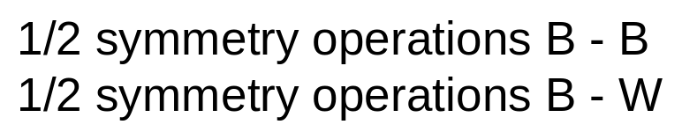

R
R
R
R
R
R
t
t
11
11
12
12
13
13
1
1
{R|t} S =
R
{B/W}
R
R
R
R
R
t
t
21
21
22
22
23
23
2
2
R
R
R
R
R
R
t
t
31
31
32
32
33
33
3
3

Slide 7
miscellaneous
Determination of the wave vector symmetry group
{R|t} leaving invariant q
symmetrize the dynamical matrix D
Symmetrization of the stresses (relaxations)
Check of the translation group

Slide 8
future work
non-magnetic space groups :
improve generators
magnetic space groups :
further testing + improvements
automatic recognition
CRYSTALLOGRAPHIC LIBRARY

Slide 9

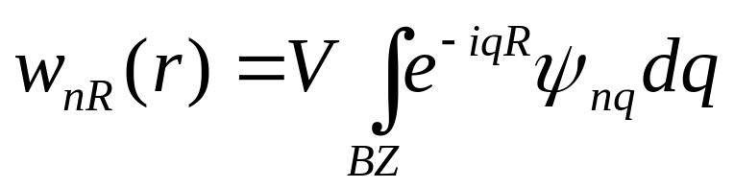
R. Caracas & X. Gonze
WORKSHOP ABINIT 2002
LATTICE WANNIER FUNCTIONS
Louvain
-
la
-
Neuve
LATTICE WANNIER FUNCTIONS
maximally localized LWF
iterative procedure :
interpolation of a certain group of bands
by maximizing the overlap between neighbouring q points
strict symmetry constraints
atomic displacement pattern

Slide 10
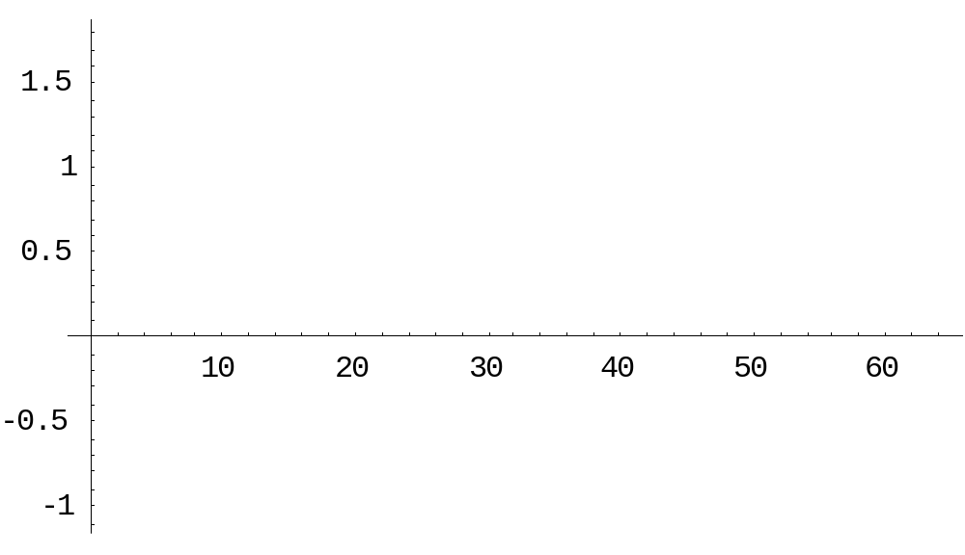
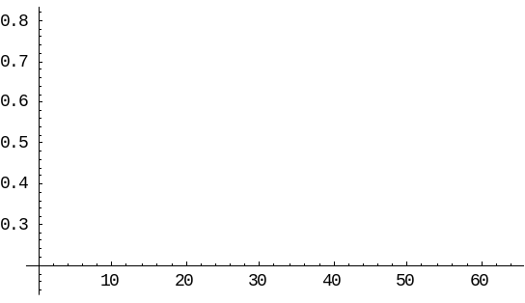
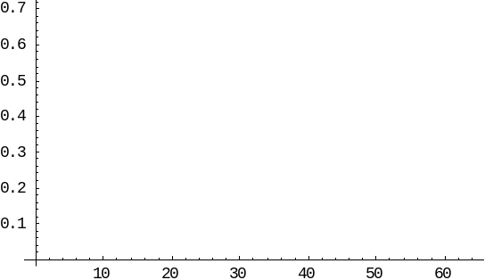
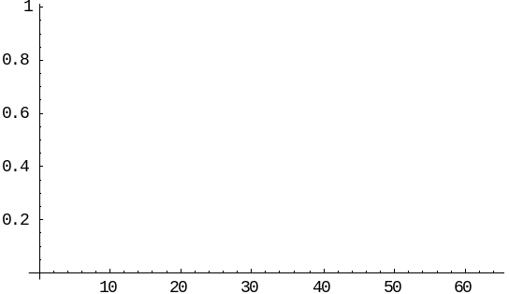
k_{β}
k_{α}
k_{γ}
k_{α} = 0.4
k_{β} = 0.1
k_{γ} = -1.0
avoided crossing
X
Γ
X

Slide 11
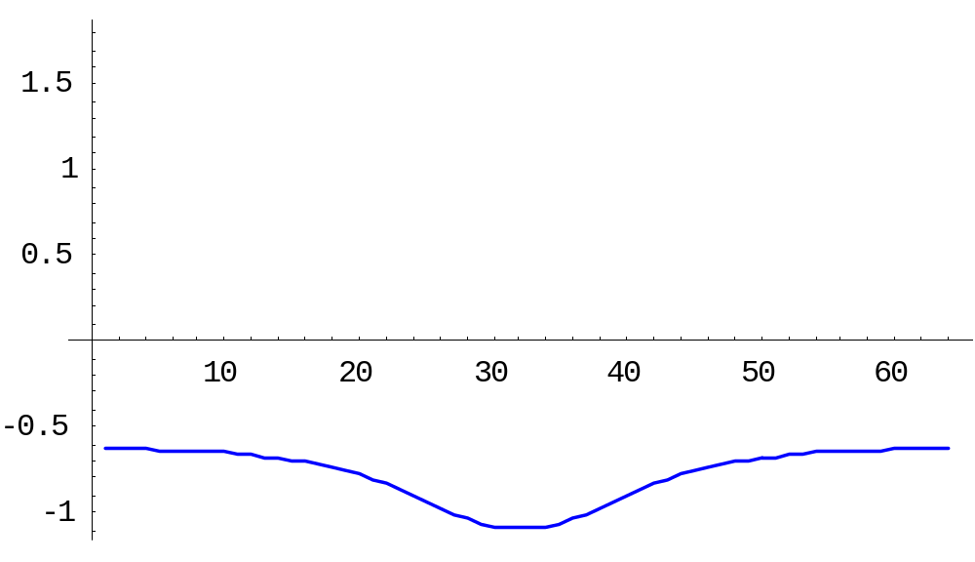
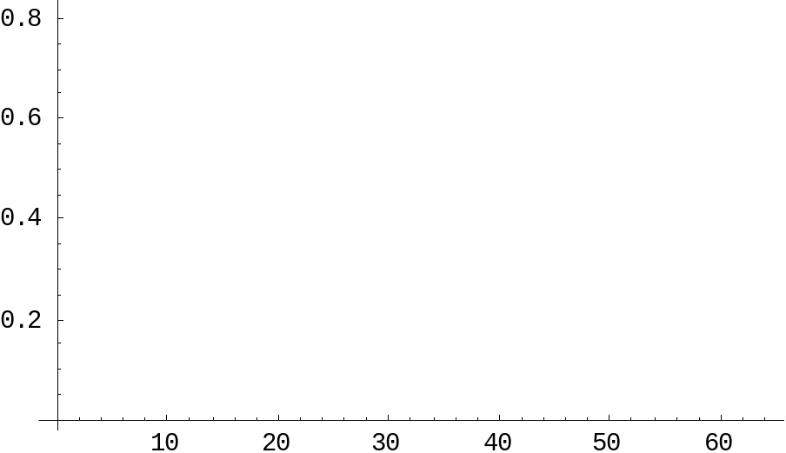
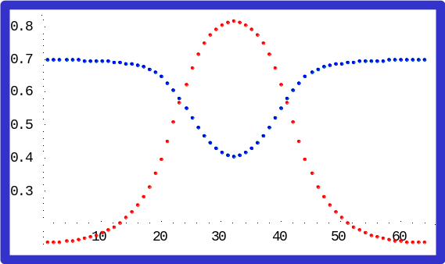
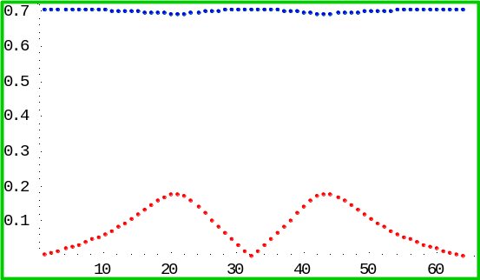
R. Caracas & X. Gonze
WORKSHOP ABINIT 2002
LATTICE WANNIER FUNCTIONS
Louvain
-
la
-
Neuve
Γ
X
Γ
X

Slide 12
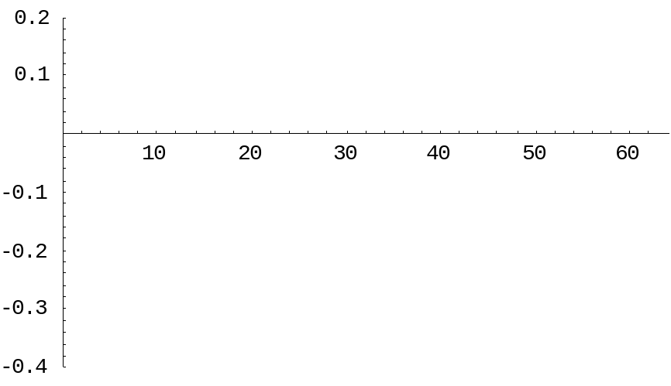
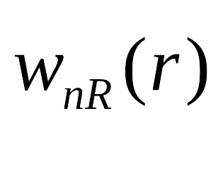
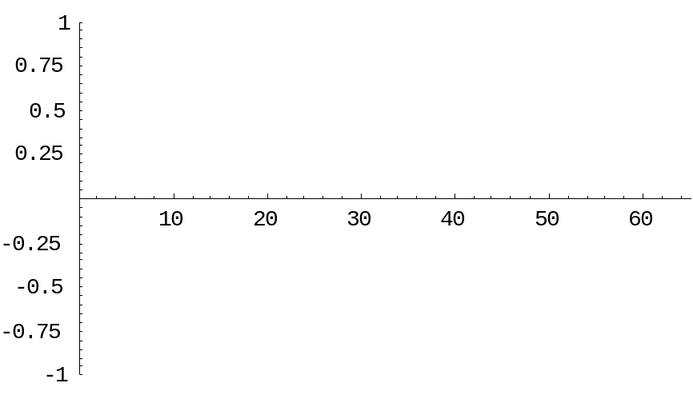
R. Caracas & X. Gonze
WORKSHOP ABINIT 2002
LATTICE WANNIER FUNCTIONS
Louvain
-
la
-
Neuve
the lattice Wannier function:
amplitude
R

Slide 13
R. Caracas & X. Gonze
WORKSHOP ABINIT 2002
LATTICE WANNIER FUNCTIONS
Louvain
-
la
-
Neuve
in ABINIT :
lwf
DEBUGGING stage
special features:
energy window of frozen states
future development
transformation to regions of frozen states of the BZ
pinning of the ψ_{nq} to general or high-symmetry points

