Slide 1




Philippe GHOSEZ
Jean-Yves RATY
Xavier GONZE
Michel COTE
Masayoshi MIKAMI
International Abinit Developer’s Workshop 2007
29 – 31 January 2007
GDR-DFT
Québec-
Wallonie/Bruxelles

Slide 2
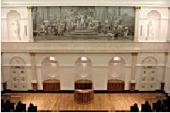
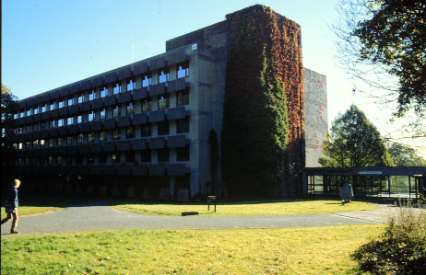
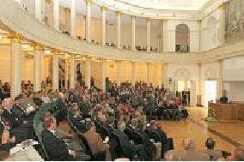
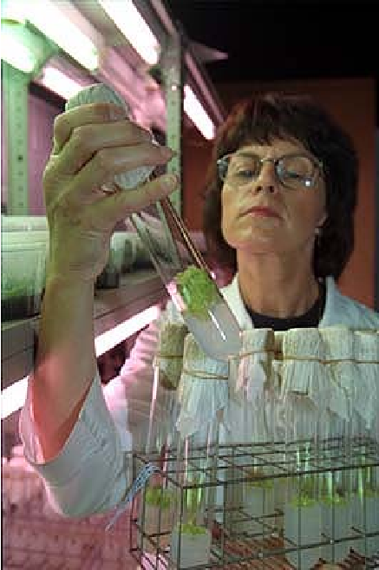
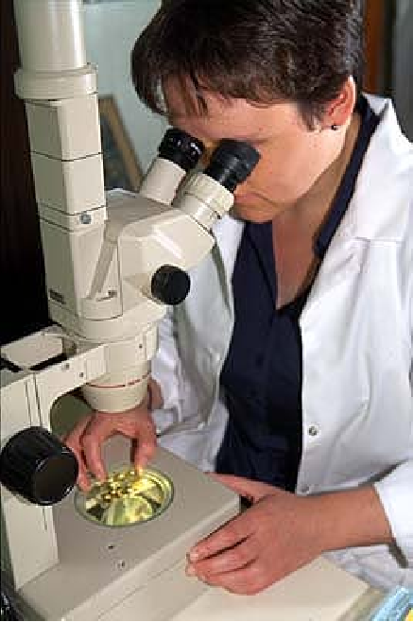
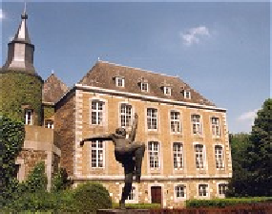
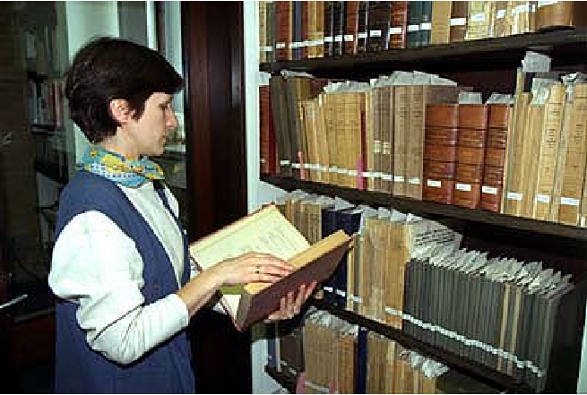
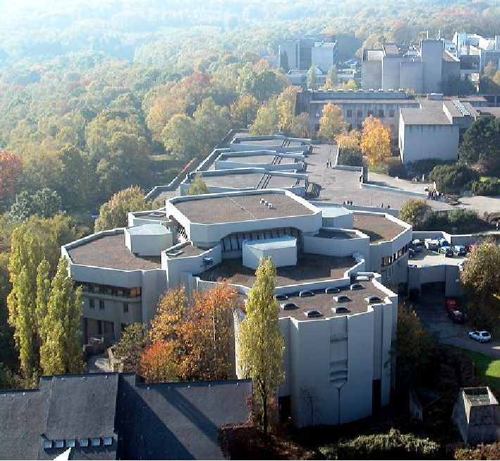
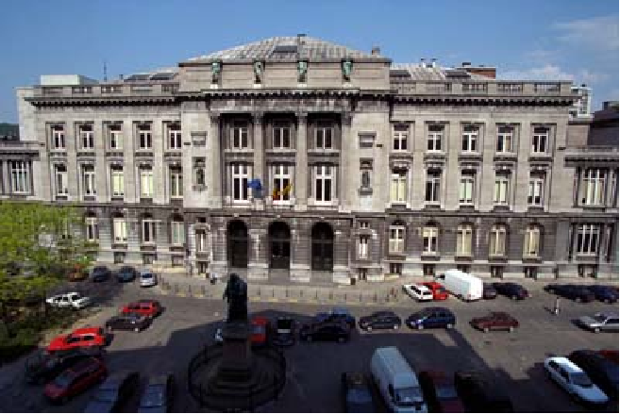
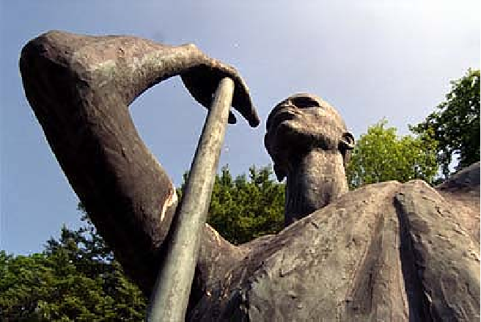
Founded in 1817
8 faculties,
17.000 students
2.500 staff members

Slide 3
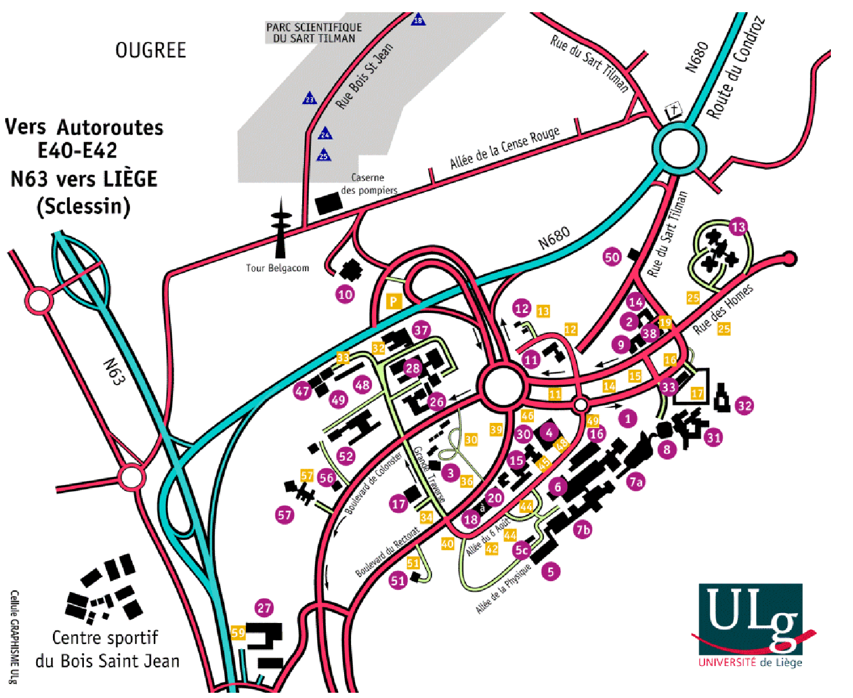
Liège
Restaurant
IADW-07

