Slide 1
ABINIT INPUT MAKER
By Simon Pesant and BenjaminTardif
29/01/2007

Slide 2
Summary
A brief presentation of the program and his advantage
The implementation of Abinit Input Maker
The XML file format
The validation of the values
Addition of another section in Abinit Input Maker
Conclusion

Slide 3
The Program
Abinit Input Maker is a graphical interface that produces input files for Abinit.
It helps to structure the different variables in the input file
It facilitates the creation of the Abinit input file (especially for beginner)
It reduces the possibility of errors in the input files (variable name and values)

Slide 4
Technical Advantages
The way it works was designed to be :
Easy to be updated with new variables
Versatile, because it can be used with other codes

Slide 5
Implementation
The program is coded in Python which is platform independent.
It has a parser that reads XML files.
The XML files contain the information about the different variables in Abinit (or other codes)
After, Abinit Input Maker creates a graphical interface which follows the structure given by the XML files.
When all the values of the variables have been given, you can directly create the input file for Abinit.

Slide 6
The XML Files
The XML parser of Abinit Input Maker recognizes 7 keywords :
SECTION : Indicate the beginning of a new section
KEYBOARDENTRY : Get variable value from the keyboard (string, int, float, ...)
CHOICE : The user must choose between different options
  DECISION : The result of a CHOICE keyword
MOUSEENTRY : Click on the value with the mouse
  OPTION : The options of a MOUSEENTRY
DIRECTENTRY : Define the value of a variable without asking the users, based on the answer given previously

Slide 7
The XML file (continued)
For each keywords, several variables can be defined :
SECTION :
-sectiontitle (name of the section)
CHOICE :
-Instruction (A short question that will be ask in the graphical interface)
DECISION :
-description (A description of the answer) related to a CHOICE
MOUSEENTRY :
-instruction (A short question that will be ask in the graphical interface)
DIRECTENTRY :
-variablevalue (The value of an Abinit variable)
-variablename (The name of an Abinit variable)
OPTION :
-variablevalue (The value of an Abinit variable)
-variablename (The name of an Abinit variable)
-description (A description of the answer) related to a MOUSEENTRY

Slide 8
The XML file (continued)
KEYBOARDENTRY :
-instruction
-variablename
-textlen (The number of line of the textbox)
-typvariable (The type of a variable. It can be int, float, array or str.)
-lenthgarray (The length of the array. Only for typvariable = array)
-maxval (The maximum value of a variable)

Slide 9
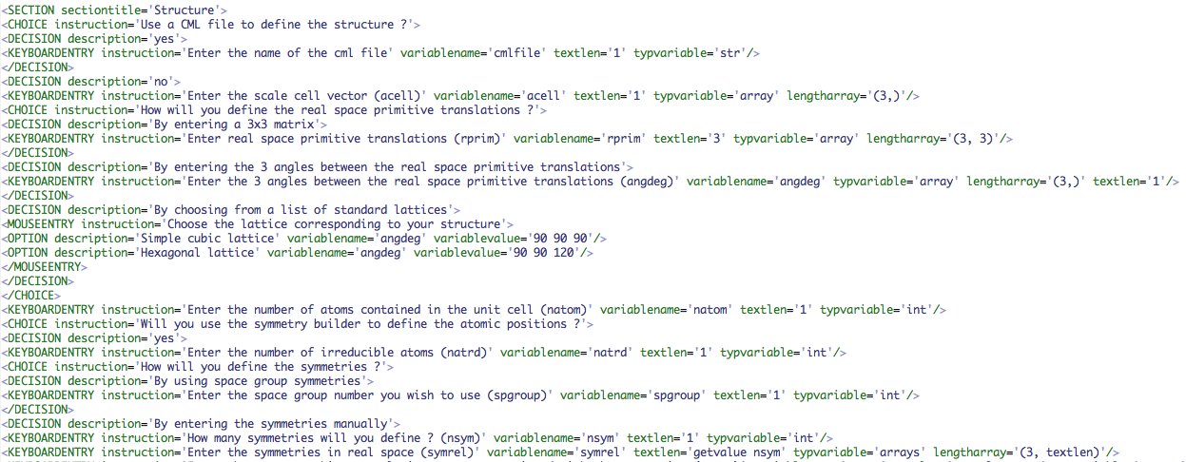
An example of XML file

Slide 10
Get Value
You can use, in your XML file, a value that will be specified during the creation of the input file to define an XML variable.
i.e. : define the dimension of typat by the value of natom
To assign to variable the value of another variable use :
getvalue nameofvariable

Slide 11
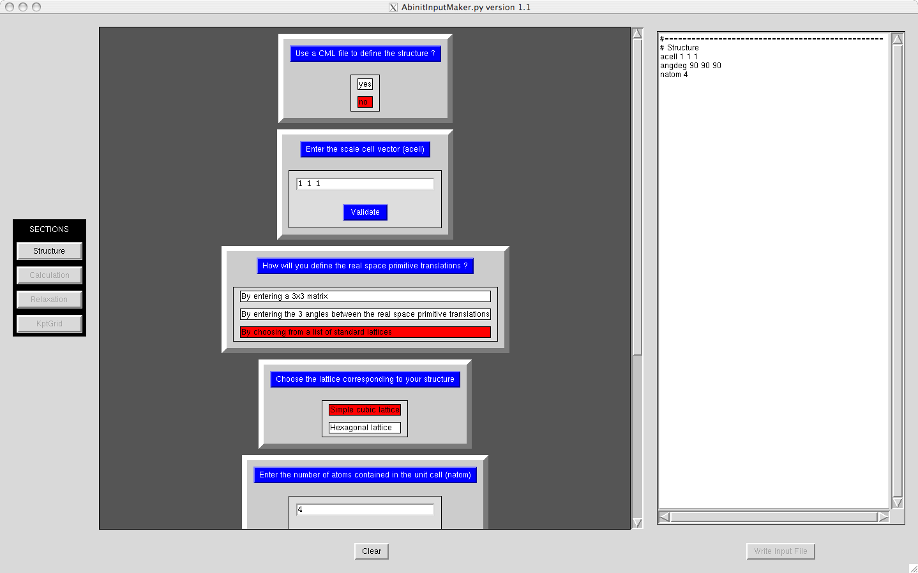
Abinit Input Maker
Preview
of the
input file
Instruction
KEYBOARDENTRY
CHOICE
DECISION
MOUSEENTRY
OPTION

Slide 12
Validation of the values
Only for a KEYBOARDENTRY
Abinit Input Maker has a validation process for each variable entered with the keyboard.
It checks the type of variable defined in the XML (using typvariable)
It verifies the shape of the value (arrays) (using the lengtharray)
For certain Abinit variables, a maximum value must be defined (ex :typat) (using maxval)
If a wrong value is given to Abinit Input Maker, the program will wait for another value and momentarily stop parsing the XML file.

Slide 13
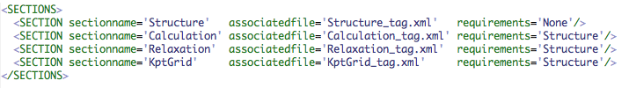
Adding a new section
Build your XML file (begin by the SECTION keyword)
Run xmlTagger.py on your file, to add the tag numbers on each code lines. The tag number is an internal variable. The program xmltagger.py add the tag number for each line of a XML file.
Update the list of XML files to parse with Abinit Input Maker in the file Section.xml. You can also put conditions before accessing to your section.

Slide 14
Conclusion
Abinit Input Maker can be easily updated to take into account the new implementation.
It can also be use with other codes.
By it validation process and the way it build an input files, many error can be avoided.

