Slide 1
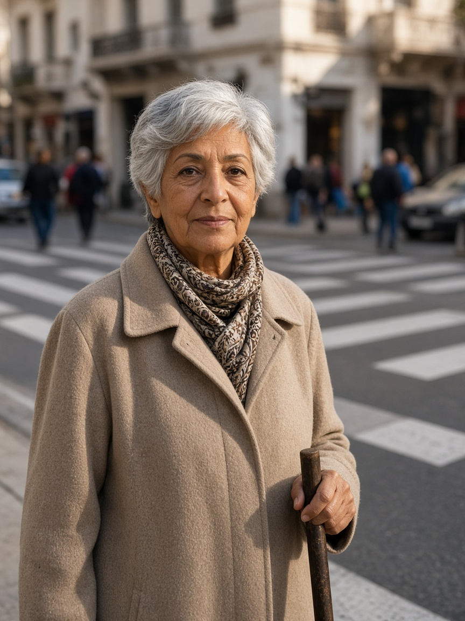
Persona 1 — Amara
Crosses a busy central street for shops and transit · Tunis design context (assumption)
DESIGN STATEMENT · SYNTHESIS, NOT A QUOTE
“I need enough time to finish crossing, even when traffic is busy.”
NEED
FEAR
Acknowledgement, shorter waiting and enough clearance to finish.
Cars receive green while she is still crossing.
USES
REJECTS
Push-button, audible/visual feedback; no phone required.
Shortened clearance, inaccessible apps, invented success claims.
P1 · AGE 74
EVIDENCE
MEASURE · PROPOSED, NOT A RESULT
Perceived wait ≈2× in one NZ study [C03]. MUTCD clearance guidance ≈1.07 m/s and slower where needed [C04].
Mean / P95 / max wait + zero clearance truncations.
Amara
Retired pedestrian; uses a cane
BIO · Represents slower walkers excluded by average-speed timing.
Illustration · not an interviewed person
PERSONALITY · Careful and independent; design assumption.
Notes:
Research-informed design persona, not an interview. I need enough time to finish crossing, even when traffic is busy. Need: Acknowledgement, shorter waiting and enough clearance to finish. Fear: Cars receive green while she is still crossing. Evidence: Perceived wait ≈2× in one NZ study [C03]. MUTCD clearance guidance ≈1.07 m/s and slower where needed [C04]. Proposed measure: Mean / P95 / max wait + zero clearance truncations.

Slide 2
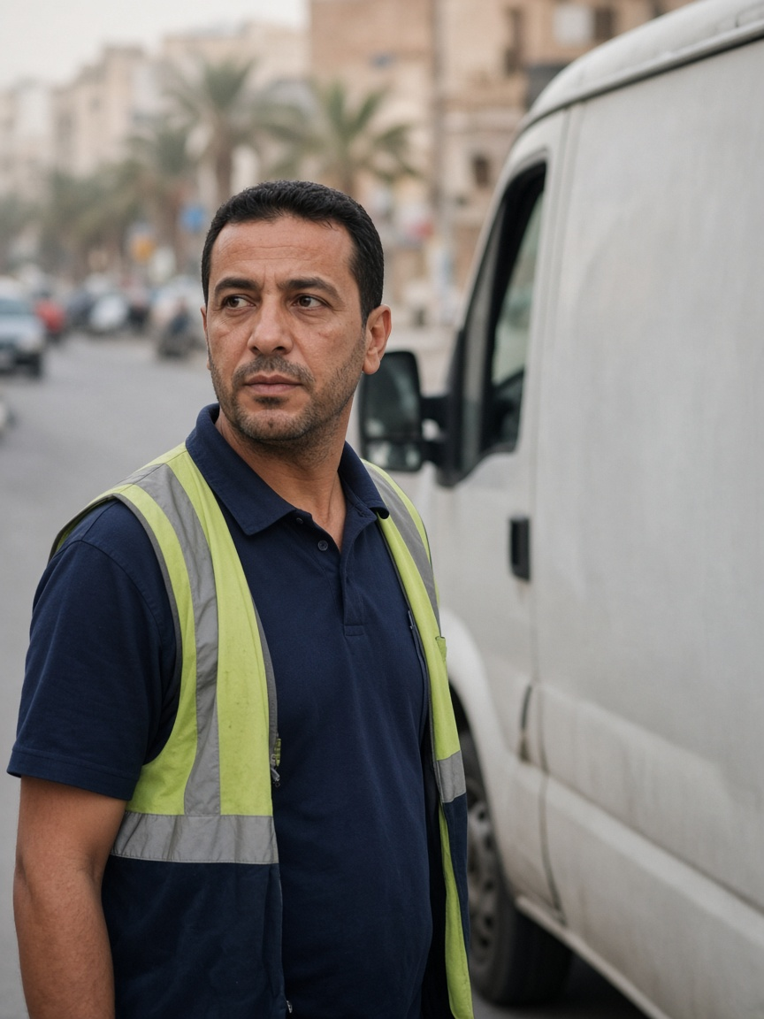
Persona 2 — David
More than 60 time-sensitive stops per workday · Tunis design context (assumption)
DESIGN STATEMENT · SYNTHESIS, NOT A QUOTE
“I can plan around a longer trip if I know how long it will actually take.”
NEED
FEAR
Predictable journeys, fewer stops and visible incidents.
A better mean hides unfinished or extreme trips.
USES
REJECTS
Work phone, GPS/navigation and delivery-round tools.
Best-case headlines and deleted unfinished trips.
P2 · AGE 41
EVIDENCE
MEASURE · PROPOSED, NOT A RESULT
DfT TAG uses 0.4 as an appraisal reliability ratio for journey-time variability [C05].
Completed/unfinished trips, P95/max duration, stops and standstill.
David
Delivery-van driver
BIO · Represents reliability and the severe tail—not only the average.
Illustration · not an interviewed person
PERSONALITY · Organised and schedule-focused; design assumption.
Notes:
Research-informed design persona, not an interview. I can plan around a longer trip if I know how long it will actually take. Need: Predictable journeys, fewer stops and visible incidents. Fear: A better mean hides unfinished or extreme trips. Evidence: DfT TAG uses 0.4 as an appraisal reliability ratio for journey-time variability [C05]. Proposed measure: Completed/unfinished trips, P95/max duration, stops and standstill.

Slide 3
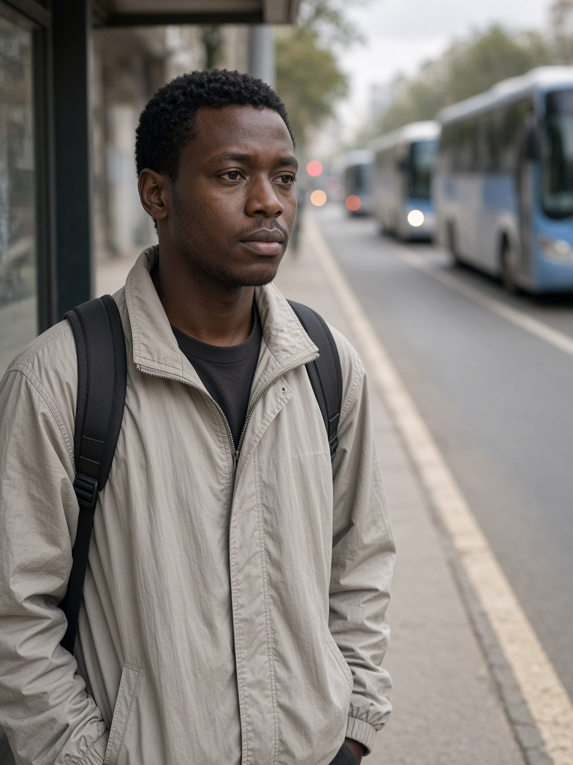
Persona 3 — Chidi
Uses a high-frequency corridor where regularity is the service · Tunis design context (assumption)
DESIGN STATEMENT · SYNTHESIS, NOT A QUOTE
“Buses should arrive regularly—not three at once after a long wait.”
NEED
FEAR
Priority only for a late bus or a large headway gap.
Three buses arrive together after one long gap.
USES
REJECTS
Passenger-information app when available; otherwise the stop.
Every-bus priority and pedestrian clearance sacrificed for transit.
P3 · AGE 27
EVIDENCE
MEASURE · PROPOSED, NOT A RESULT
DfT TAG applies a 2× value-of-time multiplier to public-transport waiting [C05].
Lateness, headway variation, passenger-wait proxy and car externality.
Chidi
Frequent bus passenger
BIO · Represents passengers harmed by bunching and unpredictable gaps.
Illustration · not an interviewed person
PERSONALITY · Routine-oriented and uncertainty-sensitive; design assumption.
Notes:
Research-informed design persona, not an interview. Buses should arrive regularly—not three at once after a long wait. Need: Priority only for a late bus or a large headway gap. Fear: Three buses arrive together after one long gap. Evidence: DfT TAG applies a 2× value-of-time multiplier to public-transport waiting [C05]. Proposed measure: Lateness, headway variation, passenger-wait proxy and car externality.

Slide 4
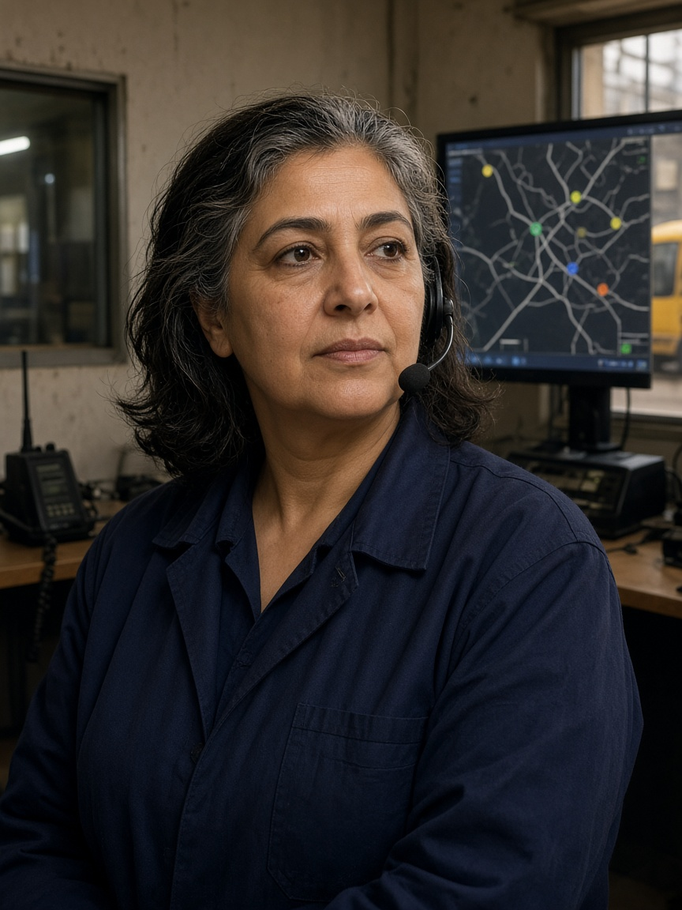
Persona 4 — Rosa
Supervises service disruption and priority decisions · Tunis design context (assumption)
DESIGN STATEMENT · SYNTHESIS, NOT A QUOTE
“Show me why priority was granted or denied, and let me respond safely.”
NEED
FEAR
Positions, headways, confidence, reason codes and a joined audit trail.
A black box refuses priority and leaves no history.
USES
REJECTS
Depot tools, vehicle-location screen, radio and dashboard.
Unsupported predictions or override outside the safety mask.
P4 · AGE 52
EVIDENCE
MEASURE · PROPOSED, NOT A RESULT
SCATS documentation describes monitoring, manual intervention and audit trails [C08].
Reason-code coverage and operator explanation of one yes and one no.
Rosa
Bus depot controller
BIO · Represents operators who must defend automated priority decisions.
Illustration · not an interviewed person
PERSONALITY · Calm, responsible and evidence-seeking; design assumption.
Notes:
Research-informed design persona, not an interview. Show me why priority was granted or denied, and let me respond safely. Need: Positions, headways, confidence, reason codes and a joined audit trail. Fear: A black box refuses priority and leaves no history. Evidence: SCATS documentation describes monitoring, manual intervention and audit trails [C08]. Proposed measure: Reason-code coverage and operator explanation of one yes and one no.

Slide 5
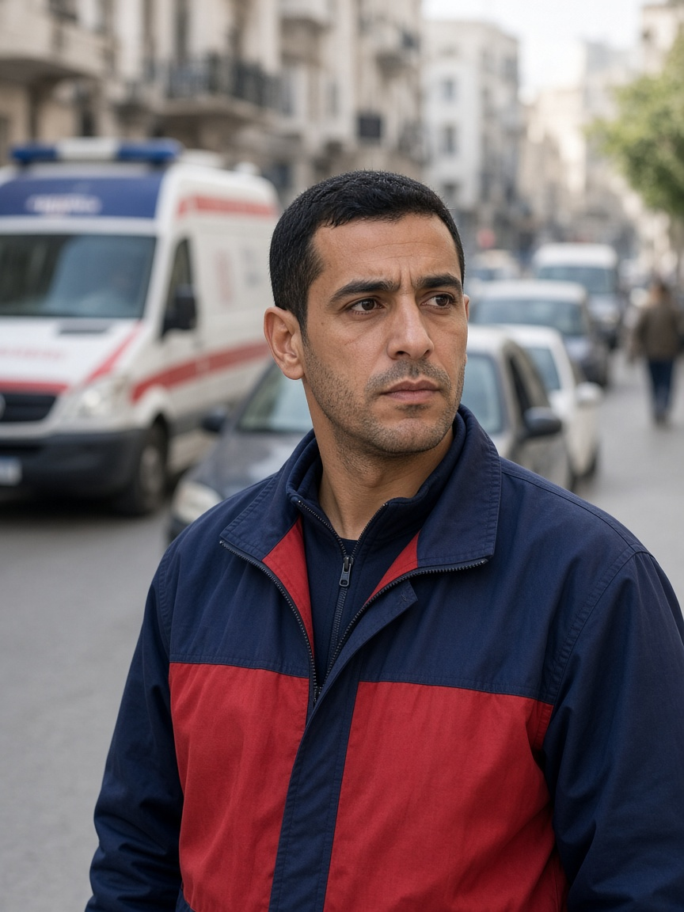
Persona 5 — Marcus
Responds through congested streets during peak periods · Tunis design context (assumption)
DESIGN STATEMENT · SYNTHESIS, NOT A QUOTE
“Get us through safely, and make sure traffic recovers after we pass.”
NEED
FEAR
Trusted route/ETA request, downstream check and controlled recovery.
A green into a full link simply moves the queue.
USES
REJECTS
Dispatch tablet, GPS, radio, lights and siren.
Cutting an occupied crossing or translating simulation into casualties.
P5 · AGE 34
EVIDENCE
MEASURE · PROPOSED, NOT A RESULT
One Taipei cohort associated each extra ALS minute with 7% lower adjusted odds [C06]. Preemption can impose network delay [C07].
Emergency effect, civilian delay, downstream rejection and recovery.
Marcus
Urban ambulance crew
BIO · Represents passage plus recovery and the civilian cost of priority.
Illustration · not an interviewed person
PERSONALITY · Urgent, precise and aware of other road users; design assumption.
Notes:
Research-informed design persona, not an interview. Get us through safely, and make sure traffic recovers after we pass. Need: Trusted route/ETA request, downstream check and controlled recovery. Fear: A green into a full link simply moves the queue. Evidence: One Taipei cohort associated each extra ALS minute with 7% lower adjusted odds [C06]. Preemption can impose network delay [C07]. Proposed measure: Emergency effect, civilian delay, downstream rejection and recovery.

Slide 6
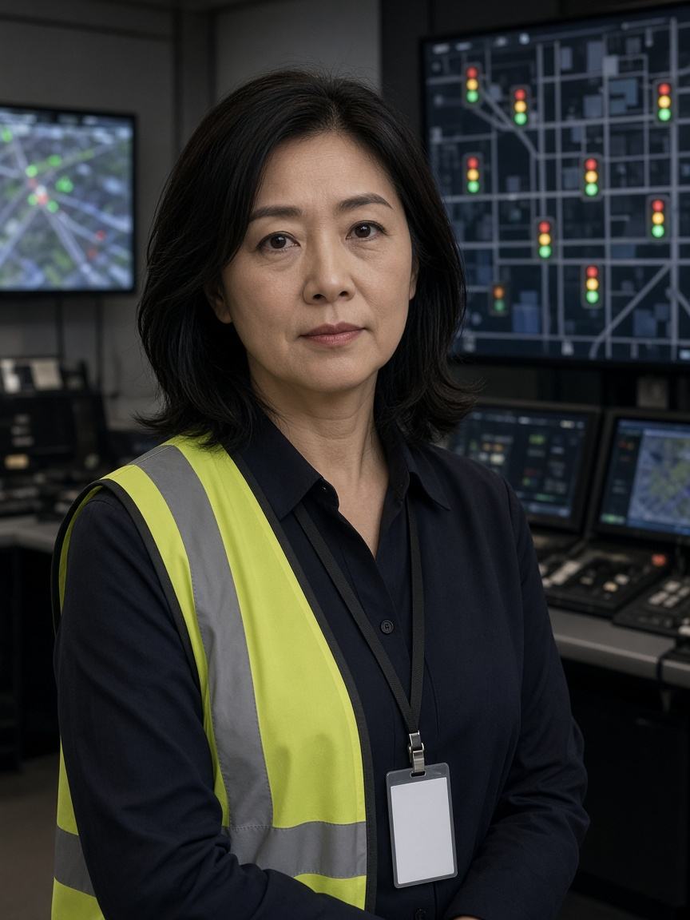
Persona 6 — Yuki
Accountable for safe automated network performance · Tunis design context (assumption)
DESIGN STATEMENT · SYNTHESIS, NOT A QUOTE
“Automation should support my decisions—not leave me responsible for a system I cannot control.”
NEED
FEAR
Mode, health, freshness, constraints, safe override and recovery.
Stale data looks healthy while control degrades.
USES
REJECTS
Signal supervisor, logs, sensor health and GIS tools.
Silent degradation, LLM actuation or unsafe manual commands.
P6 · AGE 47
EVIDENCE
MEASURE · PROPOSED, NOT A RESULT
Operational documentation motivates intervention and audit [C08]; CoFlow-5 fixes the exact authority and ladder [C16].
Legal actions, transition reasons, health evidence and fallback order.
Yuki
Traffic engineer / operations
BIO · Represents diagnosis, safe override and predictable fallback.
Illustration · not an interviewed person
PERSONALITY · Careful, process-driven and accountable; design assumption.
Notes:
Research-informed design persona, not an interview. Automation should support my decisions—not leave me responsible for a system I cannot control. Need: Mode, health, freshness, constraints, safe override and recovery. Fear: Stale data looks healthy while control degrades. Evidence: Operational documentation motivates intervention and audit [C08]; CoFlow-5 fixes the exact authority and ladder [C16]. Proposed measure: Legal actions, transition reasons, health evidence and fallback order.

Slide 7
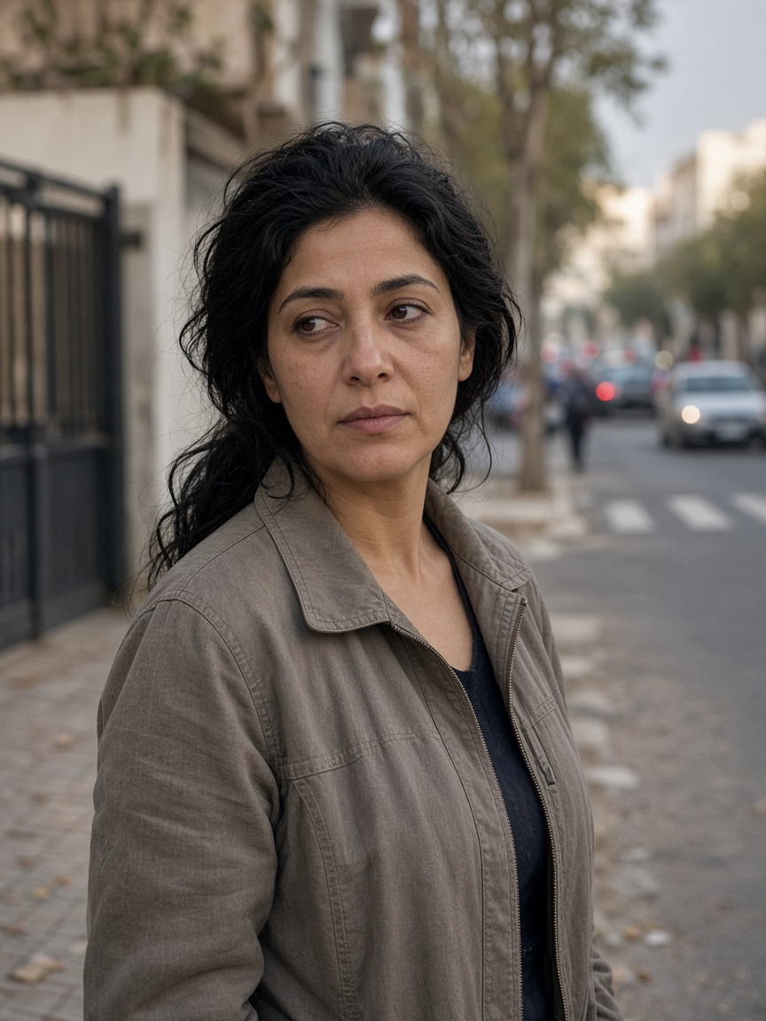
Persona 7 — Maria
Walks her child along a school-adjacent street · Tunis design context (assumption)
DESIGN STATEMENT · SYNTHESIS, NOT A QUOTE
“Cleaner traffic on the main road must not mean more exhaust outside our homes.”
NEED
FEAR
Link-level maps, school-sensitive checks and explicit displacement limits.
The main road improves by moving queues to her street.
USES
REJECTS
No specialist tool; she needs understandable maps and labels.
Calling HBEFA air quality or claiming a Tunis deployment.
P7 · AGE 38
EVIDENCE
MEASURE · PROPOSED, NOT A RESULT
In 2005–2006, 6.4M students (12.5% of the studied US population) attended schools within 250 m of a major road [C09].
Per-link stops and emission proxies near selected receptors.
Maria
Parent living near an arterial
BIO · Represents residents who can bear hidden local displacement.
Illustration · not an interviewed person
PERSONALITY · Protective, local and sceptical of averages; design assumption.
Notes:
Research-informed design persona, not an interview. Cleaner traffic on the main road must not mean more exhaust outside our homes. Need: Link-level maps, school-sensitive checks and explicit displacement limits. Fear: The main road improves by moving queues to her street. Evidence: In 2005–2006, 6.4M students (12.5% of the studied US population) attended schools within 250 m of a major road [C09]. Proposed measure: Per-link stops and emission proxies near selected receptors.

Slide 8
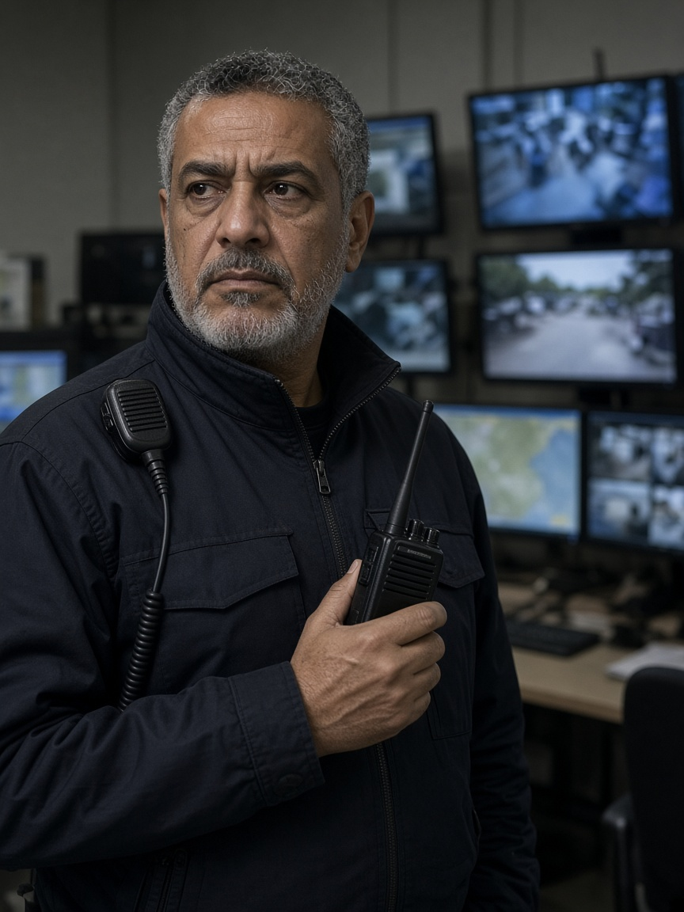
Persona 8 — Omar
Monitors incidents and coordinates operational response · Tunis design context (assumption)
DESIGN STATEMENT · SYNTHESIS, NOT A QUOTE
“Tell me what is wrong, why you think so, and whether I can still trust the data.”
NEED
FEAR
Severity, observations, uncertainty, freshness and data-health warnings.
False alarms or a frozen screen hide the real condition.
USES
REJECTS
Radio, camera wall, incident tools and dashboard.
Alerts without evidence or anomaly presented as proven cause.
P8 · AGE 55
EVIDENCE
MEASURE · PROPOSED, NOT A RESULT
FHWA estimates incidents account for about 25–30% of congestion in many US metropolitan contexts—not Tunis [C10].
Detection delay, false alarms, misses, stale data and recovery.
Omar
Network duty officer
BIO · Represents the difference between “nothing detected” and “cannot see.”
Illustration · not an interviewed person
PERSONALITY · Sceptical, methodical and operational; design assumption.
Notes:
Research-informed design persona, not an interview. Tell me what is wrong, why you think so, and whether I can still trust the data. Need: Severity, observations, uncertainty, freshness and data-health warnings. Fear: False alarms or a frozen screen hide the real condition. Evidence: FHWA estimates incidents account for about 25–30% of congestion in many US metropolitan contexts—not Tunis [C10]. Proposed measure: Detection delay, false alarms, misses, stale data and recovery.

