Slide 1
ESPRIT · 4DS · DATA SCIENCE
CoFlow-5 Synapse
Design Thinking → a reliable five-agent traffic solution
Eight research-informed personas · controlled SUMO scenarios · one signal writer · evidence before claims
EMPATHIZE
DEFINE
IDEATE
PROPOSE
people and journeys
human-centred problem
compare and cut ideas
five agents, one writer
Course HMW: How might we use data and intelligent agents to make urban traffic more efficient, adaptive and sustainable?
Professor presentation · 22 September 2026
Notes:
Open with the course question. Say that we began with people and evidence before choosing an algorithm. The presentation covers Design Thinking and the proposed solution, with current project status shown honestly.

Slide 2
COURSE BRIEF
The course challenge
The brief gives the problem and outcomes—not a predefined technical answer.
“How might we use data and intelligent agents to make urban traffic more efficient, adaptive, and sustainable?”
INFORMATION
DECISIONS
COOPERATION
EVALUATION
What should an agent observe?
What may it decide?
Independent or cooperative?
How do we know it helps?
Our answer
Cooperate through typed evidence. Only A1 acts. Compare against fixed-time and actuated control. Keep failures and limitations visible. [C01]
CoFlow-5 Synapse · Design Thinking + proposed solution
Notes:
Read the challenge once. Explain that the course allows us to choose the data, agents, cooperation and evaluation method, but requires a prototype, scenarios, baseline comparison and evidence.

Slide 3
COURSE OUTCOMES
What the professor should be able to verify
Innovation matters, but evidence matters more than technological complexity.
1
2
3
4
Working prototype
Different conditions
Baseline comparison
Strengths + limitations
A reproducible SUMO run with one legal signal writer.
Demand, emergency, pedestrian, transit and failure scenarios.
Fixed-time and actuated on matched scenario seeds.
Data, null results, externalities and missing evidence.
Evidence discipline: measured result ≠ proposed target ≠ literature finding ≠ design assumption.
CoFlow-5 Synapse · Design Thinking + proposed solution
Notes:
Explain the four required outcomes. Stress that a smaller reproducible prototype is stronger than a complex demo with no baseline or evidence.

Slide 4
METHOD
Design Thinking: the path from people to prototype
Stages 1–3 are complete as research-informed design work; current prototype evidence is tracked separately.
1
2
3
4
5
EMPATHIZE
DEFINE
IDEATE
PROTOTYPE
TEST
Personas
Journeys
Evidence
POV
Problem
HMW
Diverge
Compare
Choose
SUMO
Agents
Artifacts
Baselines
Faults
Limits
Why this matters
We did not begin with “build five AI agents.” We began with who experiences the problem, what evidence supports the need, and what a safe system must never do. [C02]
Current status rule
Old narrative status labels are not evidence. Contracts, artifacts and tests decide what is gated or verified.
CoFlow-5 Synapse · Design Thinking + proposed solution
Notes:
Walk left to right. Empathize, Define and Ideate explain why the architecture exists. Prototype and Test are governed by the harness and current evidence status, not by old slide labels.

Slide 5
EMPATHIZE
How we Empathized without inventing interviews
Literature and system documentation informed needs; journey maps exposed pain and trade-offs.
CONSULT
OBSERVE
Primary papers, official guidance and product documentation
Eight staged User Journeys from approach to recovery
DfT · FHWA · MUTCD · SCATS · SUMO
Pain, uncertainty, trade-offs and failure
IMMERSE
CHALLENGE
SUMO as a controlled street environment
Claim flags and a source-type audit
Useful for tests; not a substitute for field interviews
Prevent folklore numbers and exaggerated conclusions
Proxy validation = team/professor walkthrough of assumptions · not an interview with the persona
CoFlow-5 Synapse · Design Thinking + proposed solution
Notes:
Explain that we used three methods: consult evidence, map journeys and use SUMO as a stand-in environment. A team or professor walkthrough is proxy validation, not a stakeholder interview.

Slide 6
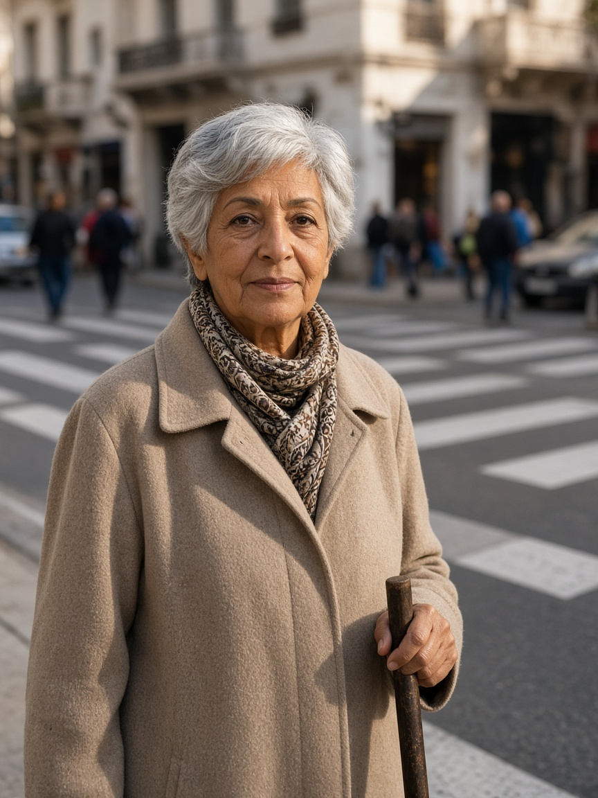
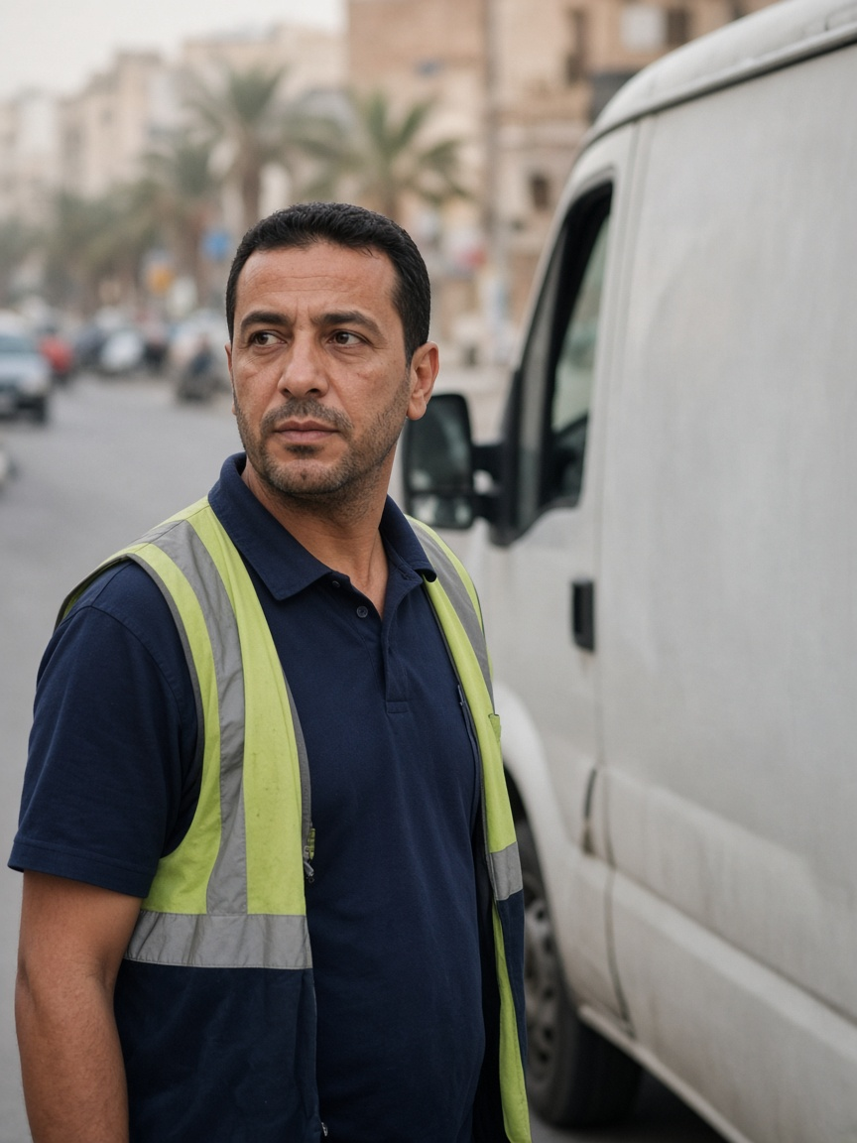
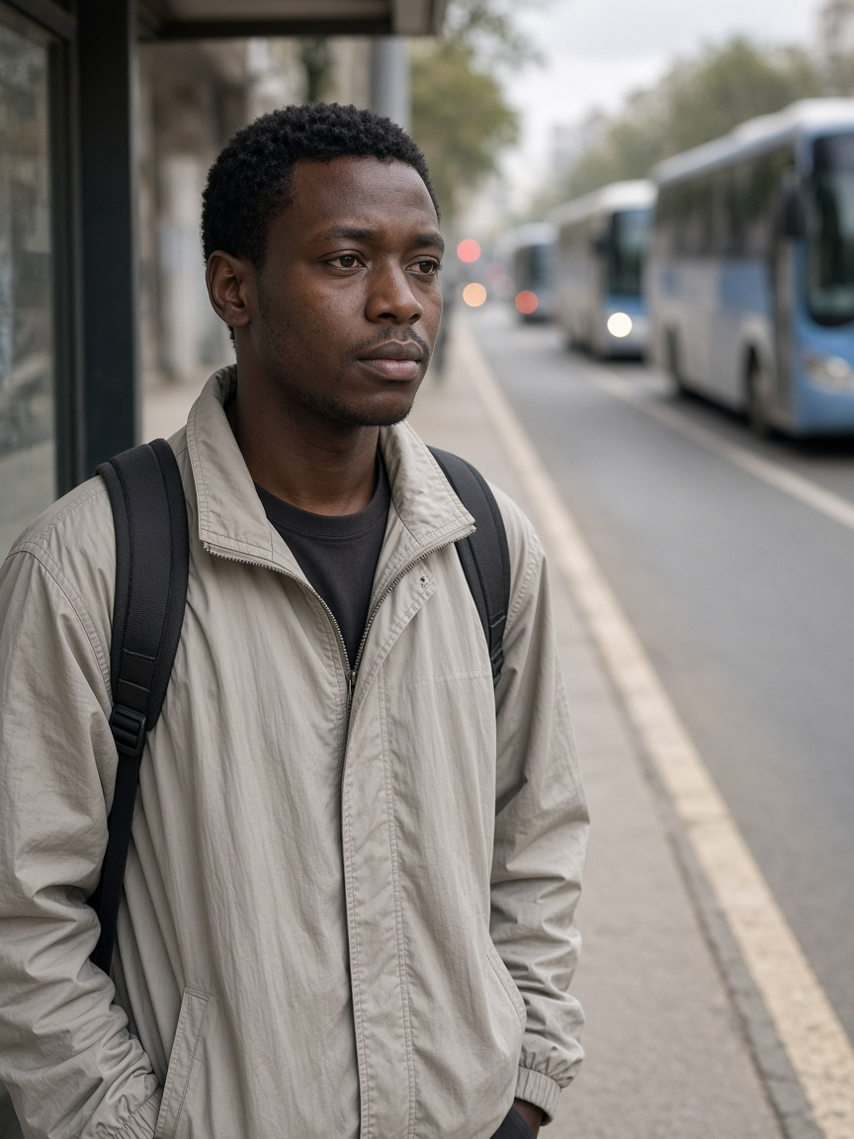
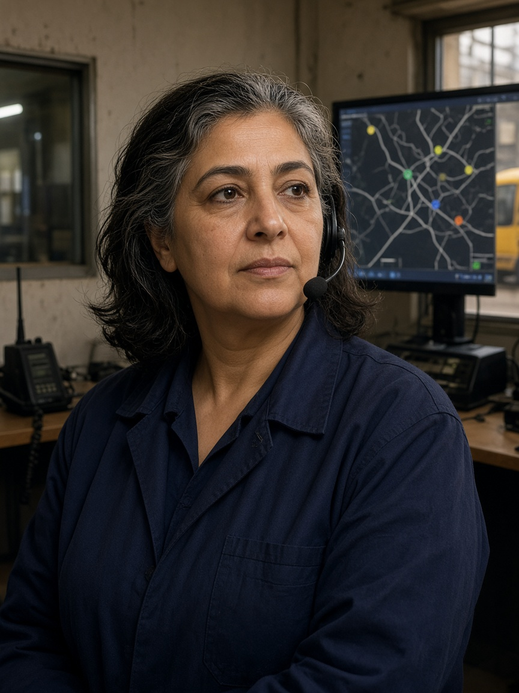
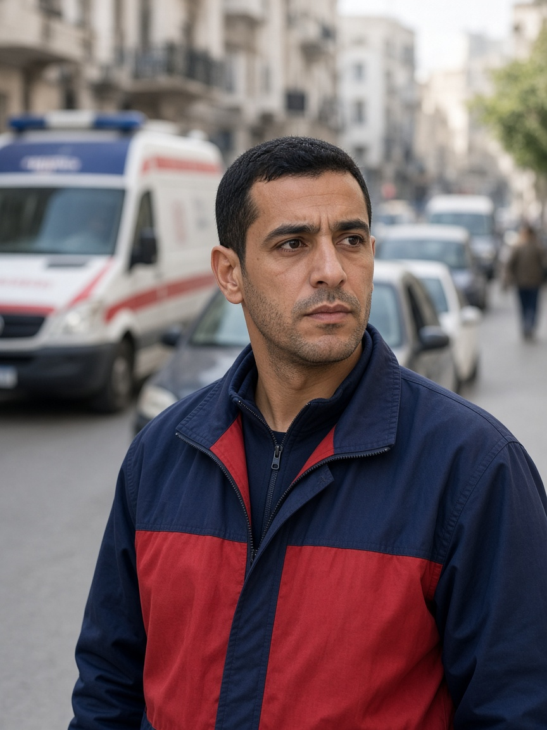
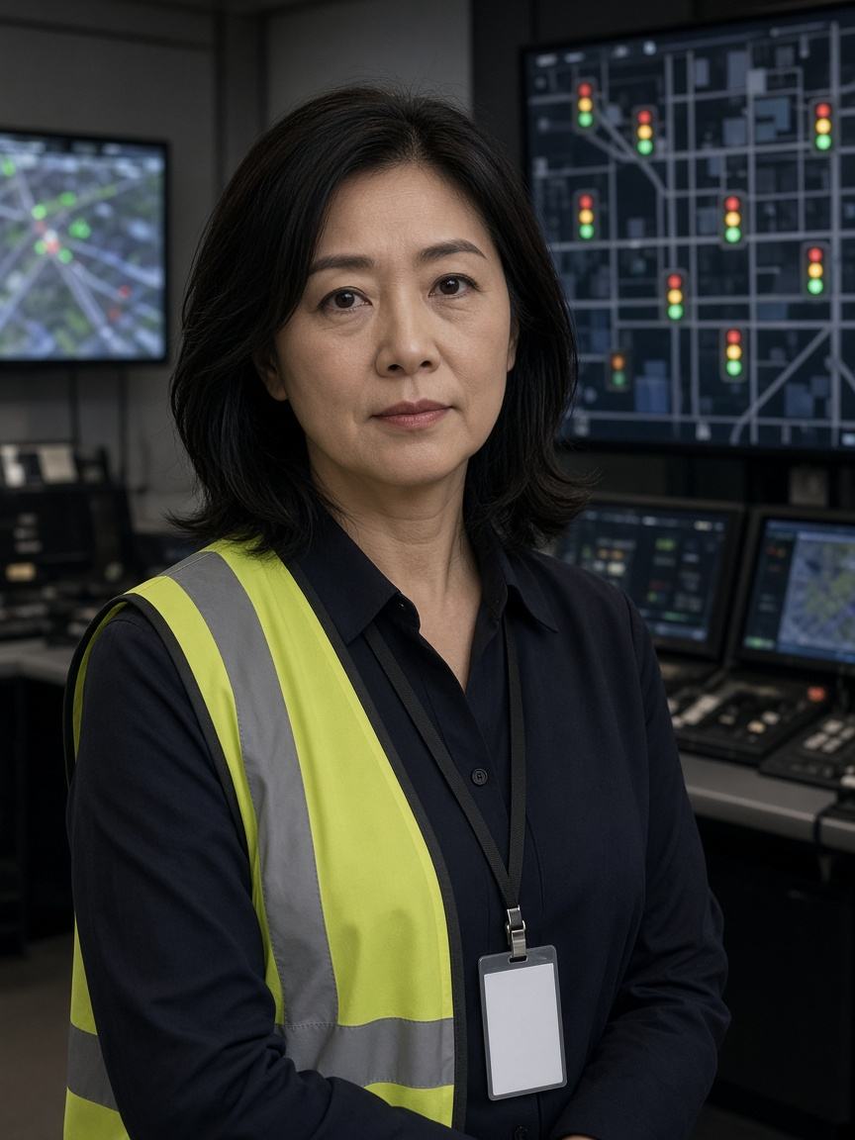
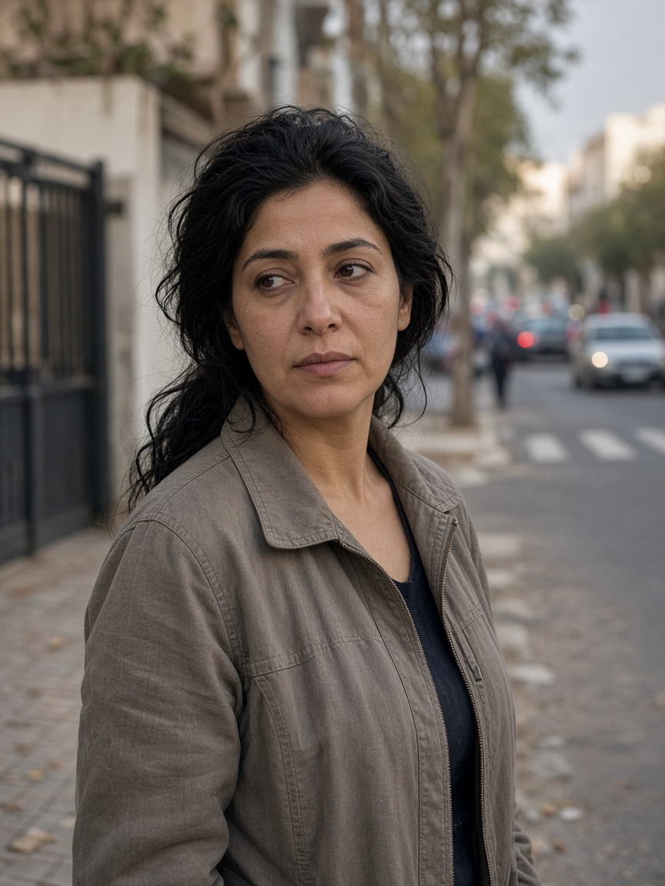
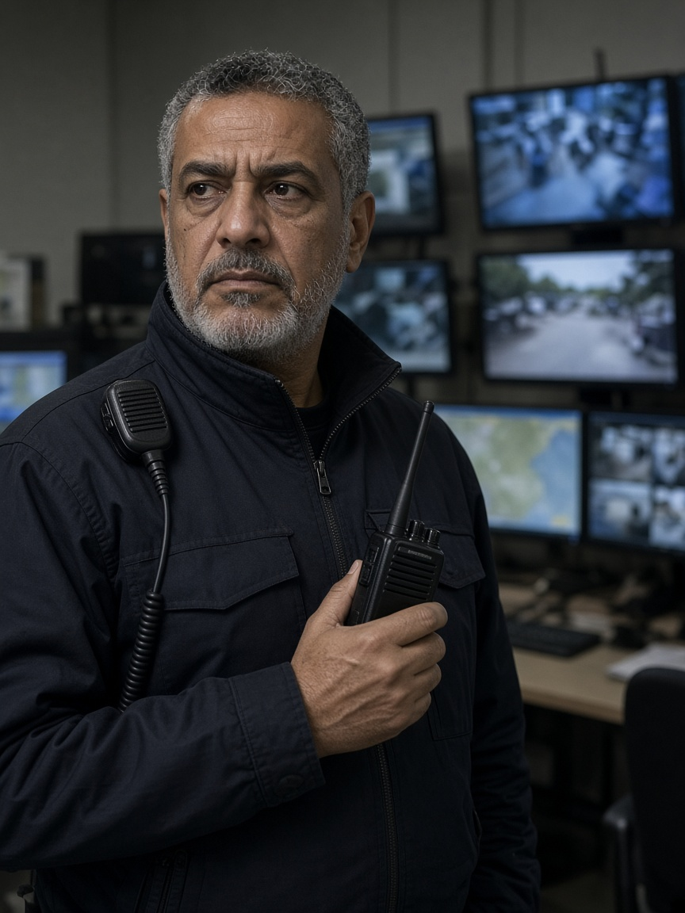
EMPATHIZE
Eight personas: traffic is more than the average car
Each persona contributes one need, one accountable component and one main evaluation question.
P1 · Amara
P2 · David
P3 · Chidi
P4 · Rosa
Retired pedestrian; uses a cane
Delivery-van driver
Frequent bus passenger
Bus depot controller
I need enough time to finish crossing, even when traffic is busy.
I can plan around a longer trip if I know how long it will actually take.
Buses should arrive regularly—not three at once after a long wait.
Show me why priority was granted or denied, and let me respond safely.
PHOTO CARD NEXT
PHOTO CARD NEXT
PHOTO CARD NEXT
PHOTO CARD NEXT
P5 · Marcus
P6 · Yuki
P7 · Maria
P8 · Omar
Urban ambulance crew
Traffic engineer / network operations
Parent living near an arterial
Network duty officer
Get us through safely, and make sure traffic recovers after we pass.
Automation should support my decisions—not leave me responsible for a system I cannot control.
Cleaner traffic on the main road must not mean more exhaust outside our homes.
Tell me what is wrong, why you think so, and whether I can still trust the data.
PHOTO CARD NEXT
PHOTO CARD NEXT
PHOTO CARD NEXT
PHOTO CARD NEXT
Canonical roster: do not append the alternate six-name IMATM roster as extra people.
CoFlow-5 Synapse · Design Thinking + proposed solution
Notes:
Introduce the eight personas quickly. Do not read every card. Tell the professor that the next eight slides show the complete persona canvases.

Slide 7
EMPATHIZE
Persona 1 — Amara
Crosses a busy central street for shops and transit. Tunis design context (assumption).
DESIGN STATEMENT · NOT AN INTERVIEW QUOTE
“I need enough time to finish crossing, even when traffic is busy.”
Need
Clear acknowledgement; wait-aware service; conservative clearance; no repeated deferral; no app requirement.
Fear
Rejects
Long waits cause fatigue. A short clearance can leave her exposed when conflicting traffic is released.
A shortened crossing for an ambulance already in conflict; inaccessible apps; targets presented as achieved results.
WHY · EVIDENCE · PROPOSED MEASURE
Amara represents slower walkers who can be excluded when signal timing assumes an average walking speed.
P1 · 74
Amara
One NZ study found perceived mean wait about 2x observed mean wait. MUTCD uses about 1.07 m/s and asks for slower values where needed. [C03][C04]
Retired pedestrian; uses a cane
Target, not a result: Mean, P95 and maximum pedestrian wait; waits above the declared threshold; zero clearance truncations.
Illustration · not a real stakeholder
Notes:
Introduce Amara as a research-informed design persona, not an interviewed person. Read the design statement, then one need, one fear, and one reject. Evidence: One NZ study found perceived mean wait about 2x observed mean wait. MUTCD uses about 1.07 m/s and asks for slower values where needed. [C03][C04] Evaluation target, not a result: Mean, P95 and maximum pedestrian wait; waits above the declared threshold; zero clearance truncations. Personality (assumption): Careful, independent, neighbourhood-aware. These traits are design assumptions, not interview findings. Technology: Pedestrian push-button, audible/visual feedback and reliable presence detection. A smartphone is not required.

Slide 8
EMPATHIZE
Persona 2 — David
More than 60 time-sensitive stops in a workday. Tunis design context (assumption).
DESIGN STATEMENT · NOT AN INTERVIEW QUOTE
“I can plan around a longer trip if I know how long it will actually take.”
Need
Reliable journey tails, fewer unnecessary stops, visible incidents and network coordination beyond one junction.
Fear
Rejects
Unpredictable surges break delivery windows. A good average can hide severe late trips and unfinished routes.
A faster average with worse P95 trips; deleting unfinished or teleported trips from evaluation.
WHY · EVIDENCE · PROPOSED MEASURE
David makes journey reliability visible: the system must report the bad tail, not only mean travel time.
P2 · 41
David
DfT TAG uses 0.4 as an appraisal reliability ratio for car/non-freight LGV journey-time variability. [C05]
Delivery-van driver
Target, not a result: Completed and unfinished trips, P95/max duration, stops per vehicle, standstill time and teleports.
Illustration · not a real stakeholder
Notes:
Introduce David as a research-informed design persona, not an interviewed person. Read the design statement, then one need, one fear, and one reject. Evidence: DfT TAG uses 0.4 as an appraisal reliability ratio for car/non-freight LGV journey-time variability. [C05] Evaluation target, not a result: Completed and unfinished trips, P95/max duration, stops per vehicle, standstill time and teleports. Personality (assumption): Organised, practical and schedule-focused. These traits are a design synthesis. Technology: Work phone, GPS/navigation and delivery-round tools; no special traffic-control interface.

Slide 9
EMPATHIZE
Persona 3 — Chidi
Uses a high-frequency corridor where regularity is the service. Tunis design context (assumption).
DESIGN STATEMENT · NOT AN INTERVIEW QUOTE
“Buses should arrive regularly—not three at once after a long wait.”
Need
Conditional priority for a late bus or large headway gap—not automatic priority for every bus.
Fear
Rejects
A long gap is followed by bunched buses. Signal delay compounds lateness and breaks connections.
Unconditional bus priority; cutting pedestrian clearance; measuring only bus travel time.
WHY · EVIDENCE · PROPOSED MEASURE
Chidi represents passengers for whom headway regularity and waiting matter more than one bus moving slightly faster.
P3 · 27
Chidi
DfT TAG applies a 2x value-of-time multiplier to public-transport waiting. Bunching evidence motivates headway measures. [C05]
Frequent bus passenger
Target, not a result: Lateness, headway variation, passenger waiting proxy and externality to other traffic.
Illustration · not a real stakeholder
Notes:
Introduce Chidi as a research-informed design persona, not an interviewed person. Read the design statement, then one need, one fear, and one reject. Evidence: DfT TAG applies a 2x value-of-time multiplier to public-transport waiting. Bunching evidence motivates headway measures. [C05] Evaluation target, not a result: Lateness, headway variation, passenger waiting proxy and externality to other traffic. Personality (assumption): Routine-oriented and sensitive to uncertainty. This is a research-informed design assumption. Technology: Passenger information or timetable application when available; otherwise direct observation at the stop.

Slide 10
EMPATHIZE
Persona 4 — Rosa
Supervises bus operations and disruption. Tunis design context (assumption).
DESIGN STATEMENT · NOT AN INTERVIEW QUOTE
“Show me why priority was granted or denied, and let me respond safely.”
Need
Positions, headways, priority status, confidence, reason codes, safe intervention and a time-stamped audit trail.
Fear
Rejects
Scattered information and unexplained refusals make incidents difficult to manage and defend later.
A black box, unsupported prediction promises and any override that bypasses the safety mask.
WHY · EVIDENCE · PROPOSED MEASURE
Rosa represents the operator who must understand why a bus request lost to safety, emergency or capacity constraints.
P4 · 52
Rosa
SCATS documentation includes monitoring, manual intervention and audit trails, motivating explainable operations. [C08]
Bus depot controller
Target, not a result: Reason-code coverage, joined decision history and a simple operator task: explain one accepted and one rejected request.
Illustration · not a real stakeholder
Notes:
Introduce Rosa as a research-informed design persona, not an interviewed person. Read the design statement, then one need, one fear, and one reject. Evidence: SCATS documentation includes monitoring, manual intervention and audit trails, motivating explainable operations. [C08] Evaluation target, not a result: Reason-code coverage, joined decision history and a simple operator task: explain one accepted and one rejected request. Personality (assumption): Responsible, calm under pressure and evidence-seeking. These are design assumptions. Technology: Depot tools, vehicle-location screen, radio, spreadsheet and an operations dashboard.

Slide 11
EMPATHIZE
Persona 5 — Marcus
Responds through congested streets during peak periods. Tunis design context (assumption).
DESIGN STATEMENT · NOT AN INTERVIEW QUOTE
“Get us through safely, and make sure traffic recovers after we pass.”
Need
Authenticated route/ETA request, downstream-capacity check, safe pre-clearance and controlled post-passage recovery.
Fear
Rejects
A green is useless when the downstream link is full. Isolated priority can leave queues and disrupted buses behind.
Truncating an occupied crossing, moving a queue one junction ahead or translating simulation seconds into casualties.
WHY · EVIDENCE · PROPOSED MEASURE
Marcus makes both benefit and civilian externality visible. Passage and recovery form one journey.
P5 · 34
Marcus
One Taipei cohort associated each additional ALS-response minute with 7% lower adjusted odds of survival to discharge. Closely spaced preemptions can impose delay in a studied network. [C06][C07]
Urban ambulance crew
Target, not a result: Emergency travel effect, civilian delay externality, blocked-downstream rejection, safety violations and recovery completion.
Illustration · not a real stakeholder
Notes:
Introduce Marcus as a research-informed design persona, not an interviewed person. Read the design statement, then one need, one fear, and one reject. Evidence: One Taipei cohort associated each additional ALS-response minute with 7% lower adjusted odds of survival to discharge. Closely spaced preemptions can impose delay in a studied network. [C06][C07] Evaluation target, not a result: Emergency travel effect, civilian delay externality, blocked-downstream rejection, safety violations and recovery completion. Personality (assumption): Urgent, precise and aware of other road users. This is a design synthesis. Technology: Dispatch tablet, GPS, radio, lights and siren; no public consumer application.

Slide 12
EMPATHIZE
Persona 6 — Yuki
Accountable for safe automated network performance. Tunis design context (assumption).
DESIGN STATEMENT · NOT AN INTERVIEW QUOTE
“Automation should support my decisions—not leave me responsible for a system I cannot control.”
Need
Current mode, health, freshness, decisions, constraints, safe override and predictable recovery.
Fear
Rejects
Stale data can look normal. Unexpected decisions are hard to diagnose, and unsafe manual takeover is not acceptable.
Silent degradation, an LLM in the control loop and a manual command that can create conflicting greens.
WHY · EVIDENCE · PROPOSED MEASURE
Yuki represents the engineer who must diagnose failure and regain control without bypassing legal signal transitions.
P6 · 47
Yuki
Operational systems document intervention and fallback concepts; they motivate—not validate—CoFlow-5's exact ladder. [C08]
Traffic engineer / network operations
Target, not a result: Legal actions, transition reasons, health evidence, fallback order, log completeness and recovery time.
Illustration · not a real stakeholder
Notes:
Introduce Yuki as a research-informed design persona, not an interviewed person. Read the design statement, then one need, one fear, and one reject. Evidence: Operational systems document intervention and fallback concepts; they motivate—not validate—CoFlow-5's exact ladder. [C08] Evaluation target, not a result: Legal actions, transition reasons, health evidence, fallback order, log completeness and recovery time. Personality (assumption): Careful, process-driven and accountable. These are design assumptions. Technology: Signal supervisor, logs, sensor-health tools and GIS/analysis software.

Slide 13
EMPATHIZE
Persona 7 — Maria
Walks her child along a school-adjacent street. Tunis design context (assumption).
DESIGN STATEMENT · NOT AN INTERVIEW QUOTE
“Cleaner traffic on the main road must not mean more exhaust outside our homes.”
Need
Link-level maps, school-sensitive checks, before/after comparison and explicit displacement limits.
Fear
Rejects
A network average can hide queues moved to her street. Modelled emissions are not the air her family breathes.
Calling HBEFA air quality, hiding a worse side street, or claiming a Tunis deployment from simulation.
WHY · EVIDENCE · PROPOSED MEASURE
Maria represents residents who bear local burdens even when a city-wide metric improves.
P7 · 38
Maria
For 2005–2006, 6.4 million students (12.5% of the studied US population) attended schools within 250 m of a major road. [C09]
Parent living near an arterial
Target, not a result: Per-link stops and emission proxies near selected receptors; displacement map; no ambient-exposure claim.
Illustration · not a real stakeholder
Notes:
Introduce Maria as a research-informed design persona, not an interviewed person. Read the design statement, then one need, one fear, and one reject. Evidence: For 2005–2006, 6.4 million students (12.5% of the studied US population) attended schools within 250 m of a major road. [C09] Evaluation target, not a result: Per-link stops and emission proxies near selected receptors; displacement map; no ambient-exposure claim. Personality (assumption): Protective, local and sceptical of averages. These traits are design assumptions. Technology: No specialist technology is assumed; she sees understandable maps and labels, not TraCI.

Slide 14
EMPATHIZE
Persona 8 — Omar
Monitors incidents and coordinates operational response. Tunis design context (assumption).
DESIGN STATEMENT · NOT AN INTERVIEW QUOTE
“Tell me what is wrong, why you think so, and whether I can still trust the data.”
Need
Severity, observations, uncertainty, freshness, data-health warnings and recovery tracked after clearance.
Fear
Rejects
False alarms destroy trust. A queue may mean an incident, demand or a dead sensor; a frozen screen can look healthy.
Alerts without evidence, a universal detection-delay number or an anomaly presented as a proven cause.
WHY · EVIDENCE · PROPOSED MEASURE
Omar represents the person who must separate “nothing detected” from “insufficient reliable data.”
P8 · 55
Omar
FHWA estimates incidents account for about 25–30% of congestion in many US metropolitan contexts; this is not a Tunis measurement. [C10]
Network duty officer
Target, not a result: Detection delay, false-alarm rate, missed incidents, stale-data handling and recovery by severity.
Illustration · not a real stakeholder
Notes:
Introduce Omar as a research-informed design persona, not an interviewed person. Read the design statement, then one need, one fear, and one reject. Evidence: FHWA estimates incidents account for about 25–30% of congestion in many US metropolitan contexts; this is not a Tunis measurement. [C10] Evaluation target, not a result: Detection delay, false-alarm rate, missed incidents, stale-data handling and recovery by severity. Personality (assumption): Sceptical, methodical and operational. These are design assumptions. Technology: Radio, camera/video wall, incident tools and an operator dashboard.

Slide 15
USER JOURNEY
Shared journey: one street, competing needs
An ambulance approaches Maria’s school street while Amara is crossing and Chidi’s late bus arrives.
1
2
3
4
5
6
Request arrives
Crossing occupied
Capacity checked
Bus request judged
Queues watched
Failure + recovery
Marcus / Yuki
Amara / Marcus
Marcus / David
Chidi / Rosa
Maria / David
Yuki / Omar
Authenticate route, ETA and urgency
Finish active clearance before conflicting movement
Reject a green into blocked downstream space
Late-only request; record accept/reject reason
Observe displaced stops and local proxy burden
Degrade visibly; then recover in known stages
Design principle
Cooperation with explicit safeguards: no specialist may hide the cost imposed on another person.
This is a human-centred scenario story. Implemented deterministic fixtures are shown later.
CoFlow-5 Synapse · Design Thinking + proposed solution
Notes:
Tell this as a story. The point is not to make one persona win every time. The point is to preserve safety, record who pays, and recover after priority.

Slide 16
EVIDENCE DISCIPLINE
Evidence register: what supports a need—and what does not
Use the source type before using the number.
32-row mixed-source evidence register, audited by source type
PRIMARY / OFFICIAL
SECONDARY / VENDOR
Original study, agency guidance or owning documentation
Useful context; narrower wording and visible source limits
TEAM JUDGEMENT
PROPOSED TARGET
Priority, weights and architecture scores—not measurements
A threshold to test—not a result or universal standard
Claim flags
No casualty interpretation · no ambient air-quality claim · no invented interviews · no best-episode headline · no Tunis deployment claim
Method and persona status [C02] · full safe wording lives in presentation-claim-ledger.json
CoFlow-5 Synapse · Design Thinking + proposed solution
Notes:
Explain the correction from older deck language. We use a 32-row mixed-source evidence register, not a claim that every row is primary evidence.

Slide 17
DEFINE
Define: the problem is not “reduce average car delay”
Averages can hide starvation, displacement, fragility and unexplained trade-offs.
Wrong framing
Human-centred framing
“Build five AI agents and reduce mean vehicle delay.”
That is a builder wish. It says nothing about who is harmed, safety, failure or evidence.
Street users and operators need signal control that treats distinct needs as first-class objectives with visible trade-offs—because throughput-only control hides who pays and can degrade silently.
MEAN DELAY
FAST BUS
GREEN FOR EV
NETWORK CO₂
can hide unfinished and extreme trips
does not guarantee regular headways
does not create downstream space
can hide a worse school-adjacent street
Design goal: measurable, constrained, explainable decisions that remain safe when data, messages or models fail.
CoFlow-5 Synapse · Design Thinking + proposed solution
Notes:
Contrast the wrong technical framing with the human-centred framing. The system exists to make distinct needs first-class and trade-offs visible.

Slide 18
DEFINE
POV statements become “How might we” questions
User + need + insight → a question broad enough for multiple solutions.
Amara
finish safely
David
predictable trips
How might we reduce waiting without shortening required clearance?
How might we improve tails, not only the mean?
Chidi
regular service
Rosa
understand decisions
How might lights help headways without prioritising every bus?
How might every accept/reject be explainable and reviewable?
Marcus
passage + recovery
Yuki
safe command
How might we create useful space and record civilian cost?
How might we diagnose, override and recover predictably?
Maria
no displacement
Omar
trustworthy alerts
How might we show where modelled burdens move?
How might we separate incident, congestion and bad data?
INTEGRATED HMW
How might we improve urban traffic for every person—not only the average car—while making trade-offs auditable and failure safe?
CoFlow-5 Synapse · Design Thinking + proposed solution
Notes:
Show that each persona need becomes a design question. Read only the integrated question and one example, such as Amara or Marcus.

Slide 19
IDEATE
Ideate: diverge before choosing
We generated alternatives across flow, emergency, multimodal, sustainability, situation and communication.
FLOW
EMERGENCY
MULTIMODAL
Fixed-time · actuated · Max-Pressure · independent RL · graph coordination · corridor offsets
Local preemption · corridor pre-clearance · route-aware requests · recovery mode
Every-bus priority · lateness-gated priority · pedestrian deadline · bus holding
SITUATION
SUSTAINABILITY
COMMUNICATION
Persistence · tree model · LightGBM · residual anomaly detection · oracle ablation
Stop/idle proxy · modelled CO₂ · link displacement maps · eco advice
Perfect comms · typed board · TTL · drop/delay emulator · LLM orchestrator
Research context—not our results
RESCO, T-REX, CoLLMLight and communication-reliability work helped us ask harder questions about stability, incidents, timing and failures. [C11][C12][C13][C14]
Divergence rule: generate first; judge later.
CoFlow-5 Synapse · Design Thinking + proposed solution
Notes:
Explain that ideation was not reverse-engineered from the chosen architecture. We considered central, independent, hierarchical, rule-based, learned and language-model approaches.

Slide 20
IDEATE
Worst Possible Idea: invert a bad design into a safeguard
Deliberately unsafe ideas made hidden assumptions visible.
BAD IDEA
WHY IT FAILS
SAFEGUARD CREATED
LLM sets lights
Latency and failure are wrong for safety-critical actuation
Synapse explains; never actuates
All agents write
Conflicting commands and unclear accountability
One signal writer: A1
Always preempt EV
Blocked exits and hidden civilian cost
Capacity check + separate externality
Every bus gets green
Early buses consume recovery time
Lateness/headway evidence required
Trust perfect data
Stale or missing messages look healthy
TTL, visible disposition and local fallback
Show best episode
Selects an extreme and hides instability
Matched evidence + null/negative results
CoFlow-5 Synapse · Design Thinking + proposed solution
Notes:
Use the first two examples to explain the technique: describe a deliberately bad idea, identify why it fails, then turn that failure into a requirement.

Slide 21
IDEATE
SCAMPER: rethink a conventional traffic controller
Seven prompts generated concrete features without assuming one AI model.
S
Substitute
P
Put to use
Assumed demand → observed queues and downstream capacity
The same observations support forecasts and incident residuals
C
Combine
E
Eliminate
Local flow + typed emergency, pedestrian and transit evidence
Perfect communication and unlimited priority assumptions
A
Adapt
R
Reverse
Max-Pressure and deterministic recovery from adaptive control
Specialists ask; one authority acts; active crossing outranks EV
M
Modify
Count people, tails and externalities—not only vehicles
Result
SCAMPER did not “prove” the architecture. It generated testable design features that still had to be compared and constrained.
CoFlow-5 Synapse · Design Thinking + proposed solution
Notes:
SCAMPER is an ideation checklist. Give two examples: substitute assumed demand with observed queues; reverse the authority so specialists ask and one controller acts.

Slide 22
IDEATE
Converge: compare architecture options
Scores and weights are team judgements—not empirical evidence.
OPTION
SAFETY
AUDIT
EVIDENCE RISK
COMPUTE
DECISION
Central learned brain
2/5
2/5
High
High
Reject
Independent junctions
3/5
3/5
Medium
Low
Reject
Hierarchical MARL
4/5
3/5
High
High
Park
One actuator + advisers
5/5
5/5
Lower
Medium
Choose
Why chosen
One writer makes authority testable. Deterministic safety remains outside learning. Specialists can be removed by ablation. Explanations cannot affect actuation.
Illustrative scores only · change the scores and discuss sensitivity before treating the matrix as a decision.
CoFlow-5 Synapse · Design Thinking + proposed solution
Notes:
Explain that evidence informed the criteria, but the numerical scores are our decision aid. The chosen option wins mainly because safety and auditability are structural.

Slide 23
PROPOSED SOLUTION
Chosen solution: five agents, one set of hands on the lights
The Control plane is deterministic at the safety boundary; Synapse remains outside actuation.
A2 · Emergency
A3 · Multimodal
A4 · Situation
A5 · Sustainability
route · ETA · urgency
crossing · late transit
forecast · anomaly
emission-proxy advice
Typed message board
immutable · expiring · reason-coded
A1 FLOW
Safety mask
Executor → SUMO
cooperative Max-Pressure + deterministic arbitration
legal phase · clearance · capacity
Only A1 writes signals
Immutable evidence
SYNAPSE NEVER ACTUATES
Accepted boundary [C16]
manifest · messages · decisions · trips · faults
reads immutable evidence only
Recovery: Max-Pressure → actuated → fixed-time · optional DQN may only precede Max-Pressure
CoFlow-5 Synapse · Design Thinking + proposed solution
Notes:
Follow the arrows from specialist evidence to A1, then safety mask, executor and SUMO. Point out that Synapse only receives immutable evidence and has no arrow to the executor.

Slide 24
PROPOSED SOLUTION
How the agents communicate
They do not call each other in a tangled chain; they publish typed evidence and A1 answers requests.
1
2
3
4
5
SPECIALIST
ENVELOPE
BOARD
A1
REPLY + EVENT
Build finite evidence
A2/A3/A4/A5
IDs · time · expiry
priority · provenance
Validate · deduplicate
ignore stale/invalid
Filter · safety check
rank deterministically
Accept/reject reason
immutable join
Envelope identity
run_id · scenario_hash · message_id · correlation_id · source · topic · simulation time · expires_at · priority · confidence · schema · payload · provenance
1 · active crossing
2 · emergency
3 · pedestrian deadline
4 · conditional late transit
5 · general flow
6 · sustainability
Failure rule
If the board is empty or unavailable, A1 continues legal local Max-Pressure control.
CoFlow-5 Synapse · Design Thinking + proposed solution
Notes:
Follow an emergency request: A2 publishes a finite expiring message, the board validates it, A1 reads matching run/scenario evidence, checks safety and capacity, then records one decision and one reply.

Slide 25
PROTOTYPE + TEST
Simulation scenarios: from controlled science to a Tunis showcase
Human-centred stories, deterministic fixtures and broader experiments have different evidence strength.
CONTROLLED BASELINES
COOPERATION FIXTURES
FAILURE FIXTURES
Fixed-time · actuated · cooperative Max-Pressure
Matched scenario hashes and seeds
Active crossing vs emergency · two emergencies · blocked downstream · pedestrian deadline · early/late bus
Absence · loss · delay · duplicate · expiry · malformed · contradiction · silence · controller recovery · Synapse isolation
Future Tunis showcase
OpenStreetMap geometry + official scheduled TRANSTU datasets. Dataset format must be verified. Road demand stays explicitly synthetic or calibrated until an observed source is verified. [C15]
DESIGNED
IMPLEMENTED
GATED
VERIFIED
persona story
code/fixture exists
contract tests pass
independent evidence review
Never use these four words as synonyms.
CoFlow-5 Synapse · Design Thinking + proposed solution
Notes:
Separate what is designed, what is already a deterministic fixture and what remains a future showcase. Do not imply the Tunis network or demand has been validated.

Slide 26
DATA SCIENCE
Data collection: input → record → metric → claim
Every conclusion must resolve to an immutable run and its evidence files.
INPUTS
phase · elapsed time · queues · downstream capacity · route/ETA · crossing state · wait · lateness/headway
RECORDS
run manifest · state · messages · decisions · trips · faults · transitions · KPIs
METRICS
safety · completion · mean/P95/max tails · emergency + civilian effects · pedestrian wait · transit regularity · robustness
CLAIMS
requirement · directional · exploratory · null/negative retained · unavailable is not imputed
JOIN SPINE · run_id + scenario_hash + event_id + message_id
Sustainability remains a modelled emission-proxy category; no residential-link ambient observations exist yet.
CoFlow-5 Synapse · Design Thinking + proposed solution
Notes:
Explain the four layers. Inputs are observations. Records preserve what happened. Metrics summarise outcomes. Claims must cite the run and keep unavailable values empty.

Slide 27
STATUS
Current evidence status and honest limits
The presentation distinguishes verified invariants from unverified performance claims.
VERIFIED NOW
NOT ESTABLISHED YET
Rows 07 and 08 are verified.
• 7 specialist requests → one decision + one reply each
• 0 specialist signal writes; 0 clearance truncations
• 8 fault classes → 8 legal local decisions
• Synapse states → identical action hashes
[C17]
• Row 09 is not verified
• Cooperative Max-Pressure traffic KPI superiority
• A4/A5 on/off value
• Residential-link sustainability outcomes
• Tunis network performance
• Multi-seed confidence intervals
Known platform boundary
Native Windows TraCI works. libsumo remains blocked by Windows application control; no libsumo throughput number is claimed.
Deterministic acceptance fixtures ≠ network-scale deployment estimates.
CoFlow-5 Synapse · Design Thinking + proposed solution
Notes:
Read the green statements, then the amber gaps. Rows 07 and 08 prove cooperation and failure behavior in deterministic evidence slices. They do not prove city-scale traffic improvement.

Slide 28
SOURCES
Resources: where the presentation comes from
Full URLs and safe wording are stored in presentation-claim-ledger.json.
COURSE + METHOD
SUMO_forStudents.docx · course transcription · Design Thinking record
[C01][C02]
PEOPLE + OPERATIONS
Vallyon · MUTCD · DfT TAG · PLOS ONE · Nelson/Bullock · SCATS · Kingsley · FHWA
[C03]–[C10]
TRAFFIC RESEARCH
RESCO · T-REX · CoLLMLight · Finkelberg · official Eclipse SUMO documentation
[C11]–[C14]
TUNIS DATA
OpenStreetMap · Tunisia Ministry of Transport open-data portal · scheduled TRANSTU datasets
[C15]
PROJECT AUTHORITY
ADR-0001 · requirements/design · row contracts, artifacts and tests
[C16][C17]
Citation rule
Literature explains why a need matters. Only CoFlow-5 artifacts and tests can establish what CoFlow-5 did.
CoFlow-5 Synapse · Design Thinking + proposed solution
Notes:
Show that the presentation is traceable. The course brief defines the assignment; research motivates needs; ADRs define architecture; gates define current evidence.

Slide 29
AUDIT APPENDIX
Appendix: corrections applied to older material
The new deck does not silently copy stale reports or generated slides.
OLD / UNSAFE
CURRENT / SAFE
Older deck overstated every evidence row
32-row mixed-source register, audited by source type
Older deck used the wrong school-proximity percentage
6.4M / 12.5% of the studied US population (2005–2006)
“7% survival lost per minute”
7% lower adjusted odds per additional ALS-response minute in one cohort
Shared-policy DQN as core A1
Cooperative Max-Pressure required; DQN optional
Policy-led recovery ladder
Max-Pressure → actuated → fixed-time
Prototype/Test labelled only planned
Use current gates and verification certificates
Tunis GTFS/live demand assumed
Verify dataset format; road demand synthetic or calibrated
These corrections protect the professor from attractive but unsupported claims.
CoFlow-5 Synapse · Design Thinking + proposed solution
Notes:
This slide helps answer “what changed?” Explain that the evidence audit narrowed claims and the accepted ADR replaced historical architecture options.

Slide 30
CLOSE
People → evidence → problem → ideas → safe architecture
8 PERSONAS
5 AGENTS
1 WRITER
3 FALLBACK MODES
Traffic is not only cars
Specialists advise
A1 alone may actuate
Max-Pressure → actuated → fixed-time
Our contribution is not an LLM traffic controller. It is a testable decision architecture with explicit authority, safety, evidence and failure behavior.
Next research question: do the proposed specialist benefits survive matched experiments without hiding costs?
Questions?
Notes:
Close with the distinction: this is not an LLM traffic controller. It is a reliable decision architecture whose value must be established through matched evidence. Invite questions and use the resources slide to answer where each claim came from.

