Slide 1
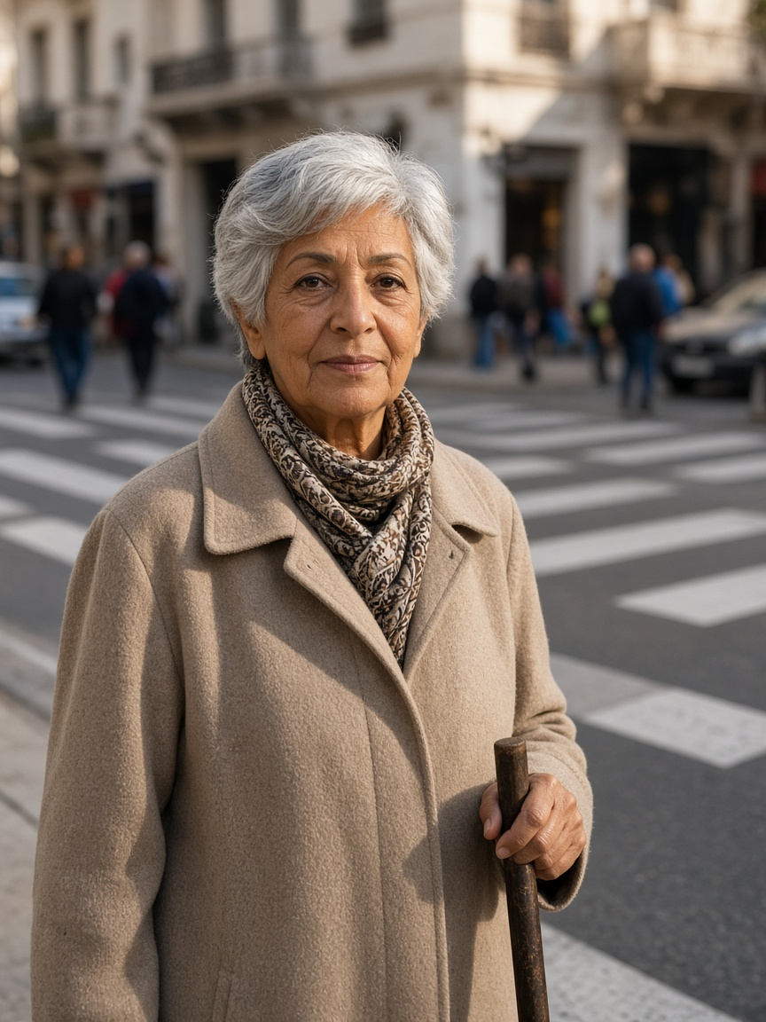
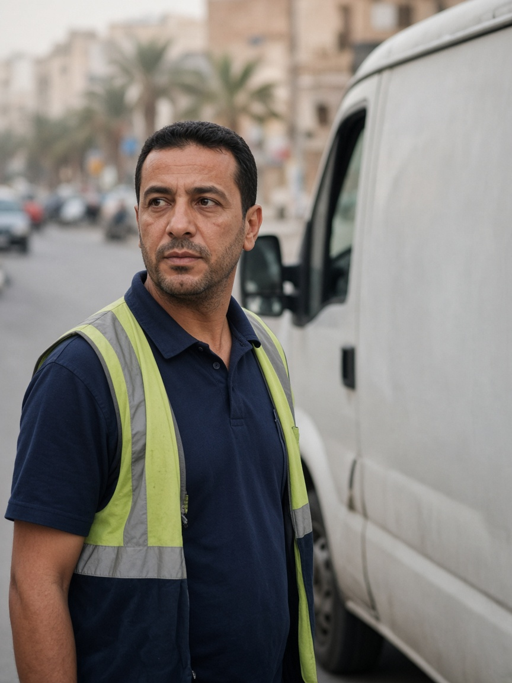
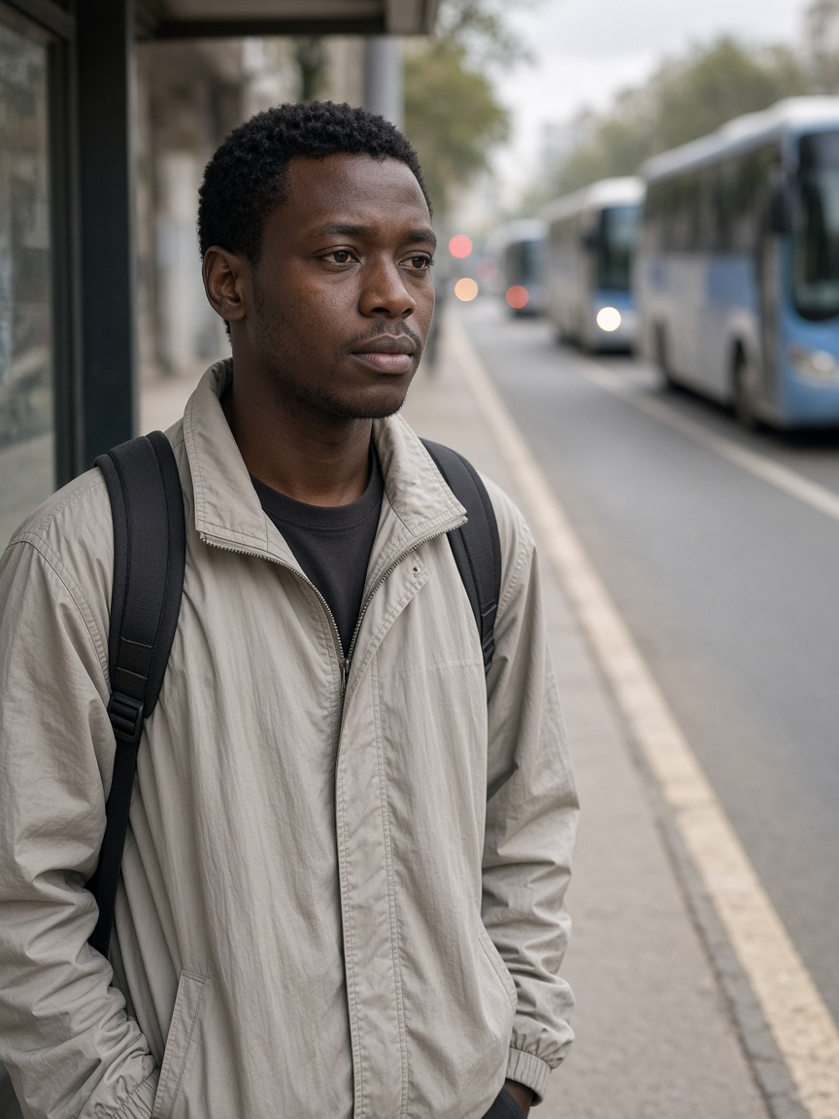
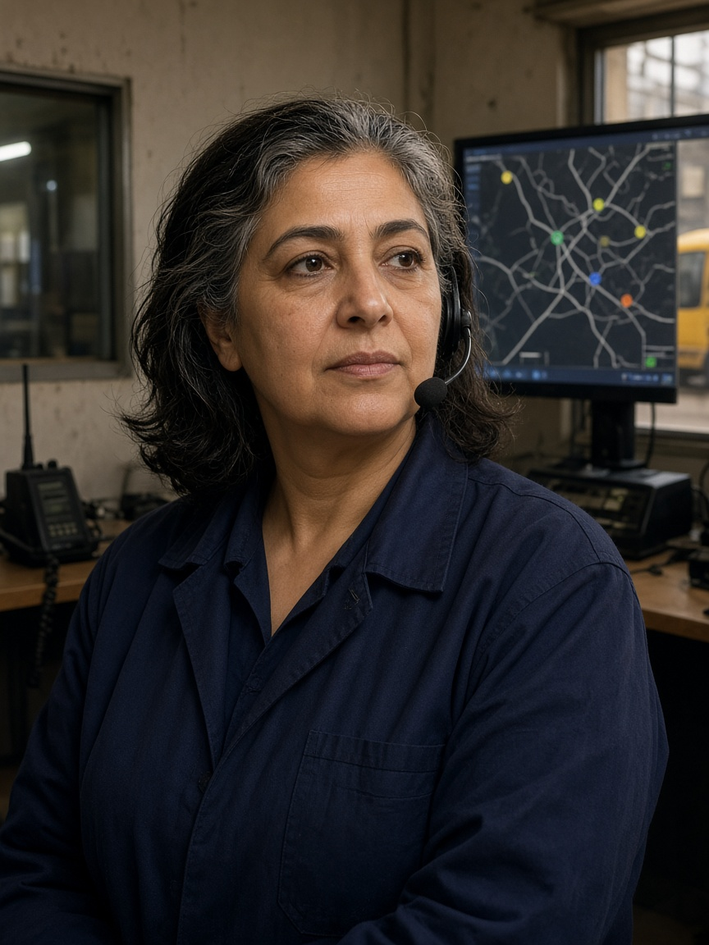
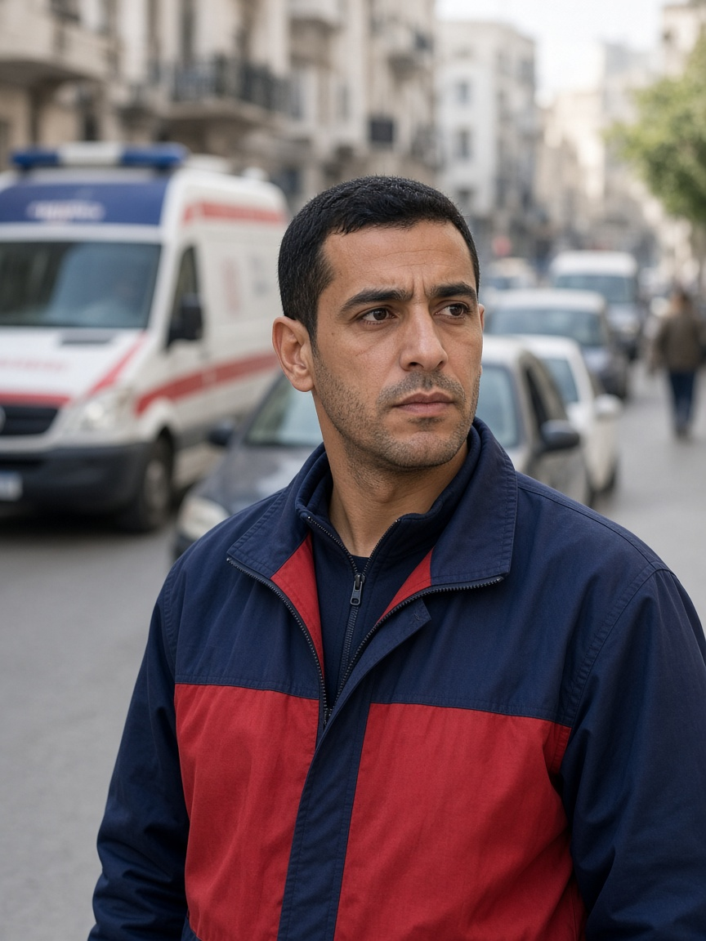
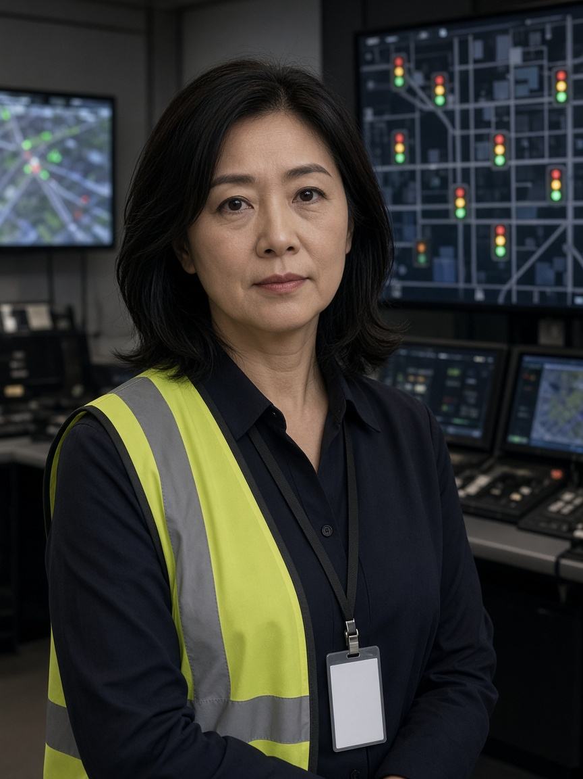
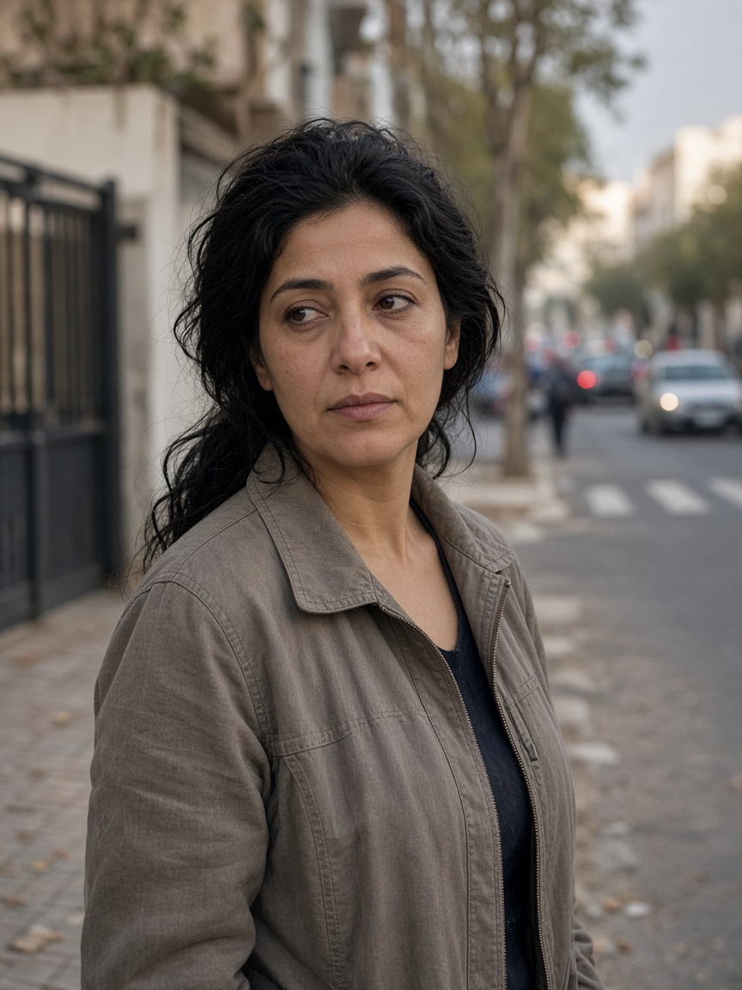
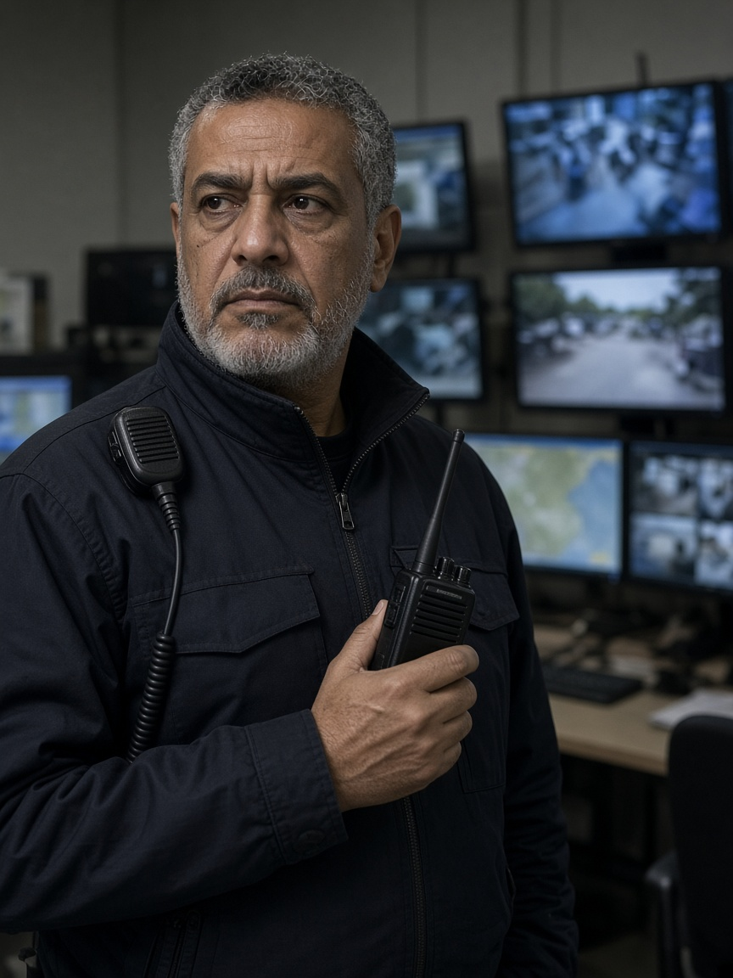
ESPRIT · 4DS · DESIGN THINKING
The light should see a person.
CoFlow-5 Synapse
8 personas · 5 agents · 1 signal writer
Illustrations—not interviews. [C02]
Notes:
Open on the faces. Say: traffic is not an average car. These are illustrations of research-informed personas, not stakeholder interviews.

Slide 2
COURSE CHALLENGE · [C01]
Not “build AI.” Prove a better decision.
How might we use data and intelligent agents to make urban traffic more efficient, adaptive and sustainable?
PROTOTYPE
CONDITIONS
BASELINE
LIMITS
works
change
compare
stay visible
Evidence matters more than technological complexity.
CoFlow-5 · evidence before claims
Notes:
Read the course question once. Then say the course expects a prototype, different conditions, a baseline comparison, and honest strengths and limitations. [C01]

Slide 3
DESIGN THINKING
People → problem → options → evidence
1
2
3
4
5
EMPATHIZE
DEFINE
IDEATE
PROTOTYPE
TEST
8 people
one problem
many options
one system
honest proof
We did not start with an LLM. We started with who could be helped—or harmed.
Research-informed personas · not interview-validated [C02]
CoFlow-5 · evidence before claims
Notes:
Walk left to right. Empathize, Define and Ideate explain why the solution exists. Prototype and Test create evidence. Old narrative status labels do not decide completion.

Slide 4
EMPATHIZE
One street. Eight human needs.
TIME
PREDICT
REGULAR
EXPLAIN
PASS
CONTROL
HOME
TRUST
Amara
David
Chidi
Rosa
Marcus
Yuki
Maria
Omar
Amara · David · Chidi · Rosa · Marcus · Yuki · Maria · Omar
Full persona cards: CoFlow-5-Persona-Cards.pptx
CoFlow-5 · evidence before claims
Notes:
Point at the one-word needs. Do not read biographies. Full evidence-backed cards are in the separate persona companion deck.

Slide 5
ONE PERSONA, ONE CONSEQUENCE
The light assumes someone faster.
NEED
Finish the crossing.
FEAR
Cars get green while she is still on it.
Evidence: perceived wait ≈2× in one study [C03] · clearance guidance ≈1.07 m/s [C04]
P1 · AMARA · 74
Measure: mean / P95 / max wait + zero clearance truncations
Illustration · not a real stakeholder
Notes:
Amara is the example persona. Her statement is a design synthesis, not an interview quote. Literature motivates the need; it is not our result. [C03][C04]

Slide 6
AMARA
MARCUS
CHIDI
already crossing
ambulance coming
late bus waiting
Who should the light serve first?
Safety → emergency → pedestrian deadline → late transit → flow → sustainability
One street · competing needs · visible trade-offs
Notes:
Tell this story in 20 seconds. A person already crossing finishes. Then emergency priority is considered only if downstream space exists. A late bus needs evidence. Every decision records who paid. [C16]

Slide 7
DEFINE
The problem is not average delay.
WRONG
HUMAN-CENTRED
“Build five AI agents and reduce mean car delay.”
Serve people—and show the trade-off when their needs conflict.
REFINED HMW
How might we improve traffic for every person—not only the average car—while staying auditable and safe when things fail?
CoFlow-5 · evidence before claims
Notes:
Contrast the rejected technical framing with the human-centred problem. Then read the How-might-we question once.

Slide 8
IDEATE
Generate widely. Cut ruthlessly.
01
02
03
BRAINWRITE
WORST IDEA
SCAMPER
central · local · rule-based · learned
LLM drives · every agent writes · every bus wins
reverse authority: specialists ask, one acts
CHOSEN
Cooperative Max-Pressure + one writer + typed advisers + deterministic safety
Rejected: LLM control · five writers · mandatory RL · best-episode reporting [C11][C16]
CoFlow-5 · evidence before claims
Notes:
Explain the ideation logic: diverge, challenge assumptions, then compare. Numerical matrix scores are team judgements, not evidence.

Slide 9
PROPOSED SOLUTION · [C16]
Five agents. One pair of hands.
A2
A3
A4
A5
A1
Emergency
Walk / bus
Situation
Sustainability
Flow
ASKS
ASKS
ADVISES
ADVISES
WRITES
typed, expiring messages
SAFETY MASK
EXECUTOR → SUMO
Only A1 writes signals.
Synapse never actuates.
Recovery: Max-Pressure → actuated → fixed-time
CoFlow-5 · evidence before claims
Notes:
Only A1 has a path to the safety mask and executor. A2 to A5 advise. Synapse reads immutable evidence and has no actuation path. [C16]

Slide 10
COMMUNICATION
Ask → check → decide → explain
1
2
3
4
ASK
CHECK
DECIDE
REPLY
A2 / A3 request
TTL · identity · capacity
A1 + safety mask
yes/no + reason
run_id · scenario_hash · event_id · message_id
Empty board? A1 still runs. Synapse failure? Light actions stay unchanged.
CoFlow-5 · evidence before claims
Notes:
Follow one request. The board validates identity and expiry. A1 safety-checks and ranks. One immutable reply and decision event close the round. If the board is empty, local Max-Pressure continues.

Slide 11
SCENARIOS + DATA
Three questions. Three evidence packs.
01
02
03
BASELINE
COOPERATION
FAILURE
fixed-time · actuated · Max-Pressure
crossing · emergency · late bus
loss · stale · controller · Synapse
trips · waits · tails
messages · decisions · KPIs
faults · recovery · action hash
No hidden exclusions: unfinished trips, faults, nulls and externalities stay visible.
Data spine: manifest → state/messages → decisions/trips/faults → KPIs
CoFlow-5 · evidence before claims
Notes:
These are three evidence layers: baseline traffic outcomes, cooperation decisions, and resilience under failure. Each produces joined records instead of a screenshot-only demo.

Slide 12
EVIDENCE NOW · [C17]
Proven behavior ≠ proven performance.
ROW 09
ROW 10
ROW 10B
0 orphans
1 / 2
70 / 84
115 records joined
A5 accepted / rejected advice
Max-Pressure trips completed
WHAT IS STILL MISSING
multi-seed inference · A4/A5 value ablations · stakeholder validation · Tunis
Rows 07, 08 and 09 plus 10, 10b and 10c are gated.
CoFlow-5 · evidence before claims
Notes:
Rows 07 through 10c are gated evidence slices. On matched seed 37, fixed-time completed 71/84 trips, actuated 84/84, and cooperative Max-Pressure 70/84. P95 wait was 33, 16, and 25 seconds. This mixed result establishes no winner or superiority. A4/A5 value remains unestablished. [C17]

Slide 13
TUNIS + RESOURCES
Local story. Controlled claims.
TUNIS SHOWCASE
SOURCE SPINE
OpenStreetMap
• Course + method [C01][C02]
+ official scheduled TRANSTU data
• People + operations [C03]–[C10]
• Traffic research [C11]–[C14]
Road demand: synthetic or calibrated—not observed.
• Project authority + evidence [C16][C17]
[C15]
32-row mixed-source evidence register · full URLs in presentation-claim-ledger.json
No lives-saved claim · no ambient air claim · no best-episode headline
CoFlow-5 · evidence before claims
Notes:
Tunis is a future data showcase, not deployment evidence. OpenStreetMap geometry and official scheduled TRANSTU datasets may be used; dataset format must be checked and road demand remains synthetic or calibrated. [C15]

Slide 14
People. Evidence. One writer.
Not an LLM traffic controller.
A testable decision architecture for urban traffic simulation.
Questions?
Notes:
Close in one sentence: CoFlow-5 is not an LLM traffic controller. It is a testable decision architecture where people define the requirements, A1 alone acts, and evidence decides what we may claim.

