Slide 1

ESPRIT 4DS · DESIGN THINKING VALIDATION
CoFlow-5 Synapse
Empathize & Ideation for a simulated, auditable traffic-signal controller in incident response
Presented to Fedi Baccar
[Team members] · [Date]
Notes:
Open with the framing: this is a validation of the Empathize and Ideation phases. We will walk one chain: research, evidence, personas, needs, problem, ideas, selected solution. Every step keeps a source.

Slide 2
STRUCTURE
Structure of this validation
1 · Empathize
2 · Ideation
1.1 Problem context
04
2.1 Problem statement
19
1.2 Target users
05
2.2 How Might We questions
20
1.3 User research & evidence
06–09
2.3 Ideas generated
21
1.4 Key findings
10
2.4 Ideation evidence
22
1.5 Personas
11–16
2.5 Selection of ideas
23
1.6 Needs & pain points
17
2.6 Final selected idea
24–26
User research → Evidence → Personas → Needs → Problem statement → Ideas → Selected solution
TRACED ON 27
Our claim: the system evaluates a constrained incident response in simulation and keeps a record of each decision.
02
Notes:
The structure follows the validation brief item by item. Slide 24 traces the full chain for each persona, which is the link the jury asked to see. State the claim boundary now: simulation only, no lives saved, no Tunis deployment.

Slide 3
PHASE 1
Empathize
Who is affected, what the evidence says, and which personas and needs follow from it.
1.1 Context · 1.2 Users · 1.3 Evidence · 1.4 Findings · 1.5 Personas · 1.6 Needs
Notes:
Phase 1 divider.

Slide 4
EMPATHIZE · 1.1 PROBLEM CONTEXT & WHY IT MATTERS
One signal decision hits several people at once
→ AMARA
→ DAVID
A light changes while someone is still crossing.
A better average can hide a trip that never finishes.
Pedestrians: 28% of 2023 deaths in the WHO investment case quoting ONSR. The 2024 strategy names older people and people with disabilities.
Vehicle occupants carry most of the health cost in the same investment case.
→ CHIDI
→ ROSA · MARCUS · OMAR
Buses bunch, then an early bus is treated as urgent.
A refusal, a full exit or a stale sensor can look like nothing.
TRANSTU reported 187.4 million paying passengers in 2018. That is not this year's headway.
The report reader, the crew and the duty officer each need a record they can check.
No public adaptive-signal network in Tunis was found.
04
Notes:
Four situations, each tied to at least one persona. Point out the footer: we looked for an adaptive-signal network in Tunis and found none public.

Slide 5
EMPATHIZE · 1.2 TARGET USERS
Six user groups, each named by a source
Who is affected | What the source says | Persona
Pedestrians, incl. older people and people with disabilities | 28% of 2023 deaths in the investment case; named in the 2024 strategy | Amara
Occupants of motor vehicles | Carry most of the health cost in the same investment case | David
TRANSTU passengers in Greater Tunis | 187.4 million paying passengers in 2018 | Chidi
Readers of the crash and incident record | ONSR compiles the national record. One reader, not a second controller. | Rosa
Road emergency crews | Civil Protection answers road emergency calls. We did not ride with them. | Marcus
Network duty officers | Must trust the alert. A residual is not a cause. | Omar
Motorcyclists (32% of 2023 deaths) are affected too, but are not a persona in this arc.
05
Notes:
Each user group comes from an existing source, and each becomes exactly one persona. Mention the motorcyclist gap before the jury does.

Slide 6
EMPATHIZE · 1.3 USER RESEARCH & EVIDENCE · METHODS
What our evidence is, and what it is not
Method | Status | What it supports
Interviews | Not collected | Nothing. No quote.
Questionnaires | Not collected | Nothing. No percentage from us.
Observation | Not done | Nothing about a Tunis crew or a specific crossing.
Existing data | Used | WHO country profile · WHO/UNIATF investment case quoting ONSR · La Presse briefing, 17 Jan 2025 · INS counts · TRANSTU 2018 report
Literature | Used | Clearance guidance · appraisal guidance on wait and reliability · SCATS audit-trail analogy · a Taipei EMS figure, labelled not Tunis
Our simulation | One matched seed | 71, 84 and 70 of 84 trips finished. Mixed. No winner. Not a Tunis result.
Primary research is the gap we name first, not last.
06
Notes:
Be upfront: no interviews, no questionnaires, no ride-along. Everything we say later rests on secondary data, literature and one simulation seed.

Slide 7
EMPATHIZE · 1.3 EVIDENCE · EXISTING DATA
2023: the same crashes, two death totals
5,796
2,273
1,216
crashes in 2023
deaths · 7,909 injuries
deaths
Identical in both accounts
WHO / Health / Interior investment case, quoting ONSR
La Presse briefing of ONSR, 17 Jan 2025
We show both. We do not average them.
A single number would hide a gap of 1,057 deaths between two official accounts.
Sources: WHO/UNIATF investment case quoting ONSR; La Presse, 17 Jan 2025
07
Notes:
This is a data-quality finding, not a footnote. Averaging would invent a number neither source published. The gap, 2,273 minus 1,216, is 1,057.

Slide 8
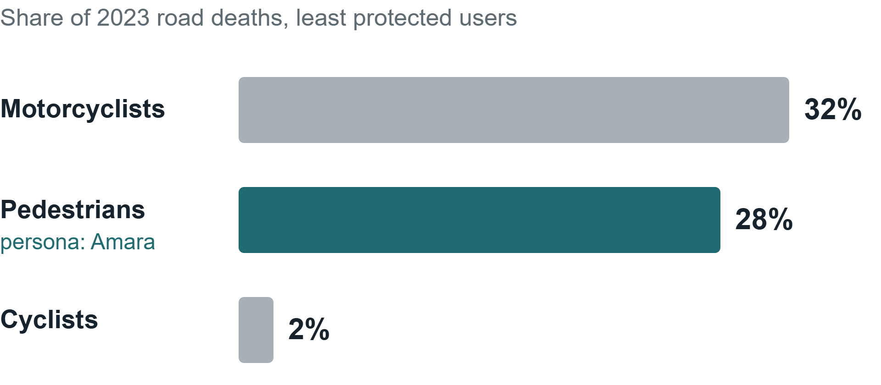
EMPATHIZE · 1.3 EVIDENCE · EXISTING DATA
The least protected users carry the deaths
>82%
of fatalities were male (investment case)
953 · 136
crashes · deaths, Tunis governorate 2024. Highest crash count; not one intersection.
2,004
WHO 2021 estimate (1,786–2,222), 16.3 per 100,000
Sources: WHO/UNIATF investment case quoting ONSR; La Presse, 17 Jan 2025; WHO country profile 2023
08
Notes:
Pedestrians are highlighted because they become Amara. Motorcyclists are the largest share but are not a persona in this arc; say so if asked.

Slide 9
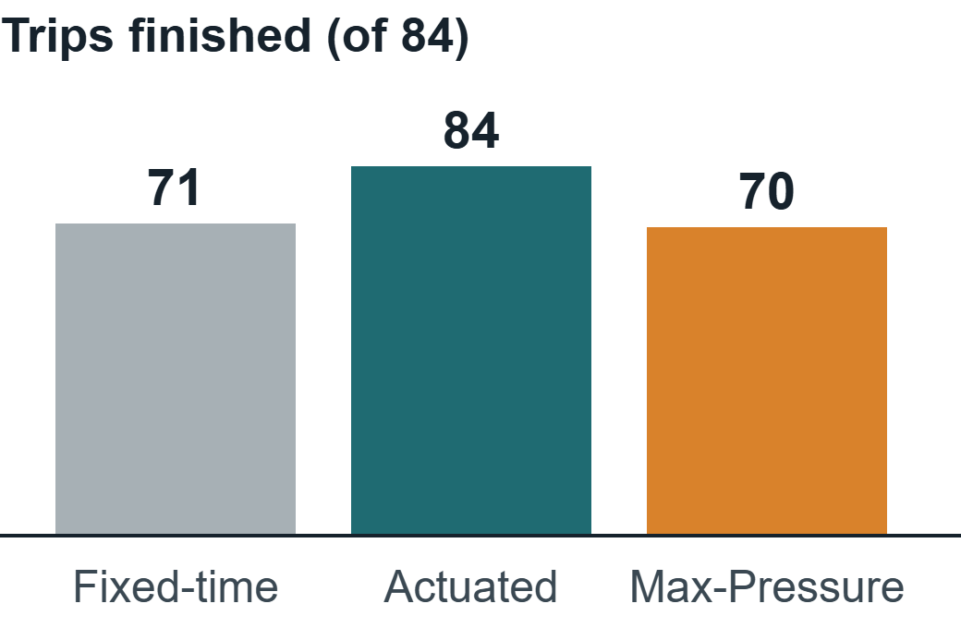
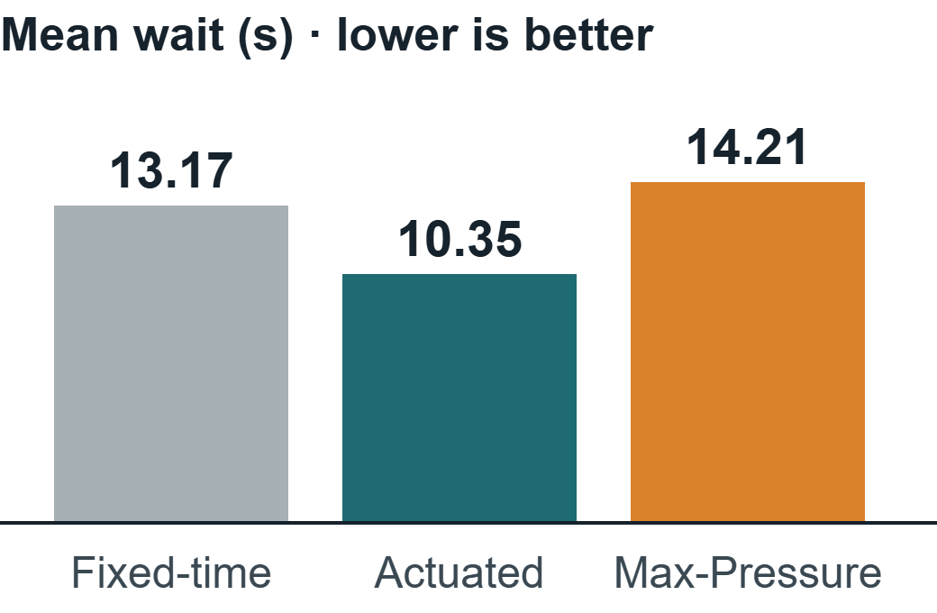
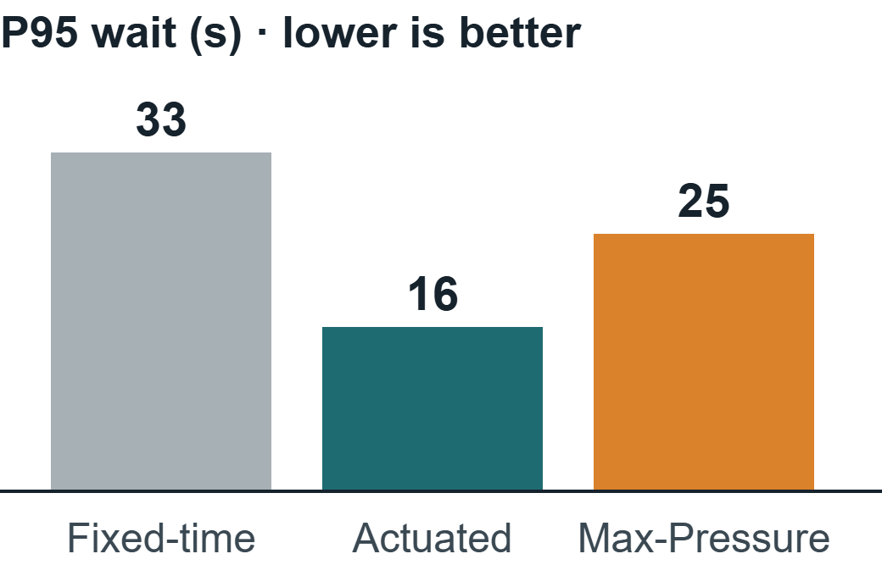
EMPATHIZE · 1.3 EVIDENCE · OUR SIMULATION
Seed 37: a mixed result, reported as mixed
WHAT THE RUN SHOWS
WHAT WE REFUSE TO CONCLUDE
Actuated finished 84 of 84 trips with the lowest mean and P95 wait. Cooperative Max-Pressure did not win on this seed.
One seed is not a winner. Unfinished trips stayed in the count. This is not a Tunis result.
Source: harness/work/10c-evidence-page/artifacts/evidence-page.txt · the classroom watch scene is seed 53, not this row
09
Notes:
This is David's evidence: the unfinished trips are kept in the denominator. Note that the controller we later select, Max-Pressure, lost on this seed. We show it anyway.

Slide 10
EMPATHIZE · 1.4 KEY FINDINGS
Five findings we can defend
1
The people harmed are named in official counts: pedestrians, occupants and public-transport passengers. The 2024 strategy adds older people and people with disabilities.
2
Two 2023 death totals, 2,273 and 1,216, sit beside the same 5,796 crashes. A single number would hide that.
3
A mean can improve while trips stay unfinished. On seed 37, actuated finished more trips; Max-Pressure did not win.
4
No public adaptive-signal network in Tunis was found, and a 2018 passenger total is not today's bus gap.
5
An alert that names a cause, or a stale sensor shown as healthy, would go beyond the evidence.
Evidence: 1 → slides 05, 08 · 2 → slide 07 · 3 → slide 09 · 4 → slide 04 · 5 → slide 16
10
Notes:
These five findings are the bridge to personas: each persona carries at least one of them.

Slide 11
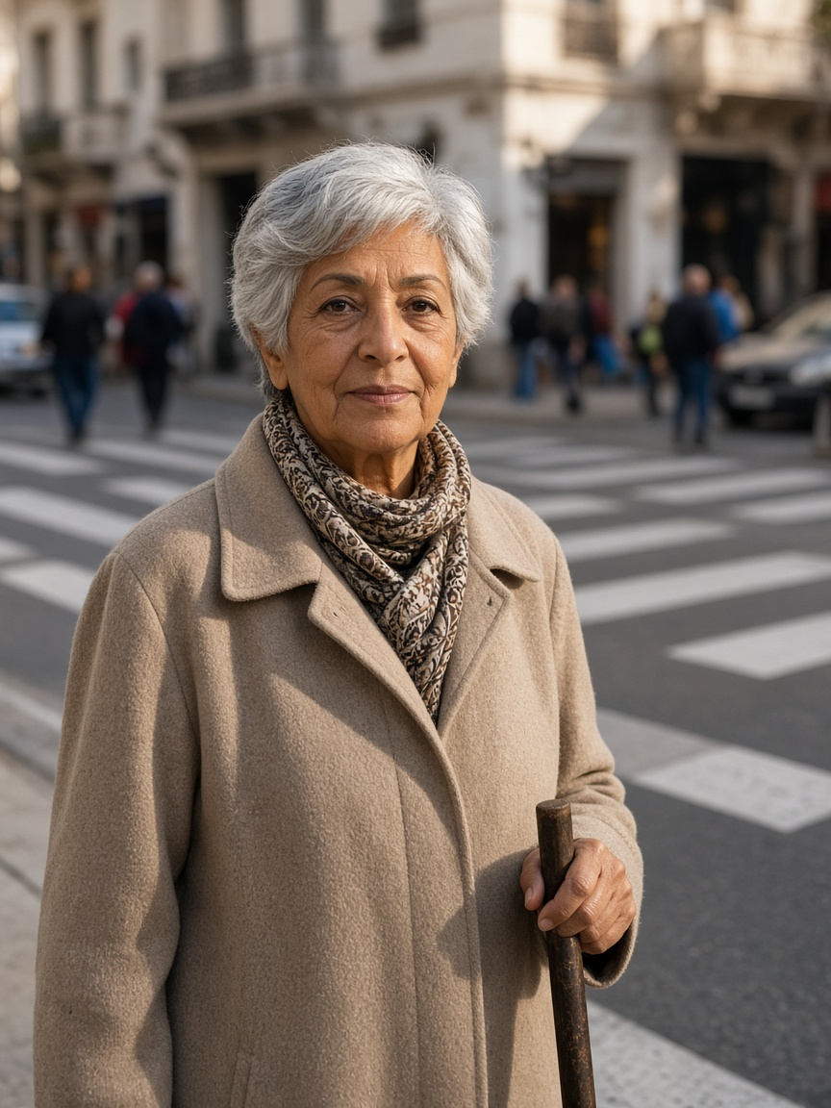
EMPATHIZE · 1.5 PERSONAS · 1 OF 6
Amara, the pedestrian still crossing
Amara, 74
Retired pedestrian · uses a cane
“I need enough time to finish crossing, even when traffic is busy.”
NEED
PAIN POINT
Acknowledgement, shorter waits, enough clearance to finish.
Cars get green while she is still in the crossing.
REJECTS
MEASURE
Shortened clearance, inaccessible apps, invented success claims.
Mean, P95, max wait · zero clearance truncations.
BASED ON
Pedestrians 28% of 2023 deaths (investment case, ONSR); the 2024 strategy names older people and people with disabilities; clearance guidance ≈1.07 m/s; perceived wait ≈2× observed in one New Zealand study.
Built from slides 05–09. Age, job and statement are design readings, not interviews. Photo is an illustration.
11
Notes:
Uses a push-button with audible or visual feedback; no phone required. Situation: crosses a busy central street for shops and transit (Tunis design context, an assumption). Zero truncations is a fixture count, not crashes prevented.

Slide 12
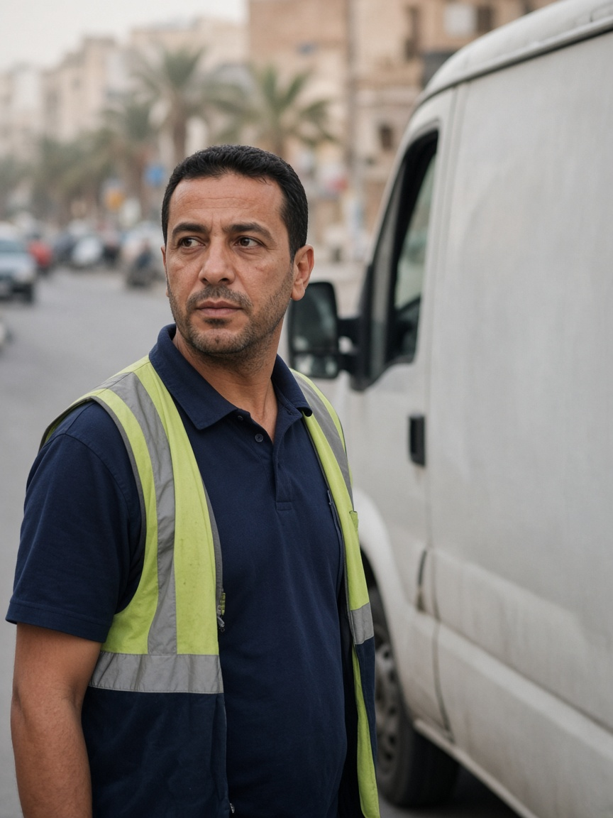
EMPATHIZE · 1.5 PERSONAS · 2 OF 6
David, the driver whose trip may not finish
David, 41
Delivery-van driver
“I can plan around a longer trip if I know how long it will actually take.”
NEED
PAIN POINT
Predictable journeys, fewer stops, visible incidents.
A better mean hides unfinished or extreme trips.
REJECTS
MEASURE
Best-case headlines and deleted unfinished trips.
Completed vs unfinished trips · P95, max duration · stops.
BASED ON
Vehicle occupants carry most of the health cost in the investment case; appraisal guidance uses 0.4 as a reliability ratio; seed 37: 71, 84 and 70 of 84 trips finished.
Built from slides 05–09. Age, job and statement are design readings, not interviews. Photo is an illustration.
12
Notes:
Uses a work phone, GPS and the delivery round. The 'more than 60 stops' day is a design reading.

Slide 13
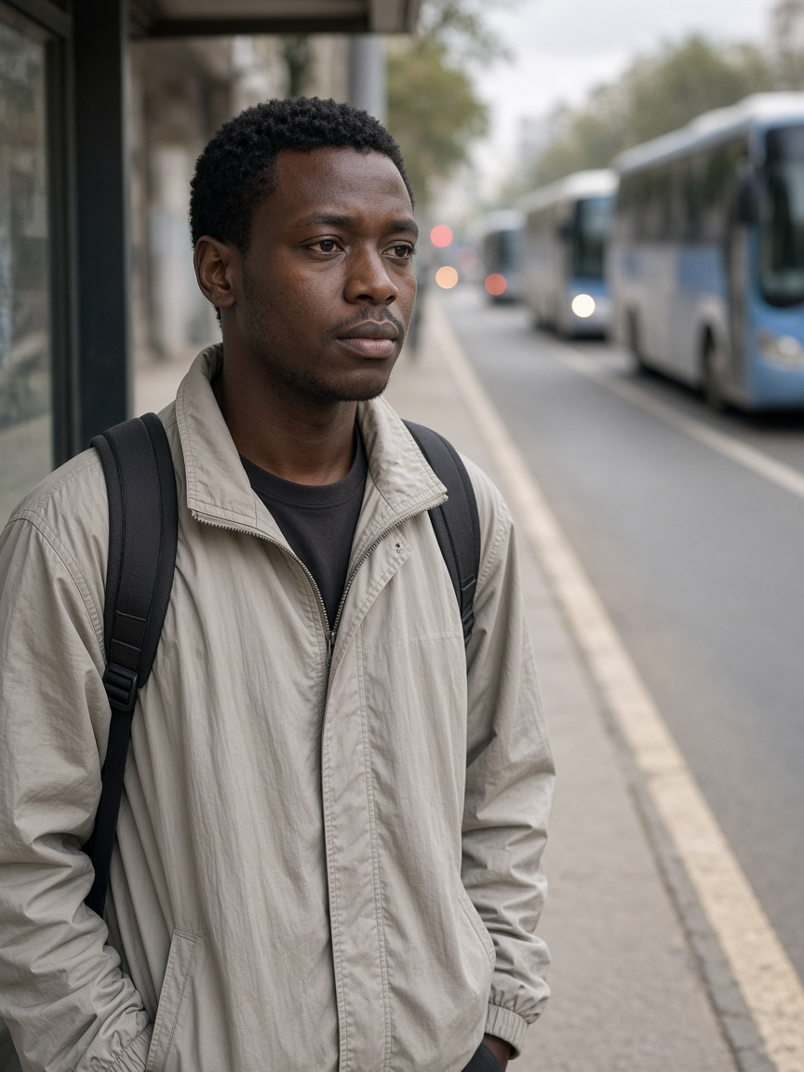
EMPATHIZE · 1.5 PERSONAS · 3 OF 6
Chidi, the passenger waiting for a regular bus
Chidi, 27
Frequent bus passenger
“Buses should arrive regularly, not three at once after a long wait.”
NEED
PAIN POINT
Priority only for a late bus or a large headway gap.
Three buses arrive together after one long gap.
REJECTS
MEASURE
Priority for every bus; clearance sacrificed for transit.
Lateness · headway variation · passenger-wait proxy.
BASED ON
TRANSTU reported 187.4 million paying passengers in 2018 (not today's figure); appraisal guidance values waiting time above in-vehicle time.
Built from slides 05–09. Age, job and statement are design readings, not interviews. Photo is an illustration.
13
Notes:
High-frequency corridor, where regularity is the service. Uses a passenger app when it exists, otherwise the stop. Measure also includes the effect on other traffic.

Slide 14
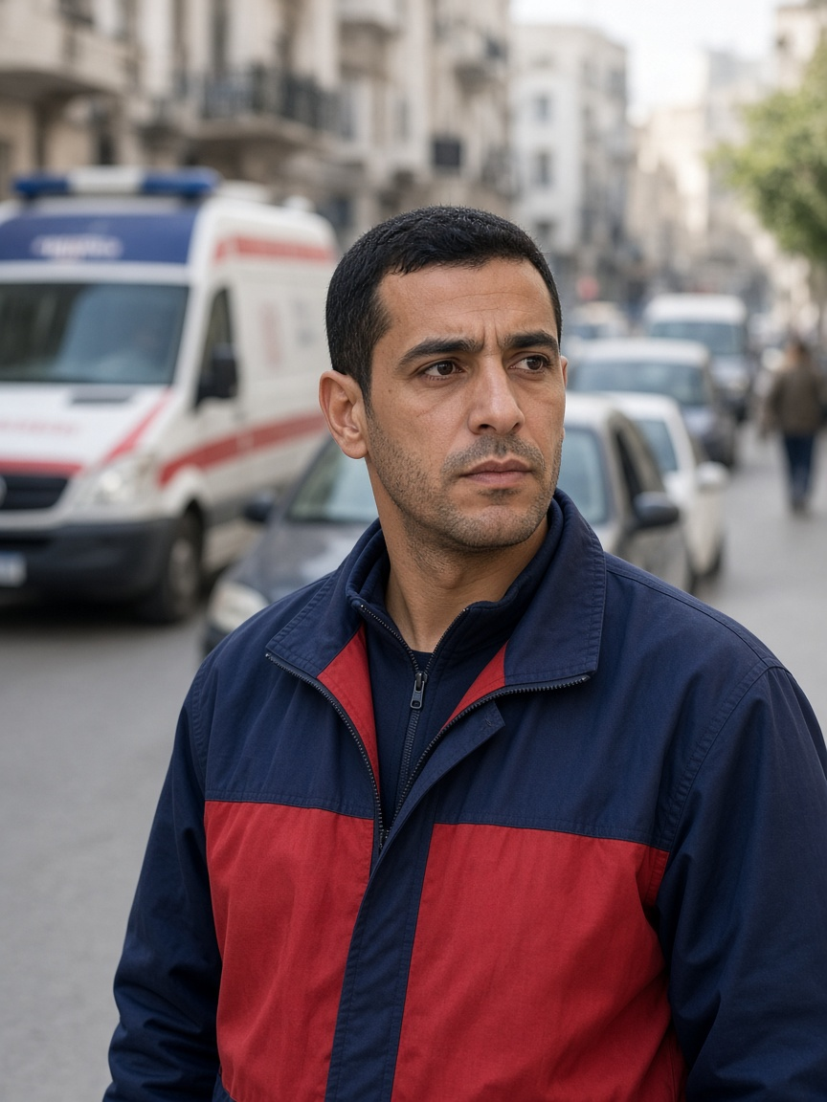
EMPATHIZE · 1.5 PERSONAS · 4 OF 6
Marcus, the crew facing a full exit
Marcus, 34
Urban ambulance crew
“Get us through safely, and make sure traffic recovers after we pass.”
NEED
PAIN POINT
A trusted route and ETA request, a downstream check, controlled recovery.
A green light into a full link only moves the queue.
REJECTS
MEASURE
Cutting an occupied crossing; seconds turned into casualties.
Emergency time · civilian delay · downstream rejection · recovery.
BASED ON
Civil Protection answers road emergencies (we did not ride with a crew); preemption can add network delay; one Taipei cohort: each extra ALS minute ≈7% lower adjusted odds, not a Tunis result.
Built from slides 05–09. Age, job and statement are design readings, not interviews. Photo is an illustration.
14
Notes:
Uses a dispatch tablet, GPS, radio, lights and siren. This simulation does not output lives saved.

Slide 15
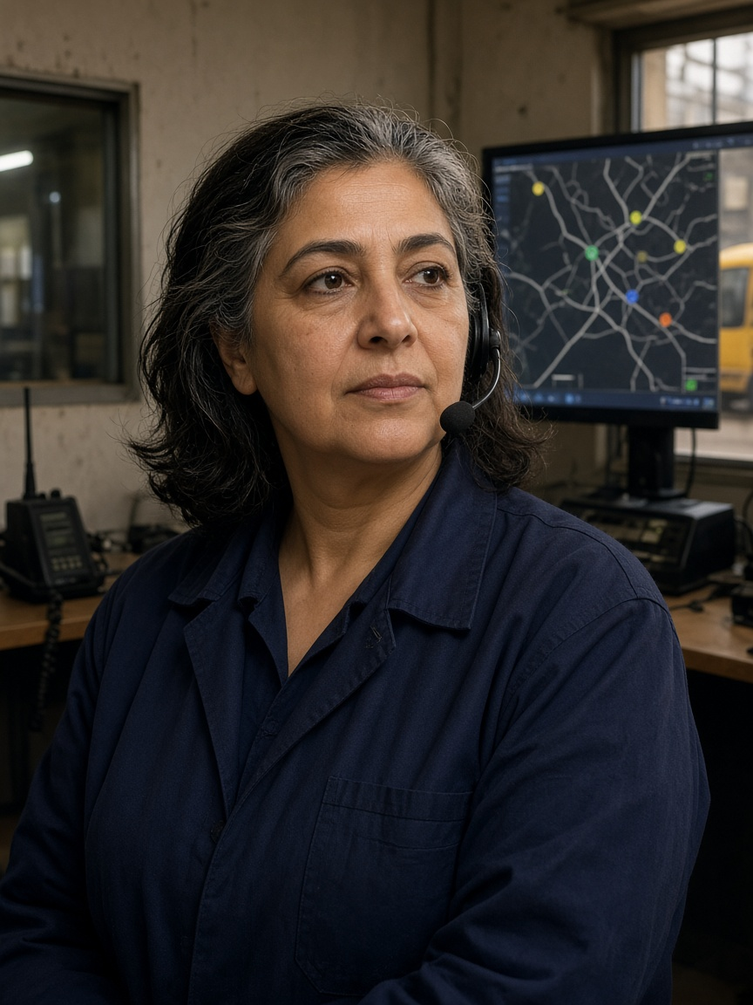
EMPATHIZE · 1.5 PERSONAS · 5 OF 6
Rosa, the reader of the refusal
Rosa, 52
Incident-report reader · never changes the light
“Show me why priority was granted or denied, and let me respond safely.”
NEED
PAIN POINT
Positions, headways, confidence, reason codes, a joined audit trail.
A black box refuses priority and leaves no history.
REJECTS
MEASURE
Unsupported predictions; overrides outside the safety mask.
Reason-code coverage · one explained yes and one explained no.
BASED ON
ONSR compiles the national crash record; SCATS documents monitoring, manual intervention and audit trails (an analogy, not a Tunis control room we visited).
Built from slides 05–09. Age, job and statement are design readings, not interviews. Photo is an illustration.
15
Notes:
Uses depot tools, a vehicle-location screen, radio and a dashboard.

Slide 16
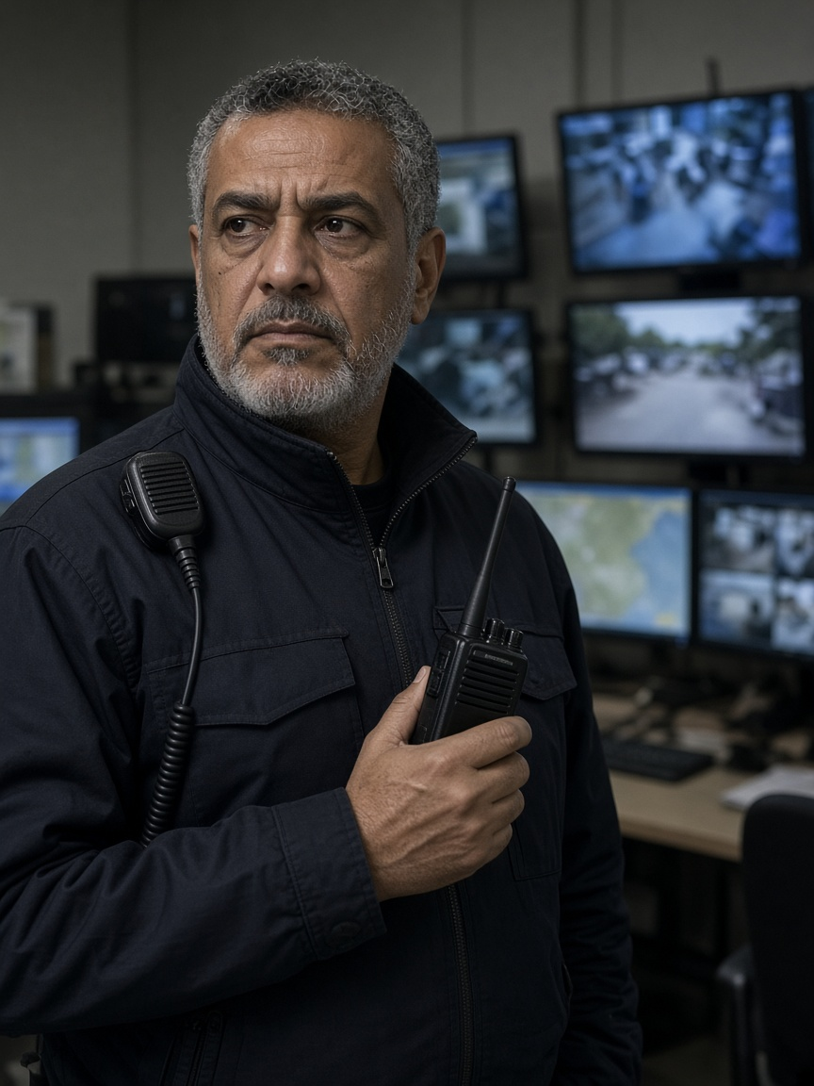
EMPATHIZE · 1.5 PERSONAS · 6 OF 6
Omar, the officer who must trust the data
Omar, 55
Network duty officer
“Tell me what is wrong, why you think so, and whether I can still trust the data.”
NEED
PAIN POINT
Severity, observations, uncertainty, freshness, a data-health warning.
False alarms, or a frozen screen hiding the real condition.
REJECTS
MEASURE
Alerts without evidence; an anomaly presented as a cause.
Detection delay · false alarms · misses · stale data · recovery.
BASED ON
The detector has classes; an anomaly does not name a cause; the estimate that incidents are ≈25–30% of congestion is a US citation, not a map of these junctions.
Built from slides 05–09. Age, job and statement are design readings, not interviews. Photo is an illustration.
16
Notes:
Uses radio, a camera wall, incident tools and a dashboard. Portrait file in the repo: p8-omar.png.

Slide 17
EMPATHIZE · 1.6 USER NEEDS & PAIN POINTS
Six needs, six pains, six expectations
Who | Need | Pain | Expectation
Amara | Enough time to finish | Cars go green while she is still crossing | The conflicting green stays held
David | The real duration, bad trip included | A better mean hides the unfinished trip | Unfinished trips stay on the page
Chidi | A regular gap | Three buses after one long wait | An early bus gets nothing
Rosa | A reason she can read later | A refusal with no history | A citation, or an abstention
Marcus | A path through, then recovery | Green into a full exit | Exit checked; delay to others logged
Omar | A class he can trust | A frozen screen, or a guessed cause | Freshness shown; stale stays stale
Each row comes from the persona card and its evidence on slides 11–16.
17
Notes:
Read the table row by row only if time allows; otherwise point to the expectation column and say it returns later as the acceptance criteria.

Slide 18
PHASE 2
Ideation
From the needs table to a problem statement, fifteen ideas, five filters and one selected concept.
2.1 Problem · 2.2 HMW · 2.3 Ideas · 2.4 Evidence · 2.5 Selection · 2.6 Final idea
Notes:
Phase 2 divider.

Slide 19
IDEATION · 2.1 PROBLEM STATEMENT
How might a simulated signal serve the person still crossing, the unfinished trip, the bus gap, the reader of the refusal, the crew at a full exit, and the officer who must not be told a residual is a cause — while only one component writes the light, and every decision keeps a source?
NOT THE PROBLEM
OUT OF SCOPE FOR THE CLAIM
“Reduce deaths in Tunisia.” This evidence cannot support that result.
Lives saved · measured air · a Tunis deployment · a winner from one seed.
Each clause is one row of the needs table (slide 17).
19
Notes:
Read the statement slowly. Each clause is one persona; the amber clause is the design constraint that shapes every idea after this.

Slide 20
IDEATION · 2.2 HOW MIGHT WE QUESTIONS
Six questions, one per persona
Who | How might we…
Amara | …hold the conflicting green until the crossing finishes, and count every time it is cut?
David | …show unfinished trips beside the mean, so a better average cannot hide the tail?
Chidi | …give green only after an unusual gap, and give an early bus nothing?
Rosa | …explain one grant or one denial with a reason code, or abstain?
Marcus | …check the exit before green, then recover, without cutting the crossing?
Omar | …publish the class, the confidence and the freshness, and refuse to name the cause?
Written from the needs table (slide 17), not collected in a workshop with users.
20
Notes:
Each question is the needs-table row turned into a design prompt.

Slide 21
IDEATION · 2.3 IDEAS GENERATED
15 ideas generated: 6 kept, 9 refused
Who | ✓ Kept | ✕ Refused | Why refused
Amara | Hold the green, count truncations | A camera that guesses her ability | Invents data about her
David | Keep unfinished trips in the count | A scraped live map treated as his trip | Not his trip; no source
Chidi | Priority only after a real gap | Green for every bus | Rewards the early bus
Rosa | One cited explanation, or abstain | A chatbot that negotiates the phase | A second writer on the light
Marcus | Request, exit check, then recovery | An always-green corridor; “lives saved” | Cuts the crossing; overclaims
Omar | Class, confidence, freshness | A news scrape that declares a crash | Guesses a cause
All | — | Map colour or news post as a real crash · heatmap with no denominator · a sentence that writes the light | No source, or a second writer
Each idea answers one HMW question on slide 20. Reasons map to the criteria on slide 23.
21
Notes:
Six kept ideas, one per persona; six refused per persona plus three cross-cutting refusals, fifteen ideas in total. The refused ideas are shown on purpose: they prove the selection was a real choice. The 'why refused' column is our reading of which selection criterion each idea fails.

Slide 22
IDEATION · 2.4 IDEATION EVIDENCE
How the ideas were generated
STEP 1
STEP 2
STEP 3
STEP 4
Start from the needs
Write ideas beside the source
Test against five filters
Keep or refuse, with a reason
Each row of the needs table became one HMW question.
Every idea checked against the selection criteria.
Candidate ideas for each HMW, written next to the evidence behind them.
Refused ideas stay on the record as evidence.
6
15
6
9
HMW questions
ideas generated
kept
refused, with reasons
Method used: need-driven idea generation, one idea per persona need. Not used: SCAMPER, mind mapping or a workshop with users.
Evidence artefact: [link or photo of the ideation board / sheet]
22
Notes:
This slide answers 'how were the ideas generated'. Be honest that no SCAMPER or user workshop was run. If you have the working sheet or board where ideas were written beside sources, add a photo or link here: it is the strongest ideation evidence you can show.

Slide 23
IDEATION · 2.5 SELECTION OF IDEAS
Five filters every kept idea had to pass
1
2
3
4
5
Names a person
Points at evidence
Invents nothing
One writer
Leaves a record
A solution with no affected person is dropped.
No interview quote, no survey percentage, no Tunis digit we lack.
Specialists request. Only A1, through the safety mask, sets the phase.
Rosa can read every grant, denial or abstention.
Published data, literature, or a labelled simulation row.
An idea that failed any filter was dropped, however attractive it looked.
Applied to all 15 ideas on slide 21: 6 passed, 9 failed.
23
Notes:
Filter 4 is highlighted because it is the architectural rule. It is what separates this design from 'an AI that controls traffic lights'.

Slide 24
IDEATION · 2.6 FINAL SELECTED IDEA
Advisers request.
One writer decides.
The record stays.
A2 · A3 · A4 · A5
A1
SYNAPSE
Specialists that can only ask.
The only writer, through the safety mask and the signal executor.
Explains the log with a citation, or abstains. Never reaches TraCI.
Evaluates incident response in simulation. It does not prevent accidents in Tunisia.
24
Notes:
The three-line summary is what the jury should remember about the architecture.

Slide 25
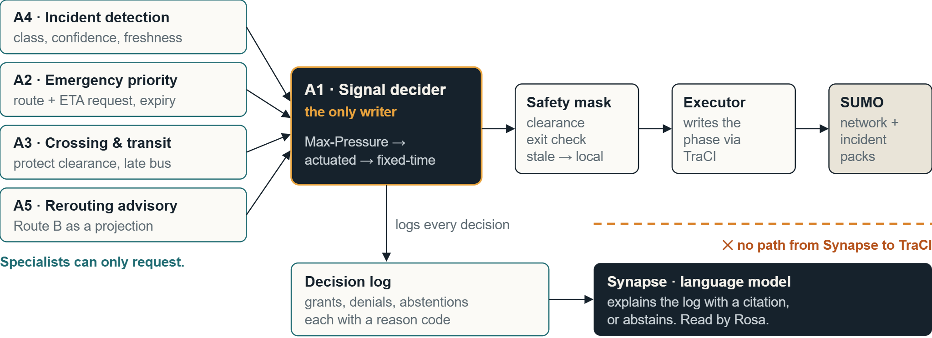
IDEATION · 2.6 FINAL SELECTED IDEA · CONCEPT
Control flow: many advisers, one writer
Recovery order after emergency priority: Max-Pressure, then actuated, then fixed-time.
25
Notes:
AI-engineering point: the language model is on the read side only. The write path is deterministic: A1, safety mask, executor, TraCI. That is how the design stays auditable and safe even if the model is wrong.

Slide 26
IDEATION · 2.6 HOW IT ADDRESSES THE NEEDS
Each persona need maps to one behaviour
Need | What the selected concept does | Path
Amara finishes the crossing | A3 asks. A1 holds the conflicting green. Truncations are counted. | A3 → A1
David sees the bad trip | Unfinished trips stay beside the mean. | Measure
Chidi gets a gap, not a bunch | A3 asks only for a late bus or a large gap. Pedestrian clearance stays ahead of the bus. | A3 → A1
Rosa can check the no | One cited reason, or an abstention. She does not write the signal. | Log → Synapse
Marcus avoids a full exit | A2 asks. A1 checks the exit, then recovers. Civilian delay is logged. | A2 → A1
Omar is not told a guessed cause | A4 publishes class, confidence and freshness. Stale data leaves A1 on local control. | A4 → A1
Incident packs change the street inside SUMO. The language model never writes the light.
26
Notes:
Traceability: every behaviour traces back to one row of the needs table.

Slide 27
THE LINK · RESEARCH → SOLUTION
The full chain, persona by persona
Persona | Evidence | Pain point | Kept idea | In the solution
Amara | Pedestrians 28% of deaths; clearance ≈1.07 m/s | Green while still crossing | Hold the green, count truncations | A3 asks, A1 holds the green
David | Seed 37: 71 / 84 / 70 trips finished | Mean hides the unfinished trip | Keep unfinished trips | Unfinished trips beside the mean
Chidi | TRANSTU 2018; waiting valued above riding | Three buses after a long gap | Priority only after a real gap | A3 asks for late bus or gap only
Rosa | ONSR record; SCATS audit-trail analogy | A refusal with no history | One cited explanation, or abstain | Reason code on every decision
Marcus | Preemption can add network delay | Green into a full exit | Request, exit check, recovery | A2 asks; A1 checks exit, recovers
Omar | An anomaly does not name a cause | A guessed cause, a frozen screen | Class, confidence, freshness | A4 publishes; stale → local control
Evidence: slides 05–09 · Personas: 11–16 · Needs: 17 · Ideas: 21 · Solution: 24–26
27
Notes:
This is the slide that answers the validation objective directly: for every persona, one line from evidence to the solution. If the jury asks 'why this feature?', point to its row.

Slide 28
SUMMARY
User research → Evidence → Personas → Needs → Problem statement → Ideas → Selected solution
Every decision points back to a source.
WE CLAIM
WE DO NOT CLAIM
STILL MISSING
The system evaluates a constrained incident response in simulation and records each decision.
Lives saved · measured air · a Tunis deployment · a winner from one seed.
Interviews with real users, and runs across more than one seed.
Questions
Notes:
Retrace the chain in one breath, restate the claim boundary, name the two gaps, then take questions.

Slide 29
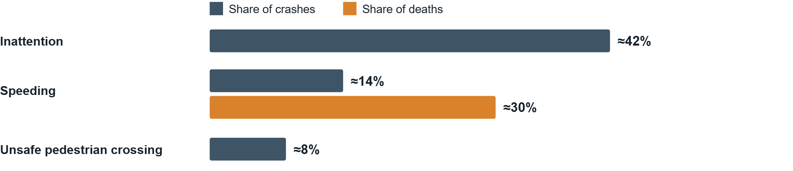
EMPATHIZE · CAUSE CLASSES, ONSR 2024
Speeding: 14% of crashes, about 30% of deaths
5,687
1,169
7,786
Cause classes, not a model of our junction.
crashes, national 2024
deaths, national 2024
injuries, national 2024
Source: La Presse briefing of the ONSR 2024 balance sheet, 17 Jan 2025
08
Notes:
The data-science reading: speeding is about severity, not frequency. The briefing gives a death share only for speeding, so the chart shows only that one. These are national cause classes and do not describe our simulated junction.

Slide 30
ROADMAP
The chain we will walk, step by step
EMPATHIZE
IDEATION
01
02
03
04
05
06
07
User research
Evidence
Personas
Needs & pain points
Problem statement
Ideas
Selected solution
Every step keeps a source. Where we have no data, the cell stays empty.
CoFlow-5 Synapse · ESPRIT 4DS
03
Notes:
Seven steps. Four in Empathize, three in Ideation. Each later step must point back to an earlier one.

Slide 31
FRAMING
One claim, and five things we do not claim
WE CLAIM
WE DO NOT CLAIM
The system evaluates a constrained incident response in simulation and keeps a record of each decision.
✕ Prevents accidents in Tunisia
✕ Lives saved
✕ Measured air quality
✕ A Tunis deployment
✕ A winner from one seed
Persona ages, jobs and statements are design readings, not interviews. Portraits are illustrations.
02
Notes:
State the boundary before any data. The jury should hear what we will not claim first, so every later number is read in that light.

Slide 32
WHAT TO REMEMBER
User research → evidence → personas → needs → problem → ideas → selected solution
An auditable simulation that keeps its evidence.
No lives saved. No measured air. No Tunis deployment. No winner.
Questions
Notes:
Close by retracing the chain in one breath, then restate the four refusals. Invite questions.

Slide 33
UX / UI · OPERATOR CONSOLE CONCEPT
A console designed for Rosa and Omar
CoFlow-5 · junction [J-__] · run [id] · scenario [hash]
SIMULATION
A4 · CONDITION
DECISION LOG
SYNAPSE
Incident or congestion
A2 ambulance · GRANTED · exit clear
“Why was the bus denied?”
Confidence: [value]
A3 bus · DENIED · early, no gap
Bus ahead of schedule; no headway gap. Cites event [#], policy [P-].
STALE · last update [hh:mm]
A3 crossing · HELD · truncations [n]
A5 Route B · ADVISORY
No supporting entry → abstains.
Cause: not named
Empty ≠ all-clear
Stale looks stale
Every no has a reason
The tail sits beside the mean
Illustrative wireframe. Rows show the interface pattern, not results.
24
Notes:
UX rationale: Omar's panel leads with freshness because a stale feed shown as healthy is his core fear. Rosa's log puts the verdict and reason on one line. Synapse is visibly allowed to abstain. The four principles at the bottom are the design rules, each tied to a persona.

Slide 34
SELECTED SOLUTION · DEMO SCRIPT
Demo: a flood, an ambulance and a readable no
01
02
03
04
05
06
Configure
Flood hits E17
A4 reads
Advisers ask
A1 decides
Proof
Pick settings and run. SUMO is the live picture. Panels start empty; empty is not an all-clear.
Mixed demand, heavy rain, then a flood pack closes edge E17. Queues form on the approaches.
Queue up, speed down, a class, a confidence, fresh or stale. No confirmed crash without a crash file.
A5 requests Route B as a projection. A3 asks to protect the crossing. An ambulance request arrives with an expiry.
Cooperative Max-Pressure. The mask passes, the executor writes the phase, Rosa reads the reason code.
Only measured fields: wait, trips, emergency delay, truncations, accept, refuse. Synapse cites or abstains.
A demo script, not a saved Tunis result and not a measured flood run. A blank on the proof slide is never filled in later.
Acceptors may reroute to Route B. A refusal stays in the log.
25
Notes:
Run the demo live if possible. Name each persona as their moment appears: Omar at step 3, Amara and Marcus at step 4, Rosa at step 5, David at step 6.

Slide 35
IDEATION · IDEAS GENERATED
Kept and refused: the refusals are evidence too
Who | ✓ Idea we kept | ✕ Idea we refused
Amara | Hold the green. Count truncations. | A camera that guesses her ability
David | Keep unfinished trips in the count. | A scraped live map treated as his trip
Chidi | Priority only after a real gap. | Green for every bus
Rosa | One cited explanation, or abstain. | A chatbot that negotiates the phase
Marcus | Request, exit check, then recovery. | An always-green corridor, or “lives saved”
Omar | Class, confidence, freshness. | A news scrape that declares a crash
Also refused: a scraped map colour or news post treated as a ground-truth crash · a heatmap with no denominator · a sentence that writes the light.
Method: one idea per persona need, written beside its source, then kept or refused. Not SCAMPER, not a user workshop.
17
Notes:
The refused column shows judgement. Several refused ideas are attractive AI features; they fail because they invent data or let a model touch the light.

Slide 36
EVALUATION · LIMITS & NEXT STEPS
What is missing, and how we close it
Limits we state openly
Next steps
No interviews, questionnaires or ride-alongs yet. Personas are design readings.
One matched seed. No winner can be claimed.
A synthetic grid, not a measured Tunis junction.
Ridership dates from 2018, and the 2023 death totals conflict.
Interview [n] people per persona group, starting with duty officers and pedestrians with reduced mobility.
Run [N] matched seeds per scenario and report intervals.
Build the grid from a dated OpenStreetMap snapshot of a Tunis corridor.
Usability-test the console: can a reader explain one yes and one no?
CoFlow-5 Synapse · Evaluation
27
Notes:
Name the limits before the jury does. The next steps map one to one onto the limits.

Slide 37
SELECTED SOLUTION · CLOSED LOOP
The loop, with personas as acceptance tests
Observe
→
A4
→
A2 · A3 · A5
→
A1
→
Safety mask
→
SUMO
→
Measure
→
Synapse
Persona | Acceptance test on the record
Amara | Crossing stays protected. Truncations are counted.
David | Unfinished trips stay in the count.
Chidi | An early bus gets nothing. Clearance stays ahead of the bus.
Rosa | Every grant and every denial has a reason code.
Marcus | The exit is checked. Civilian delay is logged. Not lives saved.
Omar | State, confidence and freshness. Stale shows as stale.
The six personas are the acceptance criteria for the record, not decoration.
22
Notes:
This is where design thinking meets testing: every persona becomes a pass/fail check on the decision record.

Slide 38
EVALUATION PLAN · PROPOSED
How we will measure: tails, not just means
Persona | Metrics | Guardrail
Amara | Mean, P95, max pedestrian wait · clearance truncations | Zero truncations is not crashes prevented
David | Completed vs unfinished · P95, max duration · stops | Unfinished trips never leave the denominator
Chidi | Lateness · headway variation · passenger-wait proxy | Effect on other traffic is reported
Rosa | Reason-code coverage · one explained yes and no | Synapse abstains rather than guesses
Marcus | Emergency time · civilian delay · downstream rejection | No conversion of seconds into lives saved
Omar | Detection delay · false alarms · misses · recovery | Stale data is never shown as fresh
Reporting protocol: every metric as mean, P95 and max across [N] matched seeds, with intervals. No winner is declared from one seed.
Metrics come from the persona cards. The multi-seed protocol is our proposal for the next phase.
26
Notes:
Data-science framing: the persona measures become a metric suite. The guardrails prevent the metrics from being over-read. Fill [N] once the seed budget is fixed.

Slide 39
EMPATHIZE · PERSONAS 1–2 OF 6
Amara and David: the crossing and the road
A
Amara, 74
D
David, 41
Retired pedestrian · uses a cane
Delivery-van driver
“I need enough time to finish crossing, even when traffic is busy.”
“I can plan around a longer trip if I know how long it will actually take.”
NEED
Acknowledgement, shorter waits, enough clearance to finish.
NEED
Predictable journeys, fewer stops, visible incidents.
FEAR
A better mean hides unfinished or extreme trips.
FEAR
Cars get green while she is still in the crossing.
REJECTS
Best-case headlines, deleted unfinished trips.
REJECTS
Shortened clearance, inaccessible apps, invented success claims.
MEASURE
Completed vs unfinished trips · P95 and max duration · stops.
MEASURE
Mean, P95 and max wait · zero clearance truncations.
Design readings, not interviews. Statements are syntheses, not quotes.
11
Notes:
Amara evidence: perceived wait about twice observed wait in one New Zealand study; clearance guidance about 1.07 m/s, slower where needed; pedestrians 28% of 2023 deaths; the 2024 strategy names older people and people with disabilities. Zero truncations is a fixture count, not crashes prevented. David evidence: appraisal guidance uses 0.4 as a reliability ratio for journey-time variability; occupants carry most of the health cost; seed 37 is mixed. The 'more than 60 stops' day is a design reading.

Slide 40
EMPATHIZE · PERSONAS 3–4 OF 6
Chidi and Marcus: the bus and the ambulance
C
Chidi, 27
M
Marcus, 34
Frequent bus passenger
Urban ambulance crew
“Buses should arrive regularly, not three at once after a long wait.”
“Get us through safely, and make sure traffic recovers after we pass.”
NEED
Priority only for a late bus or a large headway gap.
NEED
A trusted route and ETA request, a downstream check, controlled recovery.
FEAR
Three buses arrive together after one long gap.
FEAR
A green light into a full link only moves the queue.
REJECTS
Priority for every bus; clearance sacrificed for transit.
REJECTS
Cutting an occupied crossing; seconds turned into casualties.
MEASURE
Lateness · headway variation · passenger-wait proxy · side effects.
MEASURE
Emergency time · civilian delay · downstream rejection · recovery.
Design readings, not interviews. We did not ride with a crew.
12
Notes:
Chidi evidence: TRANSTU 187.4 million paying passengers in 2018, not this year; appraisal guidance values waiting above in-vehicle time. Marcus stands for Civil Protection. One Taipei cohort associated each extra ALS minute with 7% lower adjusted odds; that is not a Tunis result. Preemption can add network delay. The simulation does not output lives saved.

Slide 41
EMPATHIZE · PERSONAS 5–6 OF 6
Rosa and Omar: the people behind the record
R
Rosa, 52
O
Omar, 55
Incident-report reader · never changes the light
Network duty officer
“Show me why priority was granted or denied, and let me respond safely.”
“Tell me what is wrong, why you think so, and whether I can still trust the data.”
NEED
Positions, headways, confidence, reason codes, a joined audit trail.
NEED
Severity, observations, uncertainty, freshness, a data-health warning.
FEAR
A black box refuses priority and leaves no history.
FEAR
False alarms, or a frozen screen hiding the real condition.
REJECTS
Unsupported predictions; overrides outside the safety mask.
REJECTS
Alerts without evidence; an anomaly presented as a cause.
MEASURE
Reason-code coverage · one explained yes and one explained no.
MEASURE
Detection delay · false alarms · misses · stale data · recovery.
Design readings, not interviews. SCATS is an analogy, not a Tunis control room we visited.
13
Notes:
Rosa evidence: ONSR compiles the crash record; SCATS documents monitoring, manual intervention and audit trails. Omar evidence: the detector has classes; an anomaly does not name a cause; the estimate that incidents are about 25–30% of congestion is a US citation, not a map of these junctions.

Slide 42
SELECTED SOLUTION · DATA PROVENANCE
Provenance comes before any map
Feed | Every row must carry | If stale or missing
OpenStreetMap | Snapshot date, licence, edges covered | Show the date. Never call it today's speed.
Weather | Station, junction and hour | No join, no weather layer. Rain is not a cause.
Incident | Type, place, start, duration, severity, source, confidence | An old incident stays marked stale.
SUMO run | Run id and scenario hash | A saved run is not a live city.
Survey | Who was asked, how many, the date, the answers | No file, so the cell stays empty.
ONE INCIDENT ENGINE
Flood, weather, emergency, police, accident and combined are packs on one network, not extra AIs. Every pack carries type · location · start · duration · severity · edges · confidence · source.
Literature motivates the need. SUMO holds a labelled assumption, never an invented Tunis digit.
23
Notes:
Data-engineering discipline: the collection table comes before any visual. OSM row 14 is not started yet.

