Slide 1
ESPRIT 4DS · DESIGN THINKING VALIDATION
CoFlow-5 Synapse
Empathize and Ideation for a simulated, auditable traffic-signal controller in incident response.
Presented to Fedi Baccar
Aziz Messaoud · Eya Laourine · Fares Ben Kacem
Mohamed Aymen Hamzaoui · Oumayma Saddouri · Ranim Ben Salem
September 2026
Research → Evidence → Personas → Needs → Problem → Ideas → Solution
01
Notes:
Presented to Fedi Baccar. Team from ADR-0002. Claim: the system evaluates a constrained incident response in simulation and keeps a record of each decision. It does not prevent accidents in Tunisia.

Slide 2
EMPATHIZE · 1 · PROBLEM CONTEXT
One signal decision hits several people at once
→ AMARA
→ DAVID
A light changes while someone
is still crossing.
A better average can hide a trip
that never finishes.
Pedestrians were 28% of 2023 deaths in the WHO investment case quoting ONSR. The 2024 strategy names older people and people with disabilities.
Vehicle occupants carry most of the health cost in the same investment case.
→ CHIDI
→ ROSA · MARCUS · OMAR
Buses bunch. An early bus
is then treated as urgent.
A refusal, a full exit, or a stale
sensor can look like nothing.
TRANSTU reported 187.4 million paying passengers in 2018. That is not this year’s headway.
The report reader, the crew, and the duty officer each need a record they can check.
No public adaptive-signal network in Tunis was found.
02
Notes:
Why it matters: a signal change hits the person still crossing, the unfinished trip, the bus gap, and the people who must read a refusal, a full exit, or a stale sensor. No public adaptive-signal network in Tunis was found. This slide does not claim the project prevents deaths.

Slide 3
EMPATHIZE · 2 · TARGET USERS
Six groups. Each one is named by a source.
Who is affected | What the source says | Persona
Pedestrians, including older people and people with disabilities | 28% of 2023 deaths. Named in the 2024 strategy. | Amara
Occupants of motor vehicles | Most of the health cost in the same case. | David
TRANSTU passengers in Greater Tunis | 187.4 million paying passengers in 2018. | Chidi
Readers of the crash and incident record | ONSR compiles the national record. One reader. | Rosa
Road emergency crews | Civil Protection answers the calls. We did not ride along. | Marcus
The person who must trust the alert | A residual is not a cause. | Omar
Motorcyclists were 32% of those deaths. They are affected. They are not a persona here.
03
Notes:
Six groups named by a source. Ages and jobs on the persona cards are design readings, not interviews. Motorcyclists were 32% of 2023 deaths in the investment case. They are affected. This arc does not give them a persona.

Slide 4
EMPATHIZE · 3 · USER RESEARCH AND EVIDENCE
What we used, and what we did not collect.
Interviews
Not collected
5,796
Nothing. No quote.
Questionnaires
Not collected
crashes in 2023, in both accounts
Nothing. No percentage from us.
The crash total matches. The death total does not.
Observation
Not done
2,273
1,216
Nothing about a crew or one crossing.
Existing data
Used
deaths, and 7,909 injuries. Investment case, quoting ONSR.
deaths. La Presse briefing of ONSR, 17 Jan 2025.
WHO, the investment case, La Presse, TRANSTU 2018.
Literature
Used
We show both. We do not average them.
Clearance, reliability, an audit-trail analogy.
A single number would hide a gap of 1,057 deaths.
Simulation
One seed
SEED 37 · ONE MATCHED RUN
Mixed. No winner. Not a Tunis result.
Fixed 71/84 · Actuated 84/84 · Max-Pressure 70/84
Unfinished trips stayed in. Mixed. No winner.
Primary research is the gap we name first.
04
Notes:
Sources: WHO country profile; WHO/UNIATF investment case quoting ONSR; La Presse briefing of ONSR, 17 Jan 2025; TRANSTU activity report 2018; harness/work/10c-evidence-page seed 37. Interviews, questionnaires, and ride-alongs were not collected. Tunis governorate 2024, same La Presse article: 953 crashes, 136 deaths. Not one intersection. Seed 37: fixed-time 71/84, mean wait 13.17 s, P95 33 s; actuated 84/84, 10.35 s, P95 16 s; cooperative Max-Pressure 70/84, 14.21 s, P95 25 s. Classroom watch is seed 53, not this row.

Slide 5
EMPATHIZE · 4 · KEY FINDINGS
Five findings we can defend.
1
The people harmed are named in the counts.
Pedestrians, occupants, and public-transport passengers. The 2024 strategy also names older people and people with disabilities.
2
2023 has two death totals beside one crash total.
2,273 and 1,216, with the same 5,796 crashes. A single death number would hide that.
3
A mean can improve while trips stay unfinished.
On seed 37, actuated finished more trips. Cooperative Max-Pressure did not win.
4
We do not have a live Tunis signal network, or today’s bus gap.
No public adaptive-signal network was found. A 2018 passenger total is not a headway.
5
An alert can go beyond the evidence.
Naming a cause, or showing a stale sensor as healthy, would do that.
These are limits on what the solution may say.
05
Notes:
Each finding limits the claim. Finding 3 is seed 37 only. Finding 4: no public adaptive network found, and 2018 ridership is not today’s headway. Cause classes from the same La Presse briefing, not a model of our junction: inattention about 42% of crashes, speeding about 14% of crashes and about 30% of deaths, unsafe pedestrian crossing about 8% of crashes.

Slide 6
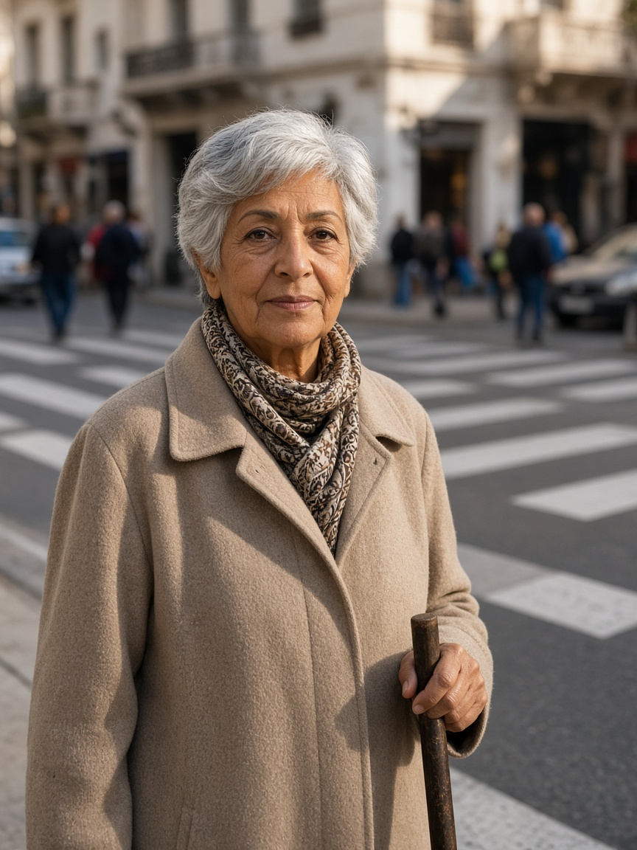
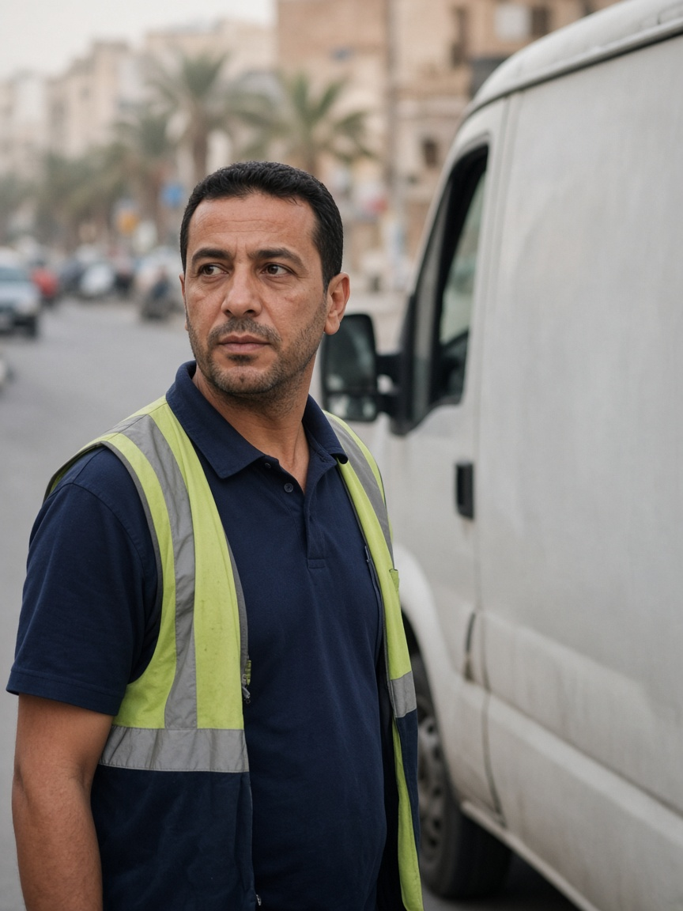
EMPATHIZE · 5 · PERSONAS · AMARA AND DAVID
The crossing, and the trip that may not finish.
Amara, 74
David, 41
Retired pedestrian. Uses a cane.
Delivery-van driver.
“I need enough time to finish crossing, even when traffic is busy.”
“I can plan around a longer trip if I know how long it will actually take.”
NEED
NEED
Enough time to finish, and a shorter wait.
The real duration, including the trip that does not finish.
PAIN
PAIN
Cars get green while she is still crossing.
A better mean hides unfinished or extreme trips.
BASED ON
BASED ON
Pedestrians were 28% of 2023 deaths in the investment case. The 2024 strategy names older people and people with disabilities. Clearance guidance is about 1.07 m/s.
Occupants carry most of the health cost in that case. Appraisal guidance uses 0.4 as a reliability ratio. On seed 37, unfinished trips stayed in the count.
Design readings, not interviews. Photos are illustrations.
06
Notes:
Design readings, not interviews. Statements are syntheses, not quotes. Portraits are illustrations. Pedestrians were 28% of 2023 deaths in the investment case. The 2024 strategy names older people and people with disabilities. Clearance guidance is about 1.07 m/s. Occupants carry most of the health cost in that case. Appraisal guidance uses 0.4 as a reliability ratio. On seed 37, unfinished trips stayed in the count.

Slide 7
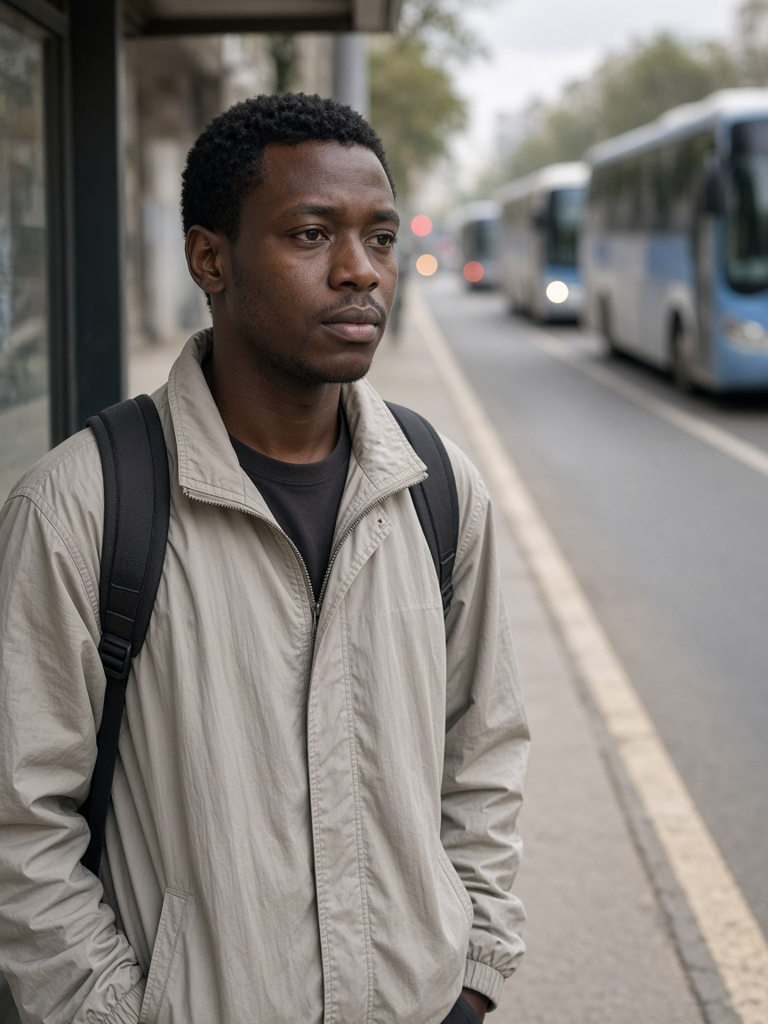
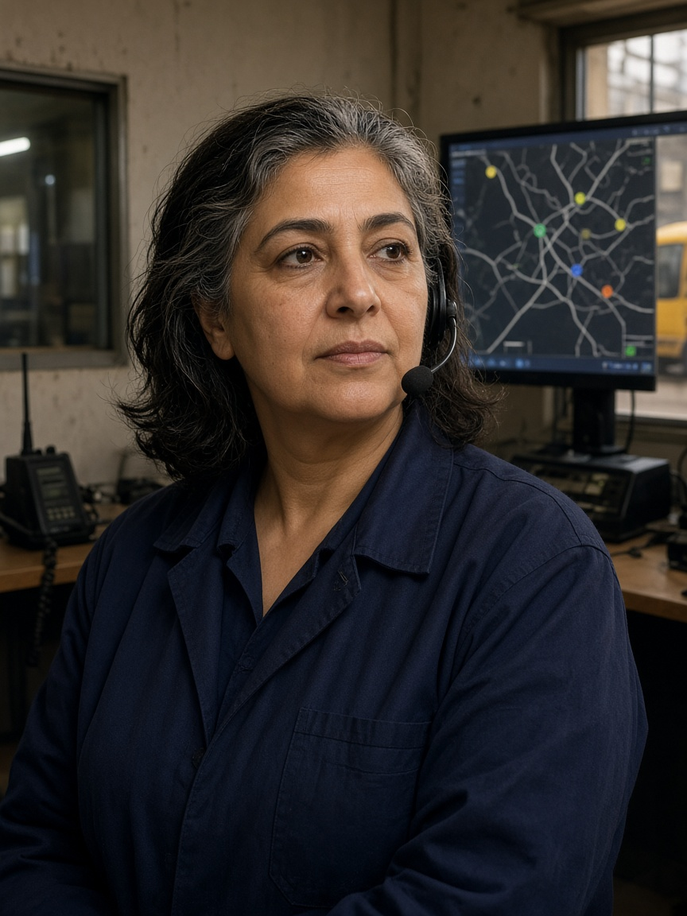
EMPATHIZE · 5 · PERSONAS · CHIDI AND ROSA
The bus gap, and the reader of the refusal.
Chidi, 27
Rosa, 52
Frequent bus passenger.
Incident-report reader. She never changes the light.
“Buses should arrive regularly, not three at once after a long wait.”
“Show me why priority was granted or denied, and let me respond safely.”
NEED
NEED
Priority only for a late bus or a large gap.
A reason code, and a record she can read later.
PAIN
PAIN
Three buses arrive together after one long gap.
A refusal with no history.
BASED ON
BASED ON
TRANSTU reported 187.4 million paying passengers in 2018. That is not this year’s headway. Appraisal guidance values waiting time above time on the bus.
ONSR compiles the national crash record. SCATS documents monitoring and audit trails. That is an analogy, not a Tunis control room we visited.
Design readings, not interviews. Photos are illustrations.
07
Notes:
Design readings, not interviews. Statements are syntheses, not quotes. Portraits are illustrations. TRANSTU reported 187.4 million paying passengers in 2018. That is not this year’s headway. Appraisal guidance values waiting time above time on the bus. ONSR compiles the national crash record. SCATS documents monitoring and audit trails. That is an analogy, not a Tunis control room we visited.

Slide 8
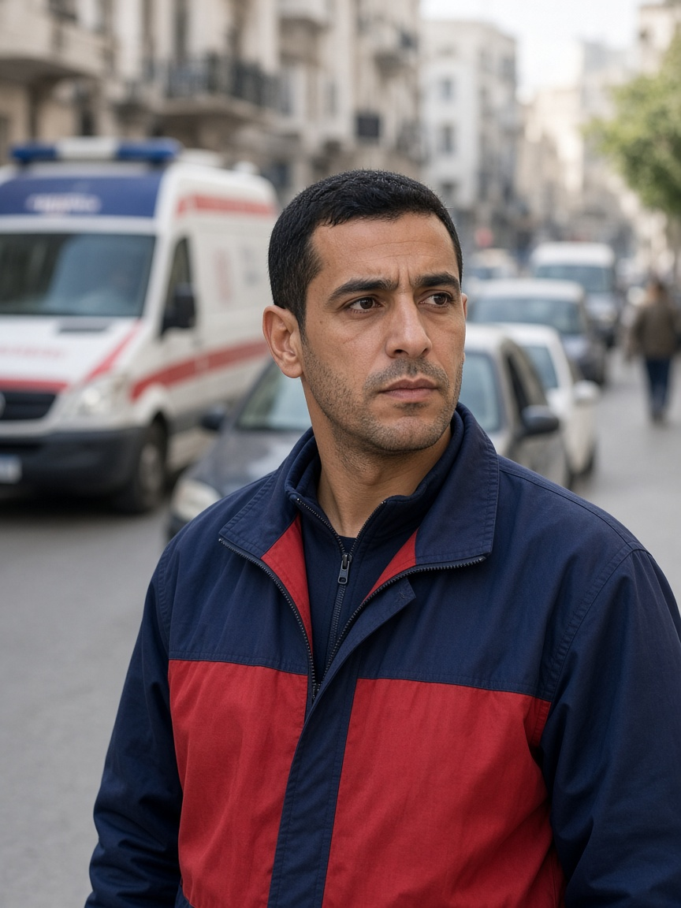
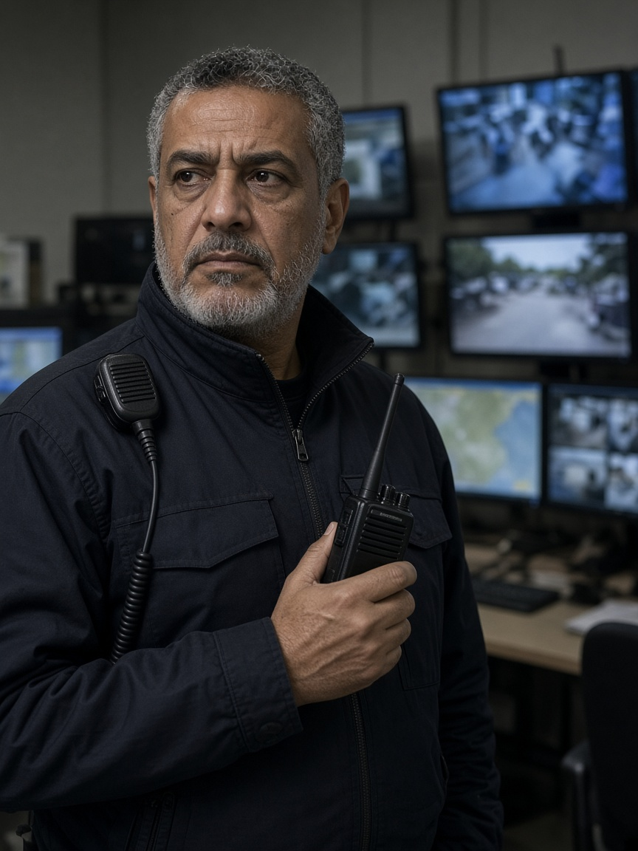
EMPATHIZE · 5 · PERSONAS · MARCUS AND OMAR
The crew at a full exit, and the officer who must trust the data.
Marcus, 34
Omar, 55
Urban ambulance crew. We did not ride with one.
Network duty officer.
“Get us through safely, and make sure traffic recovers after we pass.”
“Tell me what is wrong, why you think so, and whether I can still trust the data.”
NEED
NEED
A checked exit, then recovery. Delay to others is logged.
The class, the confidence, and the freshness.
PAIN
PAIN
A green light into a full exit only moves the queue.
A guessed cause, or a frozen screen that looks healthy.
BASED ON
BASED ON
Civil Protection answers these calls. Preemption can add delay elsewhere. A Taipei minute figure is cited as foreign. Not lives saved.
The detector has classes. An anomaly does not name a cause. A 25–30% congestion share is a US citation, not a map of these junctions.
Design readings, not interviews. Photos are illustrations.
08
Notes:
Design readings, not interviews. Statements are syntheses, not quotes. Portraits are illustrations. Civil Protection answers these calls. Preemption can add delay elsewhere. A Taipei minute figure is cited as foreign. Not lives saved. The detector has classes. An anomaly does not name a cause. A 25–30% congestion share is a US citation, not a map of these junctions.

Slide 9
EMPATHIZE · 6 · NEEDS AND PAIN POINTS
Six needs. Six pains. Six expectations.
Who | Need | Pain | Expectation
Amara | Enough time to finish | Green while she is still crossing | Conflicting green stays held
David | The real duration, bad trip included | A better mean hides the unfinished trip | Unfinished trips stay on the page
Chidi | A regular gap | Three buses after one long wait | An early bus gets nothing
Rosa | A reason she can read later | A refusal with no history | A citation, or an abstention
Marcus | A path through, then recovery | Green into a full exit | Exit checked. Others’ delay logged.
Omar | A class he can trust | A frozen screen, or a guessed cause | Freshness shown. Stale stays stale.
Each row comes from that persona and the evidence on the previous slides.
09
Notes:
Needs, pains, and expectations taken from the six cards. Not from an interview.

Slide 10
IDEATION · 7 · PROBLEM STATEMENT AND HOW MIGHT WE
One problem. Six questions.
PROBLEM STATEMENT
How might a simulated signal serve the person still crossing, the unfinished trip, the bus gap, the reader of the refusal, the crew at a full exit, and the officer who must not be told a residual is a cause — while only one component writes the light, and every decision keeps a source?
Not the problem: “reduce deaths in Tunisia.” Out of scope: lives saved, measured air, a Tunis deployment, a winner from one seed.
AMARA
DAVID
How might we hold the conflicting green until the crossing finishes, and count every cut?
How might we show unfinished trips beside the mean, so the average cannot hide the tail?
CHIDI
ROSA
How might we give green only after an unusual gap, and give an early bus nothing?
How might we explain one grant or one denial with a reason code, or abstain?
MARCUS
OMAR
How might we check the exit before green, then recover, without cutting the crossing?
How might we publish the class, the confidence, and the freshness, and refuse to name the cause?
Questions written from the needs table. Not from a workshop.
10
Notes:
The problem statement is refined from the needs table. It is not “reduce deaths in Tunisia.” The six How Might We questions were written from that table. They were not collected in a workshop with users.

Slide 11
IDEATION · 8 · IDEAS, AND HOW THEY WERE GENERATED
Six kept. Nine refused.
HOW
One idea per need, written next to its source, then kept or refused with a reason. Not SCAMPER. Not a workshop.
Who | Kept | Refused | Why refused
Amara | Hold the green. Count truncations. | A camera that guesses her ability. | Invents data about her
David | Keep unfinished trips in the count. | A scraped map treated as his trip. | Not his trip. No source.
Chidi | Priority only after a real gap. | Green for every bus. | Rewards the early bus
Rosa | One cited explanation, or abstain. | A chatbot that negotiates the phase. | A second writer on the light
Marcus | Request, exit check, then recovery. | Always-green corridor, or “lives saved.” | Cuts the crossing, or overclaims
Omar | Class, confidence, freshness. | A news scrape that declares a crash. | Guesses a cause
All | — | Map or news as a crash. Heatmap with no denominator. A sentence that writes the light. | No source, or a second writer
The refused column is part of the evidence.
11
Notes:
Method: one idea per persona need, written beside the source, then kept or refused. Not SCAMPER. Not mind mapping. Not a workshop with users. Six kept. Nine refused: six beside a persona, plus three that failed for everyone. Refused ideas stay on the record.

Slide 12
IDEATION · 9 · SELECTION OF IDEAS
Five filters. Fail one, and the idea is out.
01
Names a person
A solution with no affected person is dropped.
02
Points at evidence
Published data, literature, or a labelled simulation row.
03
Invents nothing
No interview quote, no survey percentage, no Tunis digit we do not have.
04
One writer
Specialists may request. Only A1, through the safety mask, sets the phase.
05
Leaves a record
Rosa can read a grant, a denial, or an abstention.
Applied to all 15 ideas: 6 passed, 9 failed.
12
Notes:
Five filters. An idea that failed any one of them was dropped. Six passed. Nine failed and stay on the previous slide.

Slide 13
IDEATION · 10 · FINAL SELECTED IDEA
Advisers request.
One writer decides.
The record stays.
A2 · A3 · A4 · A5
A1
SYNAPSE
Specialists that can only ask.
The only writer, through the safety mask and the signal executor.
Explains the log with a citation, or abstains. Never reaches TraCI.
After priority, recovery is Max-Pressure, then actuated, then fixed-time.
Evaluates incident response in simulation. It does not prevent accidents in Tunisia.
13
Notes:
Selected concept: advisers request, A1 alone writes through the safety mask and the signal executor, Synapse explains with a citation or abstains and never reaches TraCI. Recovery after emergency priority: Max-Pressure, then actuated, then fixed-time. This evaluates incident response in simulation. It does not prevent accidents in Tunisia.

Slide 14
THE LINK · RESEARCH TO SOLUTION
Evidence, then the person, then the behaviour.
Persona | Evidence | Pain | Kept idea | In the solution
Amara | 28% of deaths. Clearance ≈ 1.07 m/s. | Green while still crossing | Hold the green. Count cuts. | A3 asks. A1 holds the green.
David | Seed 37: 71 / 84 / 70 finished. | Mean hides the unfinished trip | Keep unfinished trips | Unfinished trips stay beside the mean.
Chidi | TRANSTU 2018. Waiting valued more. | Three buses after a long gap | Priority only after a real gap | A3 asks for a late bus or a gap only.
Rosa | ONSR record. Audit-trail analogy. | A refusal with no history | One cited reason, or abstain | A reason code on every decision.
Marcus | Preemption can add network delay. | Green into a full exit | Request, check, recover | A2 asks. A1 checks the exit, then recovers.
Omar | An anomaly does not name a cause. | A guessed cause, or a frozen screen | Class, confidence, freshness | A4 publishes. Stale leaves A1 on local control.
User research → evidence → personas → needs → problem → ideas → selected solution.
14
Notes:
The chain the validation asks to see, one row per persona: evidence, pain, the idea we kept, and the behaviour in the selected concept.

Slide 15
CLOSE
What we claim, and what we leave open.
Research → Evidence → Personas → Needs → Problem → Ideas → Solution
WE CLAIM
WE DO NOT CLAIM
The system evaluates a constrained incident response in simulation, and keeps a record of each decision.
× Prevents accidents in Tunisia
× Lives saved
× Measured air quality
× A Tunis deployment
× A winner from one seed
STILL OPEN
No interviews, questionnaires, or ride-alongs. Personas are design readings. One matched seed. A synthetic grid, not a measured Tunis junction.
Questions.
15
Notes:
Say the chain once more. Claim only the simulation record. Name what is still missing: interviews, and more than one seed.

