Slide 1
Same story as ideate-final-personas.html
The solution names the person it affects.
1 Empathize
6 Solutions
2 Personas
7 Provenance
3 Persona needs
8 Assumptions
4 Evidence
9 Incident engine
5 Ideation
10 Closed loop
Notes:
Ten stages. Six research-informed personas. Survey and interviews are empty because those files are not in the repository.

Slide 2
1 · Empathize
Who is on the road, from published counts.
Group named in the sources | Who carries that need
Pedestrians. Older people and people with disabilities, named in the 2024 national strategy. Pedestrians were 28% of the 2023 deaths (WHO/UNIATF investment case, 2025, quoting ONSR). | Amara
Occupants of motor vehicles. They carry most of the health cost in that same case. | David
TRANSTU passengers in Greater Tunis. 187.4 million paying passengers in 2018 (TRANSTU annual report) — not this year. | Chidi
The operator and the crash record. One reader. Not a second controller. | Rosa
Civil Protection, which answers road emergencies. We did not ride with a crew. | Marcus
Readers of the crash file. A residual is not a cause. | Omar
2,273 = consolidated deaths incl. post-injury deaths (WHO/UNIATF investment case, 2025); 1,216 = ONSR crash-record deaths. Same 5,796 crashes.
Notes:
These are groups named by official sources. They are not interviews. Dual death counts explained in the amber line below.

Slide 3
2 · Personas
Six readings of those groups. Not people we interviewed.
Each card states a need, a fear, and a source. The solutions later name that same person as the one affected. Two further personas — the engineer (Yuki) and the resident (Maria) — live in the system requirements, not in this accident-prevention arc.
P1 Amara
P2 David
P3 Chidi
Retired pedestrian; uses a cane
Delivery-van driver
Frequent bus passenger
Amara, while she is still in the crossing
David, on the trip that does not finish
Chidi, waiting through a long gap between buses
P4 Rosa
P5 Marcus
P6 Omar
Incident-report reader
Urban ambulance crew
Network duty officer
Rosa, reading a refusal that has no reason
Marcus, and the people his priority delays
Omar, when a queue might be a crash, demand, or a dead sensor
Notes:
Ages and jobs are design readings. The portraits are illustrations. Two further personas — the engineer and the resident — live in the system requirements.

Slide 4
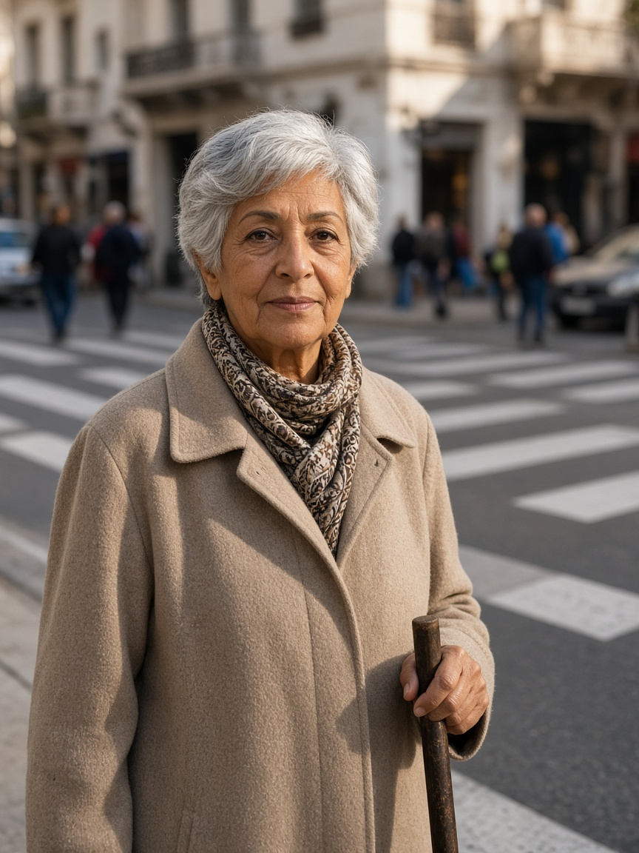
Persona 1 — Amara
Crosses a busy central street for shops and transit · Tunis design context (assumption)
DESIGN STATEMENT · SYNTHESIS, NOT A QUOTE
“I need enough time to finish crossing, even when traffic is busy.”
NEED
FEAR
Acknowledgement, shorter waiting and enough clearance to finish.
Cars receive green while she is still crossing.
USES
REJECTS
Push-button, audible/visual feedback; no phone required.
Shortened clearance, inaccessible apps, invented success claims.
P1 · AGE 74
EVIDENCE
MEASURE · PROPOSED, NOT A RESULT
Perceived wait ≈2× in one NZ study [C03]. MUTCD clearance guidance ≈1.07 m/s and slower where needed [C04].
Mean / P95 / max wait + zero clearance truncations.
Amara
Retired pedestrian; uses a cane
BIO · Represents slower walkers excluded by average-speed timing.
Illustration · not an interviewed person
PERSONALITY · Careful and independent; design assumption.
Notes:
Research-informed design persona, not an interview. I need enough time to finish crossing, even when traffic is busy. Need: Acknowledgement, shorter waiting and enough clearance to finish. Fear: Cars receive green while she is still crossing. Evidence: Perceived wait ≈2× in one NZ study [C03]. MUTCD clearance guidance ≈1.07 m/s and slower where needed [C04]. Proposed measure: Mean / P95 / max wait + zero clearance truncations.

Slide 5
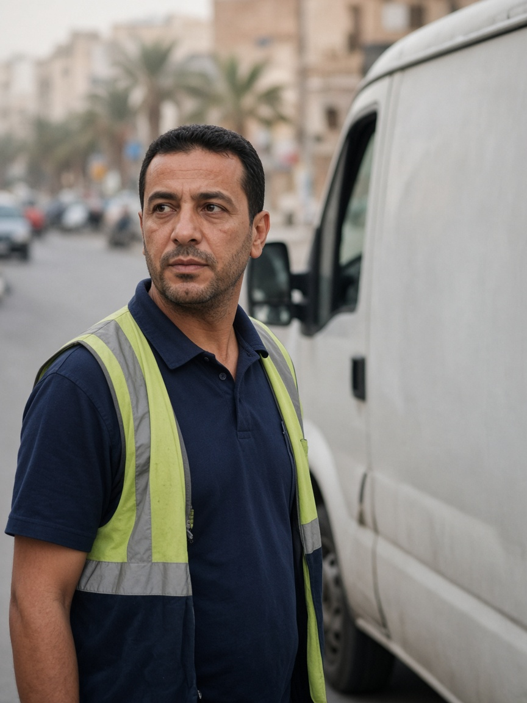
Persona 2 — David
More than 60 time-sensitive stops per workday · Tunis design context (assumption)
DESIGN STATEMENT · SYNTHESIS, NOT A QUOTE
“I can plan around a longer trip if I know how long it will actually take.”
NEED
FEAR
Predictable journeys, fewer stops and visible incidents.
A better mean hides unfinished or extreme trips.
USES
REJECTS
Work phone, GPS/navigation and delivery-round tools.
Best-case headlines and deleted unfinished trips.
P2 · AGE 41
EVIDENCE
MEASURE · PROPOSED, NOT A RESULT
DfT TAG uses 0.4 as an appraisal reliability ratio for journey-time variability [C05].
Completed/unfinished trips, P95/max duration, stops and standstill.
David
Delivery-van driver
BIO · Represents reliability and the severe tail—not only the average.
Illustration · not an interviewed person
PERSONALITY · Organised and schedule-focused; design assumption.
Notes:
Research-informed design persona, not an interview. I can plan around a longer trip if I know how long it will actually take. Need: Predictable journeys, fewer stops and visible incidents. Fear: A better mean hides unfinished or extreme trips. Evidence: DfT TAG uses 0.4 as an appraisal reliability ratio for journey-time variability [C05]. Proposed measure: Completed/unfinished trips, P95/max duration, stops and standstill.

Slide 6
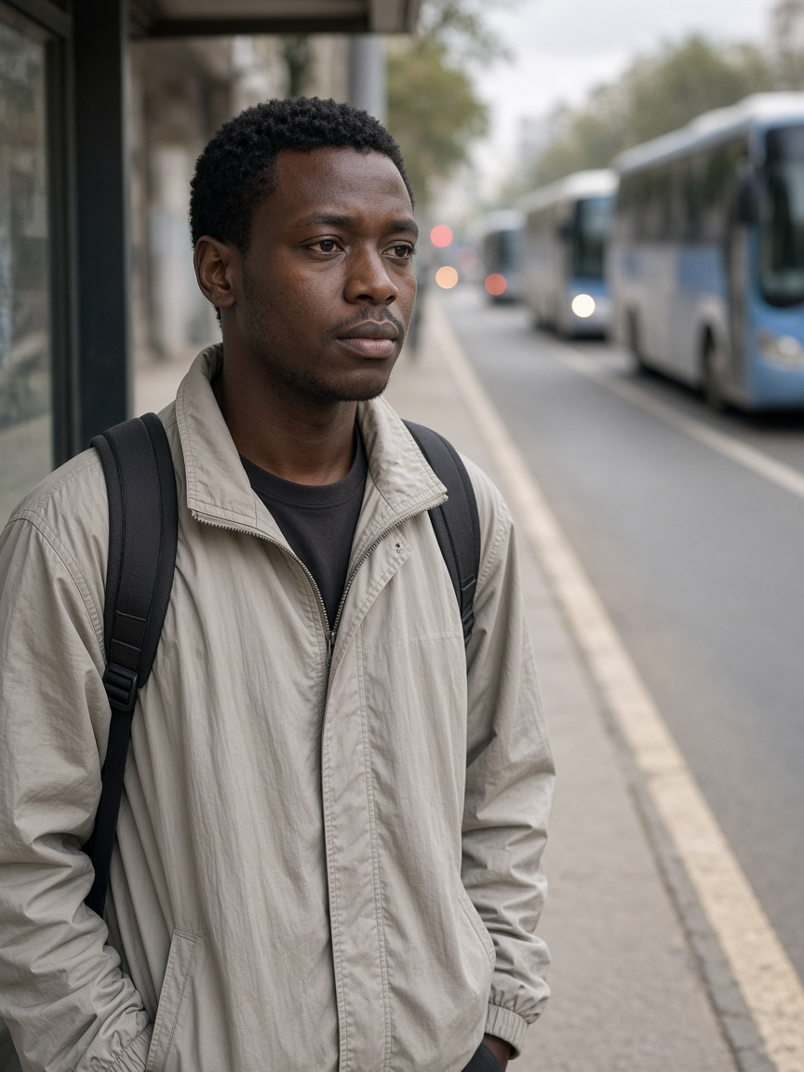
Persona 3 — Chidi
Uses a high-frequency corridor where regularity is the service · Tunis design context (assumption)
DESIGN STATEMENT · SYNTHESIS, NOT A QUOTE
“Buses should arrive regularly—not three at once after a long wait.”
NEED
FEAR
Priority only for a late bus or a large headway gap.
Three buses arrive together after one long gap.
USES
REJECTS
Passenger-information app when available; otherwise the stop.
Every-bus priority and pedestrian clearance sacrificed for transit.
P3 · AGE 27
EVIDENCE
MEASURE · PROPOSED, NOT A RESULT
DfT TAG applies a 2× value-of-time multiplier to public-transport waiting [C05].
Lateness, headway variation, passenger-wait proxy and car externality.
Chidi
Frequent bus passenger
BIO · Represents passengers harmed by bunching and unpredictable gaps.
Illustration · not an interviewed person
PERSONALITY · Routine-oriented and uncertainty-sensitive; design assumption.
Notes:
Research-informed design persona, not an interview. Buses should arrive regularly—not three at once after a long wait. Need: Priority only for a late bus or a large headway gap. Fear: Three buses arrive together after one long gap. Evidence: DfT TAG applies a 2× value-of-time multiplier to public-transport waiting [C05]. Proposed measure: Lateness, headway variation, passenger-wait proxy and car externality.

Slide 7
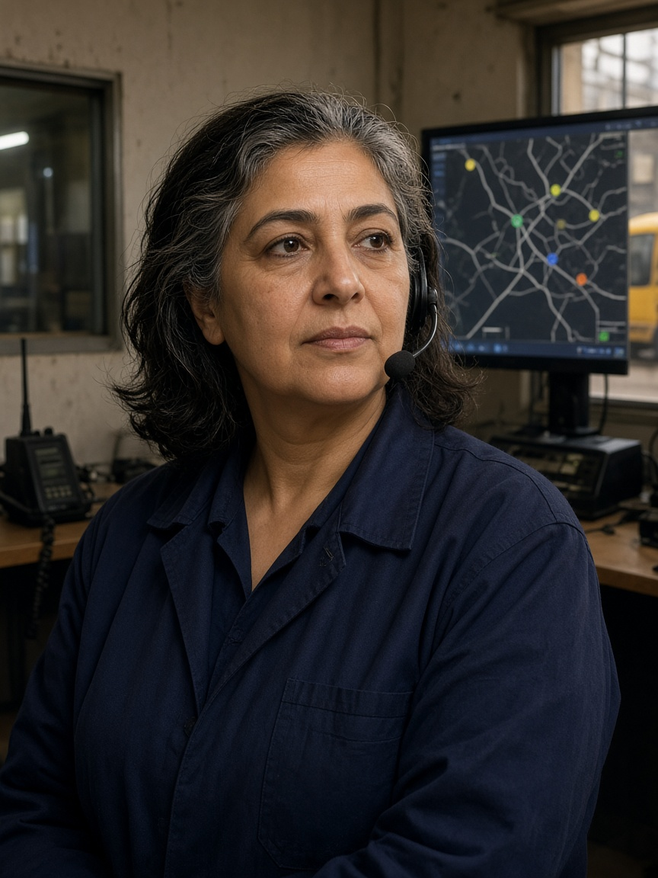
Persona 4 — Rosa
Reads disruption and the crash record. She does not change the light · Tunis design context (assumption)
DESIGN STATEMENT · SYNTHESIS, NOT A QUOTE
“Show me why priority was granted or denied, and let me respond safely.”
NEED
FEAR
Positions, headways, confidence, reason codes and a joined audit trail.
A black box refuses priority and leaves no history.
USES
REJECTS
Depot tools, vehicle-location screen, radio and dashboard.
Unsupported predictions or override outside the safety mask.
P4 · AGE 52
EVIDENCE
MEASURE · PROPOSED, NOT A RESULT
SCATS documentation describes monitoring, manual intervention and audit trails [C08].
Reason-code coverage and operator explanation of one yes and one no.
Rosa
Incident-report reader
BIO · She reads the record and the reason code. She does not write the signal.
Illustration · not an interviewed person
PERSONALITY · Calm, responsible and evidence-seeking; design assumption.
Notes:
Research-informed design persona, not an interview. Show me why priority was granted or denied, and let me respond safely. Need: Positions, headways, confidence, reason codes and a joined audit trail. Fear: A black box refuses priority and leaves no history. Evidence: SCATS documentation describes monitoring, manual intervention and audit trails [C08]. Proposed measure: Reason-code coverage and operator explanation of one yes and one no.

Slide 8
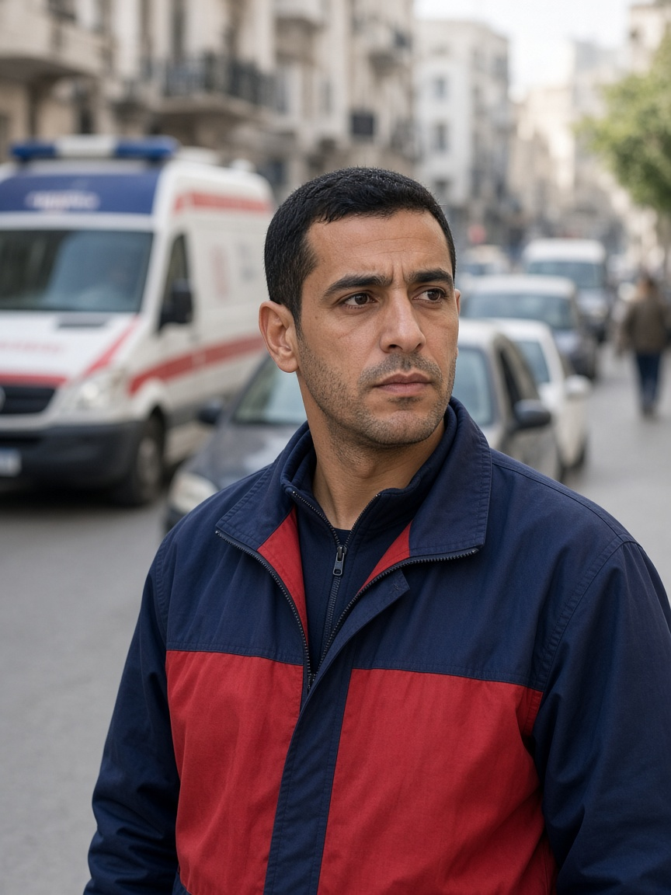
Persona 5 — Marcus
Responds through congested streets during peak periods · Tunis design context (assumption)
DESIGN STATEMENT · SYNTHESIS, NOT A QUOTE
“Get us through safely, and make sure traffic recovers after we pass.”
NEED
FEAR
Trusted route/ETA request, downstream check and controlled recovery.
A green into a full link simply moves the queue.
USES
REJECTS
Dispatch tablet, GPS, radio, lights and siren.
Cutting an occupied crossing or translating simulation into casualties.
P5 · AGE 34
EVIDENCE
MEASURE · PROPOSED, NOT A RESULT
One Taipei cohort associated each extra ALS minute with 7% lower adjusted odds [C06]. Preemption can impose network delay [C07].
Emergency time, civilian delay, downstream rejection and recovery. Not lives saved.
Marcus
Urban ambulance crew
BIO · Represents passage plus recovery and the civilian cost of priority.
Illustration · not an interviewed person
PERSONALITY · Urgent, precise and aware of other road users; design assumption.
Notes:
Research-informed design persona, not an interview. Get us through safely, and make sure traffic recovers after we pass. Need: Trusted route/ETA request, downstream check and controlled recovery. Fear: A green into a full link simply moves the queue. Evidence: One Taipei cohort associated each extra ALS minute with 7% lower adjusted odds [C06]. Preemption can impose network delay [C07]. Proposed measure: Emergency time, civilian delay, downstream rejection and recovery. Not lives saved.

Slide 9
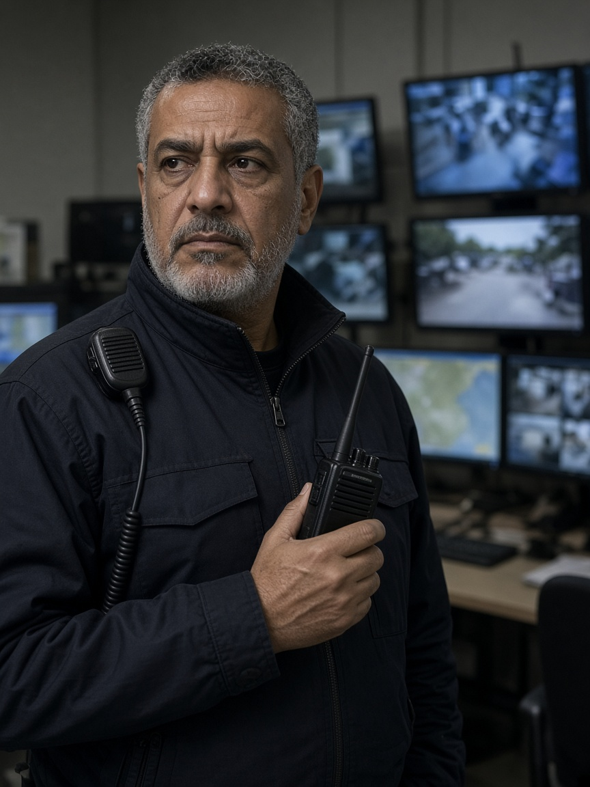
Persona 6 — Omar
Monitors incidents and coordinates operational response · Tunis design context (assumption)
DESIGN STATEMENT · SYNTHESIS, NOT A QUOTE
“Tell me what is wrong, why you think so, and whether I can still trust the data.”
NEED
FEAR
Severity, observations, uncertainty, freshness and data-health warnings.
False alarms or a frozen screen hide the real condition.
USES
REJECTS
Radio, camera wall, incident tools and dashboard.
Alerts without evidence or anomaly presented as proven cause.
P6 · AGE 55
EVIDENCE
MEASURE · PROPOSED, NOT A RESULT
FHWA estimates incidents account for about 25–30% of congestion in many US metropolitan contexts—not Tunis [C10].
Detection delay, false alarms, misses, stale data and recovery.
Omar
Network duty officer
BIO · Represents the difference between “nothing detected” and “cannot see.”
Illustration · not an interviewed person
PERSONALITY · Sceptical, methodical and operational; design assumption.
Notes:
Research-informed design persona, not an interview. Tell me what is wrong, why you think so, and whether I can still trust the data. Need: Severity, observations, uncertainty, freshness and data-health warnings. Fear: False alarms or a frozen screen hide the real condition. Evidence: FHWA estimates incidents account for about 25–30% of congestion in many US metropolitan contexts—not Tunis [C10]. Proposed measure: Detection delay, false alarms, misses, stale data and recovery.

Slide 10
3 · Persona needs
Each card has one problem. The solution has to reach that person.
Who is affected | Need on their card | Problem
Amara | Acknowledgement, shorter waiting and enough clearance to finish. | Clearance assumes a faster walk than hers.
David | Predictable journeys, fewer stops and visible incidents. | A better average hides the late or unfinished trip.
Chidi | Priority only for a late bus or a large headway gap. | Buses bunch, then the early bus is treated as urgent.
Rosa | Positions, headways, confidence, reason codes and a joined audit trail. | A refusal with no reason cannot be checked after the shift.
Marcus | Trusted route/ETA request, downstream check and controlled recovery. | A green light into a full exit only moves the queue.
Omar | Severity, observations, uncertainty, freshness and data-health warnings. | A residual can be a crash, extra demand, or a sensor that has gone quiet.
Notes:
Needs are design readings of the groups on the Empathize slide. They are not interview quotes.

Slide 11
4 · Evidence
Survey, interviews, and research. Only the research column has a source.
Who | Survey | Interview | Research that supports the need
Amara | No survey file | Not interviewed | Pedestrians were 28% of the 2023 deaths in the WHO case quoting ONSR. The 2024 strategy names older people and people with disabilities. Clearance guidance is about 1.07 m/s, slower where needed.
David | No survey file | Not interviewed | Occupants carry most of that case’s health cost. One matched seed finished 71, 84, and 70 of 84 trips. Mixed. No winner.
Chidi | No survey file | Not interviewed | TRANSTU: 187.4 million paying passengers in 2018, not this year. Waiting time is valued above in-vehicle time in DfT appraisal guidance.
Rosa | No survey file | Not interviewed | ONSR compiles the crash record. SCATS documents an audit trail. That is an analogy, not a Tunis control room we visited.
Marcus | No survey file | Not interviewed | Civil Protection answers road emergencies. A Taipei survival-per-minute figure is a citation from elsewhere. This simulation does not output lives saved.
Omar | No survey file | Not interviewed | The detector has classes. An anomaly does not name a cause. FHWA’s congestion shares are not a map of these junctions.
Notes:
No survey file. No interview transcript. Do not invent a percentage, a sample size, or a quote.

Slide 12
5 · Ideation
Each idea starts from that person’s need.
Who is affected | Need | Idea we keep
Amara | Clearance assumes a faster walk than hers. | Hold the conflicting green until she finishes, and count truncations.
David | A better average hides the late or unfinished trip. | Show unfinished trips and the tail beside the mean.
Chidi | Buses bunch, then the early bus is treated as urgent. | Ask for green only after an unusual gap. An early bus gets nothing.
Rosa | A refusal with no reason cannot be checked after the shift. | Explain one grant or denial with the reason code and a citation, or abstain.
Marcus | A green light into a full exit only moves the queue. | Authenticated request, an exit check, then recovery.
Omar | A residual can be a crash, extra demand, or a sensor that has gone quiet. | Publish the class, the residual, and whether the sample is fresh.
Refused: a scraped map as truth, a camera that guesses ability, a chatbot that writes the light, a lives-saved claim.
Notes:
A later idea still needs a file. A rejected idea does not become a solution. A sentence must not become the signal.

Slide 13
6 · Solutions
Who is affected, then the solution that reaches them.
Who is affected | Problem | Solution
Amara, while she is still in the crossing | Clearance assumes a faster walk than hers. | A3 asks. A1 holds the conflicting green. Truncations are counted.
David, on the trip that does not finish | A better average hides the late or unfinished trip. | The evidence page keeps unfinished trips in the count, next to the mean.
Chidi, waiting through a long gap between buses | Buses bunch, then the early bus is treated as urgent. | A3 asks only for a late bus or a large gap. Pedestrian clearance stays ahead of the bus.
Rosa, reading a refusal that has no reason | A refusal with no reason cannot be checked after the shift. | S2 returns one cited explanation, or an abstention. Rosa does not write the signal.
Marcus, and the people his priority delays | A green light into a full exit only moves the queue. | A2 sends route and expiry. A1 checks the exit, then recovers Max-Pressure, actuated, fixed-time.
Omar, when a queue might be a crash, demand, or a dead sensor | A residual can be a crash, extra demand, or a sensor that has gone quiet. | A4 publishes the class and the freshness. It does not name the cause. Stale data leaves A1 on local control.
Notes:
Only A1 writes the signal. Synapse explains the log or abstains.

Slide 14
10 · Provenance
The table comes first. Stale must show as stale.
Feed | What the row must carry | If it is stale
OpenStreetMap | Snapshot date, licence, and the edges it covers | Show the date. Do not call it today’s speed.
Weather | Station, junction, and hour, or the row is absent | No join means no weather layer. Rain is not a cause.
Incident | Type, place, start, duration, severity, source, confidence | An old incident stays marked stale. It does not look live.
SUMO run | run_id and scenario hash | A saved run is not a live city.
Survey | Who was asked, how many, the date, the answers | No file means the cell stays empty. No invented Tunis digits.
Notes:
Build the collection table before any map. A missing time or a missing source is stale, and the screen says stale.

Slide 15
11 · Assumptions
Literature motivates the need. SUMO holds a labelled assumption.
Person | Literature may say | SUMO may hold | SUMO must not hold
Amara | Slower clearance is required where people walk slowly | A labelled walking band and a counted truncation | Her age, or a Tunis crossing we did not measure
David | The tail matters, not only the mean | Unfinished trips kept in the count | A winner from one seed
Chidi | Waiting is costly for passengers | Priority only after an unusual gap | Today’s TRANSTU headway
Marcus | Priority can add delay elsewhere | Exit check, recovery, civilian delay | Lives saved
Omar | An incident is not the same as a dead sensor | Class, confidence, and freshness | A guessed cause
Notes:
Published findings may set a parameter. They are not a Tunis measurement, and they are not a survey result.

Slide 16
12 · Incident engine
One engine. Flood, weather, emergency, and police are packs, not extra AIs.
Flood
Weather
Emergency
Police
Accident
Combined
The same network stays. Only the incident pack changes. The change is a SUMO restriction, not a new controller.
Contract on every pack: type, location, start, duration, severity, edges, confidence, source.
A separate Flood AI, Weather AI, or Police AI is not the design.
Notes:
Common contract: type, location, start, duration, severity, edges, confidence, source. SUMO applies the restriction.

Slide 17
13 · Closed loop
Observe, then advise, then one writer, then the measure.
Observe
A4
A2 · A3 · A5
A1
Safety
SUMO
Measure
Synapse
Person | Acceptance, not decoration
Amara | Crossing stays protected. Truncations are counted.
David | Unfinished trips stay in the count.
Chidi | An early bus gets nothing. Clearance stays ahead of the bus.
Rosa | Every grant and every denial has a reason code.
Marcus | The exit is checked. Civilian delay is logged. Not lives saved.
Omar | State, confidence, and freshness. Stale shows as stale.
Notes:
Observe → A4 → specialists → A1 → Safety → SUMO → measure → Synapse. Personas are acceptance criteria.

Slide 18
14 · Start the city
Pick the settings. Run. The SUMO window is live. The ops panels start empty.
Setting | What is chosen
Network | One grid. It does not change between packs.
Demand | Mixed. Labelled as demand, not as a Tunis count.
Weather and flood | Heavy rain, then a flood pack.
Emergency | An ambulance request, with an expiry.
Compliance | A chosen share. Acceptors may reroute. Refusals stay.
Ops panels | Empty until a message arrives. Empty is not a hidden all-clear.
Notes:
Demo script. Same network for every pack. This slide does not print a result from a flood run.

Slide 19
15 · The street closes
Flood closes E17. Route B is an advisory. Compliance decides who moves.
Moment | What changes | Who decides
Rain escalates | The flood pack becomes active | The incident engine, not a new AI
E17 closes | SUMO restricts that edge | The simulator, from the pack
Queues form | Approaches to the closure fill | Observed. Not yet named as a crash.
Route B | Advisory on the driver channel | The driver. Accept reroutes. Refuse stays.
This is the scene the demo is built to show. It is not a saved Tunis result.
Notes:
SUMO applies the closure. Queues form on the approaches. A refusal does not get a forced reroute.

Slide 20
16 · A4
State, confidence, and freshness. Do not invent the cause.
What A4 may publish | What A4 may not publish
Queue up, speed down, travel time up, availability down | “Crash confirmed” with no crash file
Class: incident or congestion | The name of the cause
A confidence | A confidence with no sample
Fresh, or stale | A stale row that looks healthy
If the sample is stale, A1 gets no forecast and keeps local control.
Notes:
Omar’s acceptance: what the evidence supports. A class is not a verdict.

Slide 21
17 · Specialists
A5 offers Route B. A3 protects the crossing and the bus. Requests only.
Who | Request on the board | Not allowed
A5 | Impact on the flooded approach. Route B. A lower spill only as a projection. | Setting a phase. Calling the projection measured air.
A3 | Protect the crossing. Protect transit clearance. | An early bus. Cutting the walk.
A2 | Held for the next slide. It asks. It does not decide. | A corridor that skips the safety mask.
Requests sit on the board. They are not the signal.
Notes:
A2, A3, and A5 do not call TraCI. A5’s route is advice. A3’s constraint keeps Amara and Chidi ahead of a green.

Slide 22
18 · One writer
A2 asks. A1 alone decides. The mask passes. Rosa gets the reason code.
A2 asks
A3 · A4 · A5 advise
A1 decides
Mask passes
Executor
SUMO phase
Rosa can read | Rosa cannot do
Grant, with the reason code | Change the light herself
Denial, with the reason code | Delete the refusal
Abstention, when the citation is missing | Treat a sentence as the phase
Notes:
Cooperative Max-Pressure inside the mask. Signal Executor is the only writer. Synapse does not reach TraCI.

Slide 23
19 · Prove the loop
The map changes. The numbers are measured fields. Synapse cites the IDs.
What can be on screen | What the number must be
Corridor green, Route B, protected crossing | A picture of the run, not a Tunis map
Wait, trips, emergency delay, truncations | Taken from the run. No blank filled in later.
Accept and refuse | Counted. A refusal stays a refusal.
Synapse answer | Cites the incident, the event, and the policy. Or abstains.
The language model explains the log. It never writes the light.
Notes:
Visible change is not a result until the metric row exists. The language model never actuates.

Slide 24
20 · Close
Incident, then a constrained response, then the evidence.
Step | What is true
Incident | A pack with type, place, time, edges, confidence, and source.
Constrained response | Advisers request. A1 decides. The mask passes. SUMO moves.
Evidence | Reason codes, freshness, and measured fields. Stale shows as stale.
Not “prevents accidents in Tunisia.” No lives saved. No measured air. No deployment.
Amara, David, Chidi, Rosa, Marcus, and Omar are the acceptance criteria for that record.
Notes:
The product evaluates incident response in simulation and keeps the record. It does not prevent accidents in Tunisia.

