Slide 1
Empathize and Ideation · validation
Research, then evidence, then the person, then the idea.
1 Research
2 Evidence
3 Personas
4 Needs
5 Problem
6 Ideas
7 Selected solution
Notes:
Fedi Baccar asked for a visible link: user research, evidence, personas, needs, problem statement, ideas, selected solution. Interviews and questionnaires were not collected.

Slide 2
Empathize · Problem context
A signal decision hits several people at once.
What is happening | Why it matters here
A light changes while someone is still crossing. | Pedestrians were 28% of 2023 deaths in the WHO investment case that quotes ONSR. The 2024 strategy names older people and people with disabilities.
A better average can hide a trip that never finishes. | Vehicle occupants carry most of the health cost in that same case.
Buses bunch, then an early bus is treated as urgent. | TRANSTU reported 187.4 million paying passengers in 2018. That is not this year’s headway.
A refusal, a full exit, or a stale sensor can look like nothing. | The reader, the crew, and the duty officer each need a record they can check.
2023 deaths are published as both 2,273 and 1,216, with the same 5,796 crashes. Show both. Do not average them.
Notes:
Why it matters: published Tunisian crash counts, and no public adaptive-signal network was found. This is not a claim that the project prevents deaths.

Slide 3
Empathize · Target users
Six groups named by published sources.
Who is affected | What the source names | Persona
Pedestrians, and older people and people with disabilities | 28% of 2023 deaths in the investment case. Named in the 2024 strategy. | Amara
Occupants of motor vehicles | Most of the health cost in that case. | David
TRANSTU passengers in Greater Tunis | 187.4 million paying passengers in 2018. | Chidi
The reader of the crash record | ONSR compiles the national record. One reader, not a second controller. | Rosa
Road emergency crews | Civil Protection answers those calls. We did not ride with them. | Marcus
The person who must trust the alert | A residual is not a cause. | Omar
Notes:
These are the people affected. Ages and jobs on the cards are design readings, not interviews.

Slide 4
Empathize · User research
What was collected, and what was not.
Method | Status | What it supports
Interviews | Not collected | Nothing. No quote.
Questionnaires | Not collected | Nothing. No percentage from us.
Observation / ride-along | Not done | Nothing about a Tunis crew or a specific crossing.
Existing data | Used | WHO profile, WHO/UNIATF investment case quoting ONSR, La Presse briefing 17 Jan 2025, INS republished counts, TRANSTU 2018 report.
Literature | Used | Clearance guidance, appraisal guidance on wait and reliability, an audit-trail product analogy, a Taipei minute figure labelled as not Tunis.
Our simulation | One matched seed | 71, 84, and 70 of 84 trips. Mixed. No winner. Not a Tunis result.
Notes:
Interviews, questionnaires, and ride-alongs are not in the repository. Existing data and literature are. Inventing a sample would break the validation.

Slide 5
Empathize · Key findings
Five insights. Each one limits what we may say.
1 The people harmed are named in official counts: pedestrians, occupants, and public-transport passengers. The 2024 strategy also names older people and people with disabilities.
2 Two death totals exist for 2023, 2,273 and 1,216, beside the same 5,796 crashes. A single death number would hide that.
3 A mean can improve while trips stay unfinished. On seed 37, actuated finished more trips. Max-Pressure did not win.
4 No public adaptive-signal network in Tunis was found. A 2018 passenger total is not today’s bus gap.
5 An alert that names a cause, or a stale sensor shown as healthy, would go beyond the evidence.
Notes:
The findings come from the sources on the previous slide. They are not interview themes.

Slide 6
Empathize · Personas
Each card is a reading of one group in the evidence.
Persona | User type | Justified by
Amara, 74 | Slower pedestrian | Pedestrian share of deaths, plus the 2024 strategy, plus slower-clearance guidance.
David, 41 | Driver who needs the tail | Occupant health cost, plus one seed where unfinished trips stayed visible.
Chidi, 27 | Bus passenger | TRANSTU 2018 total, plus guidance that values waiting time.
Rosa, 52 | Reader of the record | ONSR compiles crashes. An audit trail is a product analogy, not a room we visited.
Marcus, 34 | Ambulance crew | Civil Protection exists. A foreign survival figure is cited as foreign. Not lives saved.
Omar, 55 | Duty officer | A class is not a cause. Stale data must not look healthy.
Notes:
Not interviewed people. The next six slides are the cards. The research column is why that card exists.

Slide 7
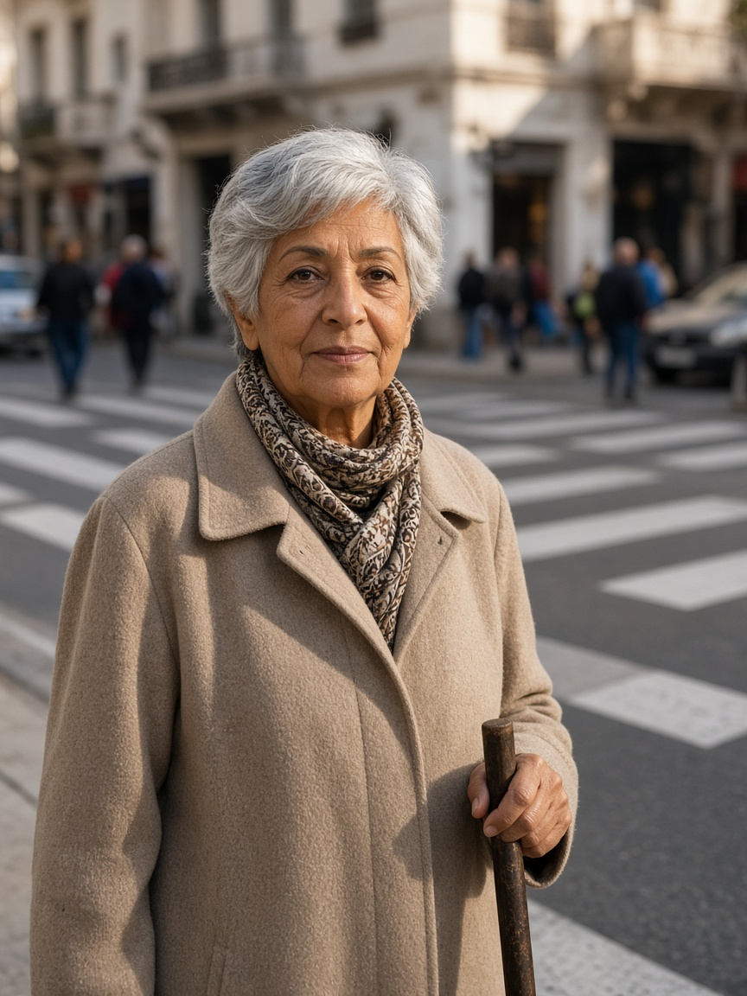
Persona 1 — Amara
Crosses a busy central street for shops and transit · Tunis design context (assumption)
DESIGN STATEMENT · SYNTHESIS, NOT A QUOTE
“I need enough time to finish crossing, even when traffic is busy.”
NEED
FEAR
Acknowledgement, shorter waiting and enough clearance to finish.
Cars receive green while she is still crossing.
USES
REJECTS
Push-button, audible/visual feedback; no phone required.
Shortened clearance, inaccessible apps, invented success claims.
P1 · AGE 74
EVIDENCE
MEASURE · PROPOSED, NOT A RESULT
Perceived wait ≈2× in one NZ study [C03]. MUTCD clearance guidance ≈1.07 m/s and slower where needed [C04].
Mean / P95 / max wait + zero clearance truncations.
Amara
Retired pedestrian; uses a cane
BIO · Represents slower walkers excluded by average-speed timing.
Illustration · not an interviewed person
PERSONALITY · Careful and independent; design assumption.
Notes:
Research-informed design persona, not an interview. I need enough time to finish crossing, even when traffic is busy. Need: Acknowledgement, shorter waiting and enough clearance to finish. Fear: Cars receive green while she is still crossing. Evidence: Perceived wait ≈2× in one NZ study [C03]. MUTCD clearance guidance ≈1.07 m/s and slower where needed [C04].

Slide 8
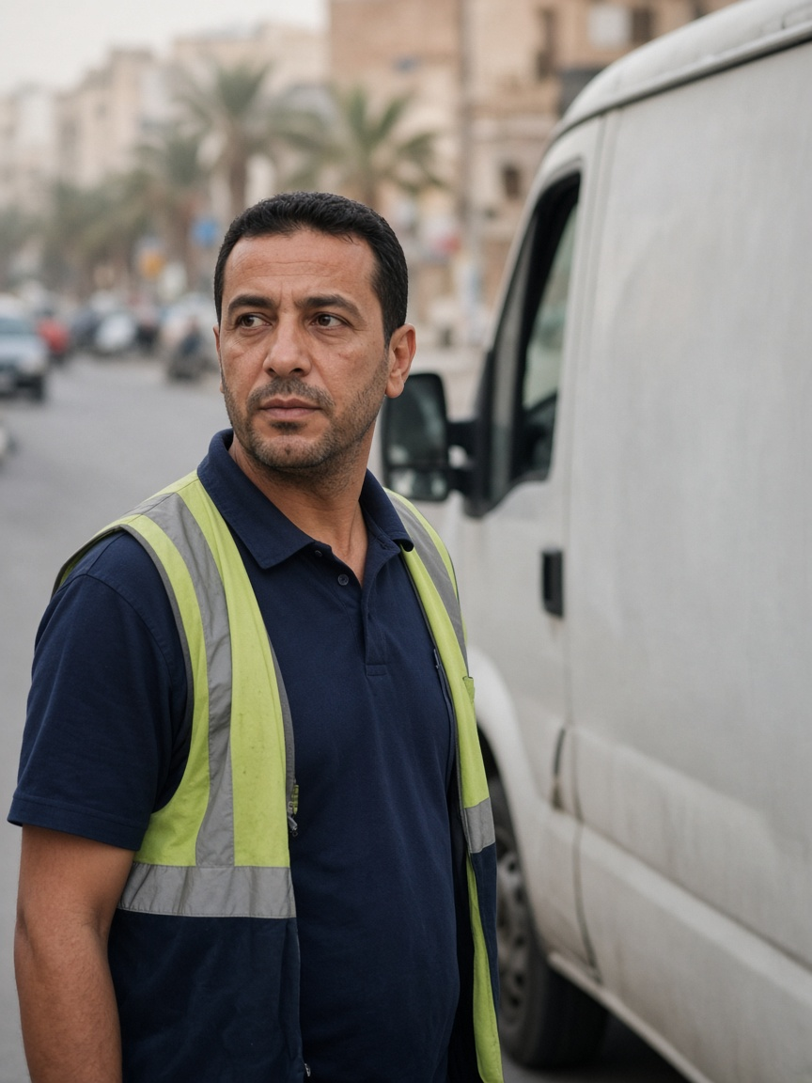
Persona 2 — David
More than 60 time-sensitive stops per workday · Tunis design context (assumption)
DESIGN STATEMENT · SYNTHESIS, NOT A QUOTE
“I can plan around a longer trip if I know how long it will actually take.”
NEED
FEAR
Predictable journeys, fewer stops and visible incidents.
A better mean hides unfinished or extreme trips.
USES
REJECTS
Work phone, GPS/navigation and delivery-round tools.
Best-case headlines and deleted unfinished trips.
P2 · AGE 41
EVIDENCE
MEASURE · PROPOSED, NOT A RESULT
DfT TAG uses 0.4 as an appraisal reliability ratio for journey-time variability [C05].
Completed/unfinished trips, P95/max duration, stops and standstill.
David
Delivery-van driver
BIO · Represents reliability and the severe tail—not only the average.
Illustration · not an interviewed person
PERSONALITY · Organised and schedule-focused; design assumption.
Notes:
Research-informed design persona, not an interview. I can plan around a longer trip if I know how long it will actually take. Need: Predictable journeys, fewer stops and visible incidents. Fear: A better mean hides unfinished or extreme trips. Evidence: DfT TAG uses 0.4 as an appraisal reliability ratio for journey-time variability [C05].

Slide 9
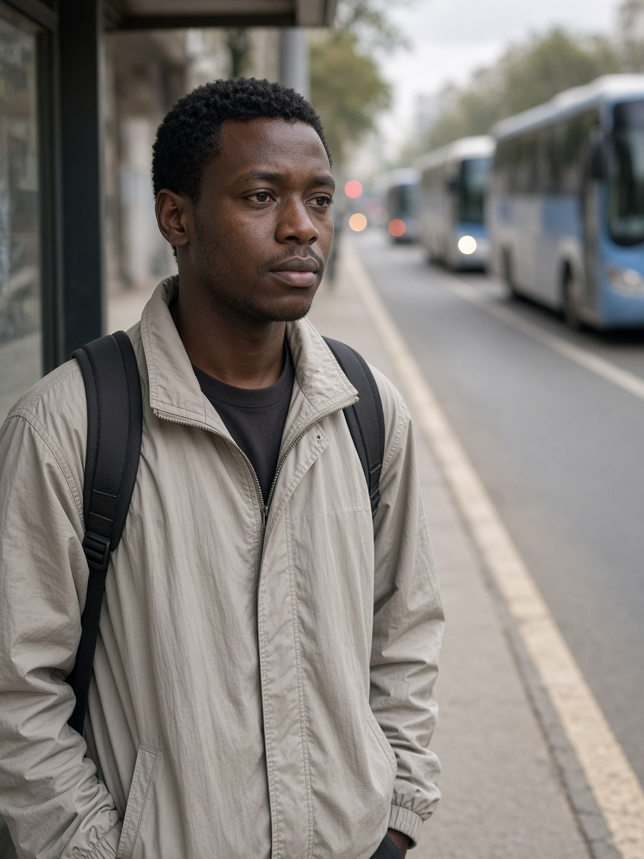
Persona 3 — Chidi
Uses a high-frequency corridor where regularity is the service · Tunis design context (assumption)
DESIGN STATEMENT · SYNTHESIS, NOT A QUOTE
“Buses should arrive regularly—not three at once after a long wait.”
NEED
FEAR
Priority only for a late bus or a large headway gap.
Three buses arrive together after one long gap.
USES
REJECTS
Passenger-information app when available; otherwise the stop.
Every-bus priority and pedestrian clearance sacrificed for transit.
P3 · AGE 27
EVIDENCE
MEASURE · PROPOSED, NOT A RESULT
DfT TAG applies a 2× value-of-time multiplier to public-transport waiting [C05].
Lateness, headway variation, passenger-wait proxy and car externality.
Chidi
Frequent bus passenger
BIO · Represents passengers harmed by bunching and unpredictable gaps.
Illustration · not an interviewed person
PERSONALITY · Routine-oriented and uncertainty-sensitive; design assumption.
Notes:
Research-informed design persona, not an interview. Buses should arrive regularly—not three at once after a long wait. Need: Priority only for a late bus or a large headway gap. Fear: Three buses arrive together after one long gap. Evidence: DfT TAG applies a 2× value-of-time multiplier to public-transport waiting [C05].

Slide 10
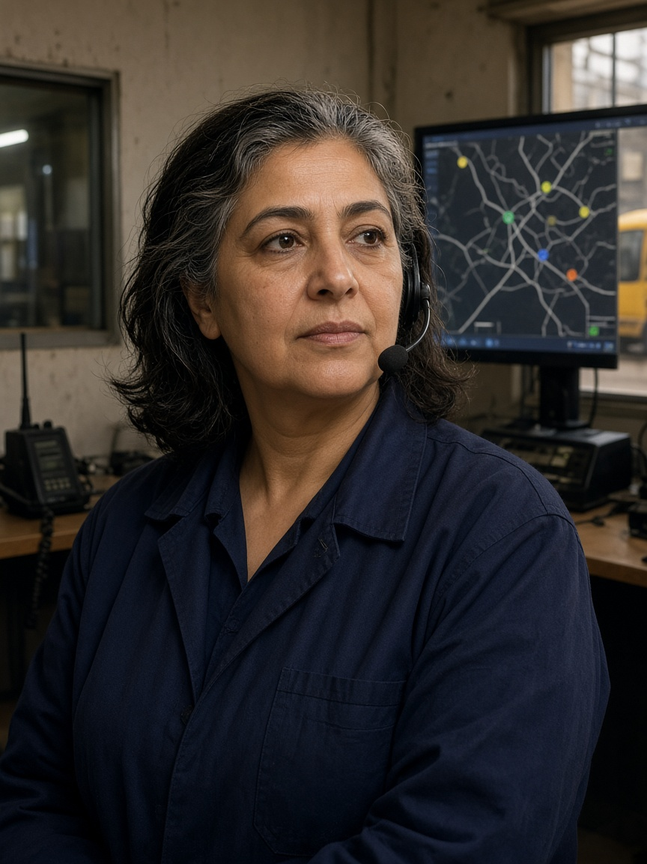
Persona 4 — Rosa
Reads disruption and the crash record. She does not change the light · Tunis design context (assumption)
DESIGN STATEMENT · SYNTHESIS, NOT A QUOTE
“Show me why priority was granted or denied, and let me respond safely.”
NEED
FEAR
Positions, headways, confidence, reason codes and a joined audit trail.
A black box refuses priority and leaves no history.
USES
REJECTS
Depot tools, vehicle-location screen, radio and dashboard.
Unsupported predictions or override outside the safety mask.
P4 · AGE 52
EVIDENCE
MEASURE · PROPOSED, NOT A RESULT
SCATS documentation describes monitoring, manual intervention and audit trails [C08].
Reason-code coverage and operator explanation of one yes and one no.
Rosa
Incident-report reader
BIO · She reads the record and the reason code. She does not write the signal.
Illustration · not an interviewed person
PERSONALITY · Calm, responsible and evidence-seeking; design assumption.
Notes:
Research-informed design persona, not an interview. Show me why priority was granted or denied, and let me respond safely. Need: Positions, headways, confidence, reason codes and a joined audit trail. Fear: A black box refuses priority and leaves no history. Evidence: SCATS documentation describes monitoring, manual intervention and audit trails [C08].

Slide 11
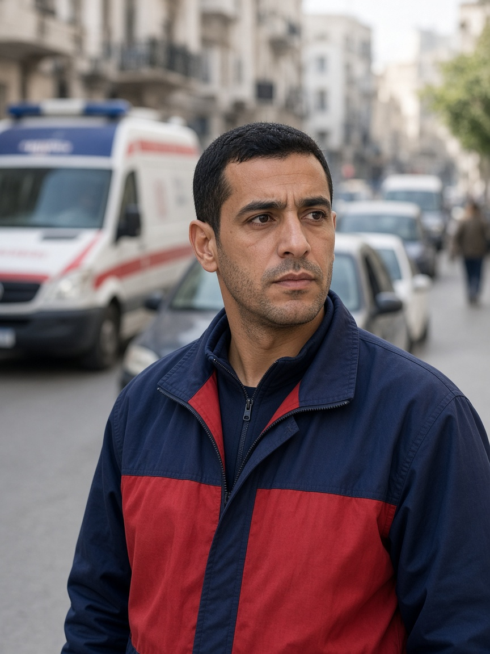
Persona 5 — Marcus
Responds through congested streets during peak periods · Tunis design context (assumption)
DESIGN STATEMENT · SYNTHESIS, NOT A QUOTE
“Get us through safely, and make sure traffic recovers after we pass.”
NEED
FEAR
Trusted route/ETA request, downstream check and controlled recovery.
A green into a full link simply moves the queue.
USES
REJECTS
Dispatch tablet, GPS, radio, lights and siren.
Cutting an occupied crossing or translating simulation into casualties.
P5 · AGE 34
EVIDENCE
MEASURE · PROPOSED, NOT A RESULT
One Taipei cohort associated each extra ALS minute with 7% lower adjusted odds [C06]. Preemption can impose network delay [C07].
Emergency time, civilian delay, downstream rejection and recovery. Not lives saved.
Marcus
Urban ambulance crew
BIO · Represents passage plus recovery and the civilian cost of priority.
Illustration · not an interviewed person
PERSONALITY · Urgent, precise and aware of other road users; design assumption.
Notes:
Research-informed design persona, not an interview. Get us through safely, and make sure traffic recovers after we pass. Need: Trusted route/ETA request, downstream check and controlled recovery. Fear: A green into a full link simply moves the queue. Evidence: One Taipei cohort associated each extra ALS minute with 7% lower adjusted odds [C06]. Preemption can impose network delay [C07].

Slide 12
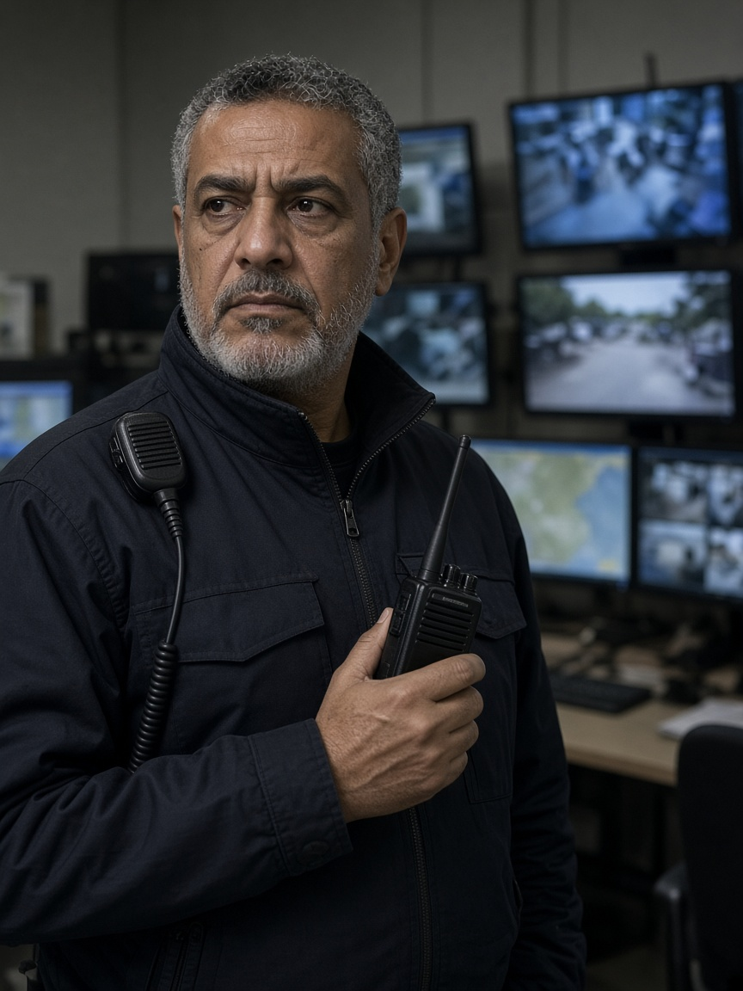
Persona 6 — Omar
Monitors incidents and coordinates operational response · Tunis design context (assumption)
DESIGN STATEMENT · SYNTHESIS, NOT A QUOTE
“Tell me what is wrong, why you think so, and whether I can still trust the data.”
NEED
FEAR
Severity, observations, uncertainty, freshness and data-health warnings.
False alarms or a frozen screen hide the real condition.
USES
REJECTS
Radio, camera wall, incident tools and dashboard.
Alerts without evidence or anomaly presented as proven cause.
P6 · AGE 55
EVIDENCE
MEASURE · PROPOSED, NOT A RESULT
FHWA estimates incidents account for about 25–30% of congestion in many US metropolitan contexts—not Tunis [C10].
Detection delay, false alarms, misses, stale data and recovery.
Omar
Network duty officer
BIO · Represents the difference between “nothing detected” and “cannot see.”
Illustration · not an interviewed person
PERSONALITY · Sceptical, methodical and operational; design assumption.
Notes:
Research-informed design persona, not an interview. Tell me what is wrong, why you think so, and whether I can still trust the data. Need: Severity, observations, uncertainty, freshness and data-health warnings. Fear: False alarms or a frozen screen hide the real condition. Evidence: FHWA estimates incidents account for about 25–30% of congestion in many US metropolitan contexts—not Tunis [C10].

Slide 13
Empathize · Needs and pain points
Need, frustration, and what they expect to see.
Who | Need | Pain | Expectation
Amara | Enough time to finish | Cars go green while she is still crossing | The conflicting green stays held
David | The real duration, including the bad trip | A better mean hides the unfinished trip | Unfinished trips stay on the page
Chidi | A regular gap | Three buses after one long wait | An early bus gets nothing
Rosa | A reason she can read later | A refusal with no history | A citation, or an abstention
Marcus | A path through, then recovery | Green into a full exit | The exit is checked. Delay to others is logged
Omar | A class he can trust | A frozen screen, or a guessed cause | Freshness is shown. Stale stays stale
Notes:
Taken from the cards. Not from an interview.

Slide 14
Ideation · Problem statement
One light. Six needs. A record that does not invent the result.
How might a simulated signal serve the person still crossing, the unfinished trip, the bus gap, the reader of the refusal, the crew at a full exit, and the officer who must not be told a residual is a cause — while only one component writes the light, and every decision keeps a source?
Out of scope for the claim: lives saved, measured air, a Tunis deployment, and a winner from one seed.
Notes:
Refined from the findings. The problem is not “reduce deaths in Tunisia.” That result is not something this evidence can support.

Slide 15
Ideation · How might we
One question per person, taken from their pain.
Who | How might we…
Amara | …hold the conflicting green until the crossing finishes, and count every time it is cut?
David | …show unfinished trips beside the mean, so a better average cannot hide the tail?
Chidi | …give green only after an unusual gap, and give an early bus nothing?
Rosa | …explain one grant or one denial with a reason code, or abstain?
Marcus | …check the exit before green, then recover, without cutting the crossing?
Omar | …publish the class, the confidence, and the freshness, and refuse to name the cause?
Notes:
The questions were written from the needs table. They were not collected in a workshop with users.

Slide 16
Ideation · Ideas generated
What we kept, and what we refused.
Who | Idea we kept | Idea we refused
Amara | Hold the green. Count truncations. | A camera that guesses her ability.
David | Keep unfinished trips in the count. | A scraped live map treated as his trip.
Chidi | Priority only after a real gap. | Green for every bus.
Rosa | One cited explanation, or abstain. | A chatbot that negotiates the phase.
Marcus | Request, exit check, then recovery. | An always-green corridor, or “lives saved.”
Omar | Class, confidence, freshness. | A news scrape that declares a crash.
Notes:
The refuse column is part of the evidence. A refused idea does not become the solution.

Slide 17
Ideation · How we chose
The method, then the criteria.
Criterion | A kept idea must…
Names the person | Say who is affected. A solution with no person is dropped.
Has a source | Point at published data, literature, or a labelled simulation row.
Does not invent | No interview quote, no survey percentage, no Tunis digit we do not have.
Does not write the light | Specialists may request. Only A1, through the safety mask, sets the phase.
Leaves a record | Rosa can read a grant, a denial, or an abstention.
Notes:
Method: one idea per persona need, written beside the source, then kept or refused. Not SCAMPER, and not a user workshop.

Slide 18
Ideation · Selected solution
Advisers request. One writer decides. The record stays.
Need | What the selected concept does
Amara finishes the crossing | A3 asks. A1 holds the conflicting green. Truncations are counted.
David sees the bad trip | Unfinished trips stay beside the mean.
Chidi gets a gap, not a bunch | A3 asks only for a late bus or a large gap.
Rosa can check the no | One cited reason, or an abstention. She does not write the signal.
Marcus is not sent into a full exit | A2 asks. A1 checks the exit, then recovers. Civilian delay is logged.
Omar is not told a guessed cause | A4 publishes class, confidence, and freshness. Stale stays stale.
Incident packs change the street inside SUMO. The language model explains the log, or abstains. It never writes the light.
Notes:
This is the concept we intend to develop. It addresses each need on the card. It does not prevent accidents in Tunisia.

Slide 19
The link
User research, then evidence, then personas, then needs, then the problem, then the ideas, then the selected solution.
No lives saved. No measured air. No Tunis deployment. No winner.
Notes:
Every step above is on a slide. The empty methods stay empty so the link is checkable.

