Slide 1

Nexus
Mechanical Engineering Collaboration & Traceability Platform
Transforming engineering files into engineering knowledge.
Mechanical Engineering Department

Slide 2
Engineering Challenges Today
Modern mechanical projects generate thousands of engineering files, revisions, design decisions and validation documents.
Unfortunately, most of this information is distributed across shared folders, emails, spreadsheets and individual knowledge, making engineering collaboration increasingly difficult.
Main Challenges:
• Difficult to identify the correct version
• Weak traceability between engineering decisions and CAD changes
• Time-consuming design reviews
• Knowledge depends on experienced engineers
• Difficult project audits and customer deliveries
Engineering data exists. Engineering knowledge is often lost.

Slide 3
Our Vision
Nexus is not simply a version control system.
It is a collaborative engineering platform designed to connect every engineering activity into one complete workflow.
Every modification becomes connected to its technical justification, validation evidence and project history.
Requirement
Issue
CAD Modification
Commit
Validation
Release
History
Complete engineering traceability from design request to released deliverable.

Slide 4
Business Value
Engineering
Faster design reviews
Reduced manual searching
Better collaboration
Standardized engineering workflow
Quality
Controlled revisions
Complete traceability
Audit-ready engineering evidence
Reduced engineering risk
Management
Project visibility
Clear responsibilities
Engineering KPIs
Long-term knowledge preservation

Slide 5
Engineering Workflow
Creo VCS follows the complete lifecycle of an engineering modification.
Project
BOM
Check-Out
CAD Modification
Commit
Export
Snapshot
Release
Validation
Merge
Every engineering action is controlled, recorded and traceable.

Slide 6
Complete Engineering Traceability
Every engineering object becomes connected.
Customer Requirement
Jira Ticket (Optional)
Engineering Issue
Affected Parts
Creo Files
Commit
Validation
Audit
Customer Delivery
Released Documents
Nothing becomes isolated anymore.

Slide 7
Why Nexus?
Unlike a traditional file management solution, Nexus manages engineering relationships rather than files alone.
Product Structure
Project Knowledge
CAD Models
NEXUS
Revision History
Engineering Issues
Deliverables
Validation Documents
Engineering Decisions

Slide 8
Benefits Compared to the Current Process
Current Process
Shared folders
Manual revisions
Disconnected information
Emails & Excel tracking
Difficult audits
Knowledge in people's minds
With Nexus
Controlled workspace
Version-controlled engineering
Complete traceability
Integrated engineering workflow
Audit-ready projects
Permanent engineering knowledge

Slide 9
Future Vision
Creo VCS has been designed as a scalable engineering platform.
Future developments include:
Central Server Architecture
PostgreSQL / SQL Server
REST API
Jira Synchronization
Power BI Dashboards
AI Drawing Analysis Enterprise Integration

Slide 10
Nexus User Guide
“ How does Nexus improve daily engineering work? “

Slide 11
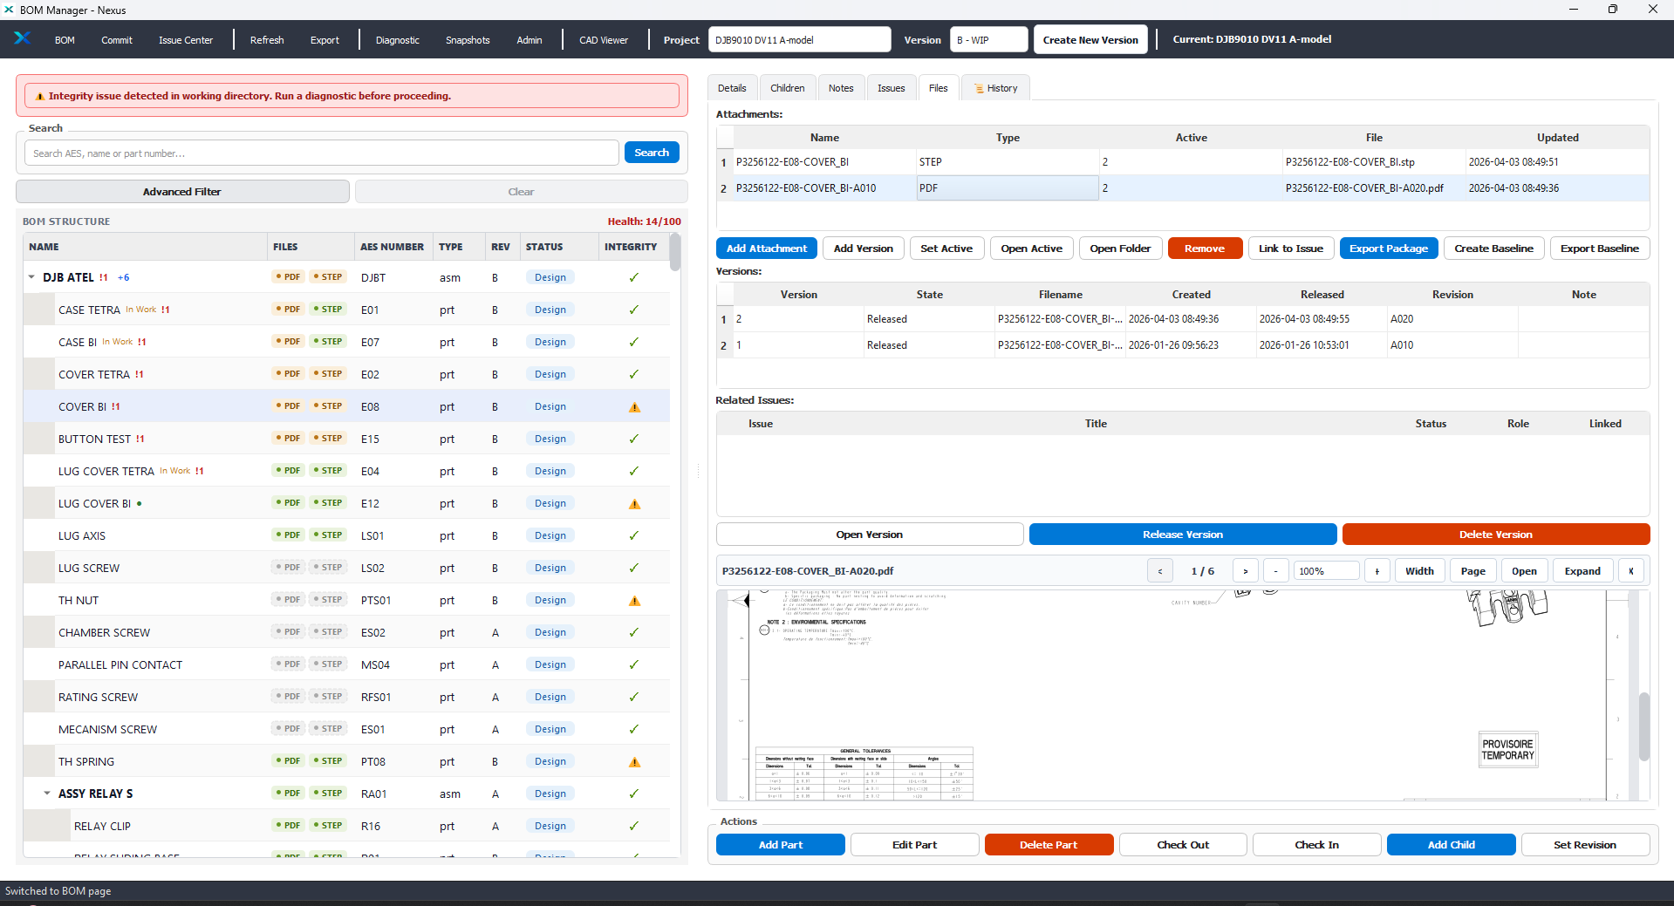
Nexus User Guide

Slide 12
Daily Engineering Workflow
A typical engineering modification follows the workflow below.
Open Project
Find the Part
Check-Out
Modify CAD
Create Commit
Release
Merge
Validation
Resolve Engineering Issue
Attach Validation Documents
Export
This workflow ensures that every engineering modification follows the same controlled process.

Slide 13
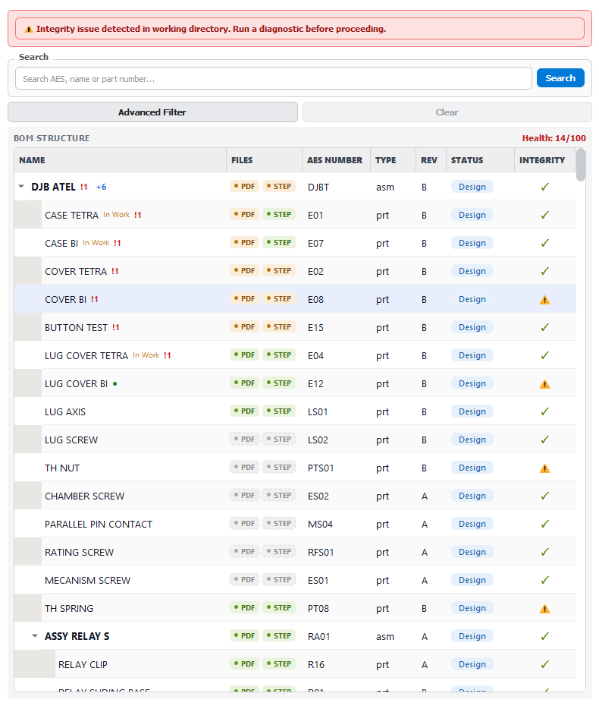
BOM Workspace
The BOM Workspace is the central entry point of the application.
From a single interface, engineers can:
Navigate the complete product structure
Search assemblies and parts instantly
View engineering status
Check document availability Monitor
engineering integrity
Review part history
The BOM always reflects the current engineering status of the project.

Slide 14
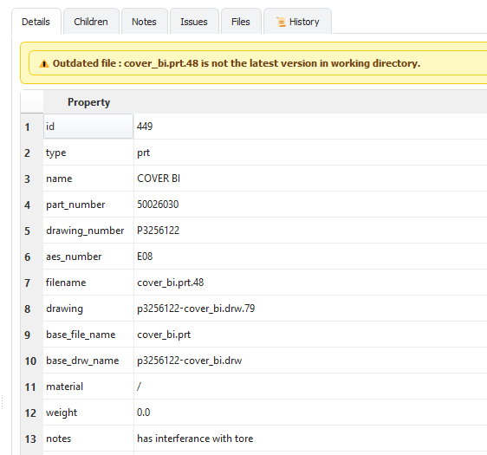
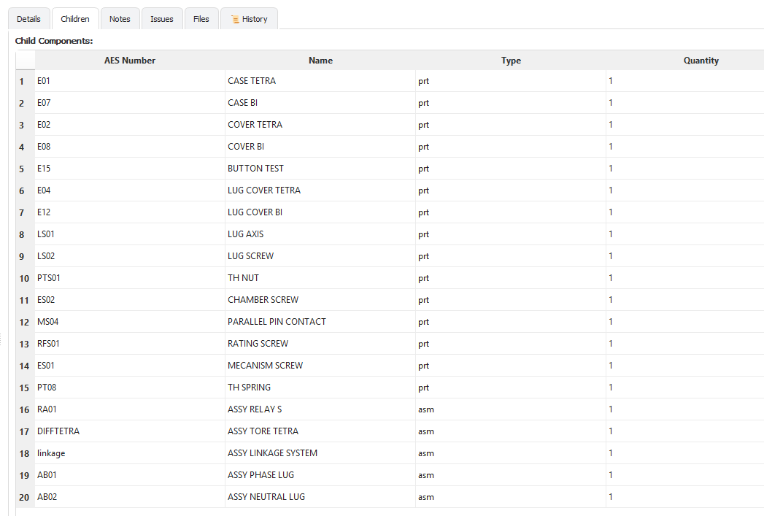
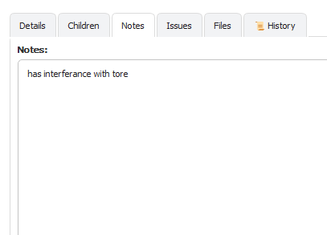
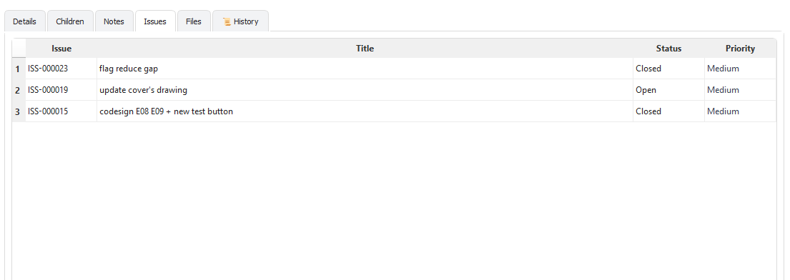
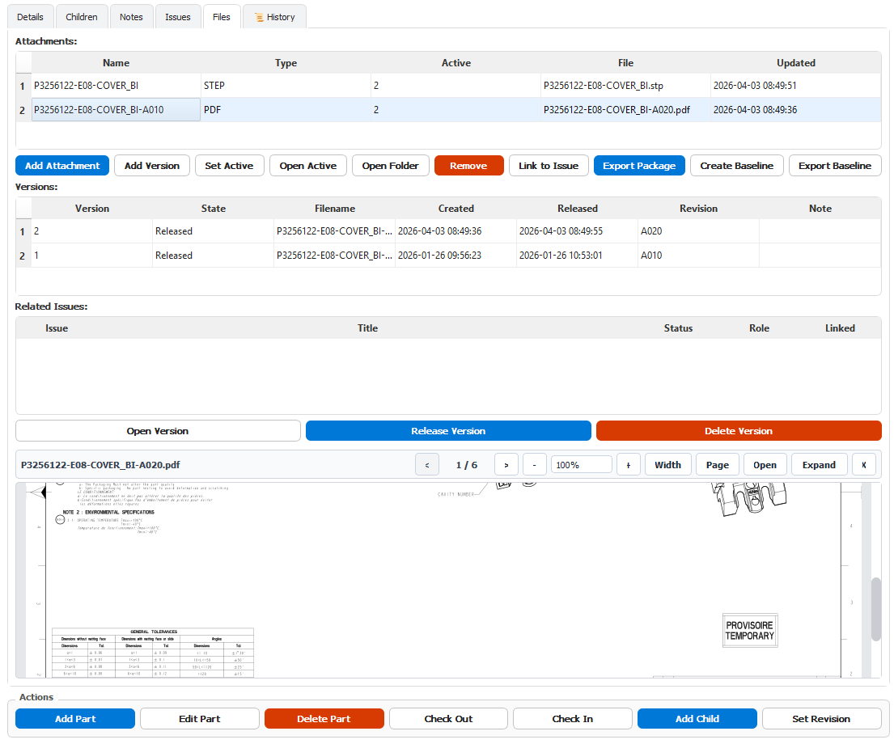
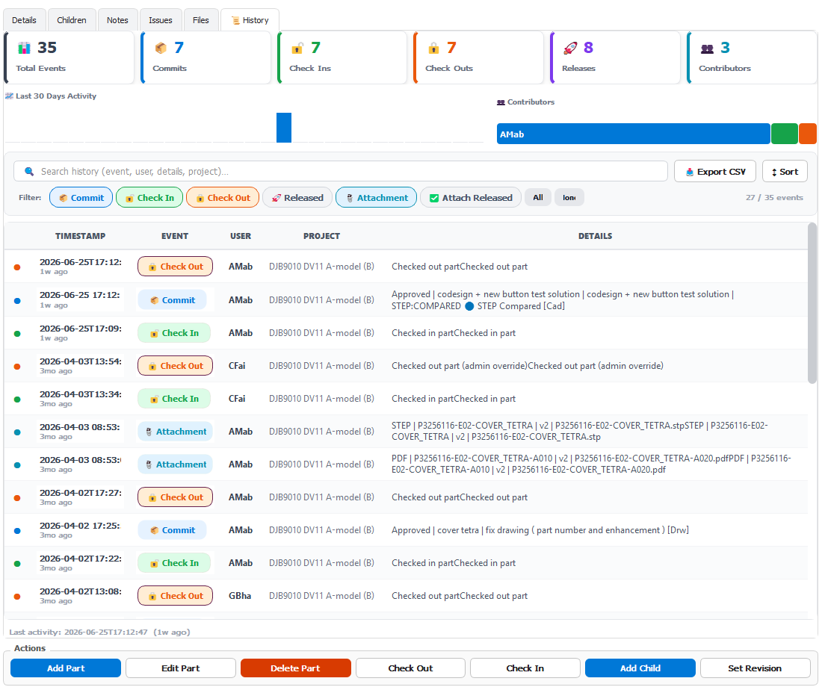
Part Information
Selecting a part immediately provides all engineering information.
Available information includes:
Part Identification
Child Components
Engineering Notes
Linked Issues
Attached Documents
Engineering History

Slide 15
Controlled Engineering Changes
Before modifying a component, the engineer performs a Check-Out.
Benefits:
Prevents simultaneous modifications
Identifies the current owner
Protects project integrity
Creates a complete audit history
After modification, the engineer performs a Commit to submit the work for validation. Or Check-in to release the part.

Slide 16
Engineering File Management
Attachment
Each component can contain multiple engineering deliverables.
Supported documents include:
Native Creo Files
Drawings
PDF
STEP
Technical Reports
Validation Documents
Document Versions
Related issue
Document Preview
Each file is version-controlled independently while remaining linked to the engineering component.

Slide 17
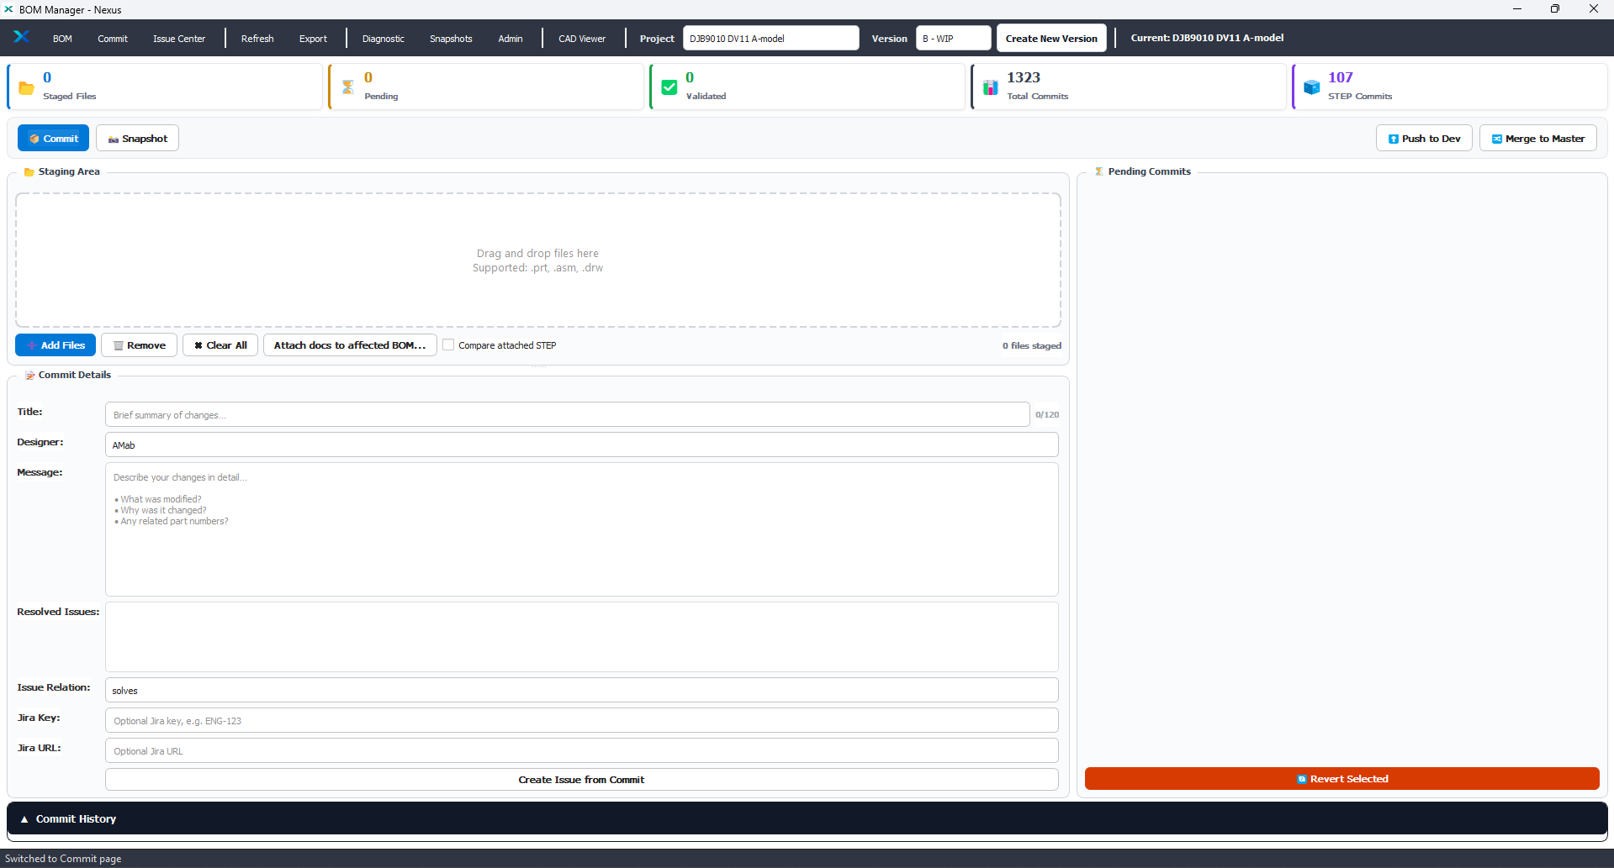
Commit Management
Create Commit
Pending Commits
A Commit represents one engineering modification.
Each commit contains:
Modified CAD Files
Engineering Description
Validation Documents
Linked Engineering Issues
Jira Reference
STEP Comparison
Complete Modification History
1
2
3
4
5
6
7
This provides complete traceability for every engineering decision.

Slide 18
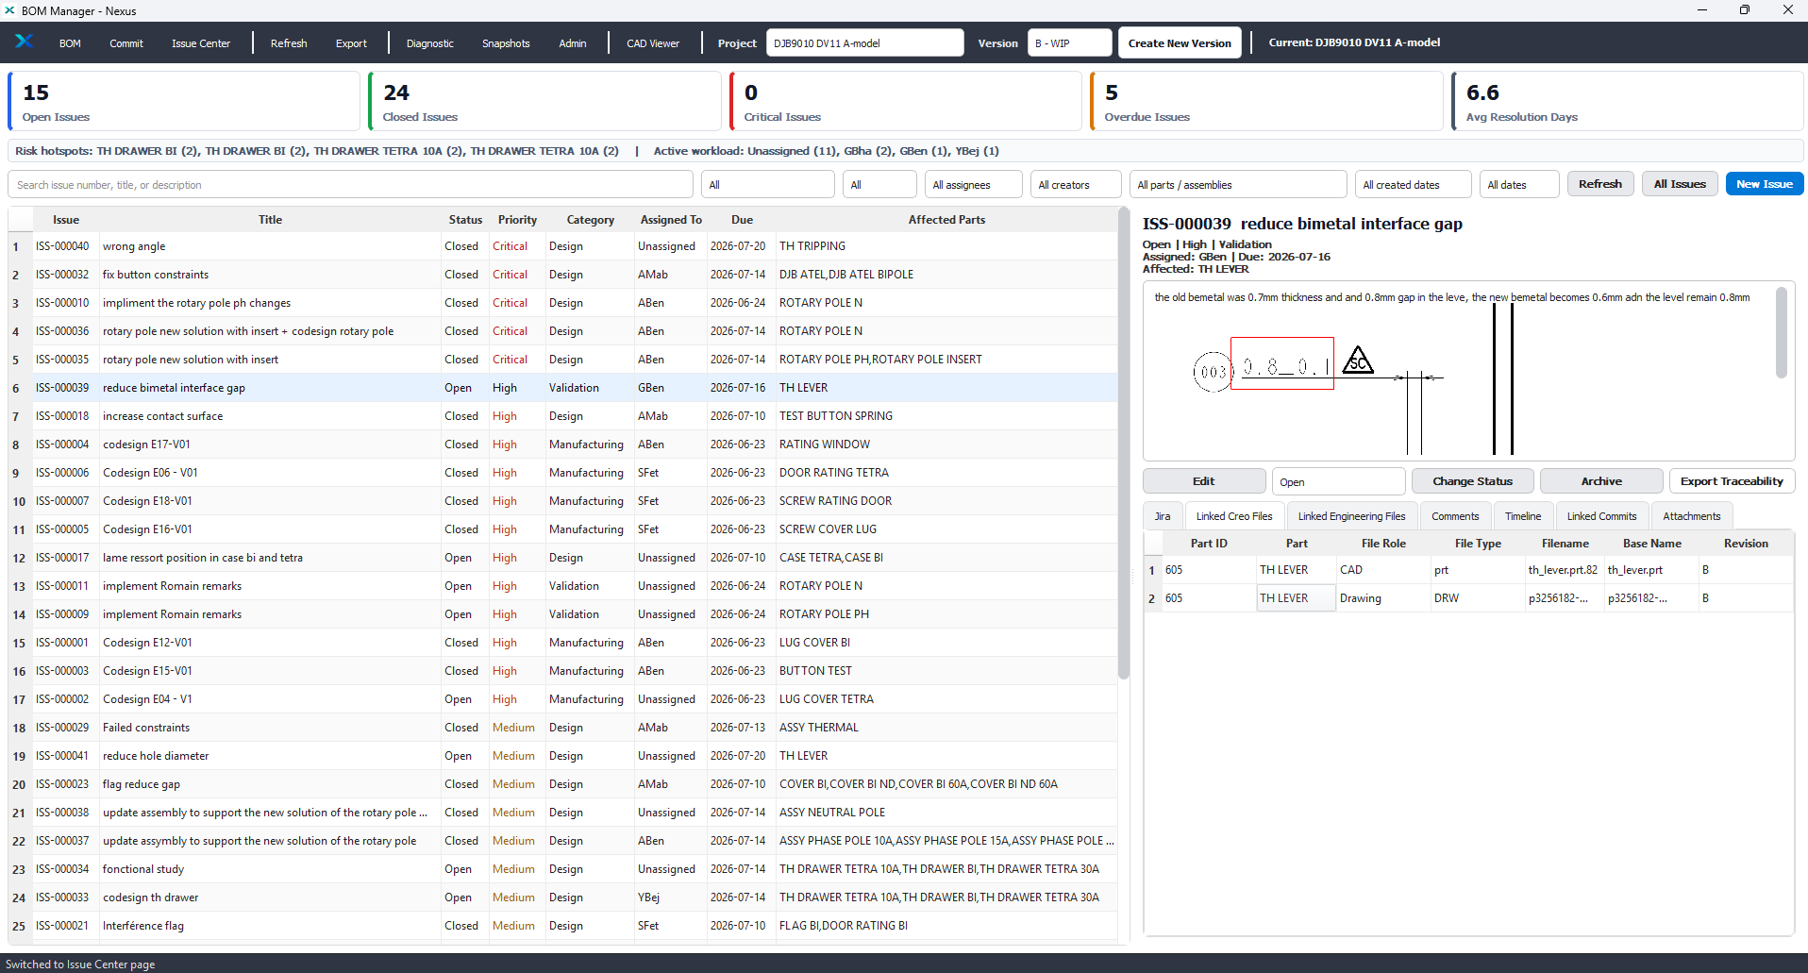
Issue Management
Engineering Issues allow teams to formally manage design problems.
Each Issue contains:
Description
Priority
Assignee
Affected Parts
Comments
Attachments
Linked Commits
Validation Status
Timeline
Every issue remains connected to the engineering history.

Slide 19
Snapshots
Snapshots preserve the exact state of a project at a given moment.
Typical use cases:
Project Milestones
Customer Deliveries
Design Reviews
Certification
Project Comparison
Snapshots provide a reliable engineering reference throughout the project lifecycle.

Slide 20
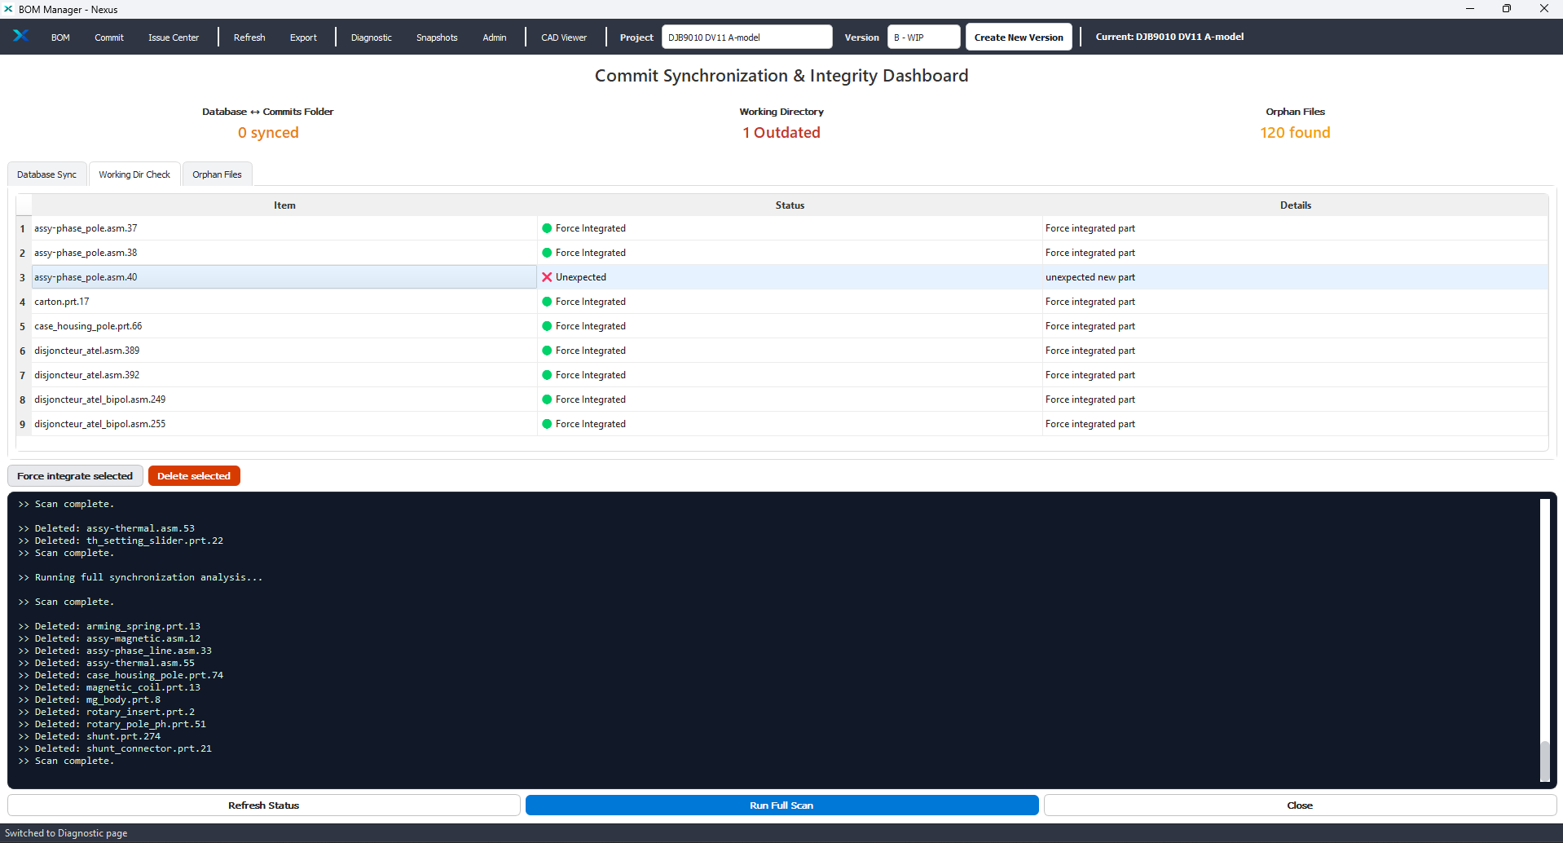
Diagnostics
Nexus always checks the workspace and before release automatically verifies project integrity.
Diagnostics detect:
Missing Files
Unexpected Files
Working Directory Issues
Database Synchronization Problems
Engineering Inconsistencies
This significantly reduces release risks.

Slide 21
Team Collaboration
Nexus enables controlled collaboration between engineers.
The platform ensures:
For SH, Nexus provides complete visibility over project progress.
At any moment, they can identify:
Controlled ownership through Check-Out
Clear validation responsibilities
Complete engineering history
Shared project visibility
Safe collaboration without file conflicts
Checked-Out Parts
Open Engineering Issues
Pending Validations
Recent Commits
Missing Deliverables
Project Health
Release Readiness
This allows faster decision-making and better workload management.

Slide 22
Conclusion
Creo VCS is more than a Version Control System.
It is a Mechanical Engineering Collaboration Platform that connects the workflow into one unified engineering ecosystem:
One Platform. One Workflow. Complete Engineering Traceability.

Slide 23
Engineering Challenges Today
02/07/2026
Codesign covers Bi & tetra
Cover_tetra
Cover_tetra_nd
Cover_bi
Cover_bi_nd
Cover_bi_60a
Cover_bi_60a_nd
Button test backup solution implementation
Cover_tetra
Cover_bi
Cover_bi_60a
Button test
Reduce gap with flag BI
Cover_bi
Cover_bi_60a
IMPACT :
test button spring
Case bi
UPDATE 3D et 2D
Test button spring
UPDATE 3D et 2D
Case Bi

Slide 24
THANK YOU

