Slide 1
DevOps Boot Camp 2021
Version Control using Git
MD MOSTAIN BILLAH

Slide 2
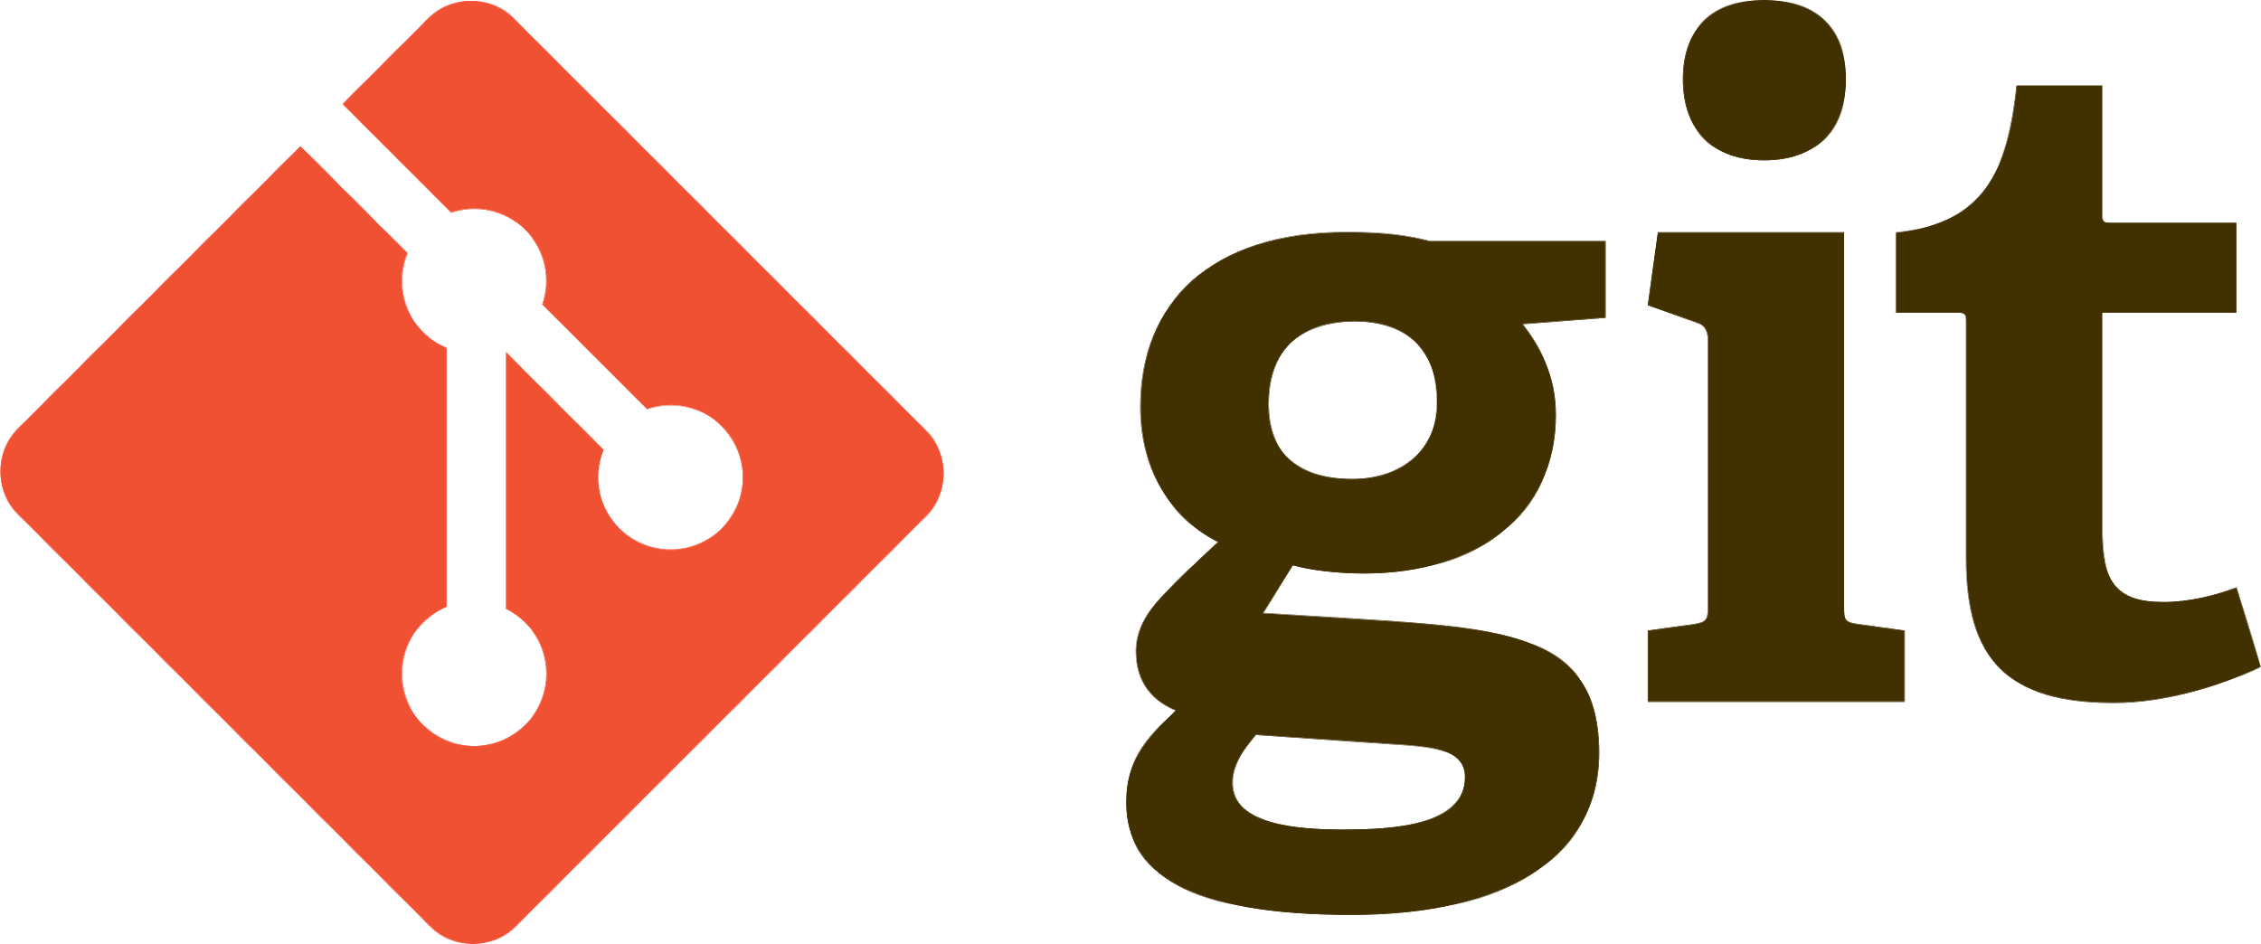
What is Git?
Git is also known as a content-addressable file system.
-Track History
-Work Together
Distributed Version Control System
Content-addressable File System
Why GIT?
Free
Open source
Superfast
Scalable
Data integrity

Slide 3
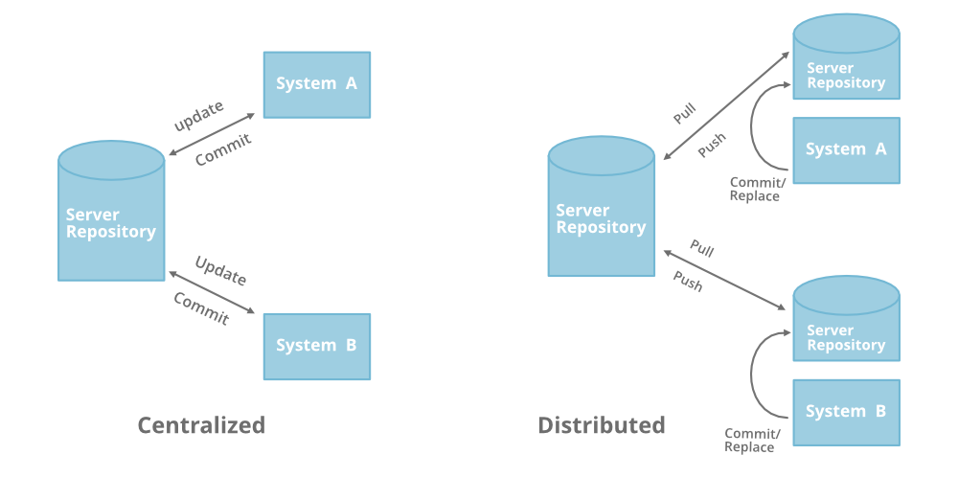
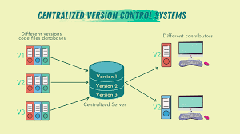
Version Control System
Fall into two categories:
Centralized (TFS, Subversion)
Distributed (Git, Mercurial)

Slide 4


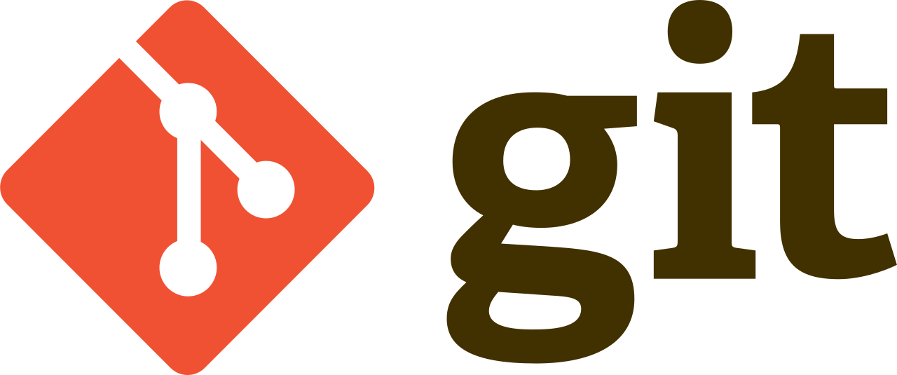
Who created ?
Linus Torvalds
In 1991

Slide 5
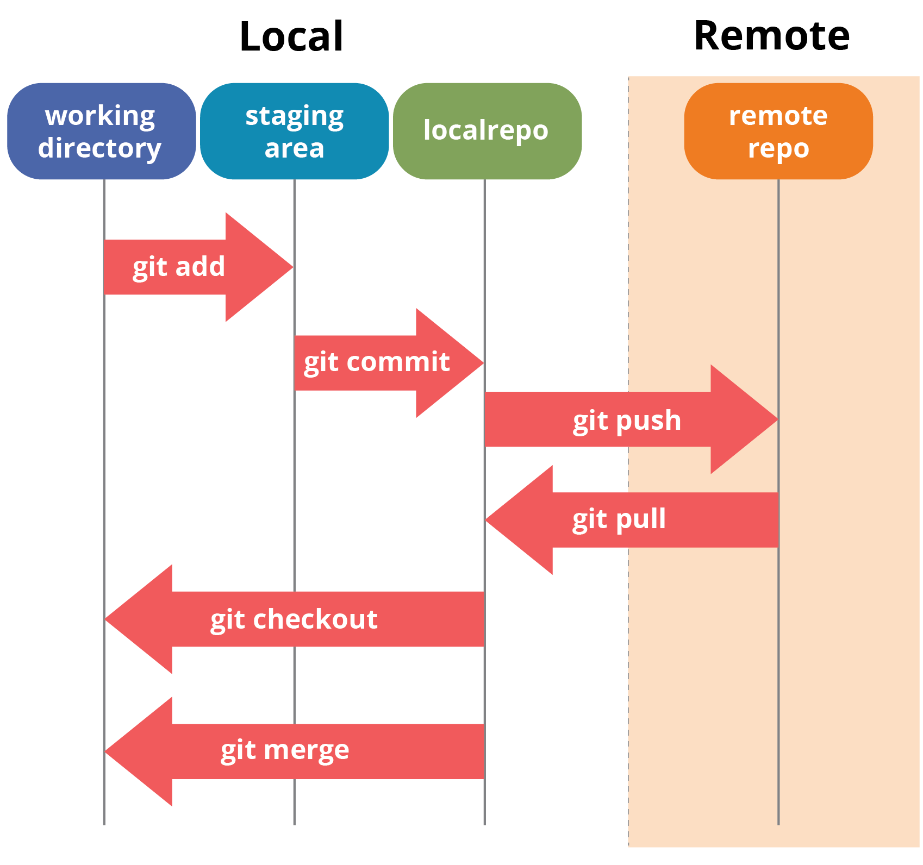
Git Architecture

Slide 6
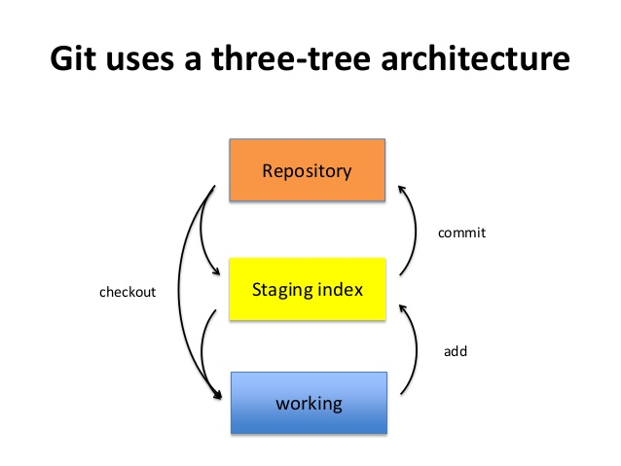
Git Architecture

Slide 7

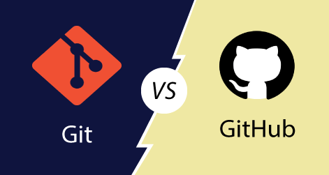


Git vs Github
Git | GitHub
Software | Service
Locally installed | Hosted on Web
Command line tool | GUI - web based
Manages repository | Space to upload a copy of repository
Independent | Depends on Git

Slide 8
Git Installation
$ git --version
$ sudo apt install git-all
sudo apt update
sudo apt install git
https://www.digitalocean.com/community/tutorials/how-to-install-git-on-ubuntu-20-04

Slide 9
Basic Commands
Git init
Git status
Git log
Git diff
Git add .
Git commit -m “message”
Git branch
Git checkout branch
Reference:
https://education.github.com/git-cheat-sheet-education.pdf

Slide 10
GitHub Repo
Please contribute to the mentioned github repo.
https://github.com/mateors/linuxcmd
https://github.com/mateors/devops
Your contribution to our github repo are highly appreciable.

