Slide 1

Overview of DevOps
MASTER-ACADEMY
Week 1
DevOps Boot Camp 2021

Slide 2
MASTER-ACADEMY
Course Outline
Module 1
1. Overview of DevOps
9. Container Orchestration using Kubernetes
2. Oracle Virtual Box
WEEK 1
WEEK 4
3. Linux commands and file system
10. Configuration Management with Ansible
4. Version Control with Git
5. Continuous Integration with Jenkins
WEEK 2
11. Continuous Monitoring Nagios
WEEK 5
6. Continuous Testing with Selenium
12. Introduction to DevOps on Cloud
7. Continuous Deployment: Containerization with Docker
13. Introduction to SSH
WEEK 3
WEEK 6
8. Containerization with Docker: Ecosystem and Networking
14. High Performance Server NGINX
DevOps Boot Camp 2021

Slide 3

Topics
MASTER-ACADEMY
Why DevOps?
What is DevOps?
DevOps Market Trends
DevOps Engineering Skills
DevOps Delivery Pipeline
DevOps Ecosystem
DevOps Boot Camp 2021

Slide 4

Objective of this Module
MASTER-ACADEMY
You will be able to understand the following concepts at the end of this module:
Understand the benefits of DevOps over other software development processes.
Gain insights of the DevOps Environment
Get overview of different DevOps tools
Gain insight of the inner working of a CI/CD pipeline
DevOps Boot Camp 2021

Slide 5
Why DevOps?
MASTER-ACADEMY
Scenario of a Company
Problems
Solution using DevOps
It’s all about Business
How does DevOps complement Agile
DevOps Boot Camp 2021

Slide 6
Scenario of a Company
MASTER-ACADEMY
Imagine a scenario about a company called jolchobi.com. The company sells artwork of Bangladesh on their online portal. They are a new startup and they want to scale fast and have a huge online presence. They chose to use Cloud to develop their product. The product uses modular components for their separate business units (BU) and they want the components to be developed by different teams or a 3rd party vendor.
Following the Goals of the Company:
To deliver the reliable and high-quality product updates frequently to production
To accelerate software delivery speed without affecting quality
Reduce feedback time between silos for smooth development of product
DevOps Boot Camp 2021

Slide 7
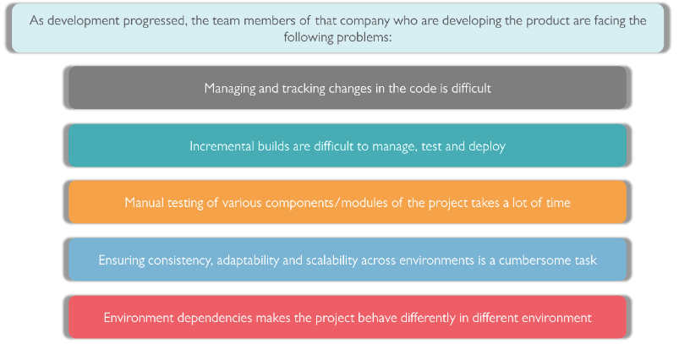
Problem
MASTER-ACADEMY
DevOps Boot Camp 2021

Slide 8
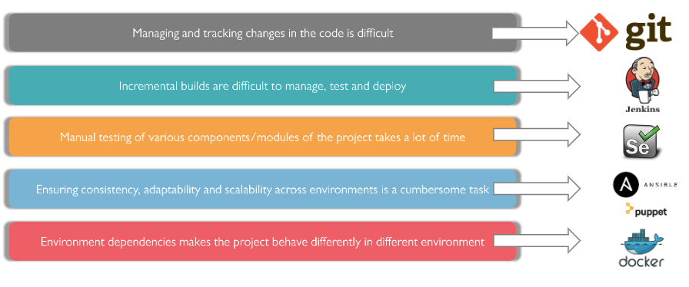
Solution using DevOps
MASTER-ACADEMY
DevOps Boot Camp 2021

Slide 9
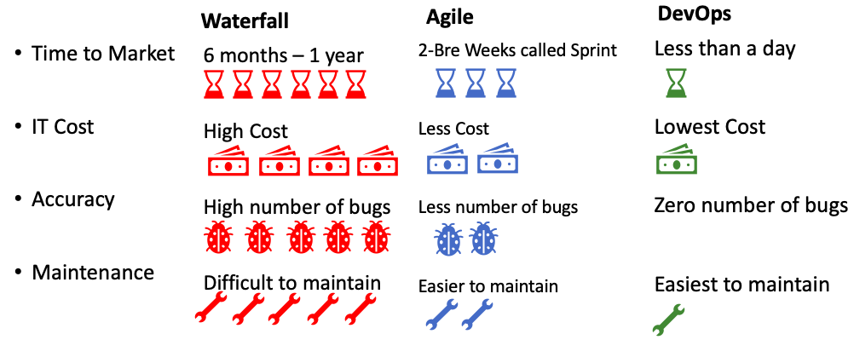
It’s all about Business
MASTER-ACADEMY
DevOps Boot Camp 2021

Slide 10
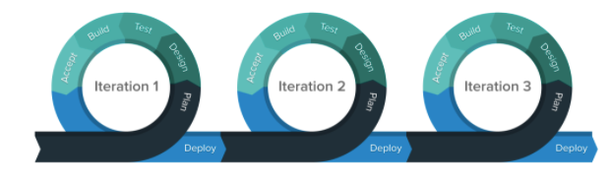
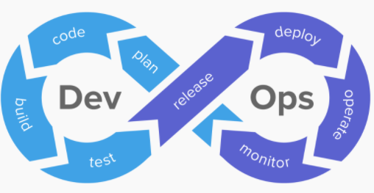
How does DevOps complement Agile
MASTER-ACADEMY
Agile is not complete without DevOps
Allows continuous feedback
Breaks the communication barrier between different silos
Shorten delivery time
Silos are teams that work on developing, updating and maintain a SW system. Examples of teams are Design team, Dev team, Testing team, Deployment team.
DevOps Boot Camp 2021

Slide 11
What Is DevOps?
MASTER-ACADEMY
Definition of DevOps
DevOps compared to other manufacturing Process
Understanding Software Development Lifecycle (SDLC)
SDLC Models – Waterfall, Agile and DevOps
Waterfall Vs Agile Vs DevOps
What does DevOps do?
DevOps Boot Camp 2021

Slide 12
Definition of DevOps
MASTER-ACADEMY
Definition: DevOps is a set of practices that combines software development and IT operations. It aims to shorten the systems development life cycle and provide continuous delivery with high software quality. (Source: Wikipedia).
“DevOps is a shift in culture and change in
mindset about how we develop and operate
software systems”
DevOps Boot Camp 2021

Slide 13






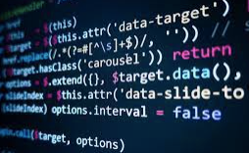
DevOps compared to other manufacturing Process
MASTER-ACADEMY
Fabric Selection
Fabric Cutting
Manufacturing
Finishing
Quality Control
Packaging
Software:
-Release 1
- Feature 1
- Feature 2
-Release 2
- Feature 3
- Feature 4
DevOps Boot Camp 2021

Slide 14
Understanding Software Development Lifecycle (SDLC)
MASTER-ACADEMY
What is SDLC?
Definition: is a framework that development teams use to produce high-quality software in a systematic and cost-effective way.
REQUIREMENT
DESIGN
DEVELOPMENT
TESTING
DEPLOYMENT
MAINTENANCE
DevOps Boot Camp 2021

Slide 15
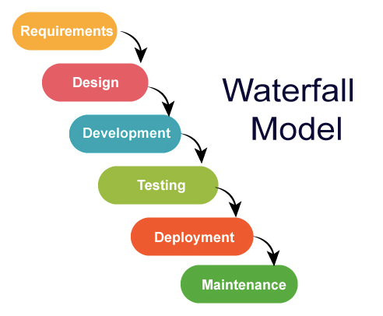
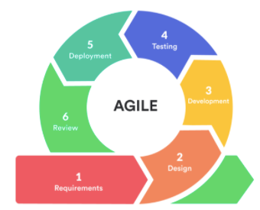
SDLC Models – Waterfall, Agile and DevOps
MASTER-ACADEMY
E V O L U T I O N
Waterfall Model
Agile Model
DevOps Model
DevOps Boot Camp 2021

Slide 16
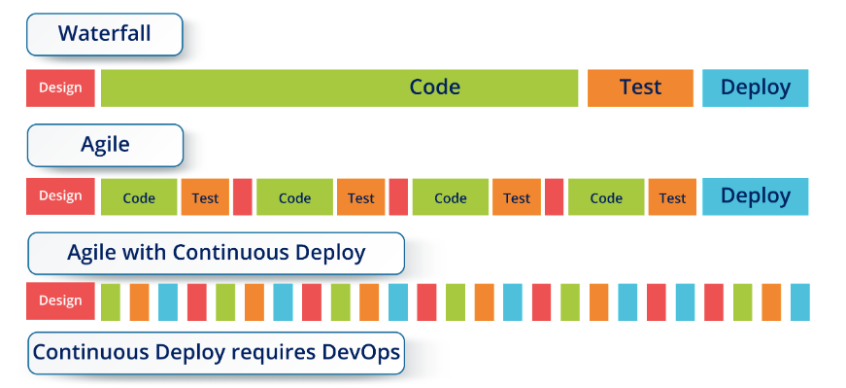
Waterfall Vs Agile Vs DevOps
MASTER-ACADEMY
DevOps Boot Camp 2021

Slide 17
SDLC Models (Cont)
MASTER-ACADEMY
E V O L U T I O N
Development Process
App Architecture
Deployment & Packaging
Infrastructure
Waterfall
Monolithic
Physical Server
On Premise DataCenter
Agile
N Tier
Virtual Server
Hosted DataCenter
DevOps
Microservice
Containers
Cloud
DevOps Boot Camp 2021

Slide 18
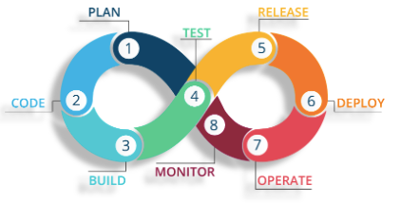
What does DevOps do?
MASTER-ACADEMY
Integrates developers and operations team
Improves collaboration and productivity by:
Automating infrastructure
Automating workflows
Continuously measuring application performance
DevOps Boot Camp 2021

Slide 19
DevOps Market Trends
MASTER-ACADEMY
DevOps Current Scenario
Job and Salary Trends
Demand of DevOps Engineers
Companies that adopted full DevOps
DevOps Boot Camp 2021

Slide 20

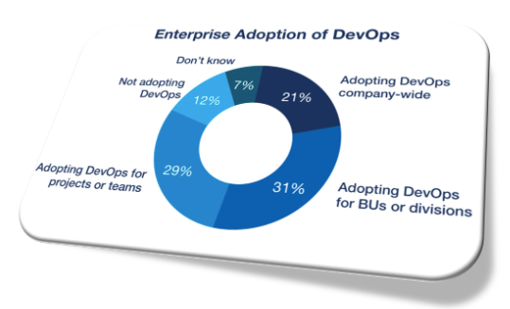
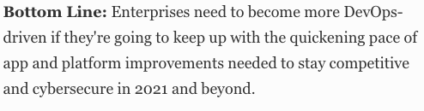
DevOps Current Scenario
MASTER-ACADEMY
DevOps Boot Camp 2021

Slide 21
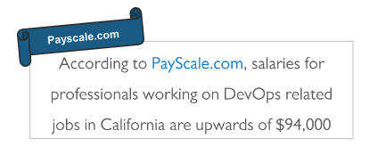
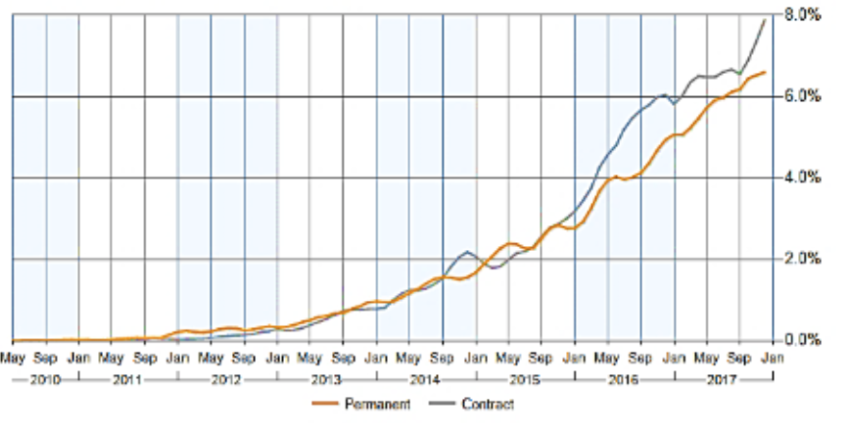
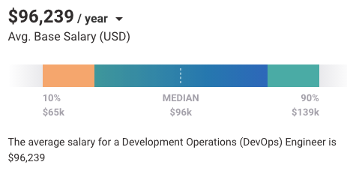
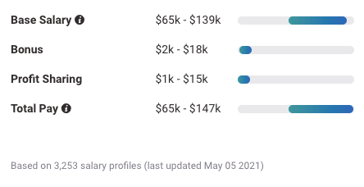
Job and Salary Trends
MASTER-ACADEMY
Job posting siting DevOps as a percentage of all IT jobs advertised
DevOps Boot Camp 2021

Slide 22
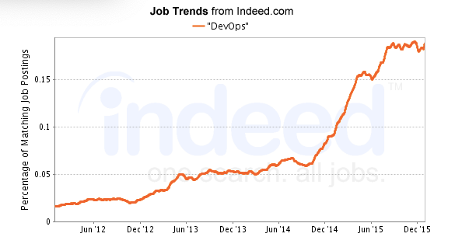
Demand of DevOps Engineers
MASTER-ACADEMY
DevOps engineer- 39%
Software engineer- 29%
DevOps consultant- 22%
Test engineer- 18%
Automation architect- 17%
Infrastructure engineer- 16%
CI/CD engineer- 16%
DevOps Boot Camp 2021

Slide 23





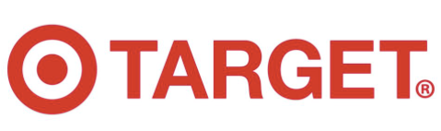

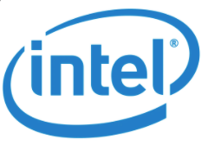

Companies that adopted full DevOps
MASTER-ACADEMY
DevOps Boot Camp 2021

Slide 24
DevOps Engineering Skills
MASTER-ACADEMY
Skill of a DevOps Engineer
DevOps Tools brief Introduction
What is continuous Deployment?
Programming and scripting languages
Networking fundamentals
DevOps Boot Camp 2021

Slide 25
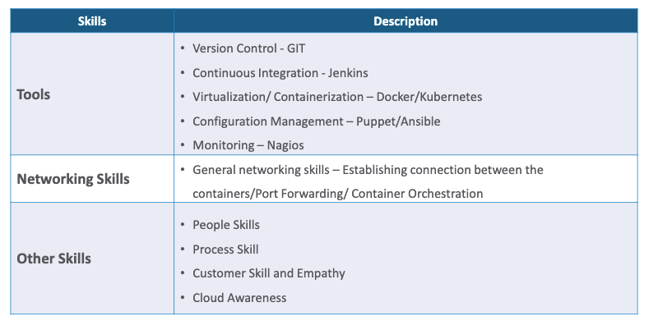
Skill of a DevOps Engineer
MASTER-ACADEMY
DevOps Boot Camp 2021

Slide 26
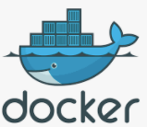
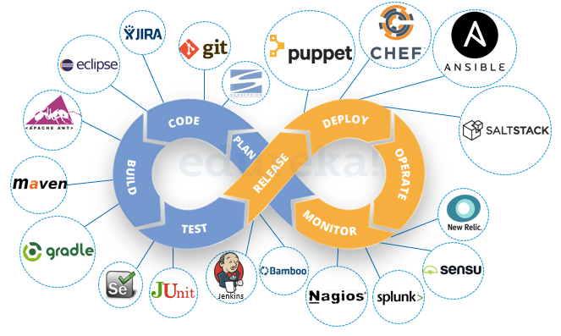
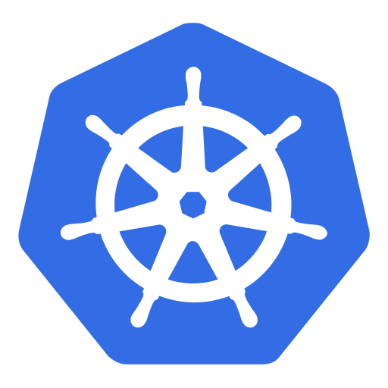
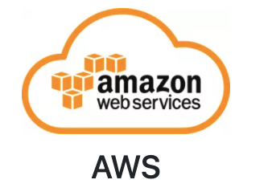
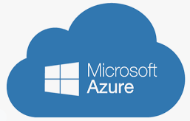
DevOps Tools brief Introduction
MASTER-ACADEMY
Deployment
Configuration Management
Continuous Development
Version Control
Continuous Deployment
CI
CD
Continuous Testing
Continuous Monitoring
Continuous Integration
DevOps Boot Camp 2021

Slide 27

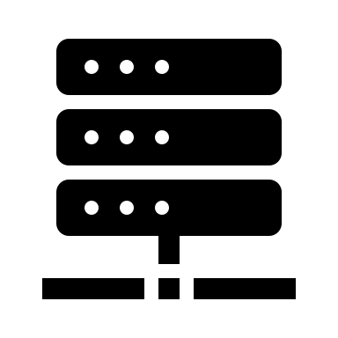
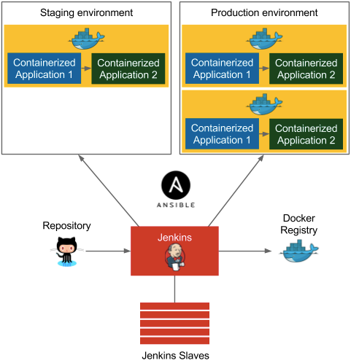
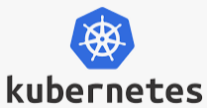
What is continuous Deployment?
MASTER-ACADEMY
Deployment
Containerization
Cloud Infrastructure
DevOps Boot Camp 2021

Slide 28

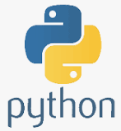
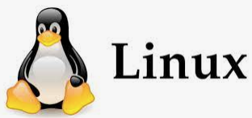

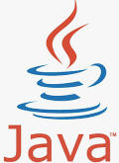

Programming & Scripting languages
MASTER-ACADEMY
DevOps Boot Camp 2021

Slide 29
Networking fundamentals
MASTER-ACADEMY
OSI Model
TCP/IP Model
LAN vs WAN
Switch Vs Router
Subnet
Port forwarding
NAT – Network address translation
DNS server
VPN – Virtual Private Network
DHCP
Links:
The OSI and TCP/IP Model
(https://youtu.be/LX_b2M3IzN8)
Networking Basics (2020)
(https://youtu.be/_IOZ8_cPgu8)
Basic Networking Commands
(https://youtu.be/_IOZ8_cPgu8)
What happens when I type www.google.com on my browser?
(https://youtu.be/dI0no0zJGJs)
DevOps Boot Camp 2021

Slide 30
DevOps Delivery Pipeline
MASTER-ACADEMY
What is DevOps delivery pipeline?
What is CI/CD and what is a CI/CD pipeline?
DevOps Boot Camp 2021

Slide 31

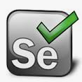
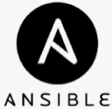
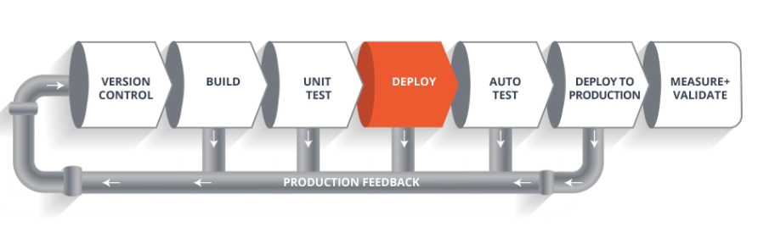
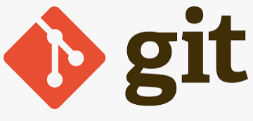


What is DevOps delivery pipeline?
MASTER-ACADEMY
DevOps Boot Camp 2021

Slide 32
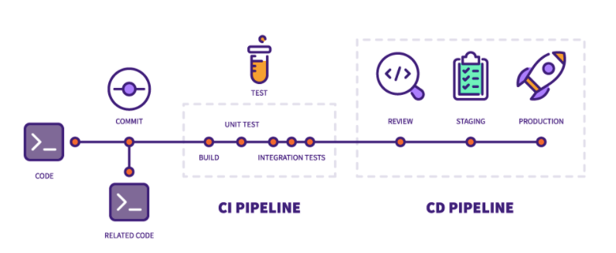
What is CI/CD and what is a CI/CD pipeline?
MASTER-ACADEMY
What is CI/CD?
CI means Continuous Integration and CD means Continuous Deployment. What does continuous mean?
CI/CD Pipeline:
DevOps Boot Camp 2021

Slide 33




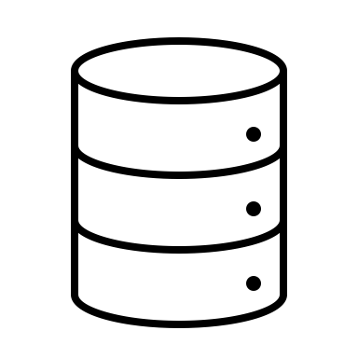
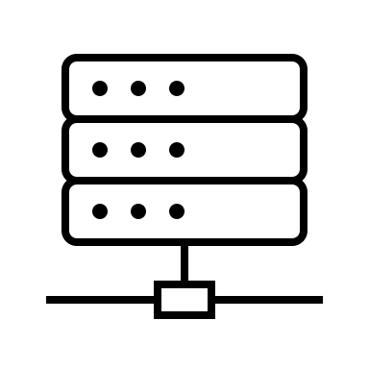



Silos in DevOps Ecosystem
MASTER-ACADEMY
E-Commerce Website
Developer
Team
Testing
Team
DevOps
Team
Operations
Team
Cloud
Server
On Premise Server
<Code Repo>
Test Server
Staging Server
End User
End User
Internet
DevOps Boot Camp 2021

Slide 34
Homework
MASTER-ACADEMY
Go through the recorded session for revision
Watch the video on Networking:
https://www.youtube.com/channel/UC8Jmb0YVLzAs_FZYhqF4E2w
Watch the video on files and folder
For next class with Mr. Mostain Billah:
Setting up Oracle virtual box
Basic Linux Commands and file system
DevOps Boot Camp 2021

Slide 35
Thank You!

