Slide 1
DevOps Boot Camp 2021
Secure Shell Protocol - SSH
MD MOSTAIN BILLAH
Founder
MASTER-ACADEMY

Slide 2
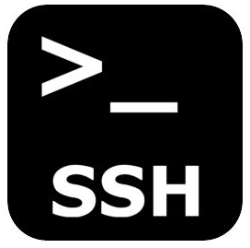
What is SSH?
SSH, also known as Secure Shell or Secure Socket Shell
-SCP
-22
is a network protocol that gives users, particularly system administrators, a secure way to access a computer over an unsecured network.
What is SSH?
Secure Shell
Communication Protocol (http, https, ftp, ssh)
Cryptographic Network Protocol
Traffic is Encrypted
Manage anything on the remote computer

Slide 3

SSH Architecture
The server must have sshd installed and running otherwise you will not be able to connect using SSH.
Client Server communication model
SSH is the client
SSHD is the Server (openssh daemon)

Slide 4

Who created ?
Tatu Ylönen
In 1995
Finish Scientist, Finland

Slide 5
Authentication
Password
SSH Key (Public / Private Key Pair)
Host Based

Slide 6
Generating Keys
> ssh-keygen
~/.ssh/id_rsa (private key)
~/..sh/id_rsa.pub (public key)
Public key goes into server
Private key remains in the client

Slide 7
Supported OS
Windows | Linux +
Windows 10 by default | Included
Older version using Putty | Shell terminal
Git Bash | -

Slide 8
Useful Commands
> ssh commands
Description | Commands
Version Check | ssh -V
Generate Keys | ssh-keygen -t rsa -b 4096 -C “comment”
Start ssh-agent | eval $(ssh-agent -s)
Add Identity ssh-agent | ssh-add ~/.ssh/id_rsa
SSH agent all keys | ssh-add -l
Connect remote | ssh user@ip
Test Github auth | ssh -T git@github.com

Slide 9
GitHub Repo
Please contribute to the mentioned github repo.
https://github.com/mateors/linuxcmd
https://github.com/mateors/devops
https://github.com/mateors/sshcmd.git
Your contribution to our github repo are highly appreciable.

