Slide 1




chapter 8
implementation support

Slide 2
Implementation support
programming tools
  levels of services for programmers
windowing systems
  core support for separate and simultaneous user-system activity
programming the application and control of dialogue
interaction toolkits
  bring programming closer to level of user perception
user interface management systems
  controls relationship between presentation and functionality

Slide 3
Introduction
How does HCI affect of the programmer?
Advances in coding have elevated programming
  hardware specific
  → interaction-technique specific
Layers of development tools
  windowing systems
  interaction toolkits
  user interface management systems

Slide 4
Elements of windowing systems
Device independence
  programming the abstract terminal device drivers
  image models for output and (partially) input
    pixels
    PostScript (MacOS X, NextStep)
    Graphical Kernel System (GKS)
    Programmers' Hierarchical Interface to Graphics (PHIGS)
Resource sharing
  achieving simultaneously of user tasks
  window system supports independent processes
  isolation of individual applications

Slide 5
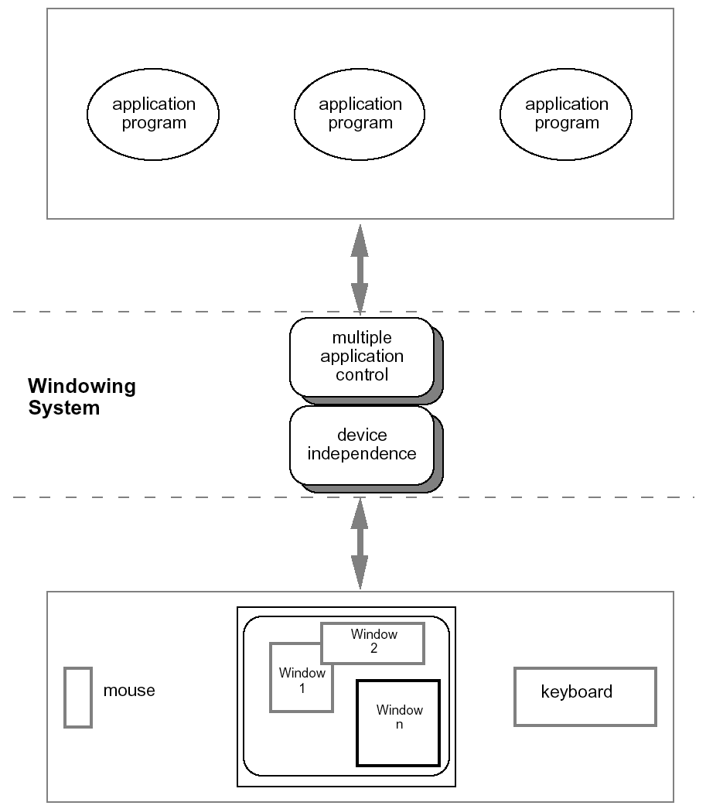
roles of a windowing system

Slide 6
Architectures of windowing systems
three possible software architectures
  all assume device driver is separate
  differ in how multiple application management is implemented
1. each application manages all processes
  everyone worries about synchronization
  reduces portability of applications
2. management role within kernel of operating system
  applications tied to operating system
3. management role as separate application
maximum portability

Slide 7
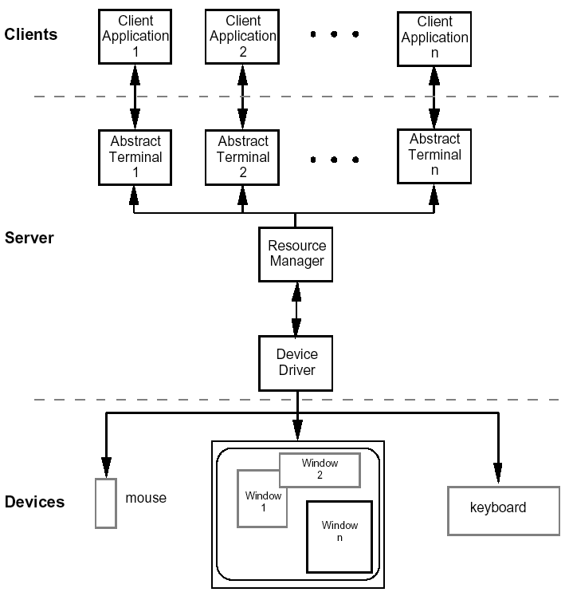
The client-server architecture

Slide 8
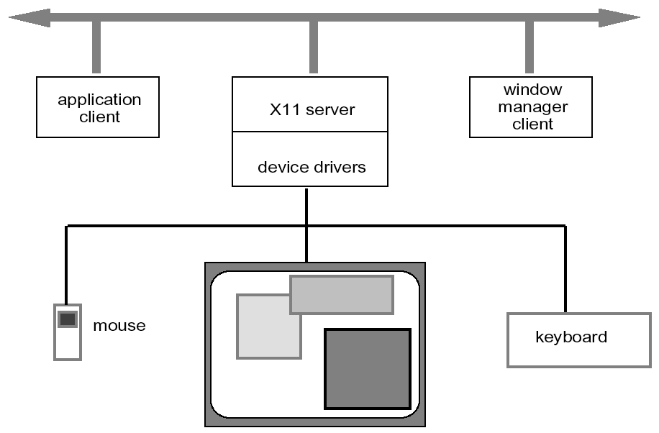
X Windows architecture

Slide 9
X Windows architecture (ctd)
pixel imaging model with some pointing mechanism
X protocol defines server-client communication
separate window manager client enforces policies for input/output:
  how to change input focus
  tiled vs. overlapping windows
  inter-client data transfer

Slide 10
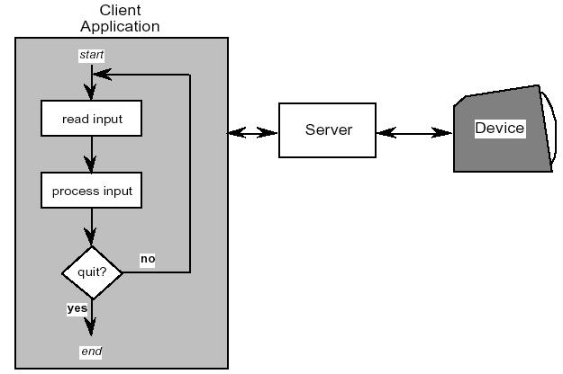
Programming the application - 1 read-evaluation loop
repeat
read-event(myevent)
case myevent.type
type_1:
do type_1 processing
type_2:
do type_2 processing
...
type_n:
do type_n processing
end case
end repeat

Slide 11
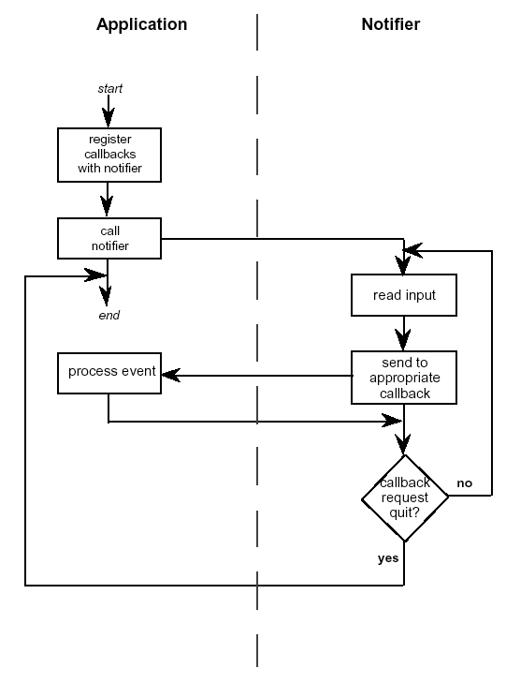
Programming the application - 1 notification-based
void main(String[] args) {
Menu menu = new Menu();
menu.setOption(“Save”);
menu.setOption(“Quit”);
menu.setAction(“Save”,mySave)
menu.setAction(“Quit”,myQuit)
...
}
int mySave(Event e) {
// save the current file
}
int myQuit(Event e) {
// close down
}

Slide 12

going with the grain
system style affects the interfaces
  modal dialogue box
    easy with event-loop (just have extra read-event loop)
    hard with notification (need lots of mode flags)
  non-modal dialogue box
    hard with event-loop (very complicated main loop)
    easy with notification (just add extra handler)
beware!
if you don’t explicitly design it will just happen
implementation should not drive design

Slide 13
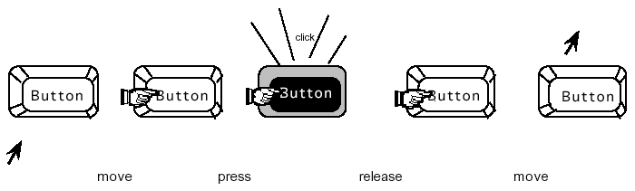
Using toolkits
Interaction objects
  input and output
  intrinsically linked
Toolkits provide this level of abstraction
  programming with interaction objects (or
  techniques, widgets, gadgets)
  promote consistency and generalizability
  through similar look and feel
  amenable to object-oriented programming
move
press
release
move

Slide 14
interfaces in Java
Java toolkit – AWT (abstract windowing toolkit)
Java classes for buttons, menus, etc.
Notification based;
  AWT 1.0 – need to subclass basic widgets
  AWT 1.1 and beyond -– callback objects
Swing toolkit
  built on top of AWT – higher level features
  uses MVC architecture (see later)

Slide 15
User Interface Management Systems (UIMS)
UIMS add another level above toolkits
  toolkits too difficult for non-programmers
concerns of UIMS
  conceptual architecture
  implementation techniques
  support infrastructure
non-UIMS terms:
  UI development system (UIDS)
  UI development environment (UIDE)
    e.g. Visual Basic

Slide 16
UIMS as conceptual architecture
separation between application semantics and presentation
improves:
  portability – runs on different systems
  reusability – components reused cutting costs
  multiple interfaces – accessing same functionality
  customizability – by designer and user

Slide 17
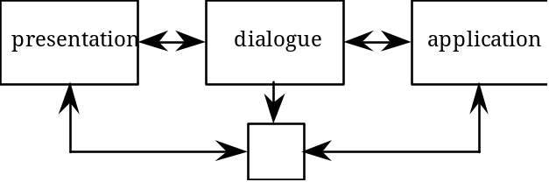
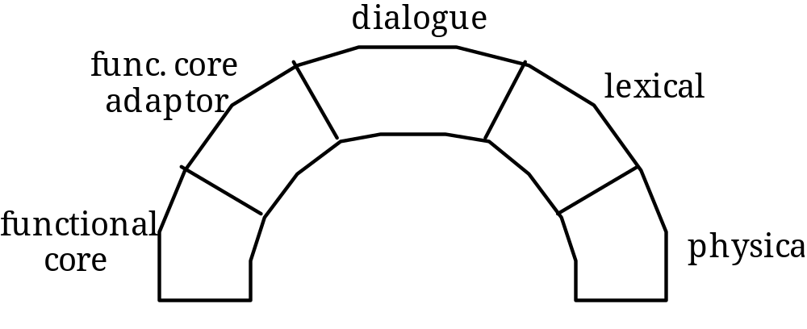
UIMS tradition – interface layers / logical components
linguistic: lexical/syntactic/semantic
Seeheim:
Arch/Slinky

Slide 18
Seeheim model
lexical
syntactic
semantic
USER
Presentation
Dialogue
Control
Functionality
(application
interface)
USER
APPLICATION
switch

Slide 19
conceptual vs. implementation
Seeheim
  arose out of implementation experience
  but principal contribution is conceptual
  concepts part of ‘normal’ UI language
… because of Seeheim …
… we think differently!
  e.g. the lower box, the switch
    needed for implementation
    but not conceptual

Slide 20

semantic feedback
different kinds of feedback:
  lexical – movement of mouse
  syntactic – menu highlights
  semantic – sum of numbers changes
semantic feedback often slower
  use rapid lexical/syntactic feedback
but may need rapid semantic feedback
  freehand drawing
  highlight trash can or folder when file dragged

Slide 21
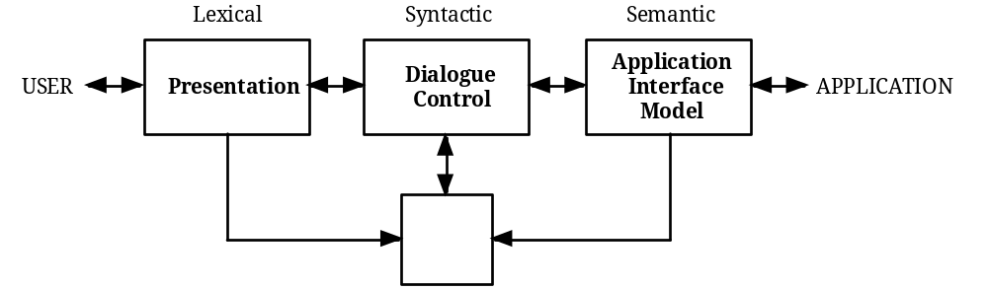
what’s this?

Slide 22
the bypass/switch
direct communication
between application
and presentation
rapid semantic feedback
but regulated by
dialogue control

Slide 23
more layers!

Slide 24
Arch/Slinky
more layers! – distinguishes lexical/physical
like a ‘slinky’ spring different layers may be thicker (more important) in different systems
or in different components

Slide 25
monolithic vs. components
Seeheim has big components
often easier to use smaller ones
  esp. if using object-oriented toolkits
Smalltalk used MVC – model–view–controller
  model – internal logical state of component
  view – how it is rendered on screen
  controller – processes user input

Slide 26
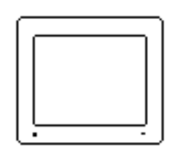

MVC model - view - controller
view
model
controller

Slide 27
MVC issues
MVC is largely pipeline model:
  input → control → model → view → output
but in graphical interface
  input only has meaning in relation to output
e.g. mouse click
  need to know what was clicked
  controller has to decide what to do with click
  but view knows what is shown where!
in practice controller ‘talks’ to view
  separation not complete

Slide 28
PAC model
PAC model closer to Seeheim
  abstraction – logical state of component
  presentation – manages input and output
  control – mediates between them
manages hierarchy and multiple views
  control part of PAC objects communicate
PAC cleaner in many ways …
but MVC used more in practice
    (e.g. Java Swing)

Slide 29
PAC presentation - abstraction - control
A
P
A
P
C
C
abstraction
presentation
control
A
P
C
A
P
C

Slide 30
Implementation of UIMS
Techniques for dialogue controller
  • menu networks • state transition diagrams
  • grammar notations • event languages
  • declarative languages • constraints
  • graphical specification
  for most of these see chapter 16
N.B. constraints
  instead of what happens say what should be true
  used in groupware as well as single user interfaces
    (ALV - abstraction–link–view)
see chapter 16 for more details on several of these

Slide 31
graphical specification
what it is
  draw components on screen
  set actions with script or links to program
in use
  with raw programming most popular technique
  e.g. Visual Basic, Dreamweaver, Flash
local vs. global
  hard to ‘see’ the paths through system
  focus on what can be seen on one screen

Slide 32
The drift of dialogue control
internal control
  (e.g., read-evaluation loop)
external control
  (independent of application semantics or presentation)
presentation control
  (e.g., graphical specification)

Slide 33
Summary
Levels of programming support tools
Windowing systems
  device independence
  multiple tasks
Paradigms for programming the application
  read-evaluation loop
  notification-based
Toolkits
  programming interaction objects
UIMS
  conceptual architectures for separation
  techniques for expressing dialogue

