Slide 1
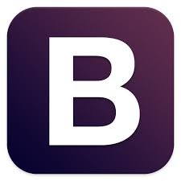
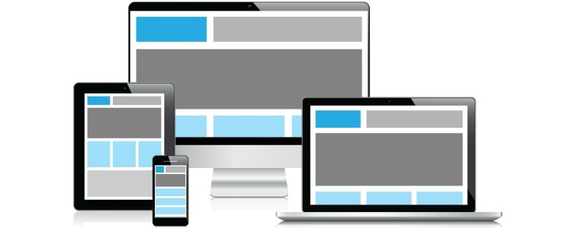
Getting Started with Twitter Bootstrap 3
Ishtdeep Singh Hora
Notes:
we’ll learn what is twitter bootstrap and why do we need it
learn how to install and use Bootstrap
explore important features

Slide 2
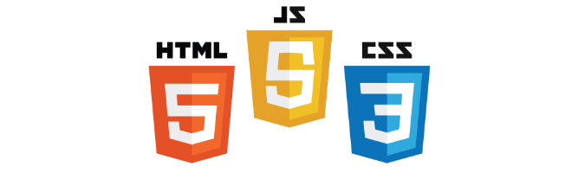
What is Bootstrap?
Powerful front end framework that helps create websites and apps faster and easier.
Notes:
twitter bootstrap is a powerful front end framework implemented by twitter. It has been widely adopted since its launch in 2011 because it help create responsive websites and apps much faster and easier.
It contains HTML5 and CSS3-based design templates for typography, forms, buttons, and other interface components, as well as several JavaScript plugins.

Slide 3
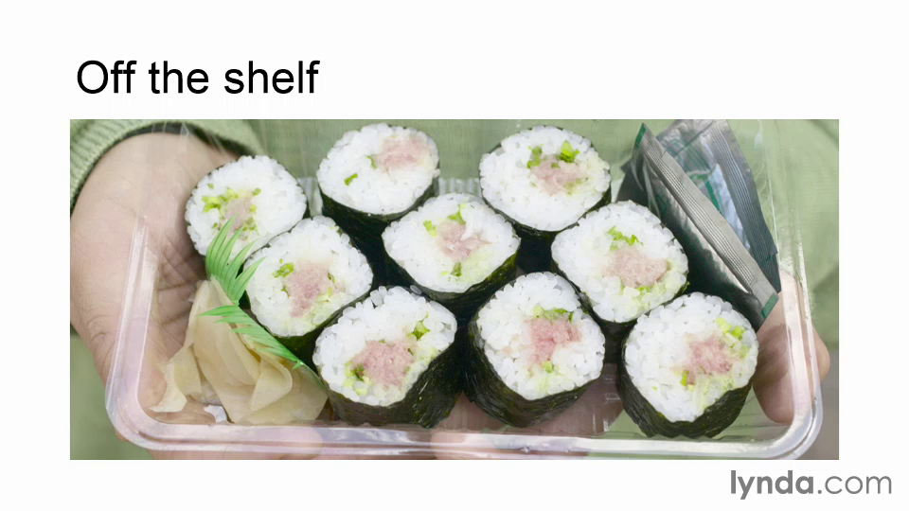

Slide 4
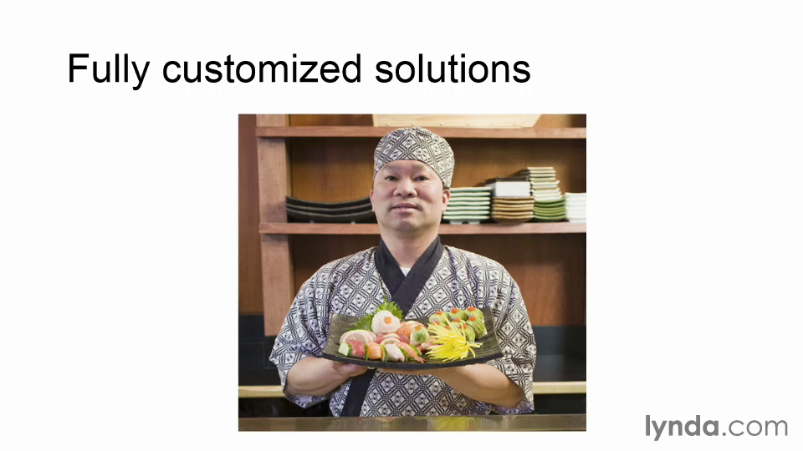

Slide 5
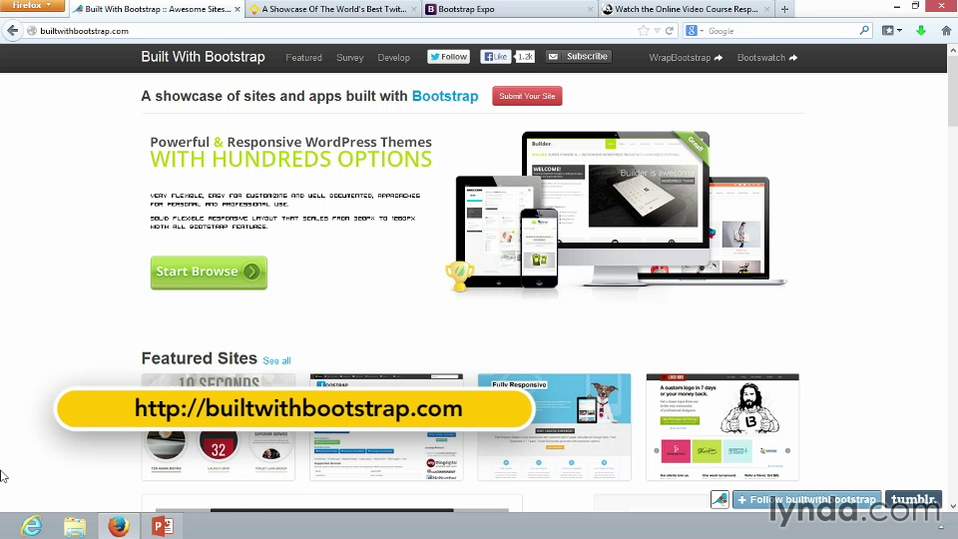

Slide 6
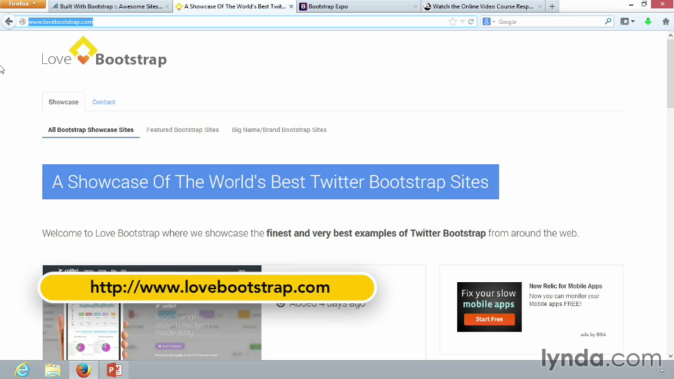

Slide 7
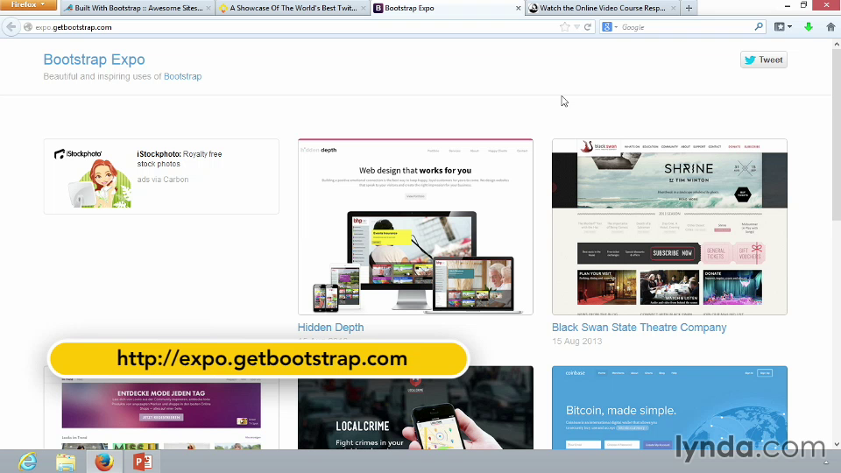

Slide 8
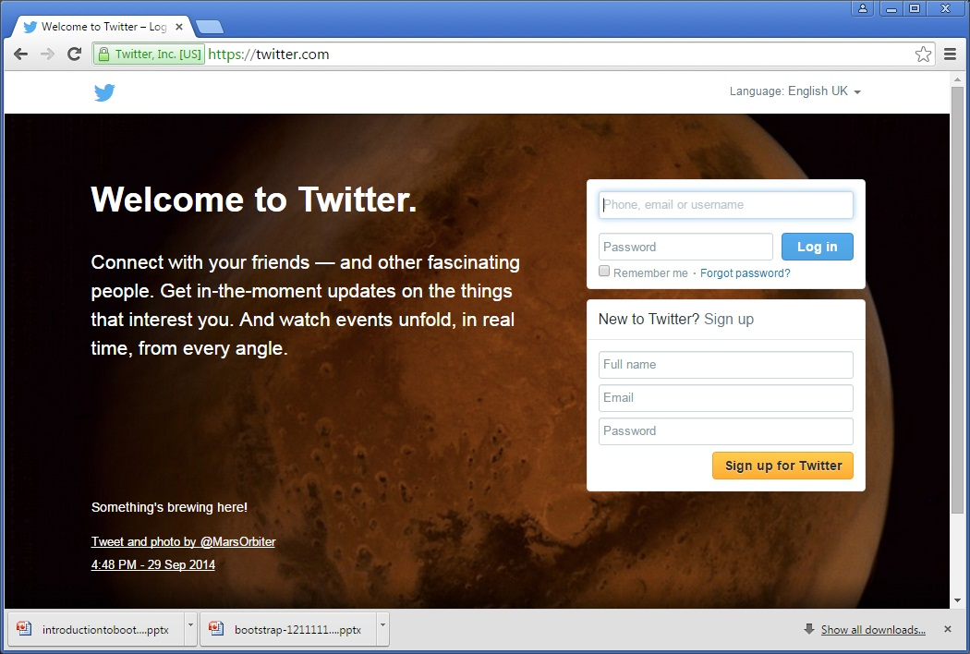
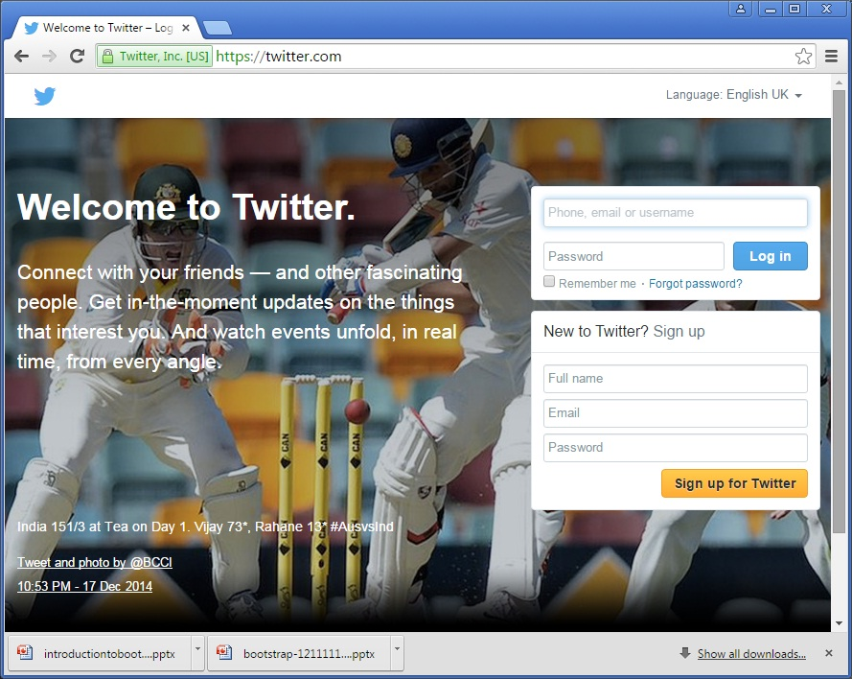

Try yourself too …

Slide 9
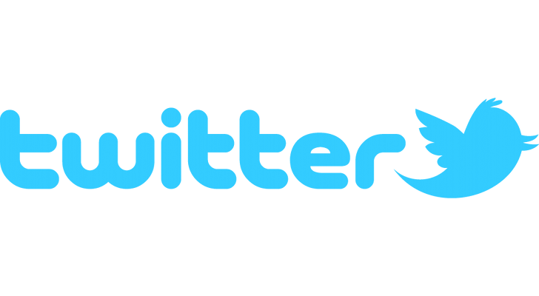



SEO

Slide 10


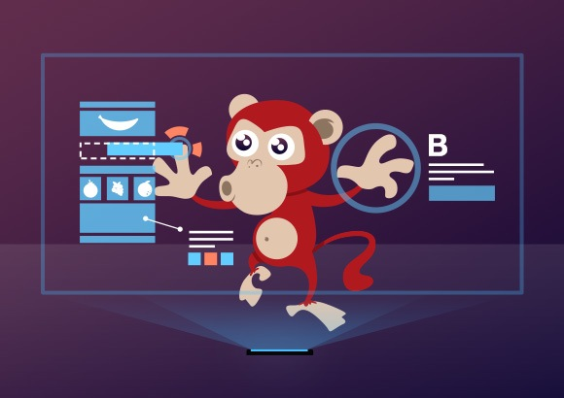

Who Should Use Bootstrap?
Developer
Designer
Notes:
With Bootstrap, web developers can concentrate on the development work, without worrying about design, and get a good looking website up and running quickly.
Conversely, it gives web designers a solid foundation for creating interesting Bootstrap themes.
with bootstrap you can easily create a mockup or a landing page that will look awesome even if you are not a designer or you are not skilled in css

Slide 11
Why Bootstrap?
Ease of use and quick to learn
Speed of development
Consistent design and common components
Wide browser compatibility
Responsive framework
Notes:
Ease of use and quick to learn :
Web designers and web developers love Bootstrap because it is flexible and easy to work with.
Speed of development
Undoubtedly one of the biggest advantages of using Bootstrap is the speed of development. Rather than coding from scratch, Bootstrap enables you to utilize ready made blocks of code to help you get started.
- Consistent design and common components
-The use of common components makes the code reusable and the projects easier to follow and understand by different developers
Wide browser compatibility
One of the important tasks of the modern web development is the creation of websites with cross-browser compatible layout. Twitter Bootstrap takes the worry of the application looking different on mozilla vs chrome. Bootstrap bring cross-browser compatibility to a higher level, by involving the mobile and tablets browsers.
Responsive framework
Bootstrap is a responsive framework out of the box. That means that your site looks good when you shift from a laptop to a tablet or a mobile device.

Slide 12
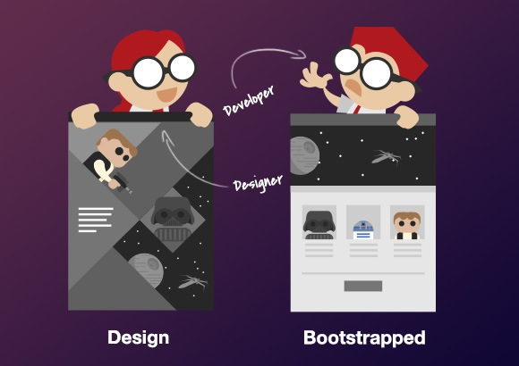
Why NOT Bootstrap?
Without additional custom design work your site will look like any other site

Slide 13
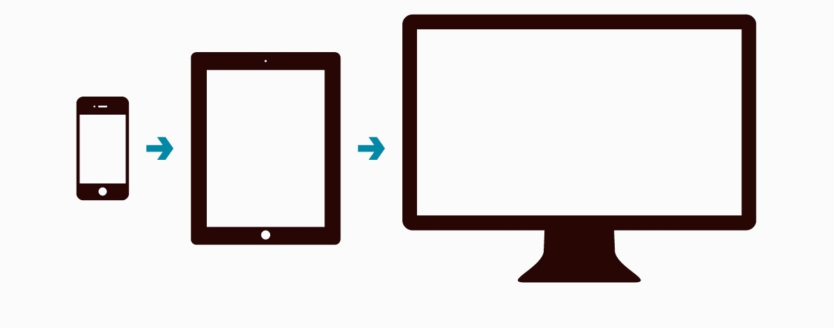
Mobile-First Strategy
1.7B mobile web users worldwide
Sites built with Bootstrap3 (and beyond) target mobile devices and scale for larger screens depending on screen size.
Notes:
mobile first means designing an online experience for mobile before designing it for the desktop Web—or any other device.
In the past, when users’ focus was on the desktop Web, mobile design was an afterthought.
But today, more people are using their mobile devices for online shopping and social networking than ever before, therefore companies must focus on designing for mobile
At any size > it’s always good design

Slide 14
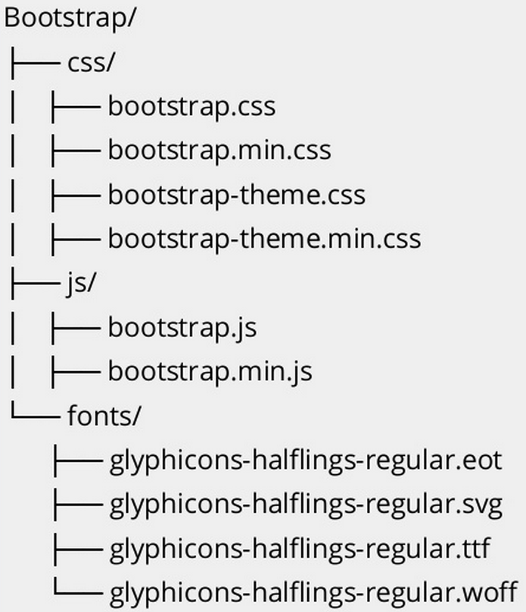
How to Get Started?
Download CSS and JS files, along with the fonts
http://getbootstrap.com/getting-started
Checkout Examples
http://getbootstrap.com/getting-started/#examples
Cheat Sheet - classes name, screen sizes, grid behavior
https://www.dropbox.com/s/gqhwxkx80gf8hwm/bootstrap3-cheatsheet.pdf?dl=0
Online Development
http://www.codeply.com/go
Notes:
the fastest way to get Bootstrap is to download the compiled and minified versions of the CSS and JS files, along with the included fonts.

Slide 15

r
BOOTSTRAP CDN
If you don't want to download and host Bootstrap yourself, you can include it from a
CDN (Content Delivery Network).

Slide 16
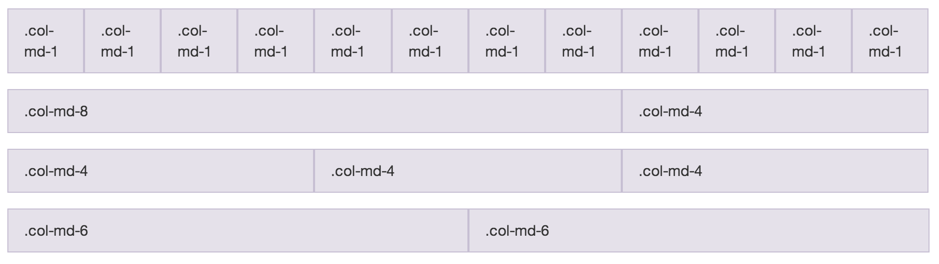
Bootstrap Grid System :-

Slide 17
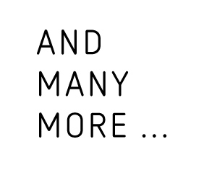

Slide 18
Thank You !! Any Queries…

