Slide 1
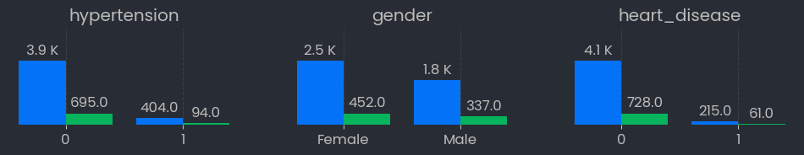
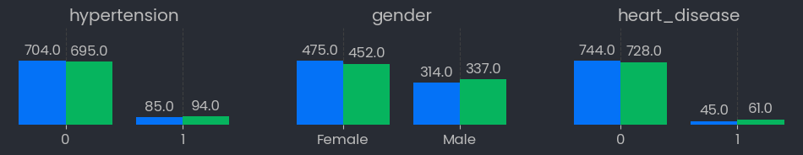
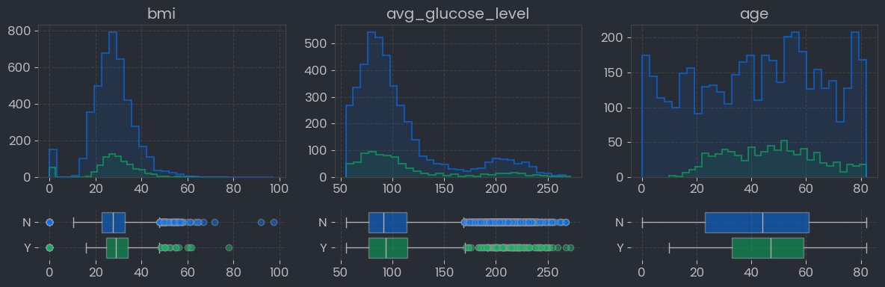
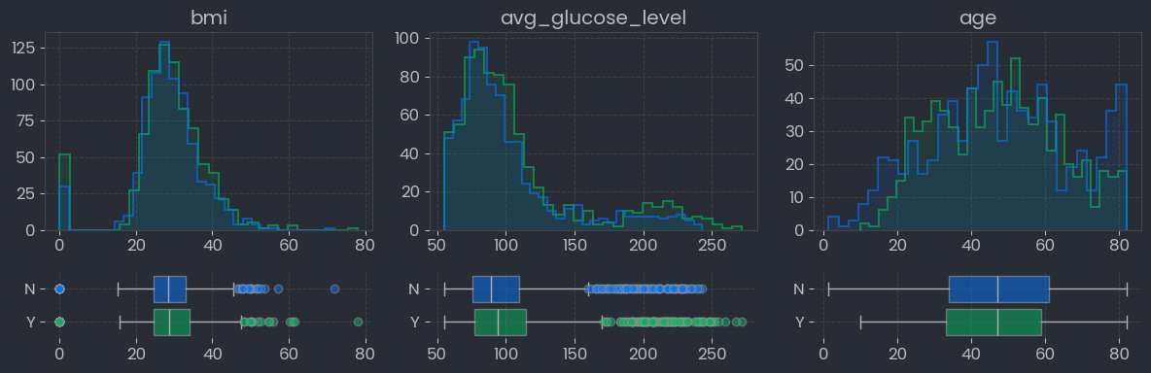
✅ Add Legend
✅ Add total smokers/non
Gender Male – Male Female
Before Matching
Y-Axis : Frequency (Total Subs)
X-Axis : Values
r
r = Y / (Y+N)
After Matching
Y-Axis : Frequency (Total Subs)
X-Axis : Values
r
r = Y / (Y+N)
15.1%
22.1%
15.1%
15.9%
15.1%
18.9%
49.5%
57.5%
48.8%
51.8%
49.7%
52.5%
Total Smokers
789
Total Non-Smokers
4,321
Y : Smokers
N : Non-Smokers
Total Smokers
789
Total Non-Smokers
789
Y : Smokers
N : Non-Smokers

Slide 2
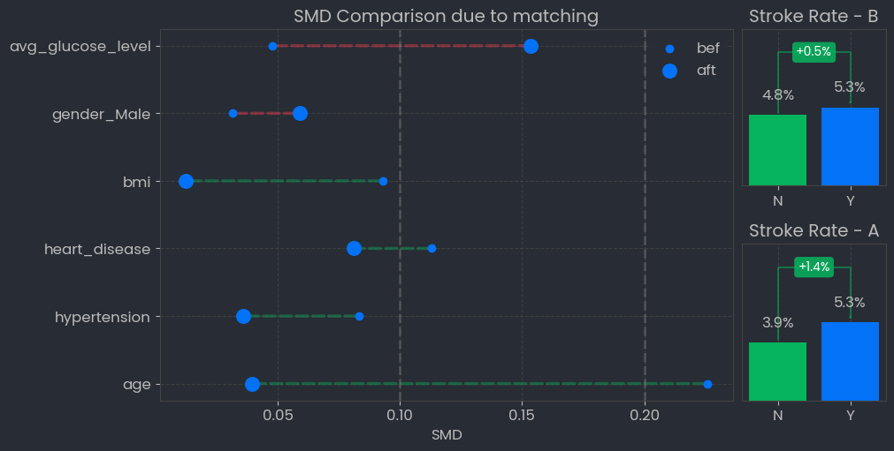
Standardized Mean Difference
Y : Smokers
N : Non-Smokers
Threshold
< 0.1 Good balance
0.1 - 0.2 Moderate
Decrease
Increase
Stroke Rate – B : Stroke Rate before matching
Stroke Rate – A : Stroke Rate after matching

Slide 3
