Slide 1

APA VIRGINIA CHAPTER 2026 CONFERENCE
Code Danville
Rewriting a legacy zoning code for Virginia's comeback city
Sean Suder, Esq.
Founder & CEO
ZoneCo (www.thinkzoneco.com)
Renee Burton
Director of Planning & Zoning
City of Danville, Virginia
City of Danville, Virginia · Chapter 41 Zoning Ordinance Update
Notes:
Welcome + introduce yourself and ZoneCo. One-line framing: Danville adopted a bold new comprehensive plan in 2024, and the city hired ZoneCo to rewrite the zoning ordinance that will deliver it. Confirm your preferred name/title line on this slide before presenting.

Slide 2
THE SETTING
Danville at a glance
A Southside Virginia mill city on the Dan River, Danville built its economy on textiles and tobacco and spent two decades reinventing itself after both industries left.
The transformation of the River District's historic tobacco warehouses, the Dan River Mills property, major downtown reinvestment, and the arrival of a resort casino have made Danville one of Virginia’s most interesting comeback stories.
~42,000
1986, 2004
Danville population
years the current zoning ordinance was adopted and comprehensively updated
2025
14/17
The zoning code now must keep pace with the city imagined by PLAN Danville.
Number of new zoning districts/ number of future land use categories in PLAN Danville
PLAN Danville comprehensive plan adopted 1/1/2025
Notes:
Set the scene for an APA audience: Danville's story — textile/tobacco collapse, River District revitalization, casino-era reinvestment. The point: the regulatory framework was written for a city that no longer exists. Verify current population figure before presenting.

Slide 3



Plan Danville Details
+ excerpt from land use plan – direct finding - implementation

Slide 4
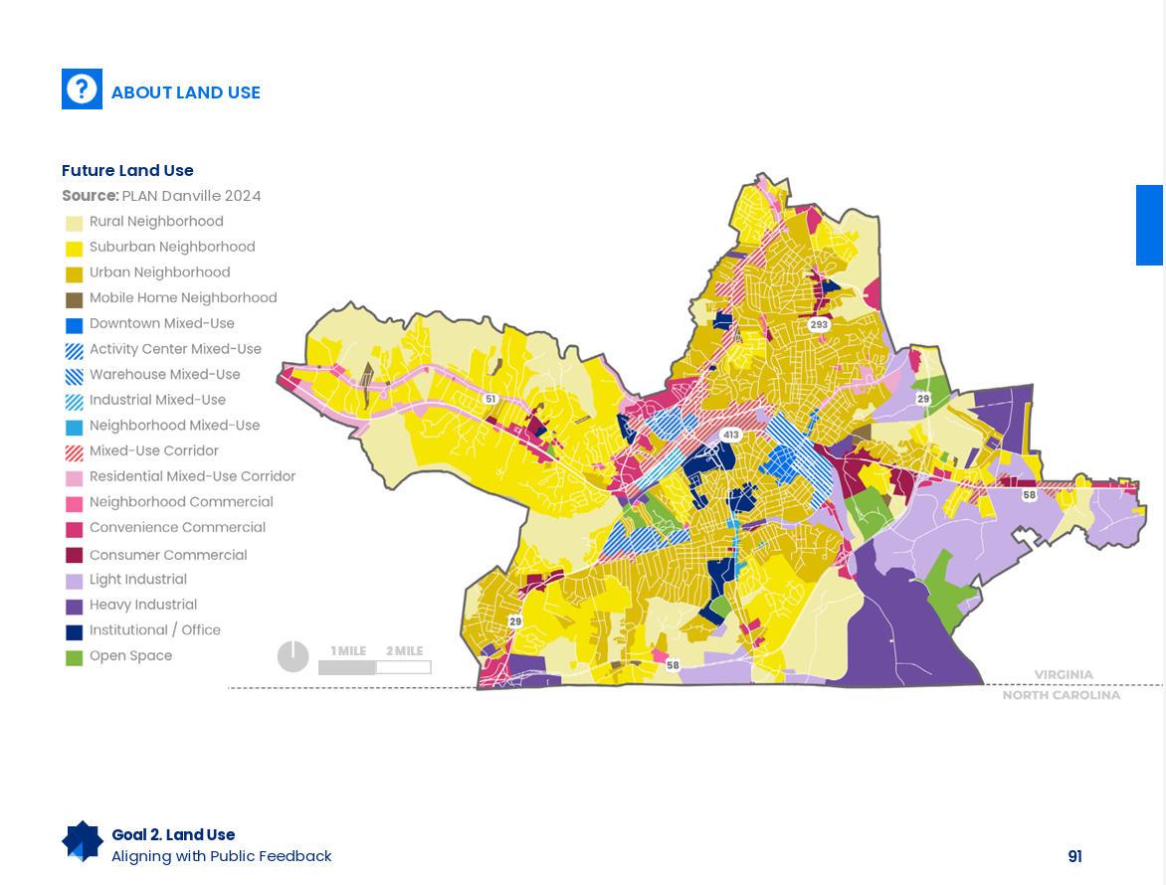


Slide 5



THE MANDATE
Why rewrite, and why now
PLAN Danville says so
The code shows its age
The city has changed
PLAN Danville’s first implementation recommendation: amend the zoning to reflect the future land use plan.
Adopted in 1986, last comprehensively updated in 2004. Two decades of piecemeal amendments have made it hard to navigate, interpret, and administer.
Technology, business, agriculture, and commuting patterns have all evolved. The code needs strategic future-proofing, not another patch.
A comp-plan-first rewrite: the zoning update exists to implement PLAN Danville — not the other way around.
Notes:
Emphasize the sequencing lesson: Danville did this in the right order — plan first (adopted 2024), then zoning. Recommendation #1 of PLAN Danville implementation is 'Amend zoning to reflect recommendations in future land use plan.' That gives the rewrite political legitimacy and a built-in policy basis.

Slide 6

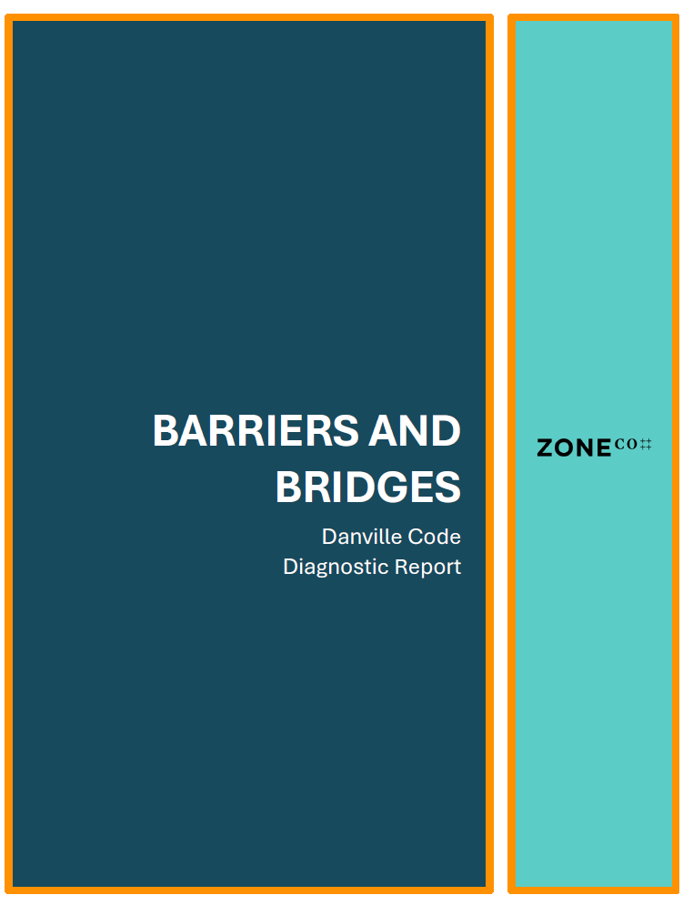


THE PATIENT
What the diagnostic found
Scattered and duplicative
Related standards live in different articles; users bounce across the code to answer one question.
Ambiguous language
Undefined and inconsistent terms invite interpretation disputes and interpretation risk is legal risk.
Procedural friction
Review pathways are unclear about who decides what, on what standard, and on what timeline.
Misaligned with the plan
District purposes and standards don't deliver the outcomes in PLAN Danville's future land use map.
Module 1 deliverable: a public Diagnostic Report evaluating Chapter 41 against the goals of PLAN Danville.
Notes:
Walk through the headline findings of the Diagnostic Report. Adjust these four to match the report's actual framing — these are the recurring categories (organization, clarity, procedures, plan alignment). Good moment for a war story: a specific provision that produced repeat variances or interpretation fights.

Slide 7



THE ZONECO METHOD
Diagnose. Calibrate. Codify. Adopted in 12 months.
1 · Diagnose
2 · Calibrate
3 · Codify
Audit the existing code against the comprehensive plan, state law, and how it actually performs in administration.
Translate plan goals into a district framework and regulatory approach — tested against real places and real parcels before drafting.
Draft the new ordinance in modules: plain language, consolidated standards, tables, and graphics — built for adoption.
DIAGNOSTIC REPORT
CALIBRATION FRAMEWORK
ADOPTION-READY CODE
Each module ends in a public deliverable — the process earns trust by showing its work.
Notes:
Explain the three-module structure and why staging matters: each module produces a public deliverable, creating checkpoints for Council, Planning Commission, and the public before the next phase begins. This de-risks the drafting phase politically.

Slide 8

MODULE 2
Calibrating the plan into regulation
PLAN DANVILLE GIVES US
CALIBRATION TRANSLATES IT INTO
A future land use map with designated character areas
Areas identified for more significant change — and neighborhoods planned to retain their character
Goals for housing, economic development, and quality of place
A right-sized district lineup mapped to plan character areas
Use permissions and dimensional standards tuned to produce the built form the plan describes
Standards stress-tested against real Danville parcels and recent development proposals
Calibration is where policy becomes math — and where most rewrites quietly fail.
Notes:
This is the slide to slow down on for a professional audience. Explain a concrete calibration example from Danville — e.g., how a plan character area translated into district standards, or a place where the old dimensional standards would have made the plan's preferred building form unbuildable.

Slide 9

MODULE 3
Drafting for the people who use it
Consolidate
Clarify
One home for each topic — parking, signs, landscaping — instead of standards scattered across articles.
Defined terms, consistent usage, and plain language that reads the same to an applicant, a planner, and a judge.
Streamline
Show, don't tell
Clear procedures: who decides, on what standard, on what timeline — with administrative approval where the plan supports it.
Tables for numeric standards and graphics for form because a diagram settles arguments a paragraph starts.
Usability is a legal strategy: a code that can't be misread can't be mis-administered.
Notes:
Show a before/after excerpt here if slides allow — a dense 1986-era paragraph next to the new table or graphic treatment of the same standard. That single visual usually lands harder than anything else in the talk.

Slide 10
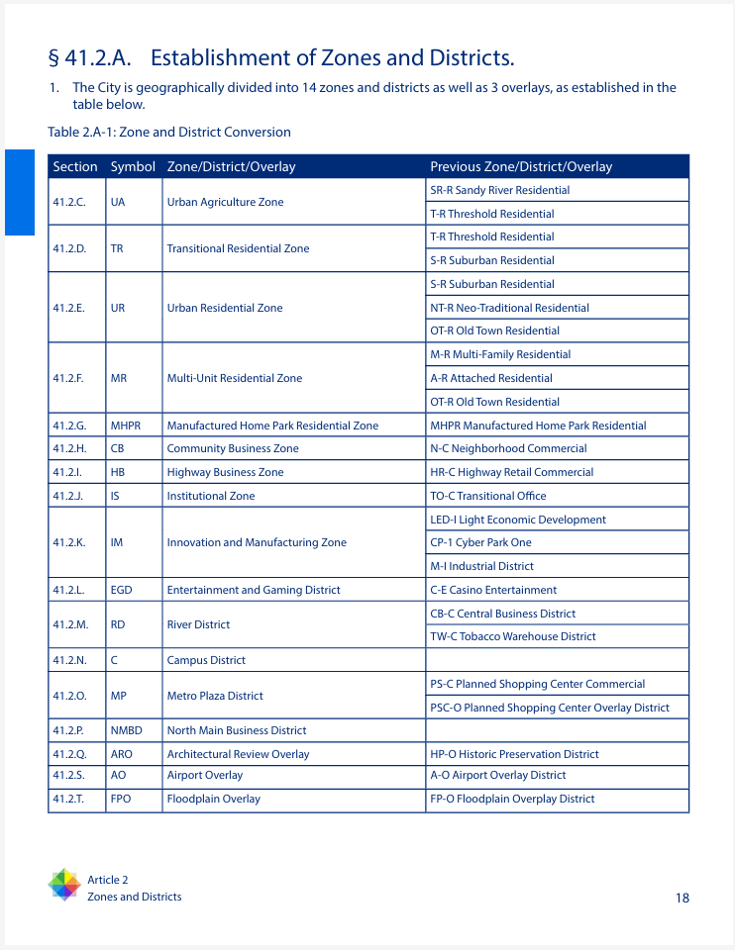
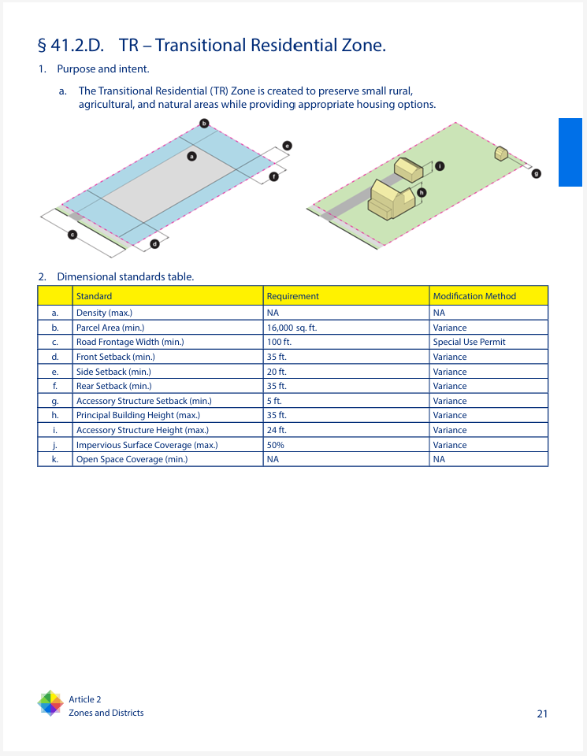
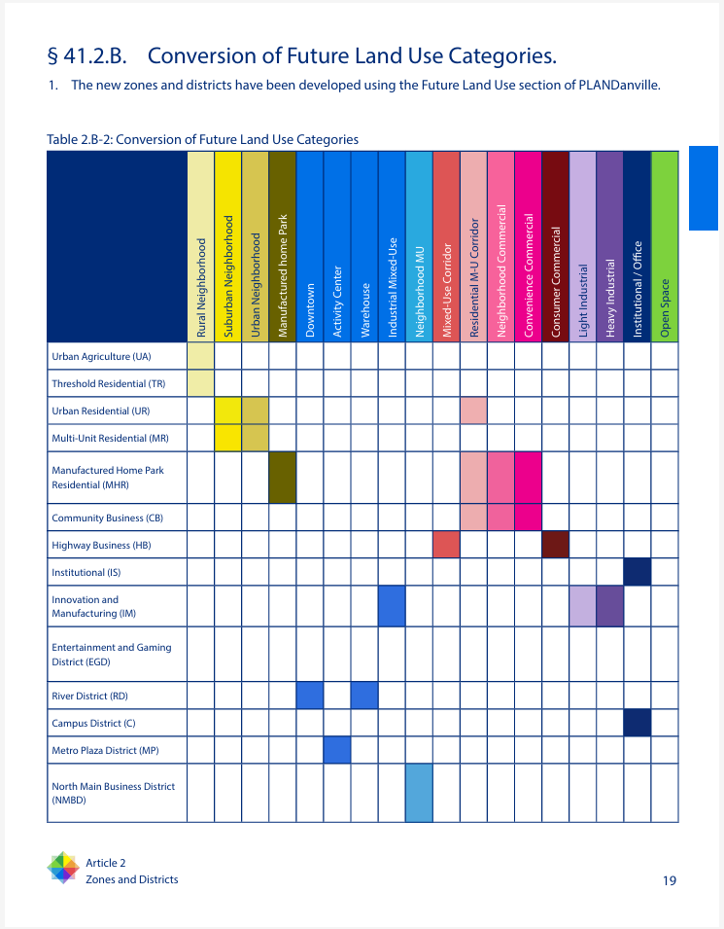

Slide 11



THE GUARDRAILS
Drafting within Virginia's legal framework
Dillon Rule discipline
Every regulatory tool must trace to an enabling grant. Virginia localities exercise only the zoning powers the General Assembly confers. Creativity must fit the statute.
Title 15.2 enabling authority
The zoning enabling framework (Va. Code § 15.2-2280 et seq.) defines the permissible subjects of regulation, purposes, and the required procedures for adoption.
Comprehensive plan linkage
The ordinance must be drawn with reasonable consideration of the comprehensive plan. PLAN Danville is both the policy basis and part of the legal defense.
Notice and hearing requirements
Statutory public notice and hearing requirements (§ 15.2-2204) shape the adoption calendar for both Planning Commission and City Council.
A defensible code is one an applicant, a planner, and a court all read the same way.
Notes:
As the room's lawyer-planner, this is your home turf. Consider adding a note on any recent General Assembly legislation relevant to the audience this session (housing bills, short-term rentals, solar, etc.) — update to the current GA session before presenting.

Slide 12
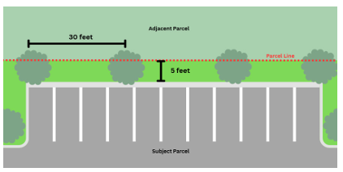
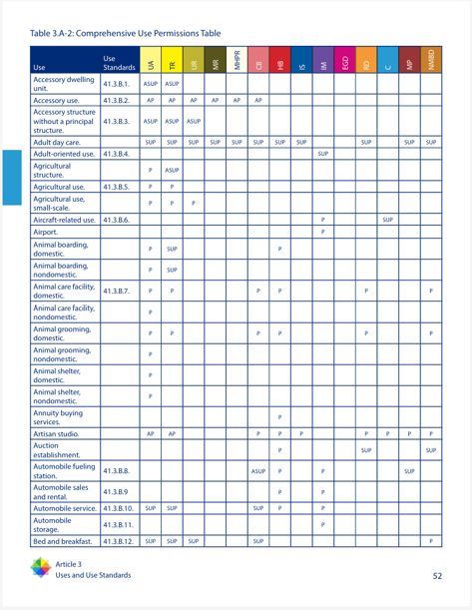
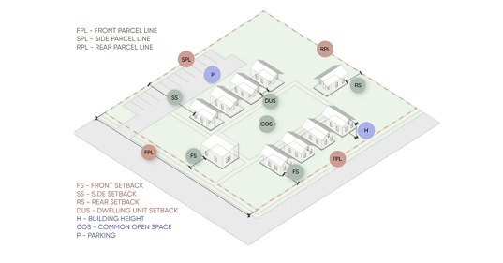
THE FOLLOW UP
New code in practice

Slide 13
THE TAKEAWAYS
Lessons for Virginia communities
1
Plan first, then zone
2
Diagnose before you draft
3
Calibrate, don't copy
A fresh comprehensive plan gives the rewrite its policy basis, its political mandate, and its legal defense. Danville sequenced it right.
A public diagnostic builds the shared factual record and everyone argues from the same findings instead of competing anecdotes.
Model codes and peer ordinances are references, not templates. Standards must be tuned to your parcels, your market, your plan.
4
Usability is defensibility
5
Time input to the draft
6
Respect the Dillon Rule
Plain language, tables, and graphics aren't cosmetic they reduce interpretation disputes, appeals, and litigation exposure.
Educate early; concentrate public input after there are real standards to react to. Maps are key. Reassure early about what isn't changing.
In Virginia, every clever regulatory idea needs an enabling home in Title 15.2. Check authority before you fall in love with a tool.
Need an amazing dedicated city staff like in Danville!
Notes:
This is the slide the audience photographs. Deliver each lesson with a one-sentence Danville example. If pressed for time earlier in the talk, protect this slide.

Slide 14
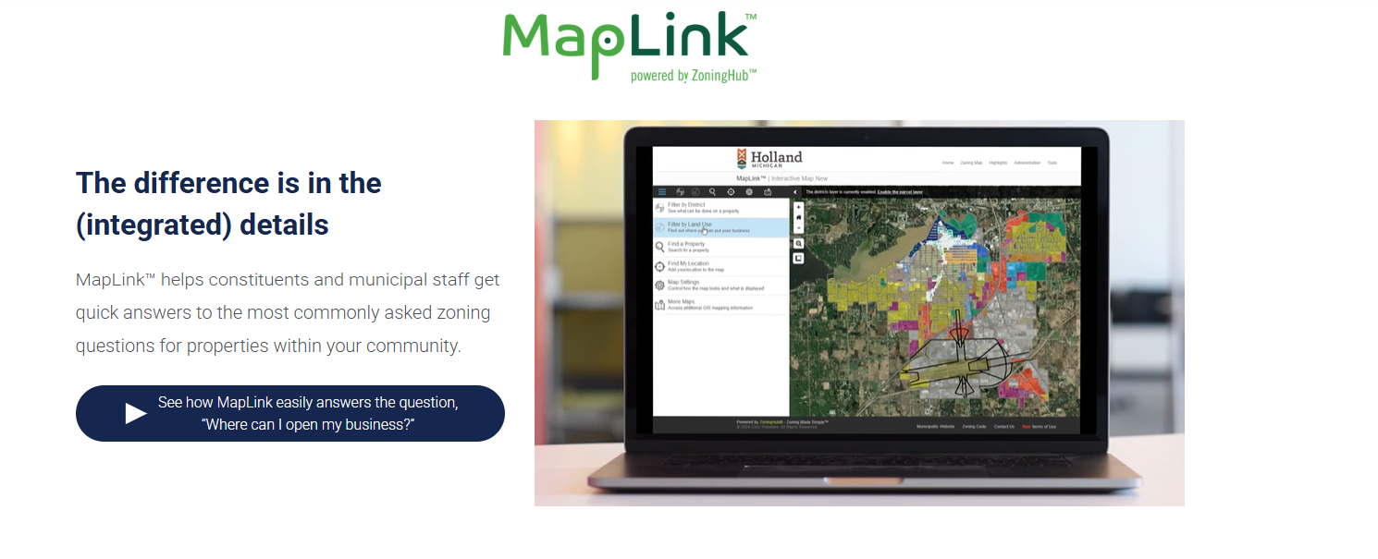
STAY TUNED
More to come for Danville zoning…

Slide 15
Thank you.
Renee Burton · Director, Planning & Zoning, City of Danville, VA
Sean Suder, Esq. · Founder & CEO, ZoneCo
www.thinkzoneco.com
Code Danville · APA Virginia Chapter
Notes:
Add your direct email and phone if you want them on screen. Consider a final invitation: 'If your locality's code predates your comprehensive plan, that's the conversation to have.'

