Slide 1
Tour Miner Getting data from twitter for developing web application
Graduate School of Science and Engineering, Yamaguchi University
B4 Katakura Shota
Thanawit Gerdprasert
Anawat Kaenthong
Merisa Puengsawad
Copyright (c) 2017 Yamaguchi Laboratory, All Rights Reserved

Slide 2
Tour Mining Script Explanation
Graduate School of Science and Engineering, Yamaguchi University
The Script is written in Java Script language with the supported of many library from the Node framework.
Node allow community to use and create the package as they want and use it for development.
Famous library that used in this project such as ‘file system’ ‘Twit’ ‘@google/map’ ‘kuromoji’ ‘express’ ‘ejs’ ‘body-parser’ and mores
Code can be found at https://github.com/carymono/tour_mining and https://github.com/carymono/tags_mining
Copyright (c) 2017 Yamaguchi Laboratory, All Rights Reserved

Slide 3
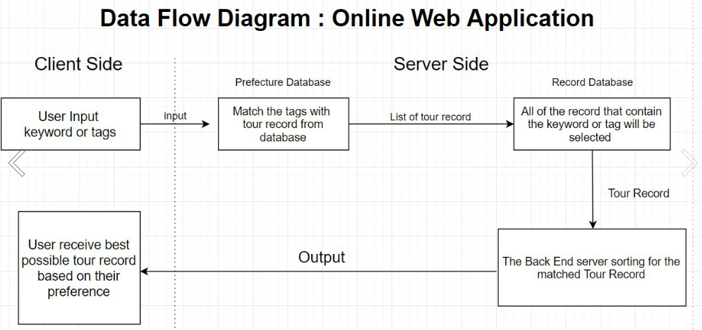
Web Application
Graduate School of Science and Engineering, Yamaguchi University
Copyright (c) 2017 Yamaguchi Laboratory, All Rights Reserved

Slide 4
1. Mining the User Script
Graduate School of Science and Engineering, Yamaguchi University
Using the Twitter API to get the User who seems to start traveling.
The result will target the user who travel and we will use the user later on for the tour generating method.
Copyright (c) 2017 Yamaguchi Laboratory, All Rights Reserved

Slide 5
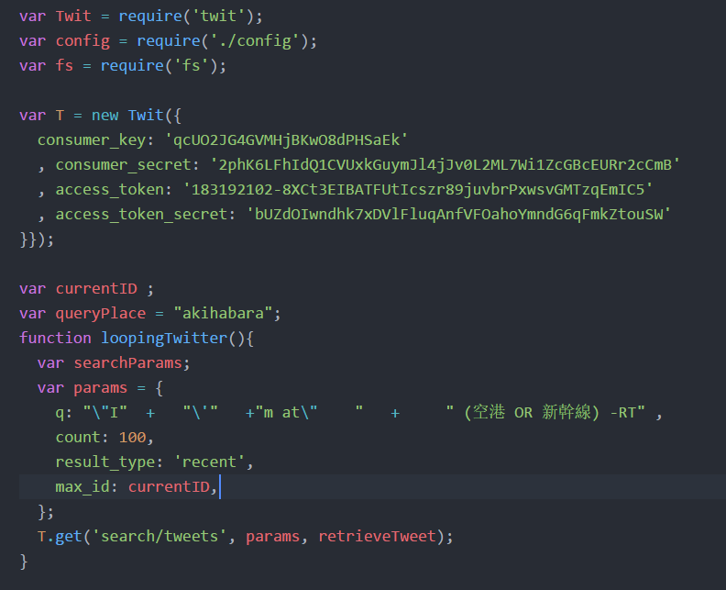
Using the Javascript’s Node framework to use the module created by the community for pulling twitter by using the require method.
Then input the API’s key in order to connect with the Twitter API
Configure the Parameter in order to specify what we want to search for
Finally, using the variable T which are the object from Twit node framework to generate API called with the callback function
Copyright (c) 2017 Yamaguchi Laboratory, All Rights Reserved

Slide 6
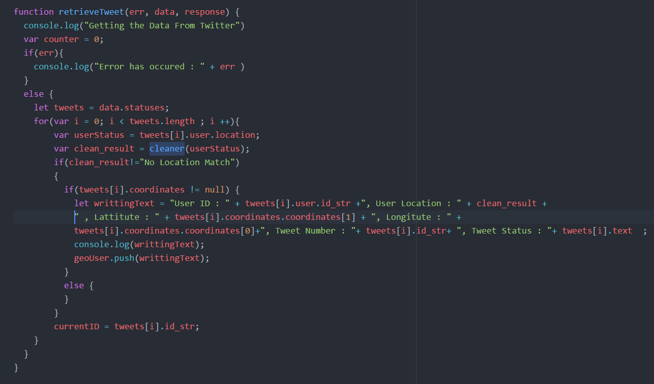
After the Tweets with specific parameter is collected, we then filter it with Geolocation and User’s Location.
User Location will be used as the start point of the traveling
The Geolocation will be used for Reverse-Geo-Coding method in order to specify user travelling location
The qualify tweet will be push into the array and will be write as the record later on.
The last line of code will save the last tweets from this process to continue looping over next 100 elements (this is because API limit only 100 elements per API call)
Copyright (c) 2017 Yamaguchi Laboratory, All Rights Reserved

Slide 7
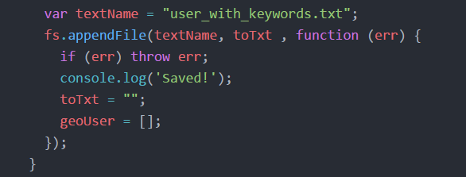
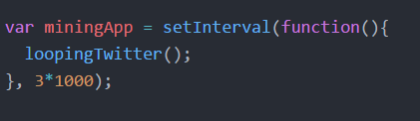
Graduate School of Science and Engineering, Yamaguchi University
Finally the Array that collect all the result will be used to write the file.
After that the process continue to loop over next 100 twitters and so on.
Copyright (c) 2017 Yamaguchi Laboratory, All Rights Reserved

Slide 8
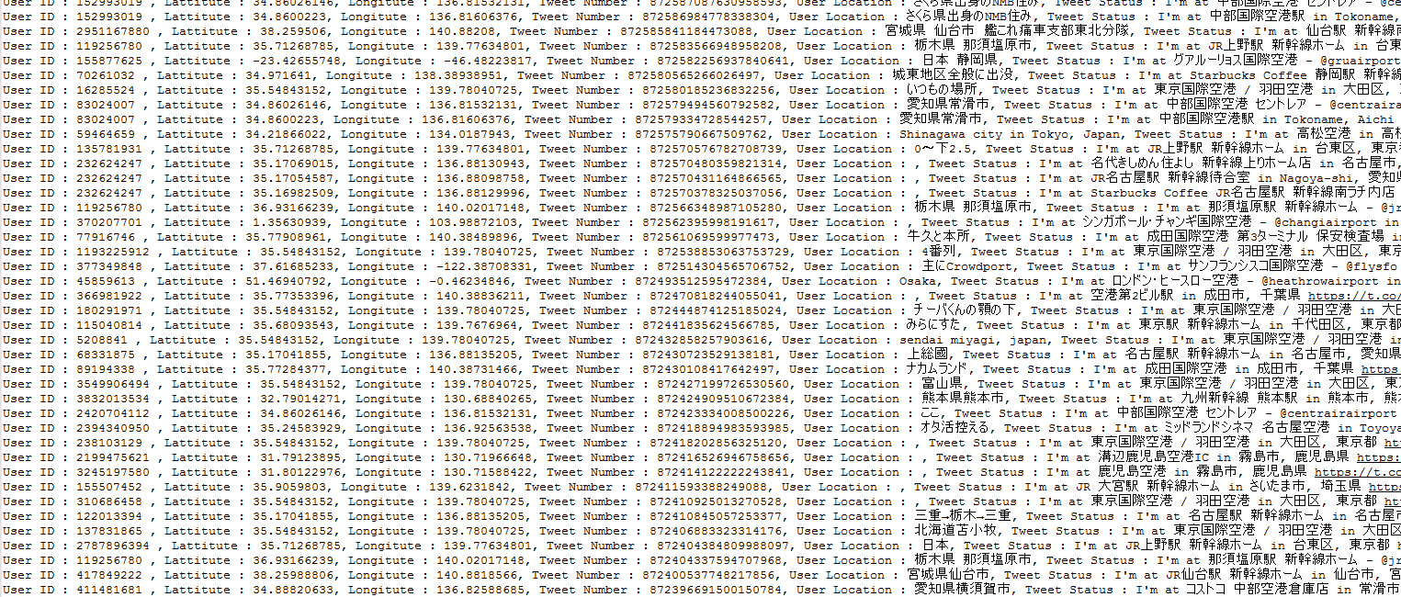
Example Output
Copyright (c) 2017 Yamaguchi Laboratory, All Rights Reserved

Slide 9
2. User Timeline Script
Graduate School of Science and Engineering, Yamaguchi University
Mining the user timeline since the selected tweeted from the User Script.
Go over last 900 tweets from the selected tweeted and collect the Geo Location from the tweet to generate tour record.
Copyright (c) 2017 Yamaguchi Laboratory, All Rights Reserved

Slide 10
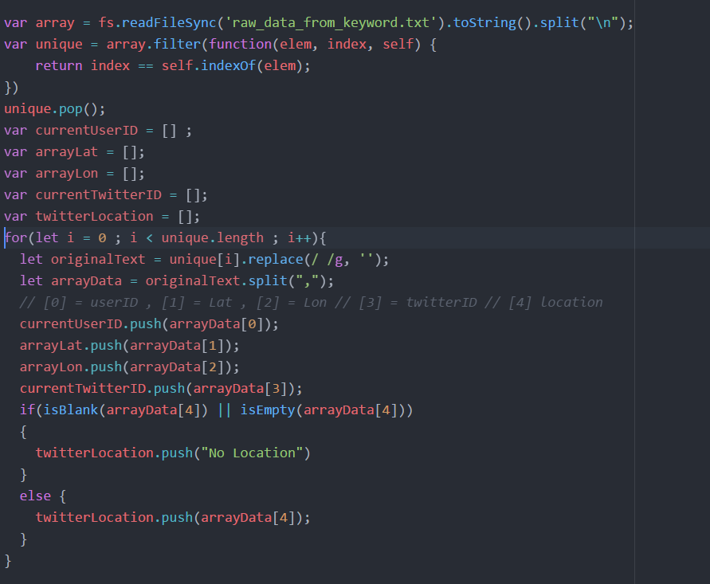
Read the user ID from the last text. Then store in the Array.
After that split the comma ‘,’ into and store each variable and stored it into the Array.
Also check if the User doesn’t have the location then put the place holder String as “No Location”
Copyright (c) 2017 Yamaguchi Laboratory, All Rights Reserved

Slide 11
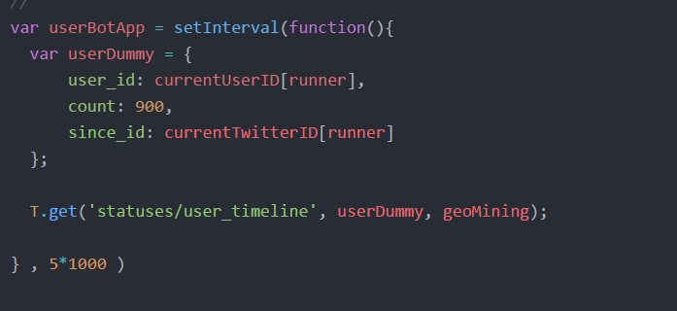
Graduate School of Science and Engineering, Yamaguchi University
Then called the User API for each element in the User Array and search the timeline for that user for 900 tweets as the input parameter.
Copyright (c) 2017 Yamaguchi Laboratory, All Rights Reserved

Slide 12
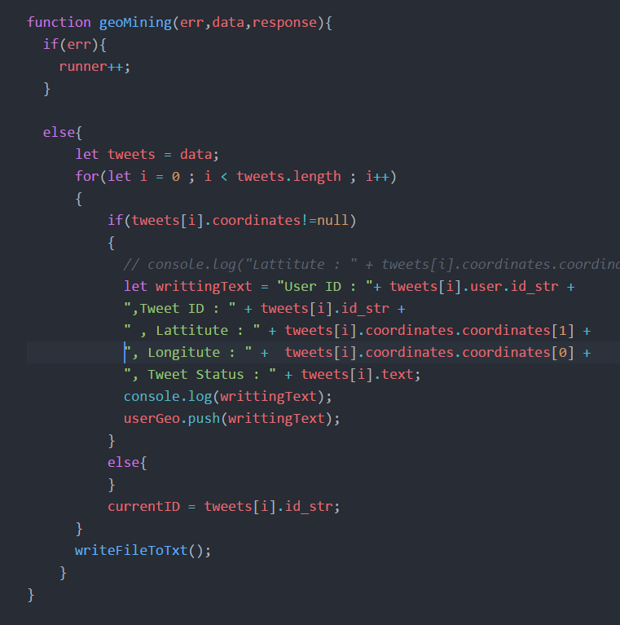
The call back function will check for the tweet geo location. If the geo location is presented then the tweets will be collected into the Array.
After the loop end(around 900 iteration), then script process with the writing function which will record the result into the text file.
Writing process is the same as last script.
Copyright (c) 2017 Yamaguchi Laboratory, All Rights Reserved

Slide 13
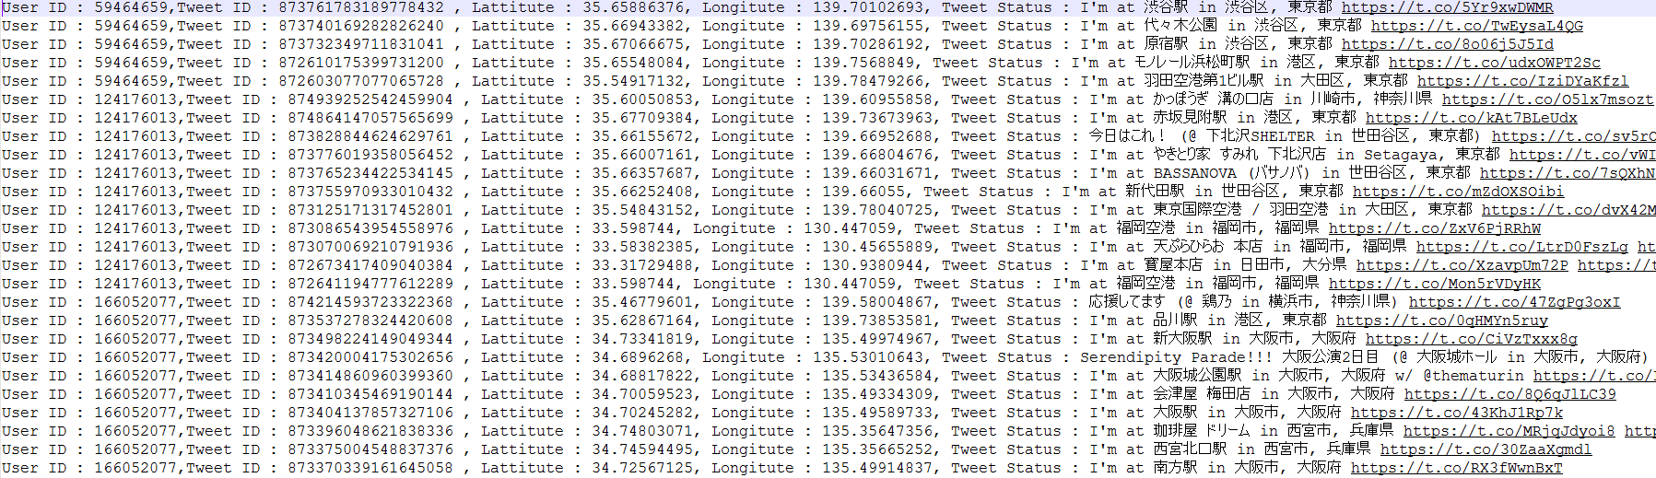
Example Output
Graduate School of Science and Engineering, Yamaguchi University
Copyright (c) 2017 Yamaguchi Laboratory, All Rights Reserved

Slide 14
3. Google Map API Script
Graduate School of Science and Engineering, Yamaguchi University
Mapped the tweet’s geo location into the real world location in order to make it readable
Also clean the data to allow it to use in the database.
Finally connect the record together for putting it in the database.
Copyright (c) 2017 Yamaguchi Laboratory, All Rights Reserved

Slide 15
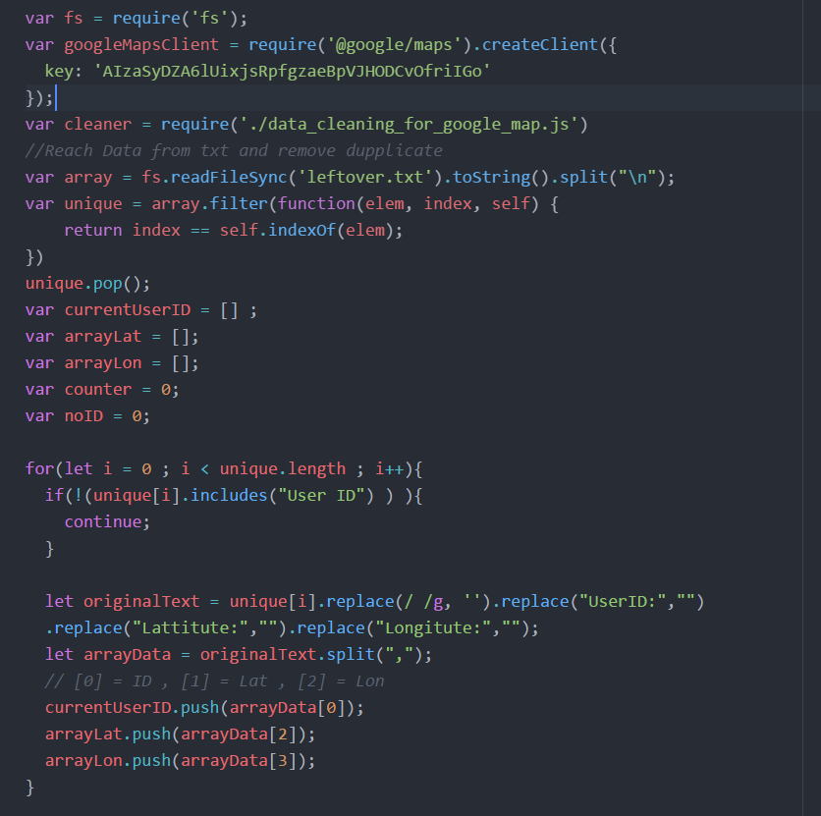
Start with the connecting the Google Map API from the Node package called @google/maps.
After that read the data from last script and split the data into different Array.
Copyright (c) 2017 Yamaguchi Laboratory, All Rights Reserved

Slide 16
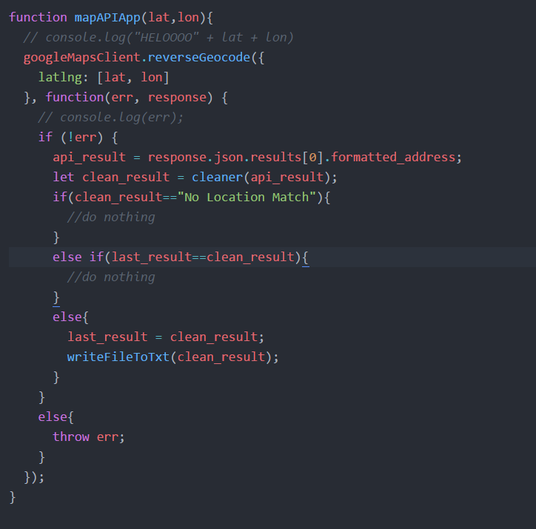
Graduate School of Science and Engineering, Yamaguchi University
After that the program create the API called from the Latitude and Longitude from the user tweets.
After the location is received then it will go through the data cleaning script to extract only the prefecture location.
After the cleaning is complete then the record is written into the text file.
Copyright (c) 2017 Yamaguchi Laboratory, All Rights Reserved

Slide 17
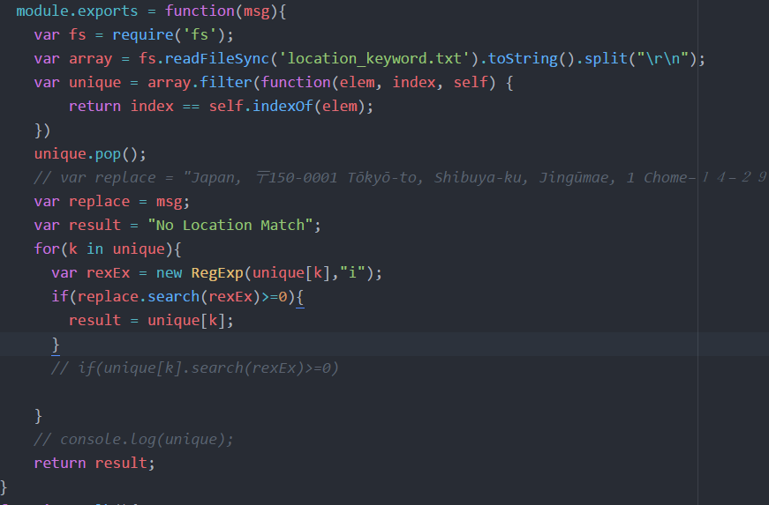
This is the cleaning script which take input from the Google Map API and mapped with the prefecture location text file
The script use Regular Expression in order to mapped the part of the location precisely.
Copyright (c) 2017 Yamaguchi Laboratory, All Rights Reserved

Slide 18
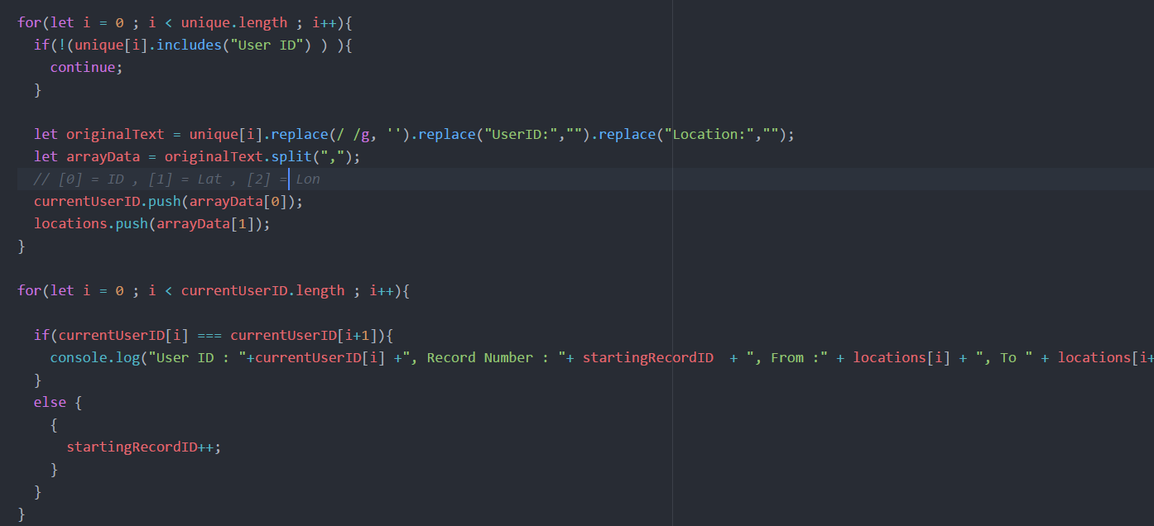
Graduate School of Science and Engineering, Yamaguchi University
Finally, the tweet is combine into record for using easier to be put in the database for application.
Copyright (c) 2017 Yamaguchi Laboratory, All Rights Reserved

Slide 19
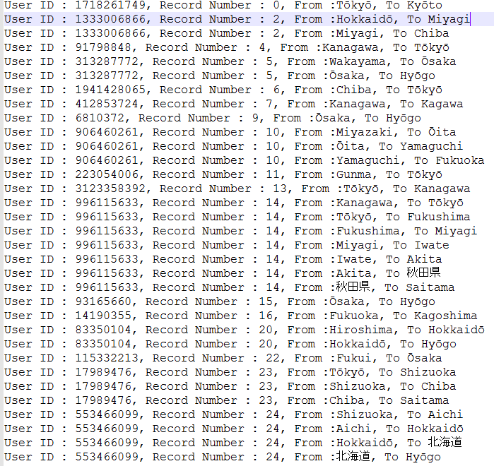
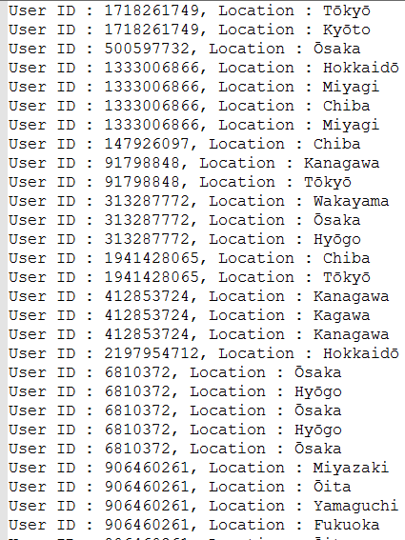
Example of the data from Google Map API
Example of the combining record
Copyright (c) 2017 Yamaguchi Laboratory, All Rights Reserved

Slide 20
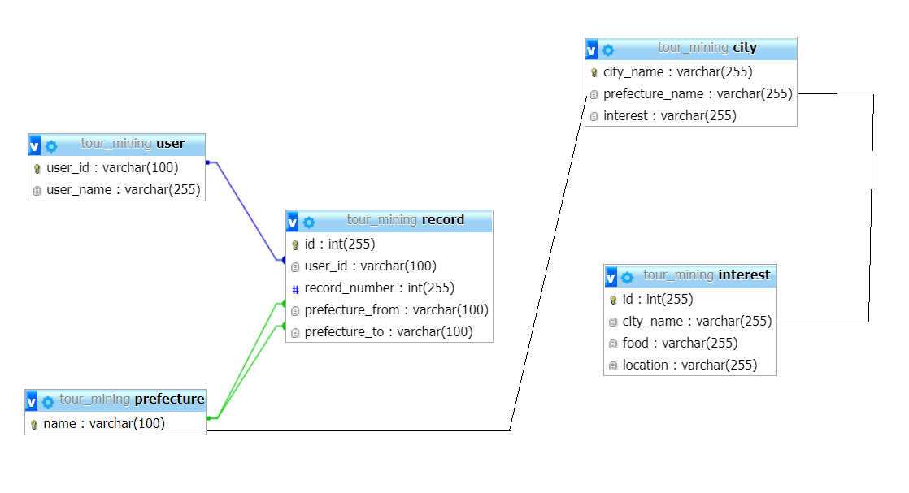
Graduate School of Science and Engineering, Yamaguchi University
Copyright (c) 2017 Yamaguchi Laboratory, All Rights Reserved

Slide 21
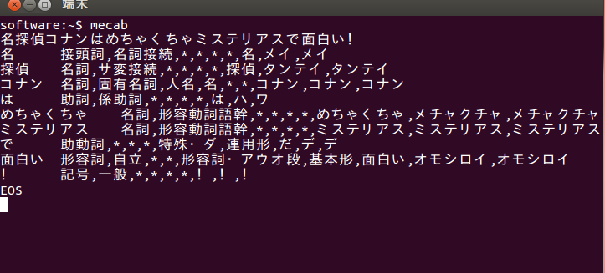
形態素解析
Graduate School of Science and Engineering, Yamaguchi University
Copyright (c) 2017 Yamaguchi Laboratory, All Rights Reserved

Slide 22

http://www.toei-video.co.jp/BD/slamdunk/keyvisual3.jpg

Slide 23
SLAM DUNKのイメージは
Graduate School of Science and Engineering, Yamaguchi University
・バスケ
・井上雄彦
・週刊少年ジャンプ
・赤髪
・桜木花道
・高校生
・あきらめたらそこで試合終了ですよ・・・？
Copyright (c) 2017 Yamaguchi Laboratory, All Rights Reserved

Slide 24
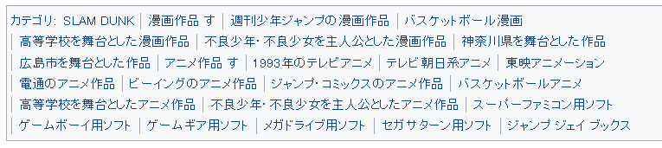
ウィキペディアのSLAM DUNKのタグは
Graduate School of Science and Engineering, Yamaguchi University
https://ja.wikipedia.org/wiki/SLAM_DUNK
Copyright (c) 2017 Yamaguchi Laboratory, All Rights Reserved

Slide 25
Demo Application
Graduate School of Science and Engineering, Yamaguchi University
Copyright (c) 2017 Yamaguchi Laboratory, All Rights Reserved

