Slide 1
Title:"Patch-Based Deepfake Localization: Unveiling Manipulated Regions in Images through Visual Artifact Analysis"
Azmain Azam Chowdhury ID: 20301272
Submitted To
Faculty : Annajiat Alim Rasel
Research Assistant : Farah
Student Tutor : Amit
Course Code: CSE424
BRAC University

Slide 2
Introduction
The thesis introduces a patch-based technique for deepfake localization, contributing to the field of multimedia forensics by enhancing the accuracy and efficiency of deepfake detection through localized analysis and pattern recognition.

Slide 3
Methods:
The main point of this thesis is to address the challenge of detecting and localizing manipulated regions within images, specifically focusing on deepfake content. The thesis introduces a novel patch-based technique that aims to identify and disclose regions in images that have been manipulated using deepfake techniques. This approach differs from traditional methods that classify entire images as real or manipulated; instead, it focuses on identifying small altered regions within images.

Slide 4
Technique used for the thesis
Rather than treating images as a whole, the thesis proposes dissecting images into smaller patches and analyzing these patches individually. By doing so, the model can capture subtle manipulation artifacts and inconsistencies that might be missed when analyzing the entire image. This localized analysis allows for a more accurate and precise identification of manipulated regions.
CNN
Moreover, the thesis combines pattern recognition and computer vision techniques, particularly using convolutional neural networks (CNNs), to extract features from these patches. This enables the model to learn intricate manipulation patterns and artifacts, enhancing its ability to distinguish between authentic and manipulated regions.

Slide 5
Existing thesis vs this thesis
In comparison to existing theses or research, this thesis focuses on a more granular approach to deepfake detection. Instead of concentrating solely on classifying entire images or videos, it hones in on identifying and localizing specific manipulated areas. This approach is particularly relevant in scenarios where only a portion of the content is manipulated. The thesis's contribution lies in its development of a method that can accurately pinpoint these manipulated regions, thereby strengthening the overall arsenal of tools to combat the proliferation of deceptive content.

Slide 6
Result
F1 Score = 2/ (1/Precision + 1/Recall)
F1 Score = 0.89
Precision =correctly localized/(incorrectly localized+missed localization)
Precision = 0.90
Recall=correctly localized/(incorrectly localized+missed localization)
Recall = 0.85
Model Accuracy= 0.89

Slide 7
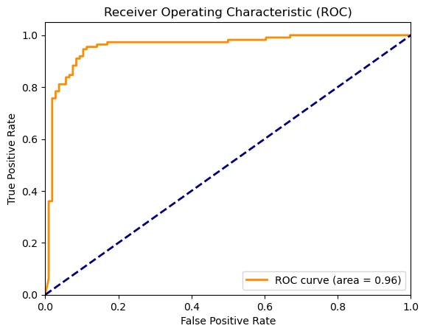
ROC CURVE

Slide 8
Conclusion
In summary, the thesis introduces a patch-based technique for deepfake localization, contributing to the field of multimedia forensics by enhancing the accuracy and efficiency of deepfake detection through localized analysis and pattern recognition.

