Slide 1
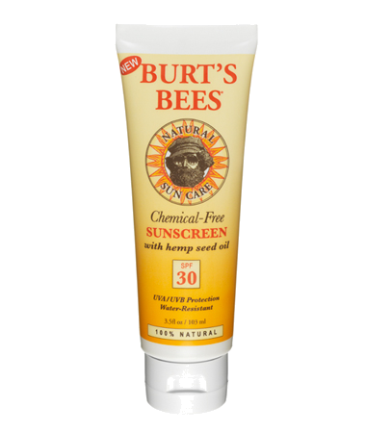
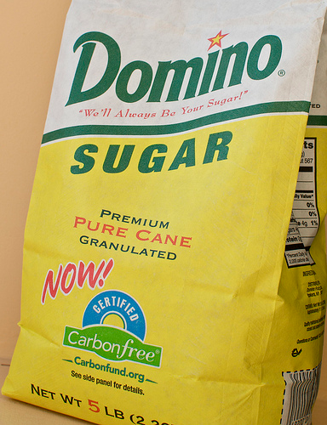
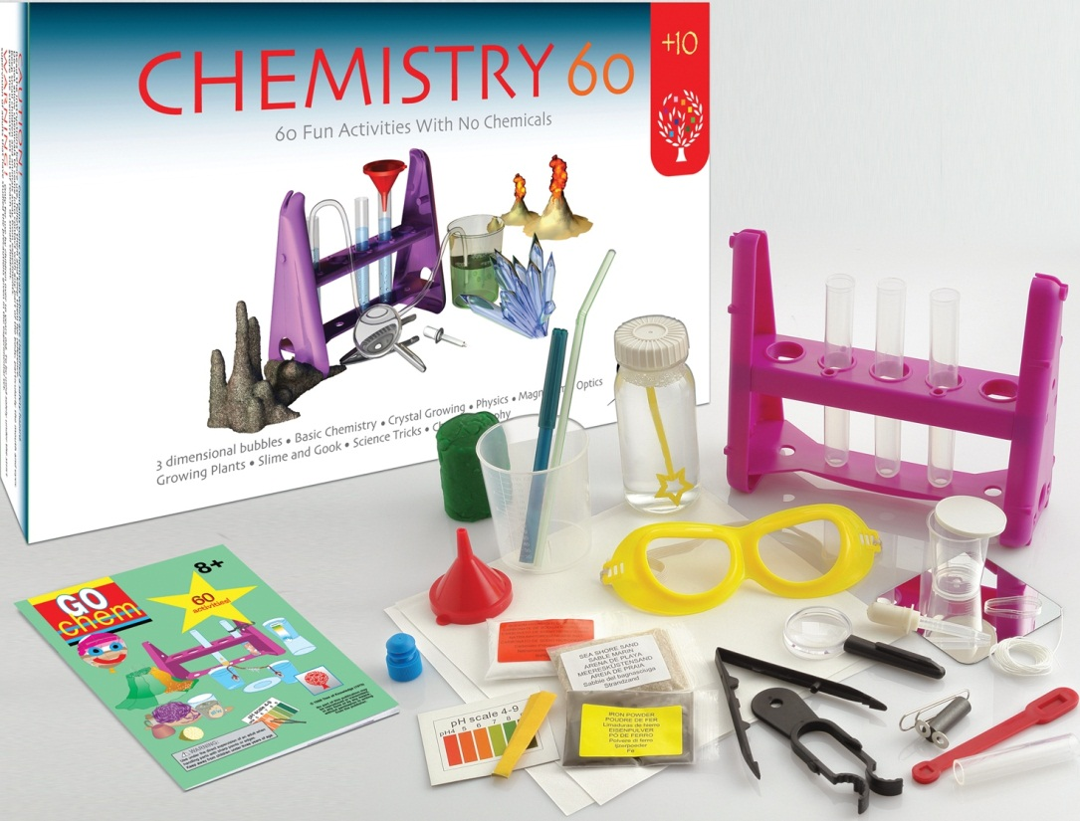
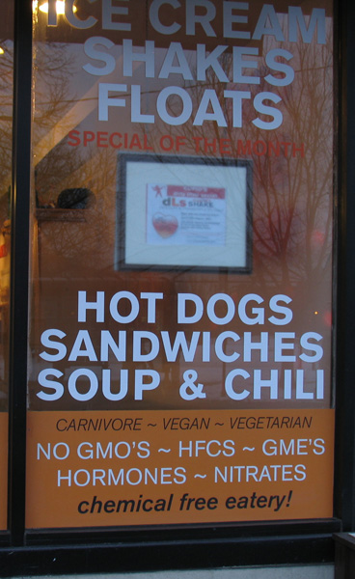
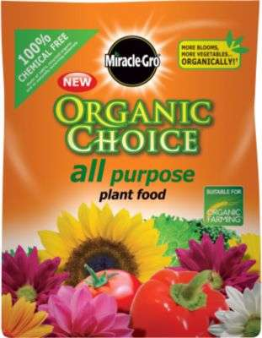
What Does “Chemical Free” Mean?
“60 Fun
Activities
With No
Chemicals”
Follow-Up Questions:
  What does harmful/safe mean?
  What is an LD₅₀?
  What about BPA? CO₂? Artificial flavors?
Talking Points:
  Natural vs. Artificial
  Organic vs. Conventional
  Marketing vs. Accuracy
Adam M. Azman, Ph.D.
bit.ly/AdamAzman

Slide 2
Photo Sources
http://www.elenco.com
http://www.burtsbees.com
http://www.dominosugar.com/carbonfree
http://www.scotts.com
http://www.justonly.ne/blog

