Slide 1
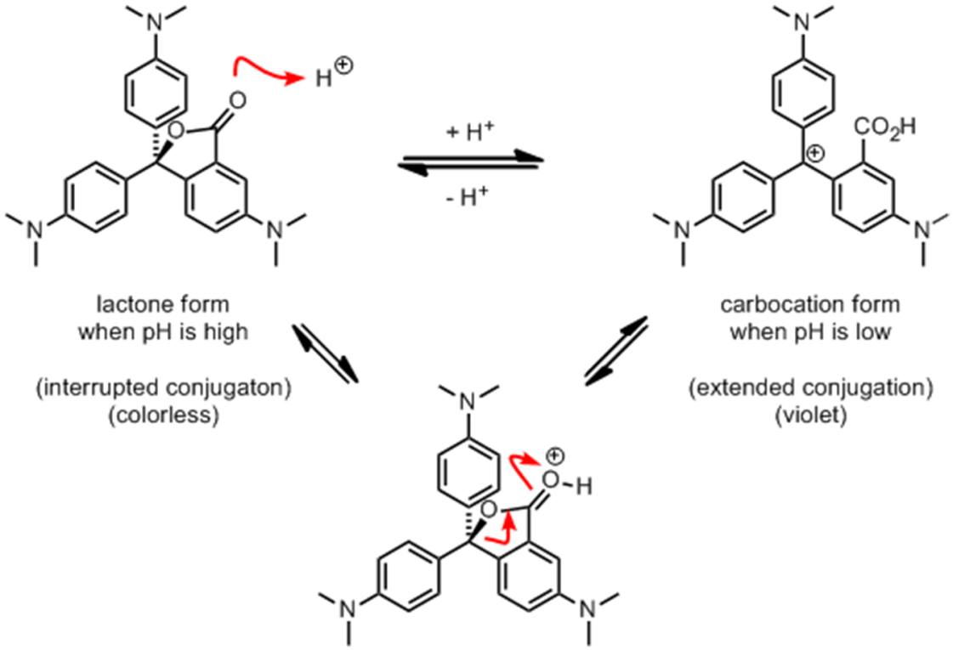
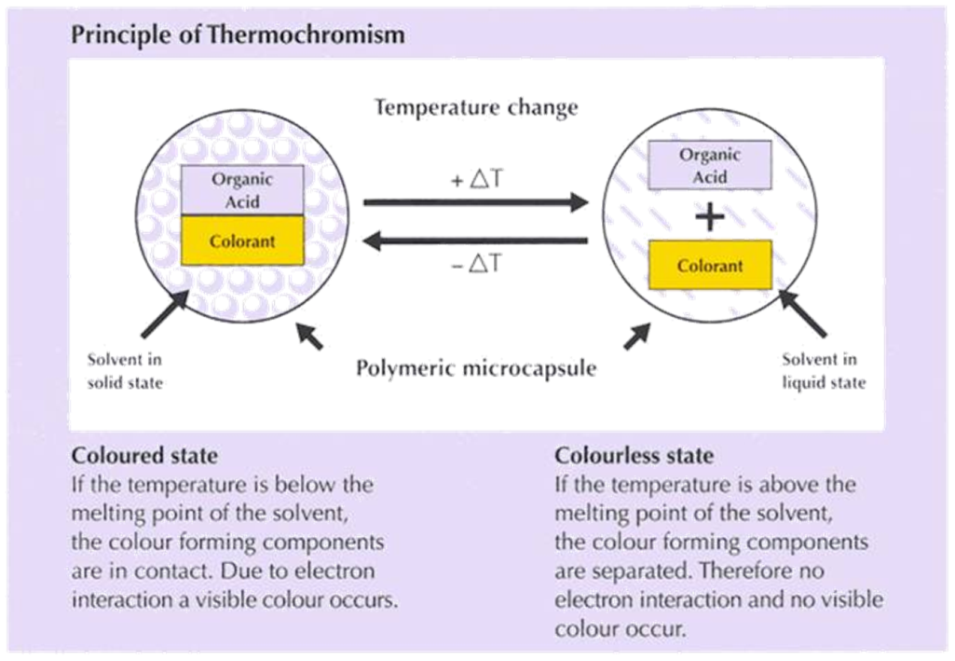
How Do Cold-Activated Bottles Work?
Talking Points:
  Conjugated π-systems & color
  Thermochromicity vs. Halochromicity
  Other applications (on-battery testers…)
Follow-Up Questions:
  How does color work?
  Why are tomatoes red/carrots orange?
  What is color blindness?
Adam M. Azman, Ph.D.
bit.ly/AdamAzman

Slide 2
Image Source
www.chromazone.co.uk

