Slide 1
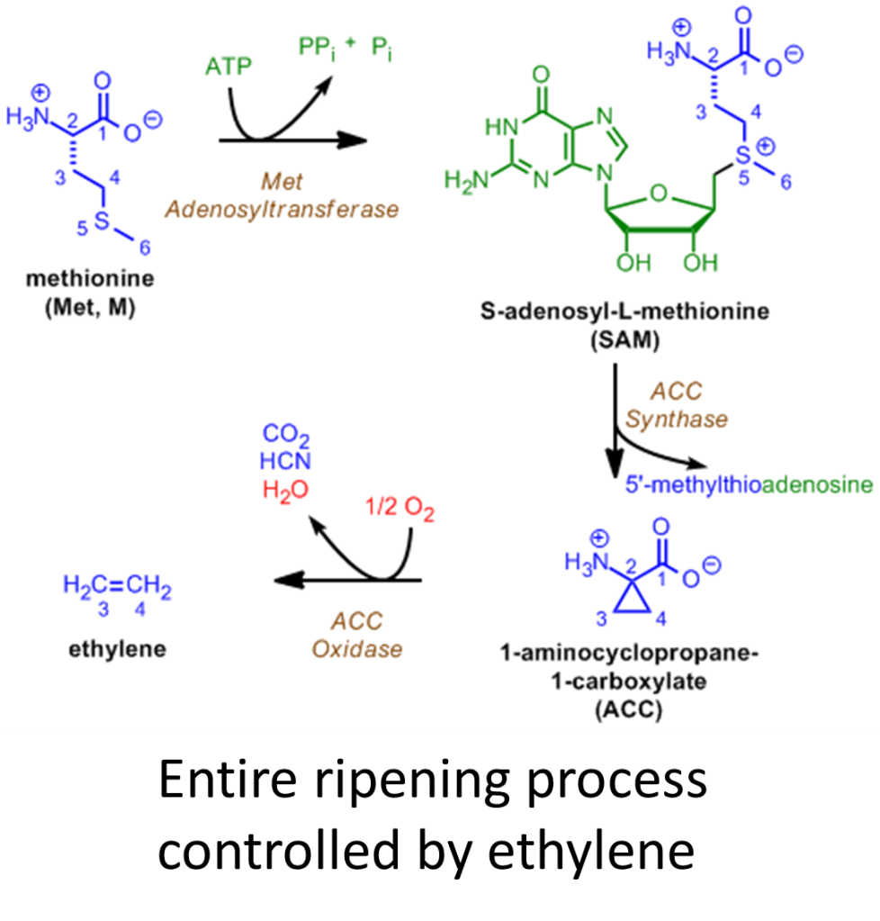
How Does Fruit Ripening Work?
As fruit ripens it becomes:
Sweeter (starches → simple sugars)
    Amylases
Colorful (chlorophyll broken down)
    Hydrolases
Less tart (acids → neutral molecules)
    Kinases
Softer (pectin broken down)
    Pectinases
Fragrant (large organics → fragrant molecules)
  Hydrolases
Talking Points:
  Plant vs animal growth hormones
  Climacteric vs non-climacteric fruit
  Ripened fruits don’t ship well
Follow-Up Questions:
  Why ripen some in fridge, some on counter?
  How do shippers inhibit ripening in transit?
  Does one bad apple really spoil the bunch?
Adam M. Azman, Ph.D.
bit.ly/AdamAzman

