Slide 1
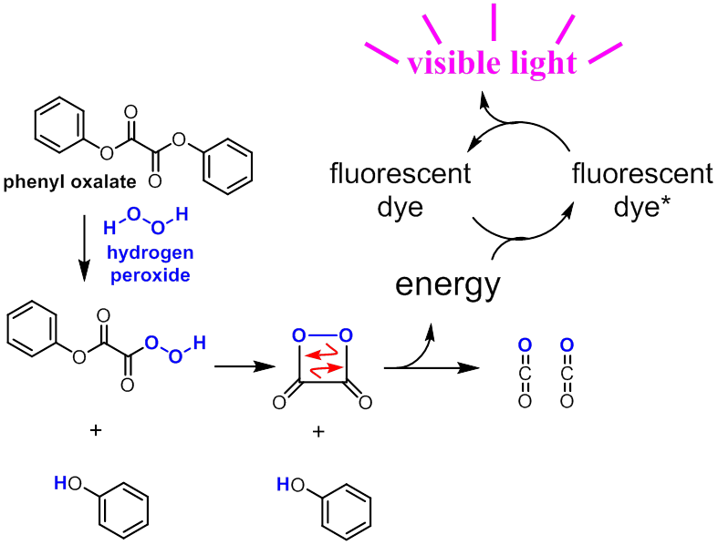
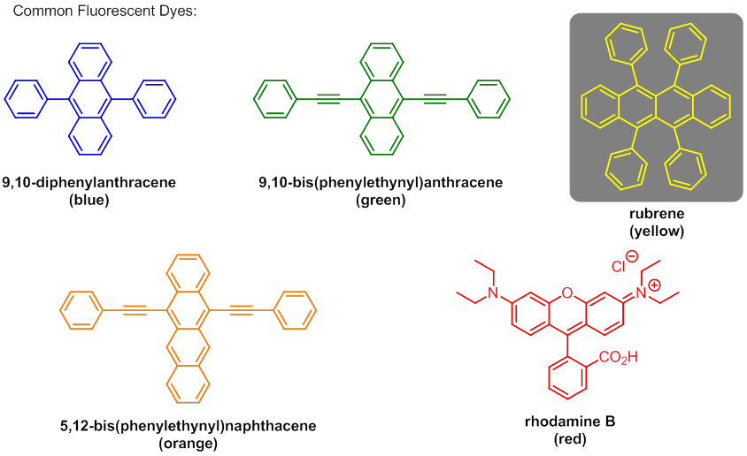
How Do Glow Sticks Work?
Talking Points:
  Conservation of energy
  Incandescence vs chemiluminescence
  Only light safe after natural disaster
Follow-Up Questions:
How does light work?
How do fireflies work?
Why do I have to ‘break’ the glow stick first?
Adam M. Azman, Ph.D.
bit.ly/AdamAzman

