Slide 1
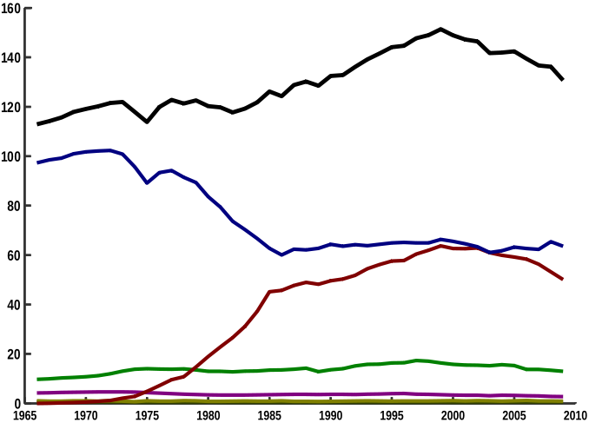
Why is High-Fructose Corn Syrup Bad?
Sucrose (table sugar):
50% glucose
50% fructose
HFCS-55 (soft drinks):
42% glucose
55% fructose
HFCS-42 (baked goods):
53% glucose
42% fructose
Sum total, all sugars
Pounds per capita
Refined Sugar
HFCS
Glucose
Others
Year
Talking Points:
  Calories & nutrition
  Government subsidies
  Glycemic Index
Follow-Up Questions:
  Why do we need different sweeteners?
  What is a ‘zero-calorie’ sweetener?
  Should a government be able to ban a food?
Adam M. Azman, Ph.D.
bit.ly/AdamAzman

Slide 2
Image Source
DOI: 10.1080/10408390600846457

