Slide 1
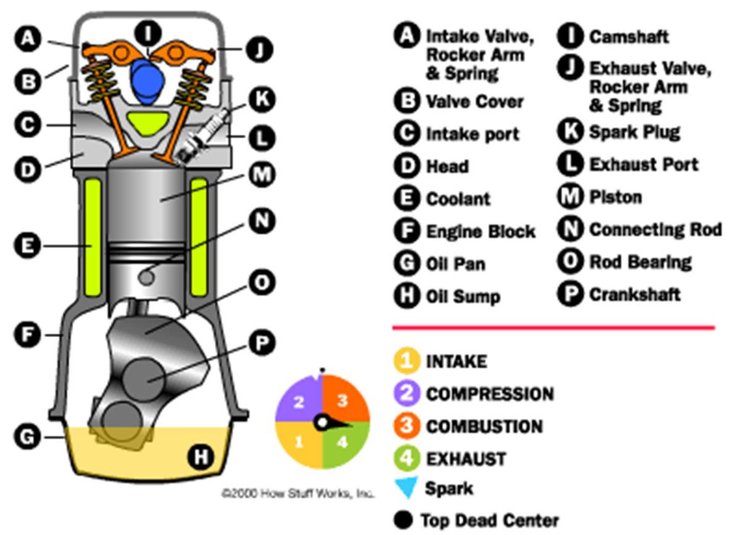
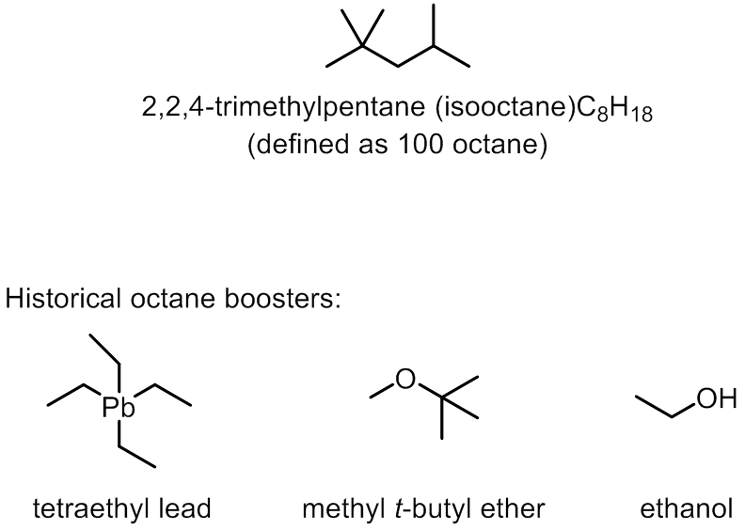
What Is an Octane Rating?
Talking Points:
  Composition of crude oil
  Compressibility and Autoignition
  Leaded vs. Unleaded and use of additives
Follow-Up Questions:
  What is diesel fuel? What about biodiesel?
  Why did we settle on fossil fuels?
  What is the future of energy?
Adam M. Azman, Ph.D.
bit.ly/AdamAzman

Slide 2
Image Source
http://auto.howstuffworks.com/engine1.htm

