Slide 1
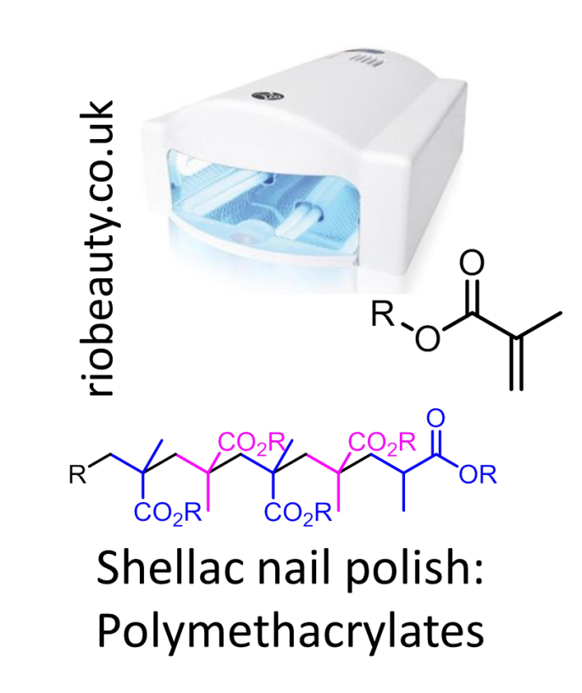
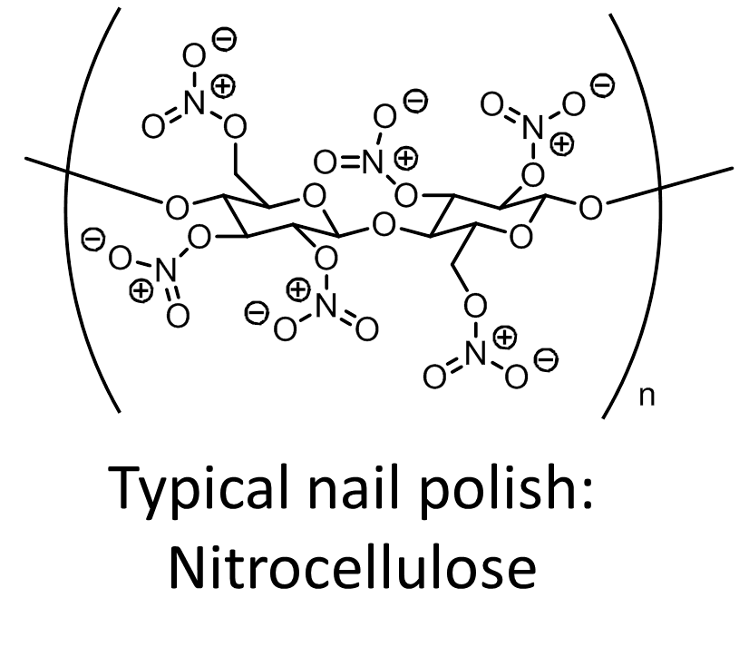
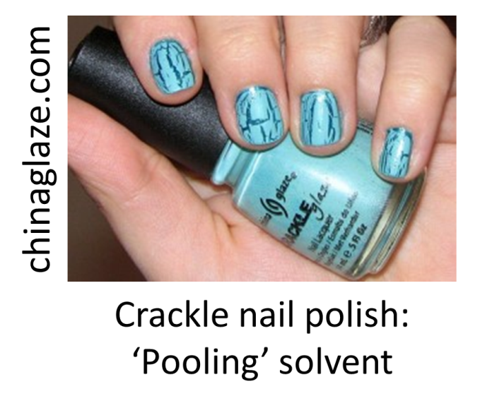
Why is Shellac Nail Polish So Durable?
Talking points:
  Polymers, Plastics & Plasticizers
  Radical polymerization
  “Accidental” discoveries
Follow-Up Questions:
  What is acetone-free nail polish remover?
  What is a plastic?
  Why is shellac sold in opaque bottles?
Adam M. Azman, Ph.D.
bit.ly/AdamAzman

