Slide 1
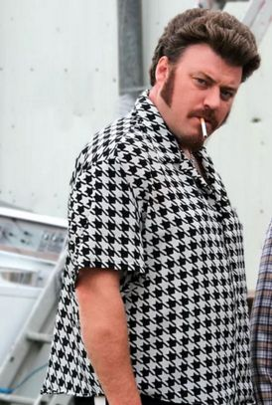
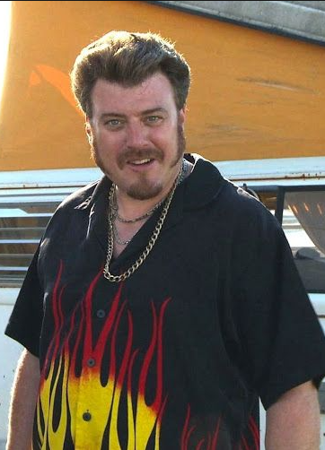
TARGET: Richard "Ricky" LaFleur |  | CLASSIFICATION: Unclassified
 |  | Email: hashmaster@sunnyvale.org Phone: 902-555-1212 Facebook Profile ID: 100010725691607 Twitter: @RickySunnyvale | Possible Alias: Jim Lahey Randy Lahey Reveen
 |  |  | Associates: Julian Bubbles Lucy Tyrone “T” Cory Trevor Jacob J-Roc Detroit Velvet Smooth
DOB: 4/7/1983 Location: Sunnyvale Trailer Park, Dartmouth, Nova Scotia Canada Other Details: Frequently visits his father Ray LaFleur who lives in the Dartmouth Dump near the trailer park | TARGET SUMMARY: Marijuana grower and smuggler believed to be operating out of the Sunnyvale Trailer Park. Also involved in stealing Barbeques and meat from the grocery store. Possibly involved in running an illegal casino operation based out of Sunnyvale Trailer Park. Numerous reports of unlawful use of a firearm.
 |  |  | Last Update: 6/21/2022

