Slide 1
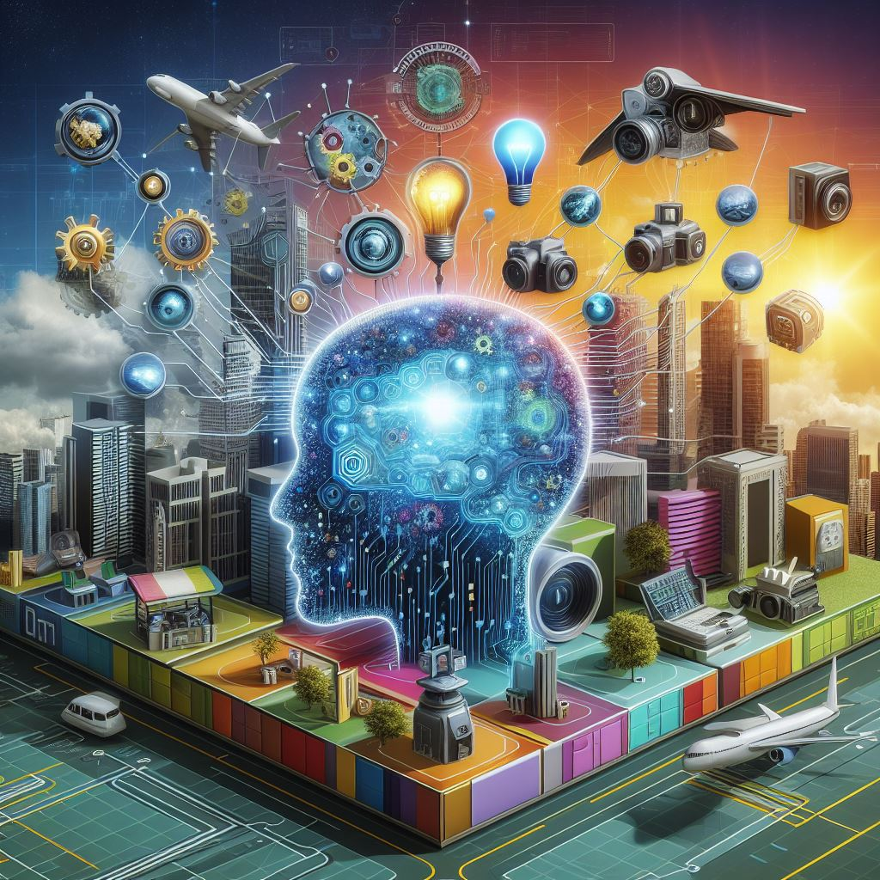

All About AI: November 2024 edition
Hysun Chung (hysun@hysun.com)
LinkedIn: https://linkedin.com/in/hysun-c
X/Twitter: @azmaveth
Blog: https://azmaveth.com

Slide 2
Last time we talked...
What is Artificial Intelligence?
What AI currently can and cannot do
Data, privacy and model deployment considerations
AI for everyday tasks (demos)
AI for productivity/work (demos)
AI for enrichment/entertainment (demos)
The future of AI and ethical implications

Slide 3
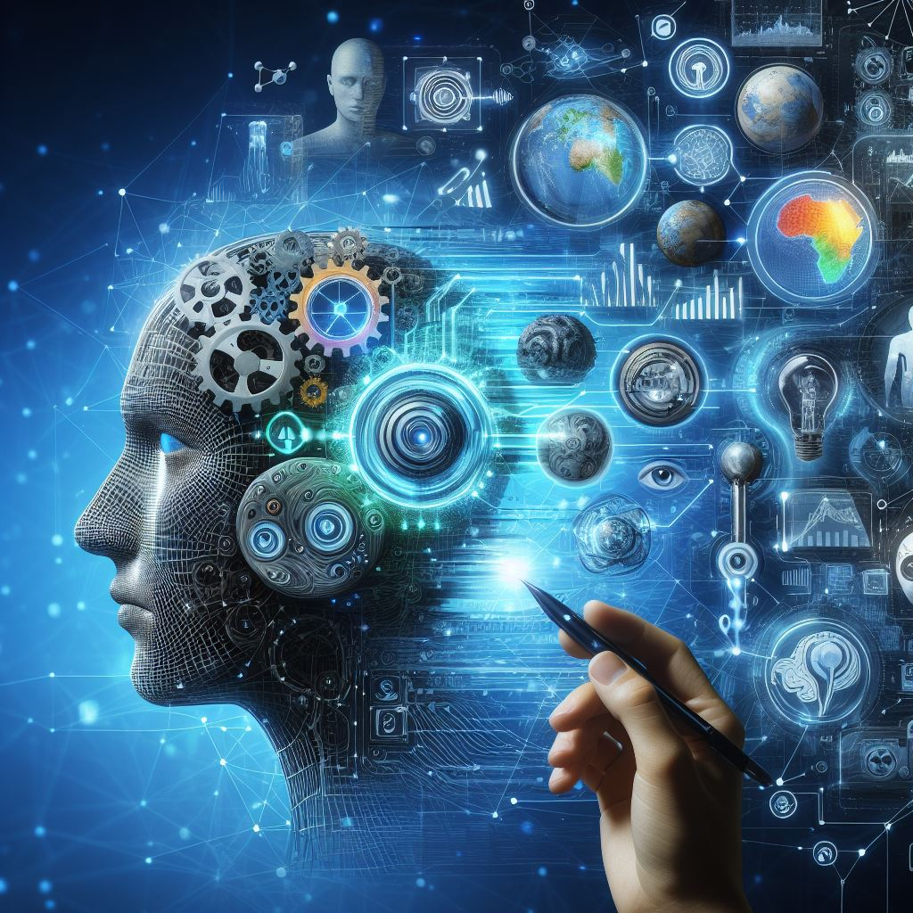
Today’s Topics
Convenient ways to leverage AI tools
AI on your mobile device
Prompting techniques
Trends to watch for

Slide 4
Every day productivity apps
Magic ToDo app: https://goblin.tools
Cleo for budgeting: https://web.meetcleo.com/
Gamma for presentations: https://gamma.app/
Luma Labs for video: https://lumalabs.ai/
Read.ai for summaries: https://www.read.ai/
Otter.ai for transcripts: https://otter.ai/
Youper for mental health: https://www.youper.ai/

Slide 5

What is prompting?
Why not just ask a question?
Prompting gives additional details to explain the question as well as what the answer should look like.

Slide 6
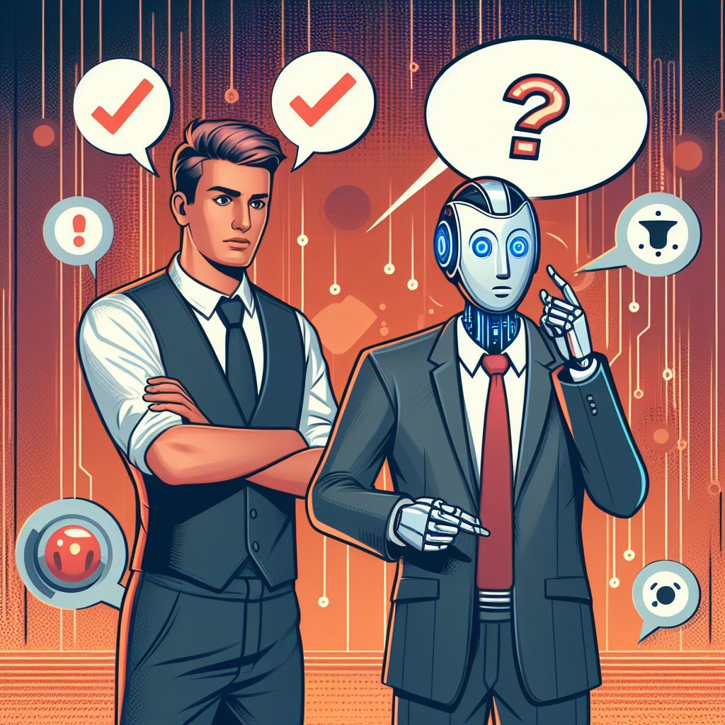
Prompting examples
Bad
  What are the differences between cats and dogs?
  What is your favorite mobile app and why?
Good
  Write a 5 paragraph essay comparing and contrasting two different types of animals, such as a dog and a cat. Be sure to include details about their physical characteristics, behaviors, and habitats.
  Design a one-page infographic that highlights the key features and benefits of your favorite mobile app. Include at least 3 data visualizations that support your points.

Slide 7
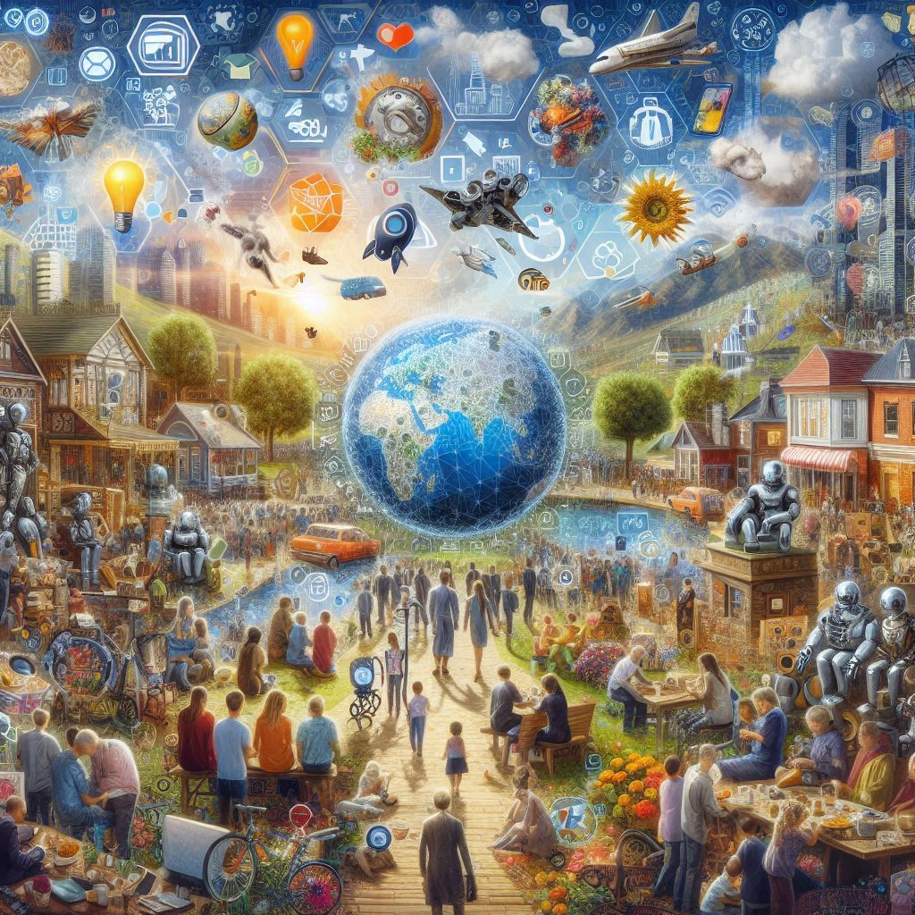
News or not?
AI in smart appliances
AI spyware in your operating system
AI as a national security strategy
  China may be winning the AI race
  How do we compete?
  What about domestic surveillance?

Slide 8

Where are we going from here?
Smaller, task-focused models
Custom chips
Less “Googling”
Elections and government
AI will be everywhere, monitoring everything.
What will you do about it?

Slide 9
Questions?

Slide 10
Resources
Youtube
  https://www.youtube.com/@matthew_berman
  https://www.youtube.com/@AIJasonZ
Blogs/News
  https://danielmiessler.com/
  https://aiweekly.co/
Online course
  https://www.coursera.org/learn/ai-for-everyone

